Slide 1
Healthcare Patient Care,
Clinical Operations & Hospital Resource
Analytics Platform
PRESENTED BY
DINESH M
SRIJHHA R M
SARAN SUBRAMANI
MALARAM MANJITH NAIDU
VAISHNAVI V

Slide 2
OVERVIEW
An end-to-end healthcare data platform that ingests hospital source files from AWS S3, processes and standardizes data through IDMC, and organizes analytics-ready information in Snowflake Silver and Gold layers.
CURRENT SCENARIO
SOLUTION
Hospital data is distributed across departments and files, with inconsistent formats and data-quality issues. Limited visibility into admissions, length of stay, bed occupancy and resource utilization makes operational decisions harder.
Use AWS S3 and IDMC for ingestion and validation; Snowflake Silver and Gold for governed processing and dimensional modelling; and analytical dashboards with Snowflake Cortex Analyst for healthcare insights
Outcome: A centralized, trusted healthcare data foundation for patient-flow analysis, bed utilization and informed hospital operations

Slide 3
OBJECTIVES
CLEANING & VALIDATION
DATA MODELING
ANALYSIS & REPORTING
Ingest seven healthcare source datasets (Patients, Hospitals, Departments, Physicians, Beds, Admissions and Patient Bed History) from AWS S3 into Snowflake Bronze, preserving the raw source data.
Use IDMC mappings to clean, validate, standardize and transform Bronze data into Snowflake Silver tables. Build six dimension tables and two fact tables in the Gold layer.
Create four healthcare data marts covering Admission Flow, Bed Occupancy, Length of Stay and Bed Pressure Risk. Develop KPI analytics and interactive Streamlit dashboards using Snowpark Python, with Cortex Analyst as an additional capability.
AWS S3 → Snowflake Bronze → IDMC → Silver → Gold → Snowpark Python + Streamlit

Slide 4
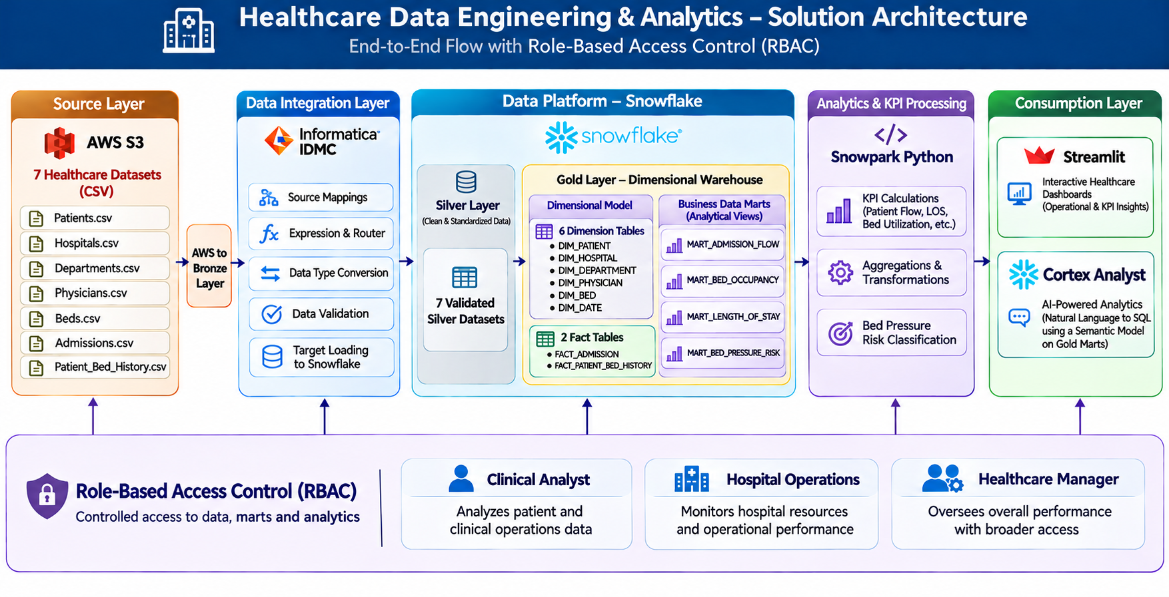

Slide 5
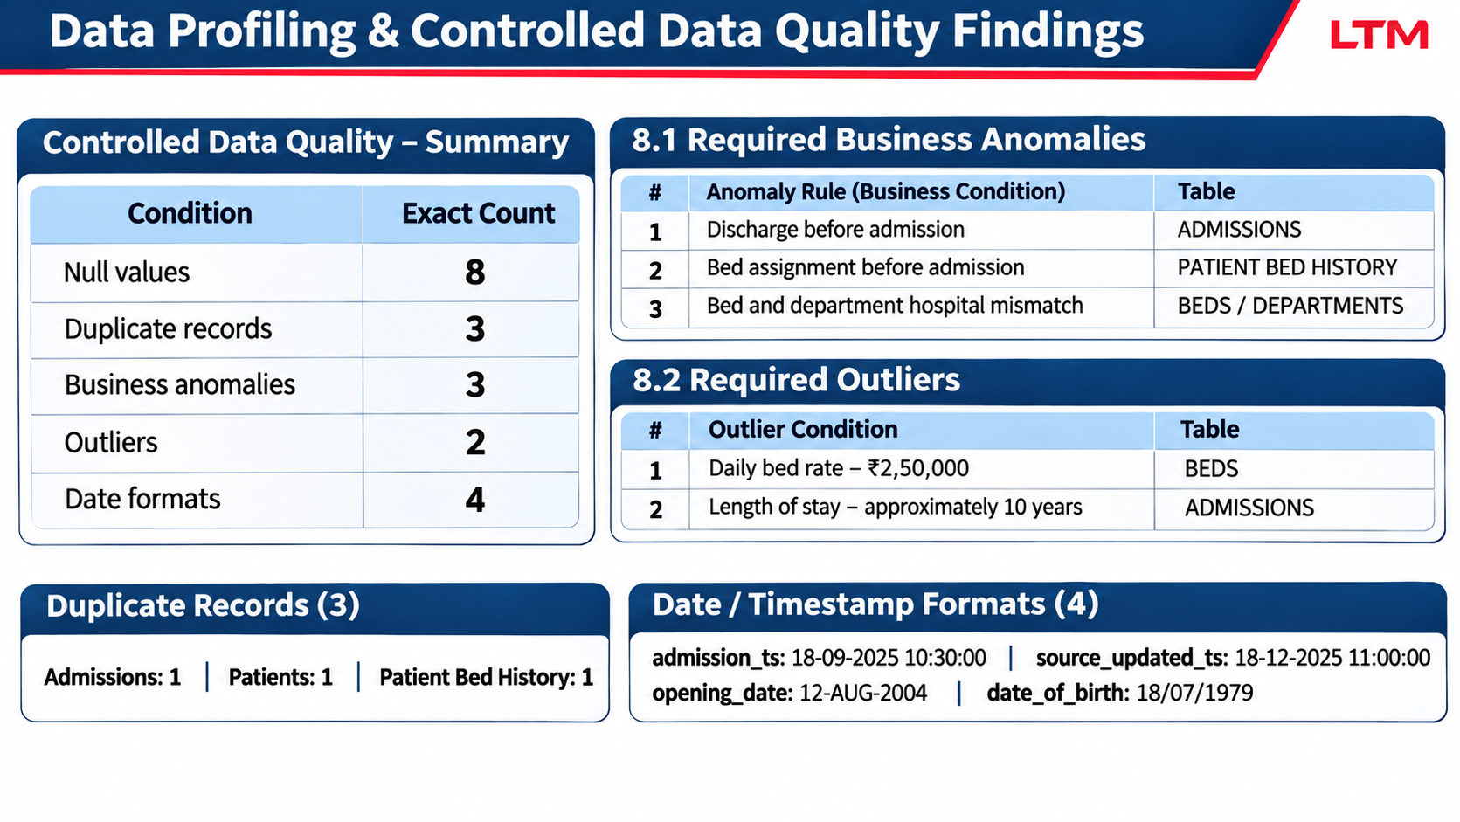
DATA PROFILING AND CONTROLLED DATA QUALITY FINDINGS

Slide 6
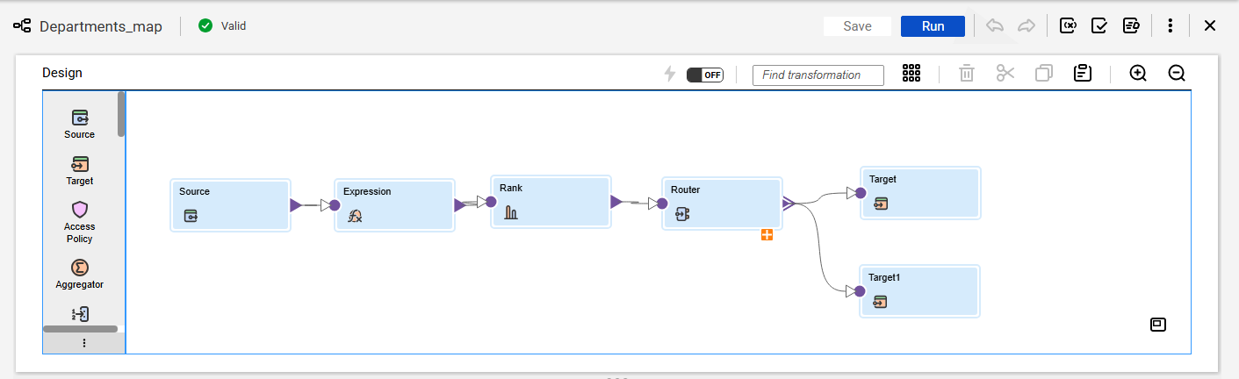
IDMC DEPARTMENTS MAPPING

Slide 7
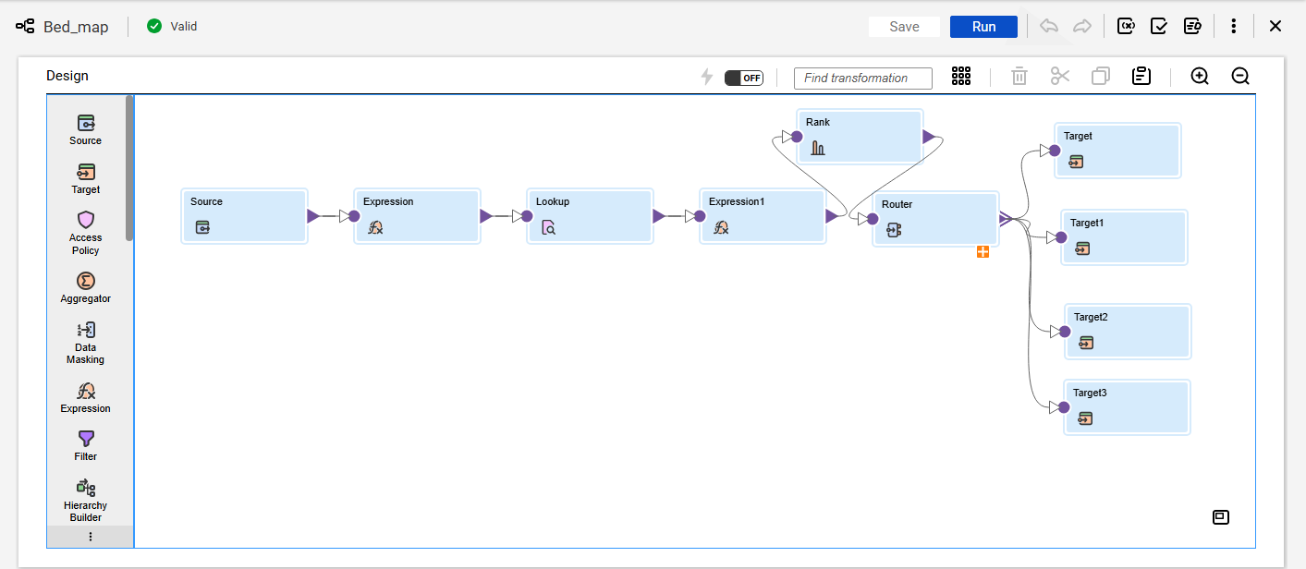
IDMC BED MAPPING

Slide 8
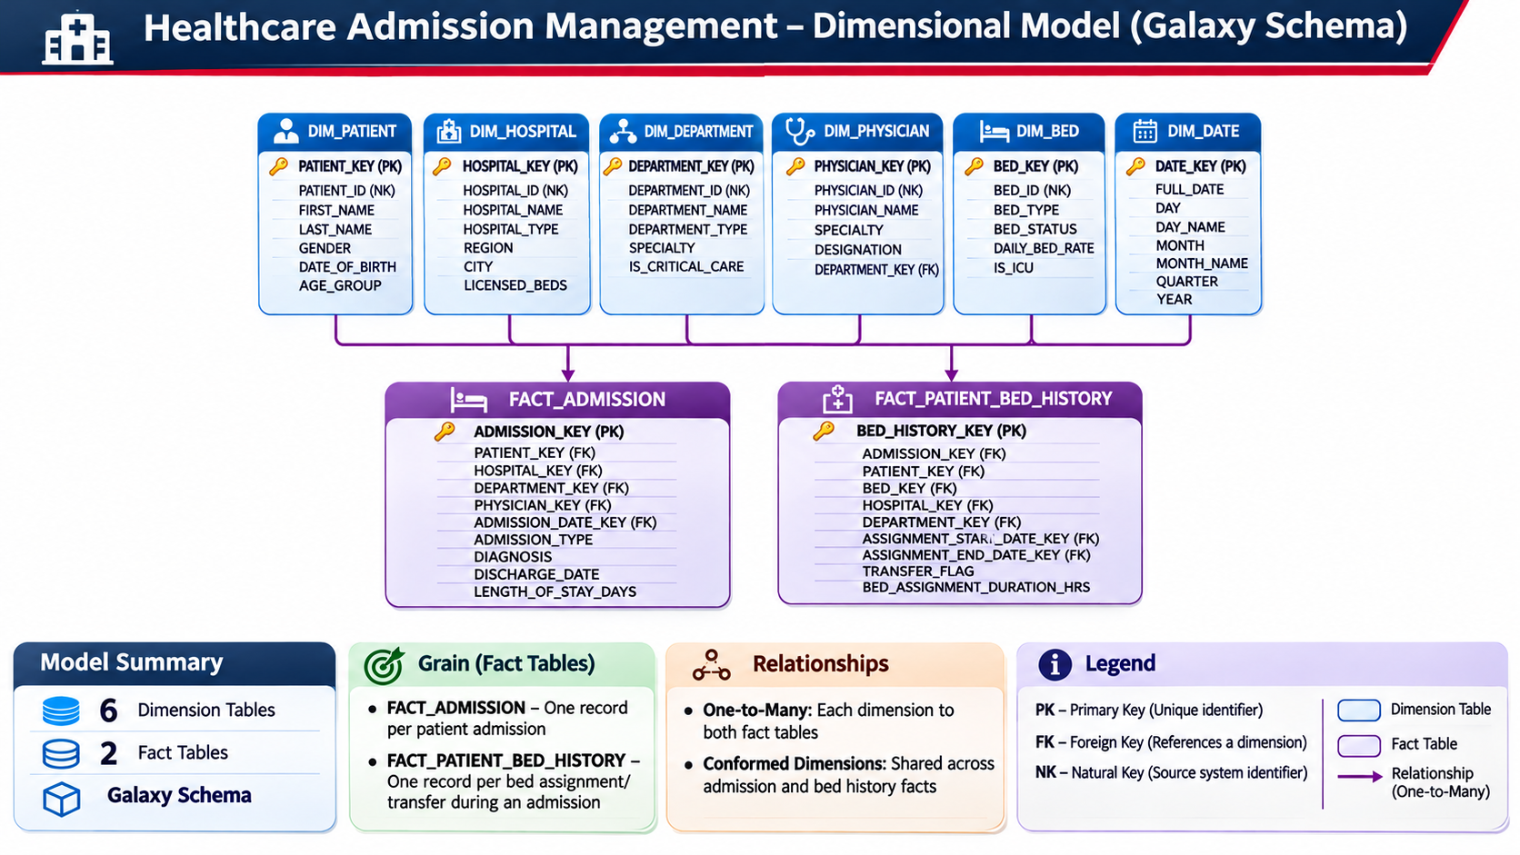
DIMENSIONAL MODEL (GALAXY SCEHMA)

Slide 9
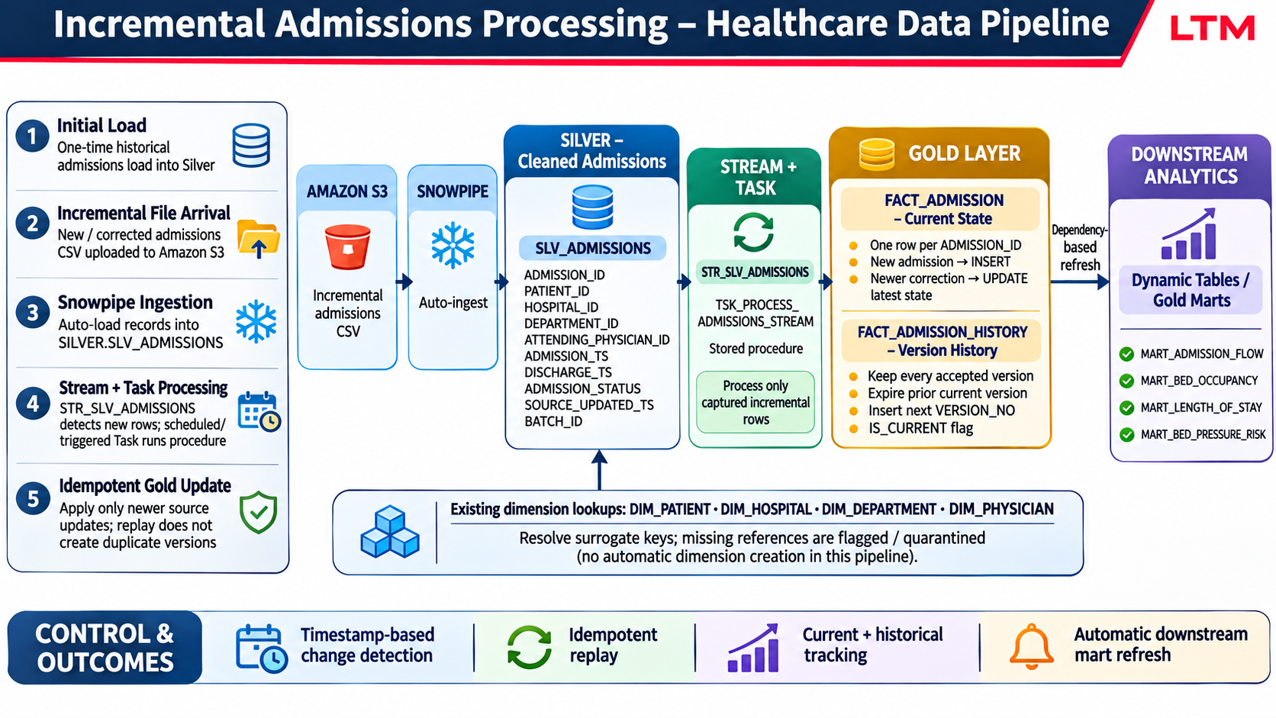
INCREMENTAL HEALTHCARE DATA PIPELINE

Slide 10
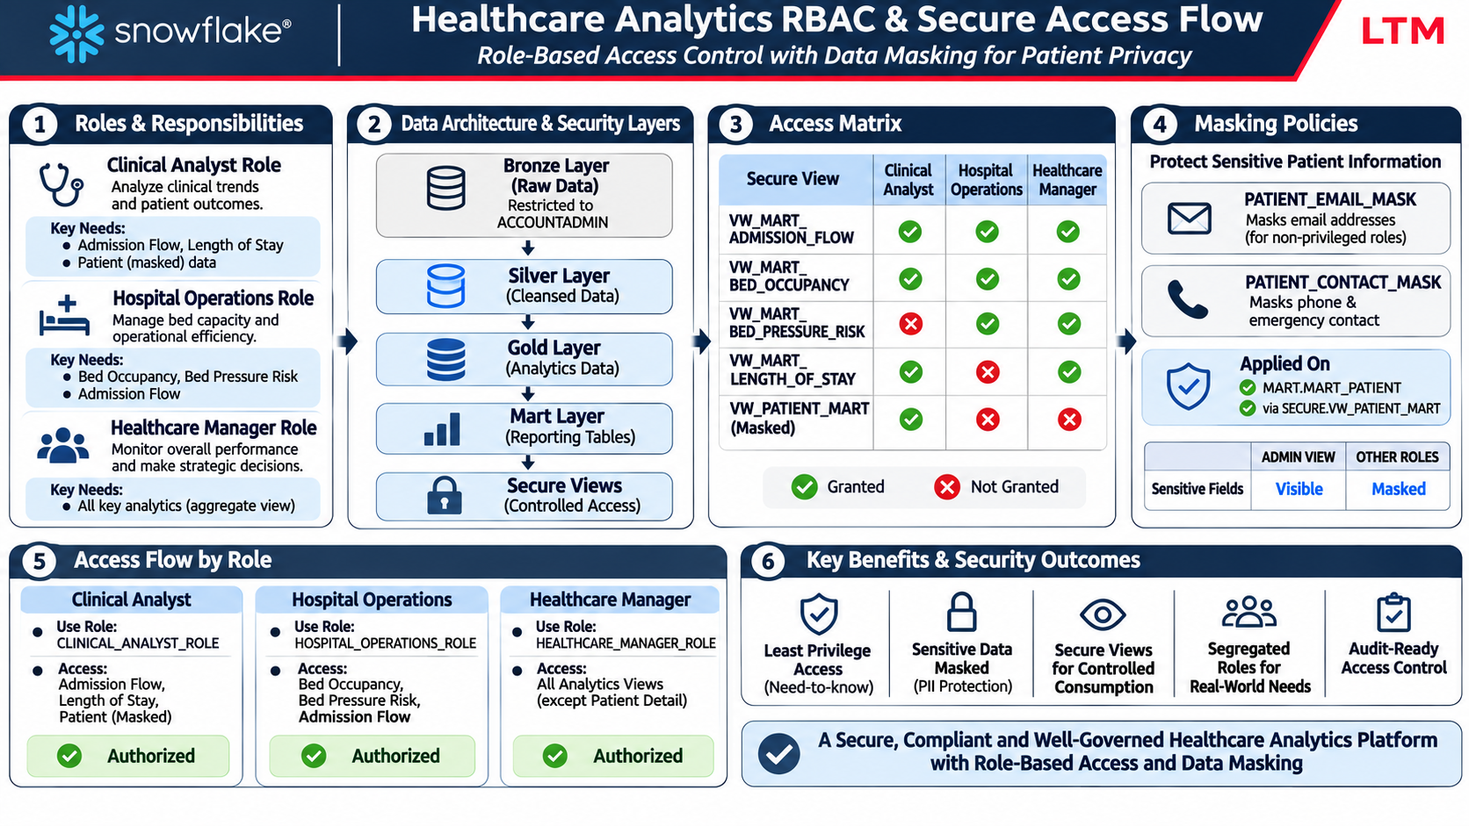
ROLE BASED ACCESS CONTROL SECURITY

Slide 11
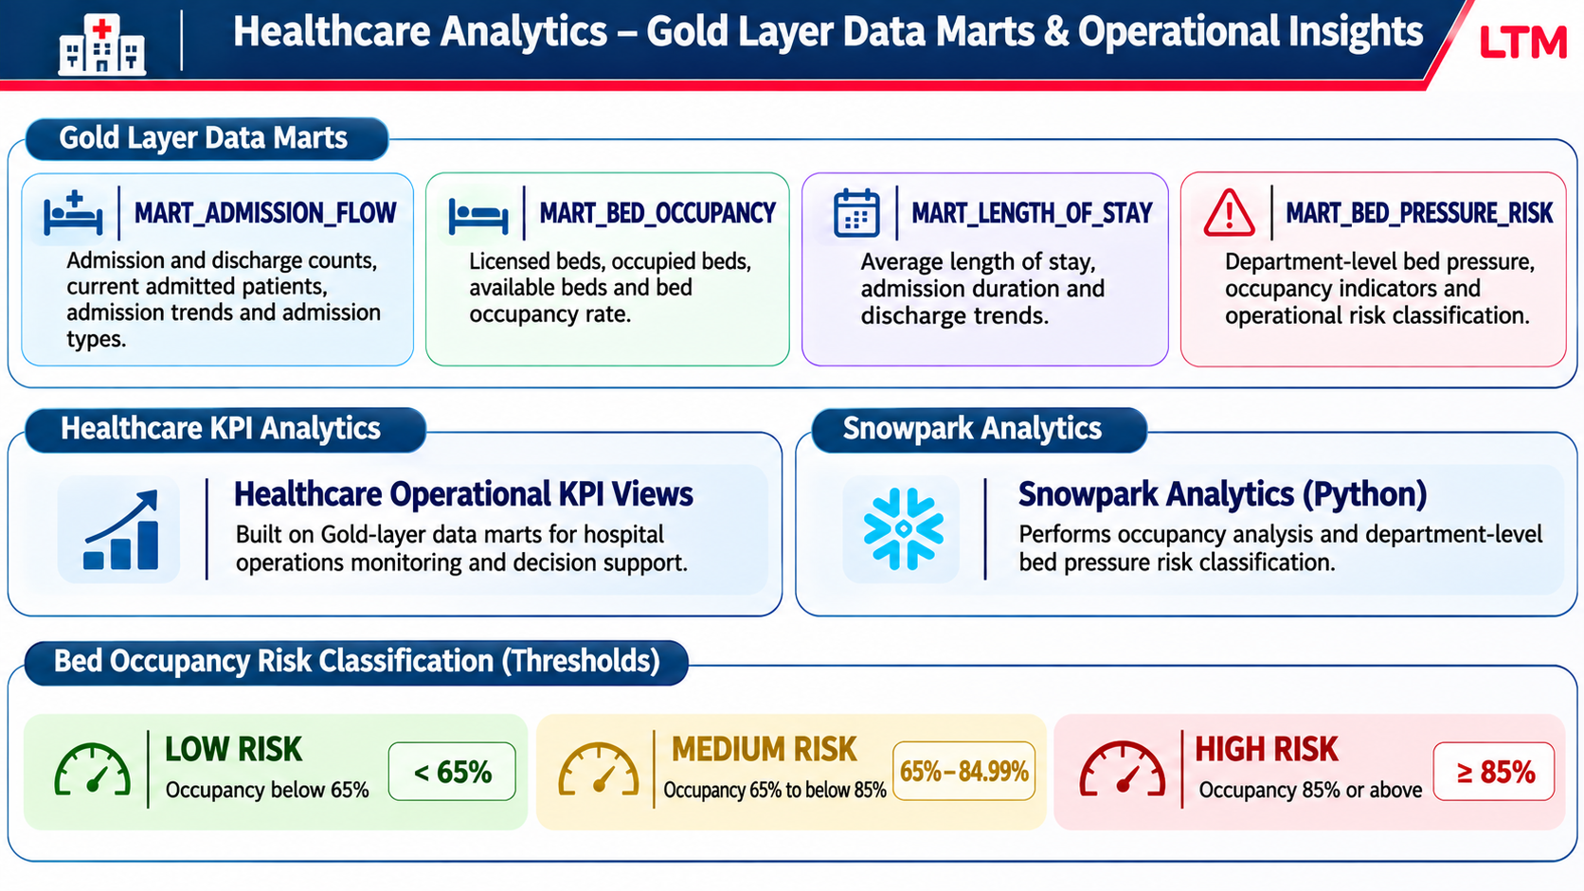
DATA MART & OPERATIONAL RISK INSIGHTS

Slide 12
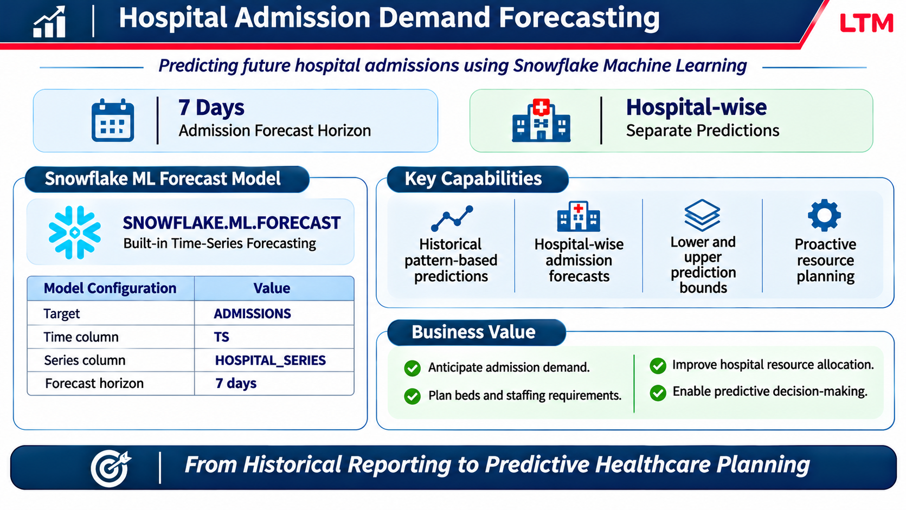
MACHINE LEARNING MODEL USP

Slide 13
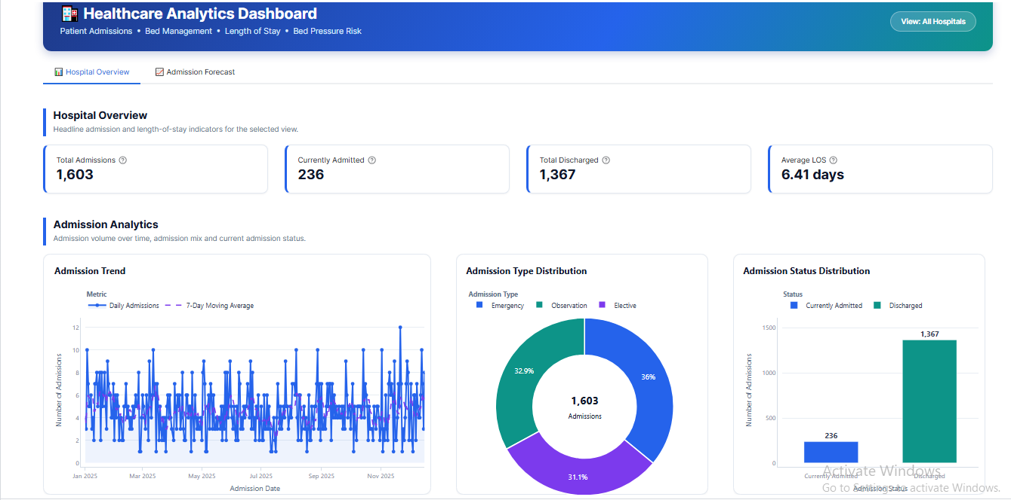
STREAMLIT DASHBOARD

Slide 14
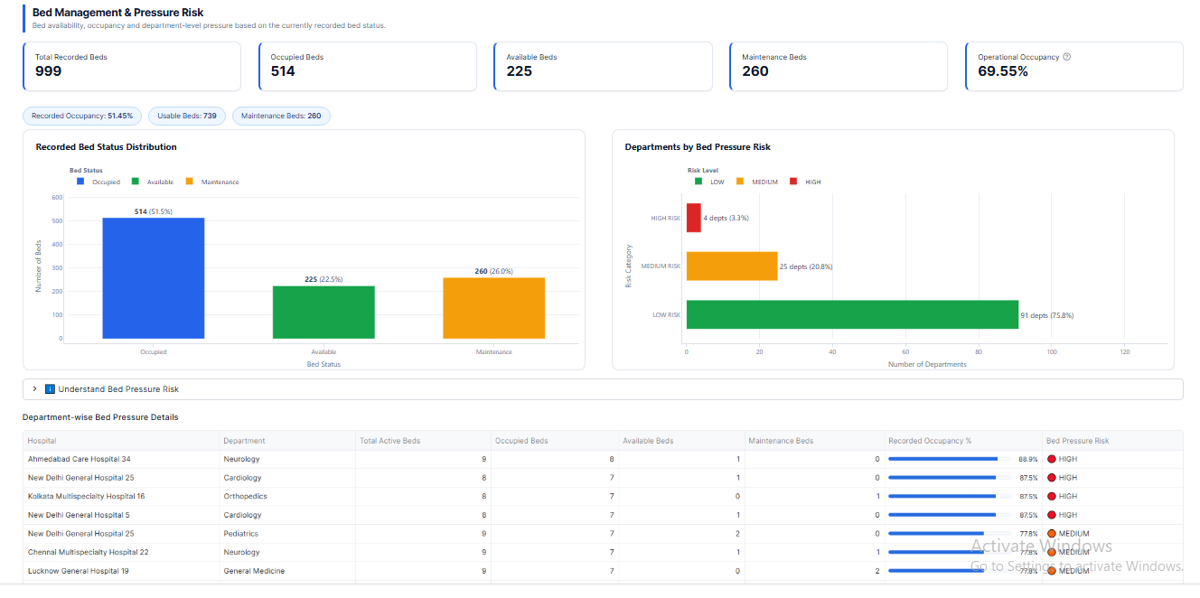
STREAMLIT DASHBOARD

Slide 15
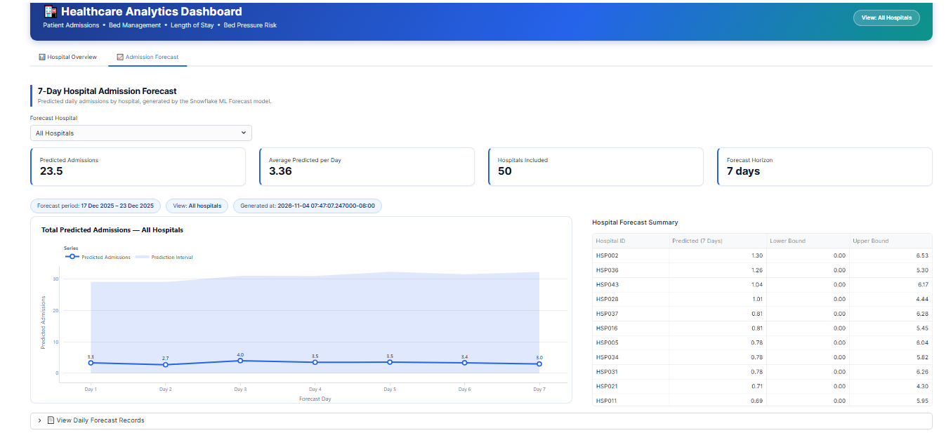
STREAMLIT DASHBOARD

Slide 16
Thank you

