Slide 1
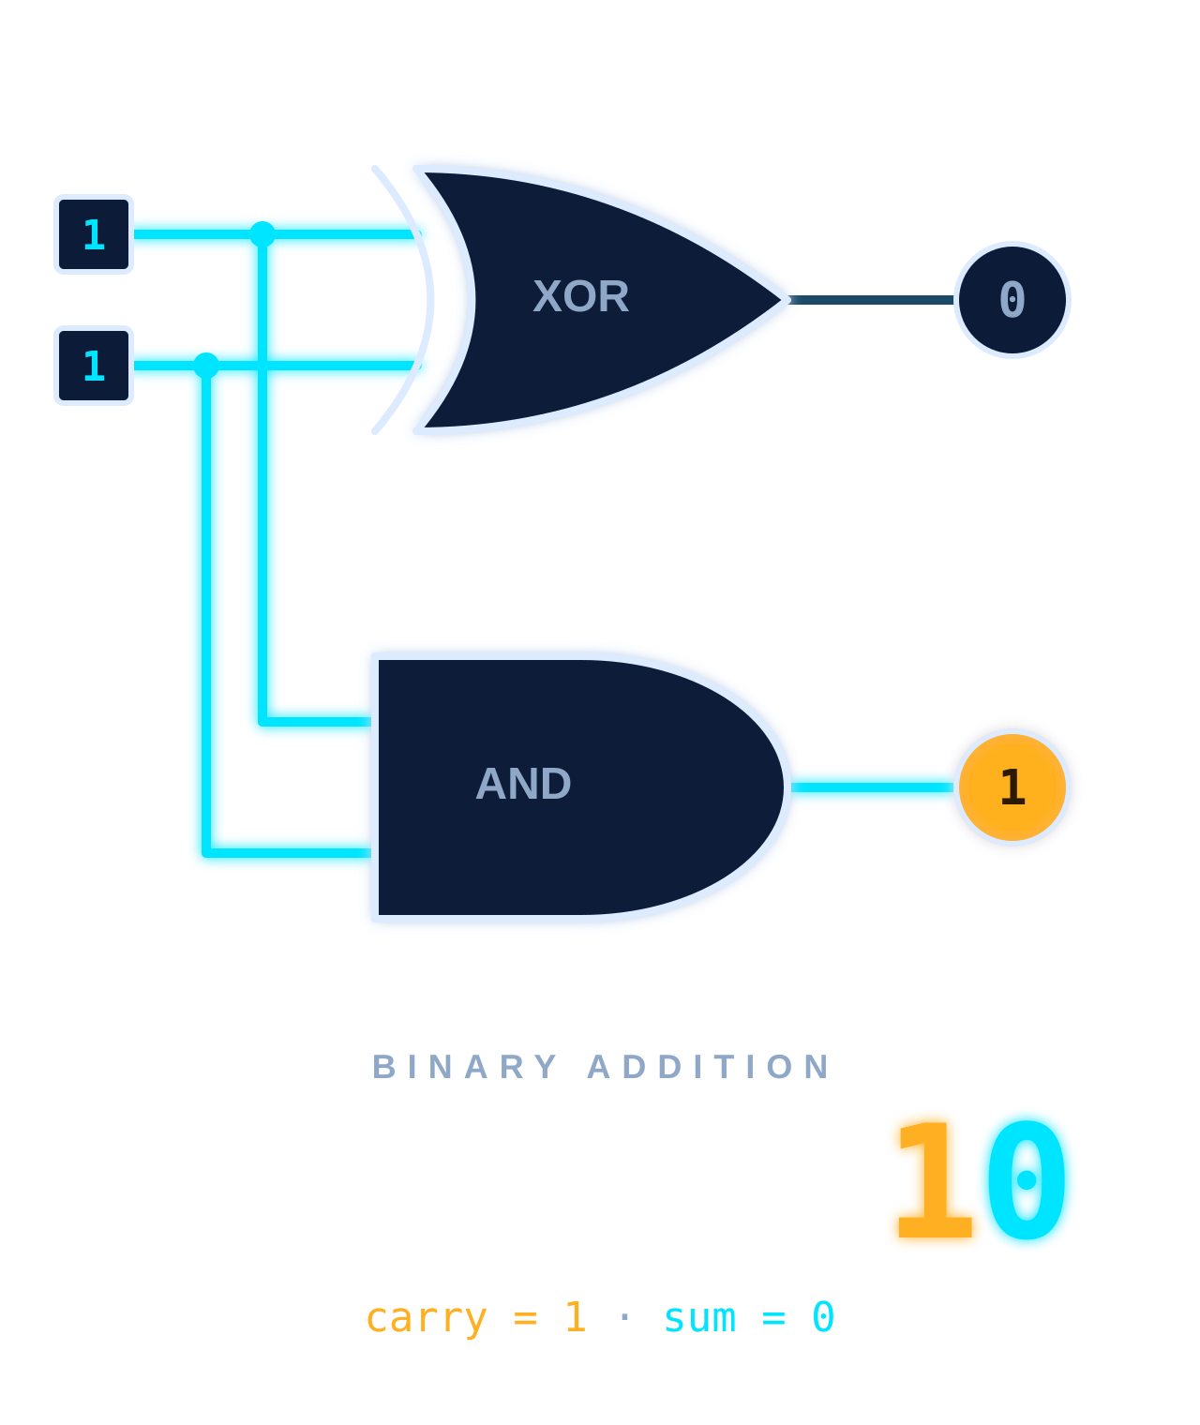
Design and Simulation of Half Adder and Full Adder Using Logisim
DIGITAL ELECTRONICS · MINI PROJECT
Digital Logic Design & Simulation
TEAM MEMBERS
suhas-2620030216
Samiksh-2620030094
Vardhan-2620030095
Akhilesh-2620080108
Notes:
Welcome. This project designs a Half Adder and a Full Adder and verifies them by simulation in Logisim. The graphic on the right shows the idea in one picture: adding 1 + 1 gives Sum 0 and Carry 1, i.e. binary 10.

Slide 2





What is a Digital Adder?
INTRODUCTION
Digital adder
Why binary addition matters
A combinational circuit that adds binary numbers using logic gates.
Subtraction, multiplication and comparison all reduce to adding bits.
Role in computers
Half vs Full adder
Adders sit inside the ALU, counters and memory-address logic.
Half adder: 2 inputs. Full adder: 3 inputs, adds the carry-in too.
BINARY INPUTS
LOGIC GATES
SUM & CARRY
A = 1 B = 0
S = 1 C = 0
Notes:
A digital adder is a combinational circuit built from logic gates. Every arithmetic operation in a processor depends on binary addition. The flow at the bottom is the whole story of this project: binary inputs go through logic gates and produce a sum and a carry.

Slide 3
Basic Binary Addition
INTRODUCTION
0 + 0 = 0
0 + 1 = 1
1 + 0 = 1
1 + 1 = 10
CARRY
SUM
CARRY
SUM
CARRY
SUM
CARRY
SUM
0
0
0
1
0
1
1
0
COLUMN ADDITION · 1 + 1
Sum
Carry
1
+ 1
───
10
The result bit that stays in the current column. It is 1 when exactly one input is 1.
The bit passed to the next higher column. It is 1 only when both inputs are 1.
1 = Carry → next column
0 = Sum → this column
Notes:
Binary has only two digits. 0+0, 0+1 and 1+0 are straightforward. 1+1 equals 2, which is written 10 in binary: a 0 stays in this column (the Sum) and a 1 moves to the next column (the Carry).

Slide 4
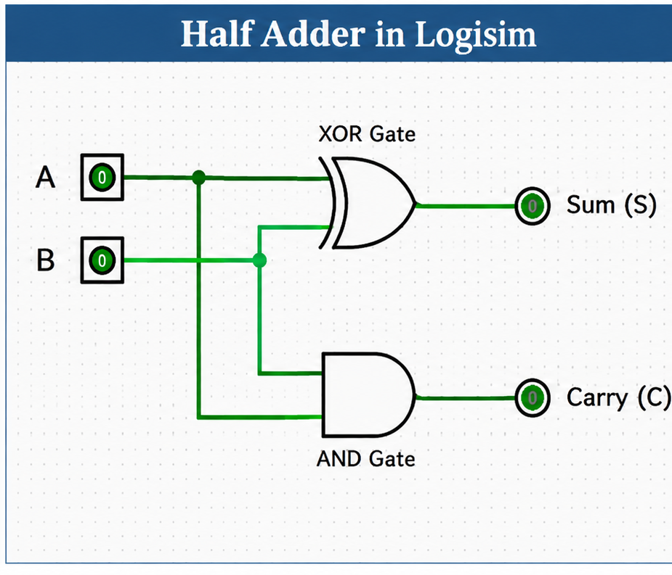
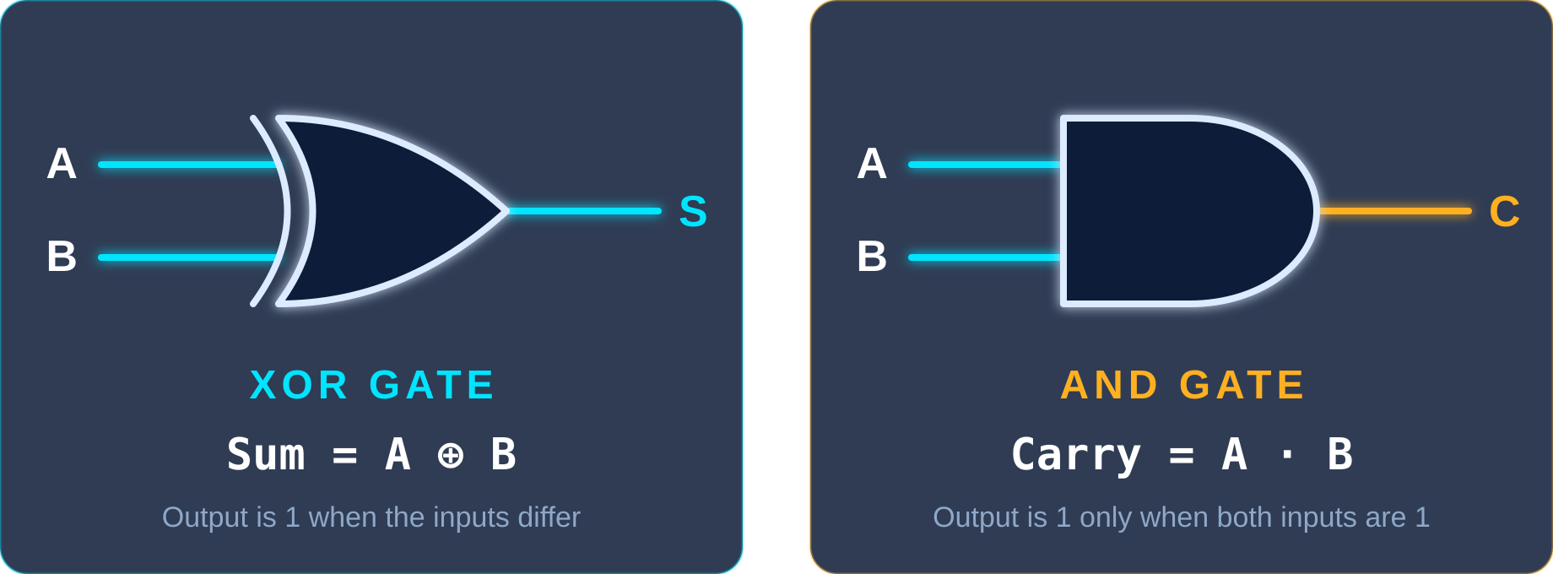
Half Adder
HALF ADDER
DEFINITION
A combinational circuit that adds two 1-bit inputs and produces a Sum and a Carry.
INPUTS
OUTPUTS
A, B
S, C
BOOLEAN EQUATIONS
Sum = A ⊕ B
Carry = A · B
Notes:
A half adder has two inputs, A and B, and two outputs, Sum and Carry. Sum is the XOR of the inputs and Carry is the AND of the inputs. No carry-in exists, which is why it is called half.

Slide 5
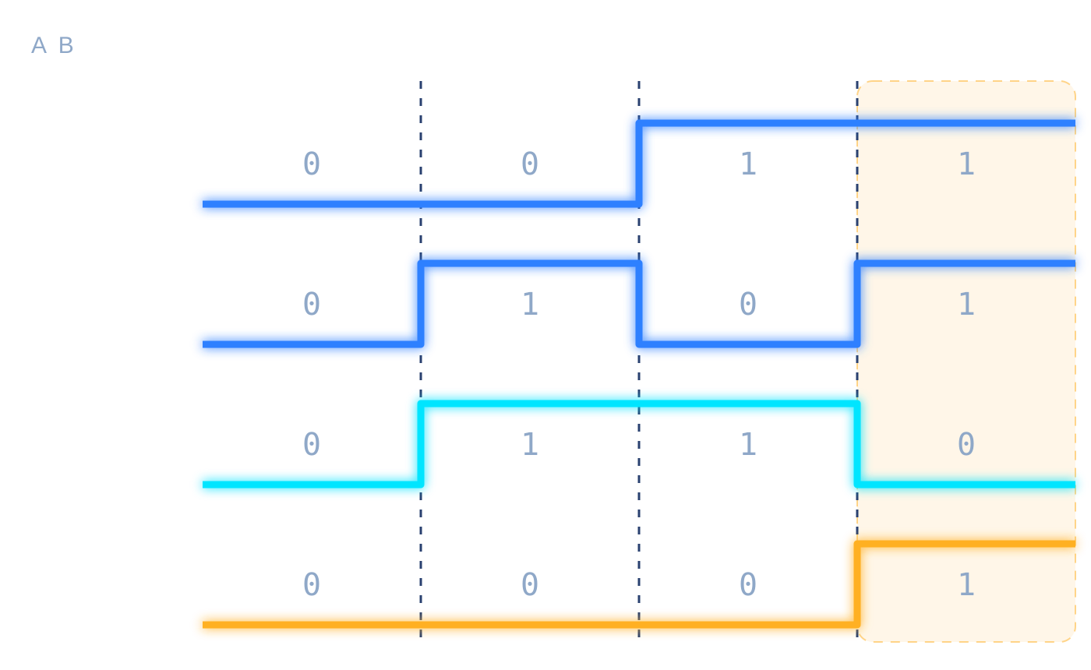
Half Adder Truth Table
HALF ADDER
A | B | SUM | CARRY
0 | 0 | 0 | 0
0 | 1 | 1 | 0
1 | 0 | 1 | 0
1 | 1 | 0 | 1
Waveforms for inputs 00, 01, 10, 11
THE OUTPUT CHANGE
Sum = 1 when the inputs differ (XOR)
Carry = 1 only when both inputs are 1 (AND)
At 1 + 1 the Sum drops back to 0 and the Carry rises to 1.
Notes:
Read the table row by row. Sum is high when exactly one input is high. Carry is high only in the last row, 1 + 1. The waveform on the right shows the same four rows as digital signals; the amber band marks the only case that produces a carry.

Slide 6
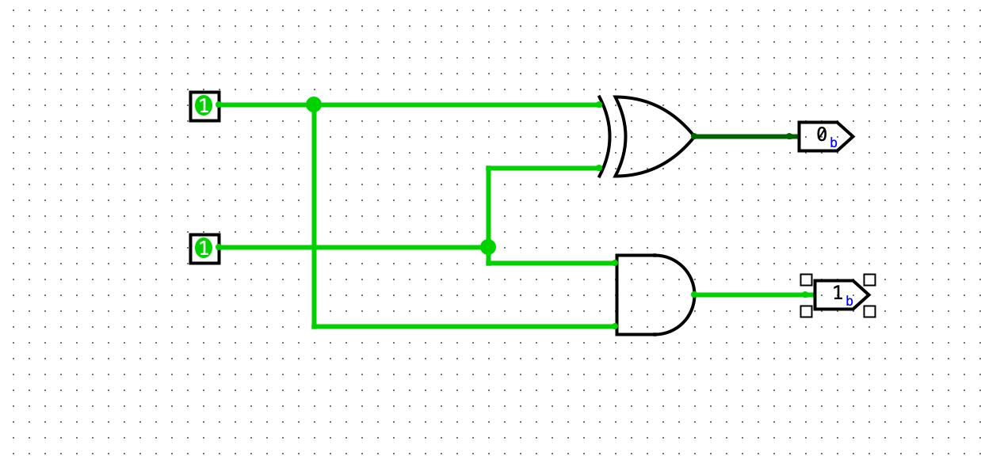
Half Adder Design in Logisim
HALF ADDER
1
Create the circuit
File ▸ New, then name it HalfAdder
2
Add input pins
Wiring ▸ Pin: place A and B (1 bit)
3
Place the gates
Gates ▸ XOR for Sum, AND for Carry
4
Wire the circuit
Connect A and B to both gates
5
Add output pins
Place two outputs: SUM and CARRY
XOR GATE
AND GATE
6
Simulate
Poke tool: toggle A, B, read outputs
Sum = A ⊕ B
Carry = A · B
Notes:
Walk through the construction in Logisim. Place two input pins and two output pins, add an XOR gate and an AND gate from the Gates library, then wire both inputs to both gates. The XOR output drives Sum and the AND output drives Carry.

Slide 7
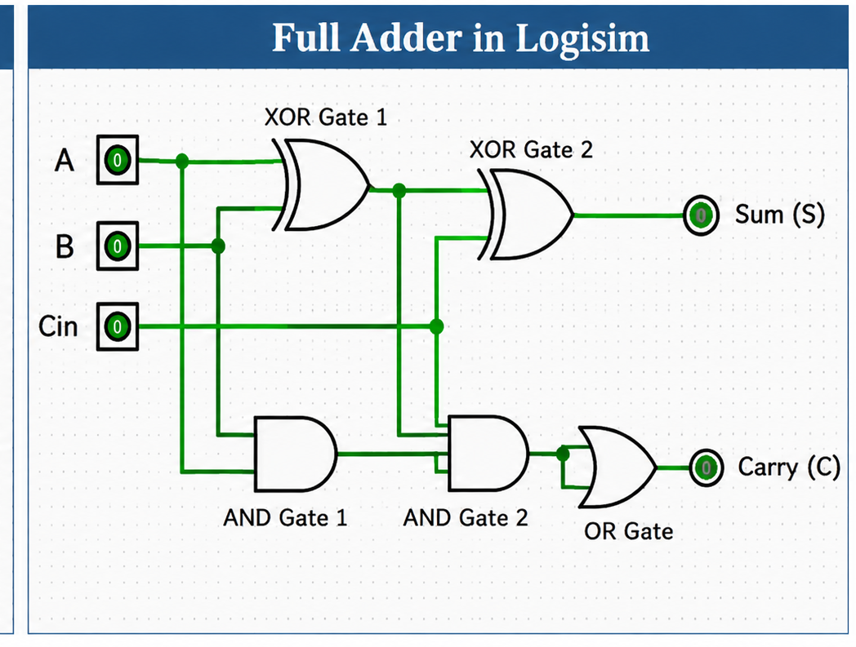
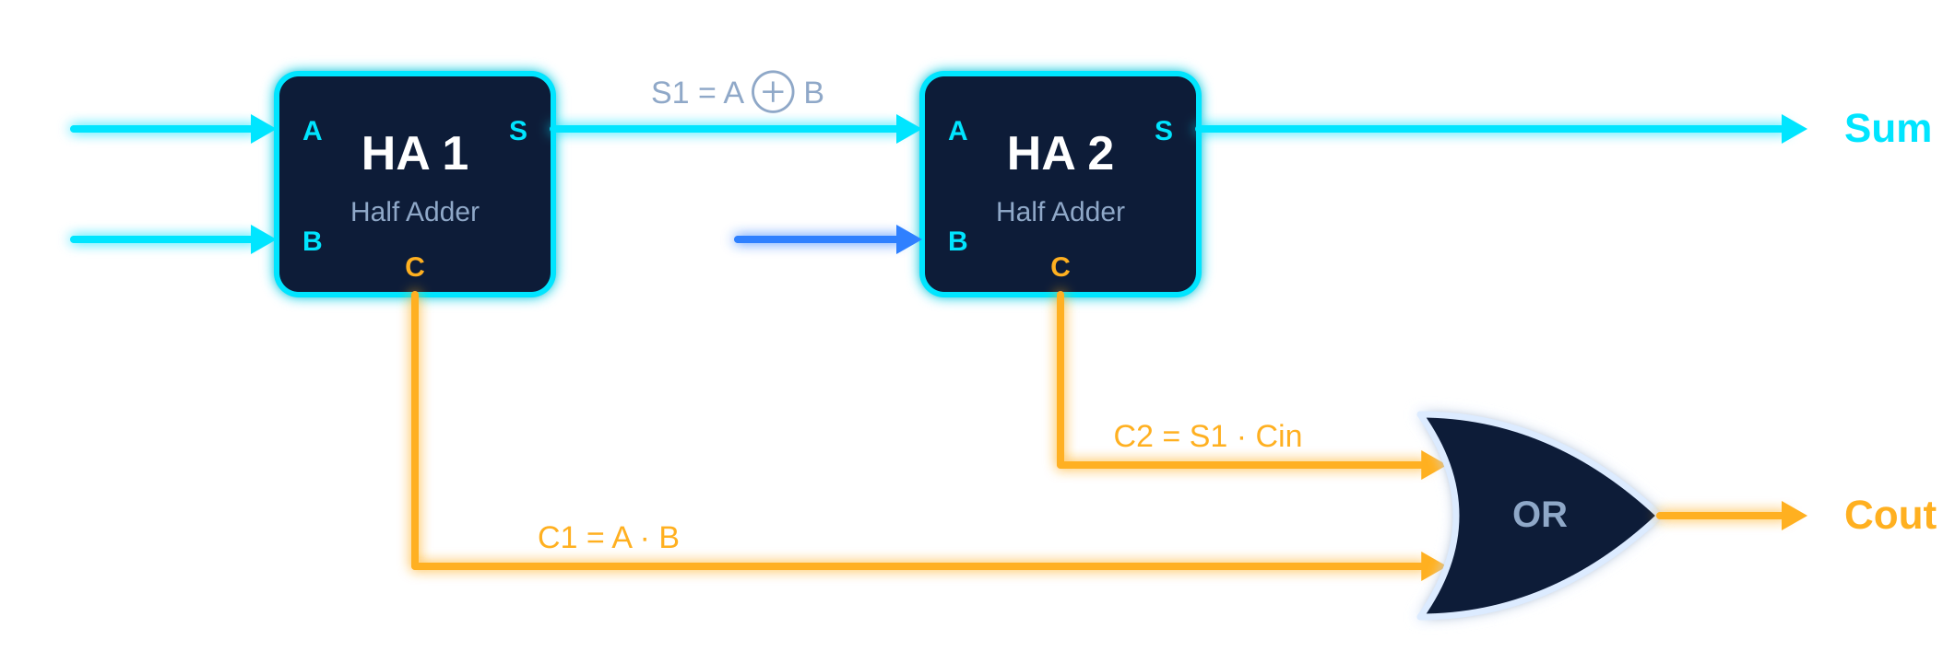
Full Adder
FULL ADDER
DEFINITION
Adds three 1-bit inputs: A, B and the carry-in (Cin) from the previous stage.
INPUTS
OUTPUTS
A, B, Cin
Sum, Cout
BUILT FROM TWO HALF ADDERS + ONE OR GATE
BOOLEAN EQUATIONS
Sum = A ⊕ B ⊕ Cin
Cout = AB + Cin(A ⊕ B)
Notes:
A full adder adds a third input, the carry-in, so adders can be chained for multi-bit numbers. Internally it is two half adders plus an OR gate: the first half adder adds A and B, the second adds that result to Cin, and the OR gate merges the two carries.

Slide 8
Full Adder Truth Table
FULL ADDER
A | B | Cin | SUM | Cout
0 | 0 | 0 | 0 | 0
0 | 0 | 1 | 1 | 0
0 | 1 | 0 | 1 | 0
0 | 1 | 1 | 0 | 1
1 | 0 | 0 | 1 | 0
1 | 0 | 1 | 0 | 1
1 | 1 | 0 | 0 | 1
1 | 1 | 1 | 1 | 1
COUNT THE 1s IN THE INPUTS
0 ones
No input is high
00
1 one
One input is high
01
2 ones
Two inputs are high
10
3 ones
All three are high
11
Notes:
The full adder simply counts how many of its three inputs are 1 and writes that count in binary: Cout is the upper bit and Sum is the lower bit. For example, two ones give binary 10, so Cout is 1 and Sum is 0.

Slide 9
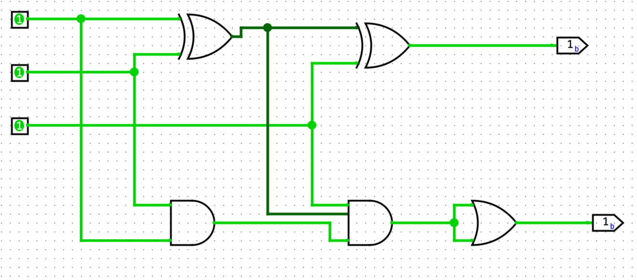
Full Adder Design in Logisim
FULL ADDER
1
Add inputs
Three 1-bit pins: A, B, Cin
2
Half Adder 1
XOR1 + AND1 take A and B
3
Half Adder 2
XOR2 + AND2 take (A XOR B) and Cin
4
Combine carries
OR gate merges both carries
TIP Project ▸ Add Circuit lets you save the Half Adder as a sub-circuit and reuse it twice, exactly how a Full Adder is built.
5
Add outputs
XOR2 gives Sum, OR gives Cout
Notes:
The full adder is built from the half adder. Two XOR and two AND gates form the two half adders, and an OR gate combines their carry outputs. The dashed boxes in the circuit mark each half adder.

Slide 10
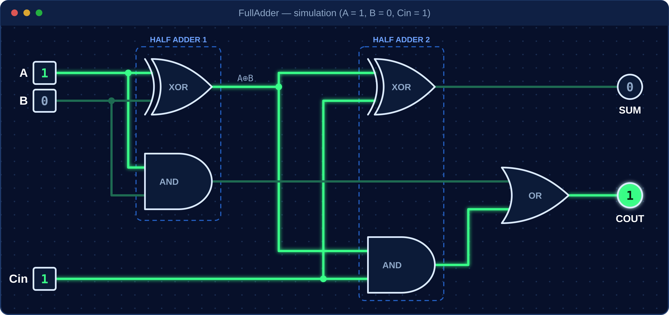
Simulation in Logisim
SIMULATION
HALF ADDER · A = 1, B = 1 → SUM 0, CARRY 1
FULL ADDER · A = 1, B = 0, Cin = 1 → SUM 0, COUT 1
4 / 4
Half adder input combinations match the truth table
8 / 8
Full adder input combinations match the truth table
Bright wire = logic 1
Dark wire = logic 0
Tip: Project ▸ Analyze Circuit builds the truth table.
Notes:
Use the Poke tool to toggle the input pins. In Logisim a bright green wire carries logic 1 and a dark wire carries logic 0. Step through all four half adder and all eight full adder input combinations and compare each result with the truth tables. Project > Analyze Circuit can also generate the truth table and expression for a cross-check.

Slide 11


Half Adder vs Full Adder
SUMMARY
Feature | Half Adder | Full Adder
Inputs | A, B | A, B, Cin
Outputs | Sum, Carry | Sum, Cout
Carry-in | No | Yes
Gates | 1 XOR + 1 AND | 2 XOR + 2 AND + 1 OR
Used for | Lowest bit only | Every higher bit
ALU in processors
Core of every CPU arithmetic unit
Ripple-carry adders
Full adders chained for N-bit sums
Counters and timers
Increment logic uses half adders
Addressing and DSP
Address calculation, multipliers, filters
CHAINING FULL ADDERS
Cout of one stage feeds Cin of the next, giving an N-bit adder.
FA0
C1
FA1
C2
FA2
C3
FA3
Notes:
The half adder is enough for the lowest bit, but every higher bit needs a carry-in, so a full adder is used. Chaining full adders gives a ripple-carry adder, the simplest multi-bit adder. Applications include the ALU, counters, address calculation and signal processing.

Slide 12


Conclusion
Half Adder
Full Adder
Logisim
S = A ⊕ B
C = A · B
S = A ⊕ B ⊕ Cin
Cout = AB + Cin(A ⊕ B)
Drag-and-drop gates
Live simulation
Adds two bits
Adds two bits and a carry-in
Results match the truth tables
Thank You
Notes:
To conclude: the half adder adds two bits, the full adder adds two bits plus a carry-in, and Logisim lets us build and verify both visually. Thank you, we are happy to take questions.

