Slide 1

SMART INDIA HACKATHON 2026
Problem Statement ID – 26043
Problem Statement - A digital platform to crowdsource societal challenges and facilitate collaborative problem solving through universities and industry partnerships.
Theme- Smart Education
PS Category- Software
Team ID-
Team Name-

Slide 2
CHALLENGES AND PROBLEMS
INNOVATION AND UNIQUENESS
Core Issue Citizens can identify and report societal problems — but there is no structured, intelligence-driven mechanism that converts those problems into verified, technically matched, collaboratively developed, and deployable solutions.
No Structured Mechanism – Citizens report issues, but there's no centralized platform to submit, verify, and track them systematically.
Broken Root-Cause Chain – Problems go unstructured → department unclear → technical need unidentified → no matched expertise → no solution owner → no field validation.
Fragmented Collaboration – Universities (research + student talent) and industries (funding + mentorship) exist, but stay disconnected from real citizen problems.
The Gap Is Connection, Not Capacity – Citizen problems: high. Government routing: fragmented. University expertise: available. Industry capability: available. Connection: missing.
Policy-Execution Gap (NEP 2020) – NEP pushes experiential learning & community engagement, but no mechanism executes it at scale.
Multi-Modal Reporting
AI Understanding
📷 Photo Evidence
🎙️ Voice Recording
📝 Text Description
📍 GPS Geo-Tagging
🌐 Local Language Support
🎙️ Speech-to-Text
🧠 NLP-based Problem Understanding
👁️ Image/Visual Analysis
🏷️ Problem Category Detection
🏛️ Smart Department Routing
Duplicate Detection & Smart Routing
Human Verification & Smart Routing
🔍 Similar Problem Detection
📍 Location-Based Matching
🔗 Duplicate Reports → Master Problem
🏛️ Correct Department Identification
⚡ Automatic Problem Routing
👤 Node Officer Verification
✅ Validates AI Classification
🏛️ Routes to Correct Department
🎓 Diverts to Relevant University/Industry
🔄 Re-routes if Required
PROPOSED SOLUTION
➢ AI-Powered Problem Pipeline Our solution lets citizens submit local issues through a mobile or web app, complete with photos, videos, location data, and a detailed description. An AI engine automatically categorizes each problem into the right domain — education, agriculture, healthcare, and more — and tags the technical expertise it will need. This removes the guesswork of routing and ensures no citizen-reported issue is lost in the system.
➢ Government-Validated Routing Once categorized, issues are sent to government officers who validate the AI's classification, approving it or re-routing it to the correct department. The AI then queries a centralized database to match the problem with universities holding relevant academic expertise, and automatically notifies them with a project brief — closing the gap between real-world problems and research capacity.
➢ University–Industry Collaboration Universities accept challenges, assign faculty leads and student teams, and draft actionable technical proposals. Industry partners join through the same portal to contribute mentorship, funding, and rapid prototyping support, while an Open Knowledge Page lets researchers, experts, and citizens explore ongoing challenges and add crowdsourced insights.
Innovation Ecosystem
Solution Impact Tracking
University Expertise🏭 Industry Collaboration🏛️ Government Departments
💡Problem → Solution
Co-creation
🤝 Citizen Participation
📊 Solution Progress
📍 Ground-Level Outcome
🧑‍🤝‍🧑 Citizen Feedback
✅ Problem Resolution
🔄 Successful Solutions → Replication

Slide 3
FEASIBILITY (Can We Build It?)
POTENTIAL CHALLENGE AND OUR MITIGATION STRATERGY
Feasibility Type | Our Readiness
Technical | AI/ML, Cloud, and Blockchain are mature technologies. Mobile penetration in Jharkhand is high.
Data | Govt department lists, UGC-affiliated HEI databases, and CSR registries already exist.
Operational | Can be piloted in 1–2 districts first. Minimal infrastructure required (just a web/mobile app).
Skill | Local engineering colleges can maintain the platform post-deployment.
Pilot in 1 District - Show quick wins - Use data to convince for state-wide rollout.
Bureaucratic resistance / Slow govt approvals
Low digital literacy among citizens
Voice-to-text submission + Offline mode + Local language UI + Helpline support.
Universities may not participate
Sign MOUs with UGC/AICTE - Offer academic credits to students - Mandate for engineering colleges.
Industry partners hesitant to invest
Start with non-monetary contributions (mentorship, cloud credits) - Show prototype success - Attract funding later.
Al misclassification / Wrong routing
Human-in-the-Loop - Govt officers always validate/re-route Al decisions.
Citizen data privacy concerns
Role-based access control + Anonymize personal data + Encrypted cloud storage.
Project abandonment after prototype
Open-Source Repository - All solutions publicly available for replication by other villages/cities.
VIABILITY (Will It Sustain?)
Viability Type | Our Approach
Financial | Hybrid Revenue Model: Govt grants (initial) + Industry CSR contributions (operational) + SaaS licensing to other states (scaling).
Social | Directly impacts SDGs (Quality Edu, Clean Water, Good Health). High citizen engagement due to transparency.
Scalability | Designed as a plug-and-play model—can be replicated in any state/UT with minimal changes.
Policy Fit | 100% aligned with NEP 2020 (experiential learning) and Digital India vision.

Slide 4
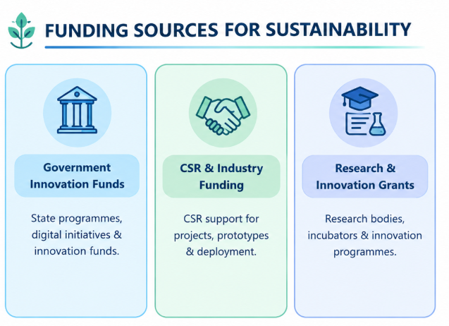
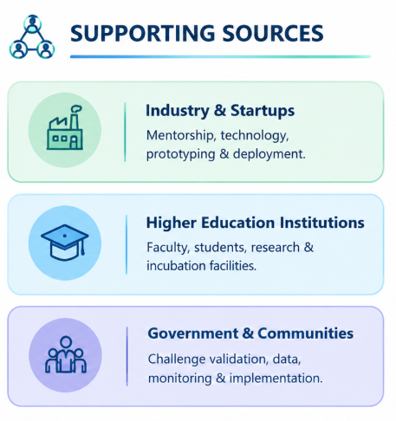
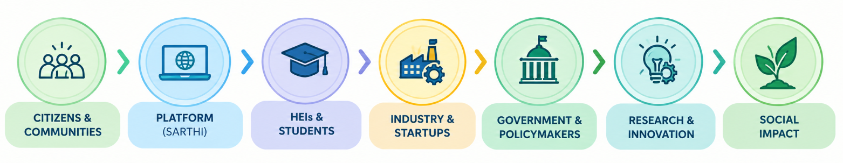
IMPACT AND BENEFITS
BUSINESS MODEL
For Government & Policymakers
Data-Driven Governance: Monitor challenge trends, domains, institutional participation and project progress.
Measurable Impact: Track solution outcomes and improve policies and public-service delivery.
For Citizens & Communities
Easy Problem Reporting: Submit local challenges with photos, videos, location and documents.
Transparency & Tracking: Track problem validation, institutional assignment and solution progress.
BENEFITS OF THE SOLUTION
For Industry & Startups
Innovation & Talent Access: Discover real-world problems and collaborate with skilled student/faculty teams.
Mentorship & Deployment: Support prototyping, testing, funding and scalable implementation.
For HEIs & Students
Real-World Learning: Work on verified societal challenges through multidisciplinary projects.
Research & Innovation: Connect student/faculty expertise with real community needs.
FINANCIAL MODEL
• Government Funding: Platform development, maintenance
and programme support through government initiatives. • CSR & Industry: Funding for selected challenges, prototypes
and deployment. • Research Grants: Project-based funding for innovation and research. • Partnership Model: Institutions and industry collaborate on
high-impact solutions.
TARGET CUSTOMERS
Citizens, community organizations, local bodies, government departments, Higher Education Institutions (HEIs), industries, startups, MSMEs, CSR organizations, research laboratories, and innovation centres.
POTENTIAL IMPACTS ON THE TARGET ECOSYSTEM
For Citizens: Faster access to innovative solutions for local challenges.
For Education: Experiential learning, multidisciplinary research and stronger industry collaboration.
For Industry: Access to talent, ideas, research expertise and deployment opportunities.
For Government: Better visibility, monitoring and evidence-based decision-making.
For Communities: Greater participation, inclusion and locally relevant solutions.
For Innovation: Converts societal challenges into research, entrepreneurship and deployable solutions.
VALUE ADDED SERVICES
• Citizens: Easy challenge submission, tracking, transparency, and solution updates. • HEIs: Real-world projects, research opportunities, multidisciplinary collaboration, and student innovation. • Industry: Access to innovation, talent, research expertise, and deployment opportunities. • Government: Dashboards, analytics, project monitoring, and measurable social-impact tracking.
SCALABILITY
Pilot in selected districts → onboard government departments & HEIs → integrate industries, startups & CSR partners → expand citizen/community participation → monitor successful projects → state-wide implementation across Jharkhand

Slide 5
RESEARCH AND REFERENCES

