Slide 1
Do Large Language Models
Have a Writing Style?
ChatGPT
Claude
DeepSeek
Gemini
Mistral
A Stylometric Comparison of LLM-Generated Texts
Research question
Can stylometric features distinguish texts generated by different LLM families?
Viola Awor · Natural Language Processing
LLM Stylometric Fingerprinting
01
Notes:
Introduce the project, the title, and the central question. Explain that the task compares five LLM families using stylometric features.

Slide 2
Motivation: meaning is not the whole story
Research motivation
LLMs often produce fluent, semantically similar answers to the same prompt.
The open question is whether their writing habits remain measurably different.
Core distinction
•
sentence structure
Semantic similarity
what the text is about
•
punctuation habits
•
word choice and lexical diversity
Stylometry
•
readability and function-word usage
how the text is written
•
discourse and AI-style markers
LLM Stylometric Fingerprinting
02
Notes:
Explain why stylometry is useful: it captures form and writing habits, not just semantic content.

Slide 3
Research question and measurable objectives
Study design
Can stylometric features distinguish texts generated by different LLM families?
•
Build a balanced corpus of LLM-generated texts.
•
Extract measurable stylometric features.
•
Test feature differences across model families.
•
Compare semantic clustering with stylometric evidence.
•
Train classifiers to predict model family.
•
Critically discuss effectiveness and limitations.
LLM Stylometric Fingerprinting
03
Notes:
State the research question and summarize the measurable objectives.

Slide 4
Dataset and experimental design
Corpus
Item
Value
Genres
Generated texts
1,000
•
Narrative
Model families
5
Texts per model
200
•
Descriptive
Genres
4
•
Argumentative
Texts per genre
250
•
Dialogue
Texts per model per genre
50
Stylometric features
43
Why balance matters
Prompt groups
200
Equal model and genre coverage reduces class-size and genre imbalance as sources of bias.
LLM Stylometric Fingerprinting
04
Notes:
Describe the balanced corpus and emphasize that each model contributes equally across all genres.

Slide 5
Methodology overview
Pipeline
1
Controlled prompts
2
API generation
3
Cleaning + length validation
4
Stylometric features
5
Semantic maps
6
Statistical tests
7
Classification
8
Streamlit dashboard
Formal task
Represent each generated text as a 43-dimensional stylometric vector, then predict model family.
φ(xᵢ) ∈ ℝ⁴³ → {ChatGPT, Claude, DeepSeek, Gemini, Mistral}
LLM Stylometric Fingerprinting
05
Notes:
Walk through the analysis pipeline and introduce the formal classification framing.

Slide 6
Stylometric features: what is measured?
Feature design
Length & sentence structure
Punctuation
Lexical diversity
•
word count
•
comma count
•
type-token ratio
•
sentence count
•
period count
•
Yule’s K
•
average sentence length
•
dash count
•
Honore’s R
•
long-sentence ratio
•
punctuation per 100 words
•
MATTR
Markers & function words
Readability
•
function-word ratio
•
Flesch reading ease
•
transition markers
•
Gunning Fog index
•
hedging markers
•
AI-style markers
LLM Stylometric Fingerprinting
06
Notes:
Explain that the features are interpretable and describe writing form rather than semantic topic.

Slide 7
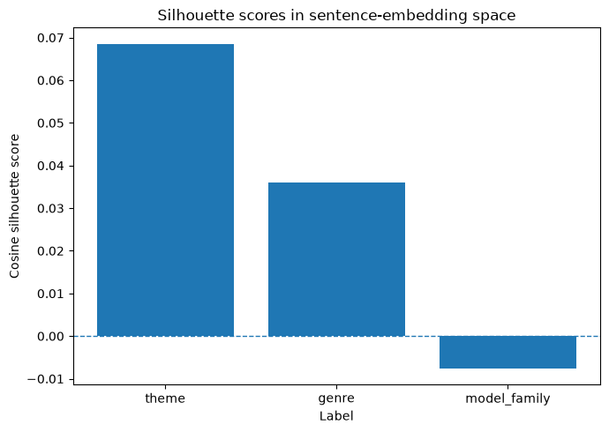
Semantic mapping: weak model-family clustering
Embeddings
Label
Cosine silhouette
Theme
0.0685
Genre
0.0361
Model family
-0.0075
Interpretation
•
Theme has the strongest semantic signal, but it is still weak.
•
Model family is slightly negative.
•
Sentence embeddings capture topic/theme more than model identity.
LLM Stylometric Fingerprinting
07
Notes:
Present the semantic silhouette scores and explain that embeddings do not strongly separate model families.

Slide 8
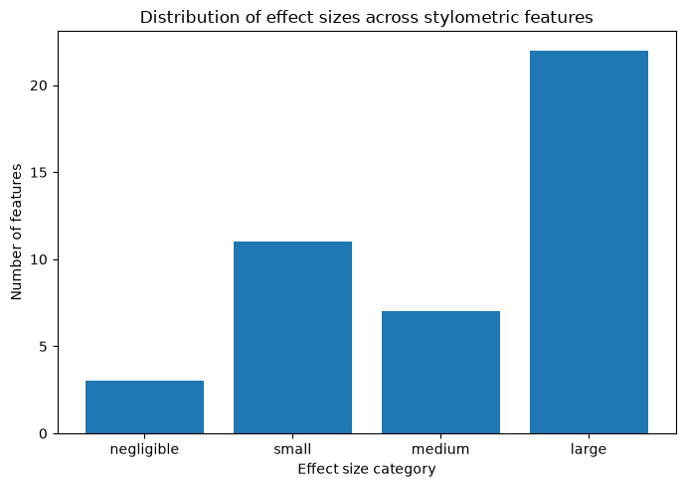
Statistical testing: model families differ in style
Kruskal-Wallis + FDR
Result
Value
Features tested
43
Significant after FDR
41
Large effects
22
Medium effects
7
Small effects
11
Negligible effects
3
Most stylometric features differ significantly across model families, and many differences are practically meaningful.
LLM Stylometric Fingerprinting
08
Notes:
Emphasize that 41 out of 43 features were significant, with 22 large effects.

Slide 9
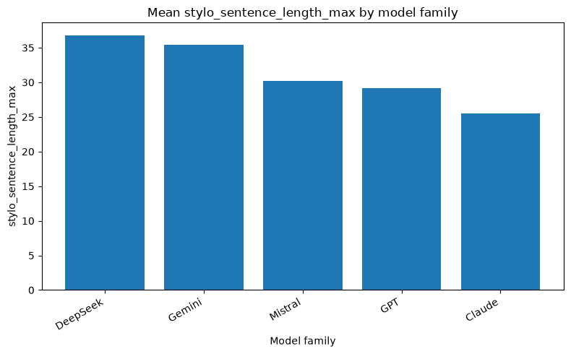
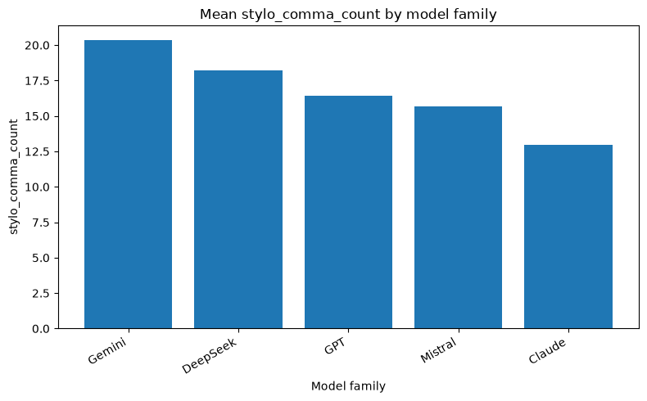
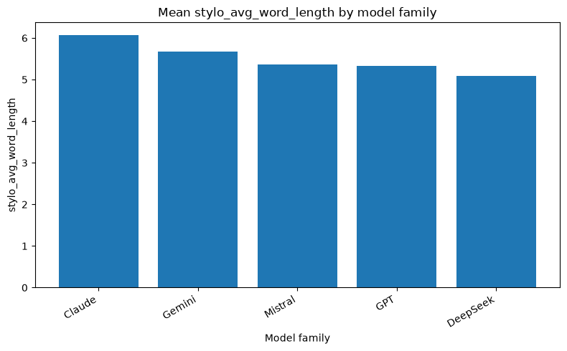
Model-specific stylometric patterns
Interpretable differences
Patterns observed in the project
•
DeepSeek: longer and more expansive sentence structures.
•
Gemini: higher comma count and comma density.
•
Claude: higher average word length and lexical density.
•
ChatGPT: higher function-word ratio.
LLM Stylometric Fingerprinting
09
Notes:
Show selected feature mean charts and interpret the model-specific patterns.

Slide 10
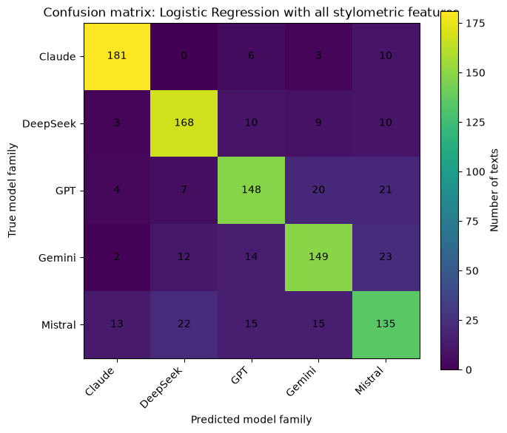
Classification: predicting the generating model family
Supervised evaluation
Classifier
Feature set
Accuracy
Macro F1
Logistic Regression
All stylometric
0.781
0.780
Random Forest
All stylometric
0.779
0.776
Random Forest
Structure/format
0.745
0.742
Logistic Regression
Content-oriented
0.602
0.599
Random baseline = 0.20
Prompt-aware GroupKFold prevents the same prompt ID from appearing in both train and test folds.
LLM Stylometric Fingerprinting
10
Notes:
Present the main classification results and show the logistic-regression confusion matrix as evidence.

Slide 11
Evaluation design: avoiding prompt leakage
Cross-validation
Why prompt-aware splitting matters
•
All models answered the same prompt set.
Evaluation metrics
•
A random split could leak prompt-specific topic patterns.
•
Accuracy
•
GroupKFold by prompt_id forces generalization to unseen prompts.
•
Macro precision
•
This makes the result a stronger test of writing style.
•
Macro recall
•
Macro F1
•
Weighted F1
LLM Stylometric Fingerprinting
11
Notes:
Explain GroupKFold and why it is important for this particular dataset design.

Slide 12
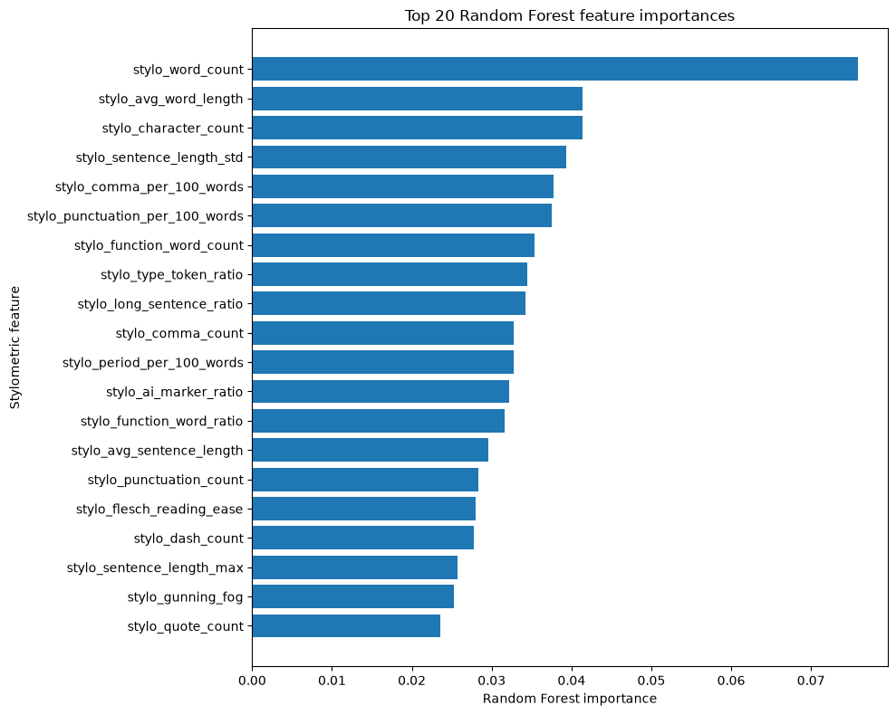
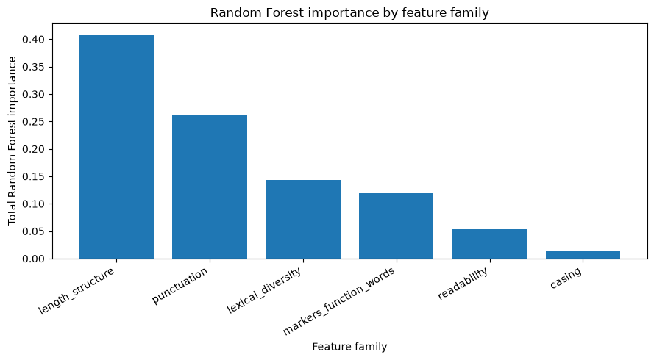
Feature importance: the fingerprint is distributed
Model interpretation
Key point: there is no single “magic” feature; model identity is distributed across several stylistic dimensions.
LLM Stylometric Fingerprinting
12
Notes:
Use feature importance to show that the predictive signal is distributed across multiple feature families.

Slide 13
Streamlit dashboard and reproducibility
Deliverables
Interactive dashboard sections
Repository organization
•
Dataset summary
•
src/: reusable modules
•
Stylometric feature explorer
•
scripts/: reproducible pipelines
•
Semantic maps
•
notebooks/: interpretation
•
Statistical-test results
•
outputs/: saved tables and figures
•
Classification performance
•
app/: Streamlit dashboard
•
Feature importance and conclusion
streamlit run app/streamlit_dashboard.py
LLM Stylometric Fingerprinting
13
Notes:
Explain that the dashboard presents saved outputs and helps make the project reproducible and explorable.

Slide 14
Limitations
Critical discussion
•
Corpus is controlled but limited to 1,000 texts.
•
Only five model families are included.
•
Results may change with different prompts, domains, or languages.
•
Model versions and decoding settings can change over time.
•
Stylometric features are interpretable but not exhaustive.
The result does not imply perfect attribution in all settings; it shows strong evidence under a controlled experimental design.
LLM Stylometric Fingerprinting
14
Notes:
Discuss limitations and frame the claim carefully.

Slide 15
Conclusion and future work
Final answer
Final answer: Yes.
Future work
Stylometric features can distinguish texts generated by different LLM families.
•
more model families and versions
•
multilingual prompts
Evidence
Main result
•
human-written comparison set
Semantic maps
weak model-family clustering
•
paraphrasing robustness
Statistical tests
41 / 43 features significant
•
style drift over model updates
Post-hoc tests
86 / 100 pairwise tests significant
Classification
78.1% accuracy vs. 20% baseline
LLMs generated semantically similar answers, but they did not write in identical styles.
LLM Stylometric Fingerprinting
15
Notes:
Close with the main answer, the strongest evidence, and future work.

