Slide 1
CREATIVITY TALK SESSION

Slide 2
EDUCATION Academic intelligence No education no jobs No academic intelligence no creativity

Slide 3
TALENTS & GIFTS It’s good to consider and support other peoples` talents and gifts.

Slide 4
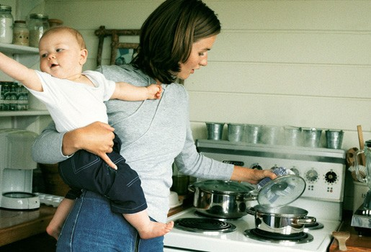
WOMEN-MULTITASKING

Slide 5
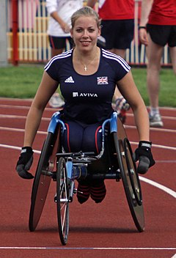
DISABILITY IS NOT INABILITY

Slide 6
IF YOU ARE NOT PREPARED TO BE WRONG YOU ARE NOT COMING UP WITH ANYTHING.

