Slide 1
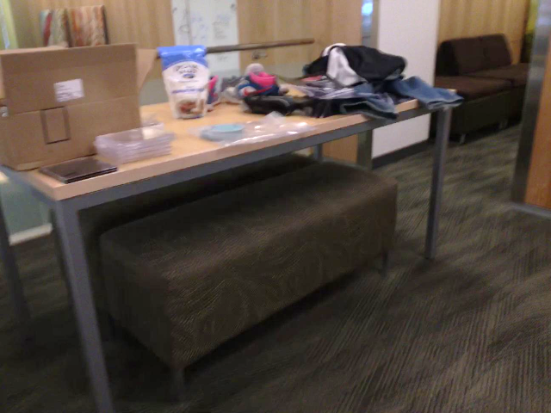
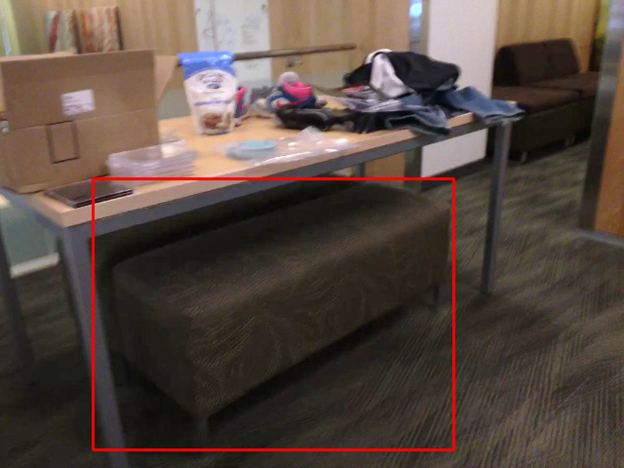
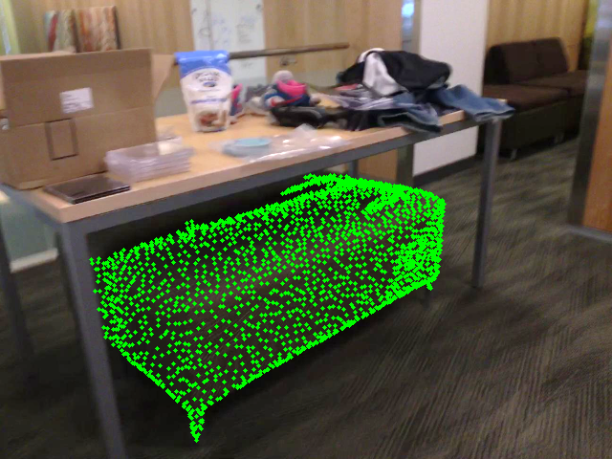
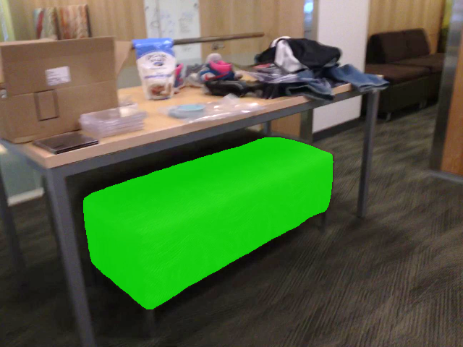


Bounding Box
Landmarks
SAM Mask
Describe only the object inside the red bounding box, considering the surrounding background context as well.
There are two images given. The first one is the original image. The second one is the original image with some green spots. Describe the object that the green spots mainly covers.
There are two images given. The first one is the original image. The second one is the original image with a green mask. Describe the object that the green mask mainly covers.
A brown ottoman with a patterned fabric covering sits on a carpeted floor.
The green masks are on a footstool.
A rectangular, upholstered bench with a textured fabric covering.
According to the description, identify what is the object.
According to the description, identify what is the object.
According to the description, identify what is the object.
Ottoman.
Stool.
Bench.

