Slide 1

Feasibility Study
17/08/2023

Slide 2
What I’ve been doing
Many more results – Have been running experiments on Iridis for the last 2 weeks
Results have given more questions than answers; now trying to create testable hypotheses
Referral work is about 95% finished, then will send it to Mohammad.
Thinking on Internship has changed

Slide 3
Major Results
 | Early Churn | Late Churn | Performance | 0% Churn Rate Early | 0% Churn Rate Late
DDQN n-step=10 | 3.8% | 1.9% | 0.13* | 9.1% | 0%
DDQN n-step=3 | 5.6% | 2.8% | 0.127 | 15.7% | 3.8%
DDQN n-step=1 | 10.9% | 5.7% | 0.036 | 29.2% | 4.7%
N-step is clearly the major driver behind policy churn.
In the original paper, they used DDQN n-step=1, and got results around 9%, roughly matching these results

Slide 4
Literature - (Variance Double down)
After reviewing more literature, other papers have also found n-step to be far more important than expected
This paper reported that performance increased when both n-step was increased and batch size was decreased – however despite their testing, they did not find a good reason for why this was. My results may provide a reason.
The reason for this is that they both of these parameter changes increased variance, hence they thought they were destabilising to learning. My results show that N-step has a very strong stabilising effect.

Slide 5
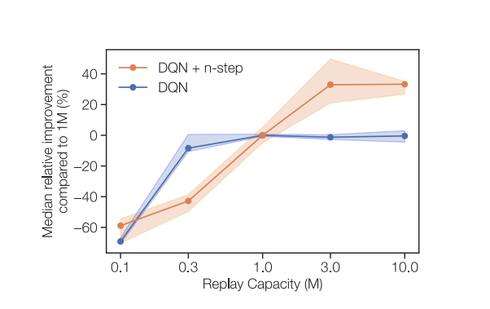
Literature – Revisiting fundamentals of Experience Replay
This paper looked to find correlations between Experience Replay size, and the age of policies in the replay buffer.
Despite this, what they found was that larger experience replays had massive performance gains, but only with n-step. Without n-step this improvement disappears entirely.
Paper also found even in offline RL, where n-step was thought to be detrimental, n-step still increases performance.
The paper also proposed some theories to explain this

Slide 6
Contrastive Factor
N-step decreases the reliance on bootstrapped targets – But is this the reason for the results?
They tested this by adjusting the discount rate to have the same reliance on bootstrapped targets, and it to have a small impact, but not enough to justify the results.
My Results: 0.999^10 = 0.99004
 | Early Churn | Late Churn | Performance | 0% Churn Rate Early | 0% Churn Rate Late
DDQN n-step=10, discount=0.99 | 3.8% | 1.9% | ? | 9.1% | 0%
DDQN n-step=1 Discount=0.99 | 10.9% | 5.7% | 0.036 | 29.2% | 4.7%
DDQN n-step=10 discount=0.999 | 4.9% | 2.5% | 0.074 | 14.4% | 4.2%

Slide 7
The paper’s other explanation
The paper also found that larger replay capacities reduced variance, and again that n-step increases variance. They proposed the idea that this could be the reason for improved performance with larger replay buffers and larger n-step, and tested this.
The results showed this could be partially responsible for the correlation, but was fairly weak.
Regardless however, this does still not explain why high n-step decreases policy churn so much. My results also showed replay size has practically no impact on policy churn, at least with high N-step.
 | Early Churn | Late Churn | Performance | 0% Churn Rate Early | 0% Churn Rate Late
DDQN n-step=10 Mem_size=100k | 3.8% | 1.9% | ? | 9.1% | 0%
DDQN n-step=10 mem_size=15k | 3.7% | 1.6% | 0.057 | 8.1% | 0%

Slide 8
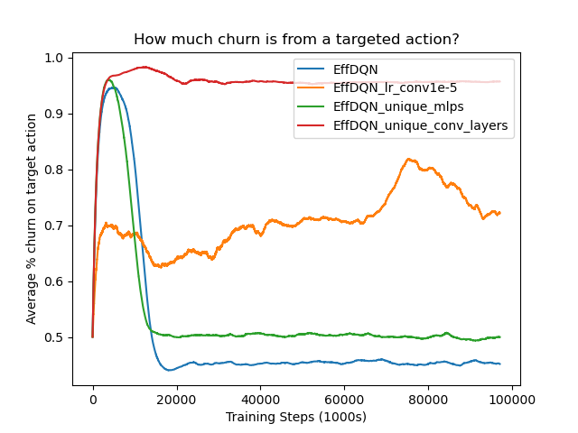
My First proposed theory
Overgeneralisation – perhaps n-step causes other actions to have be impacted less by gradient updates, hence stabilising training.

Slide 9
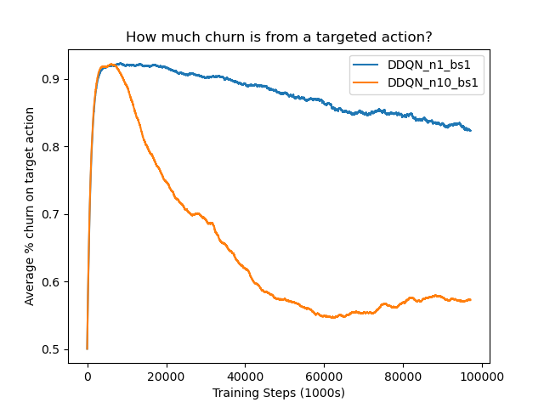
This theory was dramatically wrong
N-step massively increased how much gradient updates effected actions they were not intended for – the exact opposite of what I was hoping to find.
I am still unsure of what conclusions to draw from this, as it seems highly strange that high n-step causes actions to generalise more, but the policy to change less.
This was done on a single sample, so perhaps it is needed to repeat?

Slide 10
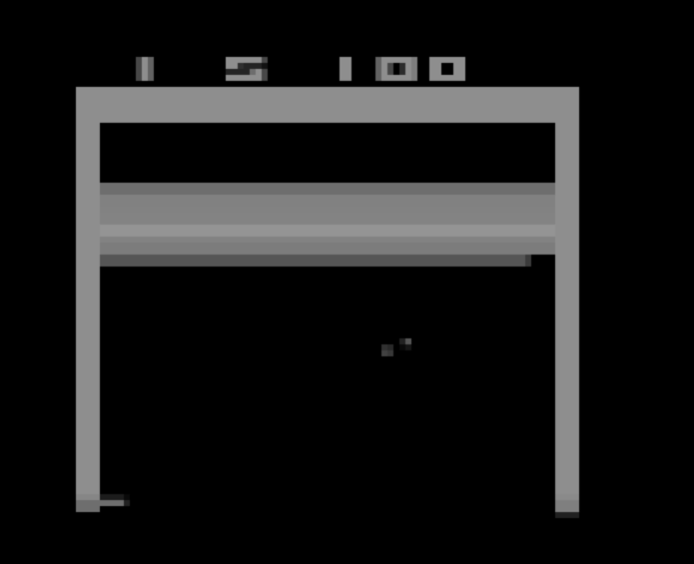

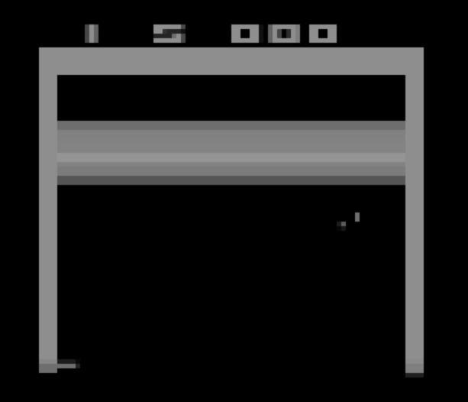
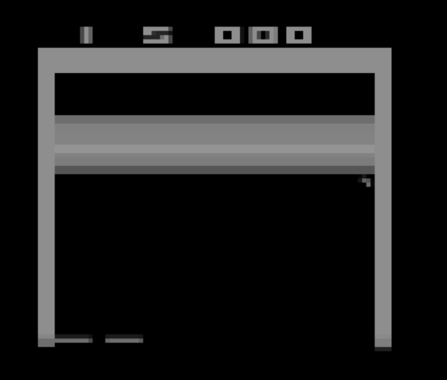
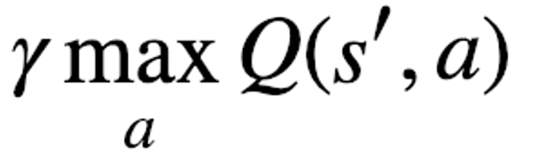
Reward Spiking
S’’’
Based on the idea that neural networks may able to predict the value of a state-action pair, but not on when they will receive the reward.
S
S’
N=1
3
‘’
N=3
Q(s,a) = r(s,a) + γ*r(s’,a)_{t+1} + γ² *r(s’’,a)_{t+1} +
r(s,a)=1 r(s,a)=0

Slide 11
Test
Instead of relying on n-step to make us look past the reward, just give the rewards a spread.
Instead of receiving over the next 5 timesteps [1,0,0,0,0], receive [0.2, 0.2, 0.2, 0.2, 0.2]

Slide 12
Results of Reward Spiking with n-step=1
 | Early Churn | Late Churn | Performance | 0% Churn Rate Early | 0% Churn Rate Late
DDQN n=10 | 3.8% | 1.9% | ? | 9.1% | 0%
DDQN n-step=1 | 10.9% | 5.7% | 0.036 | 29.2% | 4.7%

Slide 13
Other news - YouTube
Have been contemplating my internship due to recent successes.
Considering suspending on work on this instead, as money is possibly better and work is very enjoyable and specific to my PhD

Slide 14
Full Results Table
 | Early Churn | Late Churn | Performance | 0% Churn Rate Early | 0% Churn Rate Late
DDQN | 3.8% | 1.9% | ? | 9.1% | 0%
DDQN bs=16 | 3.2% | 1.6% | 0.104 | 14.8% | 0%
DDQN discount=0.999 | 4.9% | 2.5% | 0.074 | 14.4% | 4.2%
DDQN Lr=0.00025 | 3.8% | 1.7% | 0.061 | 7.8% | 0%
DDQN n-step=3, | 5.6% | 2.8% | 0.127 | 15.7% | 3.8%
DDQN n-step=1 | 10.9% | 5.7% | 0.036 | 29.2% | 4.7%
DDQN n-step=20 | 3.2% | 1.6% | 0.055 | 7.8% | 0%
DDQN mem_size=15k | 3.7% | 1.6% | 0.057 | 8.1% | 0%
DDQN n=1 spread_high | 11.3% | 5.5% | 0.043 | 30.1% | 4.4%
DDQN n=1, discount=0.904 | 4.6% | 2.4% | 0.126 | 12.8% | 0%
DDQN Augmentations | 3.3% | 1.4% | 0.160 | 19.4% | 4.0%

Slide 15
Next Week
Working full time again on the feasibility study
Will continue to look for answers regarding the n-step ideas, but want to begin writing up soon
My deadline is on the12th October
Demonstrations are usually on the 25th September, however this may also be pushed back three weeks

