Slide 1

JBoss Drools
刘俊豪

Slide 2
议程
JBoss Drools介绍
Hello Drools
Drools Rule Language
Domain Specific Language
Flow
Drools Guvnor

Slide 3
Drools简介
Drools是Redhat公司JBoss业务逻辑智能模块。www.jboss.org/drools/
Drools是处理规则的专家系统。

Slide 4
Rule Engine的优势
声明式编程
Rule Engine允许你说“做什么”，而不是“怎样去做”
Rule系统能解决非常困难的难题
逻辑和数据分离
快捷和灵活
Knowledge集中化
工具集成
良好的解释机制
易于理解的Rule

Slide 5
例子
Java语言表示，如果有一个人的名字是“Joe”，而且是个男性，就会输出他的名字跟性别。
If ( “Joe”.equal( people.getName() ) ) { if( “Male”.equal( people.getSex() ) ) { System.out.priltln(“This is a man, name is Joe.”); } }
rule "GoodBye" when People( name = ”Joe”, sex = ”Male”) then System.out.println((“This is a man, name is Joe.”); end

Slide 6
产生背景
系统庞大，业务复杂；
业务规则经常改变；
24小时服务；
业务统一管理；
降低系统维护升级成本。

Slide 7
知识背景
生产式规则引擎
Rete算法

Slide 8
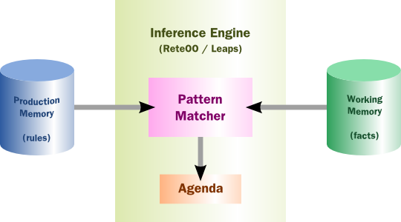
产生式规则引擎
许多产品规则系统的大脑实际上就是一个推理引擎，用于匹配facts和rules
当匹配被找到，rule actions被fire
Actions
经常会改变facts的状态，或者
在应用上执行一些“外部”action

Slide 9
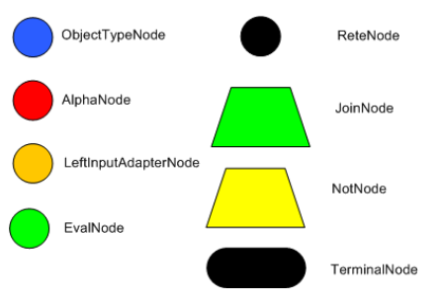
RETE网络节点

Slide 10
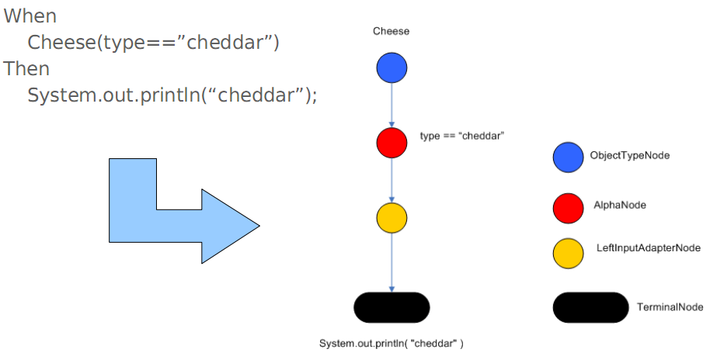
简单的RETE网络

Slide 11
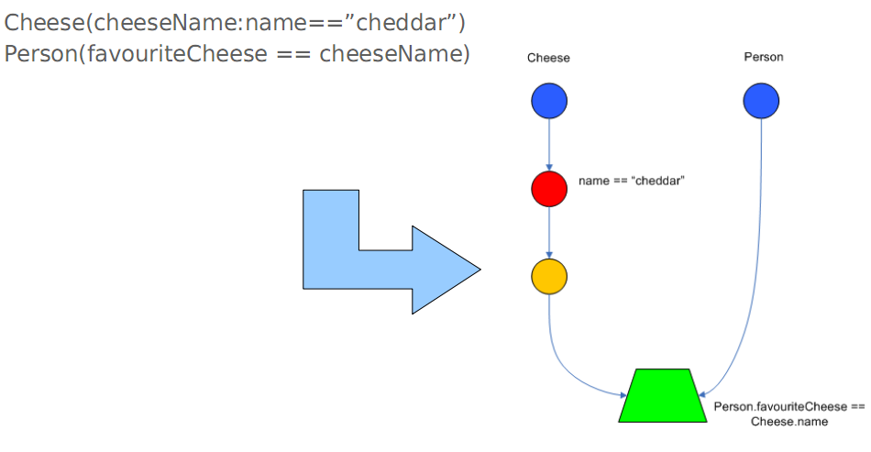
JoinNode

Slide 12
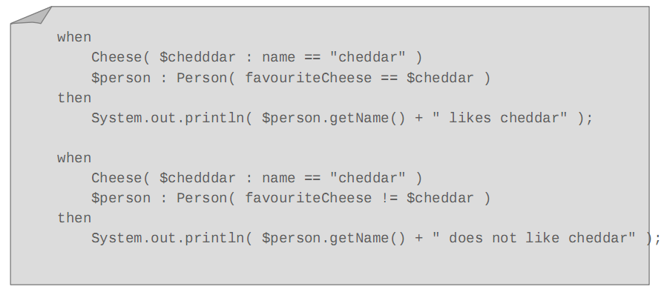
更复杂的网络

Slide 13
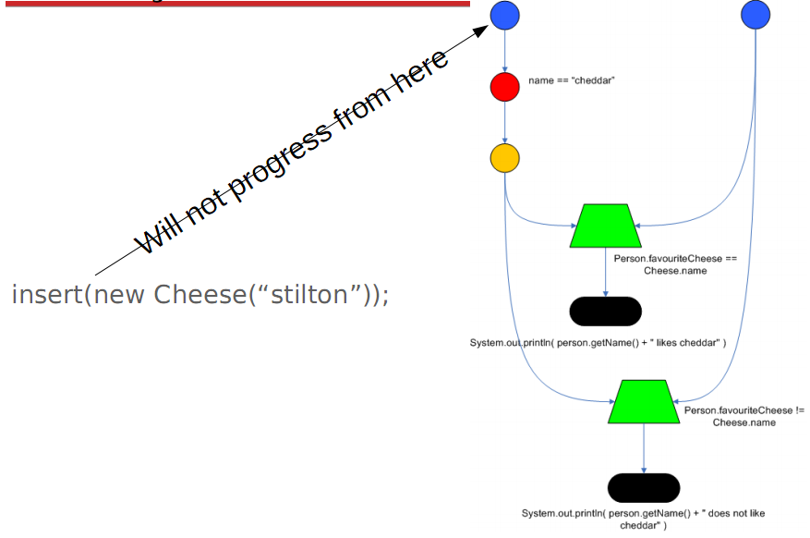

Slide 14
Drools是如何工作的？
5. Fire All Rules
Agenda
Rule
Activation
Rule
1.Parse DRL
RuleBase
Rule
Rule
Fact
Rule
Rule
Activation
Fact
Rule
Fact
2. Create
Fact
Fact
WorkingMemory
Fact
Fact
3. Assert Facts
Fact
Fact
Fact
Fact
Fact
Fact
Rule
(5) activation -> consequence
Rule
Rule
Rule
Rule
Notes:
It is important to bear in mind that, in a real-world system, there will be many rules (potentially tens of thousands) and many facts (possibly even hundreds of thousands). Let us look at the steps required to get JBoss Rules up and running and see how the system works to process our rules.
First of all, we obtain our list of rules (specified in one or more DRL, DSL or XML files) and tell JBoss Rules to parse them into memory.
<animate id=“1”/> This uses an instance of the org.drools.compiler.PackageBuilder class. A java.io.InputStream is passed to the addPackageFromDrl(…) method and then the getPackage() method is called to obtain an in-memory representation of the parsed rules. Then we can pick an implementation of org.drools.RuleBase depending on the algorithm we wish to apply (org.drools.reteoo.RuleBaseImpl for the Object Oriented Rete implementation) and load the package into a RuleBase with the RuleBase.addPackage(…) method. Now we have an in-memory definition of the Rules suitable for algorithmic processing.
<animate id=“2”/>Now we have the RuleBase defined, we need to obtain a construct that can do the work of combining rules and facts, this is known as the “Working Memory” and is created using the org.drools.WorkingMemory RuleBase.newWorkingMemory() method.
<animate id=“3”/> So the next step is to make JBoss Rules “aware” of the world in which it is operating. Each fact is asserted into the Working Memory ( WorkingMemory.assert(…) ). As the facts are asserted, JBoss Rules is actually doing a lot of the work required to understand how the facts relate to the rules and to build up the optimised Rete network that describes this relationship.
<animate id=“4”/> If we “look inside” the implementation of the WorkingMemory we can see that it is holding a reference to the Facts and a copy of the parsed Rules, we are ready to go
<animate id=“5”/> Now we ask the call the fire all rules method on the WorkingMemory (WorkingMemory.fireAllRules()) to actually trigger all the interactions between facts and rules. It is helpful and instructive at this point to consider a naïve, brute force approach. The rules engine behaves as if it has exhaustively evaluated all of the rules against all of the facts and looked to see which rules should be fired against which facts.
<animate id=“6”/> The black lines represent all the possible interactions and the red lines the ones when a particular rule matches against one or more sets of facts. Each such red line, represents an activation object in JBoss rules terminlogy and is a pair of a rules consquence and the tuple of objects on which the rule has been activated.
<animate id=“7”/> All of the activations are queued within a data construct known as an agenda. In general, the order which this activations are stacked will not be formally defined. The constructs such as salience allow some more control over how they are defined.
<animate id=“8”/> Finally, activations are processed one-by-one from the agenda, calling the consequence of the rule on the facts that activated it.
One final complication to note is that the processing of the consequence from one rule may change facts on which other activations’s on the agenda rules and facts were calculated. Thus this is actually an iterative process where the firing of one activation on the agenda can actually affect the contents of the agenda before the next activation is fired!
As you can imagine, once you have tens of thousand rules and potential hundreds of thousands of facts, a “brute force” approach which mindelessly evaluates all facts against all rules becomes unworkable. The Rete algorithm’s purpose is to provide an efficient way of handling such as situation.
<senote>To complete this overview, I would really like to add a single slide after this one that shows the basics of what the Rete algorithm is doing – pending inspiration</senote>

Slide 15
议程
JBoss Drools介绍
Hello Drools
Drools Rule Language
Domain Specific Language
Flow
Drools Guvnor

Slide 16
配置开发环境
到Jboss Drools官网的下载频道下载一下资料：
Drools Binaries(Required)
Drools Eclipse Workbench(Required)
Documentation
Java docs
Source Code
… …

Slide 17
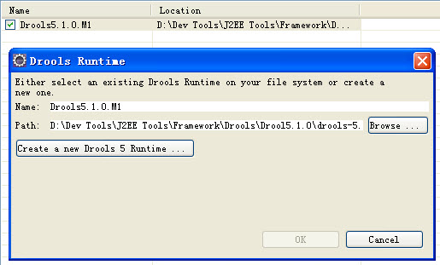
配置开发环境
解压Drools Binaries，到路径{Drools_Home}。
解压Drools Eclipse Workbench，把 features 和 plugins 放到 {Eclipse_Home}\dropins文件夹下。
打开Eclipse，到Window >> Preference >> Drools >> Install Drools Runtimes，给Eclipse指定Drools的安装路径{Drools_Home}。

Slide 18
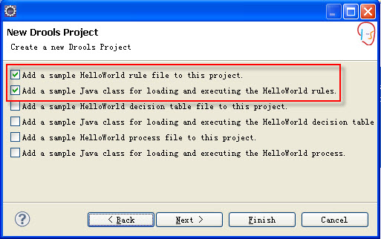
新建Hello Drools项目
打开Eclipse新建项目窗口，File >> New >> Other…
选择Drools >> Drools Project，打开新建Drools项目窗口。
输入项目名称，点Next进入下一页面。
勾上第1、2项，生成一个Hello World的例子。
点Finish 完成。

Slide 19
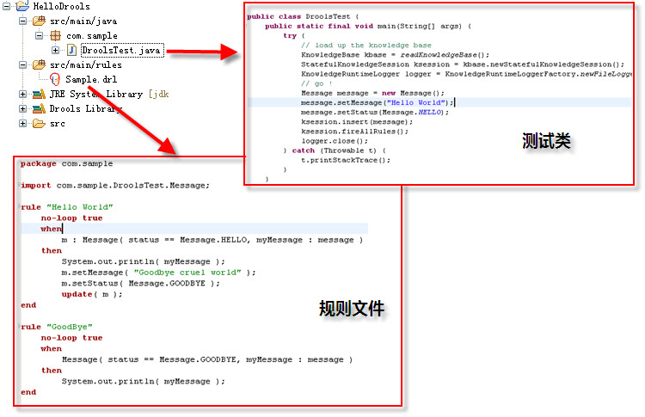

Slide 20
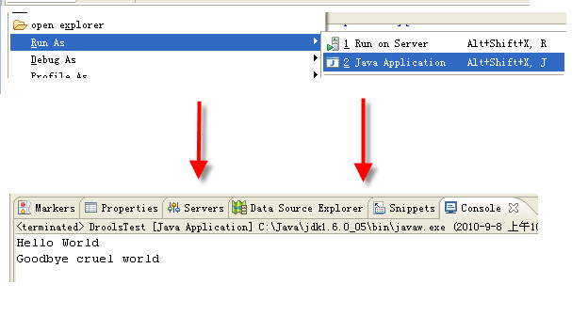
执行结果

Slide 21
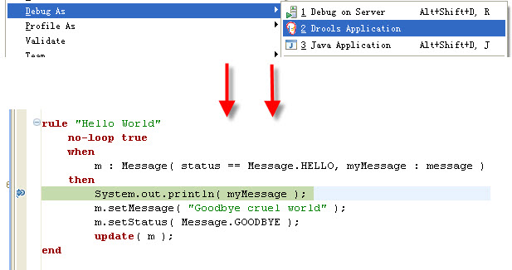
Debug规则文件

Slide 22
议程
JBoss Drools介绍
Hello Drools
Drools Rule Language
Domain Specific Language
Flow
Drools Guvnor

Slide 23
规则文件种类
DRL – Drools Rules Language
高级别的表达式语言（适合高级用户）
XML – Drools 2.x Format
XML结构化规则
DSL – Domain Specific Language
领域语义
规则模板支持自然语言
Decision Tables（决策表）
对业务分析人员非常有用
Excel, Impress or CSV
自定义UI界面
挑选关键元素
适合最终用户操作

Slide 24
DRL
Fact
Stock.java
package com.sample;
public class Stock
{
enum Action {BUY, HOLD, SELL};
public String getIndexName();
public BigDecimal getCurrentPrice();
public void setCurrentPrice(BigDecimal p);
…
public void setFlag(boolean flag);
public void setAction(Stock.Action action);
}
import com.sample.Stock;
rule "IdentifyHotBuys"
no-loop true
salience 10
when
stock : Stock (
indexName == "DJIA",
currentPrice <= 100.0,
technicalScore >= 10.1,
fundamentals >= 62.5,
attractiveness >= 87.2)
then
log("BUY:"+stock);
stock.setFlag(true);
stock.setAction("BUY");
modify( stock );
end
Rule
StockPicker.drl
术语:
Rule
Condition
Consequence
Fact
Notes:
It is very useful when attempting to get one’s head around a rules engine to dive into a concrete example of what a rule and a fact might look like in a real-world system. Here we see a very small slice through a system that is being used to automate the process of trading stocks on an exchange.
On the right we see the class that defines one of the key facts in the system and represents a Stock trading on the exchange. The key things to notice are that:
this is a plain old Java object (POJO) which has exposed its state via a number of getters and setters that follow the JavaBeans naming conventions
this is the type of POJO a well-architected imperative solution would be likely to have produced already which can be reused in JBoss Rules (although we should note it can be best practice to produce a layer of POJOs specific to Rules – perhaps at a finer level of granularity to optimise performance and readability)
On the left we see a simple rule, specified in a text file in the recommended DRL format provided with JBoss Rules 3.x . In POE (Plain Old English) this rule defines the following behaviour “when price of the stock with ticker symbol DJIA falls below $100.00 and the technical score is at least 10.1, the fundamentals metric is at least 62.5 and the perceived attractiveness is at least 87.2 then flag the stock as a BUY”. This is exactly what the rule would look like in a DSL (domain specific language) if the mappings had been configured to support a “Stock Picker DSL”.
Delving into a little more detail we can see that the rule is given a name “IdentifyHotBuys” and then has two modifiers applied to it, no-loop which ensures that is the facts on which this rule is based changed then the rule (which would normally then be fired again) is not re-activated and salience which define the priority of this rule relative to other rules and allows some control over the order in which the rules will be fired.
Other available rule attributes are:
agenda-group – partitions rules into a named group and allows only members of the group which currently has the focus to fire
auto-focus – allows automatic switching of the focus to the agenda-group this rule is in when it fires
activation-group – makes all rules in this group exclusive, i.e. only one rule from this group will fire not matter how many are activated
duration - ?not defined in docos?
The When clause specifies the conditions that must be met for this rule to fire in an HQL like object-oriented query syntax. Note that all matching objects will be found and have this rule applied. In this case, we are only likely to find one Stock object. If we had specified simply fundamentals >50.0 we would find many more. Each stock would then be matched with this rule (in what is called an activation).
The Then clause specifies the action that will be taken for each matching stock (using the stock variable to access the matched stock and some other built-in JBoss Rules objects such as the modify() method to let the rules engine know that this object has been updated and that it need to recalculate the result of any relevant rules that were referring to the object.

Slide 25
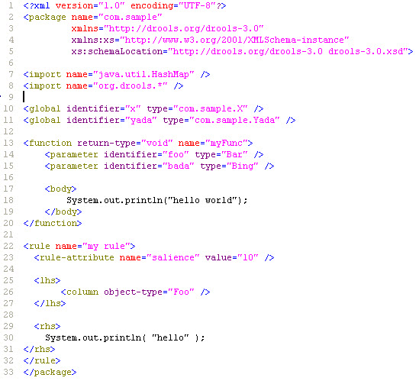
XML

Slide 26
DSL – Domain Specific Languages
rule "Platinum Priority"
#we don't want to make the high rollers wait !
when
There is a "Platinum" customer with a ticket status of "New"
then
Escalate the ticket
end
rule "Escalate"
when
There is a customer ticket with status of "Escalate"
then
Send escalation email
end

Slide 27
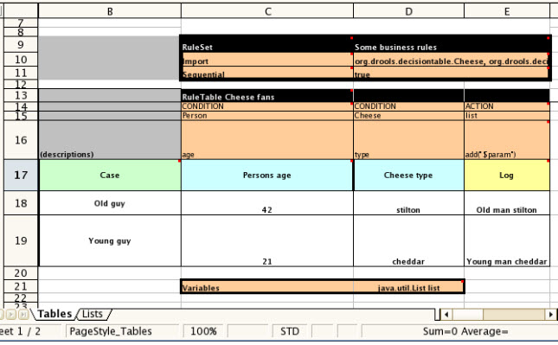
Decision Tables
解析Excel XLS 和 CSV (Open Office)

Slide 28
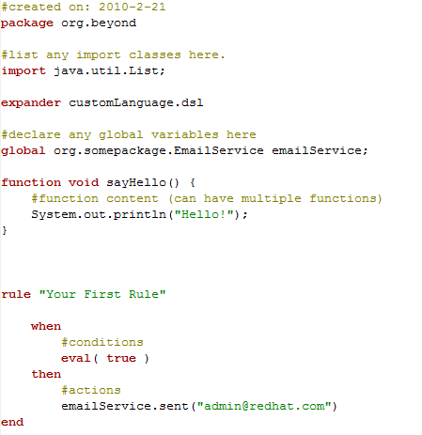
一个DRL范例

Slide 29
剖析DRL文件
Package
不必匹配目录结构
Expander
Dsl文件列表
Imports
Fact类型/领域对象的列表
Facts被插入working memory（通过insert API）
Globals
被命名的“变量”
值能在working memory中设置（通过setGlobal API）
大多用于返回结果，或者作为引用数据
在LHS中使用要注意（应该为常量结果，且是幂等的）
Functions
即一段语义代码（java）
能够在LHS中的eval或者predicate谓词表达式中使用，或者在RHS中。
Rules

Slide 30
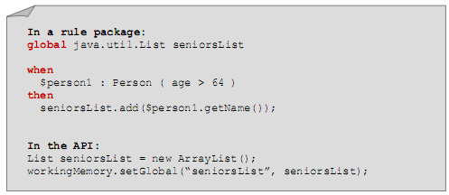
Globals
是一个命名变量
可传递常量或者工具（服务）
可作为结果返回，尤其是返回集合结果的途径
当Global变量是数字、字符或字符串类型时，在规则中是不能被改变的。
不应该当做facts的替换使用
RHS中的修改不会影响到LHS中的conditions
如果在LHS中使用，必须在facts插入前设置

Slide 31
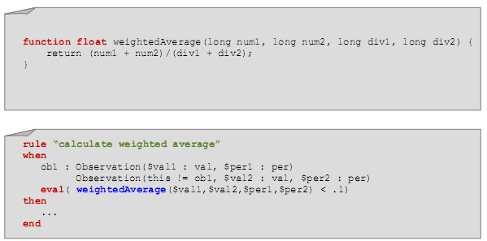
函数（Functions）
可在规则LHS或者RHS中添加各种逻辑
对字段的控制或者转换，小计算公式特别有用

Slide 32
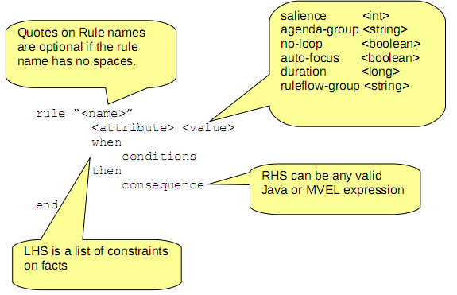
剖析Rule

Slide 33

剖析Rule
一个rule由conditions，和actions组成。当所有的conditions匹配，rule可能“fire”
Conditions即LHS（left hand side）
Actions即RHS（right hand side或者consequence）
Rule操纵应用程序中的fact（数据）

Slide 34
Facts（事实）
POJOs (Plain Old Java Objects)
插入working memory.
Hibernate and/or EJB3
整合POJOs 和 Database
Communication
修改 POJO’s 状态/属性
变化被告知rules engine
或者使用property change listener
Long-lived working memory
持久的
stateful session bean
Short-lived working memory
插入，计算，处理
stateless session bean
public class Stock {
private String symbol;
private String indexName;
private float currentPrice;
public String getSymbol() {
return this.symbol;
}
public void setSymbol(String symbol) {
this.symbol = symbol;
}
public String getIndexName() {
return this.indexName;
}
public void setIndexName(String indexName) {
this.indexName = indexName;
}
public float getCurrentPrice() {
return this.currentPrice;
}
public void setCurrentPrice(float currentPrice) {
this.currentPrice = currentPrice;
}

Slide 35
Conditions / LHS
Rule的LHS由模式（Patterns）和条件元素（Conditional Elements—CE）组成
Patterns被用来指示出fact的字段约束
每个约束必须为true才能让RHS的actions fire

Slide 36
模式（Patterns）
没有字段约束的Pattern
Person()
有文本字段约束的Pattern
Person( name == “bob” )
字段绑定的Pattern
Person( $name : name == “bob” )
变量名称可以是任何合法的java变量，$是可选的，可由于区分字段和变量
Fact绑定的Pattern
$bob : Person( name == “bob” )
变量约束的Pattern
Person( name == $name )

Slide 37
条件元素（Conditional Elements）
应用在Pattern上
and
对于顶级（非嵌套）patterns是隐式成立的
可以显式and
使用关键字’and’（不推荐使用 &&）
or
列能被显式or
使用关键字’or’（不推荐使用 ||）
重要：’or’内部会为LHS中的每个逻辑分支生成一个rule，如果逻辑分支之间不互斥，rule可能会被多次fire

Slide 38
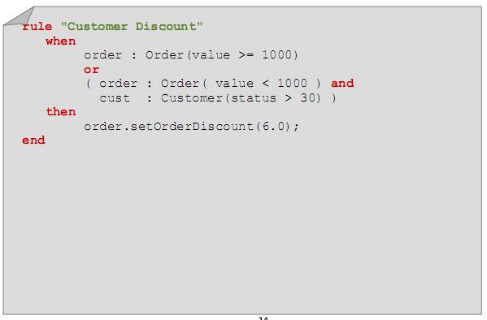
条件元素的例子

Slide 39
其他的条件元素（Conditional Elements）
Exists
Not
Accumulate
Collect
From
Forall

Slide 40
Consequence / RHS
即一段代码
Java
MVEL
典型actions：
插入新的fact
修改已经存在的fact
撤销fact
为fact的字段赋值
为global赋值
进行GC
警告：使用java的时候。不要使用if/else，for/while loops或者其他类似的java逻辑

Slide 41
Consequence / RHS
特有关键字
update( fact )
insert( new fact() )
retract( fact )
访问KnowledgeHelper——drools.XXX
getRule
比如：System.out.println(drools.getRule().getName()); 将打印出正在执行rule的名称
halt——停止rule的firings，把控制权交给应用
setFocus——针对agenda groups

Slide 42
执行时控制——Rule属性
Salience
Agenda Groups
Activation Groups
No Loop
RuleFlow

Slide 43
议程
JBoss Drools介绍
Hello Drools
Drools Rule Language
Domain Specific Language
Flow
Drools Guvnor

Slide 44
Domain Specific Language 领域特定语言
自然语言与规则代码翻译器。
适合非技术人员使用（业务分析员）。
规则更加容易理解
只要告诉规则做什么就好，不许关注怎么做。

Slide 45
议程
JBoss Drools介绍
Hello Drools
Drools Rule Language
Domain Specific Language
Flow
Drools Guvnor

Slide 46
Ruleflow
Drools已经提供了定义执行顺序的功能，比如salience，activation groups等等
当处理大量rule集的时候，管理规则的执行顺序可能会变得复杂
Ruleflow允许使用图形化的流程图来指定rule集的顺序
允许你指定rule集顺序或者并行执行
要使用ruleflow，你需要：
使用rule属性来给每个rule指定一个所属的ruleflow group
定义一个ruleflow图来描述这些ruleflow groups在执行中的顺序

Slide 47
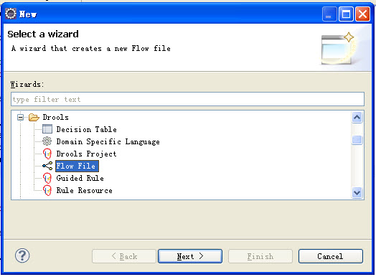
构建一个ruleflow
使用 New -> Other -> Drools -> Flow File，将创建一个新的.rf 文件

Slide 48
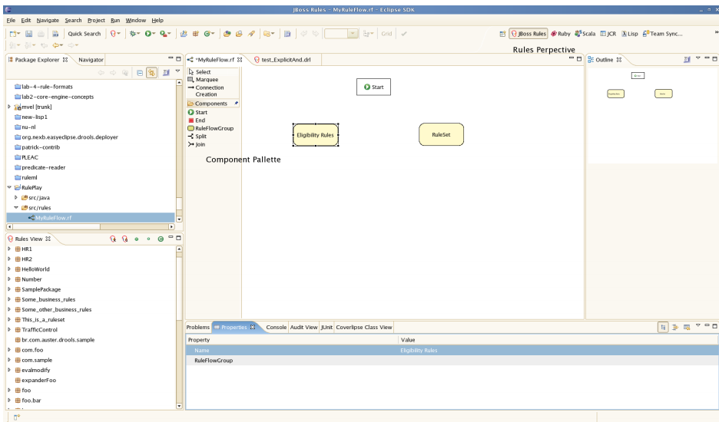
Drools透视图
打开“Drools透视图”，“properties”面板在eclispe窗口底部

Slide 49
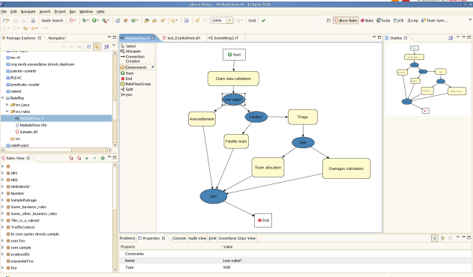

Slide 50
议程
JBoss Drools介绍
Hello Drools
Drools Rule Language
Domain Specific Language
Flow
Drools Guvnor

Slide 51
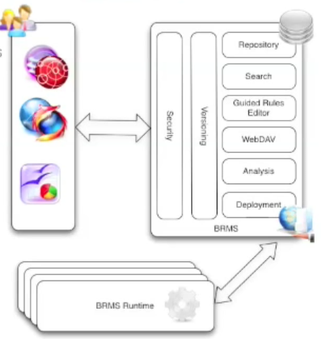
什么是Guvnor
业务规则编辑器
基于web，基于电子表格，开发工具
QA工具
测试脚本，分析工具，Rule执行
知识仓储
版本控制和回滚
搜索 & 索引
不同用户和权限
部署管理
快照和package部署
运行时
引擎可以使用仓储中的知识做出推论

Slide 52
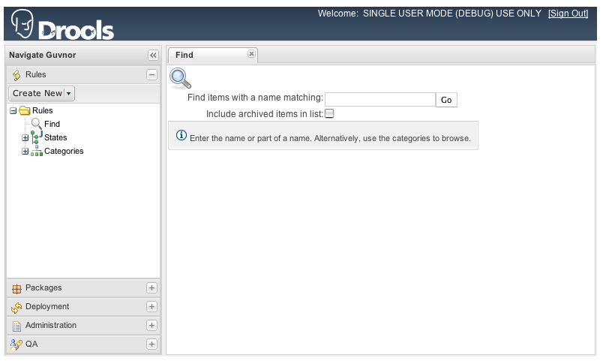
搜索资产

Slide 53
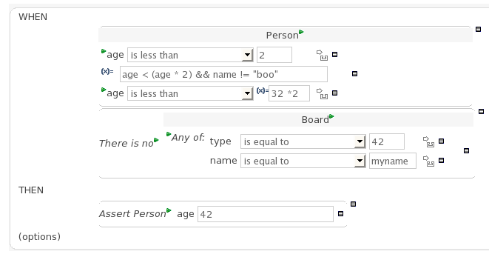
Rule编辑器

Slide 54
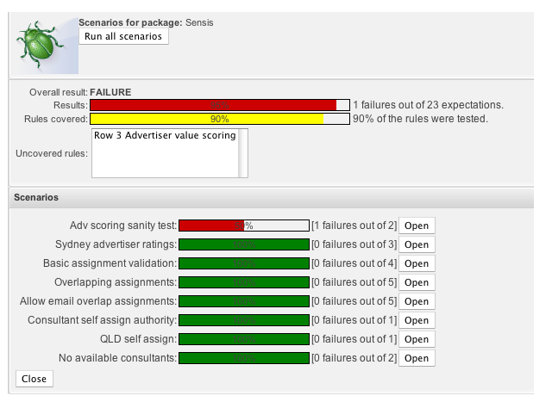
综合测试

Slide 55
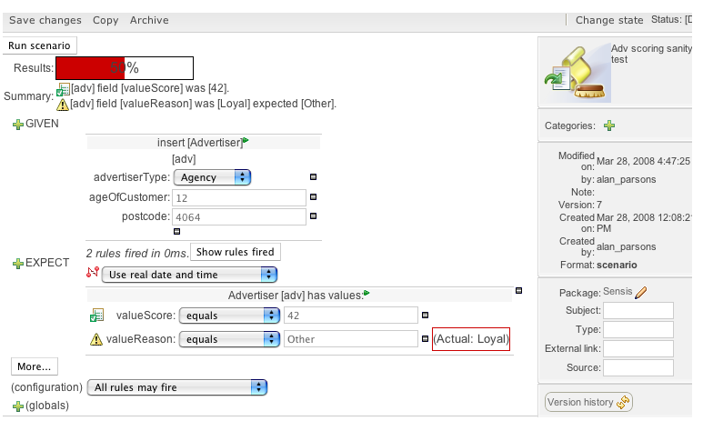
定义自己的测试

Slide 56
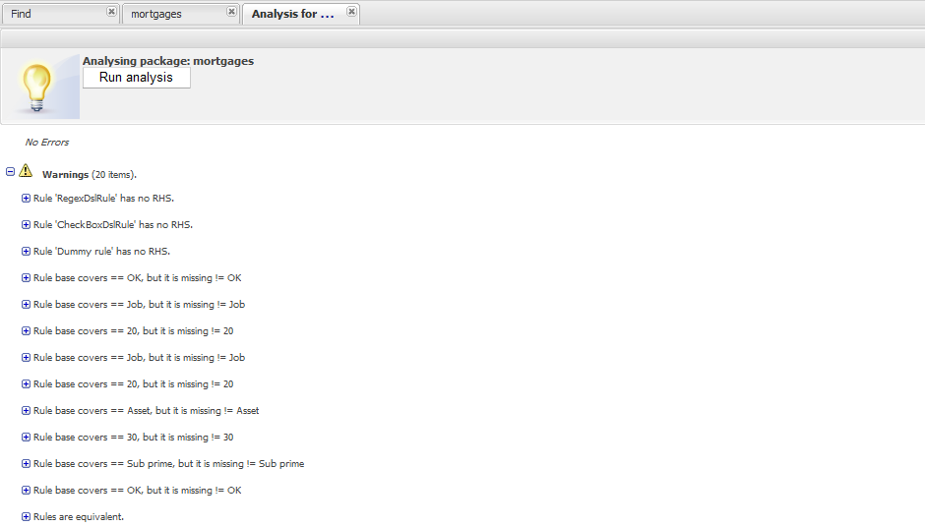
逻辑分析

Slide 57
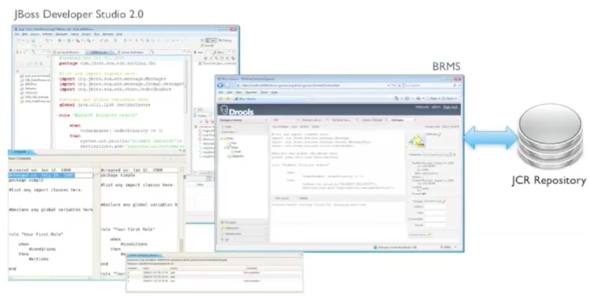
Eclipse——仓储同步

Slide 58
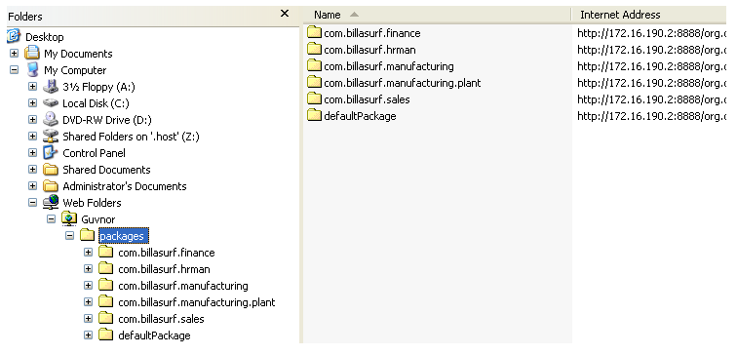
WebDAV
向文件系统一样访问仓储
存储任何/全部业务规则资产

Slide 59
使用Guvnor
什么时候使用Guvnor
管理规则（版本化/部署）
允许不同技能的用户编辑规则
尚没有设施管理规则
大量的规则
什么时候可以不使用Guvnor
已经存在的系统，规则已存在数据库
需要自己的用户交互界面
规则本身不允许和应用程序分开

Slide 60
Q & A

Slide 61
Home Work
工资计算器
实收工资
个人所得税
社保
公积金
… …

