Slide 1
Verified Address Detection
Team name : Geekycryptos
Team Details :
Sr. No | Name | Email id
1. | Atharva Tayade | atharva.tayade18@vit.edu
2. | Pratik Waso | pratik.waso18@vit.edu

Slide 2
Introduction
The field of cryptocurrencies and the blockchain is extremely exciting, with new projects and developments coming to light almost daily. The most recent buzzword around the blockchain surrounds NFTs, or non fungible tokens and the new way of tokenizing art, and media made popular.
The beauty of the blockchain is that the smart contracts take these transactions and authenticate and verify every transaction, removing the aspect of human intervention and error.
However, those who buy and sell cryptos, or who have ever transferred their holdings to another person, using wallet addresses, know just how easy it is to make a mistake and send it to the wrong place.
Sometimes you may accidentally send your cryptocurrency to the wrong wallet address.
And this mistake leads to losing your whole assets permanently as it is irreversible

Slide 3
Objective
To prevent user from sending cryptocurrency to wrong address.
To guide user how to select proper address where he needs to send his assets.
Redirecting user to third-party website (coingecko/coinmarketcap) where all details of that cryptocurrency is given and also make user to choose which chain he needs for withdrawal
Giving idea of how much fee required for withdrawal of that cryptocurrency to the user.

Slide 4
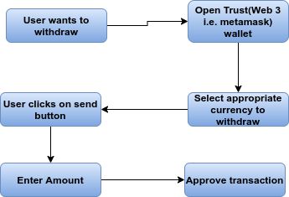
Existing Model

Slide 5
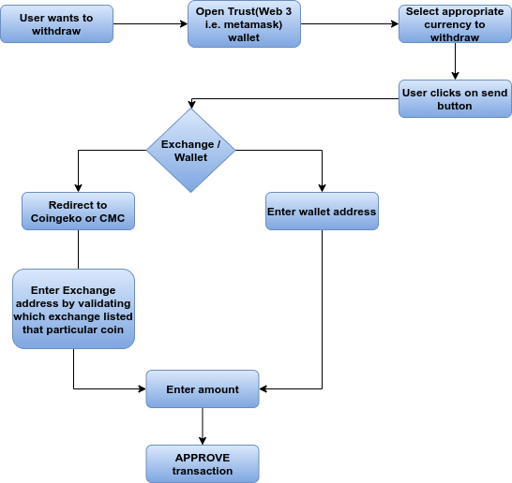
Proposed Model

Slide 6
Thank You !!

