Slide 1
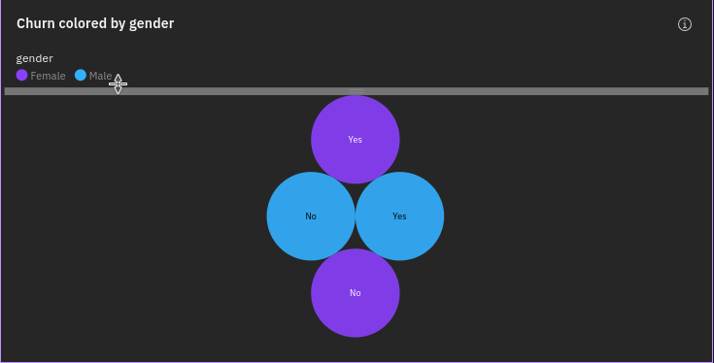
Churn by Gender
Churn No has the highest total TotalCharges due to gender Female
Gender Male has the highest TotalCharges at over 8.1 million, out of which Churn No contributed the most at nearly 6.6 million.

Slide 2
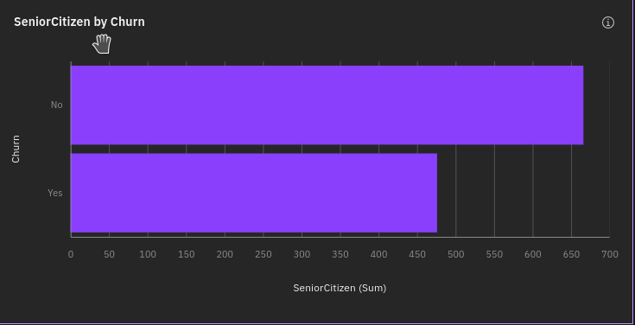
Churn By SeniorCitizen
Churn No has the highest values of both SeniorCitizen and TotalCharges.
Across all values of Churn, the sum of SeniorCitizen is over a thousand.
SeniorCitizen ranges from 476, when Churn is Yes, to 666, when Churn is No.

Slide 3
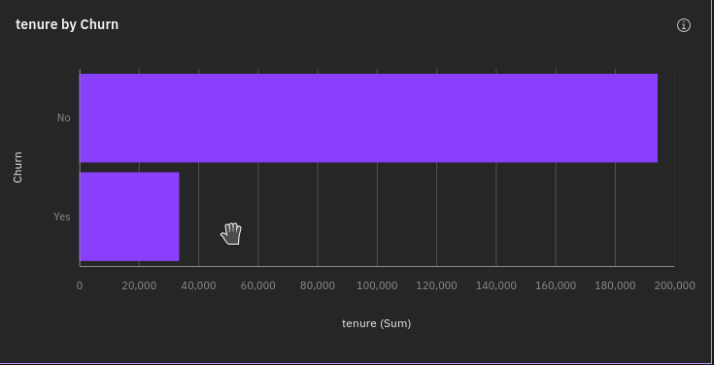
Churn By Tenure
No exceeds Yes in tenure by 160,784.
Churn No has the highest values of both tenure and TotalCharges.
Over all values of Churn, the sum of tenure is almost 228 thousand.
Tenure ranges from almost 34 thousand, when Churn is Yes, to over 194 thousand, when Churn is No.

Slide 4
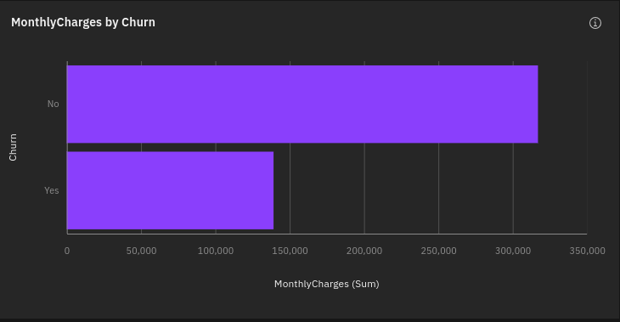
Churn by MonthlyCharges
No exceeds Yes in MonthlyCharges by 177,855.
Churn No has the highest values of both MonthlyCharges and TotalCharges.
Across all values of Churn, the sum of MonthlyCharges is over 456 thousand.
MonthlyCharges ranges from over 139 thousand, when Churn is Yes, to nearly 317 thousand, when Churn is No.

Slide 5
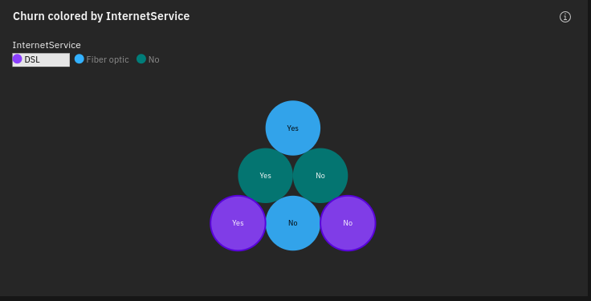
Churn By InternetService
Churn No has the highest total TotalCharges due to InternetService Fiber optic.
InternetService Fiber optic has the highest TotalCharges at over 9.9 million, out of which Churn No contributed the most at over 7.4 million.

