Slide 1










USB
PHYSICAL SECURITY

Slide 2





USB (UNIVERSAL SERIAL BUS)
PLUG-AND-PLAY: THEY ARE EASY TO USE, REQUIRING NO ADDITIONAL SOFTWARE OR DRIVERS. JUST PLUG THEM INTO A USB PORT, AND THEY’RE READY FOR USE.
USB PENDRIVES ARE COMPACT, PORTABLE DEVICES USED FOR STORING AND TRANSFERRING DATA BETWEEN COMPUTERS AND OTHER DEVICES.
COMPATIBILITY: THEY ARE COMPATIBLE WITH A WIDE RANGE OF DEVICES, INCLUDING COMPUTERS, TVS, GAMING CONSOLES, AND MORE.
NO EXTERNAL POWER NEEDED: USB PENDRIVES DRAW POWER DIRECTLY FROM THE DEVICE THEY’RE PLUGGED INTO, REQUIRING NO EXTERNAL POWER SOURCE TO FUNCTION.
DATA TRANSFER SPEED: THE SPEED OF DATA TRANSFER DEPENDS ON THE USB VERSION OF THE PENDRIVE:
USB 2.0: UP TO 480 MBPS
USB 3.0/3.1: UP TO 5-10 GBPS
STORAGE CAPACITY: USB PENDRIVES COME IN VARIOUS STORAGE CAPACITIES, RANGING FROM A FEW GIGABYTES (GB) TO SEVERAL TERABYTES (TB), MAKING THEM SUITABLE FOR DIFFERENT STORAGE NEEDS.

Slide 3

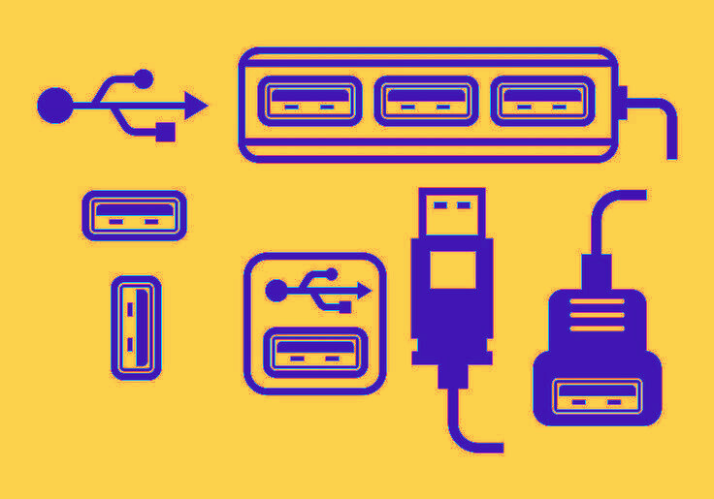


USB PORT TYPE A :
Design & Physical Features:
Rectangular Shape: The Type-A connector is flat and rectangular with a uniform size.
Pin Configuration: It typically has four pins (for USB 2.0), five pins (for USB 3.0/3.1 Gen 1), or more (for USB 3.1 Gen 2 and above).
Orientation: The connector has a specific orientation; it can only be plugged in one way, which sometimes leads to frustration when users try to plug it in upside down.USB 2.0: Supports data transfer speeds up to 480 Mbps.
USB 3.0/3.1 Gen 1: Supports data transfer speeds up to 5 Gbps (often identified by a blue interior).
USB 3.1 Gen 2: Supports speeds up to 10 Gbps.
Common Use Cases:
Peripheral Connections: Used for connecting a wide range of peripherals like keyboards, mice, external drives, and printers to computers.
Power Supply: It provides power to devices, such as charging smartphones, tablets, and other gadgets.
Data Transfer: Facilitates data transfer between devices, such as copying files between a computer and a flash drive.
Limitations:
Orientation Limitation: Unlike USB Type-C, Type-A does not support reversible plug orientation.
Size: The connector is larger compared to newer standards like USB Type-C, making it less suitable for ultra-thin devices.
Power Delivery: Limited power delivery capabilities compared to newer USB standards like USB Type-C.

Slide 4

WHY ?
An unknown USB device could be used by malicious actors to extract or exfiltrate sensitive data from your system.
Even within an organization, unauthorized use of USB devices can pose a risk.
The USB could be part of a targeted cyberattack, such as a "baiting" attack.
Cybercriminals often drop USB drives in public places, hoping someone will pick them up and plug them into a computer.
Once connected, the USB could deploy malware that compromises the system or network.
Some malicious USB devices are designed to physically damage computers by delivering a high-voltage charge, known as a "USB Killer."
Plugging in an unknown USB could lead to hardware failure.

Slide 5





MODULES USED IN OUR PROJECT
MODULES :
TKINTER
CUSTOMTKINTER
WEBBROWSER
PIL (PILLOW)
SUBPROCESS
HASHLIB
FUNCTIONS USED:
OPEN_WEBSITE
DISPLAY_LOG
BUTTON1_CLICKED
BUTTON2_CLICKED
TK METHODS:
root.title()
root.configure()
root.geometry()
root.mainloop()

Slide 6

CONCLUSUION
THE USB SECURITY APPLICATION PLAYS A CRUCIAL ROLE IN PROTECTING SYSTEMS FROM THE VARIOUS RISKS ASSOCIATED WITH USB DEVICES. BY ENABLING AND DISABLING USB PORTS BASED ON NEED AND THROUGH SECURE ACCESS CONTROLS, IT EFFECTIVELY MITIGATES THE POTENTIAL FOR MALWARE INFECTIONS, DATA BREACHES, AND UNAUTHORIZED ACCESS. THE APPLICATION NOT ONLY ENHANCES SECURITY BY CONTROLLING PHYSICAL ACCESS TO USB PORTS BUT ALSO SUPPORTS COMPLIANCE WITH DATA PROTECTION REGULATIONS AND SAFEGUARDS SENSITIVE INFORMATION.
IN TODAY'S DIGITAL LANDSCAPE, WHERE BOTH EXTERNAL AND INTERNAL THREATS ARE PREVALENT, THE ABILITY TO MANAGE USB PORT ACCESS DYNAMICALLY IS AN ESSENTIAL COMPONENT OF A COMPREHENSIVE SECURITY STRATEGY. THIS APPLICATION PROVIDES A ROBUST SOLUTION, ENSURING THAT ORGANIZATIONS CAN MAINTAIN THE INTEGRITY AND SECURITY OF THEIR SYSTEMS WHILE ALLOWING CONTROLLED AND SECURE USE OF USB DEVICES WHEN NECESSARY.

Slide 7



THANK YOU
BY TEAM
AUTOBOTS

