Slide 1
DREAM HOUSE VR
Smith bhojak 156330307008 KANDARP PANDYA 156330307049
Kishan Patel 156330307026 Pathik Shah 156330307104
Bhavin Panchasara 156330307047 Megh thakkar 156330307116

Slide 2
WHAT IS VIRTUAL REALITY ?
Virtual Reality (VR) is the use of computer technology to create a simulated environment. Unlike traditional user interfaces, VR places the user inside an experience. Instead of viewing a screen in front of them, users are immersed and able to interact with 3D worlds.
By simulating as many senses as possible, such as vision, hearing, touch, the computer is transformed into a gatekeeper to this artificial world.

Slide 3
What’s the difference Between Virtual Reality (VR) and Augmented Reality(AR) ?
AR technology renders the 3D graphics as they would appear from the viewpoint of the camera, superimposing the computer-generated images over a user’s view of the real world. Such as the popular game Pokémon Go.
In Virtual Reality, the position of the user’s eyes are located within the simulated environment. If the user’s head turns, the graphics react accordingly VR technology creates a convincing, interactive world for the user. Such as our application.

Slide 4
ABOUT sYSTEM
DREAM HOUSE VR is a android application that allows Interior designer to create and design models using objects in 3D space. It provides a dynamic environment for development of 3D models. It is Portable in the sense that after creating a model it can easily be shared and modified on other devices using the platform. Also the ability to create multiple models and work on them at same time is a feature that is not available on other existing products, And system provides overall a better user experience and easy usability for the laymen.

Slide 5
Need OF System
Existing systems are static and lack of availability.
For enhanced designing experience using Virtual Reality.

Slide 6
EXISITING SYSTEMS
Planner 5D

Slide 7
Faults in existing systems
Static Architecture Environment.
Costly for Multiple System.
Adding multiple floors it does not allow user to work simultaneously.

Slide 8
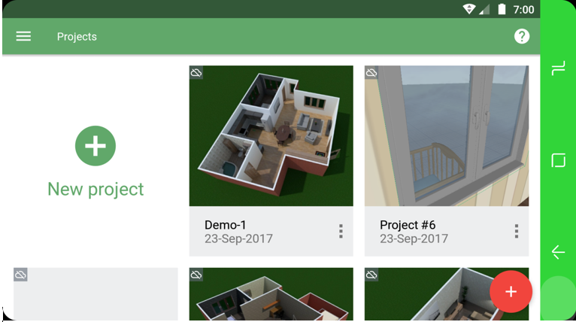

Slide 9
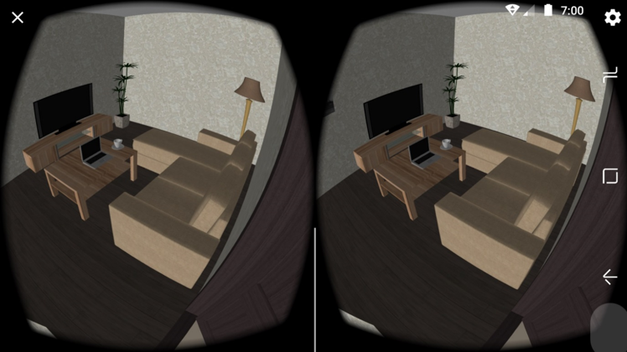

Slide 10
Solution
Dynamic Environment.
Enhanced User Experience.
Affordable in terms of multiple system development/design.

Slide 11
Modules
Providing complete 3D space for creating architecture.
Designing models using different objects.
Ability to save created 3D architecture.
Making 3D architecture portable to use in different system.
Provision for modifying and altering created 3D architecture.

Slide 12
FUNCTIONALITIES
Provision for creating Dynamic Models.
Provision for viewing Models.
Provision for saving Models.
Providing Better Graphical User Interface.
Provision for sharing the architecture or models.
Provision for adding and altering 3D architecture.
Provision for creating multiple models at a time.

Slide 13
DATA DICTIONARY
../DD/DATA_DICTIONARY v02.pdf

Slide 14
Entity-RELATIONSHIP DIAGRAM
../ERD/erd.pdf

Slide 15
DATA-FLOW DIAGRAM
../DFD/Level_0_DFD.pdf
../DFD/Level_1_DFD.pdf
../DFD/Level_2_DFD.pdf
../DFD/Level_2.1_DFD.pdf
../DFD/Level_2.2_DFD.pdf

Slide 16

Design LayOUT

Slide 17
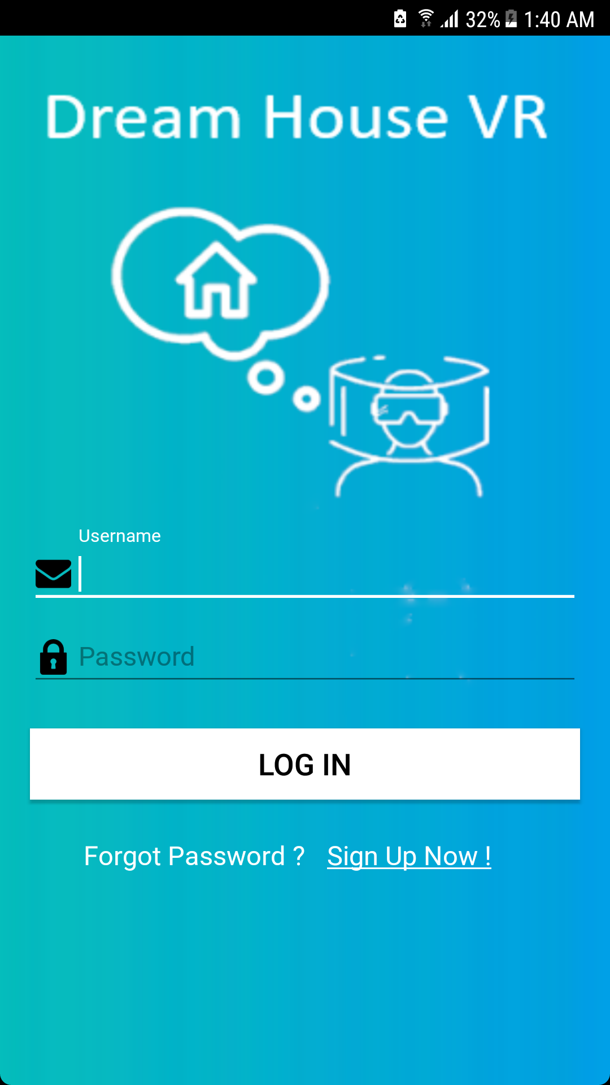

Slide 18
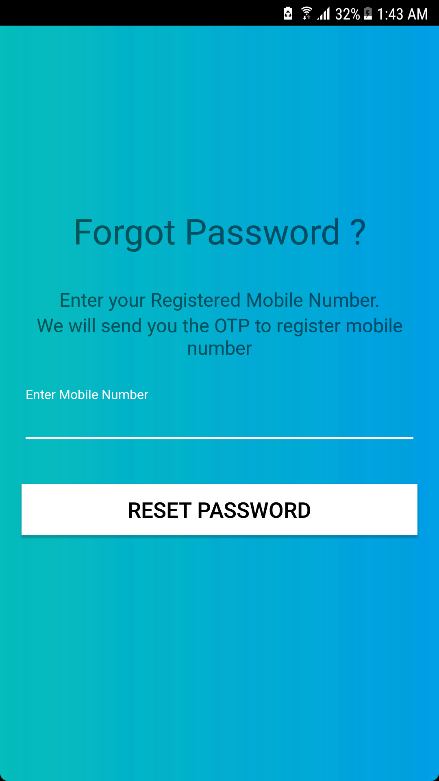

Slide 19
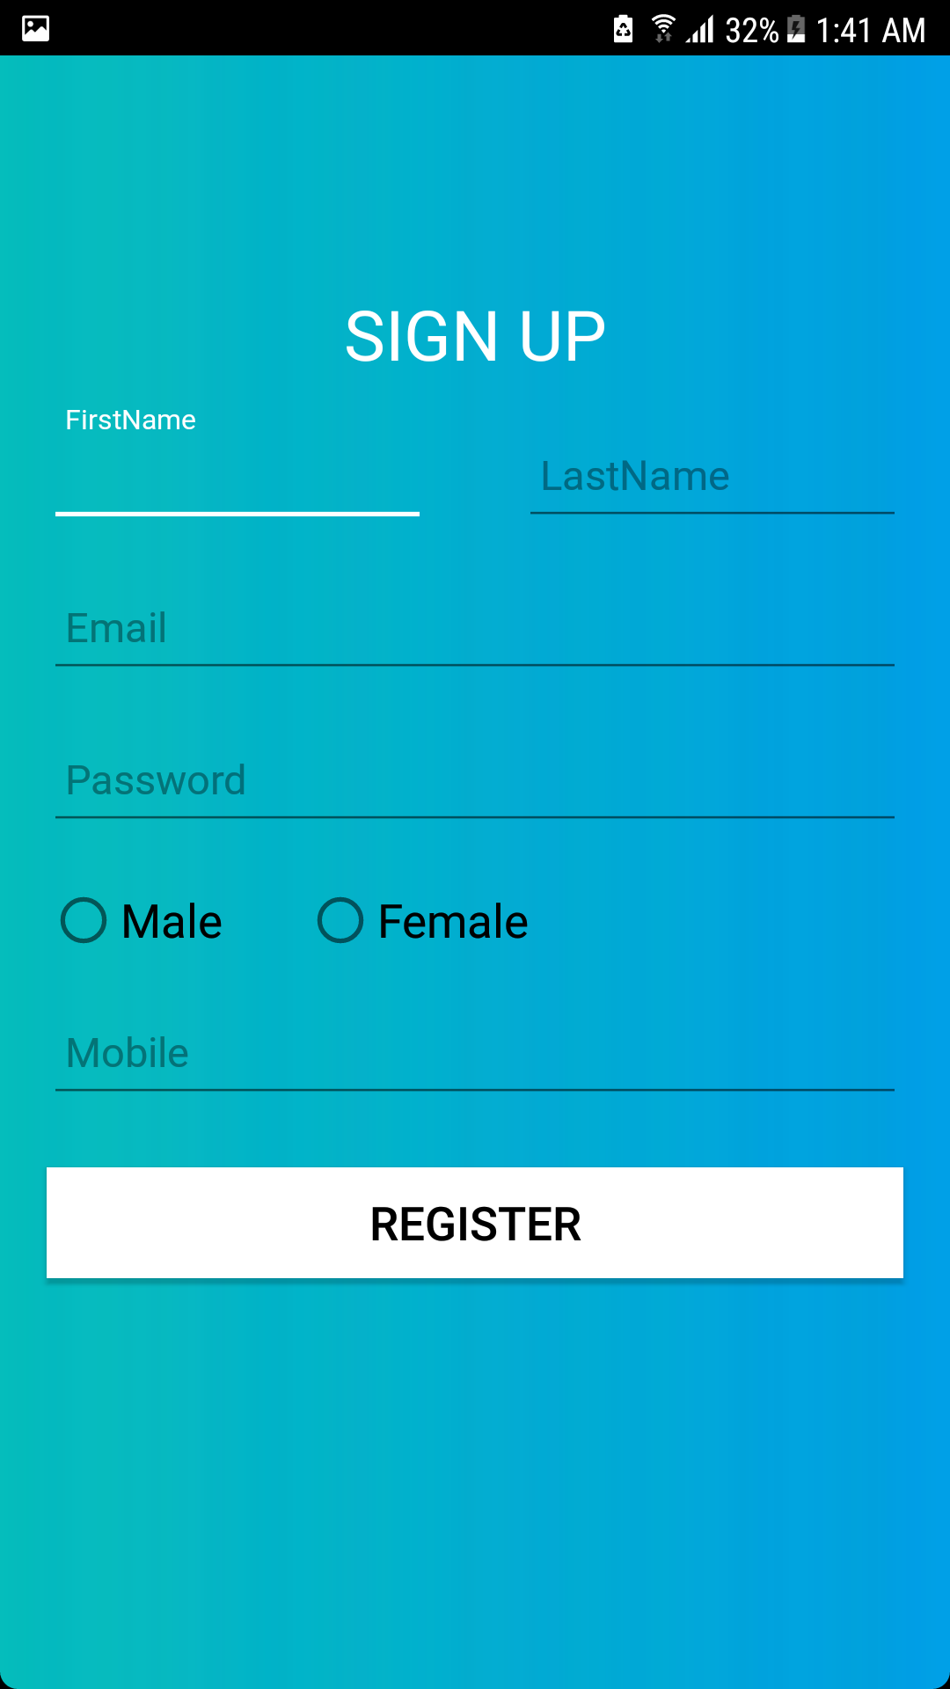

Slide 20
Thank you
Any suggestions or questions?

