Slide 1
These graphics are rather experimental. The goal was to hopefully create something original, which perhaps is seen less often, but would visually highlight better ranked treatments.
The first two present treatments on lines from 1 on the left to 12 on the right. Probabilities are shown on a continuous scale, ranging from zero in white to one in red.
The left hand graphic shows probabilities at each rank with more colour intensity to the left implying a more highly ranked treatment.
The right hand graphic instead presents cumulative probability. So the more colour in the line, the better the treatment.
The second two present the same, but with circles rather than lines, with 1 in the middle and 12 on the outside.

Slide 2
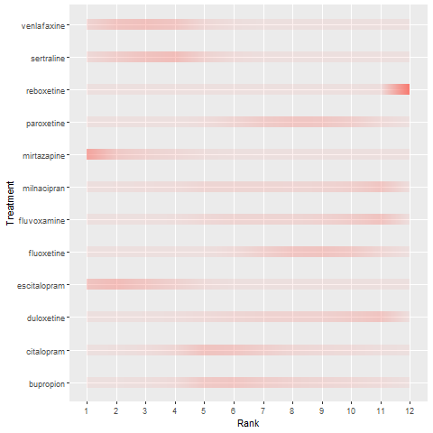
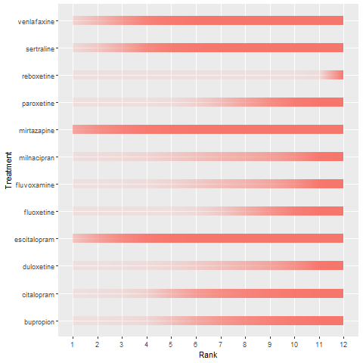

Slide 3
