Slide 1
FeBEx: In-Network De-duplication for Helium/LoRaWAN Backhaul
Project Presentation
VIS-WA/FeBEx

Slide 2
What FeBEx Does
FeBEx is a P4-programmable exchange switch between LoRa hotspots and tenant LNS backends.
It performs tenant steering using DevAddr prefix matching (LPM).
It suppresses duplicate uplink copies in-network using register-based state and epoch expiry.
It mirrors first-forwarded packets to cloud for payment receipts (Proof-of-Coverage support).

Slide 3
Why This Is Important
In Helium-style deployments, one uplink is often heard by multiple hotspots.
Each hotspot forwards a copy, creating redundant backhaul traffic and cloud-side dedup work.
Backhaul is costly and can become a scalability bottleneck as network density increases.
Moving dedup to the data plane cuts bandwidth while preserving delivery correctness and tenant isolation.

Slide 4
Current (Helium-like) Network Architecture
Edge device broadcasts one LoRa uplink.
Multiple hotspots receive and forward UDP/IP copies to backend over IP backhaul.
Cloud/backend deduplicates later and routes packets to the right tenant LNS.
This “dedup late” model wastes network and compute resources under high overlap.

Slide 5
FeBEx Contributions
1) Programmable IXP design for Helium/LoRaWAN multi-tenant traffic steering.
2) P4 in-network dedup pipeline keyed by (tenant_id, dev_addr, fcnt).
3) Epoch-based dedup state lifecycle controlled via P4Runtime controller.
4) Receipt mirroring path for cloud payment/accountability workflows.
5) End-to-end evaluation framework (E1–E7) with repeatable city-scale scenarios.

Slide 6
Implementation Details (Balanced View)
Data plane target: P4_16 on BMv2 v1model.
Pipeline stages:
Stage 1: Tenant steering table (LPM on DevAddr) -> set egress LNS port + metadata.
Stage 2: Dedup registers + dual CRC32 hash (index + verification key).
Stage 3: Drop duplicates; clone first-forwarded packet to cloud session.
Control plane: finsy/P4Runtime installs entries, toggles dedup, rotates epoch.

Slide 7
Evaluation Methodology
7 experiments (E1–E7): savings, correctness, isolation, scalability, state sizing, epoch sensitivity, receipt accuracy.
Configurable scenarios from small test to large city/stress topologies.
Traffic generation via scapy and Mininet orchestration with reproducible configs.
Metrics and plots generated from run logs into results/evaluation_summary.json and plots/*.png.

Slide 8
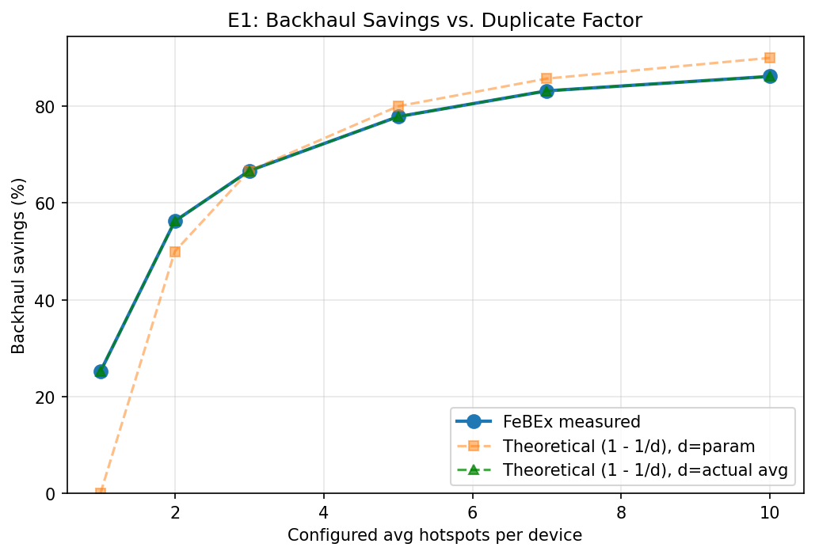
Results: Backhaul Savings
Observed savings scale with overlap:
• 25% (low overlap) to 86% (high overlap)
• Matches 1 - 1/d trend at realistic duplicate factors
• ON-path packet count stays close to unique-uplink volume

Slide 9
Results: Correctness, Isolation, and Scale
Correctness (E2): perfect 1.0 delivery ratio through realistic overlap levels; no unique-uplink suppression.
Multi-tenant isolation (E3): zero cross-tenant leakage across evaluated traffic.
Scalability (E4): savings remain strong (about 57–67%) from small to city-scale scenarios.
State sizing (E5): >=4K entries sharply reduces collision-induced leakage for N=100 regime.
Epoch sensitivity (E6): 5–10s interval balances dedup effectiveness and state freshness.

Slide 10
Takeaways and Next Steps
FeBEx demonstrates practical in-network dedup for Helium/LoRaWAN backhaul using programmable data planes.
It reduces redundant transport load while preserving delivery behavior and tenant correctness.
Current prototype validates the concept on BMv2/Mininet with repeatable experiments.
Next steps: hardware target validation, richer collision handling, and deployment-grade controller hardening.

