Slide 1
AURACROP
Name: B R Rishikiran, Vishaal M S , Vetesh D
Problem Statement Title- Smart Crop Disease Detection
Theme- AI/ML in Agriculture
PS Category- Software
Team Name: AURA

Slide 2
AuraCrop 🌱
Problem Resolution :
IDEA / SOLUTION :
AI-based crop disease detection system delivers reliable results even in low-network zones.
Provides early identification of crop diseases, reducing crop loss and increasing yield.
Eliminates dependence on manual expert availability by offering instant AI-driven suggestions.
Farmers upload images of crops (leaf, stem, fruit).
AI (Gemini + Genkit) predicts disease with confidence level.
Multilingual (Tamil/English) app + chatbot + chat history.
Escalation to AgriExperts if AI confidence is low.
Unique Value Propositions (UVP) :
Works even in low-network zones.
Simple UI for farmers.
Faster disease detection → reduces crop loss.
Continuous improvement via chat + image history.

Slide 3
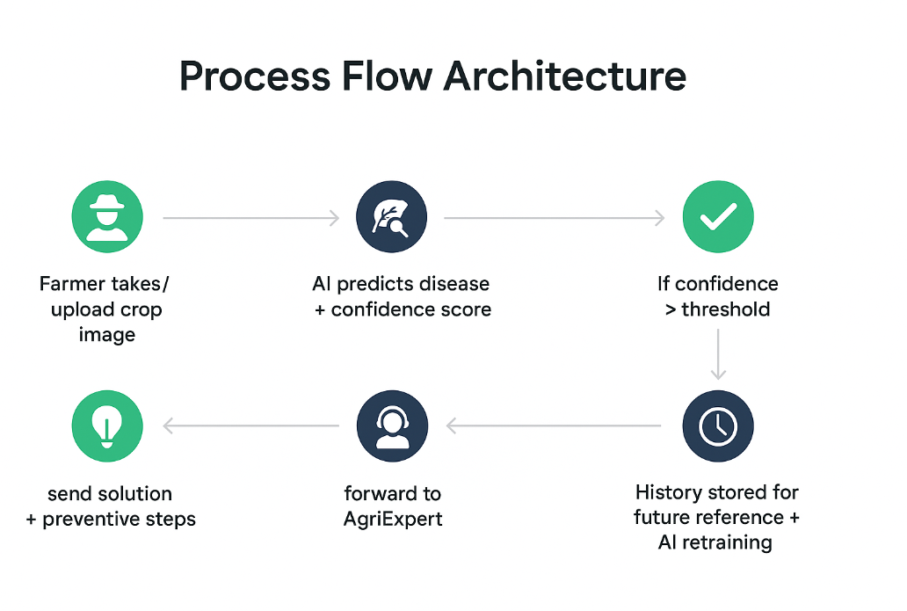
TECHNICAL APPROACH
PROCESS FLOW ARCHITECTURE
AI Model: Gemini + Genkit for disease classification.
Frontend: Next.js, TypeScript, Tailwind CSS (mobile-first).
Backend: Node.js/Express + REST APIs.
Database: Cloud DB (for storing images, history, reports).
Encryption: Secure API access with JWT-based auth.
Notifications: Push, SMS, and multilingual voice alerts.
Chatbot: Integrated with AgriExpert escalation.

Slide 4
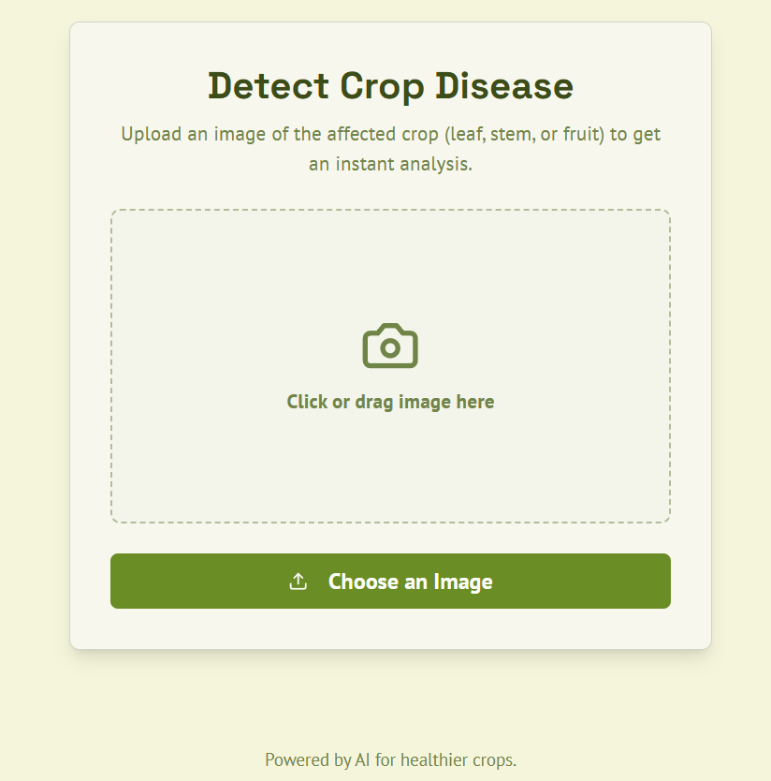
FEASIBILITY AND VIABILITY
Technical: Uses scalable AI + cloud infrastructure.
Financial: Low-cost cloud + open-source stack.
Market: Targeting farmers in India’s agri sector.
Operational: Supports offline data sync in low-network areas.
Challenges & Risks:
Farmer adoption (digital literacy).
Dataset limitations (local crop varieties).
Connectivity issues in rural zones.
Mitigation Strategies:
Voice-based UI for low-literacy users.
Expand dataset with government/university support.
Offline-first approach with sync-on-network.

Slide 5
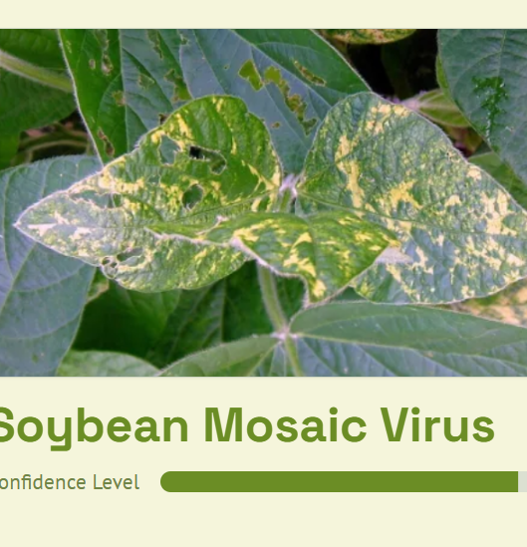
IMPACT AND BENEFITS
Positive Impact:
Social: Empowers farmers, improves accessibility.
Economic: Reduces crop loss, increases yield & income.
Environmental: Reduces overuse of pesticides, lowers waste.
Negative Impact:
Initial adoption cost.
Training required for effective usage.
Overall Benefits:
Early detection = higher productivity.
Affordable, farmer-friendly, scalable solution.

Slide 6
Thank you

