Slide 1



Introduction to Stock Market Price Prediction
Predicting stock market prices is a challenging yet rewarding endeavor. This presentation provides an overview of machine learning techniques used for stock market price prediction.
by Vishal Singh Koranga

Slide 2


Importance of Accurate Predictions
1
Informed Decisions
Accurate predictions can enable investors to make informed trading decisions.
2
Profit Maximization
By anticipating price movements, investors can potentially maximize their profits.
3
Risk Management
Accurate predictions help minimize losses by identifying potential market downturns.
4
Investment Strategies
Predictions guide the development of effective investment strategies.

Slide 3
Overview of Machine Learning Techniques
Supervised Learning
Unsupervised Learning
Reinforcement Learning
Algorithms learn from labeled data to predict future values. Examples include linear regression and support vector machines.
Algorithms discover patterns in unlabeled data. Clustering algorithms can identify groups of stocks with similar price trends.
Algorithms learn through trial and error, interacting with the environment to optimize their performance. This approach can be used to develop trading bots.

Slide 4

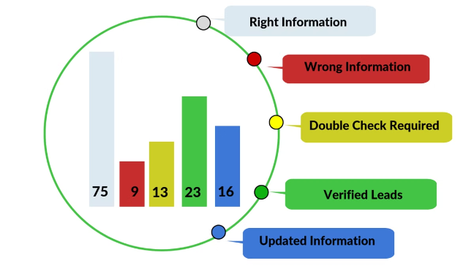
Data Preprocessing and Feature Engineering
1
Data Cleaning
Removing noise, inconsistencies, and missing values from the data.
2
Feature Extraction
Creating new features from existing data, such as technical indicators or sentiment analysis results.
3
Feature Selection
Choosing the most relevant features to improve model performance.

Slide 5

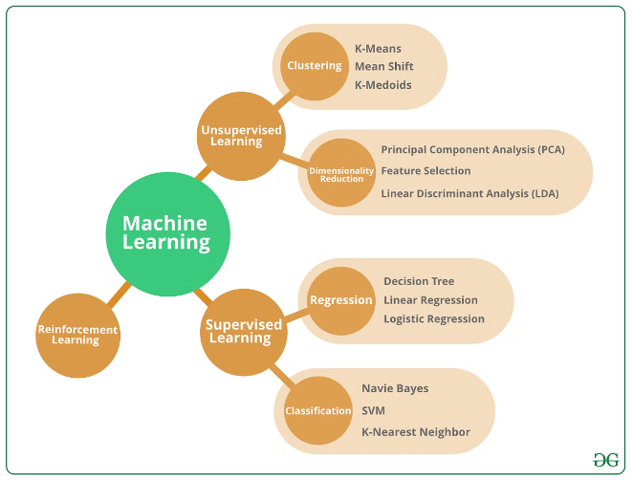
Supervised Learning Algorithms for Price Prediction
Algorithm
Description
Linear Regression
Predicts price based on a linear relationship with independent variables.
Support Vector Machines
Finds a hyperplane that optimally separates data points into different classes.
Neural Networks
Complex models that learn nonlinear relationships between input and output.
Random Forests
Ensemble learning method that combines multiple decision trees to improve accuracy.

Slide 6

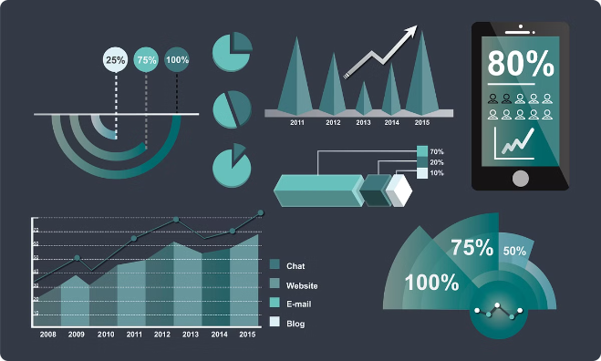
Evaluation Metrics and Model Selection
Accuracy
Measures the percentage of correct predictions.
Precision
Indicates the proportion of true positives among all predicted positives.
Recall
Measures the ability of the model to identify all positive instances.
F1 Score
Harmonic mean of precision and recall, providing a balanced measure of performance.

Slide 7




Challenges and Limitations of ML-based Prediction
Market Volatility
Data Availability
Model Overfitting
The stock market is inherently unpredictable, making it difficult for models to capture all factors.
Access to sufficient high-quality data is crucial for training accurate models.
Models may learn patterns specific to the training data, leading to poor performance on unseen data.

Slide 8





Conclusion and Future Directions
Advancements in AI
Continued research in AI and deep learning will likely lead to more sophisticated and accurate prediction models.
Big Data and Analytics
The increasing availability of data will provide valuable insights for model training and improvement.
Hybrid Approaches
Combining machine learning with human expertise can potentially enhance decision-making and risk management.

Slide 9

THANK
YOU

