Slide 1
Clustering Global Financial Cities by-Vishal Bisht

Slide 2
Relevance
The clustering of financial cities into tiers helps form a strong baseline in estimating risk premiums which are used in calculating expected returns on global investments.
The calculation of expected returns are extremely important in finalizing entry/exit decisions for investments as well as performance attribution for asset managers.
The analysis serves as a sanity check/threshold level for all other forms of estimating risk premiums.

Slide 3
Data acquisition and Preprocessing
Economic and social indicators relevant for the analysis was gathered from the following sources; World Bank, Z/Yen Group, China Development Institute, World Bank, OECD, Economist Intelligence Unit, United Nations Development Programme (UNDP).
Location data required for analyzing common venues amongst the cities were obtained using the Foursquare API.
All categorical variables were dummified before being fed into the K-Means algorithm.
All data was standardized using sklearn’s StandardScaler method before being fed into the K-Means algorithm.

Slide 4
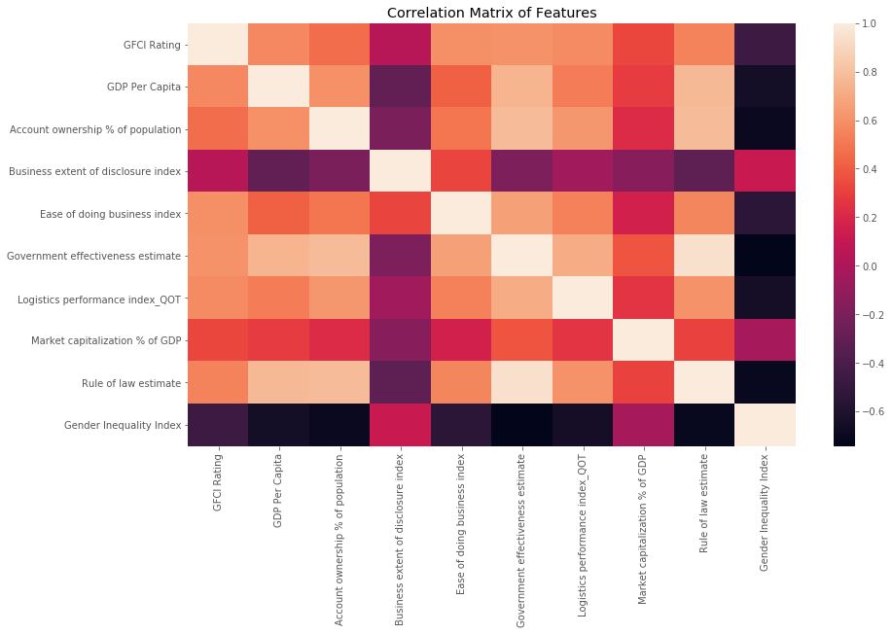
Feature correlations were far from perfect although intuitive in nature for cluster analysis

Slide 5
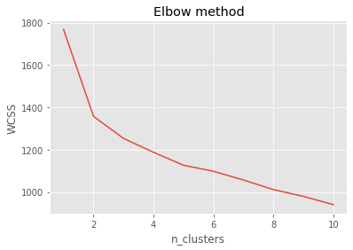
K Clusters were narrowed based on the Elbow method which indicates 2-3 clusters are appropriate

Slide 6
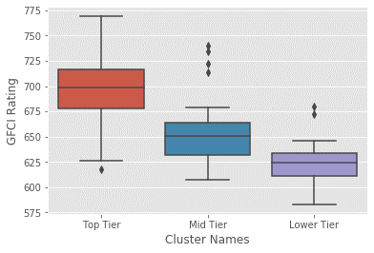
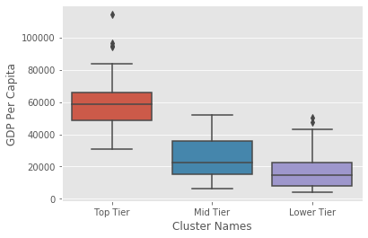
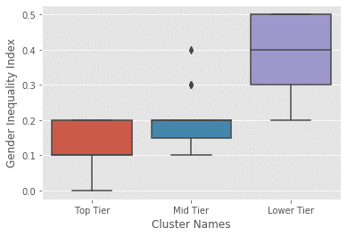
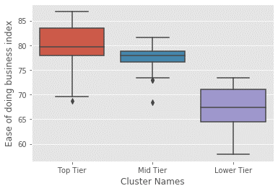
Clear distinction could be made between the features of the Top Tier cities to that of the Lower Tier cities

Slide 7
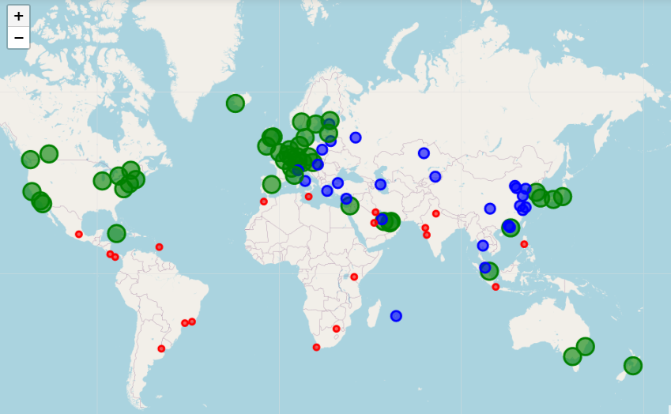
A Geographical representation showcases the concentration of Top Tier cluster around developed nations
Top Tier
Mid Tier
Lower Tier

Slide 8
Conclusion and Future directions
The model helps clearly identify clusters of cities based on their performance in economic, social and governance development which in turn helps form an accurate judgement on the risk profile of the country.
The model does not help in arriving at exact equity risk premium figures, however a strong baseline could be formed based on the risk profile of the country.
The model accuracy could subjectively improve upon availability detailed data on a city wise basis.

