Slide 1
KEYLOGGER AND SECURITY
CAPSTONE PROJECT
Presented By:
P.VISHALINI
JAYARAJ ANNAPACKIAM CSI COLLEGE OF ENGINEERING
B.TECH / INFORMATION TECHNOLOGY

Slide 2
OUTLINE
Problem Statement (Should not include solution)
Proposed System/Solution
Key Logger code
Key Logger Runs and Output
System Development Approach (Technology Used)
Algorithm & Deployment
Result (Output Image)
Conclusion
Future Scope
References

Slide 3
Problem Statement
In today's digital age, where cybersecurity threats loom large, one of the significant concerns is the proliferation of key loggers, stealthy software tools designed to monitor and record keystrokes on a user's computer without their knowledge. Keyloggers pose a severe threat to individuals and organizations as they can capture sensitive information such as passwords, credit card details, and other personal data, leading to identity theft, financial loss, and privacy breaches .

Slide 4
Proposed Solution
The proposed system aims to address the challenge of predicting the required bike count at each hour to ensure a stable supply of rental bikes. This involves leveraging data analytics and machine learning techniques to forecast demand patterns accurately. The solution will consist of the following components:
Data Collection:
Gather historical data on bike rentals, including time, date, location, and other relevant factors.
Utilize real-time data sources, such as weather conditions, events, and holidays, to enhance prediction accuracy.
Data Preprocessing:
Clean and preprocess the collected data to handle missing values, outliers, and inconsistencies.
Feature engineering to extract relevant features from the data that might impact bike demand.
Machine Learning Algorithm:
Implement a machine learning algorithm, such as a time-series forecasting model (e.g., ARIMA, SARIMA, or LSTM), to predict bike counts based on historical patterns.
Consider incorporating other factors like weather conditions, day of the week, and special events to improve prediction accuracy.
Deployment:
Develop a user-friendly interface or application that provides real-time predictions for bike counts at different hours.
Deploy the solution on a scalable and reliable platform, considering factors like server infrastructure, response time, and user accessibility.
Evaluation:
Assess the model's performance using appropriate metrics such as Mean Absolute Error (MAE), Root Mean Squared Error (RMSE), or other relevant metrics.
Fine-tune the model based on feedback and continuous monitoring of prediction accuracy.
Result:

Slide 5
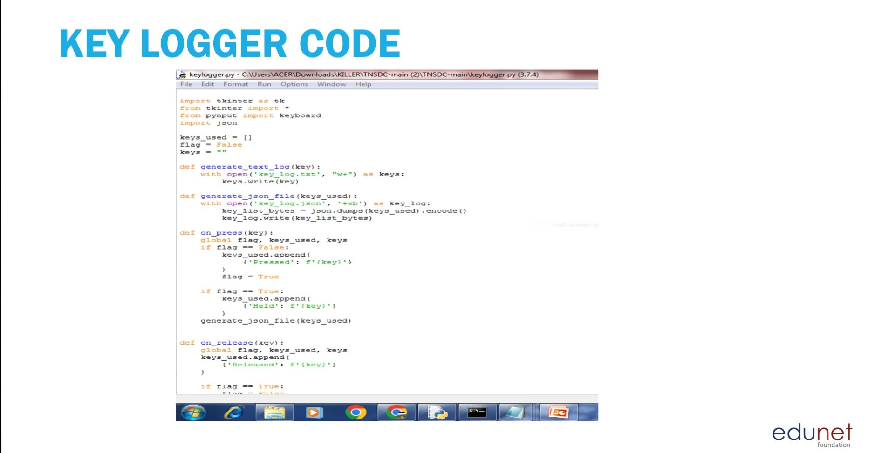

Slide 6
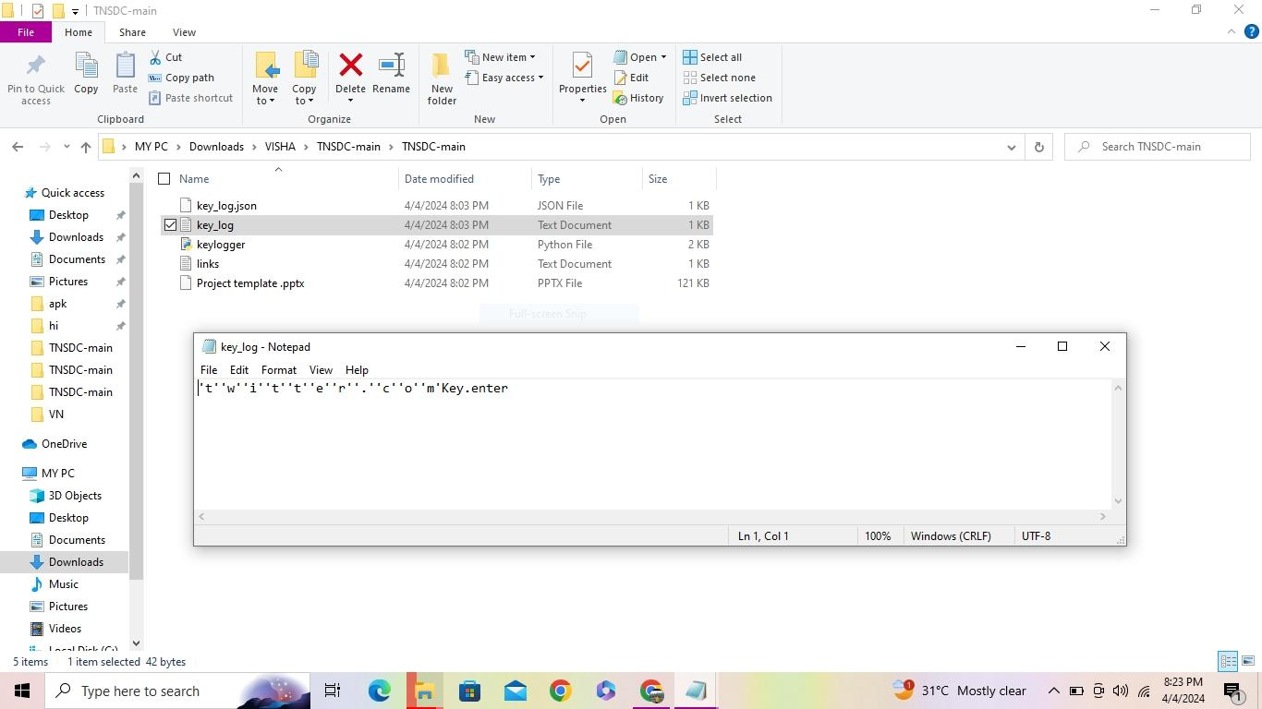
KEY LOGGER RUNS AND OUTPUT

Slide 7
System Approach
The "System Approach" section outlines the overall strategy and methodology for developing and implementing the rental bike prediction system. Here's a suggested structure for this section:
System requirements
Library required to build the model

Slide 8
Algorithm & Deployment
In the Algorithm section, describe the machine learning algorithm chosen for predicting bike counts. Here's an example structure for this section:
Algorithm Selection:
Provide a brief overview of the chosen algorithm (e.g., time-series forecasting model, like ARIMA or LSTM) and justify its selection based on the problem statement and data characteristics.
Data Input:
Specify the input features used by the algorithm, such as historical bike rental data, weather conditions, day of the week, and any other relevant factors.
Training Process:
Explain how the algorithm is trained using historical data. Highlight any specific considerations or techniques employed, such as cross-validation or hyperparameter tuning.
Prediction Process:
Detail how the trained algorithm makes predictions for future bike counts. Discuss any real-time data inputs considered during the prediction phase.

Slide 9
Result
Reduction in successful key logger attacks due to improved detection and prevention capabilities. Minimization of financial losses and data breaches resulting from compromised credentials and sensitive information. Reduction in successful key logger attacks due to improved detection and prevention capabilities. Minimization of financial losses and data breaches resulting from compromised credentials and sensitive information.

Slide 10
Conclusion
In conclusion, the proliferation of key loggers in today’s digital age presents a significant and pervasive threat to both individuals and organizations. These stealthy software tools have the capability to capture sensitive information such as passwords and credit card details, leading to severe consequences including identity theft, financial loss, and privacy breaches.

Slide 11
Future scope
Behavioural Biometrics: Integration of behavioural biometrics, such as keystroke dynamics and mouse movement patterns, into authentication systems to enhance security and detect anomalous activity indicative of key logger presence. Zero Trust Architecture: Adoption of zero trust architecture principles, where every user and device is treated as untrusted by default, to mitigate the risk of key logger infiltration and unauthorized access to sensitive data.

Slide 12
References
Here are some references that provide insights into the proliferation of key loggers and the associated cybersecurity threats Symantec ,Kaspersky Lab.

Slide 13
THANK YOU

