Slide 1
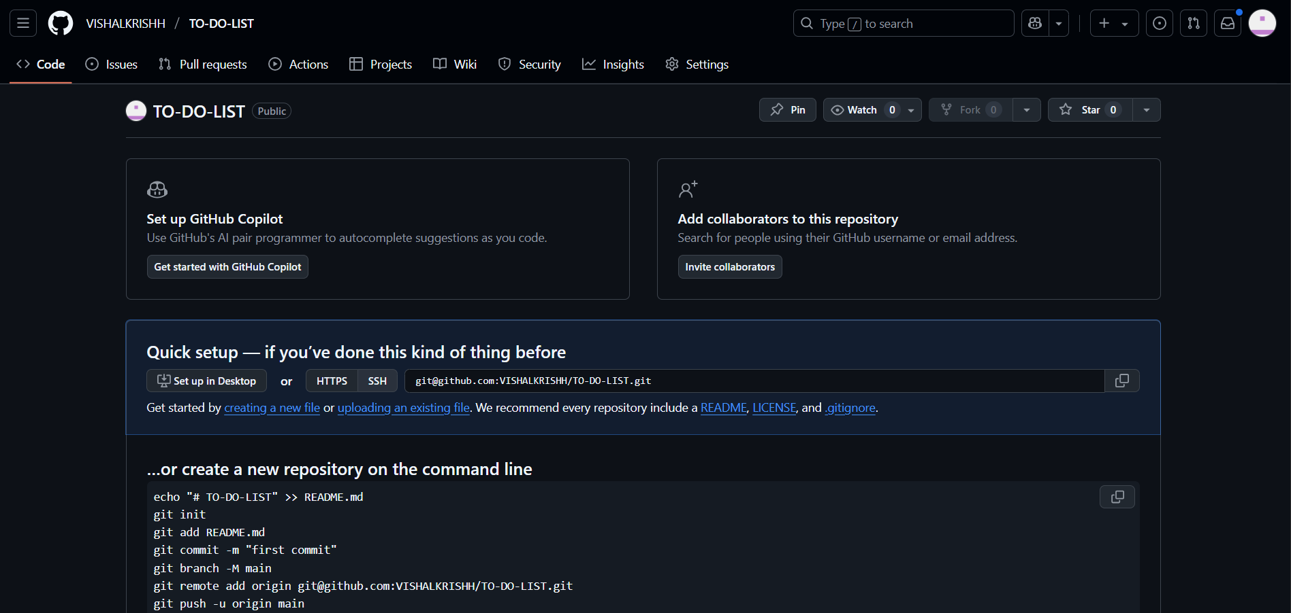
CREATED A REPO

Slide 2
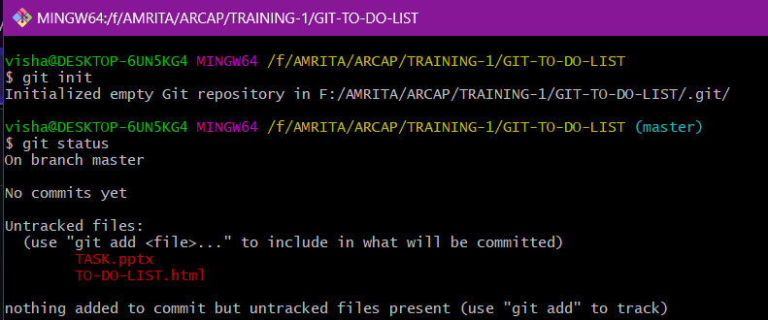
Init / status

Slide 3
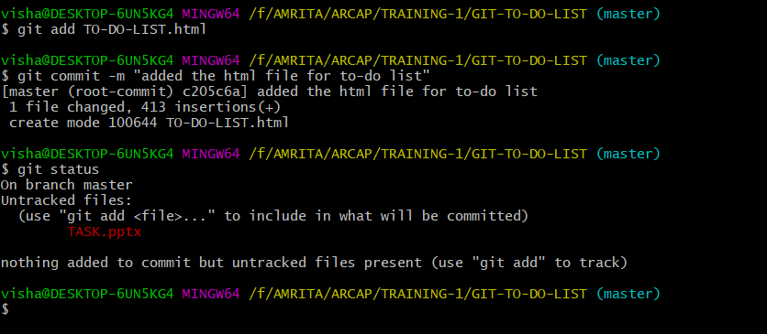
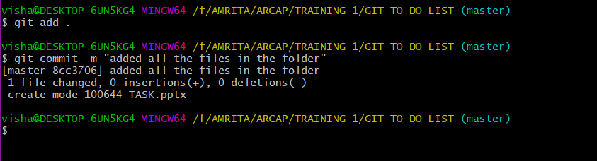
Add / commit

Slide 4
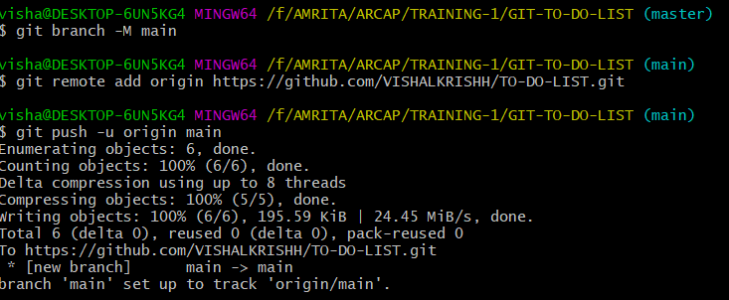
CREATED MAIN BRACH AND PUSHED

Slide 5
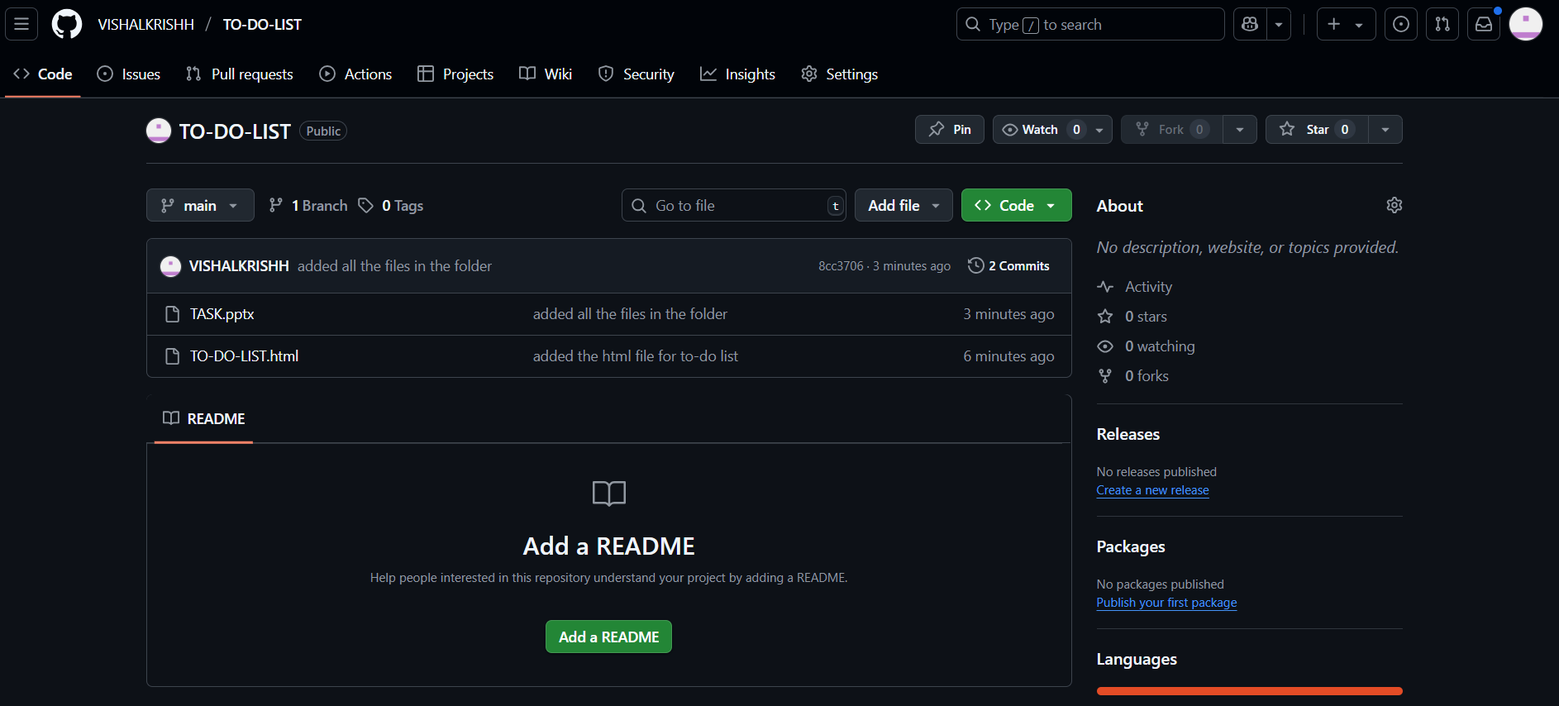
REPO AFTER PUSHING

Slide 6
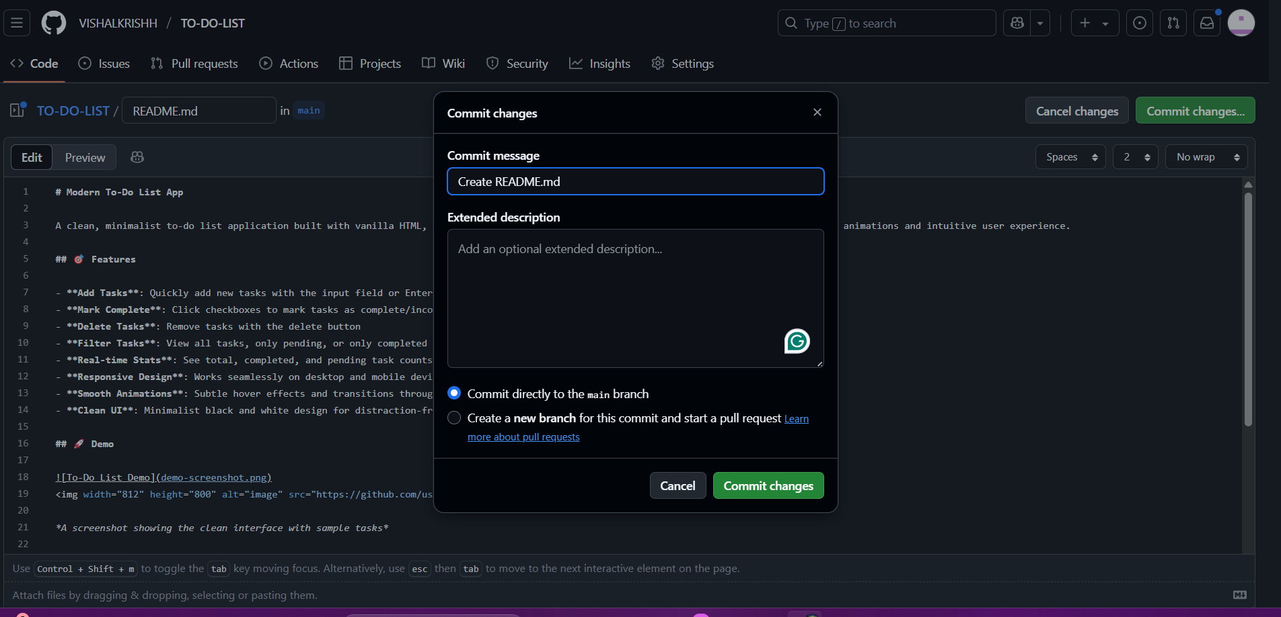
CREATED README FILE

Slide 7
REPO AFTER PUSHING

Slide 8
REPO AFTER PUSHING

Slide 9
REPO AFTER PUSHING

Slide 10
REPO AFTER PUSHING

Slide 11
REPO AFTER PUSHING

Slide 12
REPO AFTER PUSHING

Slide 13
REPO AFTER PUSHING

