Slide 1
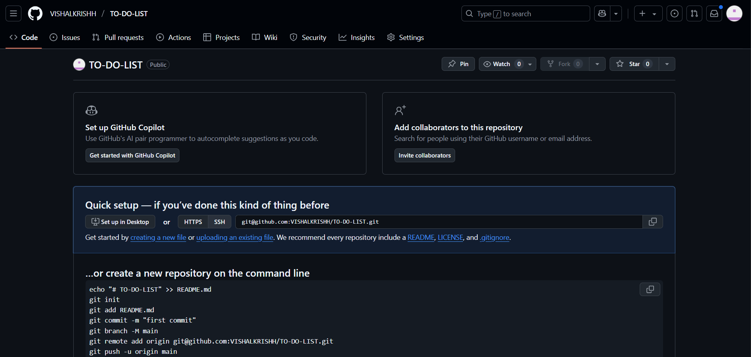
CREATED A REPO

Slide 2
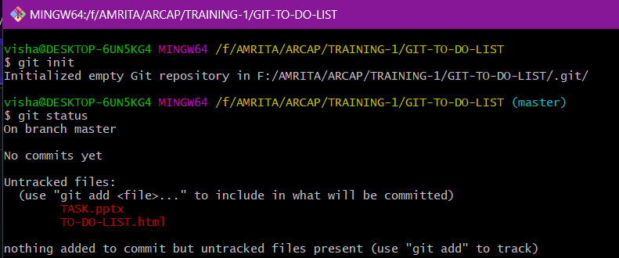
Init / status

Slide 3
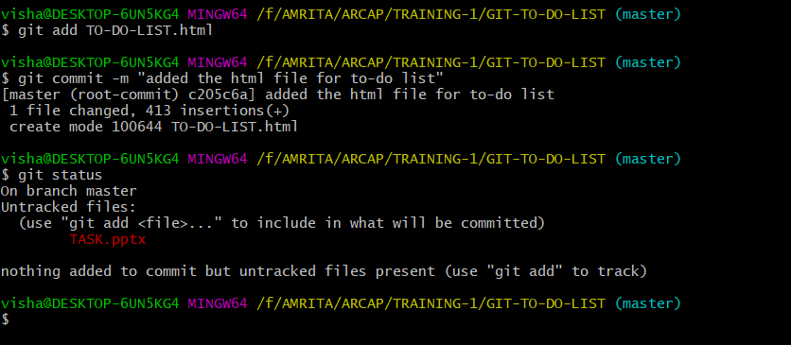
Add / commit

Slide 4
CREATED A REPO

Slide 5
CREATED A REPO

