Slide 1
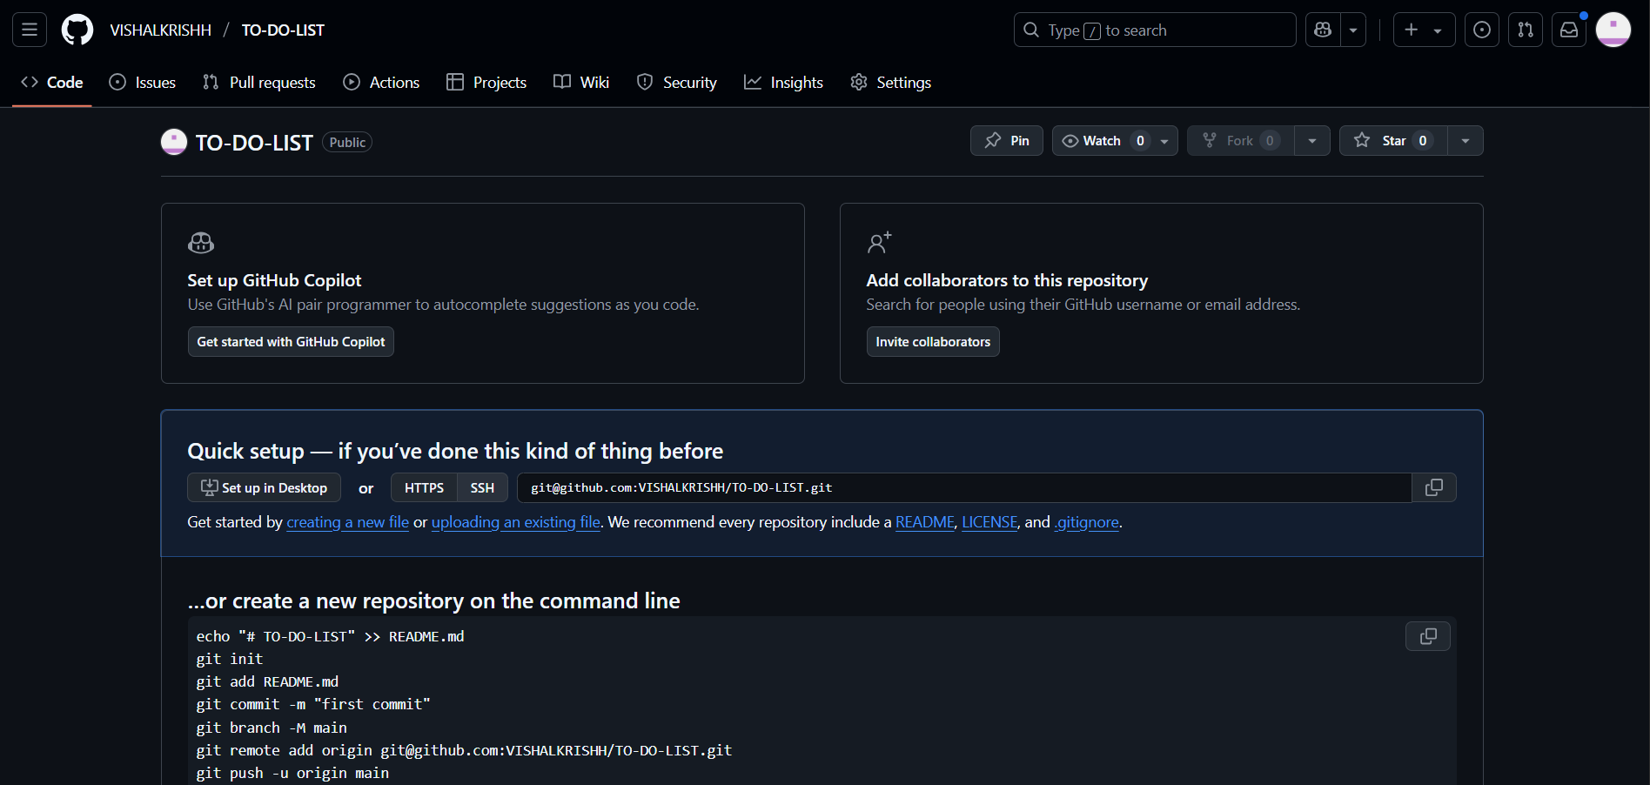
CREATED A REPO

Slide 2
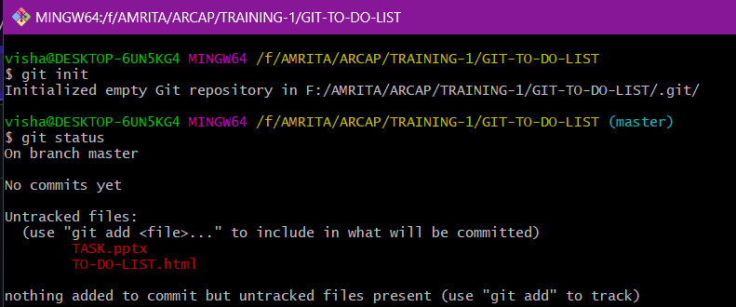
Init / status

Slide 3
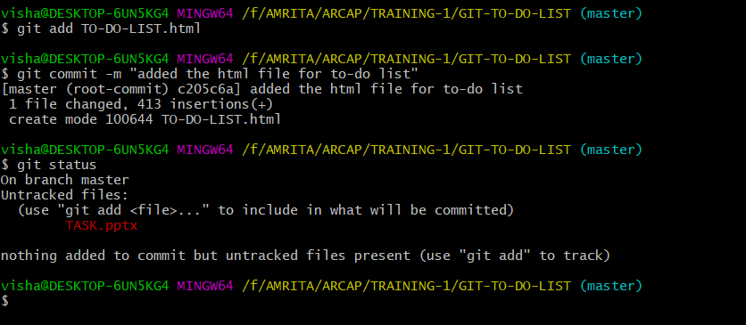
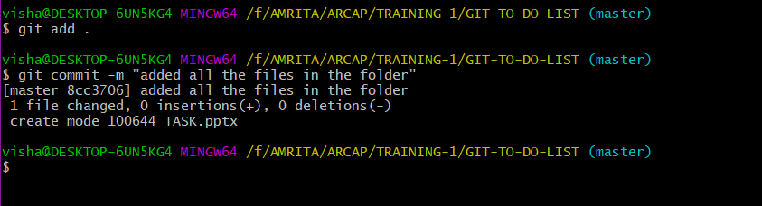
Add / commit

Slide 4
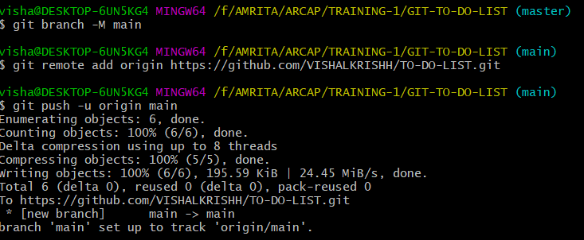
CREATED MAIN BRACH AND PUSHED

Slide 5
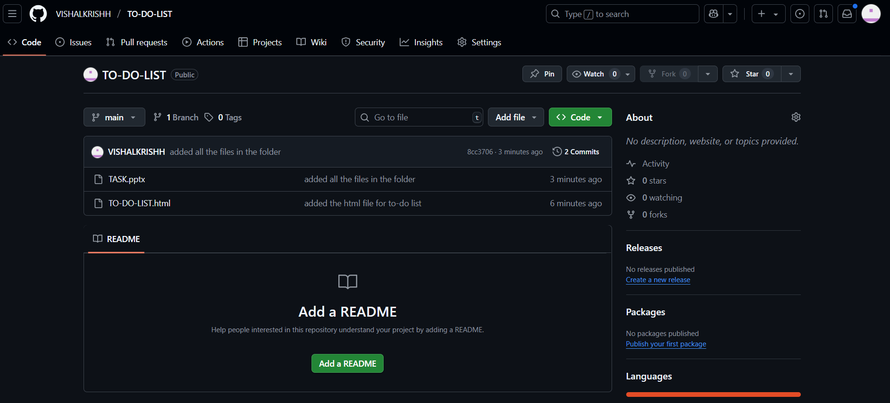
REPO AFTER PUSHING

Slide 6
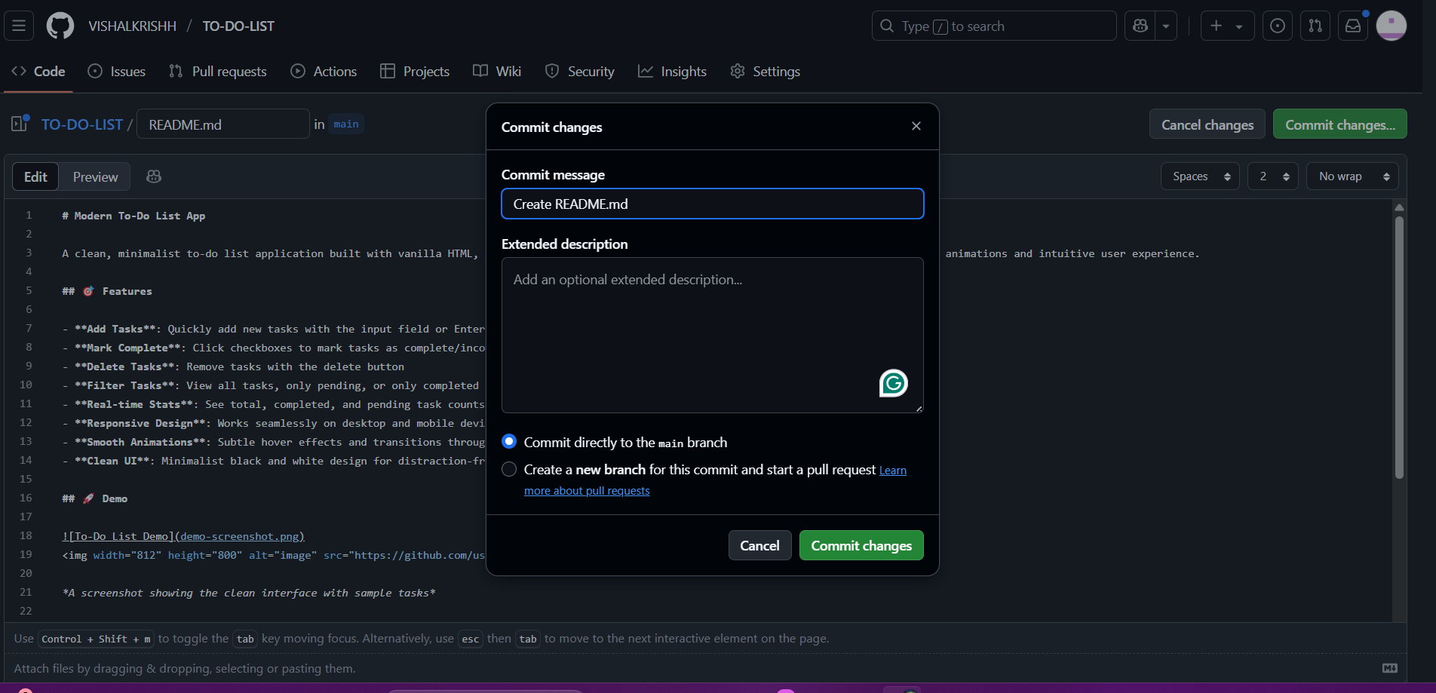
CREATED README FILE

Slide 7
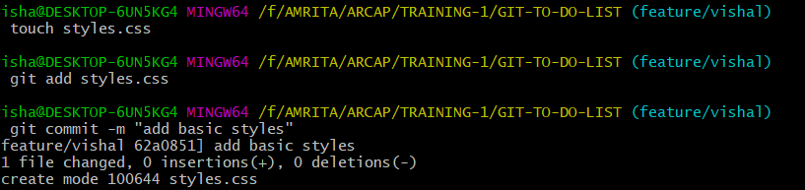
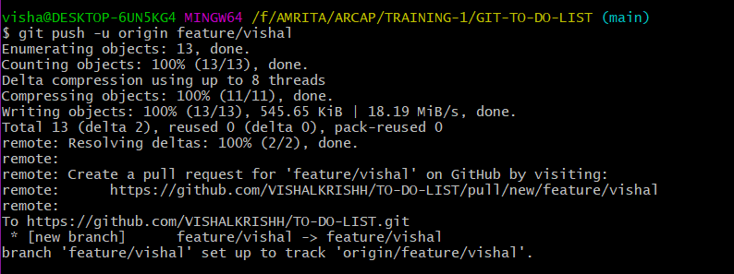
Creating another branch

Slide 8
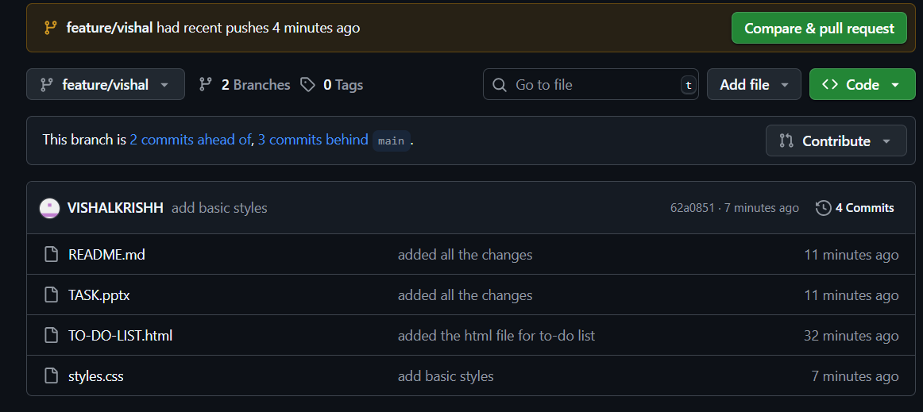
REPO AFTER PUSHING

Slide 9
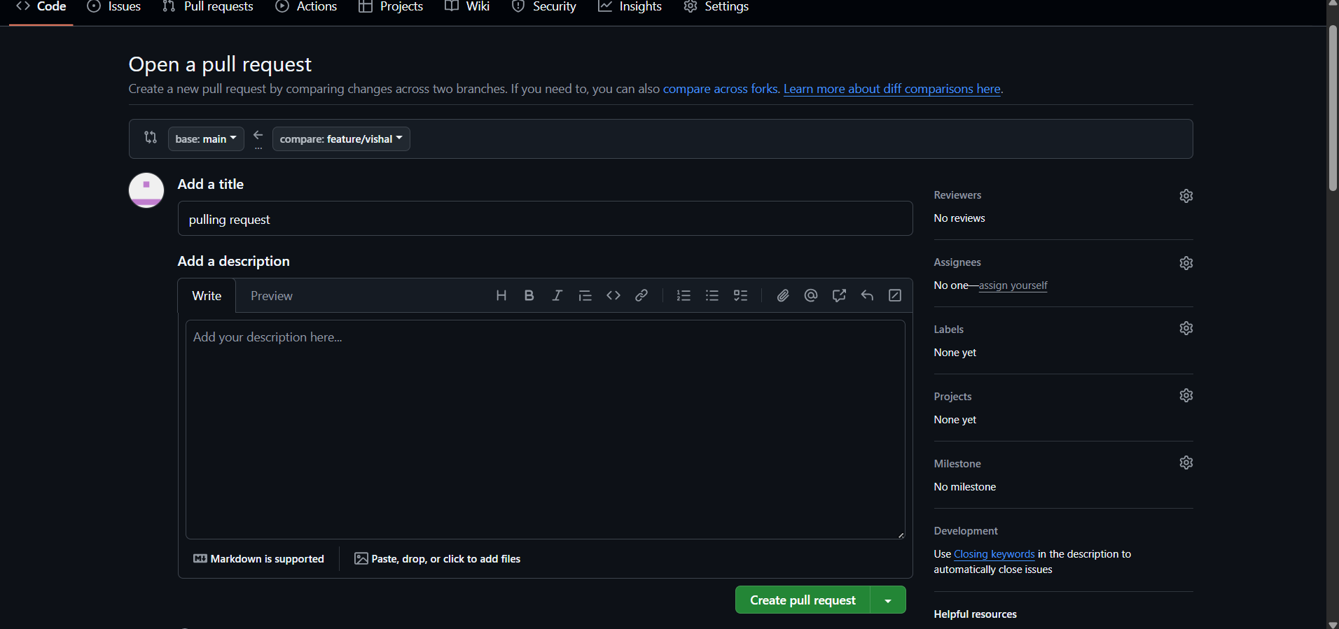
Pull request

Slide 10
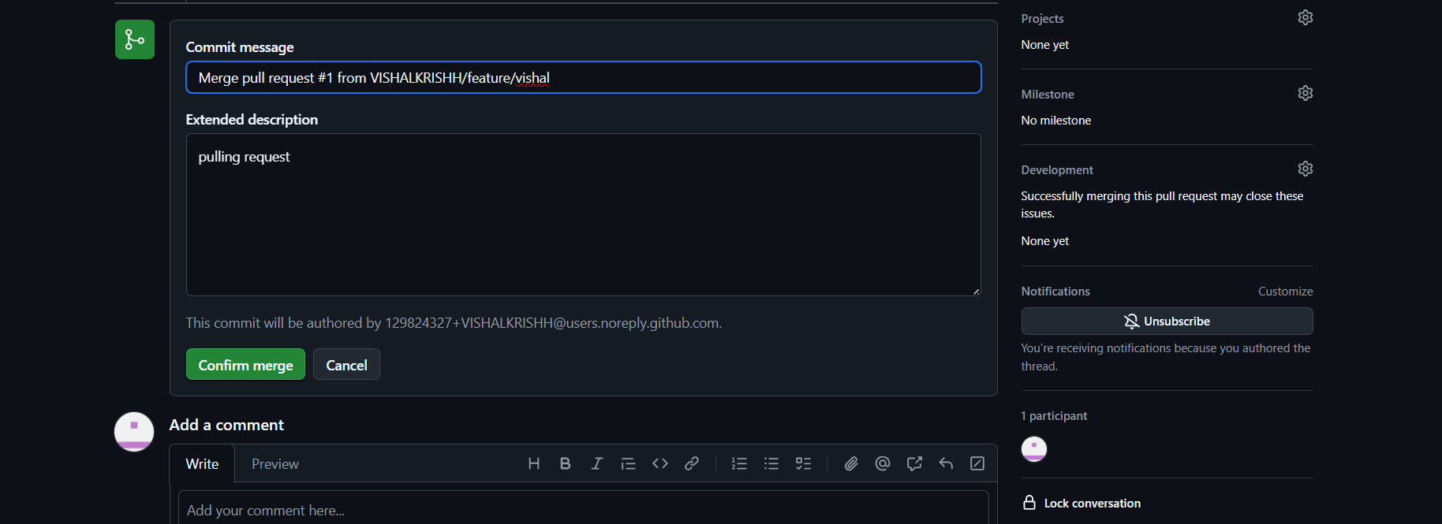
REPO merging

Slide 11
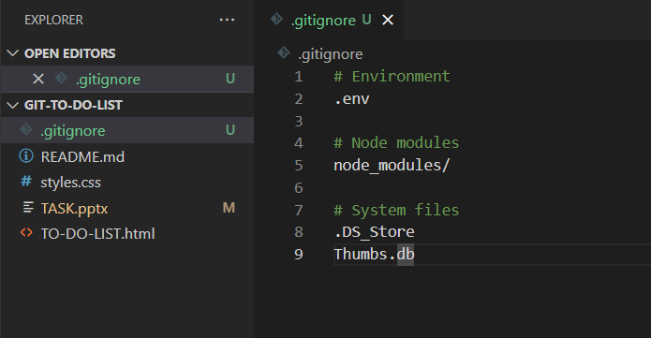
.gitignore

Slide 12
REPO AFTER PUSHING

Slide 13
REPO AFTER PUSHING

