Slide 1

Adventure Vision

Slide 2
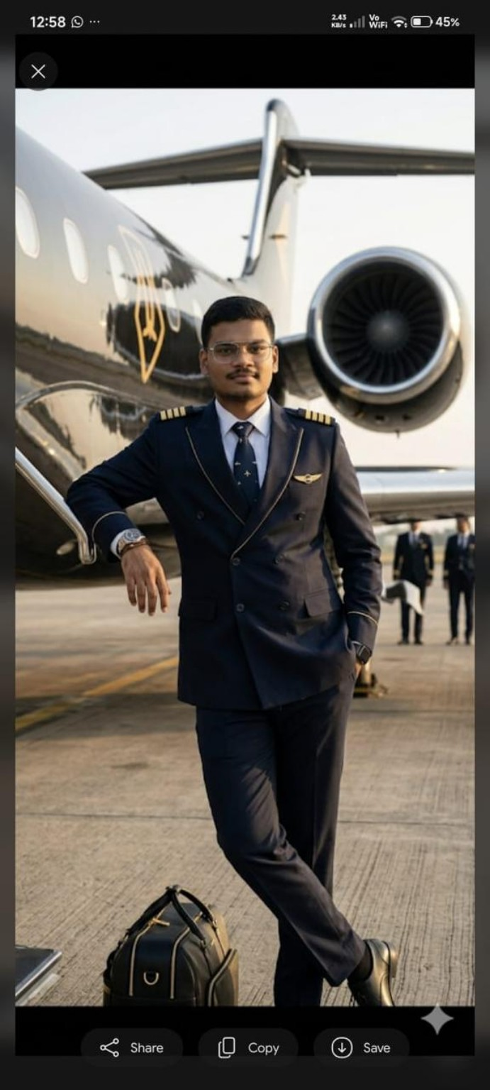
Pilot Vision

Slide 3
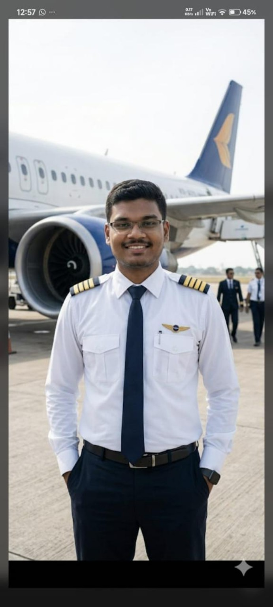
Aviation Dream

Slide 4
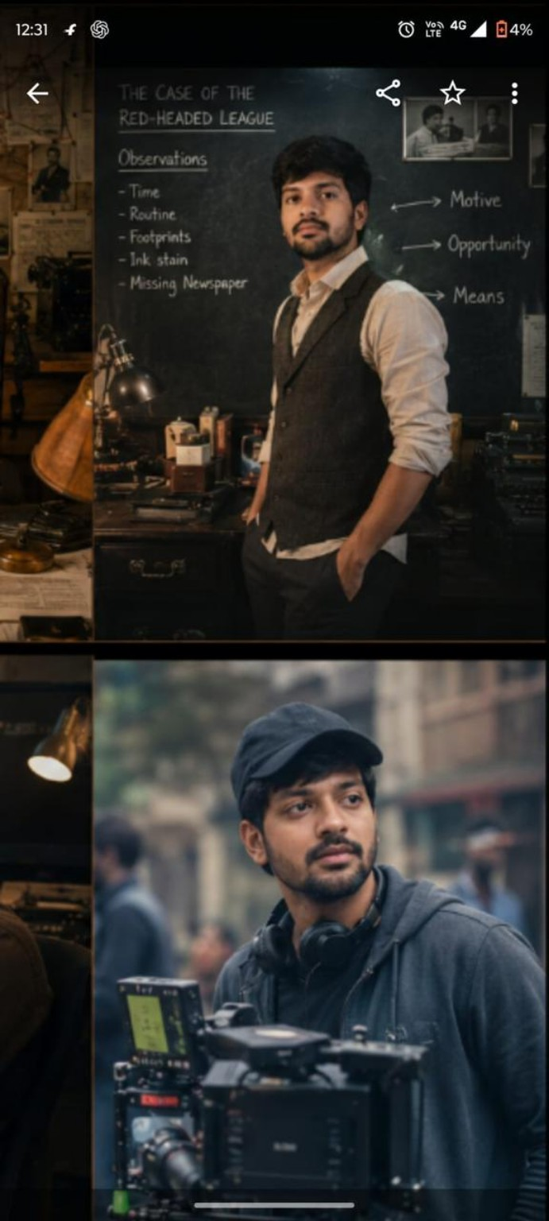
Sherlock & Director Vision

Slide 5
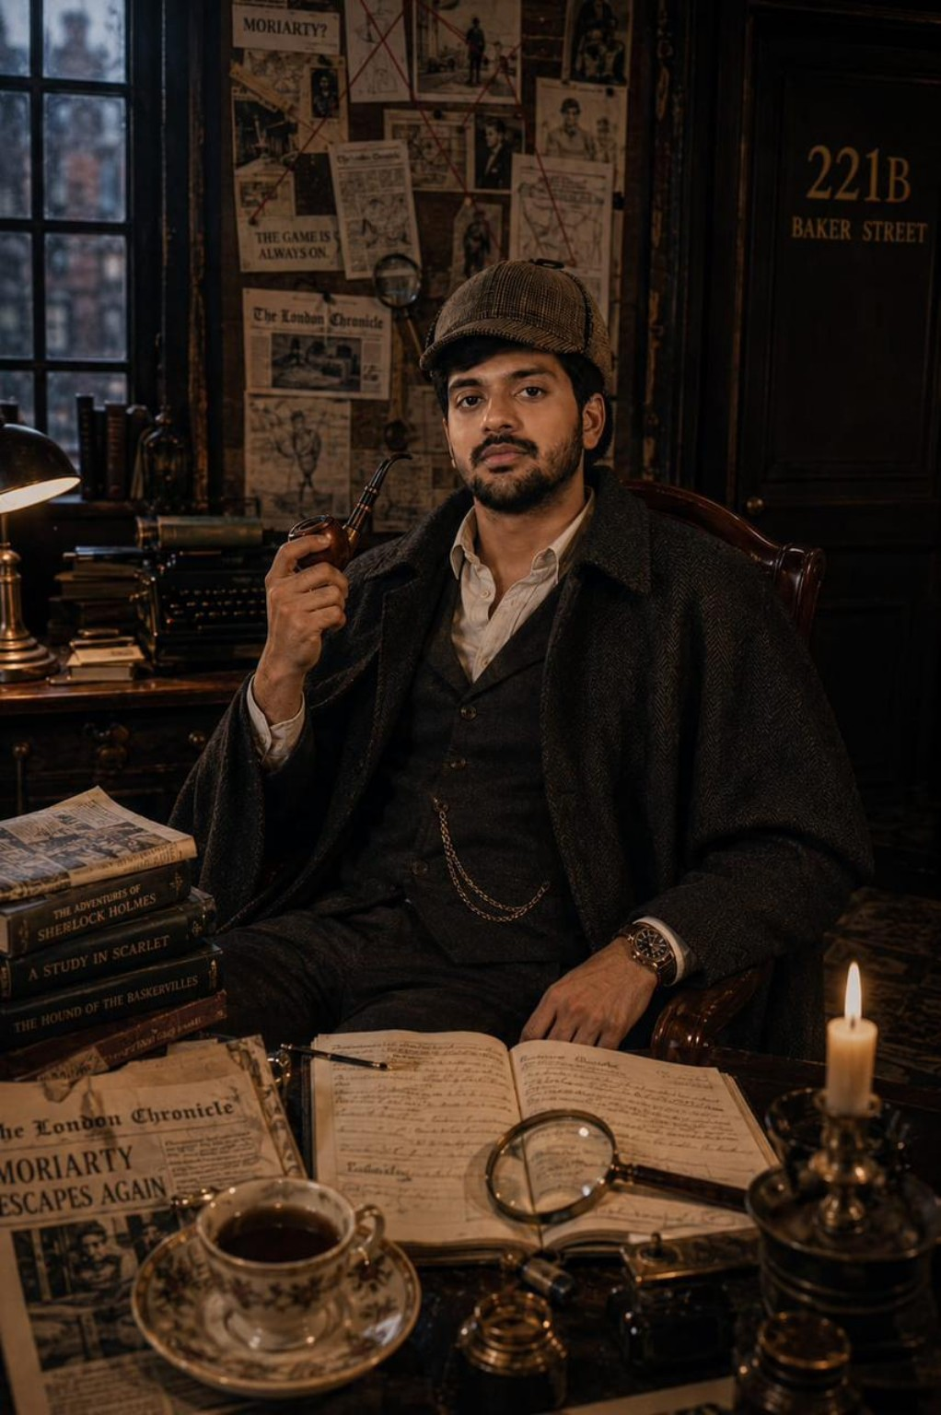
Sherlock Holmes Inspired

Slide 6
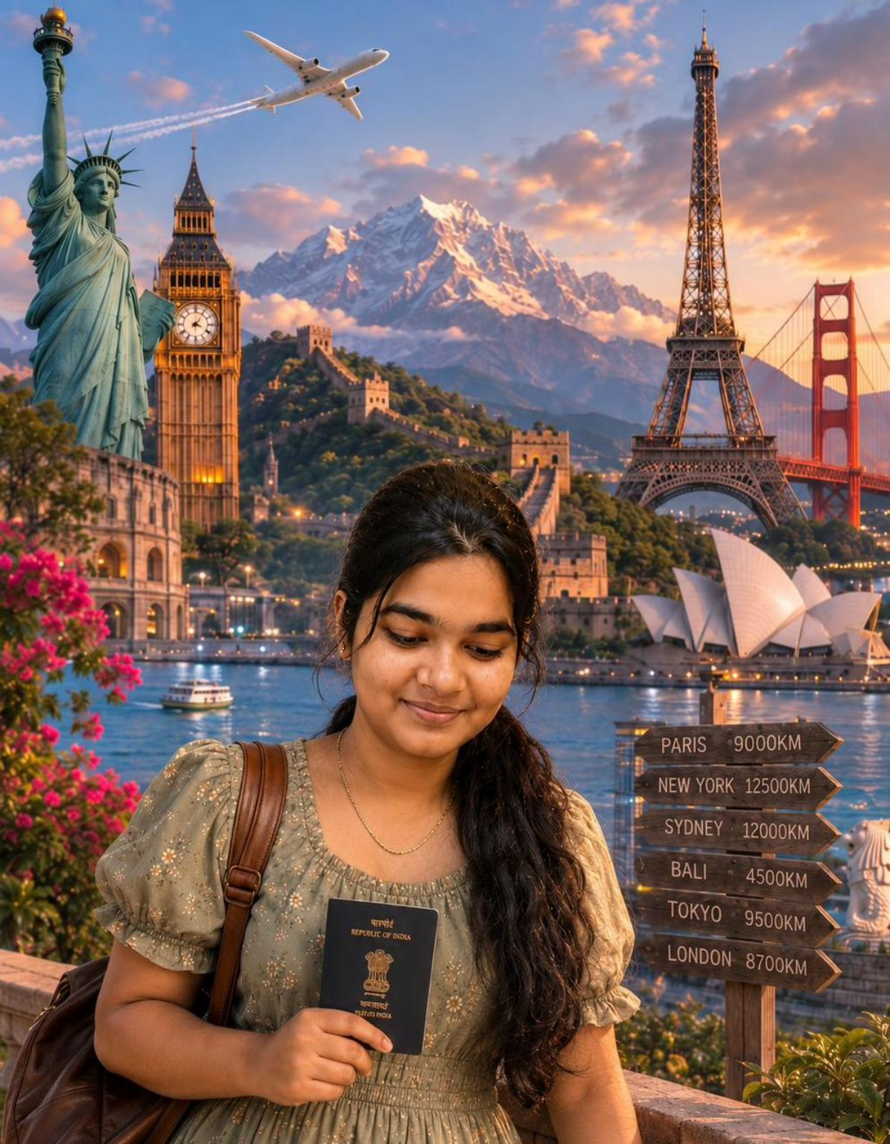
Travel Dreams

Slide 7
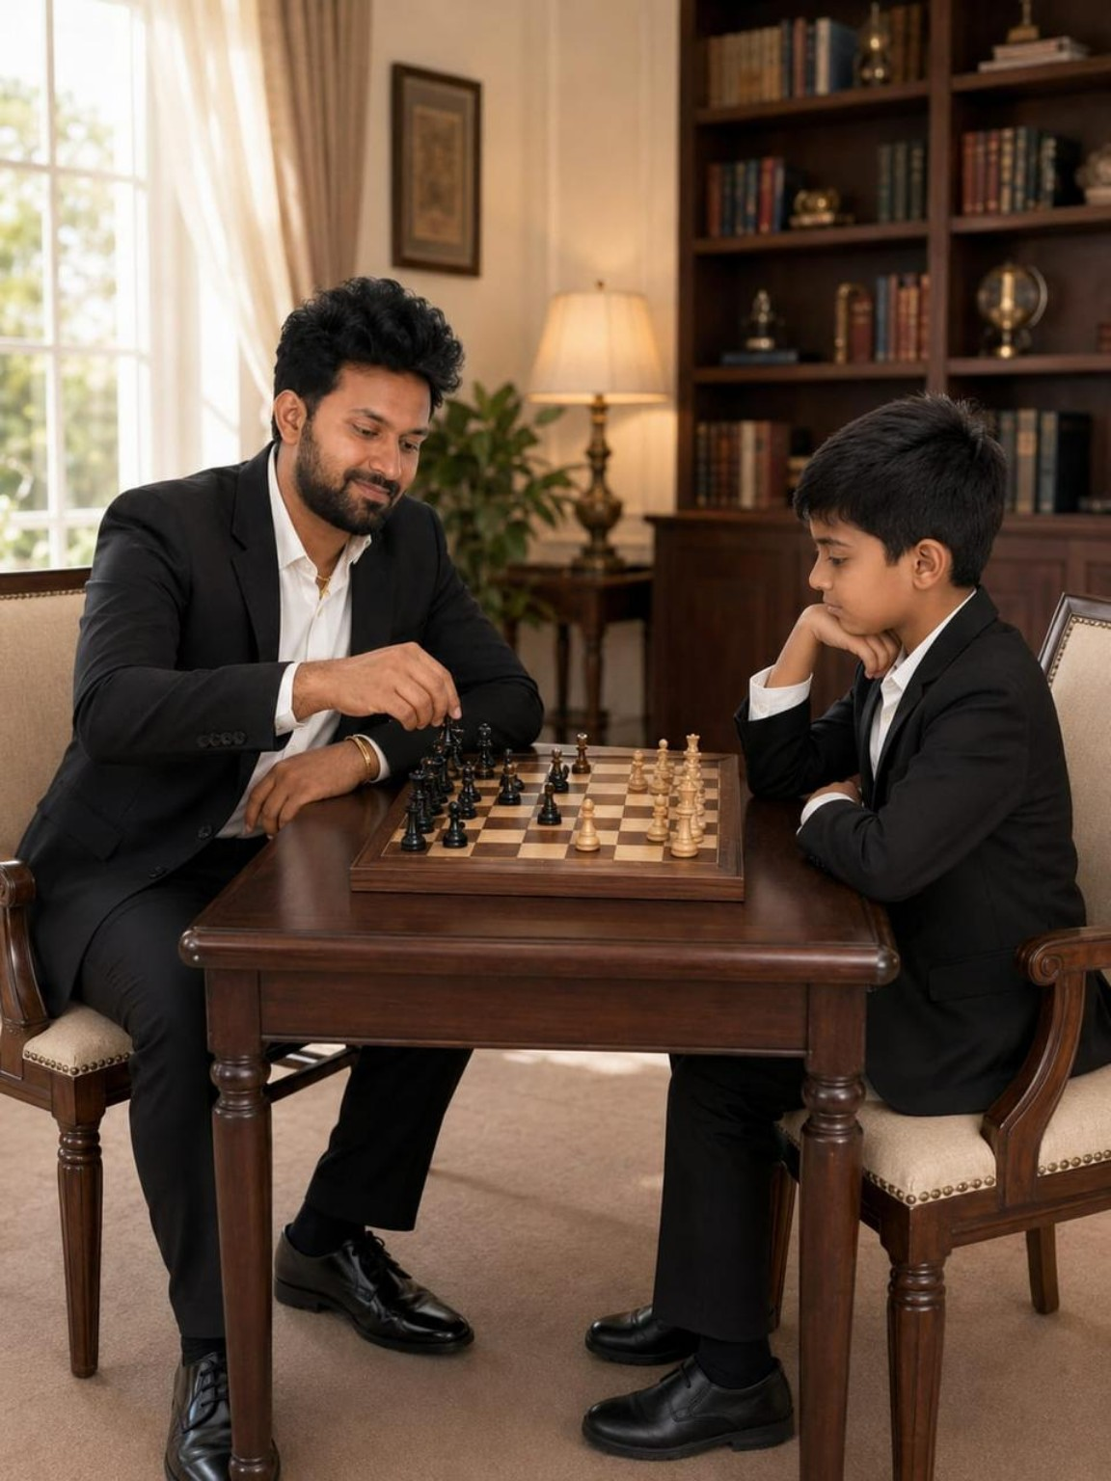
Strategy & Mentorship

Slide 8
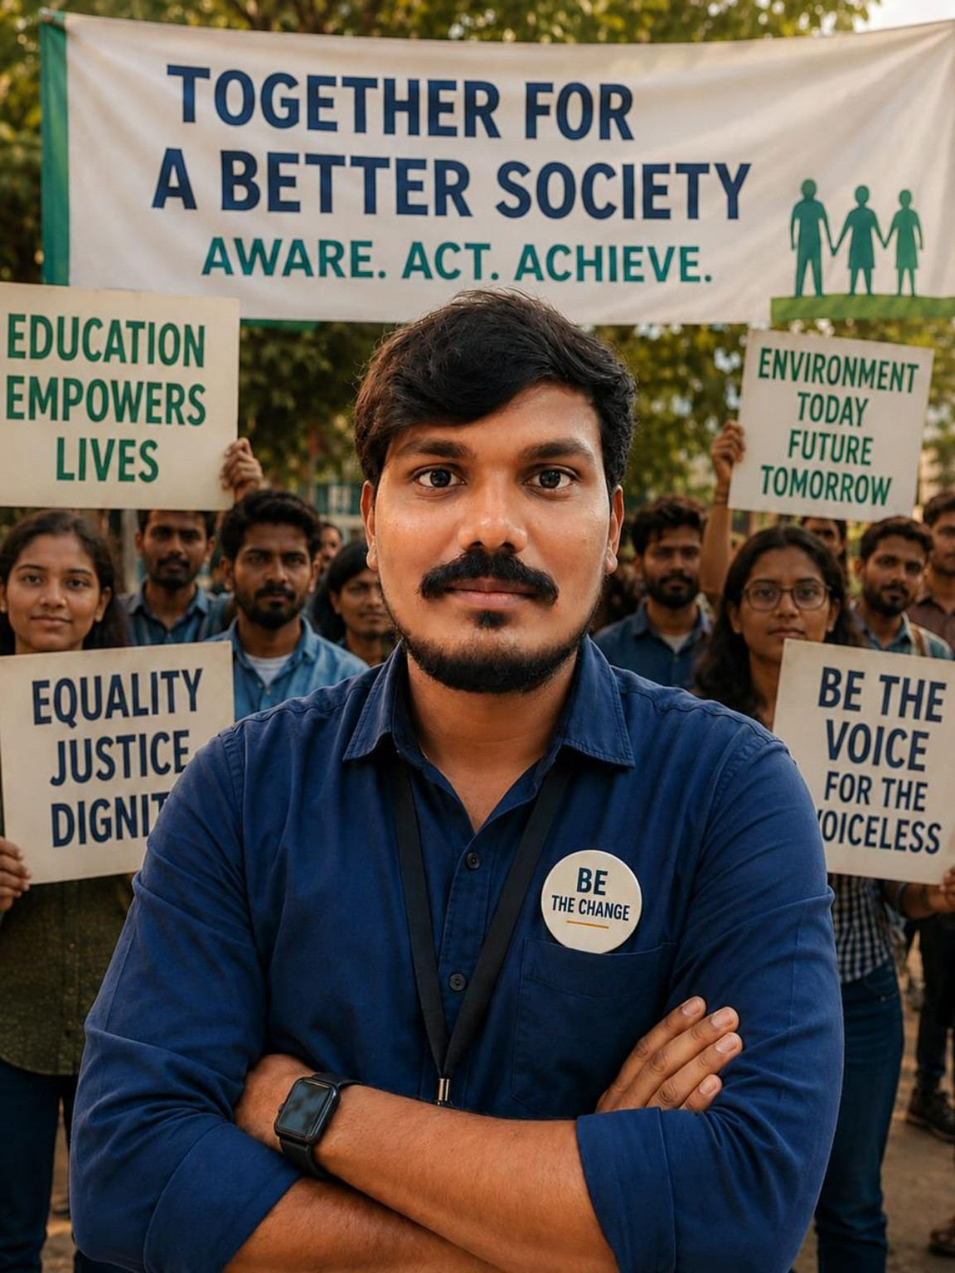
Better Society Vision

Slide 9

Service Mindset

Slide 10
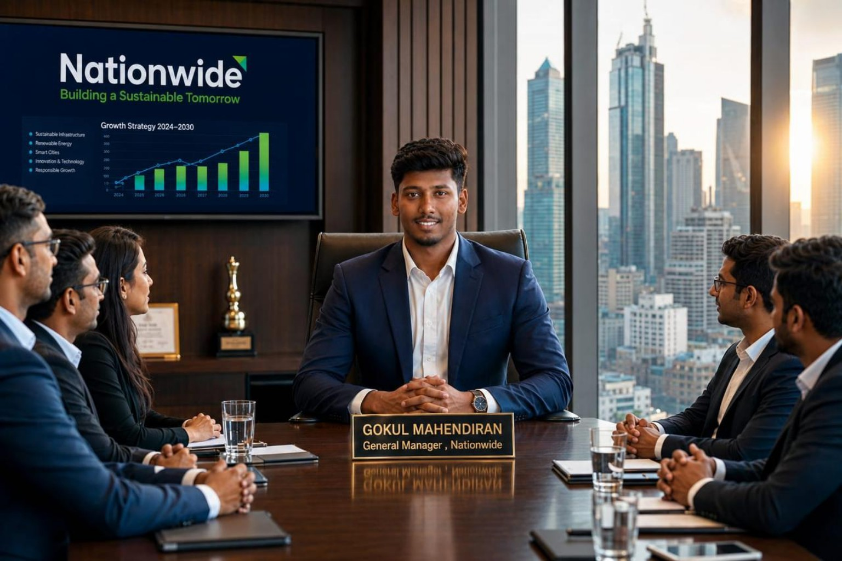
Leadership Vision

Slide 11
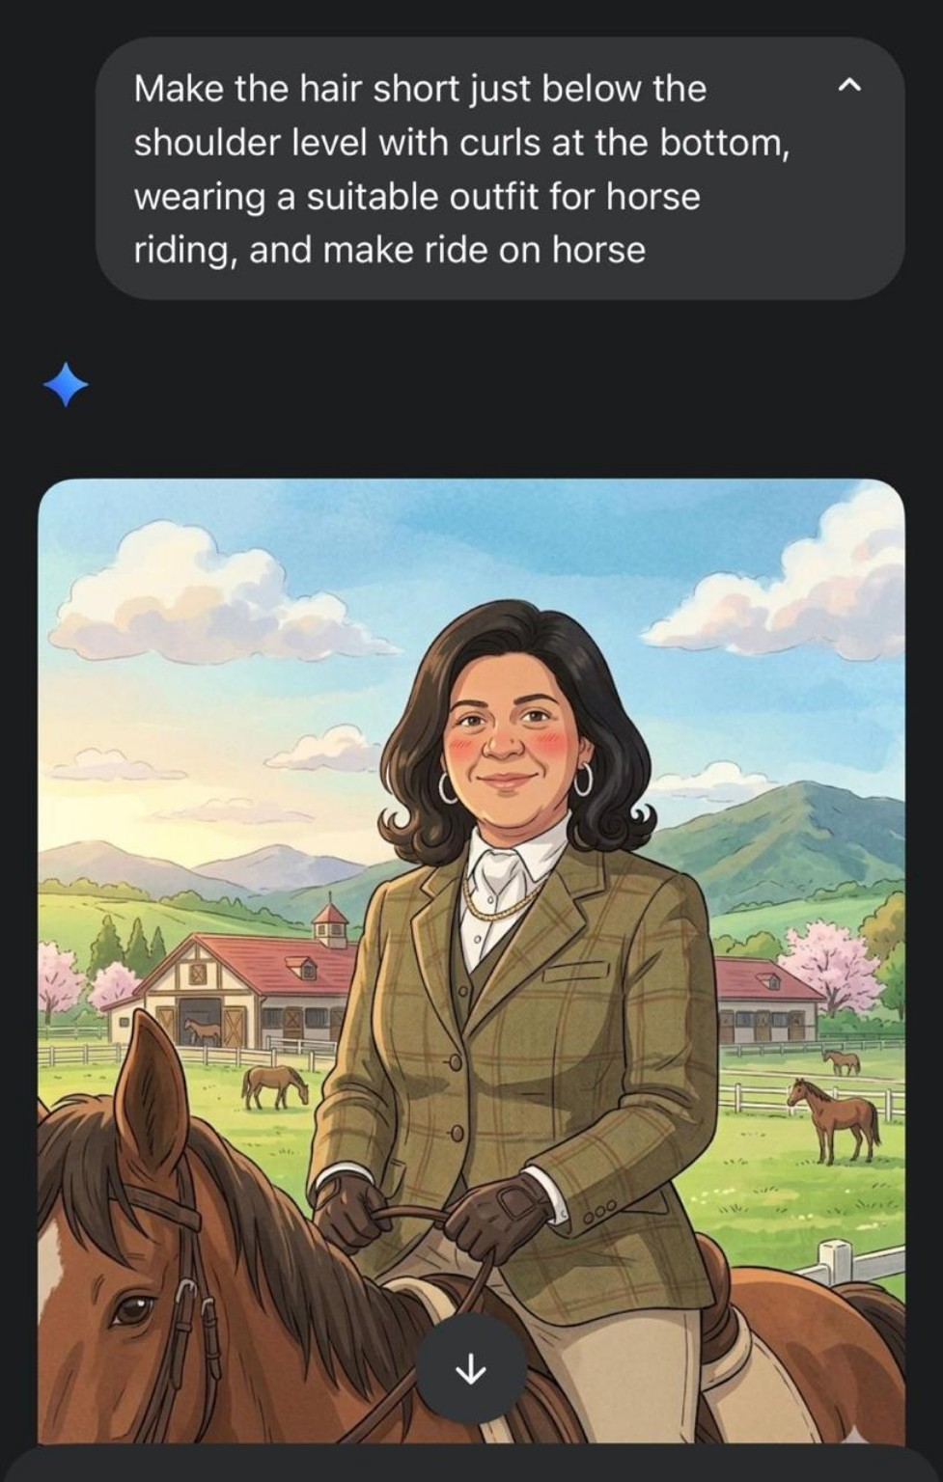
Horse Riding Vision

