Slide 1

Sentiment Analyzer
AI Based Market Sentiment & Trading Signal Prediction
Vamos | Computer Science Engineering

Slide 2




Problem Statement
Information Overload
Manual Analysis
Decision Support
Investors struggle to interpret large volumes of financial news and market data efficiently.
Traditional sentiment analysis is slow, time-consuming, and prone to human error.
Traders need automated, reliable systems to support investment decisions with data-driven insights.

Slide 3
Project Objectives
01
02
Sentiment Analysis
Trend Prediction
Analyse financial news sentiment using Natural Language Processing techniques.
Predict market trend direction with confidence-based forecasting models.
03
04
Signal Generation
Confidence Scores
Generate Buy/Sell/Hold trading signals based on analysed sentiment data.
Provide probabilistic confidence scores for each trading recommendation.

Slide 4





Technology Stack
Python
Machine Learning
NLP Models
Core programming language for ML implementation
Scikit-learn for model training and evaluation
FinBERT and Transformer architectures for sentiment analysis
Streamlit
Pandas & NumPy
Interactive frontend dashboard for user interface
Data manipulation and numerical computing libraries

Slide 5

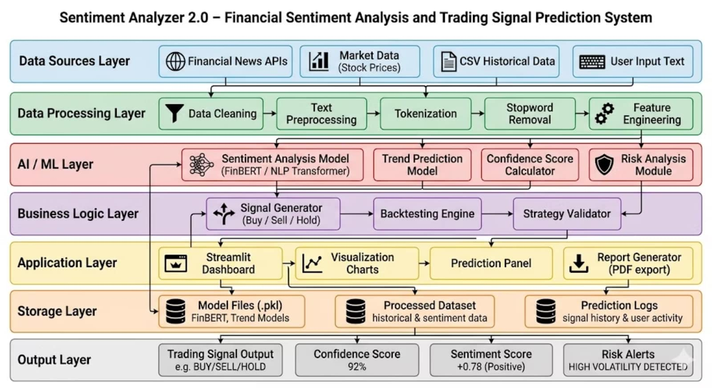
System Architecture

Slide 6





Working Methodology
Input Collection
Financial news articles and market reports are fed into the system.
Text Preprocessing
Data cleaning, tokenisation, and feature extraction from raw text.
Sentiment Scoring
NLP models assign sentiment scores ranging from negative to positive.
Model Prediction
Machine learning algorithms analyse patterns and predict market movements.
Trading Signal
Final Buy/Sell/Hold recommendation with confidence percentage displayed.

Slide 7
Key Features
Real-Time Analysis
Confidence-Based Prediction
Risk Signals
Continuous sentiment analysis of live financial news feeds with instant processing.
Warning indicators for high-volatility periods and uncertain market conditions.
Probabilistic scoring system indicates reliability of each trading signal generated.
Backtesting Support
Professional Dashboard
Historical data analysis to validate model performance and accuracy metrics.
Clean, intuitive user interface with visualisations and interactive controls.

Slide 8
Performance Results
78%
2.3%
15%
Accuracy Rate
RMSE Score
Average Return
Correct directional predictions
Root mean square error
Backtested portfolio performance
Model demonstrates strong predictive capability with acceptable error rates for trading applications.

Slide 9
Challenges & Future Improvements
Challenges Faced
Future Enhancements
Noisy financial data with inconsistencies
Model overfitting to training data
Difficulty detecting trend reversals
Complex data preprocessing requirements
Real-time API integration for live data
Deep learning architectures (LSTM/GRU)
Portfolio optimisation algorithms
Cloud deployment for scalability

Slide 10

Conclusion
Data-Driven Decisions
Emotional Trading Reduction
Enhanced Insights
AI-powered analysis transforms raw financial news into actionable trading signals.
Real-time sentiment processing provides competitive advantage in fast-moving markets.
Objective, algorithmic recommendations remove emotional bias from investment decisions.
Thank You

