Slide 1

ASSESSMENT PROJECT
Exam Hall & Seat
Allocation System
AI-Assisted Development, Testing & Documentation
Flask-Based Web Application
Automated Test Suite
AI-Assisted Iteration
PRESENTED FOR UNIVERSITY / PROJECT ASSESSMENT
Notes:
SPEAKER NOTES: Open with the project title and framing. This is an assessment project built as a Flask web application, developed and tested with AI assistance, and validated by actually running the app and its test suite. SCRIPT (approx. 20-40 sec): "Good afternoon. I'm presenting the Exam Hall and Seat Allocation System — a Flask-based web application built for this assessment, developed and tested with AI assistance and verified by actually running the project."

Slide 2







Problem & Objective
THE PROBLEM
OBJECTIVE
Manual allocation is time-consuming for administrators
Student data must be processed accurately, every time
Build a web-based system to simplify student data management, exam session management, hall management and seat allocation.
Hall capacity must be carefully considered before seating
Students need clear, unambiguous seating information
Manual Process
Automated System
Repeated manual allocation work increases the risk of errors
Scope: student data, exam sessions, halls, and seat allocation.
Exam Hall & Seat Allocation System
2
Notes:
SPEAKER NOTES: Explain the real-world problem administrators face when allocating exam halls and seats manually, then state the objective the project addresses. SCRIPT (approx. 20-40 sec): "Manually assigning students to exam halls is slow and error-prone — capacity limits, accurate student data, and clear seating information all have to be tracked by hand. The objective of this project is a web-based system that manages student data, exam sessions, halls, and seat allocation in one place."

Slide 3







Solution & Key Features
A single Flask web application covering the full allocation workflow.
Administrator Authentication
Student Data Upload & Validation
Exam Session Management
Hall Management
Secure sign-in restricts management features to logged-in admins.
Accepts Excel, CSV or PDF; every row is validated before saving.
Sessions store subject, date, time and student information.
Halls are configured by rows x columns to define capacity.
Automatic Seating Allocation
Allocation Regeneration
Student Search
Dashboard Overview
Seats are generated automatically for each exam session.
Allocations can be regenerated on demand per session.
Students are looked up instantly by register number.
Live counts of students, sessions, halls and allocations.
Exam Hall & Seat Allocation System
3
Notes:
SPEAKER NOTES: Walk through the eight core features as a set of cards rather than reading each line — group them mentally as data-in (upload), configuration (sessions, halls), automation (allocation), and lookup (search, dashboard). SCRIPT (approx. 20-40 sec): "The system covers the full workflow: administrators sign in, upload and validate student data, configure exam sessions and halls, and then generate seating allocations automatically — which can be regenerated at any time. Students can be searched by register number, and a dashboard ties it all together."

Slide 4




System Architecture
Logical flow of the application, based on the confirmed project structure.
Administrator
Student Data
Web Interface
Exam Sessions
Flask Application
Halls
Application Routes / Services
Allocations
Database
manages
TESTING LAYER
Application
Automated Tests
pytest
Exam Hall & Seat Allocation System
4
Notes:
SPEAKER NOTES: This is a logical view, not a deployment diagram — reflects only the structure confirmed in the project: admin, web UI, Flask app, routes/services, and a database managing four data domains. Automated tests run against the application via pytest. SCRIPT (approx. 20-40 sec): "At a high level, the administrator interacts through a web interface backed by a Flask application. Routes and services manage a database covering student data, exam sessions, halls, and allocations. All of this is validated by an automated pytest test suite running against the application."

Slide 5


Testing, Evidence & AI-Assisted Iteration
28
1
11
Deliberate red run performed;
final pytest run completed
successfully.
PASSED
SKIPPED
WARNINGS
AI CHANGE LOOP
Prompt
Analyze
Implement
Test
Failure
Diagnose
Correct
Re-test
Final Result
Each iteration follows the loop above: a change is prompted and implemented, the test suite is run, and any failure is diagnosed, corrected, and re-tested until the suite passes. AI was used as a development and testing assistant throughout this process.
Results were verified by actually running the project and its tests — AI did not independently validate the system.
Exam Hall & Seat Allocation System
5
Notes:
SPEAKER NOTES: State the pytest numbers plainly (28 passed, 1 skipped, 11 warnings), mention the deliberate red run, then explain the AI loop as a repeatable process — without overstating AI's role. Be explicit that a human/the developer ran and verified the tests, AI assisted rather than replaced verification. SCRIPT (approx. 20-40 sec): "The automated pytest suite shows 28 tests passed, 1 skipped, and 11 warnings, and a deliberate red, or failing, run was performed and corrected before the final successful run. Development followed an AI-assisted loop — prompt, implement, test, diagnose failures, correct, and re-test — but every result here was verified by actually running the project."

Slide 6
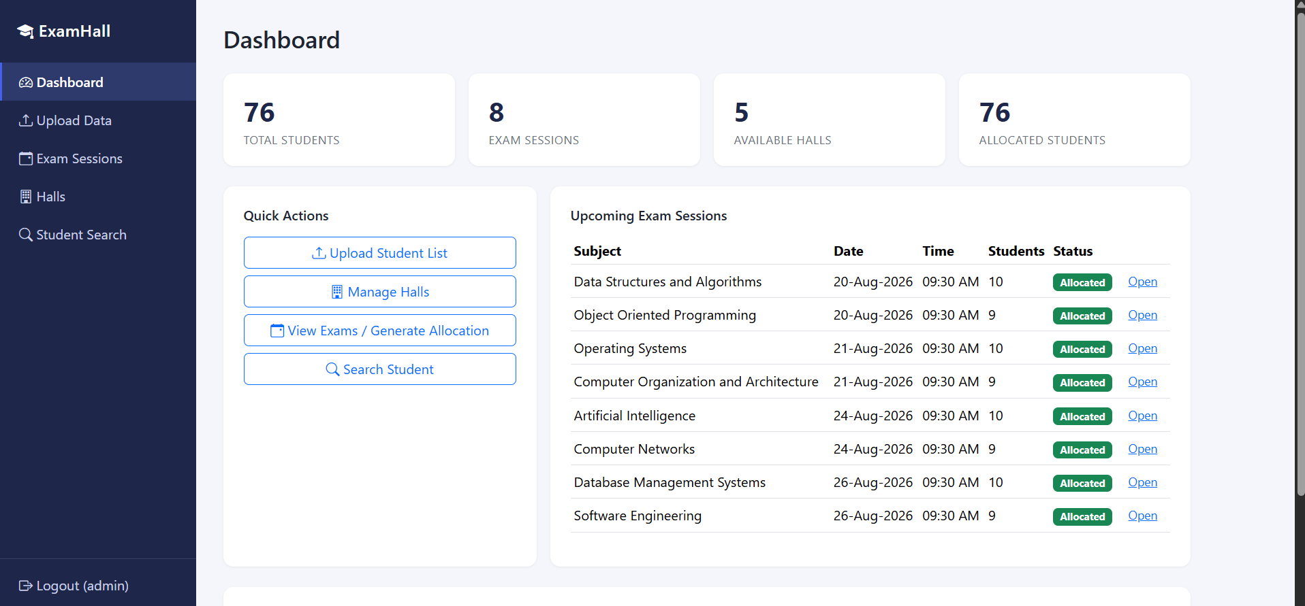
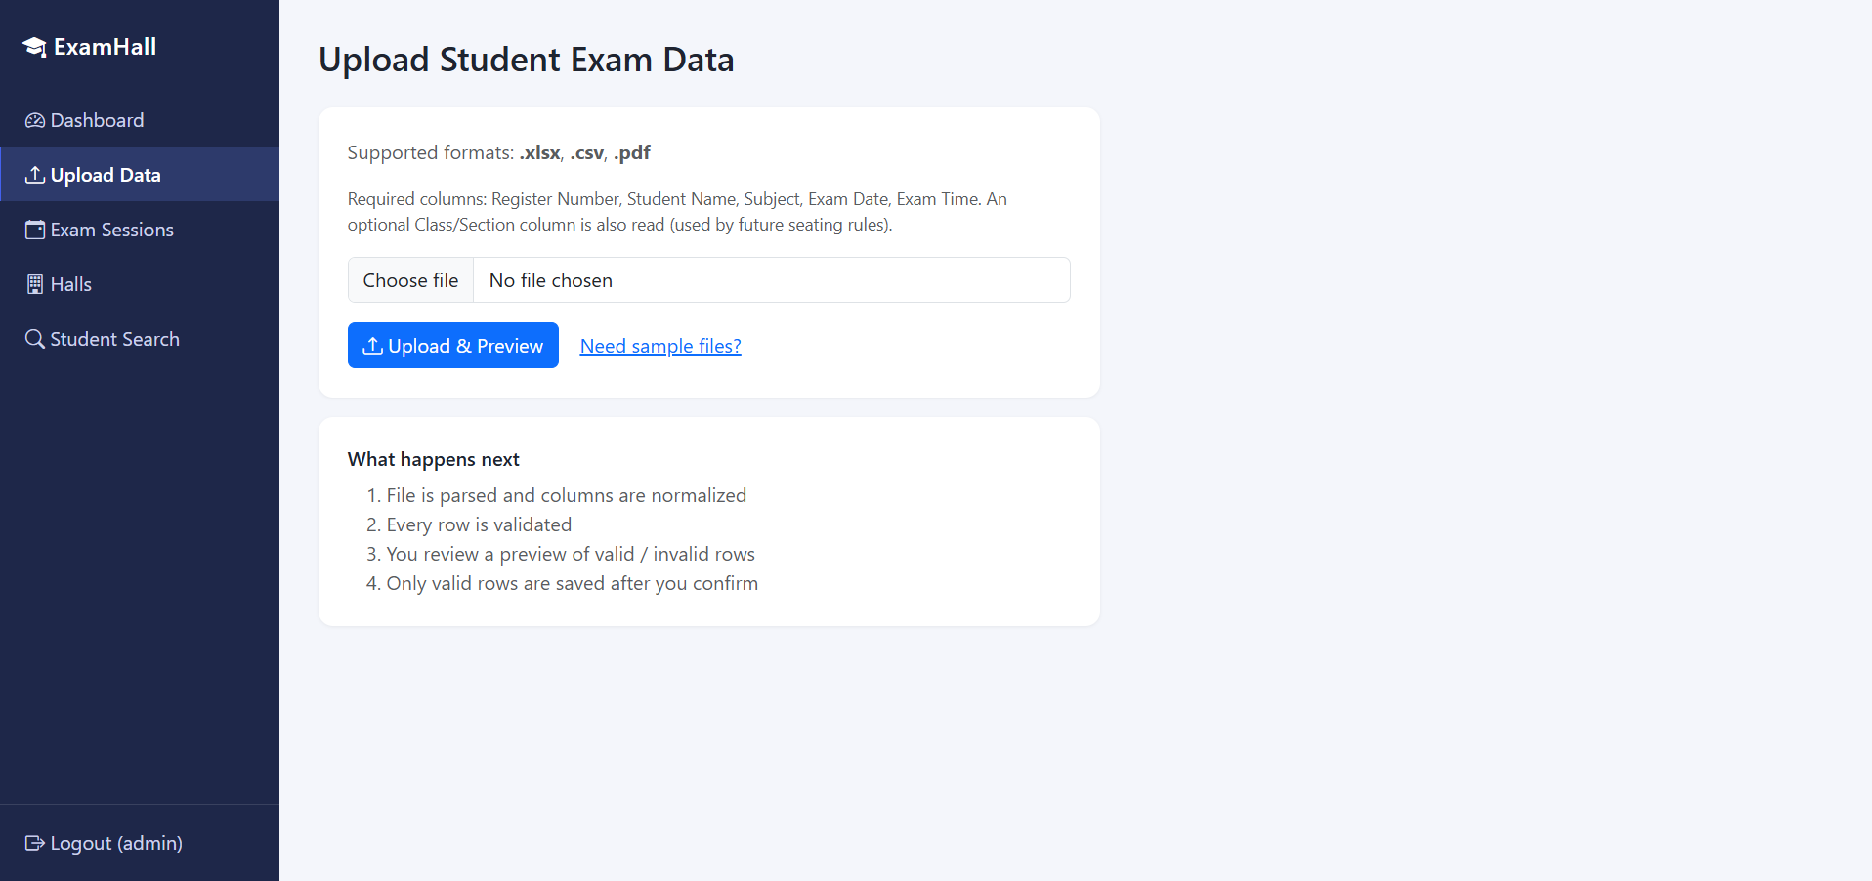
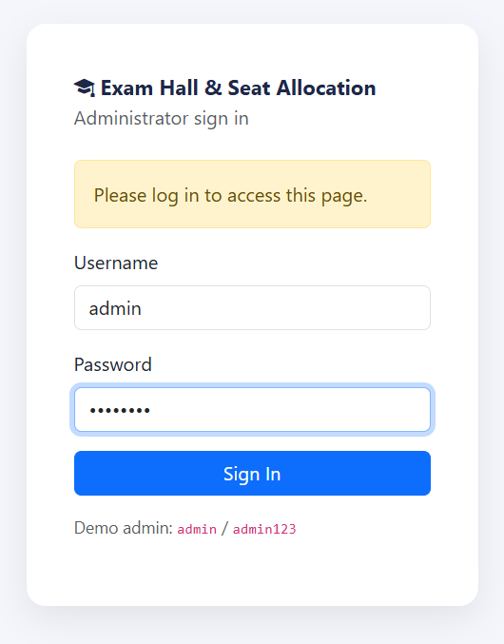
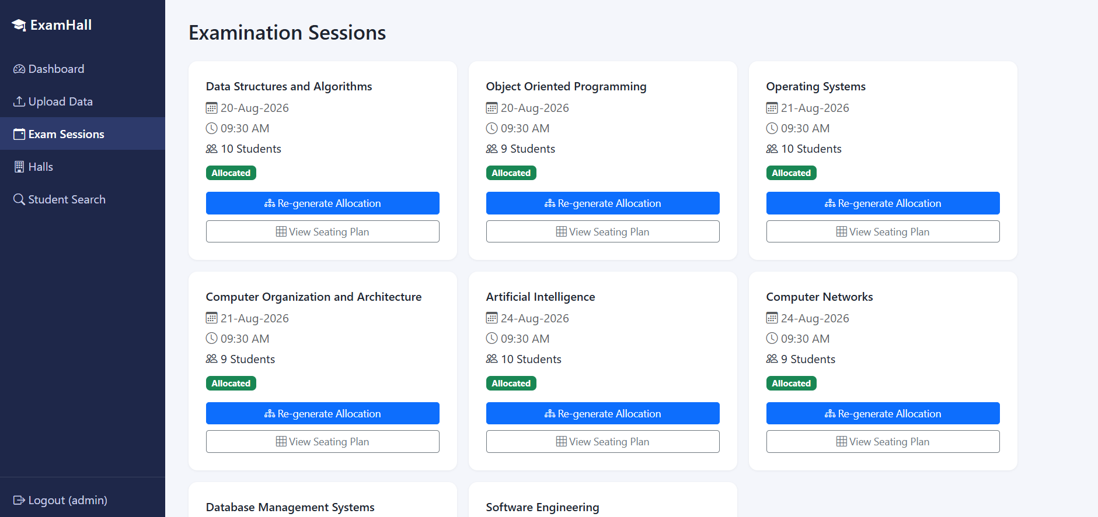
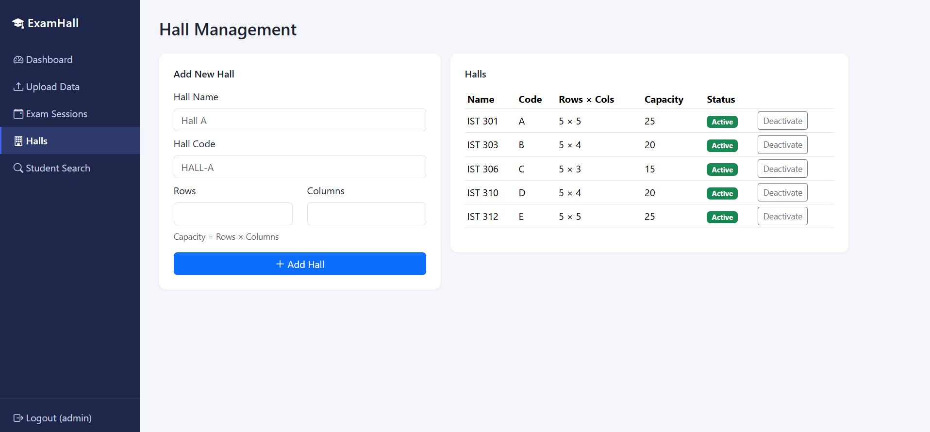
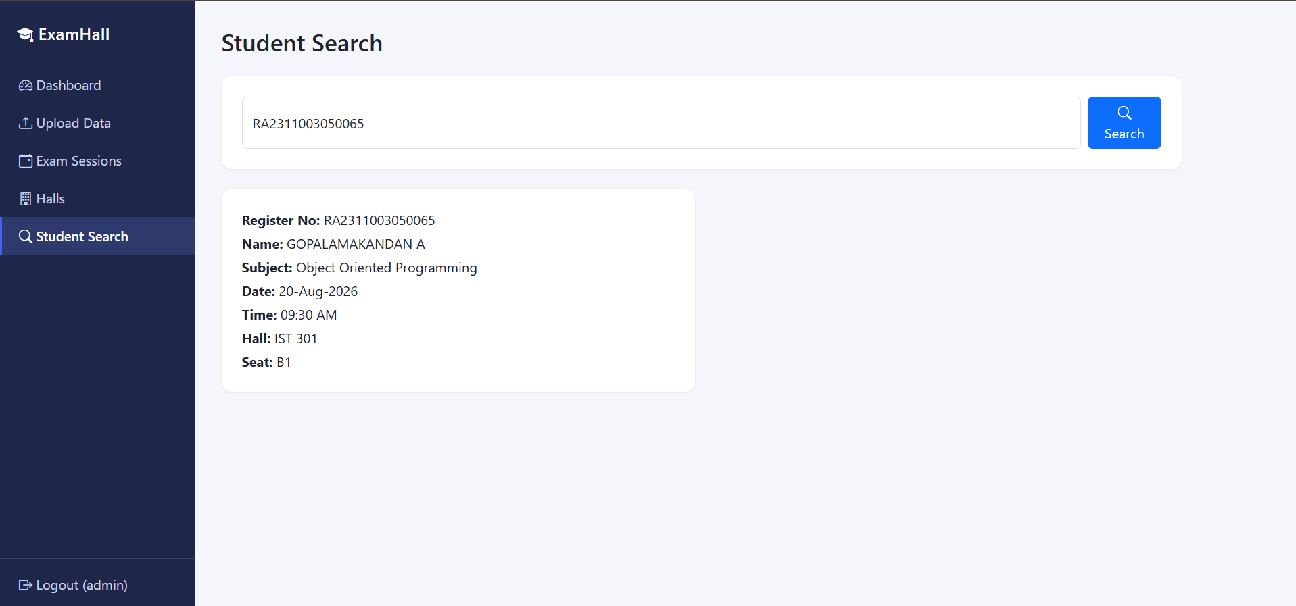
Test Evidence & Application Demo
Screens captured directly from the running application.
Authentication
Dashboard
Data Validation
Exam Sessions
Hall Management
Student Allocation / Search
Exam Hall & Seat Allocation System
6
Notes:
SPEAKER NOTES: Walk through the six screens in order: login, dashboard with live counts, data upload/validation, exam sessions, hall management, and student search with allocated seat. Keep commentary brief per screen since this is a visual slide. SCRIPT (approx. 20-40 sec): "These captures show the system in action — administrator login, the dashboard with live counts, the data upload and validation screen, exam session cards, hall management with row-by-column capacity, and student search returning a register number's allocated hall and seat."

Slide 7
Results & Deliverables
FINAL RESULT
ASSESSMENT DELIVERABLES
Application runs successfully end-to-end
Source code, application & README
✓
Done
Test suite with captured evidence
Student data can be uploaded and validated
✓
Done
Deliberate red-run evidence
✓
Done
Exam sessions can be managed
AI-assisted iteration summary
✓
Done
Halls and capacities can be configured
Architecture document
–
Not provided
Seating allocations can be generated
Design document
–
Not provided
User guide
Students can search their allocation
–
Not provided
Presentation
✓
Done
Automated tests provide regression coverage
5-minute demo video
–
Not provided
Exam Hall & Seat Allocation System
7
Notes:
SPEAKER NOTES: Present results as verified facts, then be transparent about deliverable status — presentation, source code, test evidence, red-run evidence and the AI-iteration summary are complete; architecture, design, user guide and demo video are marked as not yet provided rather than claimed. SCRIPT (approx. 20-40 sec): "In summary, the application runs end-to-end: uploading and validating data, managing sessions and halls, generating allocations, and searching students, all backed by automated tests. Against the assessment checklist, source code, test evidence, the red-run, the AI-iteration summary and this presentation are complete; the architecture, design, and user-guide documents and the demo video are still to be delivered."

Slide 8
Conclusion & Live Demo
The system provides a structured web-based approach to exam hall and seat allocation, supported by automated testing and AI-assisted development.
LIVE DEMO SEQUENCE
1
Login
2
Open Dashboard
3
Upload student data
4
View exam sessions
5
Manage halls
6
Generate / re-generate allocation
7
Search a student
8
Show hall and seat allocation
9
Show test results
Thank You
Notes:
SPEAKER NOTES: Close with the one-line conclusion, then transition directly into the live demo using the numbered sequence as your on-screen checklist. End the video/talk with Thank You. SCRIPT (approx. 20-40 sec): "To conclude: this system brings a structured, web-based approach to exam hall and seat allocation, backed by automated testing and AI-assisted development. I'll now walk through it live — logging in, opening the dashboard, uploading data, managing sessions and halls, generating allocation, searching a student, and finishing with the test results. Thank you."

