Slide 1
Strategic Analysis for RetailPulse: Enhancing Sales and Efficiency
Data Analyst Take Home [Level 3]
VISHNU MANI DEEP ALA
NUEL Inc.

Slide 2
About the Dataset
This dataset represents a transactional sales data of a retail company, capturing detailed information about customer orders. It includes 21 columns that provide insights into the sales, shipping, and profitability of various products across different regions in the United States. Key features of the dataset include:
Order Details: Contains unique identifiers such as Row ID and Order ID, along with the Order Date, Ship Date, and Ship Mode.
Customer Information: Includes Customer ID, Customer Name, and the Segment (e.g., Consumer, Corporate, or Home Office).
Geographic Data: Provides the Country, City, Postal Code, and Region.
Product Details: Includes Product ID, Category, Sub-Category, and Product Name.
Sales Performance Metrics: Tracks Sales, Quantity, Discount, and Profit for each transaction.

Slide 3
PROBLEM STATEMENT
The retail company aims to optimize its sales and profitability while improving customer satisfaction and operational efficiency. However, challenges such as uneven regional sales performance, low-profit margins for certain product categories, and delays in shipping impact overall business outcomes.
The goal is to analyze this dataset to uncover patterns, trends, and insights, enabling the company to:
What are the primary factors influencing sales?
How do customer demographics and behavior vary across locations?
How do external factors like weather and holidays impact sales?

Slide 4
EXTERNAL DATA
To enhance the analysis and provide more context, I integrated an external dataset containing a comprehensive list of U.S. holidays from 2004 to 2021. This dataset was sourced from Kaggle: U.S. Holiday Dates (2004–2021).
Key Features of the Dataset:
Date: The specific date of each holiday.
Holiday Name: The name of the holiday (e.g., 4th of July, Thanksgiving).
Weekday: The day of the week for each holiday.
Month/Day/Year: Provides individual breakdowns of the date components.

Slide 5
DATA PRE-PROCESSING
To enhance the analysis and focus on the most relevant time frame, I performed the following steps:
Filtered Holiday Data: Extracted holidays from the original dataset for the years 2014 to 2018, narrowing down the records from the original range of 2004 to 2021.
Integration with Transaction Data: Merged the holiday dataset with the transactional dataset using the Order Date column. This integration allowed each transaction to be associated with a corresponding holiday, if applicable.
Creation of the Holiday Column: Added a new column, Holiday, to the transactional dataset.
If a transaction occurred on a holiday, the column was populated with the name of the holiday (e.g., "4th of July").For non-holiday dates, the column was filled with "No Holiday

Slide 6
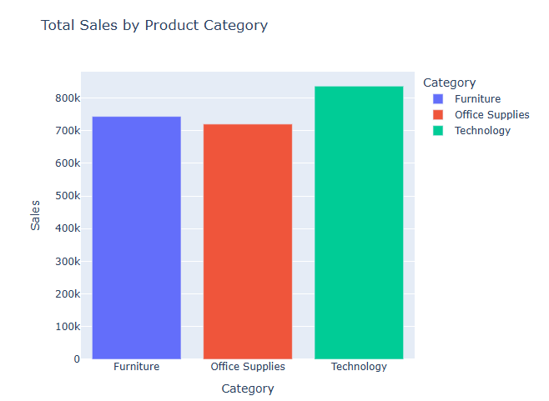
EXPLORATORY DATA ANALYSIS
Technology: This category is a clear revenue driver. It's crucial to maintain and potentially expand the product range in this category.
Furniture: This category also performs well. It's important to continue offering competitive and attractive furniture options.
Office Supplies: This category requires closer attention. Analyze the specific products within this category that are selling well and those that are not. Consider strategies to boost sales in this category.

Slide 7
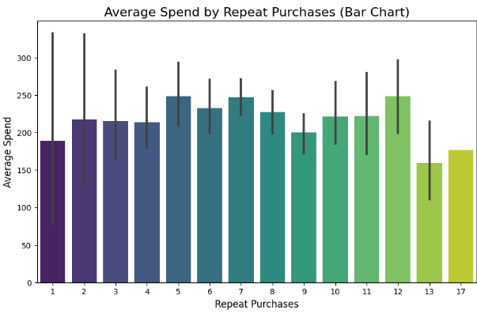
CUSTOMER SEGMENTATION
Generally, average spend increases with repeat purchases. This suggests that loyal customers tend to spend more per transaction.
Customers with 1-3 repeat purchases have lower average spend. This group might be exploring the brand or still building loyalty.
The average spend peaks around 6-8 repeat purchases. This indicates a sweet spot where customers are frequent and valuable.
Average spend drops slightly after 8 repeat purchases. This could be due to factors like customer churn or a shift to lower-priced products.
There's a significant drop in average spend for customers with 13-17 repeat purchases. This warrants further investigation to understand the reasons.

Slide 8
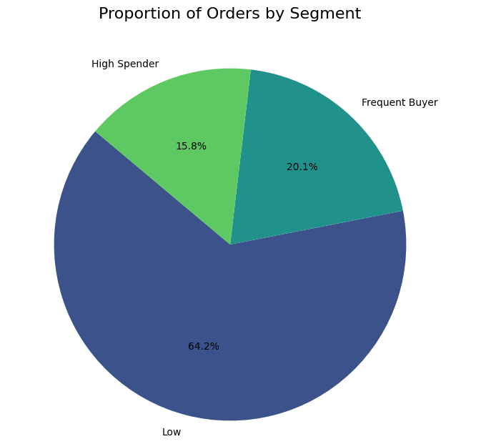
Low: This segment represents a large portion of your customer base. It's crucial to analyze the characteristics of this segment to understand their needs and preferences. Consider strategies to upsell or cross-sell to this segment to increase their average order value.
Frequent Buyers: This segment is highly valuable due to their repeat purchases. Focus on retention strategies to keep these customers engaged and coming back for more. Analyze their purchase history to identify their preferred products and tailor marketing efforts accordingly.
High Spenders: This segment is driving a significant portion of your revenue. Prioritize their needs and preferences. Consider loyalty programs or exclusive offers to incentivize their continued patronage.

Slide 9
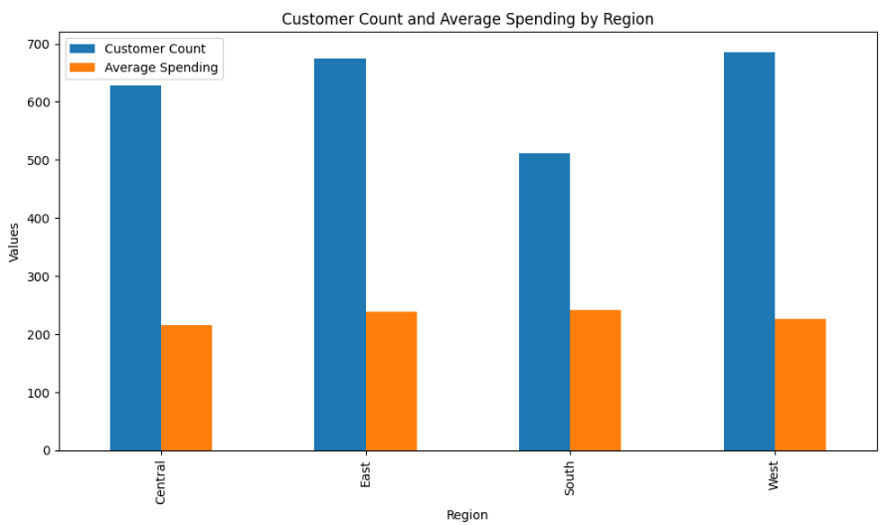
Customer Relationship Management (CRM): Implement a CRM system to track customer interactions, preferences, and purchase history. This data can be used to personalize marketing efforts and improve customer satisfaction.
Loyalty Programs: Introduce loyalty programs to incentivize repeat purchases and reward loyal customers.
Targeted Marketing: Utilize data analytics to identify customer segments within each region and tailor marketing campaigns to their specific needs and preferences.
Product Development: Analyze customer feedback and preferences in each region to develop products that are relevant and appealing to the target audience.

Slide 10
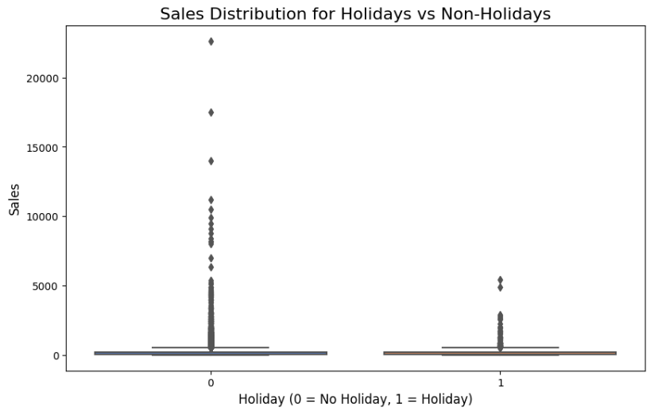
Sales are generally higher on holidays. The box plot for holidays is shifted upwards compared to non-holidays, indicating a higher median and overall distribution of sales.
Increased consumer spending: Holidays are often associated with increased consumer spending due to gift-giving, travel, and festive celebrations.
Special promotions: Businesses often run special promotions and discounts during holidays to attract customers.
Seasonality: Some businesses may experience natural seasonality, with higher sales during specific holidays or seasons.

Slide 11
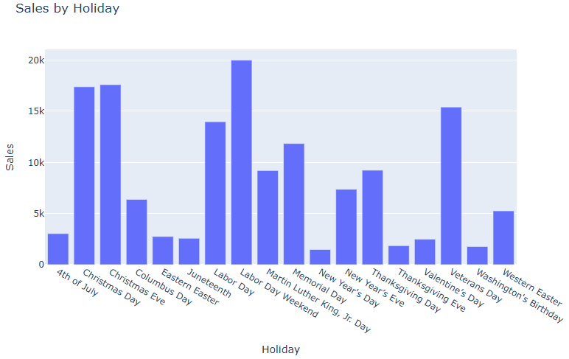
Christmas: The high sales during this period are likely due to gift-giving traditions and increased consumer spending.
Labor Day: This holiday often coincides with the end of summer and back-to-school shopping, which could contribute to the higher sales.
New Year's Day: This holiday may see increased sales due to celebrations and resolutions for the new year.
Valentine's Day: This holiday is associated with gifting and romantic occasions, driving sales in specific product categories.

Slide 12
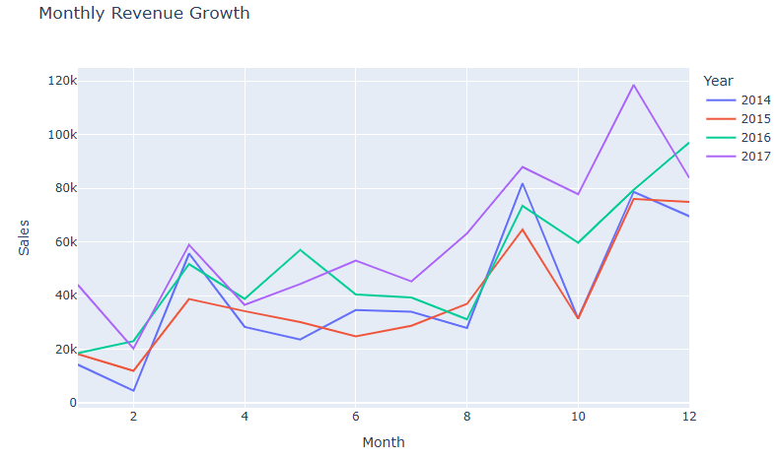
SALES TRENDS
January and February: These months generally show lower sales compared to the rest of the year. This could be due to seasonal factors, post-holiday spending, or other external influences.
March to May: Sales tend to increase during these months. This could be attributed to factors like the start of the new year, spring season, or promotional activities.
June to August: Sales seem to fluctuate during this period. There might be some seasonality or other factors impacting sales during these months.
September to November: Sales generally show a significant upward trend during these months. This could be due to the holiday season and increased consumer spending.
December: Sales often peak in December, likely due to the holiday season and year-end spending.

Slide 13
SALES PERFORMANCE
Seasonal Planning: By identifying the seasonal trends in monthly sales, businesses can plan their marketing campaigns, inventory levels, and staffing accordingly. For example, they can increase marketing efforts and stock up on inventory during peak seasons like September to December.
Addressing Low Months: Analyzing the reasons for lower sales in January and February can help businesses implement strategies to mitigate the impact. This could involve targeted promotions, special offers, or introducing new products to attract customers.
Capitalizing on Peak Months: Businesses should capitalize on the increased sales during peak months by maximizing their marketing efforts, optimizing inventory levels, and ensuring efficient customer service.

Slide 14
STRATEGIES TO IMPROVE BUSINESS
1. Leverage Seasonal Trends:
Capitalize on Peak Months (September-December):
Increase Marketing Efforts: Implement targeted marketing campaigns during these months, such as holiday-themed promotions, email campaigns, and social media advertising.
Optimize Inventory: Ensure adequate stock levels for high-demand products during the holiday season to avoid stockouts.
Staffing Adjustments: Consider increasing staffing levels to handle increased order volume and customer inquiries during peak months.
Address Low Months (January-February):
Offer Incentives: Run promotions, discounts, or loyalty programs to attract customers during these slower months.
Introduce New Products or Services: Launch new product lines or services to generate interest and drive sales during the off-season.
Cross-Selling and Upselling: Encourage customers to purchase additional products or upgrade their orders during low months.
2. Improve Customer Relationships
Loyalty Programs: Implement a loyalty program to reward repeat customers and encourage repeat purchases.
Personalized Marketing: Use customer data (like purchase history, demographics, and preferences) to personalize marketing messages and offers. This can increase customer engagement and drive sales.
Customer Service: Provide excellent customer service to build strong customer relationships and encourage repeat business.

Slide 15
3. Analyze Product Performance:
Identify Best-Selling Products: Analyze sales data to identify the best-selling products during different months and seasons. Focus marketing and inventory efforts on these products.
Identify Low-Performing Products: Analyze product sales data to identify underperforming products. Consider discontinuing or modifying these products to improve profitability.
4. Refine Pricing Strategies:
Dynamic Pricing: Implement dynamic pricing strategies to adjust prices based on demand, seasonality, and competitor pricing.
Cost Analysis: Analyze product costs to ensure profitability and optimize pricing strategies.
5. Leverage Data Analytics:
Data-Driven Decision Making: Utilize data analytics to gain insights into customer behavior, market trends, and sales performance. This data can be used to inform business decisions and improve overall performance.
6. Monitor and Adapt:
Regularly review sales data to track progress and identify new trends or challenges.
Continuously monitor and adapt your sales and marketing strategies based on the insights gained from data analysis.

Slide 16
CONCLUSION
The analysis of monthly revenue growth reveals several key trends. Sales exhibit a clear seasonal pattern, with peak performance typically observed from September to December (Q4) and a dip in revenue during January and February (Q1). This pattern suggests that factors such as holiday shopping and year-end spending likely influence sales activity. Furthermore, 2017 stands out as the year with the highest overall sales performance.
By understanding these trends, businesses can proactively adjust their strategies to optimize operations and capitalize on seasonal opportunities. This may involve optimizing inventory levels, adjusting staffing, and implementing targeted marketing campaigns during peak seasons.

