Slide 1


Deforestation Detection
VISHNU PRAKASH
https://github.com/VISHNUPRAKASH6126
/Deforestation-detection.git

Slide 2

Learning Objectives
Understand the environmental impact of deforestation.
Learn how satellite imagery helps in land cover monitoring.
Apply machine learning to detect deforested areas.
Develop a system to visualize and report deforestation trends.
GOAL
Source :
www.freepik.com/

Slide 3
Tools and Technology used
Python – Programming Language
TensorFlow / PyTorch – For model training
Google Earth Engine – Satellite image data
OpenCV – Image processing
Matplotlib / Seaborn – Visualization
Jupyter Notebook / Colab – Development platform

Slide 4
Methodology
Data Collection – Gather satellite images from Google Earth Engine.
Preprocessing – Clean and enhance image resolution.
Training AI Models – Use CNN to classify forest vs non-forest.
Detection – Compare images over time to identify changes.
Visualization – Map areas of deforestation.

Slide 5
Problem Statement:
Deforestation is a major threat to biodiversity and climate balance.
Manual monitoring is slow, expensive, and not scalable.
There is a need for an automated, efficient, and accurate detection system.

Slide 6
Solution:
Develop an AI-powered tool that scans satellite images over time.
Automatically highlights areas of tree cover loss.
Provides alerts and reports for early intervention.

Slide 7
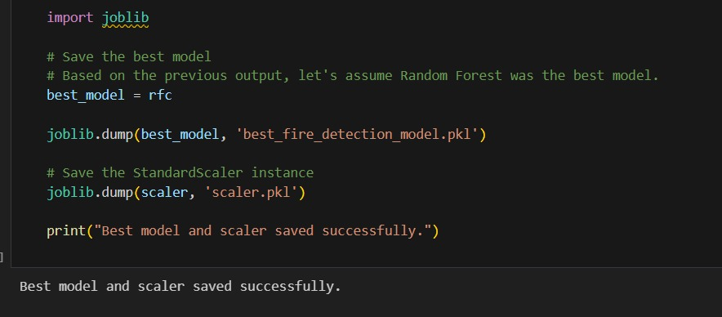
Screenshot of Output:

Slide 8
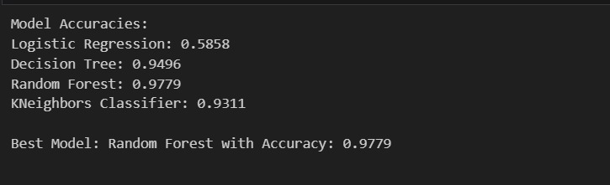

Slide 9
Conclusion:
The project demonstrates a scalable solution for monitoring deforestation.
It aids in environmental decision-making and policy enforcement.
Future work can integrate real-time alert systems and more precise geolocation mapping.

