Slide 1
CAMPUS LOST & FOUND INTELLIGENCE PLATFORM
FoundIT: System Architecture & UML Specification
Complete Engineering Blueprints: Behavioral Models, Multi-Modal AI Pipelines, Cryptographic Handover Protocols, and Distributed Data Schemas
⚡ Next.js 16 + React 19
TypeScript App Router with serverless API microservices & Turbopack SSR.
🧠 Multi-Modal AI Engine
YOLOv8 tagger, CLIP visual vectors, Sentence Transformers & Cosine Similarity ≥75%.
🔐 Secure 6-Digit Handover
Masked chat anonymity, SHA-256 hashed OTPs, 15m expiry & 3-attempt throttle.
🗄️ MongoDB Enterprise Store
8 normalized schemas, atomic report state locks, and immutable audit logs.
TETEAM MEMBERS:
VENKATRAMAN M
SADHANAN SUNDAR S
VISHNURAAM K

Slide 2
SYSTEM ARCHITECTURE BLUEPRINT
UML & Architectural Taxonomy Index
Systematic categorization of the 13 FoundIT architectural models across three core software engineering pillars.
PILLAR 01
Behavioral & Interaction Models
01. Use Case Diagram
User roles, system boundaries, and «include»/«extend» capabilities.
02. Activity Diagram
End-to-end workflow from campus OAuth login to physical handover.
04. Sequence Diagram
34-step synchronous & WebSocket message flow across tiers.
05. State Machine
Lifecycle progression from draft to similarity match and resolution.
PILLAR 02
Structural & Physical Models
03. Domain Class Diagram
OOP domain entities, inheritance hierarchy, and method signatures.
11. Component Diagram
Modular decoupled services, AI processors, and UI components.
12. Deployment Diagram
Physical/cloud nodes, Docker containers, ports, and protocols.
13. Entity-Relationship (ER)
MongoDB 8-collection relational schema, PKs, FKs, and cardinalities.
PILLAR 03
Process & Data Flow Engineering
06. High-Level Architecture
6-tier enterprise topology from client SPAs to GPU acceleration.
07. DFD Level 0 (Context)
System boundary interactions with students, Google OAuth, and SMTP.
08. DFD Level 1 (Decomposition)
7 functional processes interacting with 7 isolated data stores.
09 & 10. DFD Levels 2 & 3
Deep dive into multi-modal AI matching and 4-stage OTP verification.

Slide 3
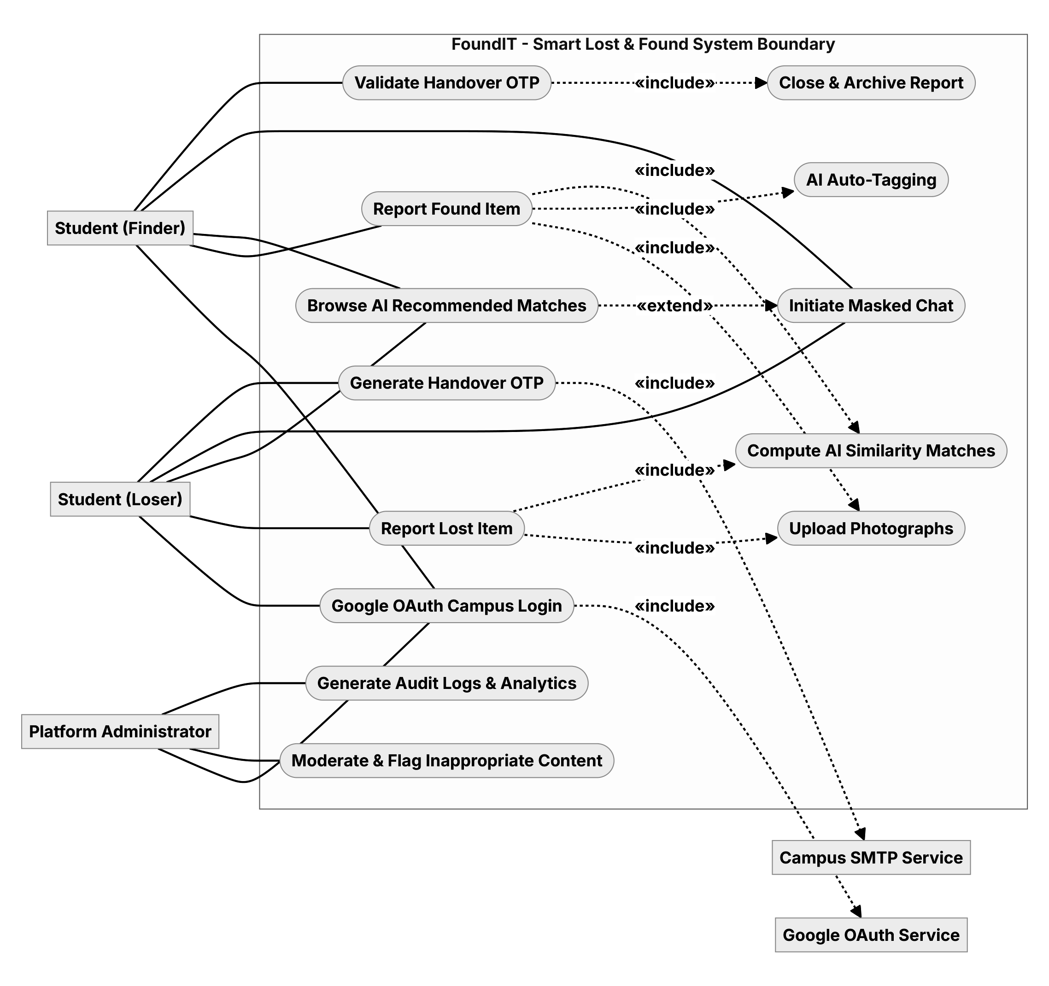
UML BEHAVIORAL SPECIFICATION
Diagram 01 | Use Case: Actor Roles & System Boundaries
Defines user interactions, system boundary, and functional dependencies within FoundIT.
1. Primary System Actors & Roles
• Student (Loser): Reports lost items, uploads photos, reviews recommendations, initiates masked chat, generates handover OTP.
• Student (Finder): Reports found items, confirms YOLO tags, interacts anonymously, validates handover OTP.
• Platform Administrator: Moderates flagged content, oversees user suspensions, generates compliance audit logs.
2. External Service Integrations
• Google OAuth 2.0: Institutional campus SSO gating («include» dependency for all portal logins).
• Campus SMTP Gateway: Automated email dispatch for match discoveries and OTP notification tokens.
3. Core Use Case Relationships
• Browse Matches → Masked Chat: «extend» relationship unlocked only when AI similarity score ≥ 75%.
• Item Intake → AI Inference: «include» dependency invoking image embedding and auto-tagging.
• Validate OTP → Archive Report: «include» dependency guaranteeing atomic report resolution.

Slide 4
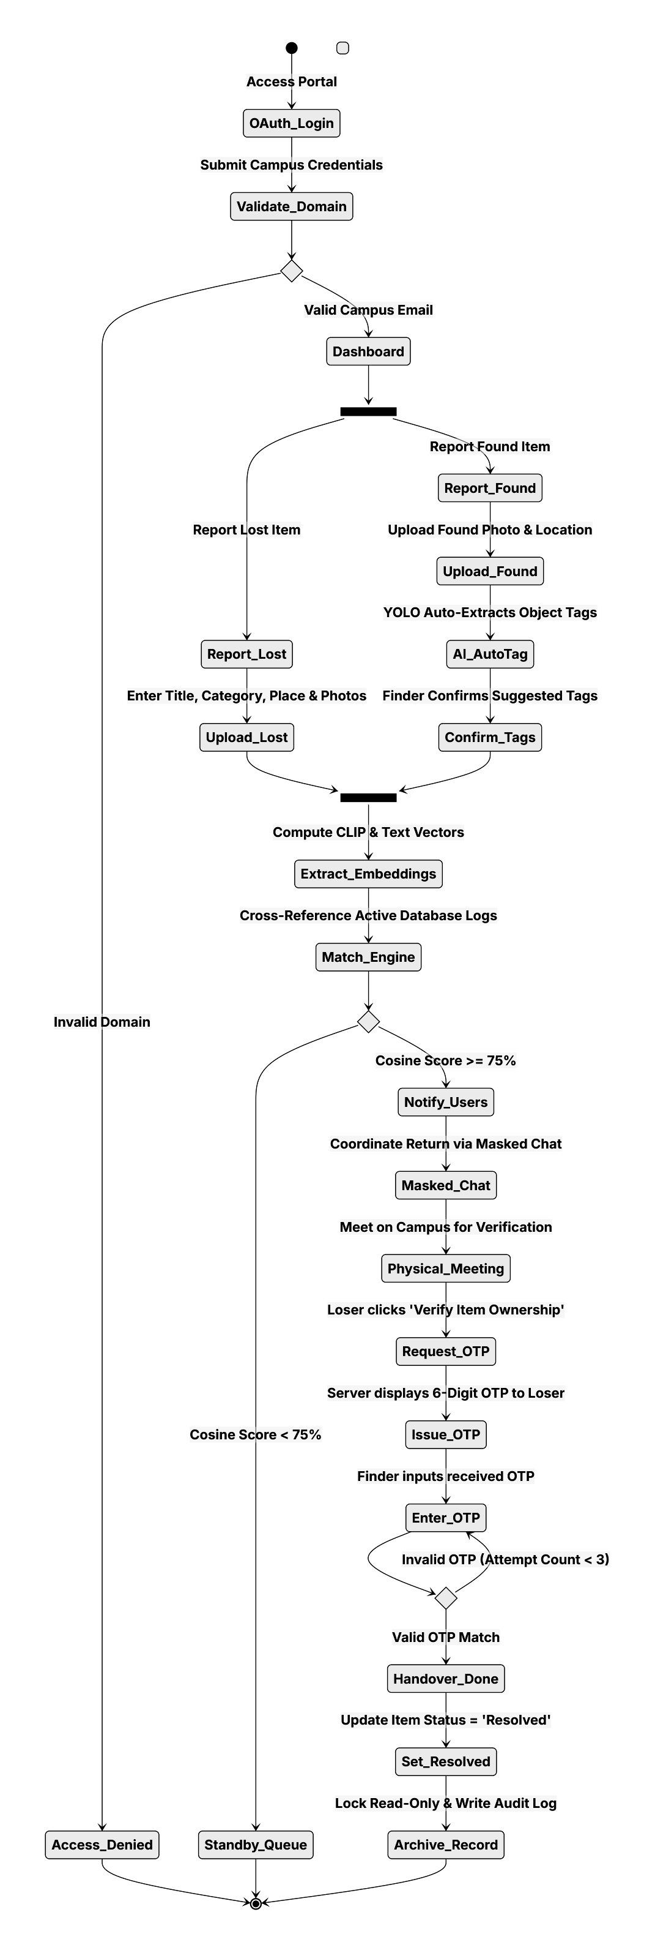
UML BEHAVIORAL SPECIFICATION
Diagram 02 | Activity: End-to-End Operational Lifecycle
Step-by-step logic from institutional authentication through AI matching to physical handover.
1. Authentication & Ingestion Branching
• Domain Gatekeeper: Validates university email format; invalid domains are rejected with Access_Denied.
• Dual-Path Intake: Segregated reporting flows for Lost (metadata + photos) vs. Found items.
2. Multi-Modal AI Pipeline Execution
• YOLOv8 Detection: Identifies object tags automatically, prompting finder to confirm or adjust tags.
• CLIP & Text Embeddings: Generates 512-dim visual and semantic vectors stored in MongoDB.
• Cosine Threshold (≥ 75%): Valid matches trigger immediate user alerts; low scores enter Standby_Queue.
3. Physical Verification & Resolution
• Masked Coordination: Anonymous WebSocket chat coordinates physical campus rendezvous point.
• Cryptographic Handover: Loser generates 6-digit OTP; finder submits code for hash comparison.
• Atomic Case Closure: Successful verification transitions status to 'Resolved' and writes audit record.

Slide 5
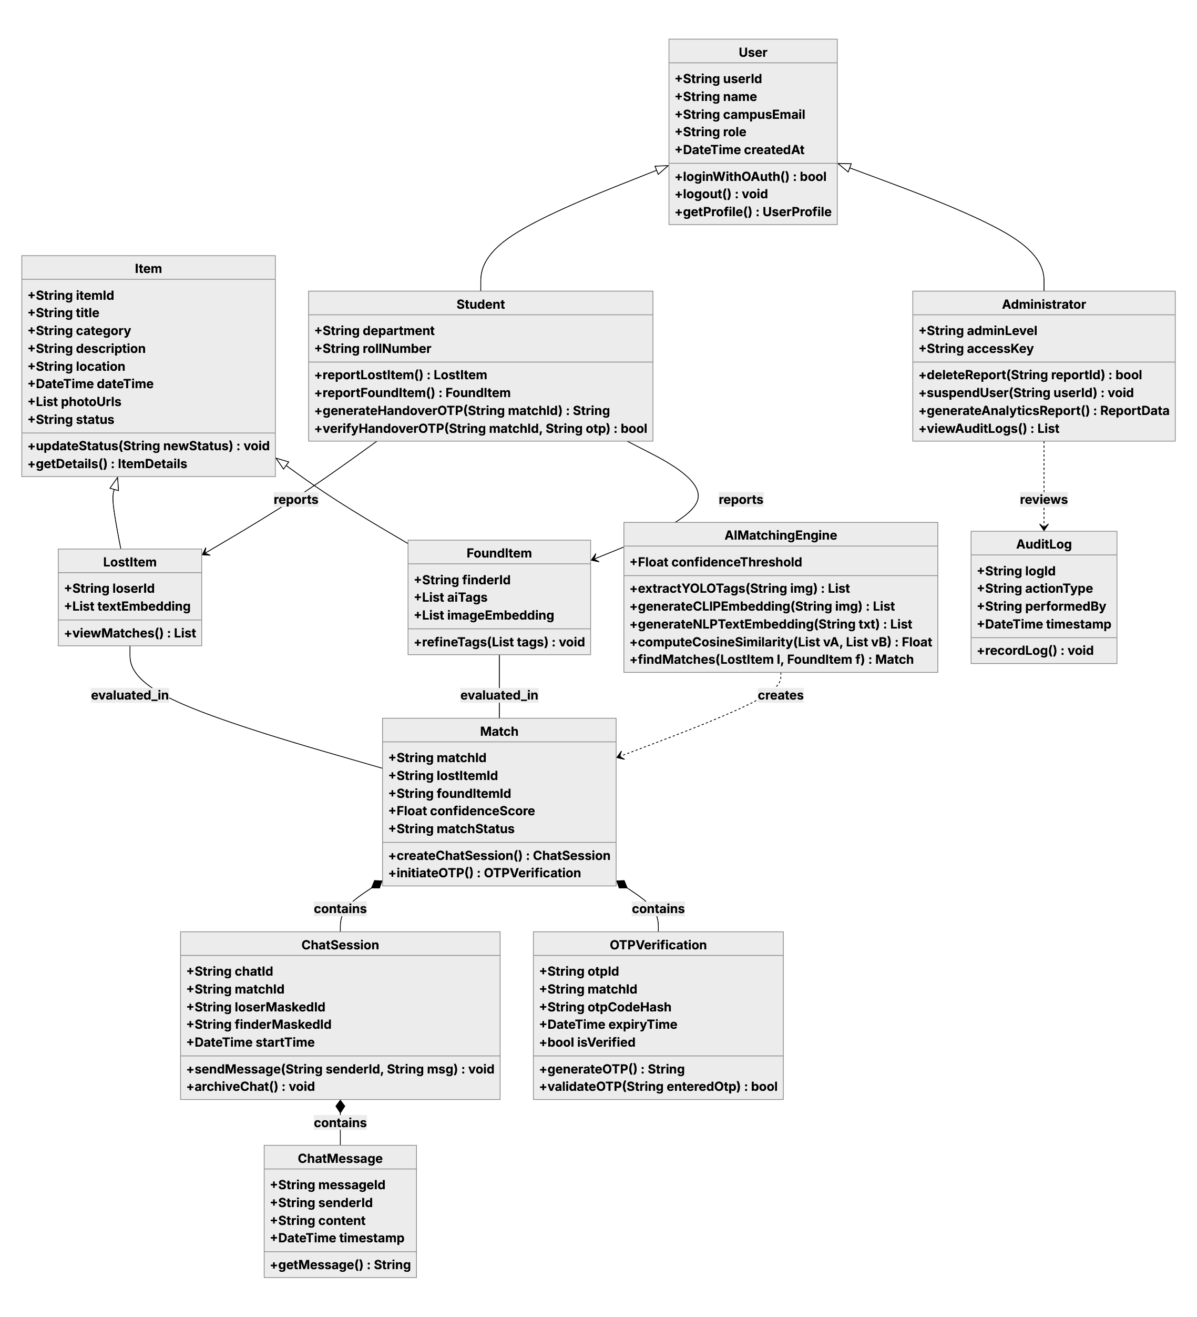
UML STRUCTURAL SPECIFICATION
Diagram 03 | Class Diagram: Domain Models & OOP Architecture
Object-oriented architecture illustrating domain entities, inheritance hierarchies, and method contracts.
1. User Inheritance Hierarchy
• User (Abstract Base): Defines userId, name, campusEmail, role, createdAt | loginWithOAuth(), logout().
• Student (Specialized): Adds department, rollNumber | reportLostItem(), reportFoundItem(), generateHandoverOTP().
• Administrator: Adds adminLevel, accessKey | deleteReport(), suspendUser(), generateAnalyticsReport().
2. Item Polymorphism & State Encapsulation
• Item (Base): Defines itemId, title, category, description, location, status | updateStatus().
• LostItem vs FoundItem: Lost items manage textEmbedding; Found items encapsulate aiTags & imageEmbedding.
3. Engine, Chat & Security Contracts
• AIMatchingEngine: Core inference methods extractYOLOTags(), generateCLIPEmbedding(), computeCosineSimilarity().
• ChatSession & Message: 1:N composite structure maintaining masked IDs and chronological timestamps.
• OTPVerification & AuditLog: Cryptographic token validation (validateOTP()) and immutable system auditing.

Slide 6
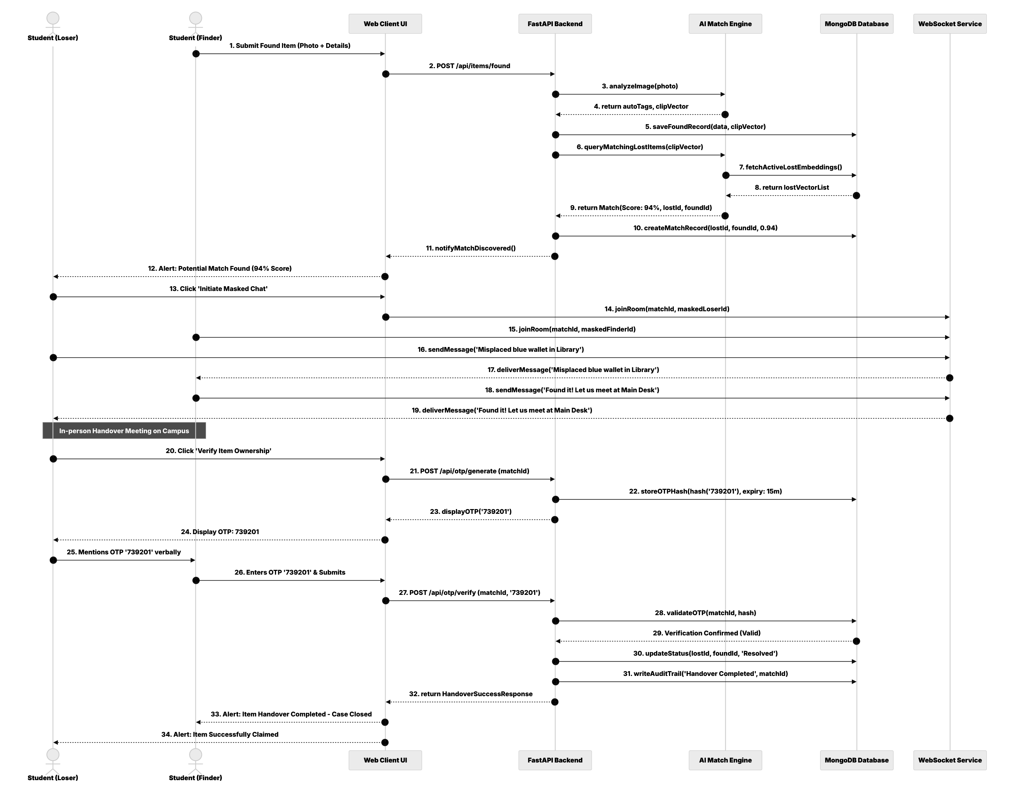
UML BEHAVIORAL SPECIFICATION
Diagram 04 | Sequence: 34-Step Match, Chat & Handover Flow
Chronological message sequencing across Web Client, FastAPI/Node Backend, AI Engine, MongoDB, and WebSockets.
Phase 1: Ingestion & AI Scoring (Steps 1–12)
• Found Submission: Finder posts item photo and metadata via POST /api/items/found.
• AI Inference: Backend triggers YOLO auto-tagging and generates 512-dim CLIP vectors.
• Cosine Discovery: Engine discovers active lost report matching with 94% similarity score.
• Dual Alerting: High-priority match notification banners dispatched to both student dashboards.
Phase 2: Masked WebSocket Chat (Steps 13–19)
• Room Initialization: Loser initiates chat; server creates room with maskedLoserId and maskedFinderId.
• Real-Time Messaging: WebSocket service delivers bi-directional messages across client UIs.
• Privacy Guarantee: Real names, emails, and phone numbers remain completely hidden.
• Handover Meeting: Students confirm item details and agree to meet in person at Main Desk.
Phase 3: OTP Handover & Resolution (Steps 20–34)
• OTP Generation: Loser clicks 'Verify Ownership' (POST /api/otp/generate); server yields code 739201.
• SHA-256 Storage: Token stored as cryptographic hash (15m TTL); displayed only on loser screen.
• Desk Verification: Finder enters verbal code (POST /api/otp/verify); server validates hash.
• Case Closure: Report marked 'Resolved', audit trail committed, and case closed.

Slide 7
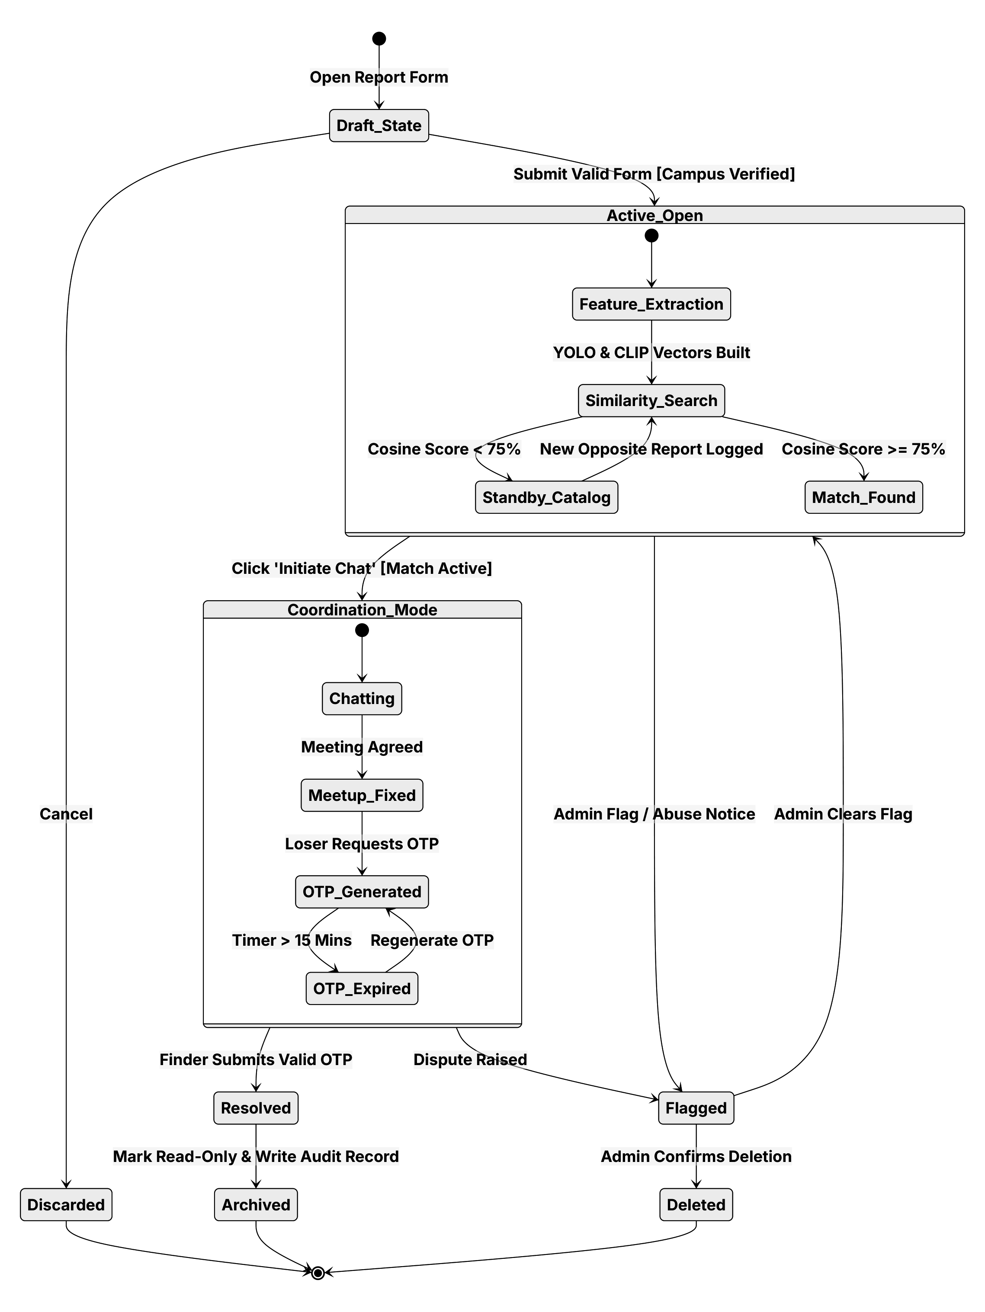
UML BEHAVIORAL SPECIFICATION
Diagram 05 | State Machine: Report & Claim Lifecycle
Finite state machine tracking item reports from draft creation to terminal resolution.
1. Ingestion & Search States
• Draft_State → Active_Open: Report form submitted with verified campus domain credentials.
• Feature_Extraction: Real-time visual extraction producing YOLO tags and CLIP embeddings.
• Similarity_Search: Vector engine cross-references active catalog records.
2. Matching & Discovery States
• Standby_Catalog: Entered if similarity score < 75%; awaits incoming counter-reports.
• Match_Found: Activated when cosine similarity ≥ 75%; unlocks mutual coordination mode.
3. Handover & Resolution States
• Chatting → Meetup_Fixed: Masked communication to coordinate physical handover meeting.
• OTP_Generated → Resolved: Loser creates challenge; valid OTP transitions status to 'Resolved'.
• OTP_Expired: Exceeding 15-minute TTL forces loser to regenerate challenge token.
4. Exception States
• Flagged → Deleted / Archived: Abuse reports trigger administrator moderation and audit recording.

Slide 8
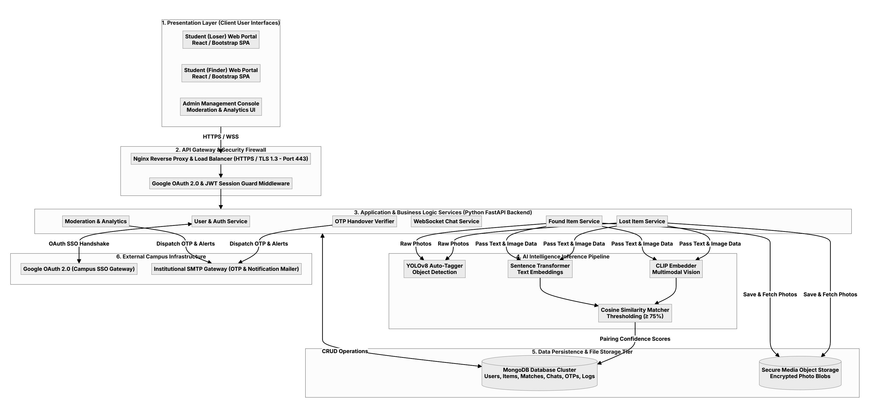
SYSTEM ARCHITECTURE SPECIFICATION
Diagram 06 | Architecture: 6-Tier Enterprise Topology
Multi-tier decoupled architecture spanning client SPAs, reverse proxy, microservices, AI inference, and storage.
Tiers 1 & 2: Presentation & Gateway
• Client Portals: Responsive Next.js 16 / React 19 SPAs for Loser, Finder, and Admin console.
• Reverse Proxy & SSL: Nginx reverse proxy and load balancer terminating TLS 1.3 on Port 443.
• Security Guard: Middleware enforcing Google OAuth 2.0 validation and JWT session guards.
Tiers 3 & 4: Application & AI Services
• Business Logic: User auth, lost/found services, WebSocket chat, and OTP verifier microservices.
• YOLOv8 Detection: Instant object detection extracting visual labels from uploaded photos.
• Multimodal Vectors: Sentence Transformers (text) + CLIP Embedder (visual) with ≥75% Cosine matcher.
Tiers 5 & 6: Data Persistence & Cloud
• MongoDB Cluster: Enterprise document store for users, items, matches, chats, OTPs, and logs.
• Object Storage: Encrypted media storage volume for high-resolution item photo blobs.
• External Gateways: Google Cloud OAuth 2.0 (Campus SSO) and Campus SMTP Gateway.

Slide 9
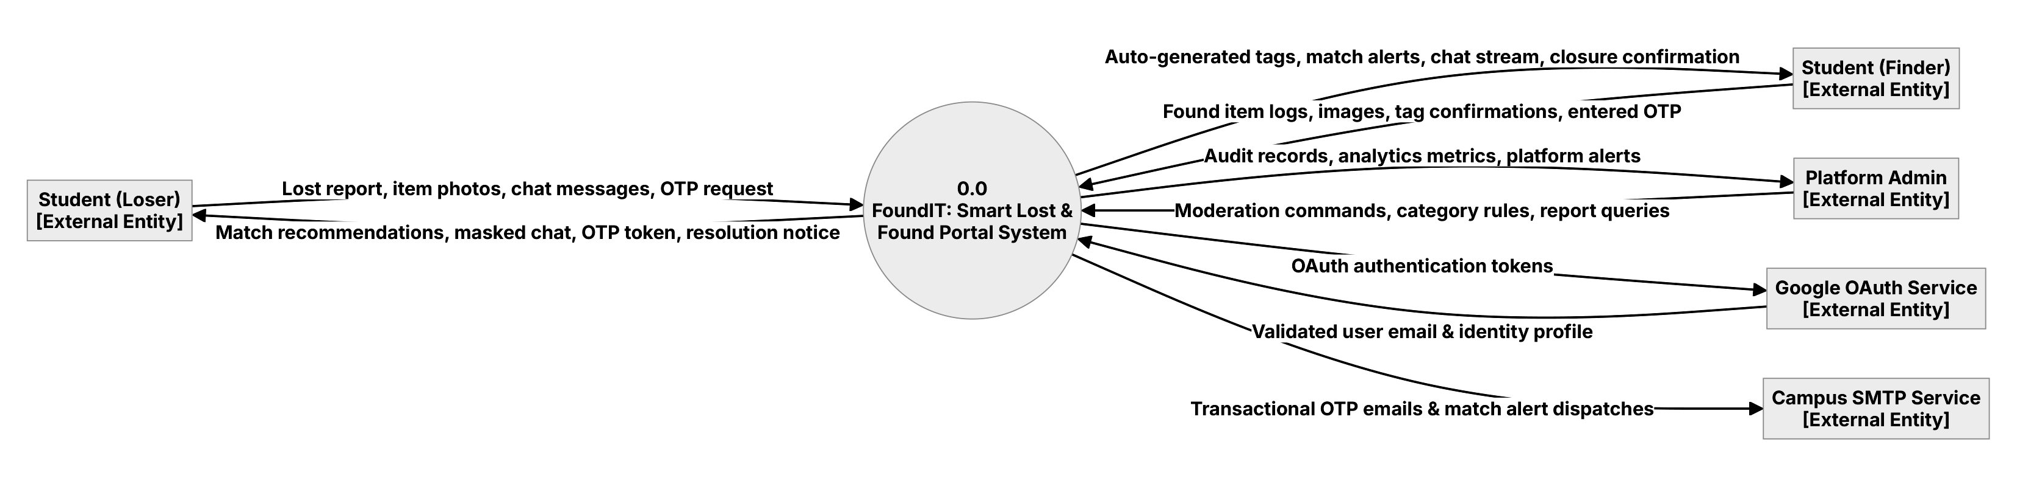
DATA FLOW SPECIFICATION (LEVEL 0)
Diagram 07 | DFD Level 0: Macro Context & External Boundaries
Top-level data boundaries between FoundIT System (0.0) and all external entities.
Student Actors (Loser & Finder)
• Loser Inflows / Outflows: Submits lost reports, photos, chat, OTP request; receives match alerts, masked chat, OTP token.
• Finder Inflows / Outflows: Submits found logs, images, tag confirmations, entered OTP; receives AI tags, match alerts, chat stream.
• Lifecycle Termination: Both parties receive mutual handover confirmation upon case closure.
Institutional Cloud Services
• Google OAuth Service: Exchanges OAuth tokens for validated campus email and user profile attributes.
• Campus SMTP Service: Dispatches automated transactional emails for match discoveries and OTP updates.
• Campus Network Guard: Restricts account creation strictly to authorized university domains.
Platform Administration
• Administrative Controls: Ingests moderation commands, category taxonomies, and audit report queries.
• System Monitoring: Emits immutable audit records, real-time analytics metrics, and abuse violation alerts.
• Security Governance: Provides full compliance oversight over disputed claims and suspended users.

Slide 10
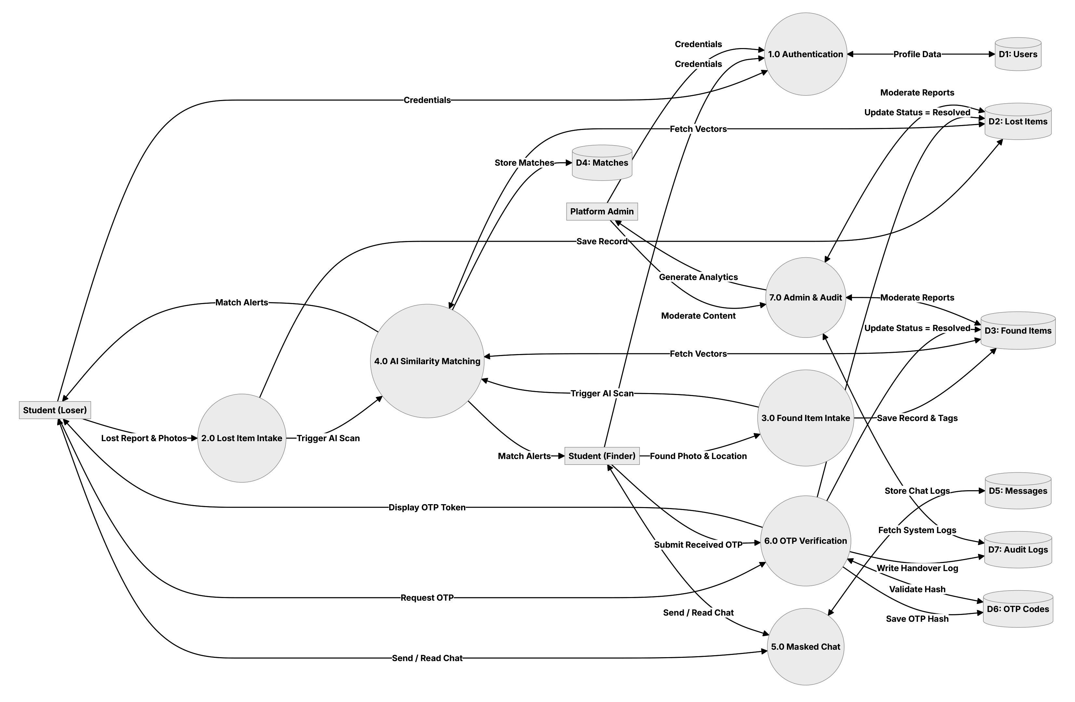
DATA FLOW SPECIFICATION (LEVEL 1)
Diagram 08 | DFD Level 1: System Subsystem Decomposition
Decomposition of FoundIT into seven functional processes and seven isolated data stores.
Intake & Identity (Processes 1.0–3.0)
• 1.0 Authentication: Verifies Google OAuth tokens and populates D1: Users store.
• 2.0 Lost Intake: Validates misplaced item forms and stores records in D2: Lost Items.
• 3.0 Found Intake: Processes found records, persists tags in D3: Found Items, and triggers AI scan.
AI & Coordination (Processes 4.0–6.0)
• 4.0 AI Matching Engine: Cross-references D2 and D3 vectors; writes pairings to D4: Matches.
• 5.0 Masked Chat: Powers anonymous bi-directional messaging stored in D5: Messages.
• 6.0 OTP Verification: Manages challenge tokens and cryptographic hashes in D6: OTP Codes.
Governance & Storage (Process 7.0)
• 7.0 Admin & Audit: Monitors platform health, executes moderation, and writes to D7: Audit Logs.
• Data Store Isolation: Strict boundary separation prevents cross-subsystem pollution and data corruption.
• Traceability: All report status transitions produce linked records in D4, D6, and D7.

Slide 11
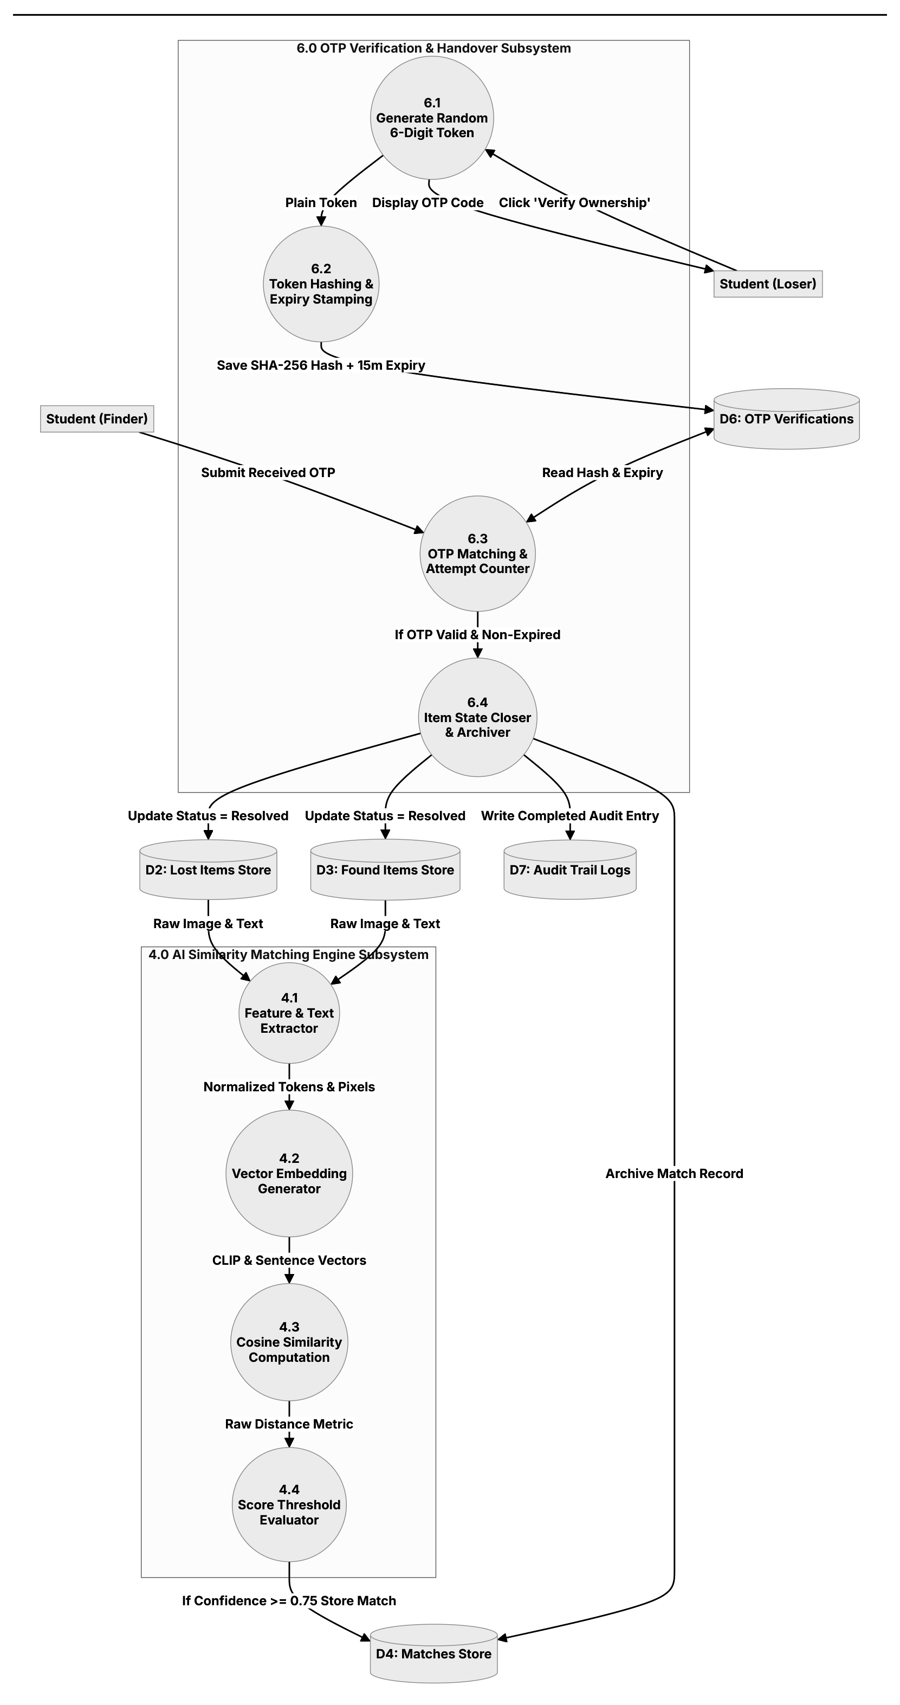
DATA FLOW SPECIFICATION (LEVEL 2)
Diagram 09 | DFD Level 2: AI Similarity & OTP Handover Engines
Detailed internal decomposition of Process 4.0 (AI Matching) and Process 6.0 (OTP Handover).
1. Subsystem 4.0: AI Similarity Engine
• 4.1 Feature Extractor: Tokenizes title/description and normalizes photo pixels.
• 4.2 Vector Generator: Computes 512-dim visual CLIP vectors and NLP sentence embeddings.
• 4.3 Cosine Computation: Measures angular distance between active lost and found vectors.
• 4.4 Threshold Evaluator: If score ≥ 0.75, writes pairing to D4: Matches and fires notifications.
2. Subsystem 6.0: OTP Verification Pipeline
• 6.1 Random Token Generator: Generates 6-digit cryptographically secure alphanumeric challenge.
• 6.2 Token Hashing & TTL: Computes SHA-256 hash, attaches 15m expiration, stores in D6: OTP Codes.
• 6.3 OTP Matching & Throttle: Compares received token with hash; tracks failed attempt count.
• 6.4 State Closer & Archiver: Atomically locks item as 'Resolved' and commits audit record to D7.

Slide 12
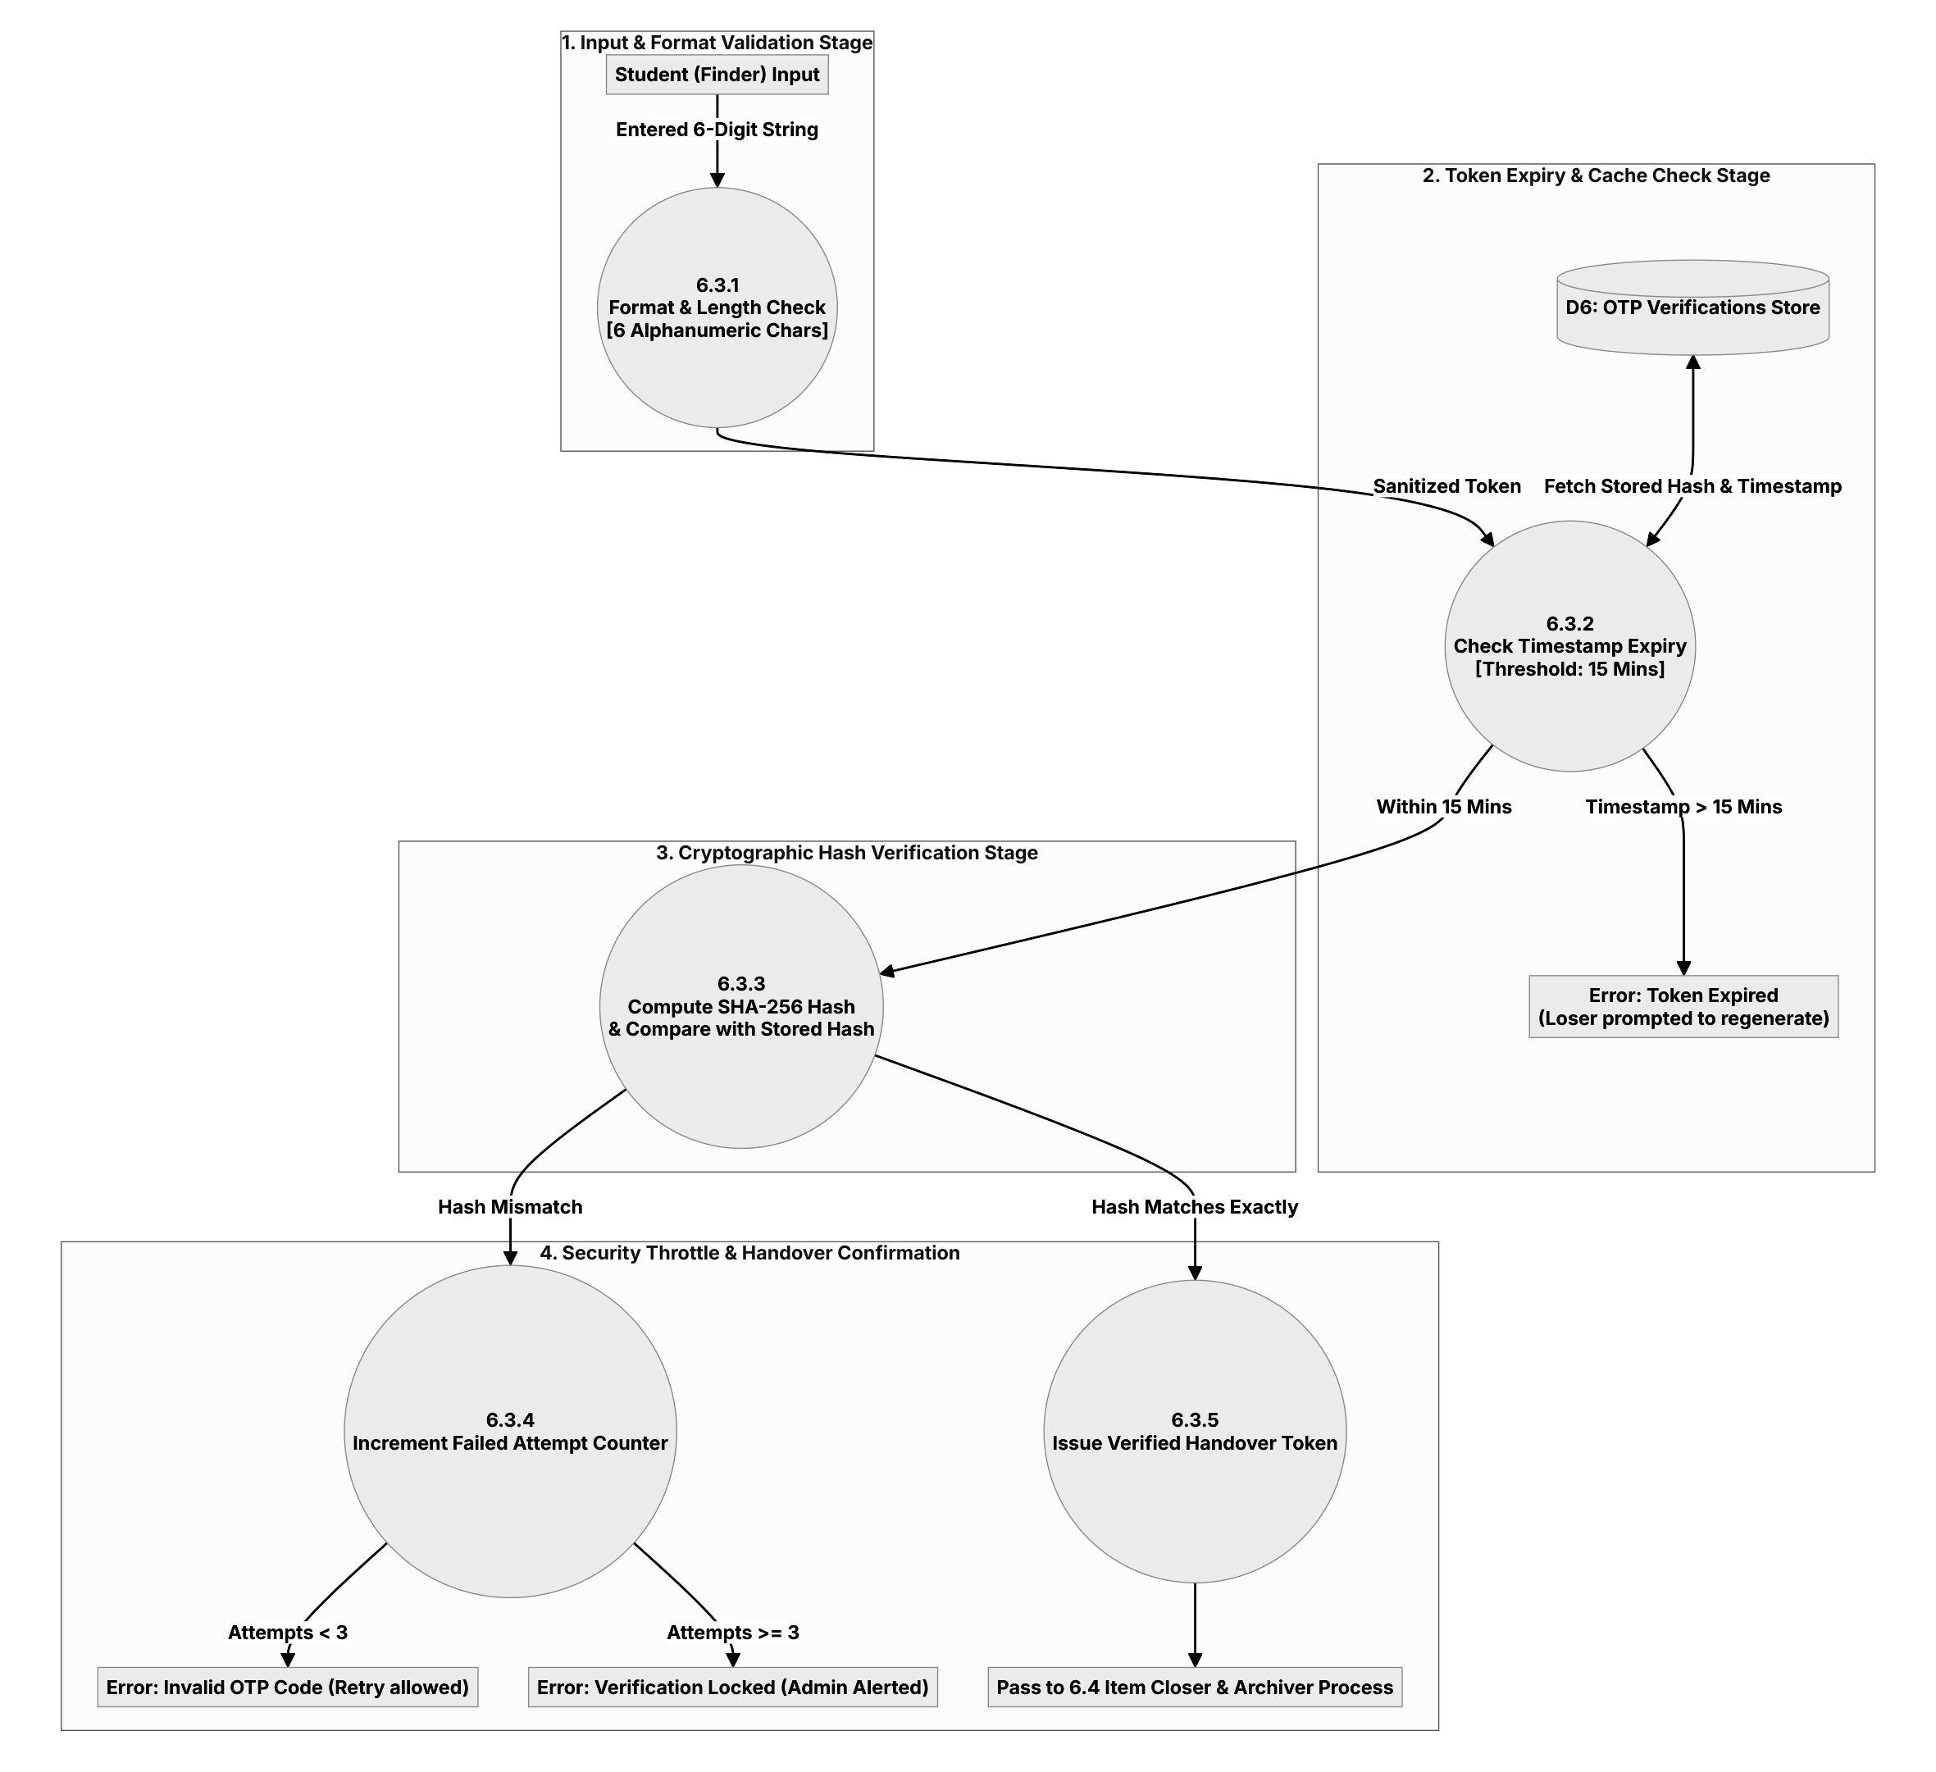
DATA FLOW SPECIFICATION (LEVEL 3)
Diagram 10 | DFD Level 3: Cryptographic OTP Verification Engine
Micro-level 4-stage security inspection pipeline governing item claim verification.
Stages 1 & 2: Input & TTL Check
• 6.3.1 Format & Length: Enforces strict 6-character length and alphanumeric character mask.
• 6.3.2 Expiry Validation: Queries D6; verifies timestamp within 15-minute TTL window.
• Timeout Handling: If elapsed time > 15m, rejects with Error: Token Expired (prompts regeneration).
Stage 3: Cryptographic Hashing
• 6.3.3 SHA-256 Computation: Hashes incoming token and compares with stored cryptographic digest.
• Timing Attack Resistance: Uses constant-time string comparison to prevent side-channel exploits.
• Branching Logic: Routes seamlessly into Mismatch Handler vs. Verification Confirmation.
Stage 4: Throttle & Confirmation
• 6.3.4 Security Throttle: Mismatch increments failure counter. Retries permitted up to 3 attempts.
• Lockout Defense: At ≥ 3 failed attempts, locks verification and generates administrator security alert.
• 6.3.5 Verification Success: Emits handover confirmation token and triggers 6.4 Item Archiver.

Slide 13
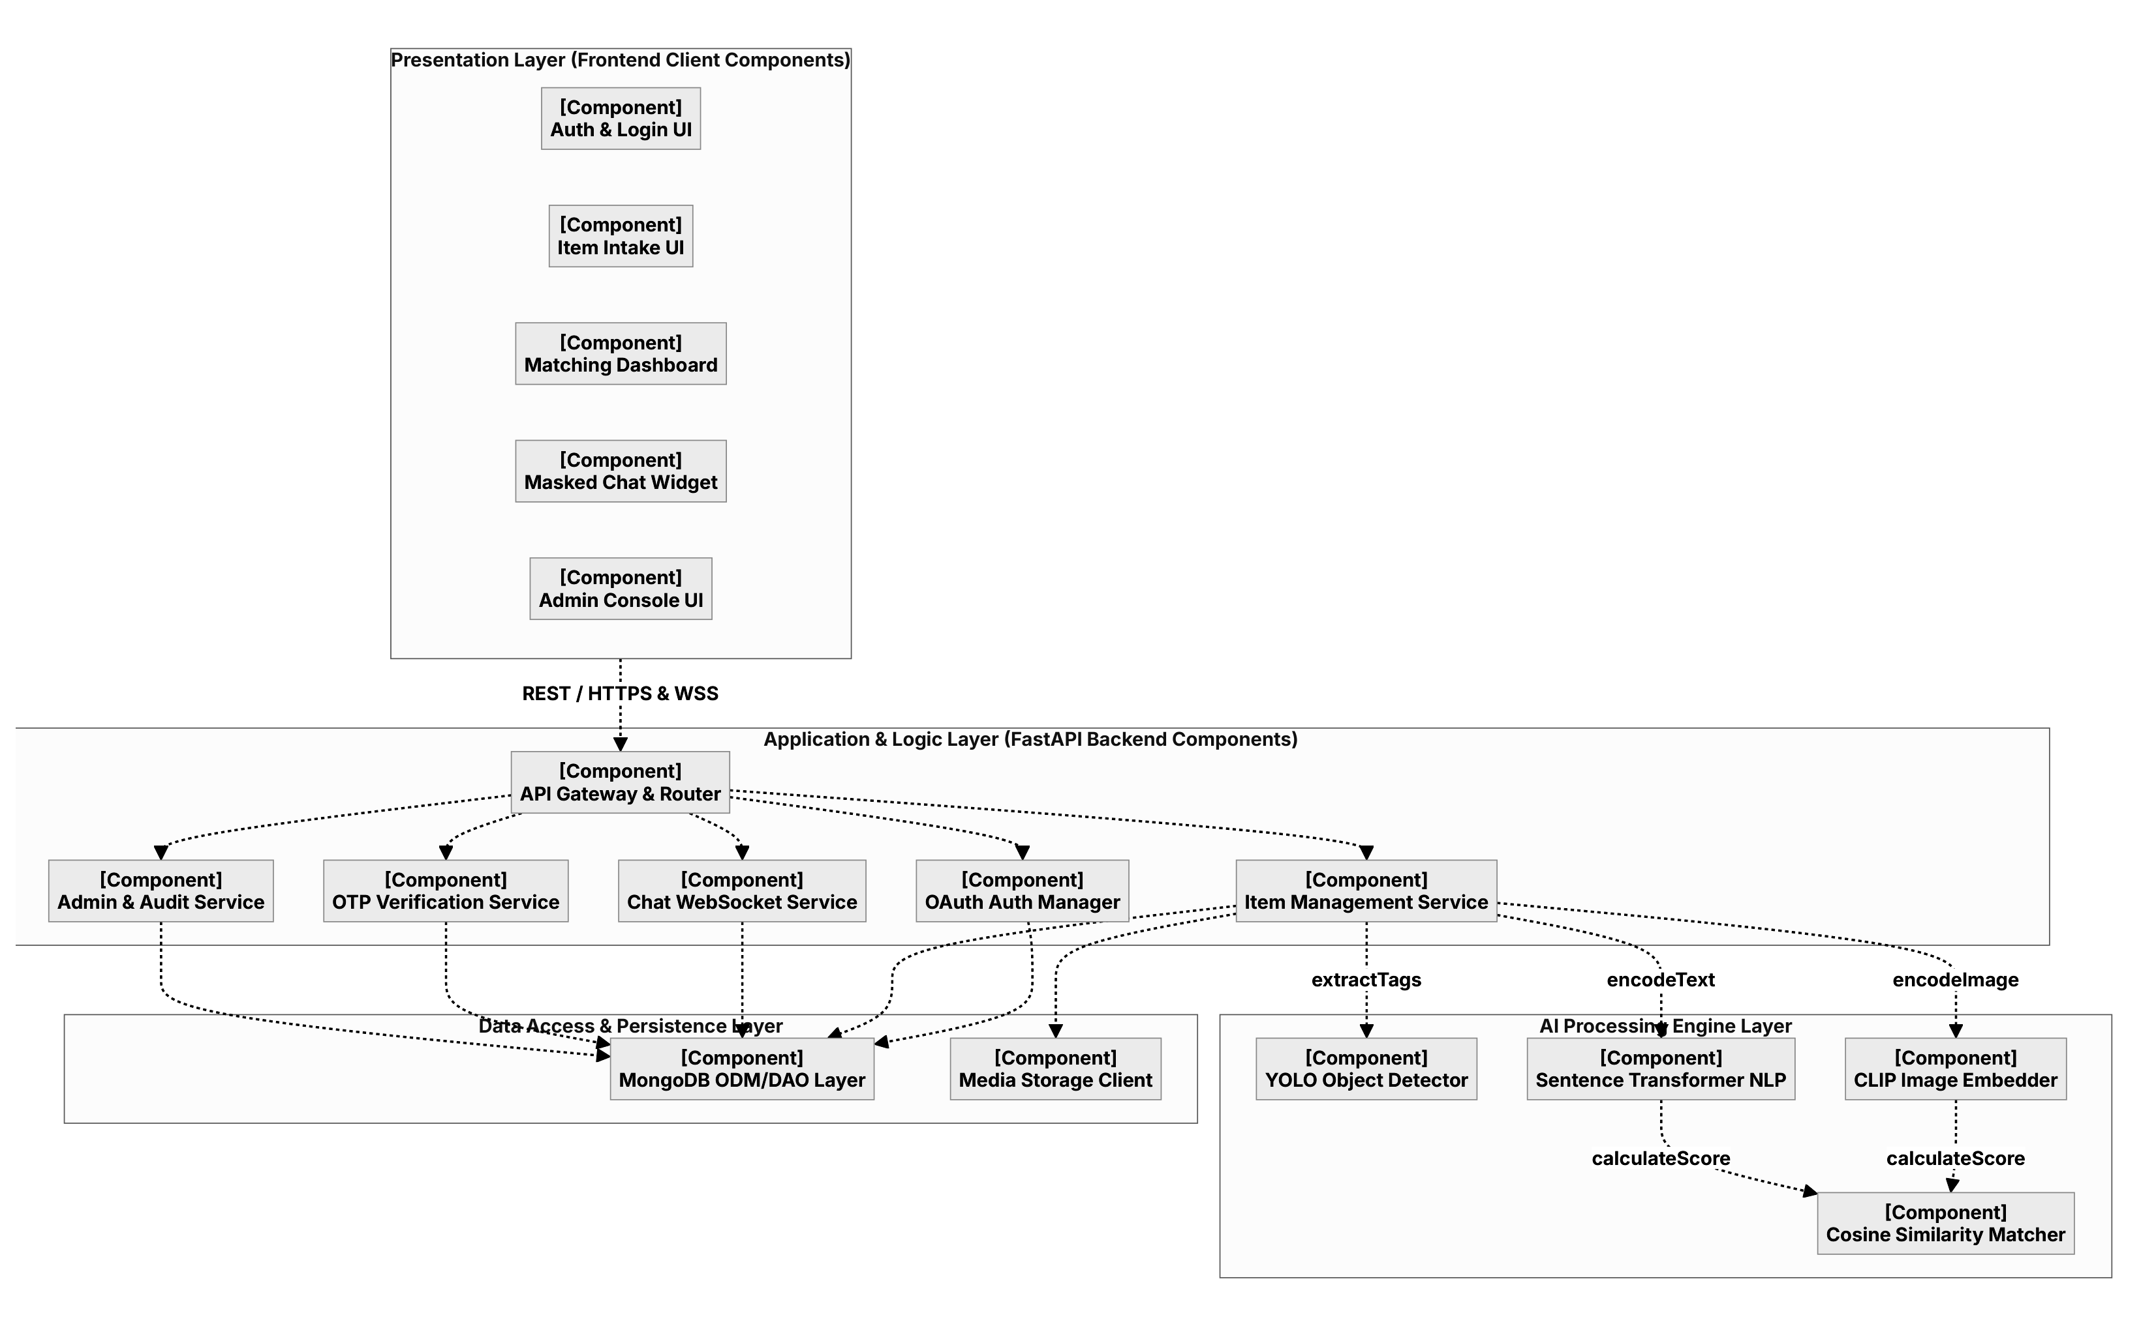
UML STRUCTURAL SPECIFICATION
Diagram 11 | Component: Layered Service Contracts & Ports
Structural decomposition illustrating decoupled UI modules, backend controllers, and AI pipelines.
Presentation Client Layer
• Auth & Login UI: Manages Google OAuth 2.0 redirects, token capture, and session hydration.
• Item Intake & Dashboard: Interactive forms with client Canvas image preprocessing and match feeds.
• Masked Chat & Admin Console: Real-time WebSocket widget and administrative moderation interface.
Application & Logic Services
• API Gateway & Router: Dispatches incoming REST endpoints (/api/reports, /api/handover) and WSS routes.
• Core Services: Item Management, Chat WebSocket Service, OTP Verifier, and Admin Auditing.
• Decoupled Contracts: Clean interfaces isolate business logic from database schema changes.
AI Engine & Data Access
• AI Inference Components: YOLO Object Detector (extractTags), CLIP Embedder (encodeImage), Cosine Matcher.
• Data Access Layer: MongoDB ODM/DAO managing typed Mongoose schemas and queries.
• Media Storage Client: Secure signed storage handler for high-resolution item photo blobs.

Slide 14
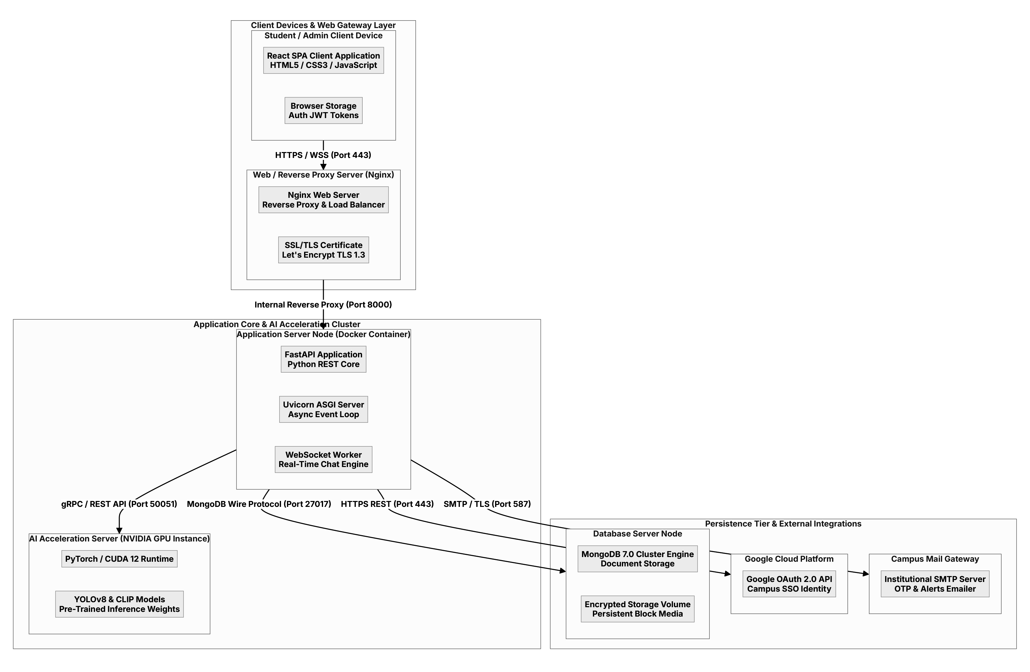
UML STRUCTURAL SPECIFICATION
Diagram 12 | Deployment: Physical Topology & Network Protocols
Hardware execution environment, container orchestration, network ports, and security protocols.
Client Tier & Web Gateway (Port 443)
• Client Devices: Modern student/admin web browsers running responsive React SPA; JWT auth storage.
• Nginx Reverse Proxy: Edge reverse proxy and load balancer terminating TLS 1.3 (Port 443 HTTPS/WSS).
• Internal Proxying: Upstream forward to application container on internal Port 8000.
Application Core & AI GPU Cluster
• Application Server: Docker container running FastAPI / Node.js 24 with Uvicorn ASGI event loop.
• Real-Time Engine: WebSocket worker handling concurrency for live anonymous messaging.
• AI Acceleration Node: Dedicated NVIDIA GPU running PyTorch/CUDA 12 for YOLOv8 & CLIP (Port 50051).
Persistence Tier & External Cloud
• MongoDB Database Server: Enterprise MongoDB 7.0 replica cluster running on Port 27017 with encrypted EBS.
• Google Cloud Platform: OAuth 2.0 API gateway for zero-trust institutional identity validation.
• Campus Mail Gateway: SMTP server with TLS on Port 587 for OTP codes and match notifications.

Slide 15
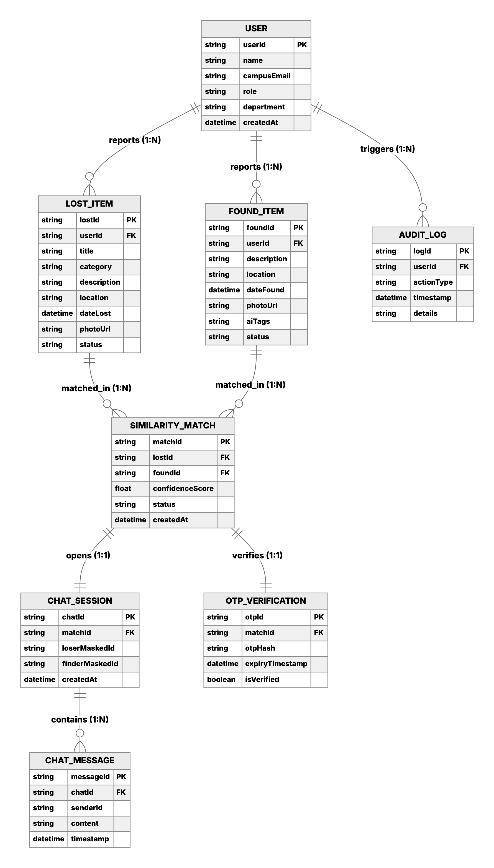
DATABASE SCHEMA SPECIFICATION
Diagram 13 | ER Diagram: Relational Data Schema & Integrity
Complete entity-relationship blueprint showing 8 collections, keys, and cardinalities.
1. Core User & Item Entities
• USER: userId (PK), name, campusEmail, role, department, createdAt.
• LOST_ITEM: lostId (PK), userId (FK), title, category, description, location, dateLost, status.
• FOUND_ITEM: foundId (PK), userId (FK), description, location, dateFound, photoUrl, aiTags, status.
2. Relational Cardinalities
• USER → LOST_ITEM / FOUND_ITEM: 1 : N (One user reports multiple lost or found items).
• LOST_ITEM & FOUND_ITEM → SIMILARITY_MATCH: 1 : N (Items evaluated across match candidates).
• SIMILARITY_MATCH → CHAT_SESSION: 1 : 1 (One private chat room per discovered pairing).
• CHAT_SESSION → CHAT_MESSAGE: 1 : N (One chat room contains multiple ordered messages).
• SIMILARITY_MATCH → OTP_VERIFICATION: 1 : 1 (One cryptographic challenge per matched claim).
3. Security & Audit Entities
• OTP_VERIFICATION: Stores otpHash and expiryTimestamp; never stores raw cleartext codes.
• AUDIT_LOG: Immutable record capturing logId, userId (FK), actionType, timestamp, details.

Slide 16
TECHNICAL SYNTHESIS & REVIEW
FoundIT: Production Stack & Engineering Guarantees
Synthesis of full-stack implementations, architectural decisions, and enterprise security guarantees.
FULL-STACK ARCHITECTURE
Next.js 16 + React 19 + TypeScript
• Unified App Router: Next.js 16 (Turbopack) consolidates React 19 SSR and serverless Node.js 24 API routes.
• Strict Type Safety: TypeScript 5 eliminates runtime anomalies across database payloads and OAuth sessions.
• Tailwind CSS v4: Utility-first responsive styling with clean light-theme contrast ratios.
INTELLIGENCE PIPELINE
Multi-Modal AI Recommendation Engine
• HTML5 Canvas Feature Extractor: Client-side spatial luminance grid & color histogram generation.
• YOLOv8 + CLIP Embedder: Multimodal computer vision identifying objects and mapping high-dimensional vectors.
• Cosine Similarity Thresholding: Real-time vector scoring (≥ 75%) immediately linking lost and found catalog records.
SECURITY & PRIVACY
Zero-Knowledge Cryptographic Handover
• Masked Chat Identity: Anonymized WebSocket UUIDs shield personal phone and contact details.
• SHA-256 OTP Verification: One-time tokens stored only as cryptographic hashes with 15-minute TTL.
• Brute-Force Throttle: 3-attempt maximum lockout policy automatically triggers platform administrator alerts.
PERSISTENCE & AUDIT
MongoDB Enterprise Data Architecture
• 8 Segregated Schemas: High-performance document modeling for users, items, matches, chats, and OTPs.
• Atomic State Locking: Handover completion automatically converts reports to immutable read-only records.
• Comprehensive Audit Trail: Dedicated D7 store recording every administrative action and resolved claim.

