Slide 1

Domain: Python
Technology: Artificial Intelligence
DEEP LEARNING BASED CAT BREED CLASSIFICATION
<Name of the Students>

Slide 2
Index
Abstract
Introduction
Literature review
Existing Method
Drawbacks
Proposed method
Advantages
Implementation
Algorithms
Hardware and Software Requirements
Architecture
UML diagrams
Results
Conclusion
References

Slide 3
Abstract:
The automatic classification of animal images is an onerous task due to the challenging image conditions, especially when it comes to animal breeds. In this paper, we built a model based on Convolutional Neural Network (CNN) of deep learning that which can classify the cat breeds. We are mainly considering the CNN based transfer learning that which is used to train the dataset of cat breed and based on this training we can classify the cat breeds.
Keywords: Cat Breed, Classification, Deep Learning, CNN

Slide 4
Introduction:
The cat (Felis catus) is a domestic species of small carnivorous mammal. It is the only domesticated species in the family Felidae and is often referred to as the domestic cat to distinguish it from the wild members of the family. A cat can either be a house cat, a farm cat or a feral cat; the latter ranges freely and avoids human contact. Domestic cats are valued by humans for companionship and their ability to hunt rodents. About 60 cat breeds are recognized by various cat registries.
The cat is similar in anatomy to the other felid species: it has a strong flexible body, quick reflexes, sharp teeth and retractable claws adapted to killing small prey. Its night vision and sense of smell are well developed. Cat communication includes vocalizations like meowing, purring, trilling, hissing, growling and grunting as well as cat-specific body language. A predator that is most active at dawn and dusk, the cat is a solitary hunter but a social species. It can hear sounds too faint or too high in frequency for human ears, such as those made by mice and other small mammals. It secretes and perceives pheromones.

Slide 5
Introduction:
Image classification is a procedure to automatically categorize all pixels in an image of a terrain into land cover classes. Normally, multispectral data are used to perform the classification of the spectral pattern present within the data for each pixel is used as the numerical basis for categorization. This concept is dealt under the broad subject, namely, Pattern Recognition. Spectral pattern recognition refers to the family of classification procedures that utilizes this pixel-by-pixel spectral information as the basis for automated land cover classification. Spatial pattern recognition involves the categorization of image pixels on the basis of the spatial relationship with pixels surrounding them. Image classification techniques are grouped into two types, namely supervised and unsupervised. The classification process may also include features, such as, land surface elevation and the soil type that are not derived from the image. A pattern is thus a set of measurements on the chosen features for the individual to be classified. The classification process may therefore be considered a form of pattern recognition, that is, the identification of the pattern associated with each pixel position in an image in terms of the characteristics of the objects or on the earth's surface.

Slide 6
Literature Review:
S. No | Journal Type with year | Authors | Title | Outcomes
1 | Ecological Inform., vol. 52, Jul. 2019, pp. 57–68. | A. Ahmeda, H. Yousifa, R. Kaysb, and Z. Hea | ‘Semantic region of interest and species classification in the deep neural network feature domain | Classified Semantic region of interest and species
2 | ’ Int. J. Comput. Visions, vol. 127, no. 365, pp. 1–13, Jan. 2019 | B. Kong, J. Supanci˘ c, D. Ramanan, and C. C. Fowlkes | ‘Cross-domain ˘ image matching with deep feature maps | image matching with deep feature maps
3 | ’ IEEE Access. vol. 7, pp. 59728–59736, 2019. | M. Zhanyu, Y. Ding, S. Wen, J. Xie, Y. Jin, Z. Si, and H. Wang | Shoeprint image retrieval with multi-part weighted CNN | Shoeprint image retrieval
4 | in Proc. Int. Conf. Comput. Vis. (ICCV), Dec. 2013, pp. 1641–1648 | L. Xie, Q. Tian, R. Hong, S. Yan, and B. Zhang | Hierarchical part matching for fine-grained visual categorization | visual categorization

Slide 7
Existing Method:
This model emphasizes an existing method that which is designed using the ANN algorithm of deep learning. As the automatic classification of animal images is a difficult task due to the challenging image conditions, and therefore its detection and analysis methods should be improved. Where, the classification of animal breeds is important to recognize for which ANN is used that which can classify the animal breeds and mainly for the cat breeds.

Slide 8
Disadvantages in Existing Method:
• Less feature compatibility
• Fixed size input and output
• Low accuracy

Slide 9
Proposed Method:
IIn our proposed method we are performing the cat breed classification using convolution neural network (CNN) of deep learning. The automatic classification of animal images is an onerous task due to the challenging image conditions, especially when it comes to animal breeds. In this paper, we built a model based on Convolutional Neural Network (CNN) of deep learning, where we are using the transfer learning method (MobileNet) that which can classify the cat breeds. We are mainly considering the CNN based transfer learning that which is used to train the dataset of cat breed and based on this training we can classify the cat breeds. The block diagram of the proposed method is shown in below figure.

Slide 10
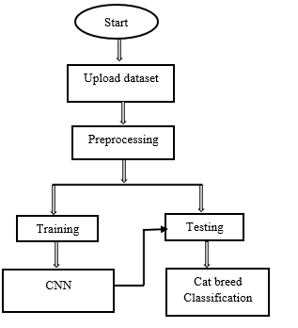
Proposed Method:
Block diagram of proposed method

Slide 11
Advantages of Proposed Method:
• Accurate classification
• Less complexity
• High performance

Slide 12
Implementation
System:
Takes the data
Preprocessing the dataset
Training
User:
Registration
Login into website
Cat Breed Classification
Logout

Slide 13
Algorithm:
CNN:
In deep learning, a convolutional neural network (CNN, or ConvNet) is a class of deep neural networks, most commonly applied to analyzing visual imagery.
A convolutional neural network consists of an input layer, hidden layers and an output layer. In any feed-forward neural network, any middle layers are called hidden because their inputs and outputs are masked by the activation function and final convolution. In a convolutional neural network, the hidden layers include layers that perform convolutions. Typically this includes a layer that does multiplication or other dot product, and its activation function is commonly ReLU. This is followed by other convolution layers such as pooling layers, fully connected layers and normalization layers.

Slide 14
Hardware & Software Requirements:
H/W Configuration:
• Processor - I3/Intel Processor
• Hard Disk -160GB
• RAM - 8Gb
S/W Configuration:
• Operating System : Windows 7/8/10 .
• Server side Script : HTML, CSS & JS.
• IDE : Pycharm.
• Libraries Used : Numpy, IO, OS, Flask, keras.
• Technology : Python 3.6+.

Slide 15
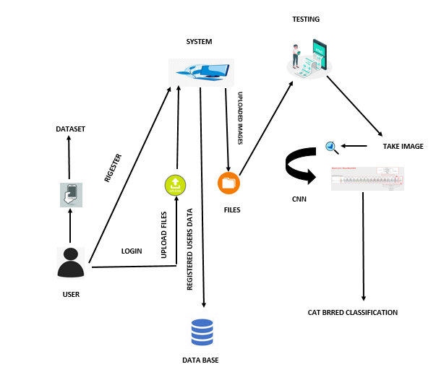
Architecture:

Slide 16
Use Case Diagram
A use case diagram in the Unified Modeling Language (UML) is a type of behavioral diagram defined by and created from a Use-case analysis. Its purpose is to present a graphical overview of the functionality provided by a system in terms of actors, their goals (represented as use cases), and any dependencies between those use cases. The main purpose of a use case diagram is to show what system functions are performed for which actor. Roles of the actors in the system can be depicted.

Slide 17
Use Case Diagram

Slide 18
Class Diagram
In software engineering, a class diagram in the Unified Modeling Language (UML) is a type of static structure diagram that describes the structure of a system by showing the system's classes, their attributes, operations (or methods), and the relationships among the classes. It explains which class contains information.

Slide 19
Sequence Diagram
A sequence diagram in Unified Modeling Language (UML) is a kind of interaction diagram that shows how processes operate with one another and in what order. It is a construct of a Message Sequence Chart. Sequence diagrams are sometimes called event diagrams, event scenarios, and timing diagrams.

Slide 21
Collaboration Diagram
In collaboration diagram the method call sequence is indicated by some numbering technique as shown below. The number indicates how the methods are called one after another. We have taken the same order management system to describe the collaboration diagram. The method calls are similar to that of a sequence diagram. But the difference is that the sequence diagram does not describe the object organization where as the collaboration diagram shows the object organization.

Slide 23
Deployment Diagram
Deployment diagram represents the deployment view of a system. It is related to the component diagram. Because the components are deployed using the deployment diagrams. A deployment diagram consists of nodes. Nodes are nothing but physical hardware used to deploy the application.

Slide 24
Activity Diagram
Activity diagrams are graphical representations of workflows of stepwise activities and actions with support for choice, iteration and concurrency.
In the Unified Modeling Language, activity diagrams can be used to describe the business and operational step-by-step workflows of components in a system.
An activity diagram shows the overall flow of control.

Slide 26
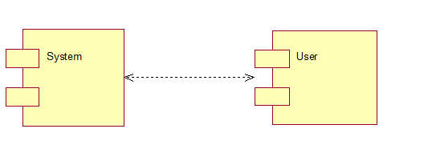
Component Diagram
A component diagram, also known as a UML component diagram, describes the organization and wiring of the physical components in a system. Component diagrams are often drawn to help model implementation details and double-check that every aspect of the system's required functions is covered by planned development.

Slide 27
ER Diagram:
An Entity–relationship model (ER model) describes the structure of a database with the help of a diagram, which is known as Entity Relationship Diagram (ER Diagram). An ER model is a design or blueprint of a database that can later be implemented as a database. The main components of E-R model are: entity set and relationship set.
An ER diagram shows the relationship among entity sets. An entity set is a group of similar entities and these entities can have attributes. In terms of DBMS, an entity is a table or attribute of a table in database, so by showing relationship among tables and their attributes, ER diagram shows the complete logical structure of a database. Let’s have a look at a simple ER diagram to understand this concept.

Slide 28
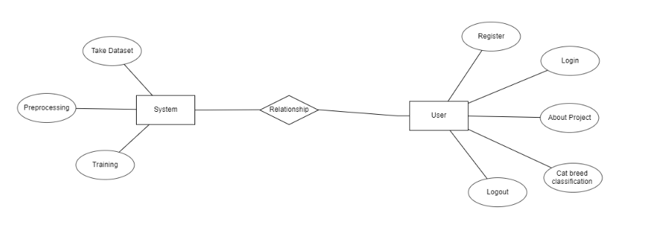

Slide 29
DFD Diagram
A Data Flow Diagram (DFD) is a traditional way to visualize the information flows within a system. A neat and clear DFD can depict a good amount of the system requirements graphically. It can be manual, automated, or a combination of both. It shows how information enters and leaves the system, what changes the information and where information is stored. The purpose of a DFD is to show the scope and boundaries of a system as a whole. It may be used as a communications tool between a systems analyst and any person who plays a part in the system that acts as the starting point for redesigning a system.

Slide 30
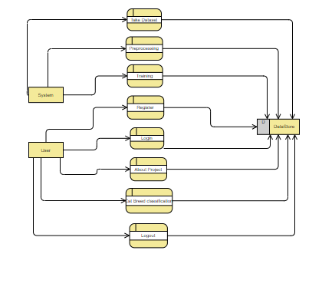

Slide 31
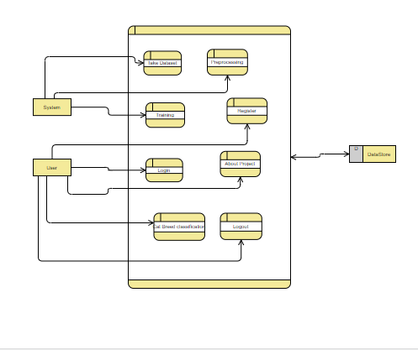

Slide 32
Results
In this application, we have considered the dataset of cat breed images and trained using CNN algorithm.
In the testing the image is uploaded and the image is classified.

Slide 33
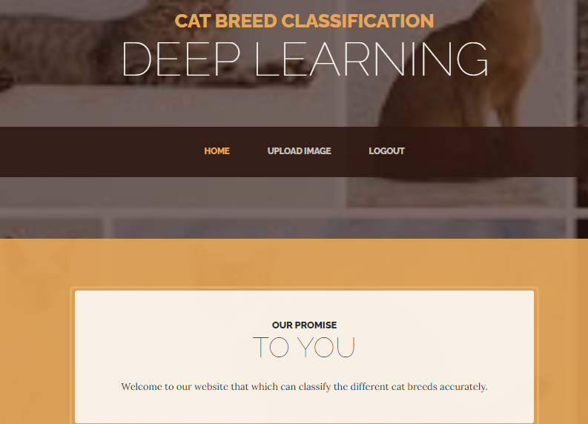
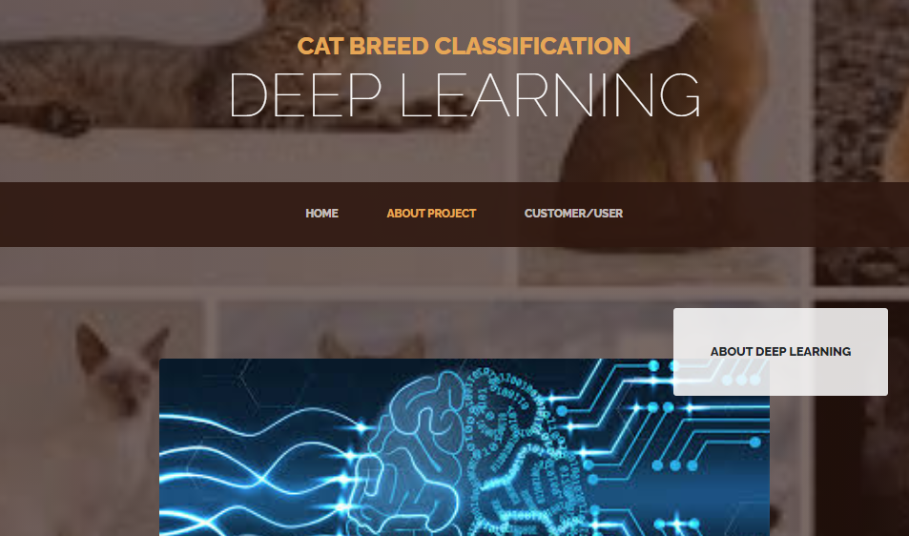
Results:
Home Page
About Project

Slide 34
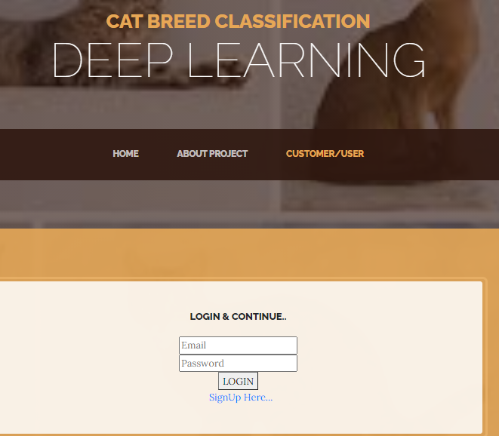
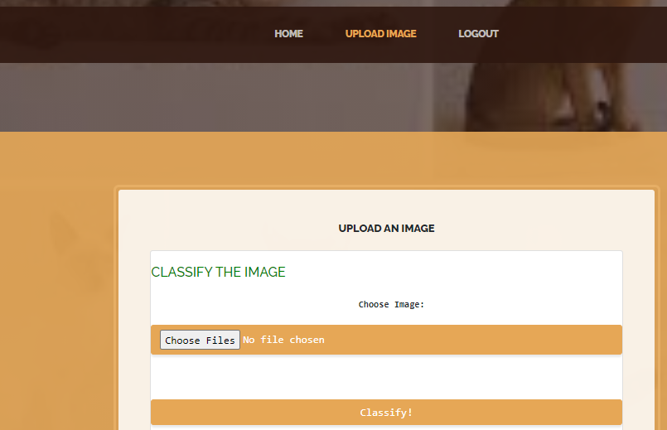
Results and Discussions:
Login page
Image Uploading

Slide 35
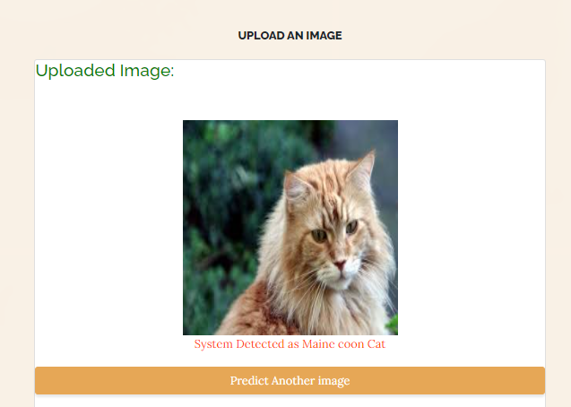
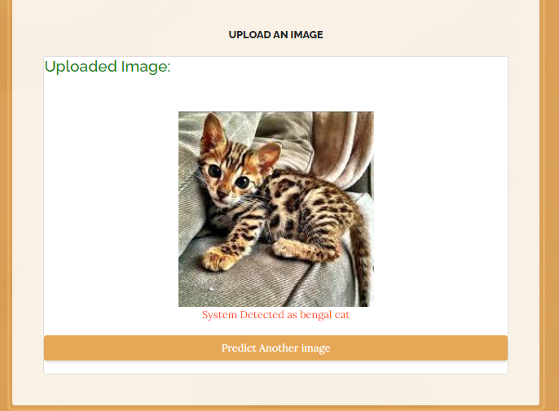
Results and Discussions:
Image Classified as Maine Coon Cat
Image Classified as Bengal Cat

Slide 36
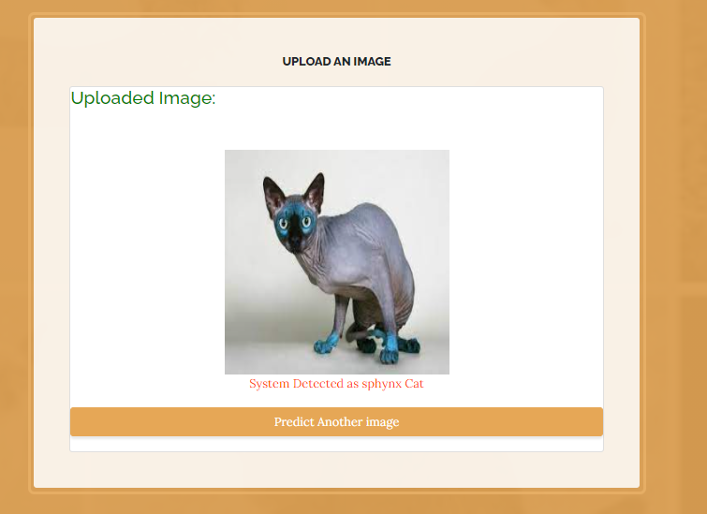
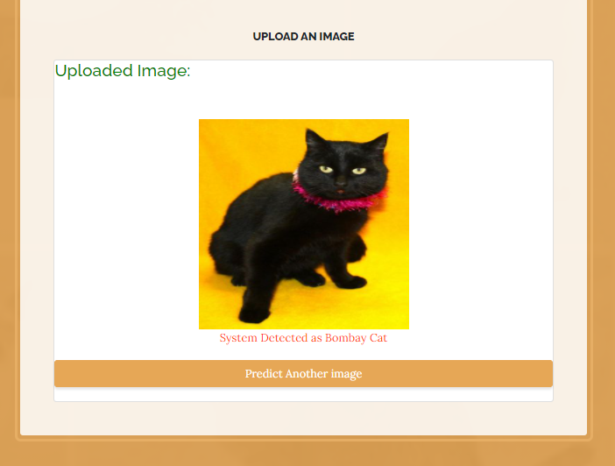
Results and Discussions:
Image Classified as Bombay Cat
Image Classified as Sphynx Cat

Slide 37
Conclusion:
In this project we have successfully classified the images of cat breeds using the convolution neural network of the deep learning. Here, we have considered the dataset of images with 4 classes which are 4 different cat breeds and trained using CNN. After the training we have tested by uploading the image and classified it.

Slide 38
References:
[1] A. Ahmeda, H. Yousifa, R. Kaysb, and Z. Hea, ‘‘Semantic region of interest and species classification in the deep neural network feature domain,’’ Ecological Inform., vol. 52, Jul. 2019, pp. 57–68.
[2] B. Kong, J. Supanci˘ c, D. Ramanan, and C. C. Fowlkes, ‘‘Cross-domain ˘ image matching with deep feature maps,’’ Int. J. Comput. Visions, vol. 127, no. 365, pp. 1–13, Jan. 2019.
[3] M. Zhanyu, Y. Ding, S. Wen, J. Xie, Y. Jin, Z. Si, and H. Wang, ‘‘Shoeprint image retrieval with multi-part weighted CNN,’’ IEEE Access. vol. 7, pp. 59728–59736, 2019.
[4] L. Xie, Q. Tian, R. Hong, S. Yan, and B. Zhang, ‘‘Hierarchical part matching for fine-grained visual categorization,’’ in Proc. Int. Conf. Comput. Vis. (ICCV), Dec. 2013, pp. 1641–1648.
[5] T. Berg and P. Belhumeur, ‘‘Poof: Part-based one-vs.-one features for fine-grained categorization, face verification, and attribute estimation,’’ in Proc. IEEE Conf. Comput. Vis. Pattern Recognit. (CVPR), Jun. 2013, pp. 955–962.

