Slide 1
HOUSE PRICE PREDICTION
CAPSTONE PROJECT
Presented By:
Patel Vishrutkumar Dineshbhai
Vidush Somany Institute of Technology and Research
Computer Science Engineering

Slide 2
OUTLINE
Problem Statement
Proposed System/Solution
System Development Approach (Technology Used)
Algorithm & Deployment
Result
Conclusion
Future Scope
References

Slide 3
PROBLEM STATEMENT
In the current real estate market, determining the right price for a house is a complex task. The price of a house is influenced by a multitude of factors such as the type of dwelling, lot size, overall condition, year built, and more. Accurate price prediction is crucial for both buyers, who want to ensure they are not overpaying, and sellers, who aim to get the maximum possible price. It is also important for real estate agencies and online property listing platforms that need to provide reliable price estimates. However, due to the high variability and complexity of these factors, predicting house prices remains a challenging problem. The crucial part is the prediction of house prices based on various features to provide a stable and reliable estimate.

Slide 4
PROPOSED SOLUTION
The proposed system aims to address the challenge of predicting house prices based on various features. This involves leveraging data analytics and machine learning techniques to forecast house prices accurately. The solution will consist of the following components:
Data Collection: Gather historical data on house sales, including features like the type of dwelling, lot size, overall condition, year built, and other relevant factors.
Data Preprocessing: Clean and preprocess the collected data to handle missing values, outliers, and inconsistencies. Feature engineering to extract relevant features from the data that might impact house prices.
Machine Learning Algorithm: Implement several machine learning algorithms including Random Forest Regressor, Decision Tree Regressor, Gradient Boosting Regressor, and K-Nearest Neighbors (KNN). These models will be trained and tested on a split of the dataset to predict house prices based on historical patterns.

Slide 5
PROPOSED SOLUTION
Deployment: Develop a user-friendly interface or application that provides real-time predictions for house prices. Deploy the solution on a scalable and reliable platform, considering factors like server infrastructure, response time, and user accessibility.
Evaluation: Assess the model’s performance using the Mean Absolute Percentage Error (MAPE) as the evaluation metric. Fine-tune the model based on feedback and continuous monitoring of prediction accuracy.
Result: Present the MAPE of each model and discuss which model performed the best. This will provide a reliable estimate of house prices to all stakeholders in the real estate market.

Slide 6
SYSTEM APPROACH
The system approach outlines the overall strategy and methodology for developing and implementing the House Price Prediction system.
System Requirements:
A computer with a Python environment installed.
Access to the house price dataset.
Sufficient memory and processing power to handle data preprocessing, model training, and prediction.
Libraries Required to Build the Model:
Pandas: Used for data manipulation and analysis. It provides data structures and functions needed to manipulate structured data.
Matplotlib and Seaborn: Used for data visualization. They provide a flexible and powerful declarative framework for creating static, animated, and interactive visualizations in Python.
Scikit-learn: Used for machine learning and statistical modeling including classification, regression, clustering, and dimensionality reduction.
NumPy: Used for numerical computations and working with arrays.

Slide 7
SYSTEM APPROACH
Data Collection: The dataset is collected and loaded into a pandas DataFrame.
Data Preprocessing: The data is cleaned and preprocessed. This includes handling missing values, outliers, and inconsistencies. Feature engineering is performed to extract relevant features from the data that might impact house prices.
Model Building: Several machine learning algorithms are implemented including Support Vector Regressor (SVR), Random Forest Regressor, Decision Tree Regressor, Gradient Boosting Regressor, and K-Nearest Neighbors (KNN). These models are trained and tested on a split of the dataset to predict house prices based on historical patterns.
Model Evaluation: The model’s performance is assessed using the Mean Absolute Percentage Error (MAPE) as the evaluation metric.
Deployment: The final model is deployed to make real-time prediction

Slide 8
ALGORITHM & DEPLOYMENT
Algorithm Selection:
Random Forest Regressor: This is a meta estimator that fits several classifying decision trees on various sub-samples of the dataset and uses averaging to improve the predictive accuracy and control over-fitting.
Decision Tree Regressor: This algorithm builds regression models in the form of a tree structure and breaks down our dataset into smaller subsets while at the same time an associated decision tree is incrementally developed.
Gradient Boosting Regressor: This algorithm produces a prediction model in the form of an ensemble of weak prediction models, typically decision trees. It builds the model in a stage-wise fashion, and it generalizes them by allowing optimization of an arbitrary differentiable loss function.
K-Nearest Neighbors (KNN): This algorithm assumes that similar things exist in close proximity and predicts the value of any given point in the dataset by averaging the values of the ‘k’ closest points.

Slide 9
ALGORITHM & DEPLOYMENT
Data Input: The input features used by the algorithms include type of dwelling, lot size, overall condition, year built, and other relevant factors.
Training Process: The algorithms are trained using the historical house price data. The data is split into a training set and a test set, with the training set used to train the model and the test set used to evaluate its performance. The models are trained to find the best parameters that minimize the difference between the predicted and actual house prices.
Prediction Process: Once trained, the models make predictions for house prices based on the input features of the dataset. The output is a continuous value representing the predicted price of the house.
Deployment: The final model is deployed to make real-time predictions. This could be in the form of a web application or a software component in a larger system, depending on the specific requirements of the project.

Slide 10
RESULT
Model Performance:
Random Forest Regressor: The Random Forest model achieved a MAPE of 19.20%. This shows that the Random Forest model’s predictions were on average 19.20% different from the actual prices.
Decision Tree Regressor: The Decision Tree model achieved a MAPE of 22.96%. This means that the Decision Tree model’s predictions were on average 22.96% different from the actual prices.
Gradient Boosting Regressor: The Gradient Boosting model achieved a MAPE of 19.16%. This indicates that the Gradient Boosting model’s predictions were on average 19.16% different from the actual prices.
K-Nearest Neighbors (KNN): The KNN model achieved a MAPE of 20.58%. This shows that the KNN model’s predictions were on average 20.58% different from the actual prices.

Slide 11
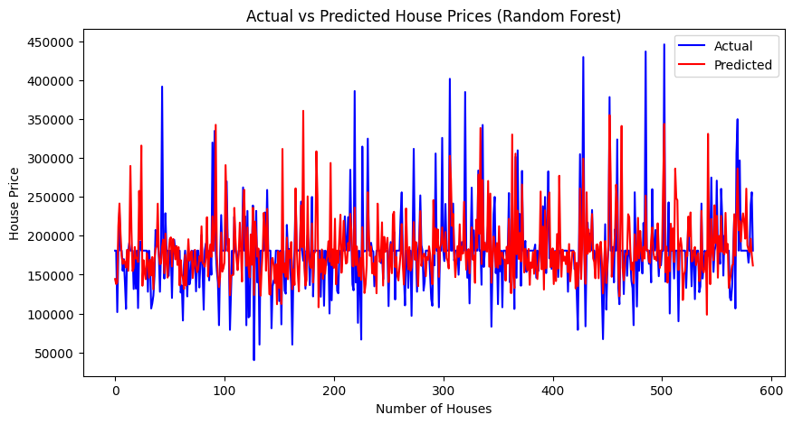
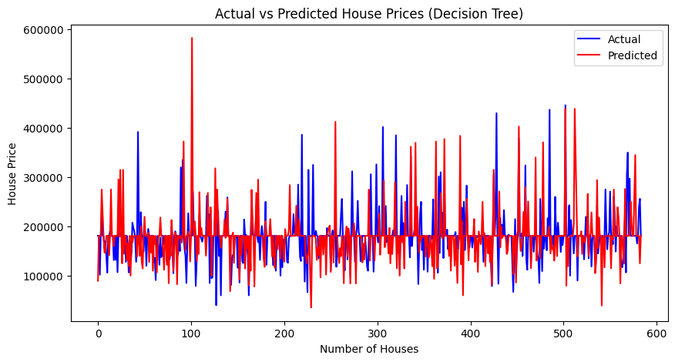

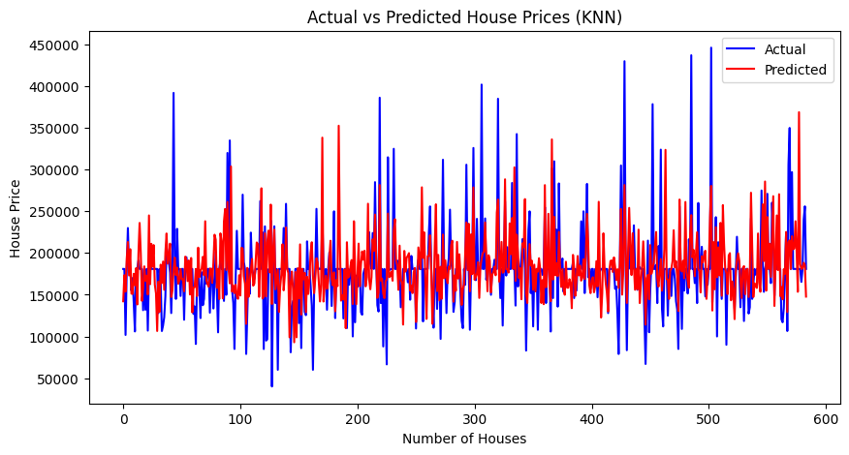
RESULT
Visualizations: includes line graphs to compare the predicted and actual house prices for each model.

Slide 12
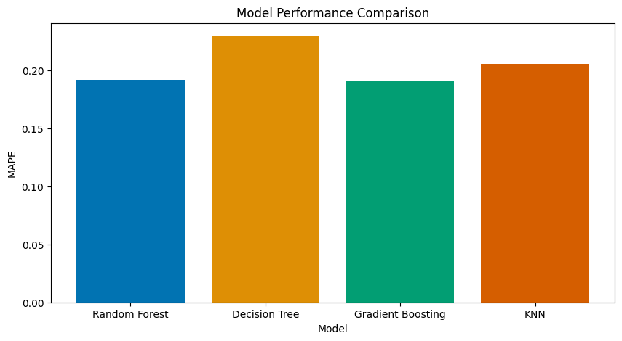
RESULT
Model Comparison: Based on the performance comparison of the models, the Gradient Boosting Regressor has the lowest Mean Absolute Percentage Error (MAPE).

Slide 13
CONCLUSION
In conclusion, the project ‘House Price Prediction using Machine Learning’ has demonstrated the effectiveness of various machine learning algorithms in predicting house prices. The Gradient Boosting Regressor model emerged as the best-performing model.
The findings from this project highlight the potential of machine learning in the real estate industry. The Gradient Boosting Regressor model was able to predict house prices with a MAPE of 19.16%, indicating a high level of accuracy.
During the implementation of the project, several challenges were encountered, such as handling missing values and outliers in the data, and selecting the most relevant features for the prediction. However, these challenges were addressed through data preprocessing techniques and feature engineering.
Potential improvements for this project could include exploring more advanced machine learning models, incorporating additional features into the dataset, or fine-tuning the models further to improve their performance.
The importance of accurate house price predictions cannot be overstated. For buyers, it ensures they are getting a fair deal, and for sellers, it helps them price their property appropriately. For real estate agencies and online property listing platforms, it provides a reliable estimate that they can present to their users.

Slide 14
FUTURE SCOPE
The ‘House Price Prediction using Machine Learning’ project has a promising future scope. Here are some potential enhancements and expansions for the system:
Incorporating Additional Data Sources: The model’s performance could potentially be improved by incorporating additional data sources. For instance, data related to the neighborhood such as proximity to schools, hospitals, and public transportation could be included. Also, macroeconomic factors like interest rates, inflation rates, and housing market trends could provide valuable context.
Optimizing the Algorithm for Better Performance: There is always room for improvement in machine learning models. More advanced techniques such as hyperparameter tuning, ensemble methods, or deep learning could be explored to enhance the model’s performance.
Expanding the System to Cover Multiple Cities or Regions: Currently, the model is trained on a specific dataset. However, house prices can vary greatly from one city or region to another. Expanding the system to include data from multiple cities or regions could make the model more robust and widely applicable.
Integration of Emerging Technologies: Emerging technologies such as edge computing could be used to deploy the model closer to the data source, reducing latency and improving real-time prediction capabilities. Advanced machine learning techniques like reinforcement learning or neural networks could also be explored to improve the prediction accuracy.

Slide 15
REFERENCES
Pedregosa et al., “Scikit-learn: Machine Learning in Python”, JMLR 12, pp. 2825-2830, 2011.
McKinney & others, “pandas: powerful Python data analysis toolkit”, 2010.
Hunter, J. D., “Matplotlib: Visualization with Python”, 2007.
Waskom M., “Seaborn: statistical data visualization”, 2021.
Jain, A., & Kumar, A. M., “House price prediction: a comparison of multiple linear regression and artificial neural networks”, Journal of AI and Data Mining, 2018.
Brownlee, J., “Machine Learning Mastery”, 2020.

Slide 16
THANK YOU

