Slide 1


Slide 2
405 FOUND
TEAM

Slide 3
405 FOUND
TEAM
SHREY YADAV
VISHWAJEET YADAV
RAHUL RANA
CHIRAG GUPTA
BHUPESH CHAUDHARY

Slide 4
WHAT IS THE PROJECT?
understanding the problem statement.

Slide 5
PROBLEM STATEMENT
One common challenge faced by users is converting HTML (Hypertext Markup Language) documents to DOCX (Microsoft Word) format. While both formats serve different purposes, there are scenarios where it's necessary to convert HTML content into a more widely used and editable format like DOCX.

Slide 6
CHALLENGES
STRUCTURAL DIFFERENCES BETWEEN HTML AND DOCX
PRESERVING FORMATTING AND STYLES
DEALING WITH HYPERLINKS AND REFERENCES
MINIMIZING DATA LOSS
SCALABILITY AND PERFORMANCE

Slide 7
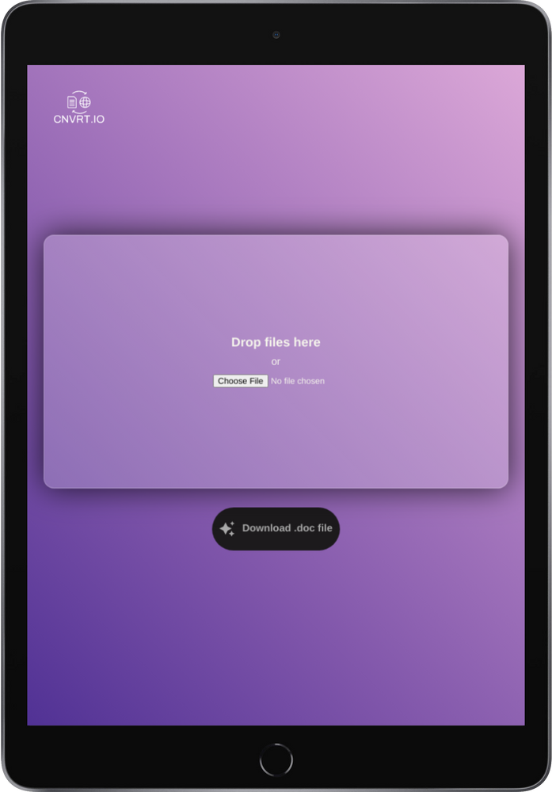
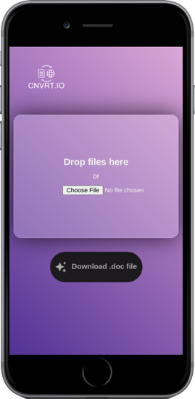

Solution
overview
We used Jquery library to convert HTML to DOCX. We have also made a frontend website where user can easily upload and download the doc file.
https://convert-html-to-doc.netlify.app

Slide 8
APPROACH 1 : Using JS

Slide 9
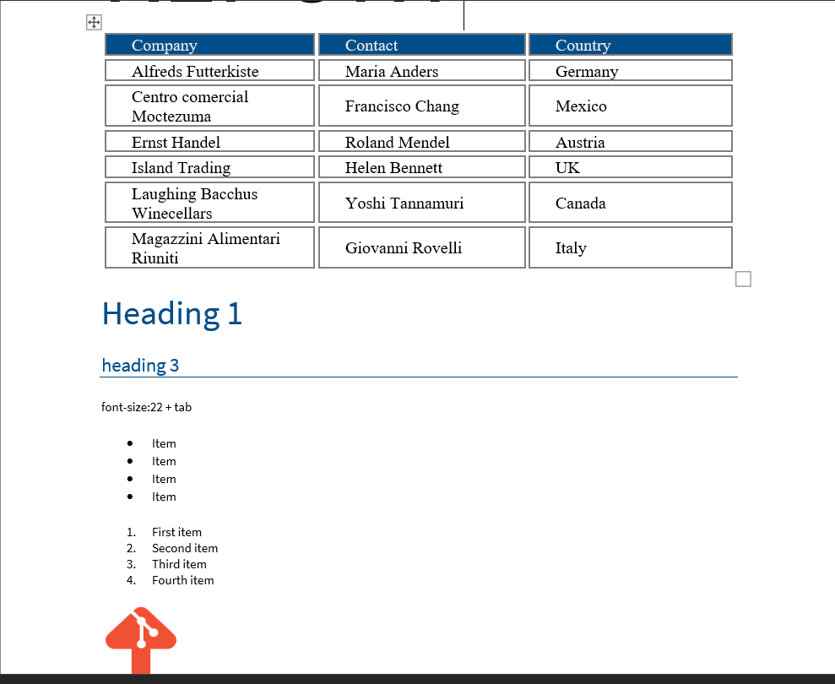
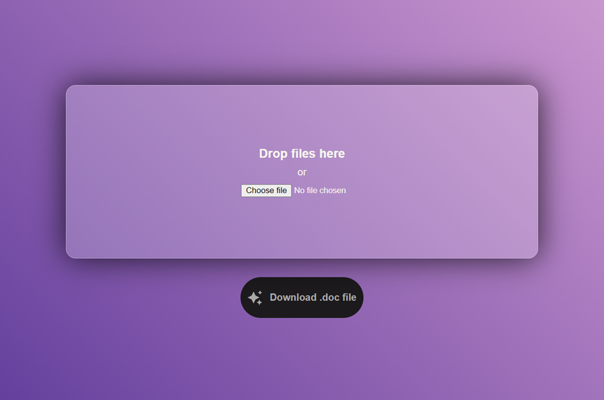

SAMPLE RESULTS

Slide 10
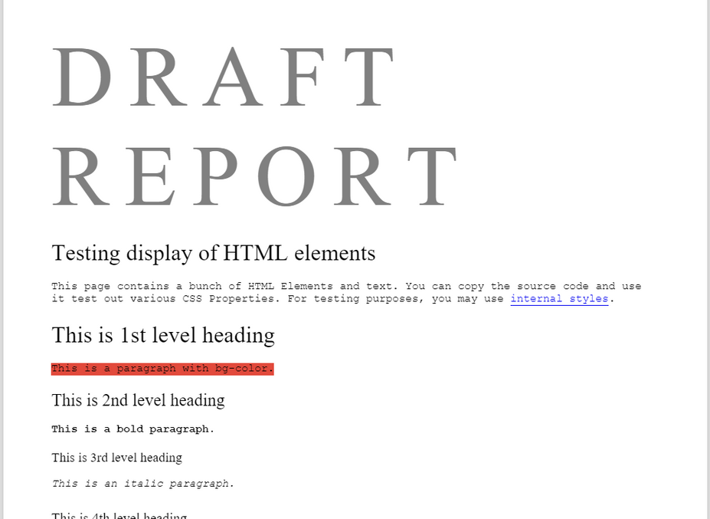
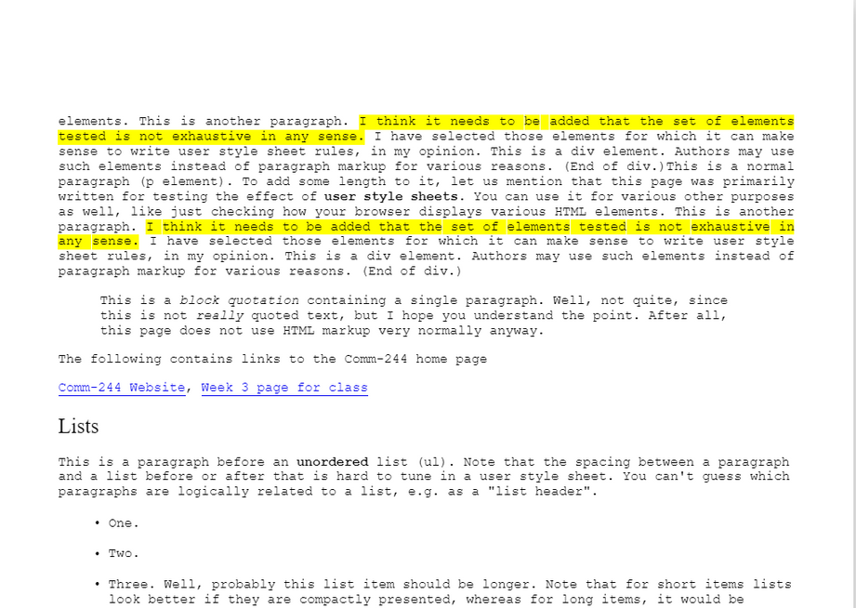
ADVANTAGES
WE CAN RETAIN MOST OF THE CRUCIAL DATA, Hyper-Links AND STYLING CSS.

Slide 11
DRAWBACKS
WATERMARKS, HEADNOTES/FOOTNOTES AND INTERNAL CSS ARE NOT RETRIEVED PROPERLY.

Slide 12
APPROACH 2 : Using Python

Slide 13
OVERVIEW
WE USED A THIRD-PARTY PYTHON MODULE TO CONVERT HTML TO DOCX.
Module names :
aspose.words
python-docx

Slide 14
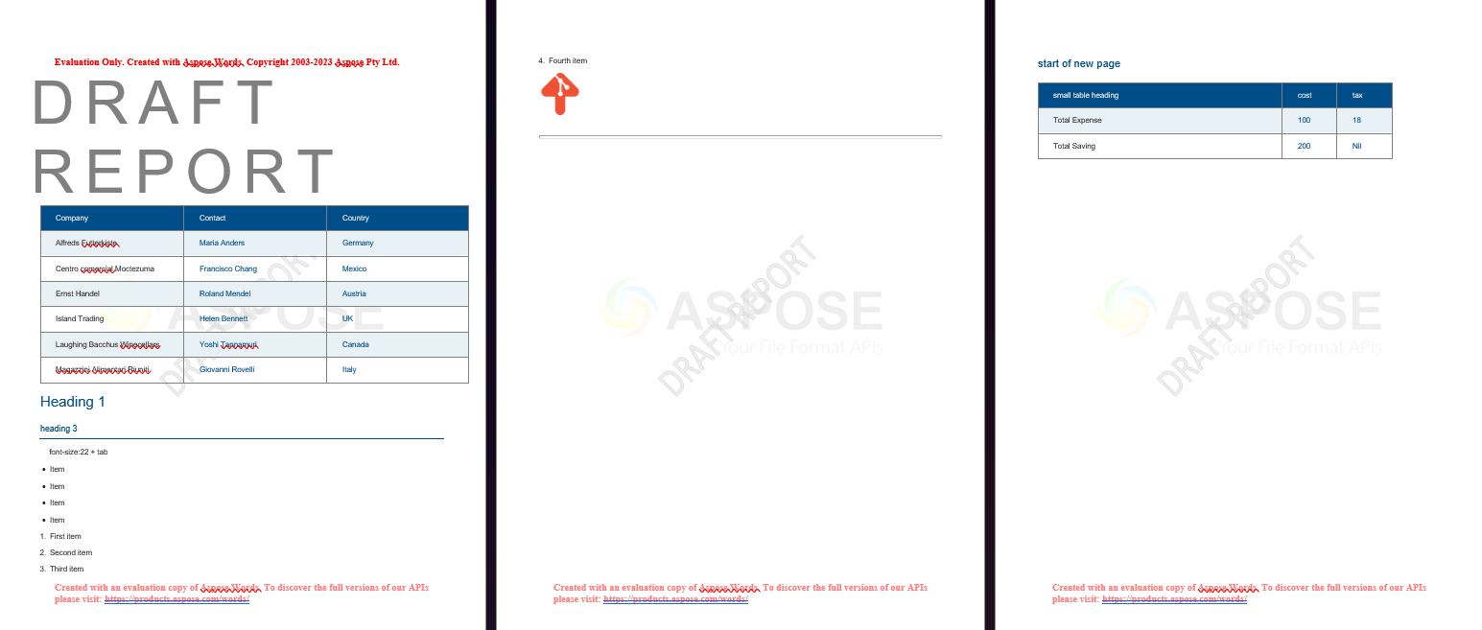
SAMPLE RESULTS

Slide 15
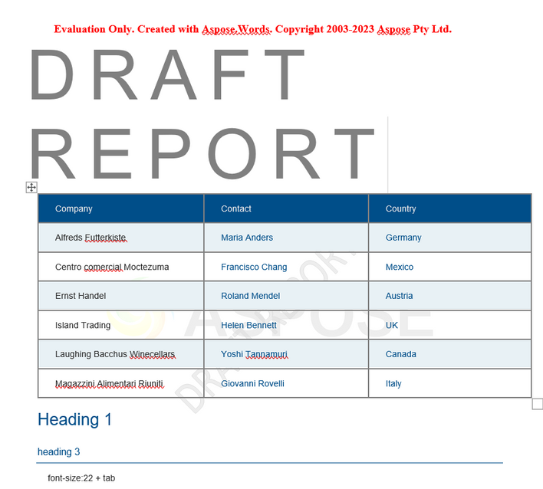

DRAWBACKS
Third-party APIs have their own licensing and watermarks that can affect the quality of the resulting data.

Slide 16
Conclusion
The first approach i.e. using Javascript is preferable as it provides cleaner data and can be used without investment. Although, if we talk about big companies who can purchase third party licensing, they can also use python modules

