Slide 1



MRV : Interpreting Medical Report Into Voice
in Regional Languages
;
Team members :
M.Dharshini(24619111)
A.Devi(24619108)
B.Jothi Lakshmi(24619106)
Guide: Department:
Dr.G.Revathy,M.E, Ph.D B.Tech CSE
Assistant Professor Artificial Intelligence
(Department of Artificial Intelligence & Machine Learning
& Machine Learning
1

Slide 2
INTRODUCTION
Medical reports often contain complex terminologies that are difficult for patients to understand, especially due to language barriers. To overcome these challenges, our project Medical Report Voice (MRV) provides a simple and multilingual platform to make medical information easily understandable.
The application allows users to upload medical reports in PDF or image format. It extracts the report text using OCR and simplifies complex medical terms into clear, patient-friendly explanations. The Text-to-Speech feature converts these explanations into voice, helping users understand their reports easily. Multiple language options allow users to access information in their preferred language. Additionally, the Health Trend feature helps track changes in health parameters over time, while the Report History feature saves previously uploaded reports for future reference. Thus, MRV makes medical information more accessible through report uploading, text extraction, simplification, multilingual support, voice explanation, health tracking, and history management.

Slide 3
ABSTRACT
Understanding medical reports is difficult because of complex terminologies used in medical reports. This study proposes the creation of a healthcare application using AI for interpreting the medical reports and making the reports more user-friendly. Medical reports such as CBC, thyroid, and Pulse Reports can be uploaded by the users into the app and using Optical Character Recognition (OCR), data in the report can be extracted. The Large Language Model (LLM) uses this information to interpret the medical report in simple language. Explanation of this interpretation is given in the form of both text and audio in regional languages using Text-to-Speech (TTS) Technology. In addition, the app provides pictorial explanation of body parts involved in the medical condition, important terms in the medical field, and tutorial videos for the first-time users. In addition to these features, Report History allows the user to view past reports while Health Trend Analysis allows the user to track health parameters.
Keywords: AI, OCR, LLM, TTS, Medical Report Interpretation, Regional Languages, Report History, Health Trend Analysis
2

Slide 4
BASE PAPER
Problem: Medical reports contain complex terms that are difficult for patients to understand. Language barriers make interpretation harder.
Objective: To develop an AI-based system that simplifies medical reports into patient-friendly language while preserving important information.
Methodology: The system accepts PDF, image, and text reports. OCR extracts text from scanned reports. A hybrid T5 + LLaMA model simplifies medical terms while maintaining context. The simplified report is then displayed to users.
Advantages: Easy to understand, supports scanned reports, preserves medical information, reduces communication barriers, and improves patient understanding.
Limitations: No multiple language support or voice explanation. It mainly depends on text-based explanations.
Authors: Komal Parate, Sonal Nimbalkar, Himanshu Talekar, Devang Chopkar, Mayank Hirekhan and Aastha Pathak.

Slide 5
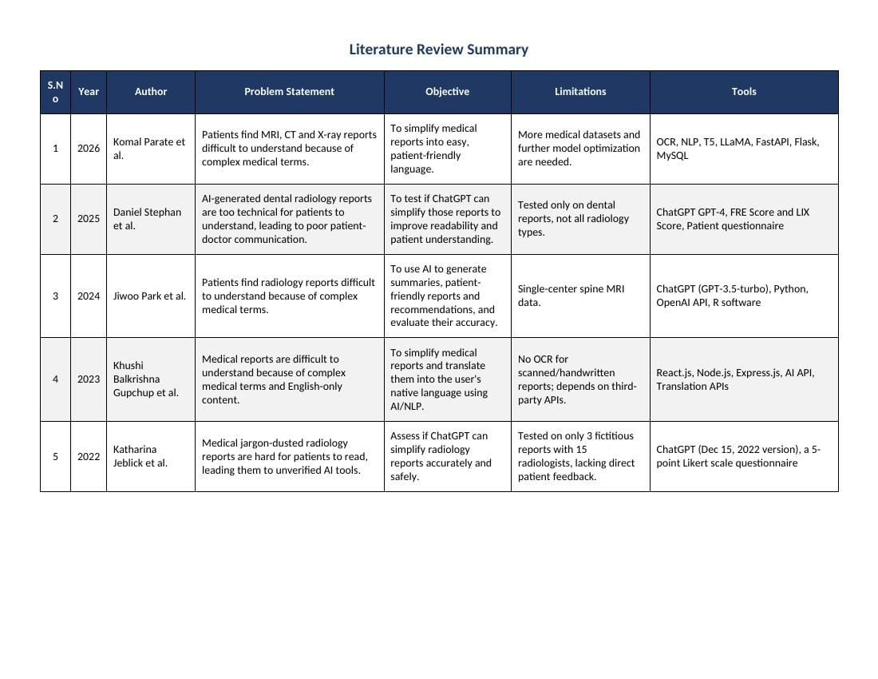
LITERATURE SURVEY
4

Slide 6
RESEARCH GAP
1. Limited Support for Scanned Medical Reports
Many existing systems focus on digital reports, with limited OCR support for scanned images and handwritten documents.
2. Lack of Multilingual Medical Explanation
Most systems focus on English, making medical information difficult for patients who prefer regional languages.
3. Absence of Integrated Health Tracking
Existing systems mainly simplify individual reports, with limited features for tracking health changes and accessing previous reports.
4. Limited Voice-Based Accessibility
Most systems provide text-based results, with limited Text-to-Speech support in the user's preferred language.

Slide 7
THE PROBLEM STATEMENT
Patients often face difficulties in understanding medical reports due to complex medical terminology and language barriers. The lack of simple explanations in preferred languages, limited voice accessibility, and difficulty in maintaining and reviewing previous health records make it challenging for patients to clearly understand and monitor their health conditions.
5

Slide 8
OBJECTIVE
To develop an AI-based multilingual medical report application.
To extract medical information from PDF and image reports using OCR.
To simplify complex medical terminologies into patient-friendly explanations.
To provide voice explanations through Text-to-Speech in the user's preferred language.
To support multiple languages and reduce communication barriers.
To track changes in health parameters through Health Trend analysis.
To store and retrieve previously uploaded reports through Report History.
To improve patient awareness and make medical information easily accessible.
6

Slide 9
EXISTING SYSTEM
The existing systems focus on simplifying complex medical and radiology reports using AI and Natural Language Processing (NLP). They aim to convert technical medical terminology into simple, patient-friendly language, improve report readability, and support better communication between patients and doctors. Some systems also provide summaries, recommendations, and translation into users’ native languages.
These systems use technologies such as OCR, NLP models, T5, LLaMA, ChatGPT, and AI-based APIs. Readability is evaluated using measures such as the Flesch Reading Ease (FRE) and LIX scores, along with questionnaires.
However, the existing systems have several limitations. Some are restricted to specific report types, such as dental reports or spine MRI reports. Others use limited datasets and require further model optimization. Certain systems do not support OCR for scanned or handwritten reports and depend on third-party APIs for translation. Some evaluations also lack direct patient feedback.
Overall, existing systems provide AI-based medical report simplification, but their support for different report types, scanned documents, multilingual access, and patient-focused evaluation remains limited.

Slide 10
PROPOSED SYSTEM
1. Report Upload: Users can upload medical reports in PDF, JPG, and PNG formats.
Types of Reports: Supports common laboratory reports, such as Complete Blood Count (CBC), Blood Sugar, Lipid Profile, Liver Function Test (LFT), Kidney Function Test (KFT), and Thyroid Test reports.
2. Text Extraction: Uses PDF.js to extract text from text-based PDF reports.
3. OCR Processing: Uses Tesseract.js OCR to recognize text from scanned reports and image files.
4. Text Processing: Extracts and organizes medical test names, values, and related information.
AI-Based Simplification: LLM (Qwen) complex medical terms into simple, patient-friendly explanations.
5. Risk Identification: Displays indicators such as Normal, Moderate, and High based on the extracted information.
6. Multilingual Support: Provides simplified explanations in the selected language.
7. Voice Explanation: Uses Text-to-Speech (TTS) to read out the simplified report.
8. Report History: Stores previous report details using Local Storage, allowing users to view them later.

Slide 11
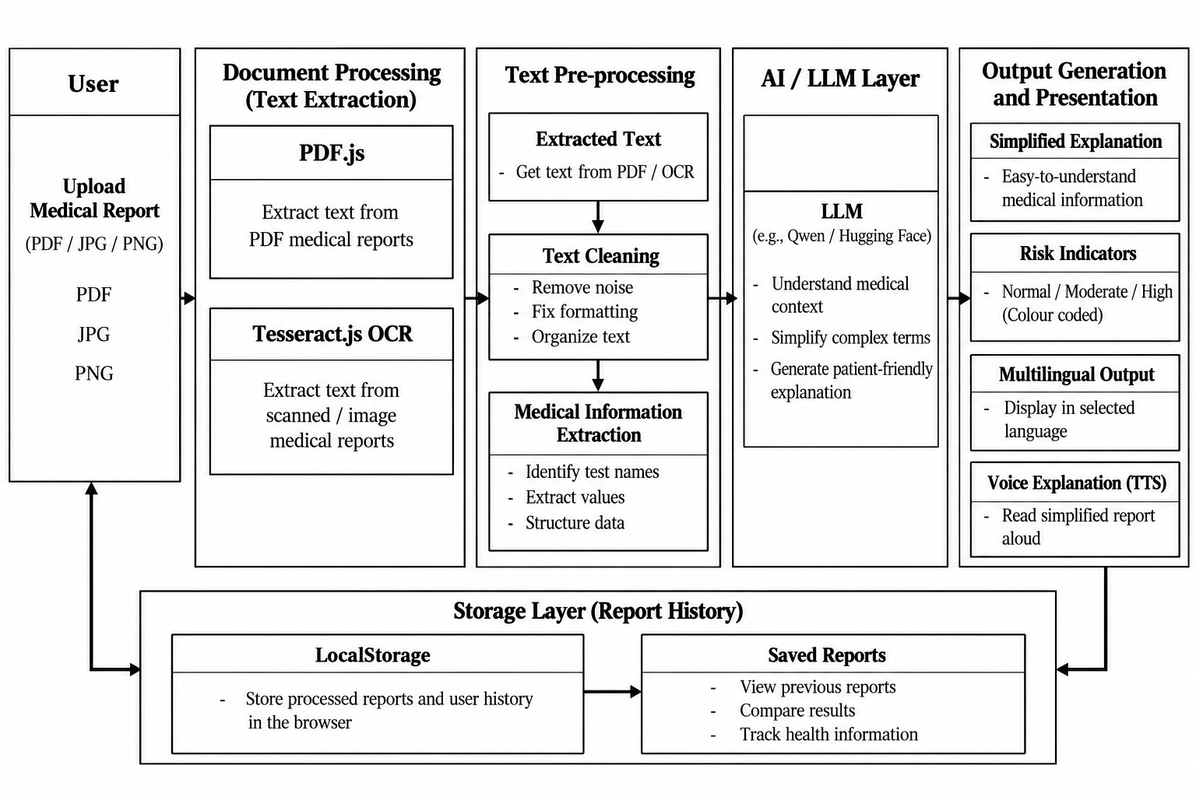
ARCHITECTURE
8

Slide 12
METHODOLOGY
1. Medical Report Upload: Users can upload PDF, JPG, and PNG files. Supports CBC, Blood Sugar, Pulse rate report and Thyroid reports. The uploaded report is processed for text extraction.
2. Text Extraction & Medical Information Extraction: PDF.js extracts text from digital PDF reports, while Tesseract.js performs OCR on scanned reports and images. The extracted text is processed to identify medical test names, values, units, and reference ranges, organizing the information for further AI processing
3. AI-Based Simplification: Qwen LLM processes the extracted medical information. Complex medical terms are converted into simple language. Patients receive easy-to-understand explanations.
4. Risk Identification: Analyses extracted values and available reference ranges. Displays risk levels as Normal, Moderate, or High. Helps users understand the report more easily.
5. Multilingual Support: Users can select their preferred language. Simplified explanations are provided in the selected language. This helps improve accessibility for different users.
6 Voice Explanation: Text-to-Speech converts explanations into audio. Users can listen to their simplified report. This supports users who prefer audio explanations.
7. Report History: Previous report details are stored using Local Storage. Users can access their saved report history. This allows easy reference to earlier reports.

Slide 13
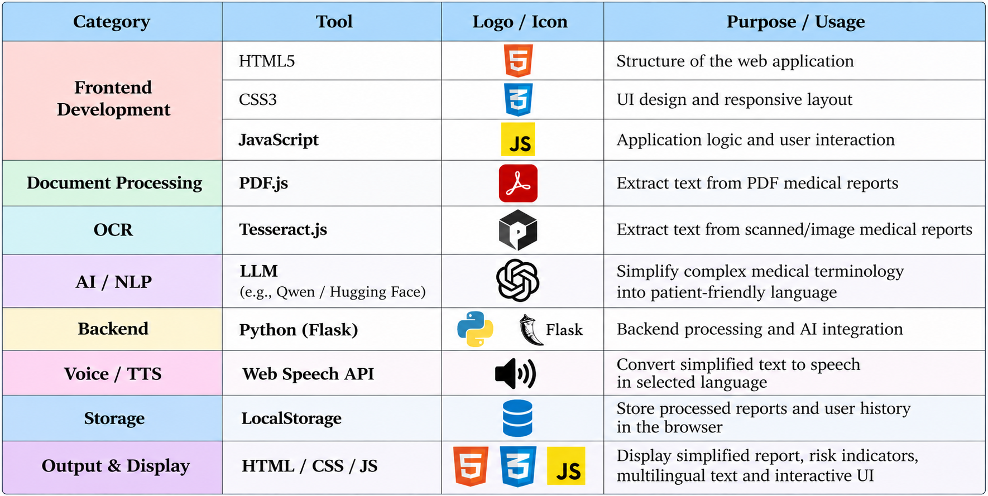
TECHNOLOGY USED

Slide 14
DATASETS
The proposed system utilizes a pre-trained AI model for simplifying medical reports. Hence, no separate dataset was used for training the model. Instead, a collection of sample medical reports was used to test and evaluate the application's functionality. These sample reports were used to verify the report upload process, text extraction, AI-based simplification, and voice explanation features.
The sample medical reports used for testing are provided through the following links:
https://github.com/abachaa/MedQuAD?utm_source=chatgpt.com⁠
https://huggingface.co/datasets/Sadou/medical-reports-simplification-dataset⁠
https://huggingface.co/datasets/Akhil-reddy/Medical-Balanced?utm_source=chatgpt.com⁠
https://huggingface.co/datasets/ClinOCR-Bench/ClinOCR-Bench?utm_source=chatgpt.com⁠
https://github.com/nepython/MedSiML?utm_source=chatgpt.com⁠

Slide 15
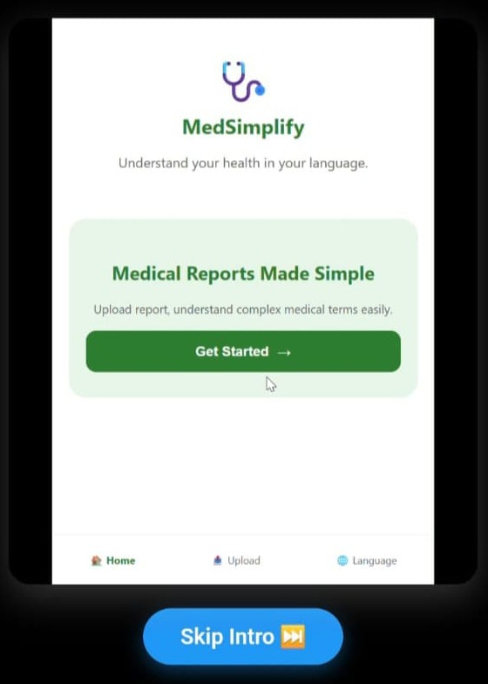
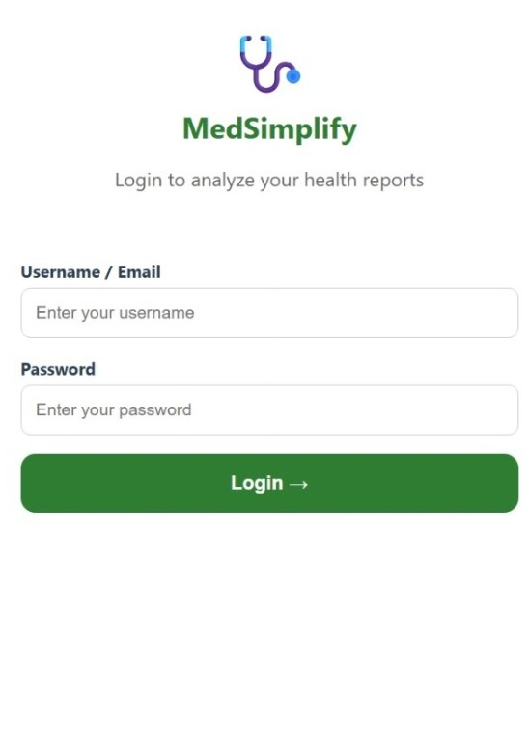
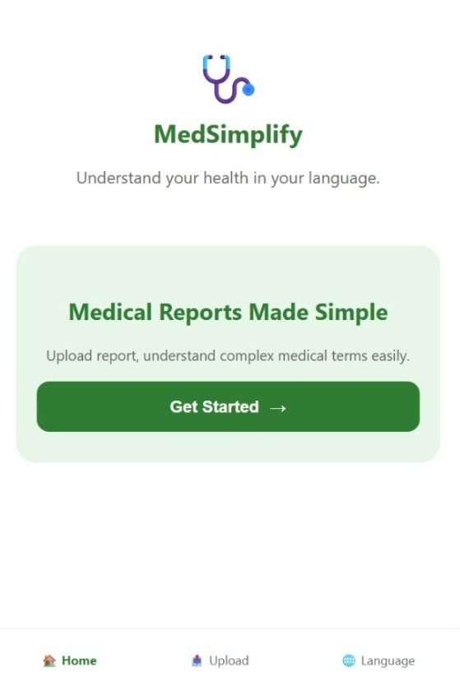
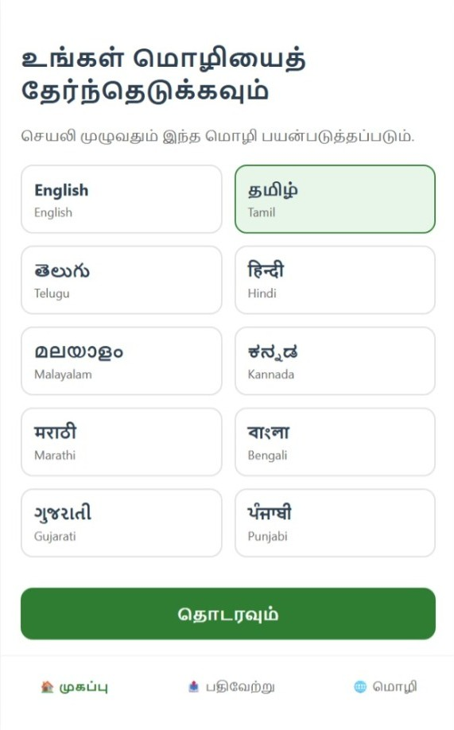
IMPLEMENTATION

Slide 16
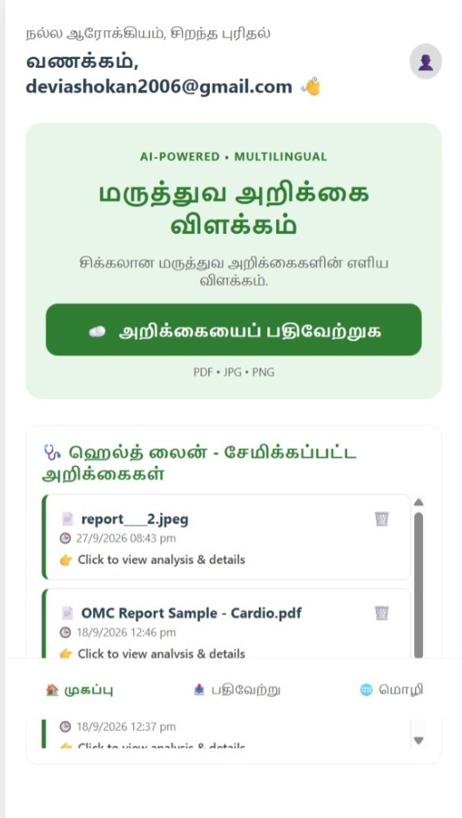
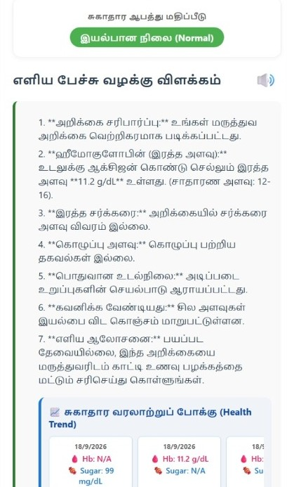
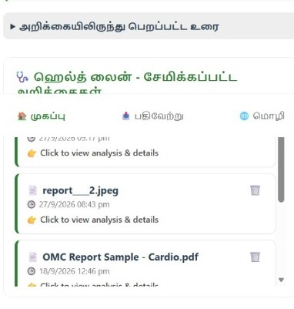
IMPLEMENTATION

Slide 17
RESULTS
The MRV system successfully allows users to upload medical reports, select their preferred language, extract text using OCR, and simplify complex medical information into easy-to-understand language. It also provides voice explanations, displays health trends from previous reports, and maintains report history for future reference. Overall, the system makes medical reports more accessible and easier for patients to understand.

Slide 18
FUTURE ENHANCEMENT
1. Interactive Regional-Language Voice Assistant:
In the future, MRV can include an interactive voice assistant that allows patients to ask questions about their medical reports in their preferred regional language. The system can respond with simple explanations and read the answers aloud using text-to-speech technology.
2. AI-Powered Report Comparison:
In the future, MRV can use AI to compare a patient's current medical report with previous reports. The system can identify changes in medical test values and highlight whether each value has increased, decreased, or remained stable. It can present these changes using simple summaries, tables, and visual indicators.
3.Medical Report Reminder Notifications:
In the future, MRV can send notifications reminding patients to upload their latest medical reports after scheduled health check-ups. This will help users maintain an updated medical history and compare their results over time.

Slide 19
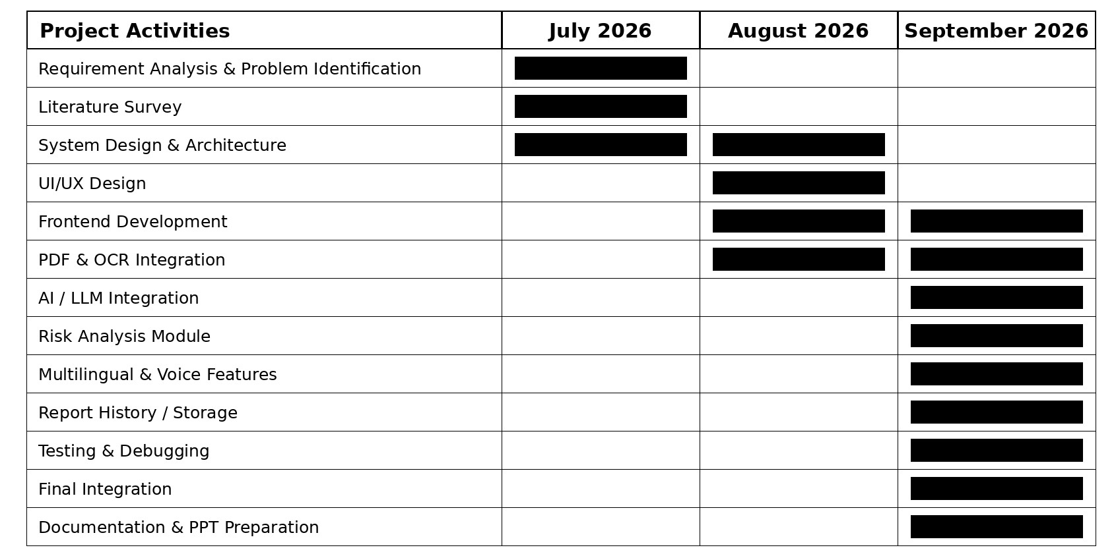
GANTT CHART
9

Slide 20
CONCLUSION
MRV is a web-based system that helps patients understand medical reports. It extracts text from PDFs and images, simplifies it with an LLM (qwen) AI and presents it in the user's chosen language, as shown in the Tamil output. The prototype also gives a health-risk indicator, voice output, and a health-trend view of earlier readings, making reports easier to access. It is a patient-information prototype, not a diagnostic tool. Future work will focus on Interactive Regional-Language Voice Assistant, AI-Powered Report Comparison, Medical Report Reminder Notifications.
12

Slide 21
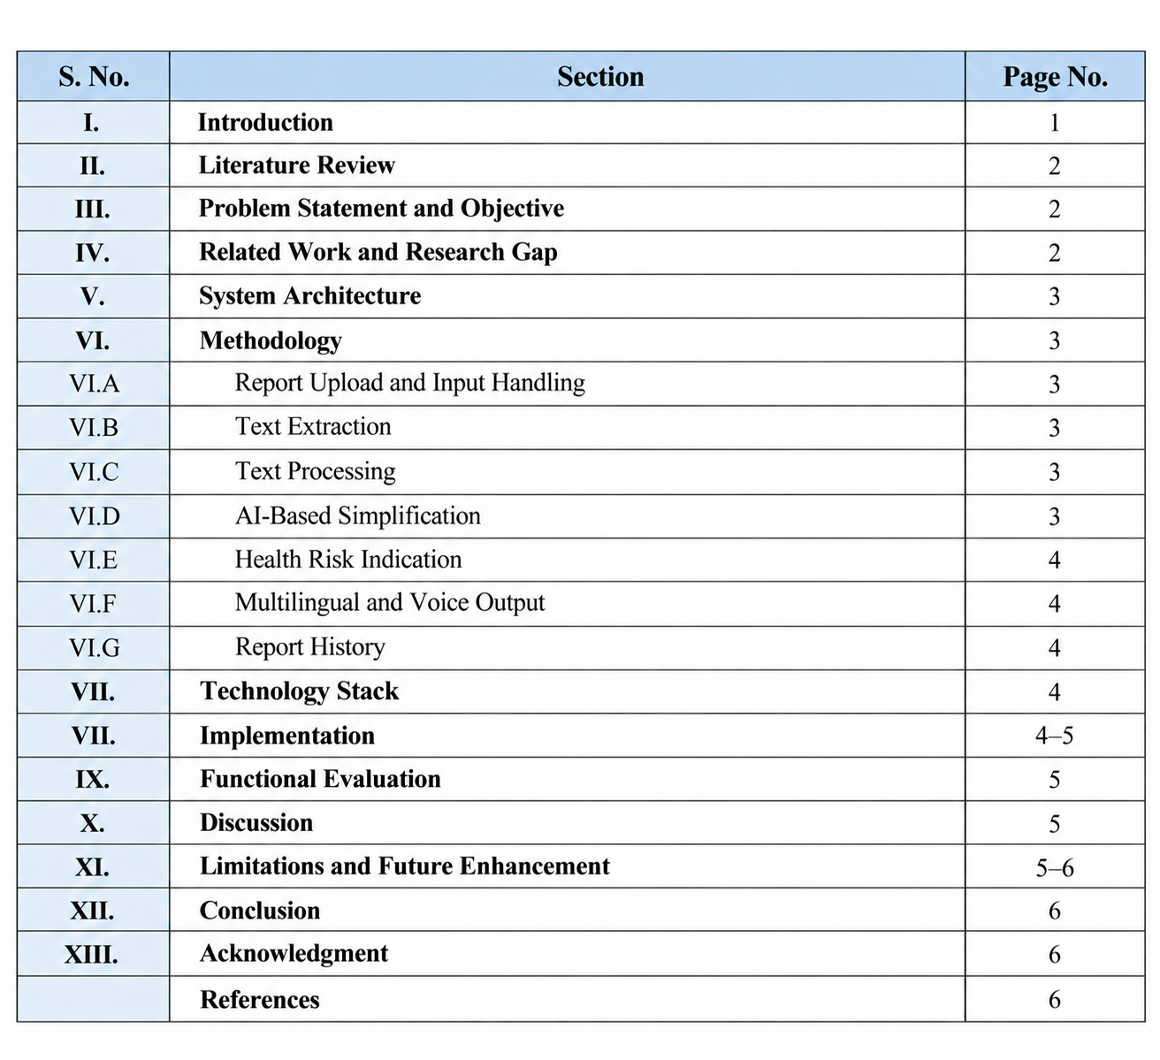
CONFERENCE PAPER TOC

Slide 22

Thank You!
13

