Slide 1
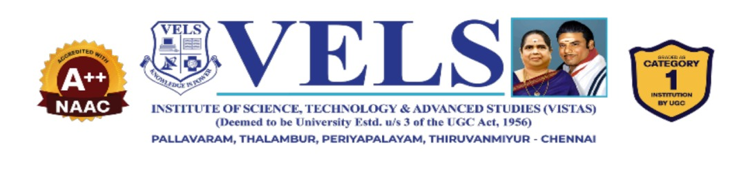
AI-Based Smart Expense
Management System
Automated Categorization • Spending Prediction • Anomaly Detection • Budget Recommendations
DEPARTMENT
TEAM MEMBERS
PROJECT SUPERVISOR
Kotakonda Shravan B
S. Thahseen Basha
Varun Sekar V
Mrs. Janani P , M.tech
Department of CSE (AI & ML)
Vels University, Chennai

Slide 2
Project Abstract
The AI-Based Smart Expense Management System automates personal expense tracking by capturing transaction details directly from payment notifications and converting them into structured records.
Naive Bayes
Linear Regression
Isolation Forest
Storage & Action
Stores processed records in local SQLite database and generates personalized budget recommendations.
Categorizes incoming transaction descriptions into preset expense categories.
Predicts future spending trends and month-end expenditure based on history.
Identifies and flags unusual transaction patterns and spending anomalies.
Key Focus
Automation + Intelligence + Real-Time Financial Insight.

Slide 3
Problem Statement
Research Need
An end-to-end unified workflow combining automated notification parsing, machine-learning classification, predictive modeling, anomaly detection, and actionable budgeting.
Manual & Tedious
No Automatic Capture
Users frequently forget to log transactions, causing gaps in personal expense records.
Conventional tools rely entirely on repetitive manual input and category selection.
Limited Prediction
No Anomaly Awareness
Standard trackers offer basic historical summaries without forward-looking spending projections.
Irregular or suspicious spending behavior goes unnoticed without automated alerts.

Slide 4
Literature Survey
No. | Literature Area | Key Finding from Report | Method / Relevance
1 | AI/ML in Personal Finance | AI/ML is increasingly vital for automated transaction analysis and personal decision-making. | Underpins categorization, prediction, anomaly detection, and budgeting.
2 | Transaction Classification | Text-based NLP techniques extract merchant names and descriptions to assign predefined spending categories. | Naive Bayes: Lightweight, fast, and computationally efficient for text data.
3 | Expense Prediction | Historical trends can project upcoming short-term and monthly spending. | Linear Regression: Transparent, interpretable continuous estimation.
4 | Anomaly Detection | Highlights transactions that deviate substantially from regular user habits. | Isolation Forest: Efficiently isolates rare or unusual outlier entries.
5 | Research Gap | Existing solutions separate transaction capture from predictive and anomaly analytics. | Unifies notification parsing, categorization, forecasting, and budgeting into one pipeline.

Slide 5
Existing System vs. Proposed System
Feature | Existing System | Proposed System
Data Entry | Manual transaction logging | Automated notification capture
Categorization | Manual category tagging | Machine learning (Naive Bayes)
Data Persistence | Unstructured or basic spreadsheets | Structured local SQLite storage
Future Forecasting | None or strictly descriptive summaries | Continuous predictive modeling (Linear Regression)
Fraud / Anomaly Detection | Not integrated | Automated outlier detection (Isolation Forest)
Budgeting | Static, fixed user limits | Dynamic, personalized budget recommendations
Workflow | Fragmented and multi-step | Unified, end-to-end automated pipeline

Slide 6
Research Gap
Existing solutions address individual functions, but the complete workflow remains fragmented.
Fragmented Tools
Manual Data Entry
Transaction capture, categorization, prediction and anomaly analysis are often handled separately.
Users may need to record transactions manually, creating gaps in expense history.
Limited Prediction
No Unified Anomaly + Budgeting
Conventional trackers focus mainly on historical summaries instead of forward-looking spending.
Unusual spending detection and actionable budget support are not integrated into one pipeline.
Gap Addressed
A unified end-to-end workflow connecting notification parsing, ML categorization, prediction, anomaly detection and budgeting.

Slide 7
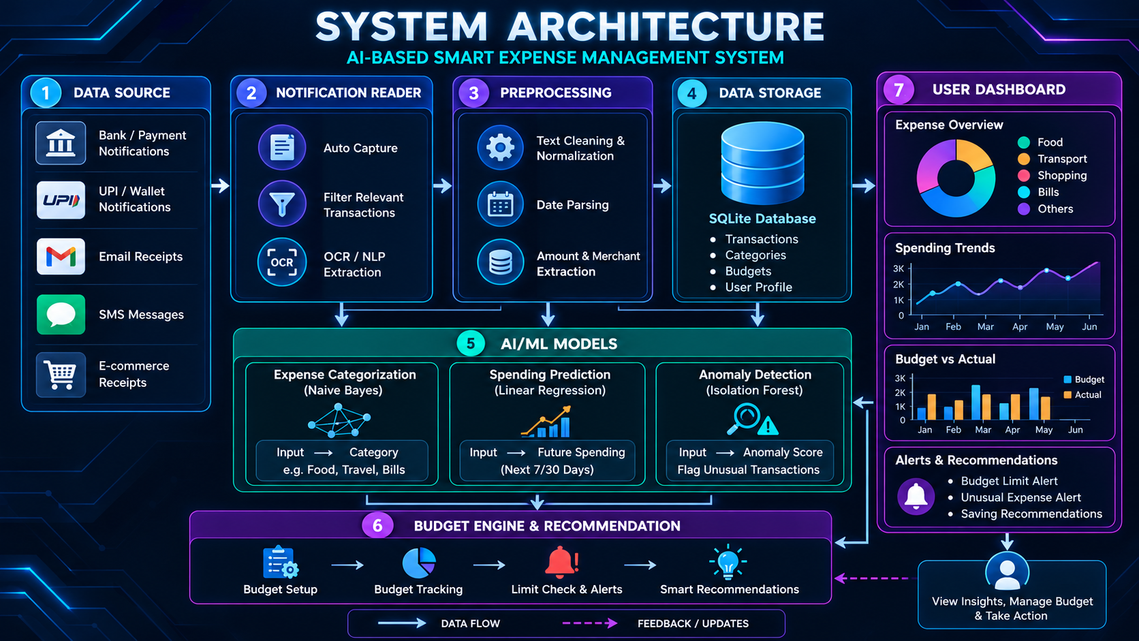

Slide 8
Methodology & Implementation Flow
Capture
Extract
Listen to and read incoming payment notifications in real time.
Parse raw notification text for amount, merchant name, date, and payment mode
Classify
Predict
Naive Bayes maps text tokens to expense category (e.g., Food, Travel, Utilities).
Linear Regression estimates month-end and category-level expenditure.
Detect
Recommend
Isolation Forest analyzes transaction size and frequency to isolate outliers.
Budget engine generates adaptive financial advice and spending limits.
Final Output
Clean transaction log • Forward expense forecast • Anomaly alerts • Dynamic budget advice.

Slide 9
Implementation Module
The system is organized into connected modules that transform raw payment notifications into actionable financial insight.
1. Notification Capture
2. Text Processing
Reads incoming payment notifications and identifies relevant transaction messages.
Extracts amount, merchant, date and payment mode from raw notification text.
3. ML Categorization
4. Spending Prediction
Naive Bayes classifies transactions into predefined expense categories.
Linear Regression estimates future and month-end expenditure from history.
5. Anomaly Detection
6. Budget & Dashboard
Isolation Forest flags unusual transaction patterns and spending anomalies.
Stores records in SQLite and provides budget tracking, alerts and recommendations.
INPUT → PROCESSING → AI/ML ANALYSIS → STORAGE → INSIGHT & ACTION

Slide 10
Result (Current Progress)
Current progress documented in the project material
System Design
AI/ML Pipeline
End-to-end architecture and methodology flow have been defined.
Naive Bayes, Linear Regression and Isolation Forest are selected for the core intelligence modules.
Data Storage
Testing Plan
SQLite is defined for structured storage of transactions, categories, budgets and user data.
Dataset preparation, unit testing, model evaluation and end-to-end integration testing are scheduled.
Current Status
The project has defined the architecture, modules, models and development/testing workflow; quantitative model results are not included in the current PPT.

Slide 11
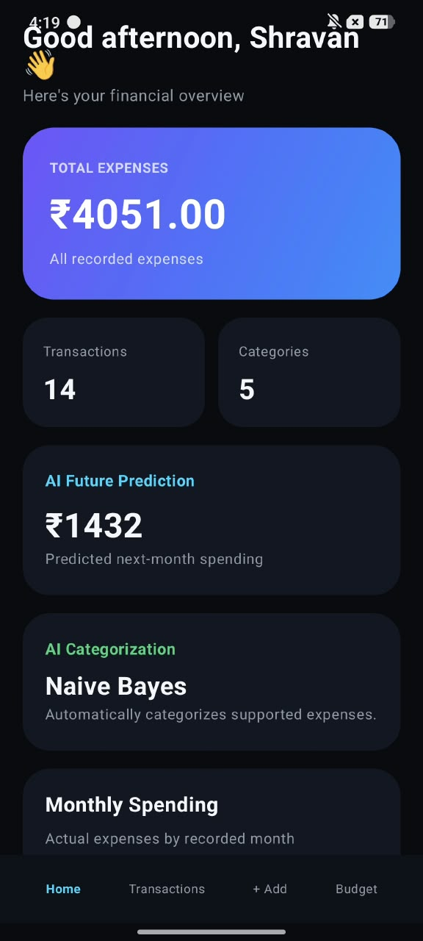

Slide 12
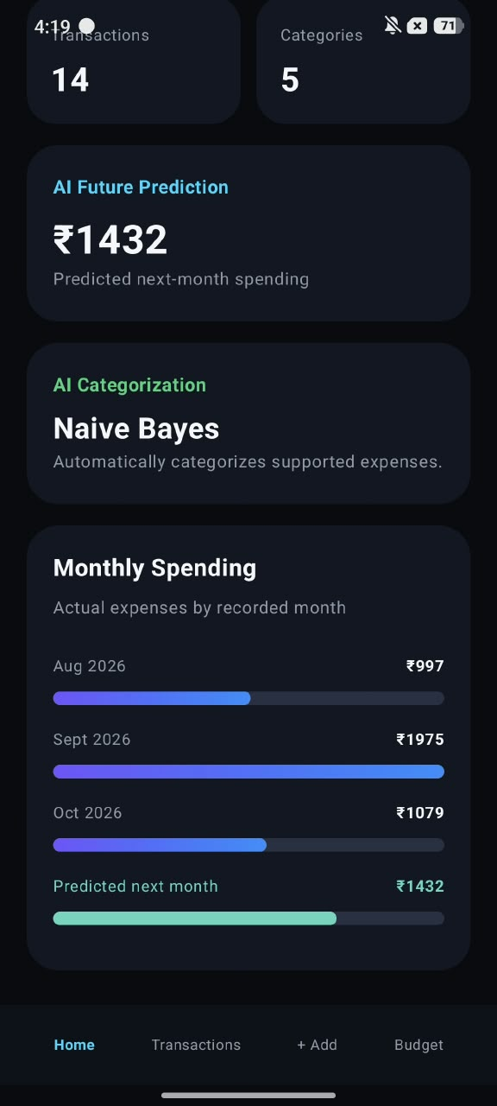

Slide 13
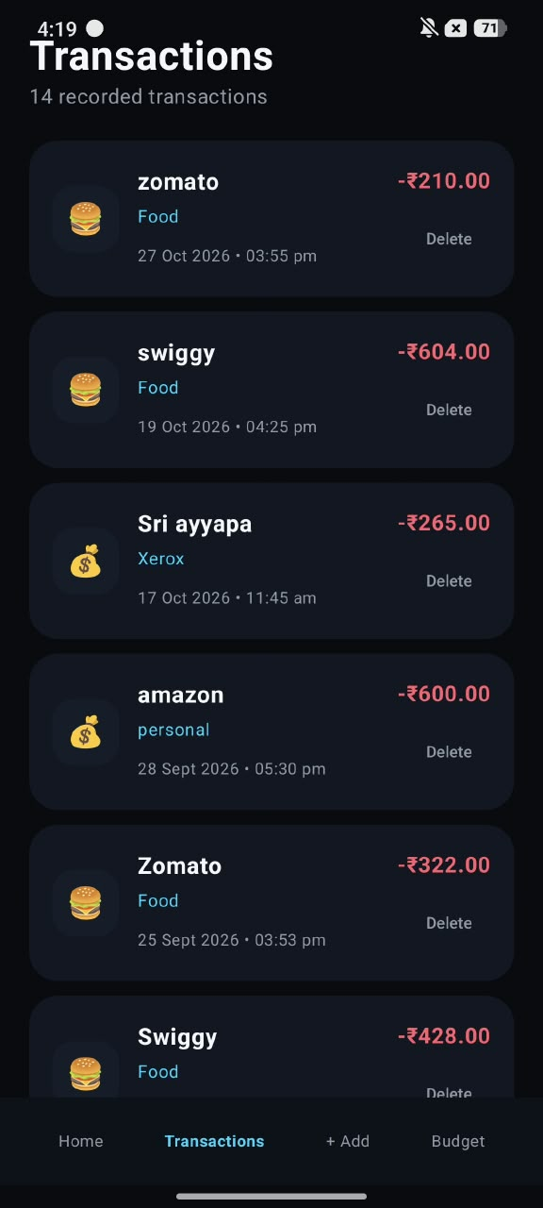

Slide 14
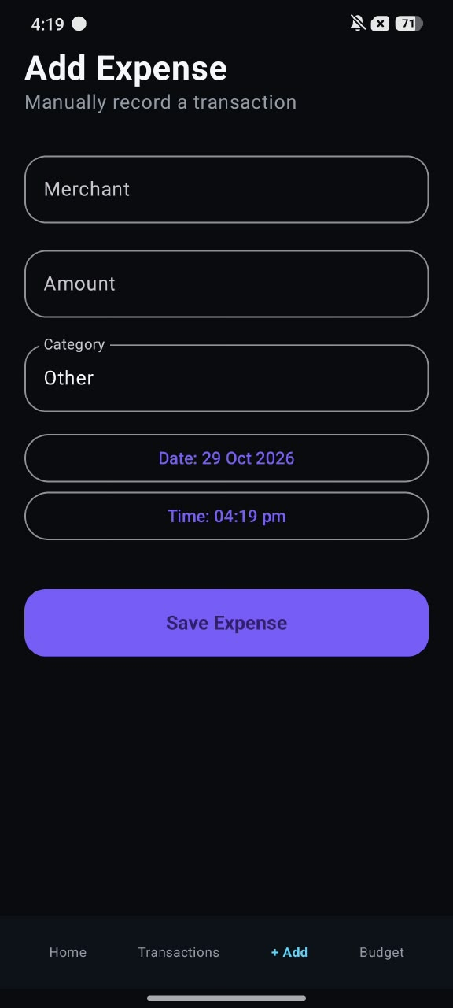

Slide 15
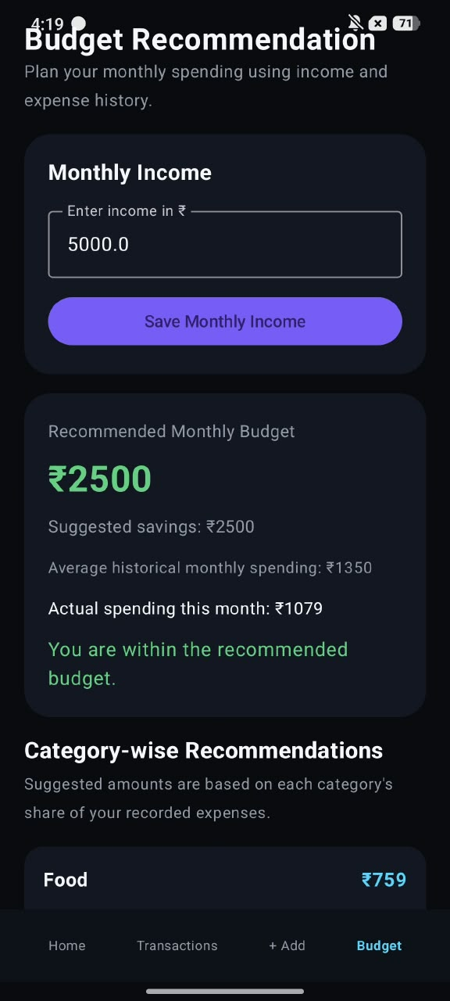
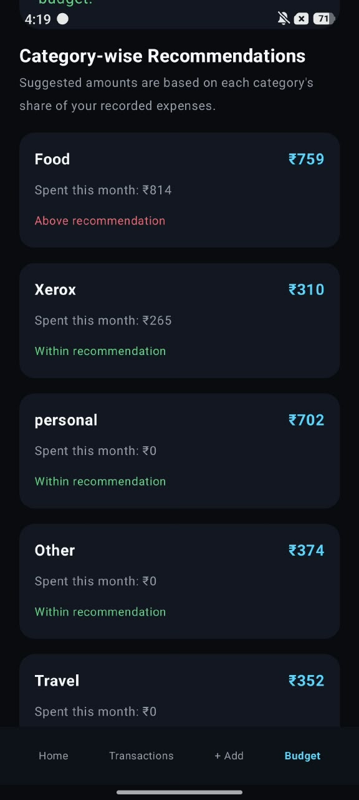

Slide 16
Future Enhancement
Potential extensions to make the system more capable, adaptive and user-friendly.
More Data Sources
Advanced Prediction
Extend capture beyond payment notifications to additional receipt and transaction sources.
Explore richer forecasting methods as more historical user data becomes available.
Smarter Anomaly Detection
Personalized Budgeting
Improve anomaly analysis using user-specific spending patterns and feedback.
Generate more adaptive category limits and recommendations from individual behavior.
Mobile / Cloud Integration
Continuous Learning
Support broader access, synchronization and a more complete user dashboard.
Use corrected categories and user feedback to improve future classification and recommendations.

Slide 17
Gantt Chart — Development Schedule
JULY Month
AUGUST Month
Phase / Task | W1 | W2 | W3 | W4 | W5 | W6 | W7 | W8
Requirement Analysis | ■
Literature Survey | ■ | ■
UI & Database Schema Design |  | ■ | ■
Notification Parser Module |  |  | ■ | ■
ML Categorization Engine |  |  |  | ■ | ■
Spending Prediction Module |  |  |  |  | ■ | ■
Anomaly Detection Pipeline |  |  |  |  |  | ■ | ■
Dashboard & Full Integration |  |  |  |  |  |  | ■ | ■

Slide 18
Gantt Chart — Testing & Delivery Schedule
SEPTEMBER Month
OCTOBER Month
Phase / Task | W1 | W2 | W3 | W4 | W5 | W6 | W7 | W8
Dataset Preparation & Labeling | ■ | ■
Unit Testing (Modules) |  | ■ | ■
ML Model Evaluation & Tuning |  |  | ■ | ■
End-to-End Integration Testing |  |  |  | ■ | ■
Bug Fixing & Optimization |  |  |  |  | ■ | ■
Documentation & Report Drafting |  |  |  |  |  | ■ | ■
Prototype Demo Preparation |  |  |  |  |  |  | ■
Final Review & Submission |  |  |  |  |  |  |  | ■

Slide 19
Conclusion
The proposed system brings transaction capture, AI categorization, spending prediction, anomaly detection and budgeting support into one lightweight workflow.
Unified Pipeline
Automated Data Capture
Smart Categorization
Replaces manual record keeping with an automated, intelligent finance pipeline.
Uses lightweight Naive Bayes for high-speed textual transaction classification.
Eliminates manual data entry overhead through direct notification parsing.
Forward-Looking Analytics
Proactive Security & Awareness
Intelligent Budgeting
Employs Linear Regression to project future financial commitments accurately.
Identifies abnormal transactions using Isolation Forest outlier detection.
Converts raw historical records into proactive, personalized financial guardrails.

Slide 20
Thank You!
Questions & Discussion
Primary Reference
AI-Based Smart Expense Management System with Automated Categorization and Budget Recommendations — Mini Project Report, Department of CSE (AI & ML), Vels University, Chennai.
Literature Base
Section 2 (Literature Survey) — Covers AI/ML in personal finance, text-based expense classification, regression forecasting, and outlier isolation models.
PRESENTED BY
DEPARTMENT
• Kotakonda Shravan B
• S. Thahseen Basha
• Varun Sekar V
CSE (AI & ML), Vels University, Chennai

