Slide 1
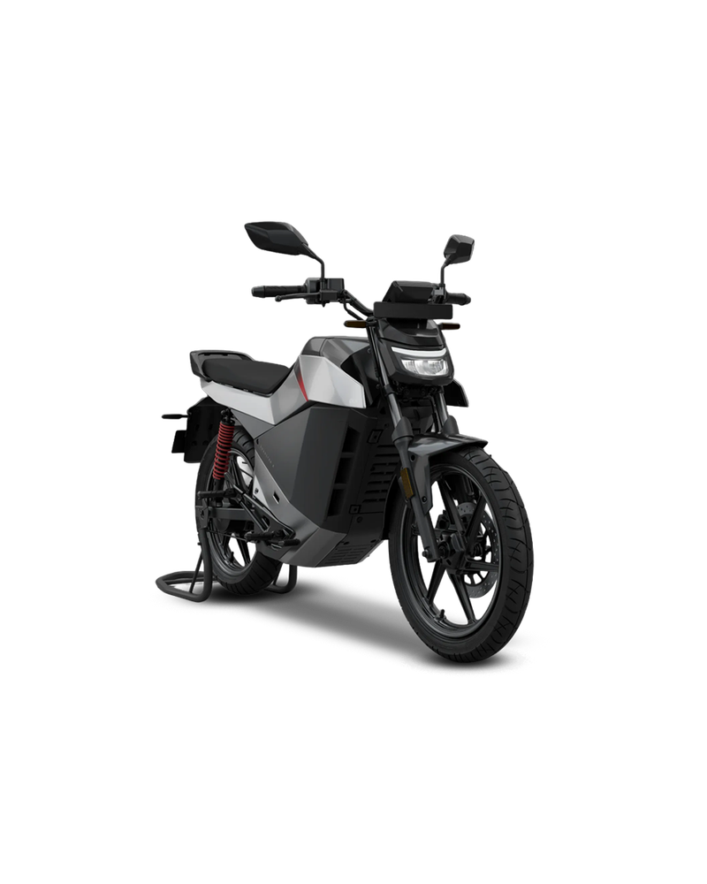

AI‑Powered Multi‑Brand E‑Bike Recommendation and Smart Monitoring System
B.Tech CSE (Artificial Intelligence & Machine Learning)
Soundarya M, Saraniya A, Josphin Sheran J
Register No: 24619160, 24619128, 24619116•
Dept. of Artificial Inteligence & Machine Learning
College: VISTAaS
Guide: Dr.Manikandan [ Assistant Professor ]
Slide 1 • AI‑Powered Multi‑Brand E‑Bike Recommendation and Smart Monitoring System

Slide 2
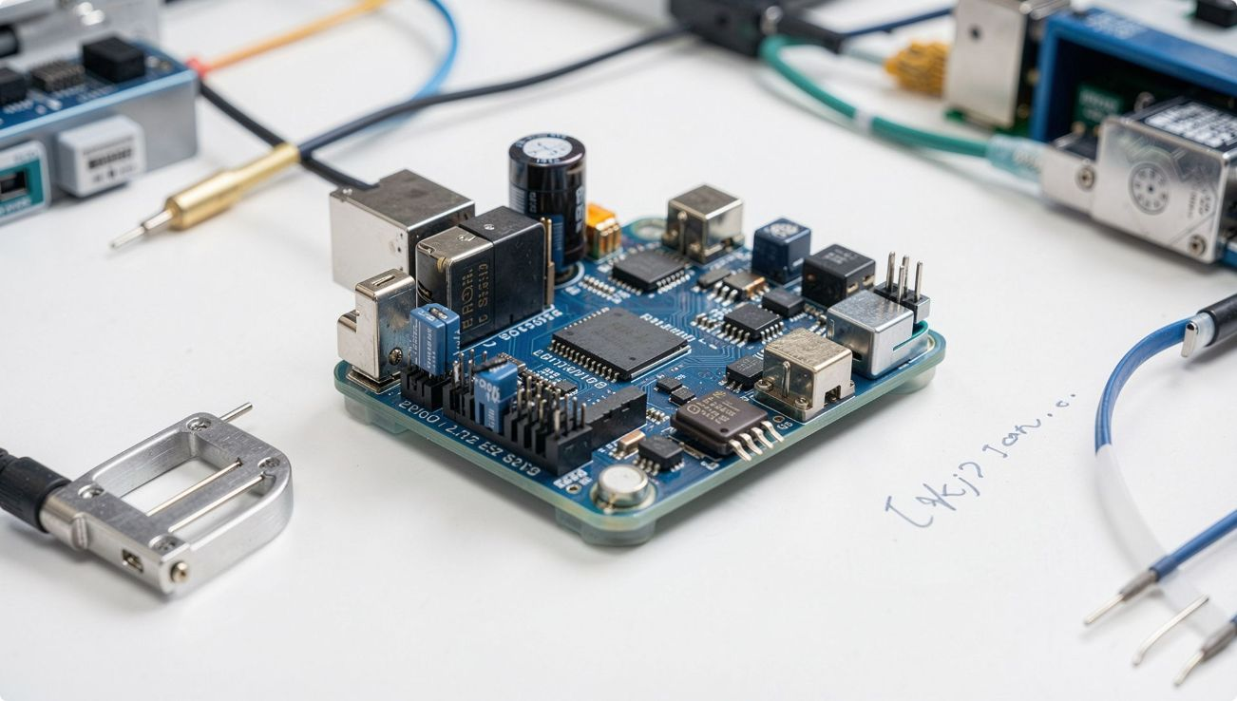
Abstract
The AI-Powered Multi-Brand E-Bike Recommendation and Smart Monitoring System is an intelligent solution that helps users choose the most suitable electric bicycle while continuously monitoring battery health and vehicle performance. The system uses Artificial Intelligence (AI) to recommend e-bikes based on user preferences such as budget, travel distance, speed, and battery capacity across multiple brands.
It also integrates an ESP32 microcontroller, smart Battery Management System (BMS), current and temperature sensors, and an LCD/mobile interface to monitor real-time parameters including battery percentage, voltage, current, temperature, and estimated range. The collected data enables predictive battery health analysis and provides alerts for overheating, low battery, and abnormal operating conditions.
This project improves decision-making, enhances battery safety, reduces maintenance costs, and promotes efficient adoption of electric mobility through a smart, user-friendly platform.
Slide 2 • Concise academic abstract

Slide 3
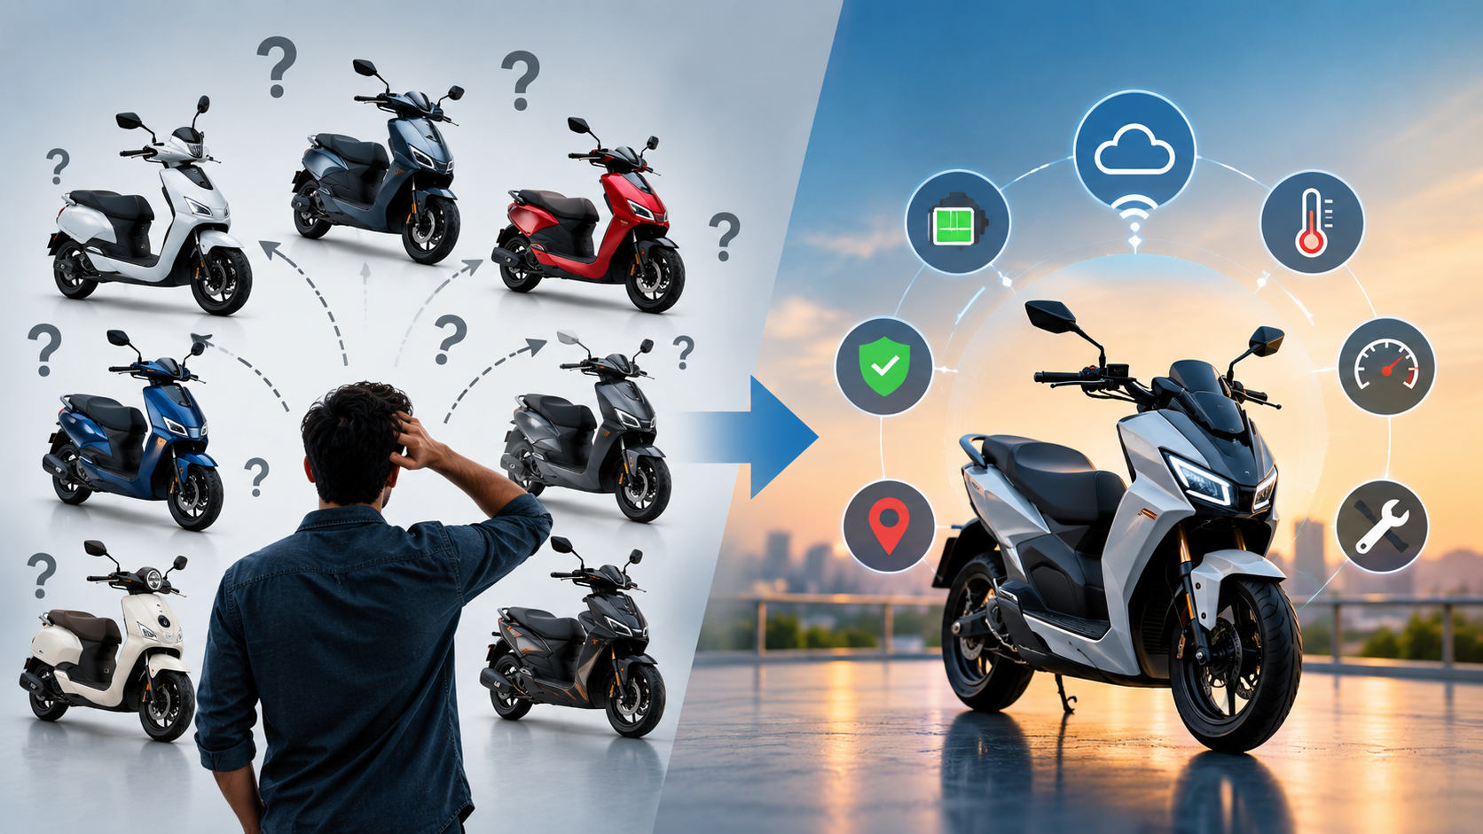
Problem Statement
E‑bike market has many brands and models with varied specifications.
Non‑technical buyers find technical specs (range, battery, motor) hard to interpret.
Comparison sites require manual specification matching; limited personalization.
Recommendation results often lack clear explanation or compatibility rationale.
Post‑purchase monitoring and recommendation systems rarely integrate.
Raw sensor data often lacks translation into actionable health or maintenance guidance.
There is a need for an integrated platform that couples explainable pre‑purchase recommendation with continuous post‑purchase monitoring and alerts.
Slide 3 • Clear articulation of the core problem

Slide 4
Project Objectives
1. Multi‑brand recommendation
2. Simple user input
3. Compatibility scoring
Accept budget, distance, terrain, height, weight, purpose and preference.
Compare requirements with product specs to compute scores and rankings.
Develop a system to compare multiple manufacturers and models.
4. Explainable recommendations
5. IoT monitoring prototype
6. Alerts & maintenance
Design ESP32‑based telemetry for battery, motor, vibration and motion.
Detect anomalies, raise alerts and suggest maintenance actions.
Provide human‑readable reasons for each recommendation.
7. Integrated platform
Combine recommendation and monitoring for a continuous user experience.
Slide 4 • Ten concise objectives

Slide 5
Literature Survey
Selected studies and related works (placeholders used where exact references are unavailable).
Paper / Study | Year | Approach / Main Contribution | Limitation / Relevance
A Machine Learning Based Bike Recommendation System Catering To User’s Travel Needs | 2020 | Survey of product recommendation algorithms (rule‑based, content‑based, collaborative). | General methods; limited to e‑commerce contexts.
U-Park: A User-Centric Smart Parking Recommendation System for Electric Shared Micromobility Services | 2024 | Battery monitoring techniques for EVs and state‑of‑health indicators. | Focus on battery management hardware; not integrated with user recommendations.
Smart Bike Monitoring System Using IoT | 2023 | IoT architectures for vehicle telemetry using lightweight MCUs and MQTT/HTTP. | Prototype communication focus; limited discussion of explainability.
Artificial Intelligence and IoT based Smart Battery Management System for Electric Vehicle | 2022 | Explainable recommendation frameworks for consumer products. | Conceptual explanations; few real‑world e‑bike examples.
An IoT-Based Measurement Device for E-bike Tracking Performance Analysis | 2024 | Predictive maintenance approaches using vibration and temperature features. | Requires labelled failure data; not always available for small fleets.

Slide 6
Research Gap
Approach | Recommendation | Multi‑brand | Explainability | IoT Monitoring | Maintenance | Integrated Platform
Traditional comparison | — | ✓ | — | — | — | —
Basic recommendation | ✓ | Limited | Limited | — | — | —
IoT monitoring | — | — | — | ✓ | Limited | —
Battery monitoring | — | — | — | ✓ | ✓ | —
Proposed system | ✓ | ✓ | ✓ | ✓ | ✓ | ✓
Key observation: Existing work often covers either recommendation or monitoring. There is limited integration across recommendation, explainability and continuous IoT‑based health assessment.
Slide 6 • Professional comparison table

Slide 7
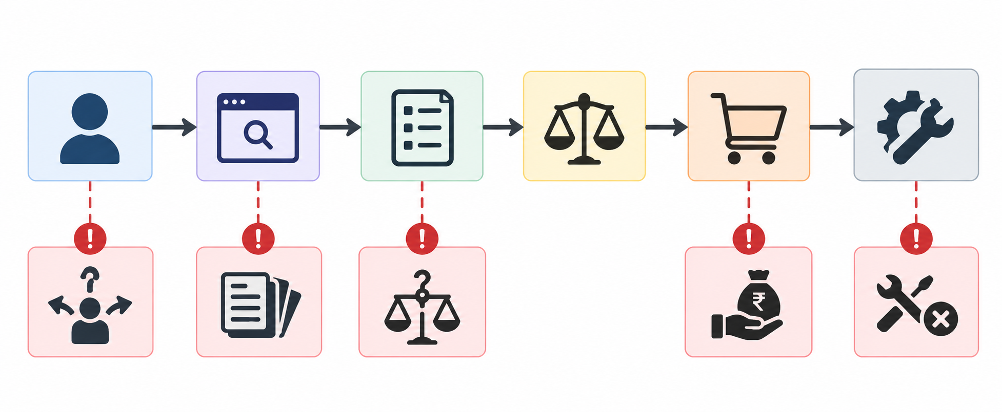
Existing Systems
Brand‑specific websites
Existing ecosystem components are largely fragmented:
Brand websites + Comparison sites + Recommendation tools + IoT monitoring tools
↓
Fragmented user experience
Provide product data but limited cross‑brand comparison and personalisation.
Generic comparison sites
Display specifications; users perform manual comparisons.
Basic recommendation tools
May suggest options but often lack transparent explanations.
Standalone IoT monitoring
Capture telemetry and show readings; limited integration with selection tools.
Slide 7 • Clear explanation of current approaches

Slide 8
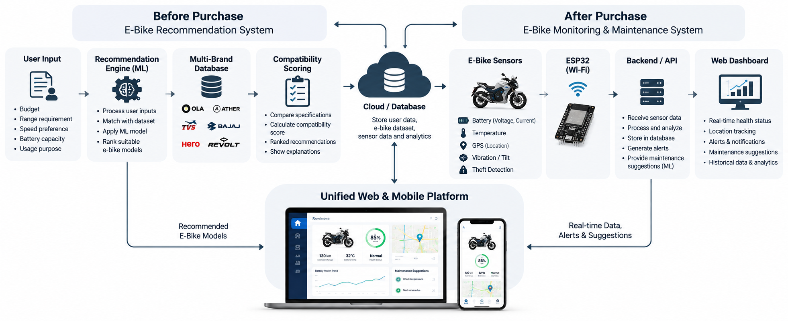
Proposed System — Two Connected Stages
Slide 8 • Concise two‑stage overview with engineering diagram

Slide 9
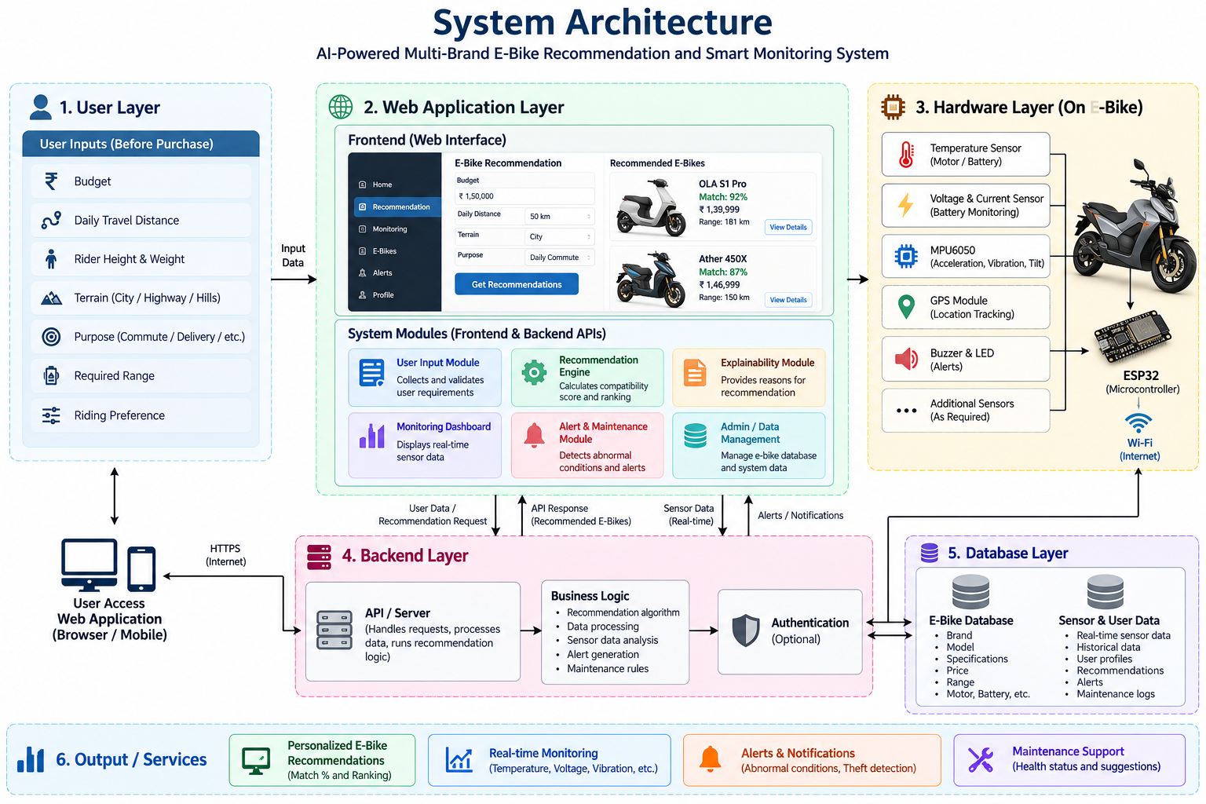
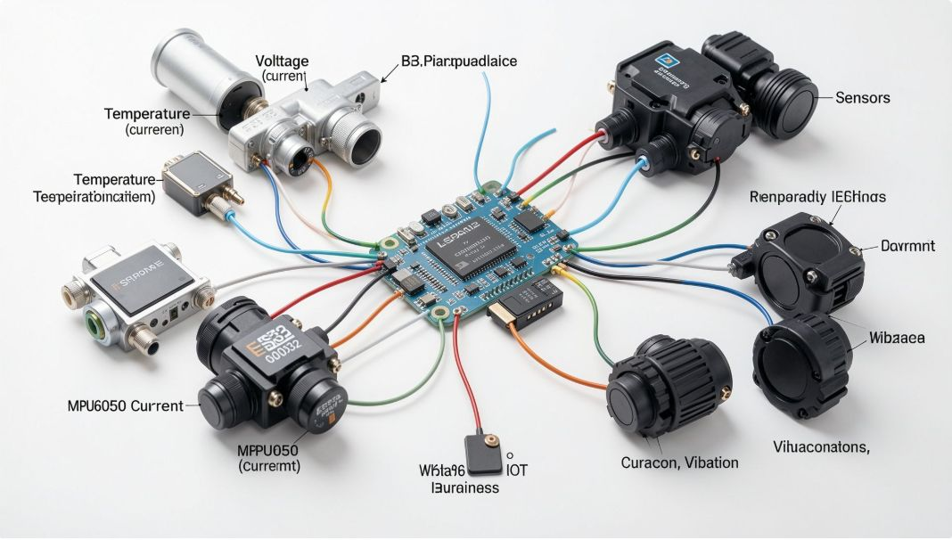
System Architecture
Clean technical architecture separated into hardware and software layers.
Recommendation flow: User requirements → Recommendation engine → Multi‑brand dataset → Compatibility score → Ranked results
Hardware layer
Communication
Backend
Software & UX
Temperature sensor, Battery voltage/current sensors, MPU6050 (vibration/tilt), optional GPS → ESP32
ESP32 → Wi‑Fi / Internet (HTTP / MQTT)
API server → Database (product dataset & telemetry store)
Web app: Recommendation engine, Monitoring dashboard, Alerts & Maintenance modules
User layer
End user interacts via web interface for selection and monitoring
Slide 9 • Engineering block diagram with software/hardware separation

Slide 10
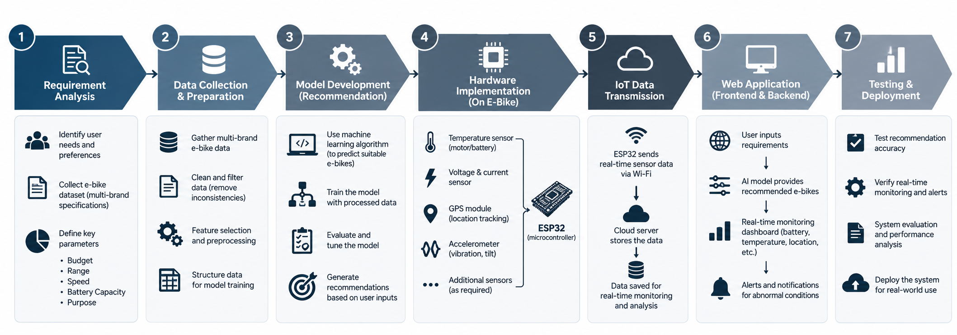
Methodology — Prototype Workflow
Slide 10 • Methodology as a structured process flow suitable for faculty review
Footer: AI‑Powered Multi‑Brand E‑Bike Recommendation and Smart Monitoring System • Slide 10

Slide 11


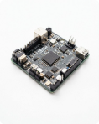







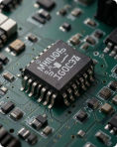


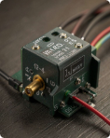
Technology Used
Software
Hardware
HTML
CSS
ESP32
Buzzer
Structure the recommendation web interface and static pages.
Visual styling to match academic theme and responsive layouts.
Microcontroller for sensor collection and network communication.
Local audible warning for detected abnormal conditions.
JavaScript
Recommendation algorithm
Temperature sensor
LEDs
Client-side interactivity for forms and UI behaviour.
Rule-based / similarity scoring to match users to e-bike specs.
Monitors motor / ambient temperature for thermal alerts.
Visual status indicators (power, fault, connectivity).
Web interface & API
Database
MPU6050
Optional GPS
Serves user inputs and recommendation results; backend integration point.
Stores structured e-bike specifications and user session data.
Measures acceleration and gyro for vibration, tilt and motion analysis.
Location tracking if the hardware configuration includes it.
Python / ML libraries
Voltage / current sensor
Used only if ML models were implemented (scikit-learn, pandas).
Monitors battery electrical parameters for health and charging status.

Slide 12
Dataset
The recommendation engine compares user requirements against structured e‑bike specifications.
A. E‑Bike Product Data
B. User Input Data
Prototype dataset — structured multi‑brand e‑bike specifications collected for demonstration.
Input | Purpose
Budget | Filter brands/models within user's price range
Daily distance | Estimate required battery range
Height / Weight | Assess rider fit and load capacity
Terrain / Purpose / Riding preference | Match motor, suspension, and frame suitability
Required range | Directly compared to claimed range for compatibility scoring
Attribute | Example | Type | Notes
Brand / Model | BrandX Model Y | String | Identifier for matching and display
Price | Numeric | Number | Used for budget compatibility
Battery capacity / Claimed range | Wh / km | Number | Used to evaluate required range
Motor power / Max load / Weight | W / kg | Number | Relevance to terrain and rider
If a production dataset is assembled later, add size, source and update cadence here.

Slide 13
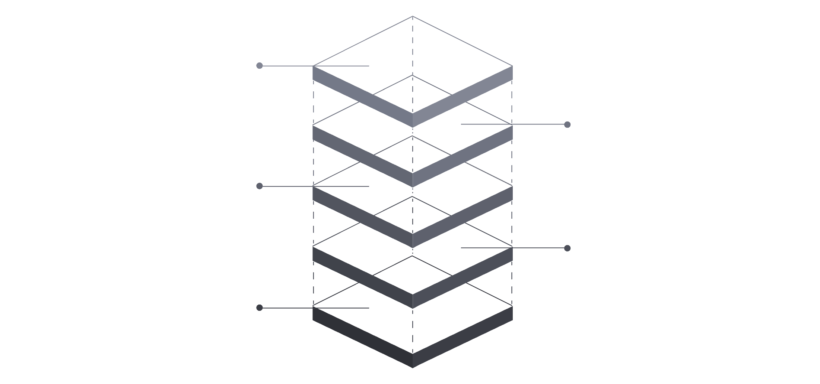
Implementation — System Modules
System decomposed into discrete modules for clarity, testing and incremental development.
IoT Monitoring
Stream telemetry from devices
Explainability
Provide transparent rationale
Recommendation Engine
Generate personalized suggestions
E-Bike Database
Store bike specs and usage logs
User Input
Collect rider preferences and data
Diagram: arrows indicate data flow from User Input → Recommendation Engine → Web Dashboard; IoT Monitoring feeds Alerts and Dashboard.
1
2
3
4
Module 1: User Input
Module 2: E‑Bike Database
Module 3: Recommendation Engine
Module 4: Explainability
Collects Budget, Distance, Height, Weight, Terrain, Purpose, Range, Preference.
Stores Brand, Model, Price, Range, Motor, Battery, Weight, Terrain suitability.
Computes compatibility scores, rankings and recommendations.
Generates human‑readable reasons (budget, range, terrain suitability).
5
6
7
Module 5: IoT Monitoring
Module 6: Alert & Maintenance
Module 7: Web Dashboard
Collects temperature, voltage/current, vibration, motion, tilt and other sensors.
Detects abnormalities and issues warnings, maintenance suggestions.
Displays recommendations, sensor readings, health status and alerts.

Slide 14
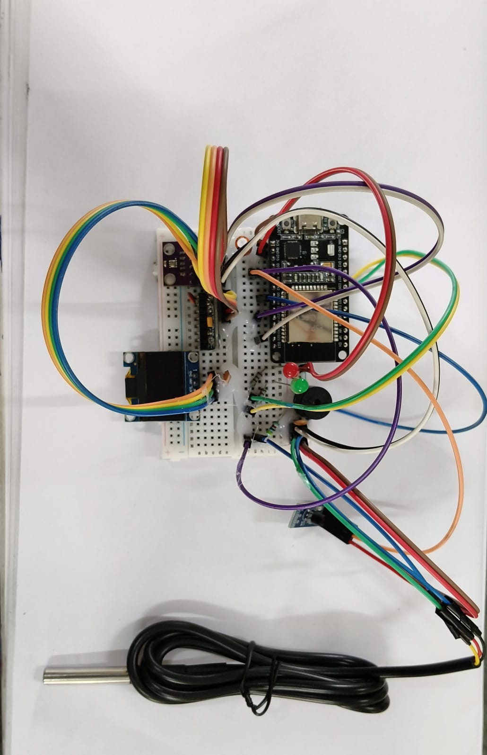
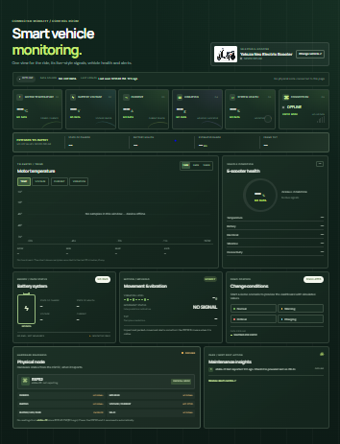
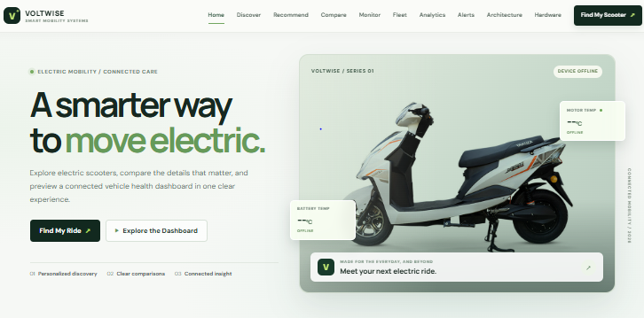
Results — Current Progress
Software Progress
Hardware Progress
Monitoring Progress
[INSERT ACTUAL WEBSITE SCREENSHOT]
[INSERT ACTUAL ESP32 + SENSOR PHOTOGRAPH]
[INSERT ACTUAL DASHBOARD SCREENSHOT]
Visible: user input form, recommendation output, match percentage and ranked list (replace placeholder with real screenshot).
Photograph should show ESP32 connected to sensors and wiring; label components in the figure caption.
Dashboard panels: Temperature, Battery Voltage, Current, Vibration, System Status. If prototype lacks real readings, label as “Prototype / simulated demonstration”.

Slide 15
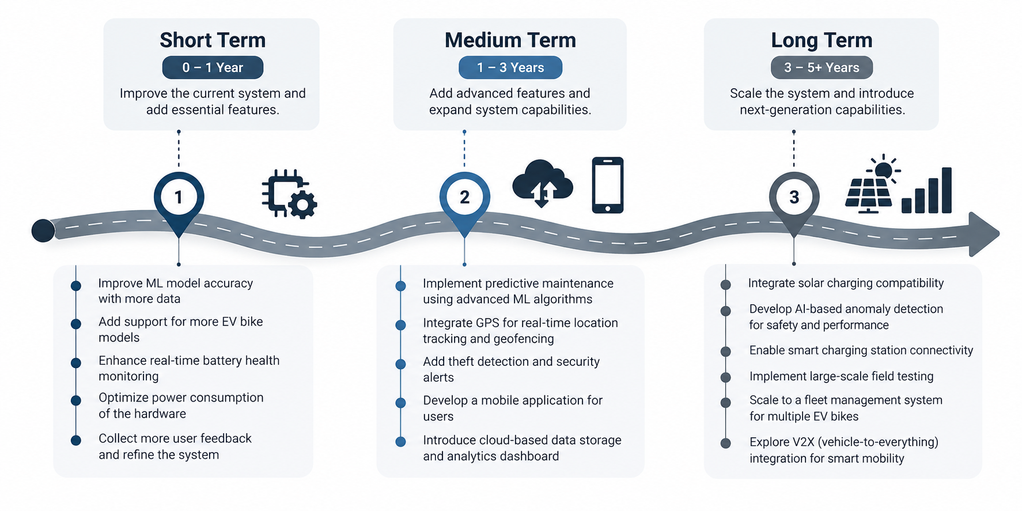
Future Enhancements — Roadmap

Slide 16
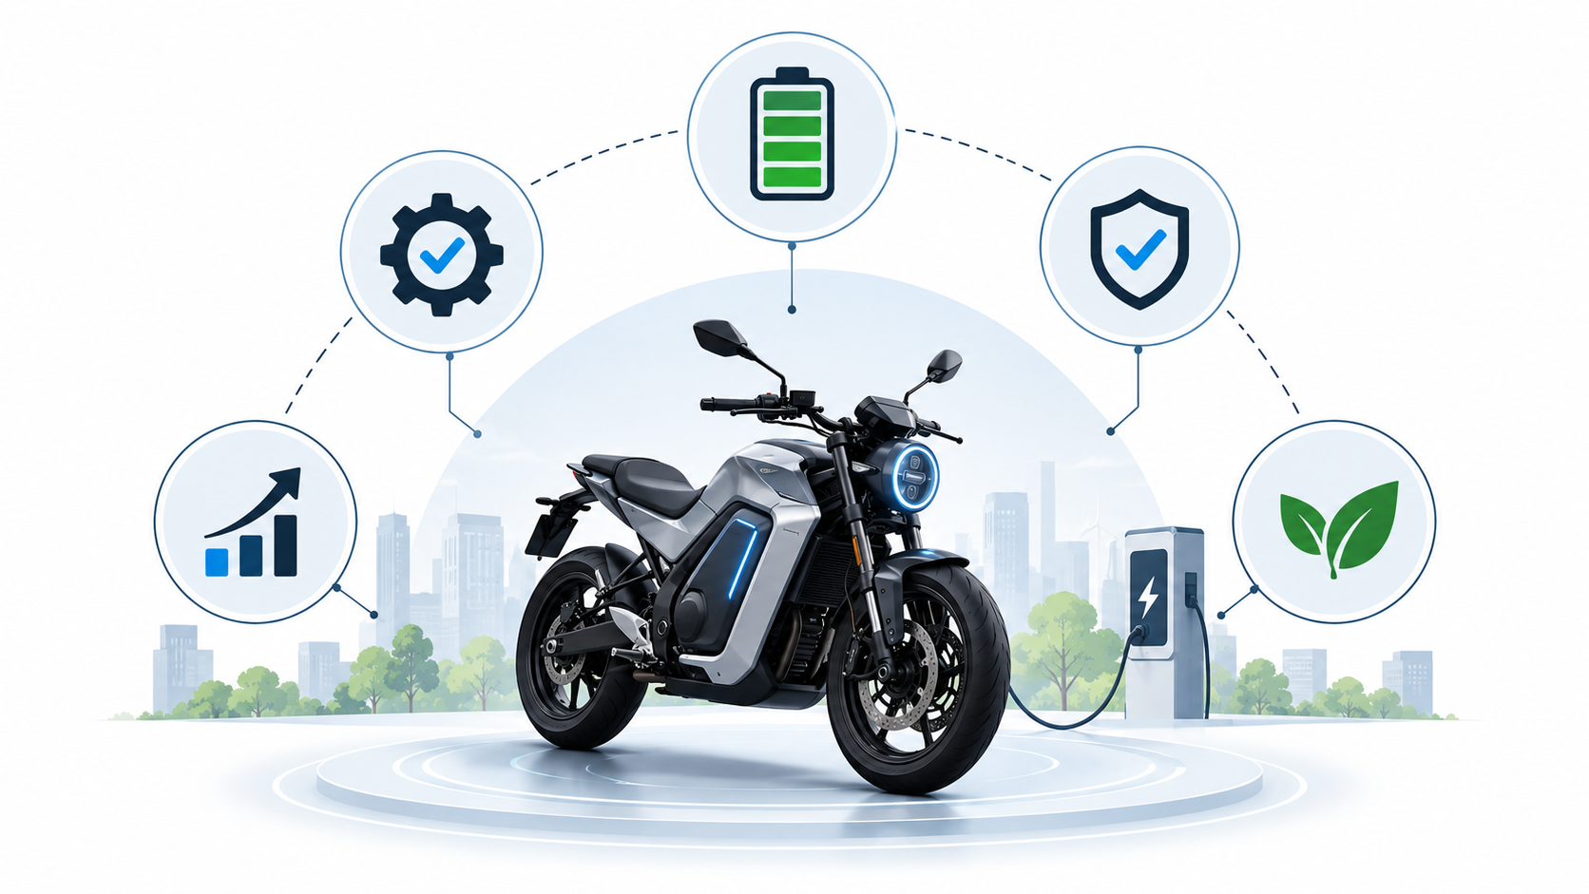
Conclusion
The project integrates pre‑purchase intelligence with post‑purchase monitoring to produce a unified e‑bike platform.
The recommendation module helps users identify e‑bikes based on individual requirements.
Multi‑brand comparison reduces manual specification comparison effort.
Explainable compatibility scoring provides transparent reasons for each recommendation.
The IoT module enables continuous monitoring of temperature, electrical parameters and motion.
ESP32 bridges onboard sensors to the software dashboard for near‑real‑time visibility.
The monitoring system can detect abnormal conditions and issue alerts for maintenance.
The prototype establishes a foundation for future ML models and predictive‑maintenance features.
Thus, the proposed system connects e‑bike selection with post‑purchase intelligent monitoring within a single platform.

Slide 17
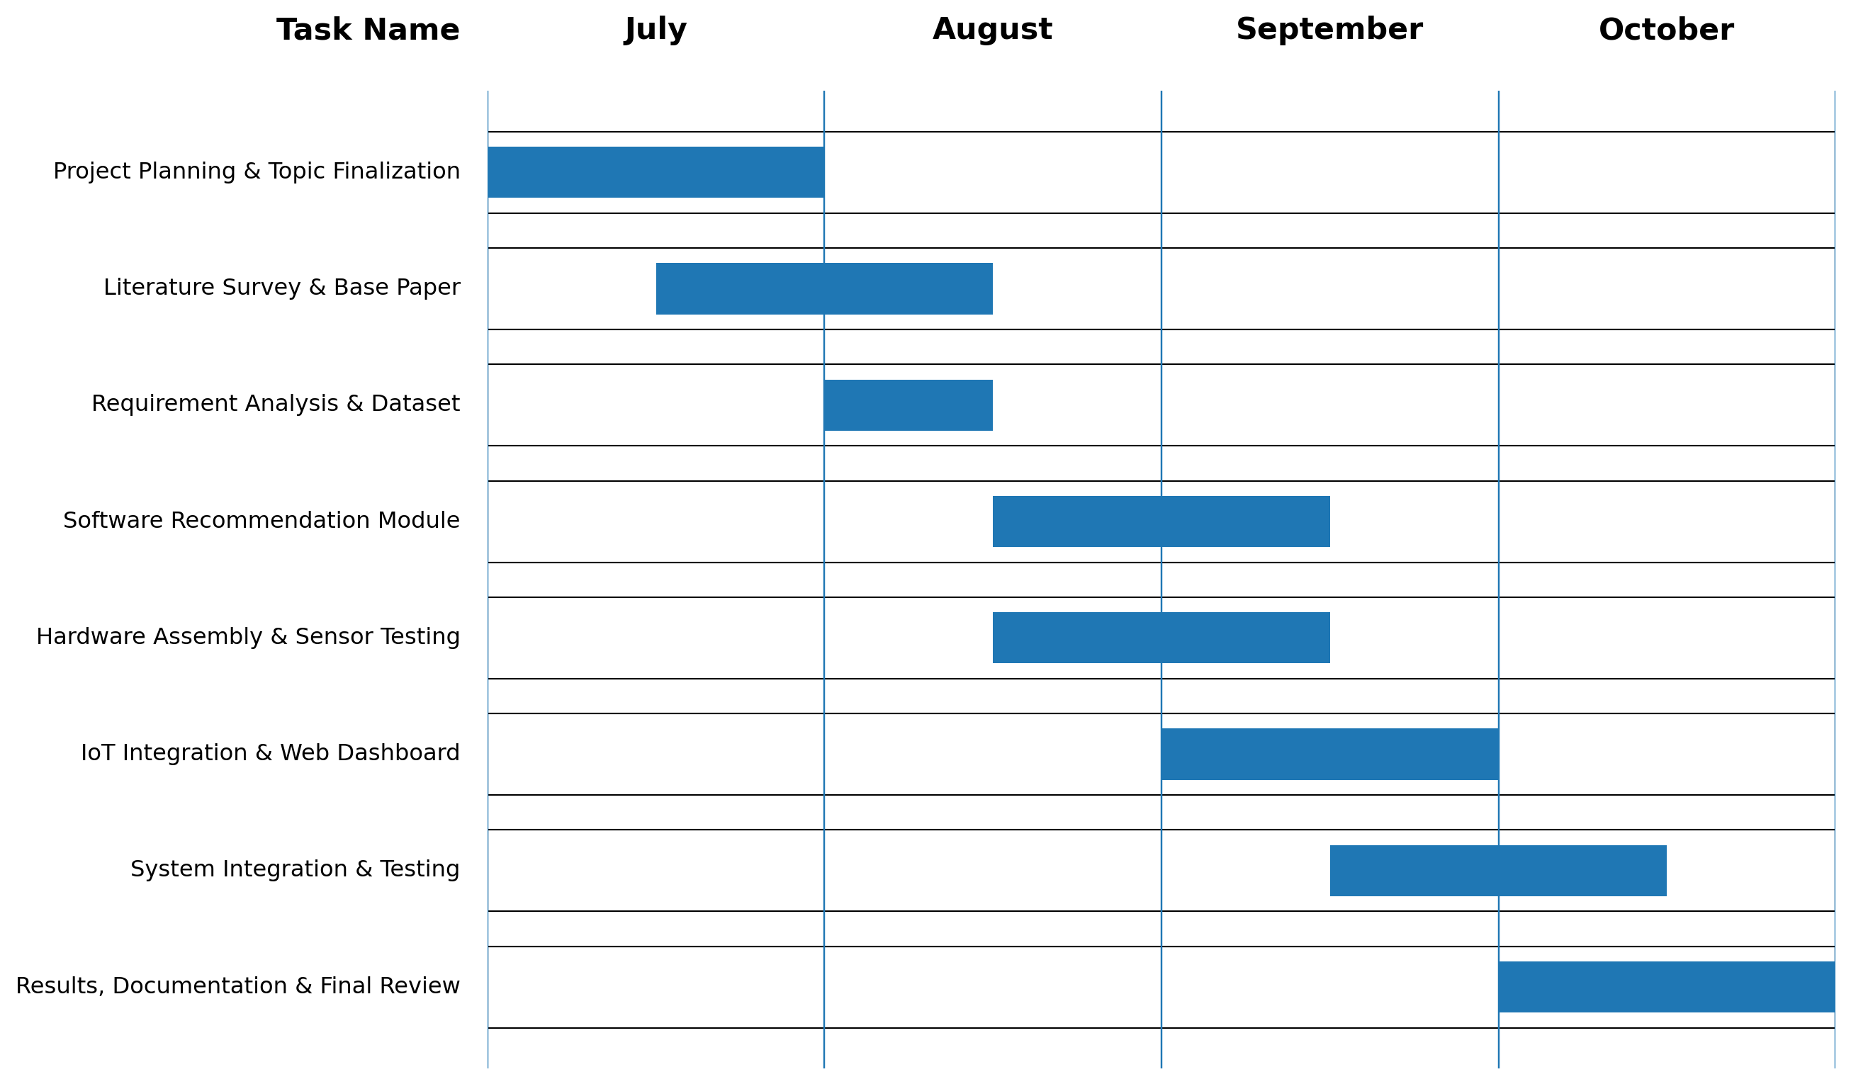
Gantt Chart — Project Timeline

Slide 18
THANK YOU
Questions & Discussion
AI‑Powered Multi‑Brand E‑Bike Recommendation and Smart Monitoring System

