Slide 1
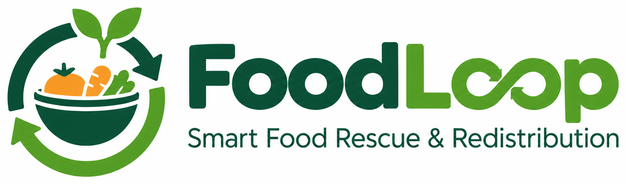

FOODLOOP PROJECT PRESENTATION
Sukrish T | Arun A | Sadham Hussian R
Project Guide: Akash S
A clear workflow for listing surplus food, matching recipients, and tracking collection.
01

Slide 2
Abstract
FoodLoop is a web-based surplus-food rescue and redistribution concept designed to make it easier for donors to share available food with recipient organisations that can use it. A donor can create a listing with the food category, quantity, pickup location, availability and collection deadline. Recipient organisations can review the available listings and compare them with their needs and pickup capacity. The system can then apply clear, rule-based checks to prioritise suitable donations using factors such as urgency, recipient fit and collection feasibility, while showing the main reasons behind a recommendation. After a recipient reserves a donation, the donor and recipient can confirm collection details and update the pickup outcome. These records can support a simple dashboard of completed, pending, cancelled and missed collections. FoodLoop’s aim is to connect listing, matching, reservation and collection tracking in one understandable workflow; cloud storage, authentication and live notifications should only be described as working features after they have been configured and tested.
Project scope: a clear donation-to-collection workflow; deployment and data persistence must be verified separately.
FOODLOOP | PROJECT PRESENTATION
2

Slide 3
Problem Statement
Edible surplus food can remain unused while community groups and people in need may struggle to find suitable supplies. In many donation situations, information about the food, quantity, collection location and time limit is shared through separate messages or inconsistent records. This makes it difficult for recipients to compare available donations quickly and decide which ones they can collect safely and on time. The coordination process can also become unclear when a donation needs to be reserved, when pickup arrangements change, or when a collection is cancelled or missed. Without a structured record of these events, donors and recipient organisations may find it difficult to understand the status of a donation or review the results of their work. A further challenge is that recommendations should not feel arbitrary: users need a clear explanation of why one eligible donation is prioritised over another. FoodLoop addresses this coordination problem by proposing one workflow for publishing surplus food, checking recipient suitability, prioritising listings transparently, recording reservations and tracking collection outcomes.
FOODLOOP | PROJECT PRESENTATION
3

Slide 4
Project Objectives
The main outcomes the FoodLoop concept is designed to support
01
Create donation listings with category, quantity, location, and collection deadline
02
Match available listings against recipient needs and capacity
03
Rank suitable donations using transparent urgency rules
04
Explain why each listing is recommended
05
Track reservation, collection, cancellation, and missed pickup
06
Summarise activity and outcomes from recorded data
FOODLOOP | PROJECT PRESENTATION
4

Slide 5
Literature Survey
Selected published studies relevant to food redistribution, digital platforms and collection logistics
Paper / Study | Year & Journal | Approach / Main Contribution | Relevance to FoodLoop
Oroski & da Silva — “Understanding food waste-reducing platforms: A mini-review” | 2023 Waste Management & Research, 41(4), 816–827 | Reviews digital food-waste-reducing platforms and how they connect surplus supply with demand. | Supports the use of a digital listing and donor–recipient connection workflow.
Orgut, Ivy, Uzsoy & Hale — “Robust optimization approaches for the equitable and effective distribution of donated food” | 2018 European Journal of Operational Research, 269(2), 516–531 | Develops optimization approaches for fair and effective food-donation distribution under uncertainty. | Highlights the importance of recipient capacity and fair allocation; FoodLoop uses simpler prototype rules.
Dubey & Tanksale — “A multi-depot vehicle routing problem with time windows, split pickup and split delivery for surplus food recovery and redistribution” | 2023 Expert Systems with Applications, DOI: 10.1016/j.eswa.2023.120807 | Models surplus-food pickup and redistribution with vehicle capacity and time-window constraints. | Shows why collection deadlines and feasibility matter; full route optimization is outside the current scope.
“From Waste to Worth: Enhancing Access to Edible Surplus Food Using a Mobile App for Better Distribution” | 2025 Procedia Computer Science, 269, 749–761 | Describes a mobile application concept using listings, pickup scheduling and geolocation to support redistribution. | Relates to digital access and pickup coordination; FoodLoop should validate its own workflow with users.
Note: These studies inform the design; they do not prove FoodLoop’s effectiveness. Evaluate the prototype using local partner feedback and recorded test results.
FOODLOOP | PROJECT PRESENTATION
5

Slide 6
Research Gap
Comparing the workflow elements highlighted in the project
Approach | Listings | Matching | Urgency | Explanation | Pickup tracking | Recurring analytics
Manual coordination | Limited | Manual | Varies | — | Limited | —
Donation portal | Yes | Yes | Varies | Limited | Yes | —
Routing tool | — | Yes | Yes | — | Limited | Limited
FoodLoop concept | Yes | Yes | Yes | Yes | Yes | Yes
Research question: can listings, explainable prioritisation, reservations, and collection tracking work together in a simple workflow for the intended local context?
FOODLOOP | PROJECT PRESENTATION
6

Slide 7
Existing Systems
Common approaches and the gap FoodLoop explores
Donation listings
Food-sharing services
Logistics tools
Publish surplus food details, but recipients may still need to compare options manually.
Connect donors and recipients, with different eligibility and collection processes.
Support routing or scheduling, but may not cover the full donation lifecycle.
FoodLoop focuses on connecting listing, matching, explanation, reservation, and collection records in one workflow.
FOODLOOP | PROJECT PRESENTATION
7

Slide 8
Proposed System
From creating a listing to recording the collection outcome
01
LIST
02
CHECK
03
RANK
Donor enters food details, quantity, location, and deadline.
System validates required fields and checks recipient fit.
Transparent rules consider urgency and collection feasibility.
04
EXPLAIN
05
RESERVE
06
RECORD
Recipient can see why an option is prioritised.
Recipient reserves the donation and confirms collection details.
Pickup status and outcome are recorded for the dashboard.
LIST → CHECK → RANK → EXPLAIN → RESERVE → COLLECT → RECORD
FOODLOOP | PROJECT PRESENTATION
8

Slide 9
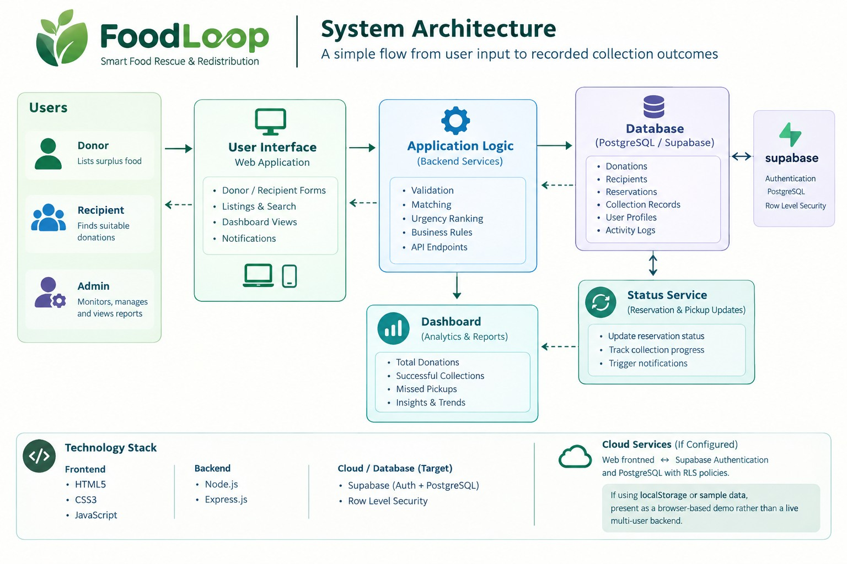

Slide 10
Methodology — Prototype Workflow
The steps followed by the proposed workflow
01
Submit listing
Donor enters the available food, quantity, location, and deadline.
02
Validate details
Check required fields and reject missing or invalid values.
03
Check recipient fit
Compare listing details with recipient needs and capacity.
04
Rank options
Apply transparent urgency and feasibility rules.
05
Reserve donation
Record the reservation and agreed collection details.
06
Record outcome
Update collection status and use records in dashboard summaries.
FOODLOOP | PROJECT PRESENTATION
10

Slide 11
Technology Used
Technologies described in the project and their intended role
FRONTEND
HTML5 / HTML
Page structure and content.
STYLING
CSS3
Layout, readability, and responsive presentation.
APPLICATION LOGIC
JavaScript
Forms, validation, matching rules, and interface behaviour.
STATIC HOSTING
Netlify
Possible hosting for a static web front end.
TARGET DATA LAYER
Supabase PostgreSQL + Auth
Target shared database and authentication design, if configured and tested.
Do not present target cloud services as completed features unless deployment, authentication, and persistence have been verified.
FOODLOOP | PROJECT PRESENTATION
11

Slide 12
Dataset and Data Requirements
Core records needed to compare donations and track collection
Record | Key fields
Donation | Category, quantity, unit, availability time, pickup location, deadline
Donor | Contact or organisation ID, listing details
Recipient | Food categories, required quantity, service location, pickup capacity
Reservation | Donation, recipient, reservation time, status
Collection | Pickup status, completion time, cancellation or missed pickup
Notes / notifications | Work notes, resolution summary, recipient, read flag
Optional photos | Storage path, linked record, upload time
Use clearly labelled demo records until verified partner data is available.
FOODLOOP | PROJECT PRESENTATION
12

Slide 13
System Modules
Modules intended to connect donation input with collection outcomes
Donation input
Recipient profile
Create listings and validate required fields.
Store recipient requirements and pickup capacity.
Matching & urgency ranking
Recommendation explanation
Compare suitability and prioritise by transparent rules.
Show the main reasons a listing is prioritised.
Reservation & pickup
Analytics dashboard
Track reservation, collection, cancellation, and missed pickup.
Summarise completed, pending, and missed collections.
Shared cloud data depends on the deployed implementation and must be verified before claiming it is live.
FOODLOOP | PROJECT PRESENTATION
13

Slide 14
Testing & Evaluation
Checks to run before presenting the prototype as reliable
□
Listing validation
Create a complete listing; reject missing or invalid values.
□
Availability rules
Confirm expired or reserved donations are not shown as available.
□
Matching behaviour
Change recipient needs and confirm ranking responds appropriately.
□
Reservation conflicts
Attempt duplicate reservations and check for conflicts.
□
Persistence
Refresh the page and verify saved records remain available.
□
Dashboard accuracy
Compare dashboard totals with the underlying records.
□
Access control
Verify users can change only records they are allowed to access.
Report observed test results only; do not imply tests passed before they are run.
FOODLOOP | PROJECT PRESENTATION
14

Slide 15
Future Enhancements
Possible next steps after prototype testing and partner feedback
Live map and routing
Help partners plan practical collection routes.
Status notifications
Send reminders and updates for reservation and pickup changes.
Verified organisations
Introduce checks for participating donors and recipient organisations.
Ranking evaluation
Use completed pickup records to assess whether ranking rules are useful.
Local pilot
Work with partners and measure collection outcomes in a real setting.
These are proposed enhancements, not claims about features already implemented.
FOODLOOP | PROJECT PRESENTATION
15

Slide 16
Limitations & Conclusion
What the concept supports—and what still needs validation
LIMITATIONS
CONCLUSION
• Ranking depends on the quality of details entered by users.
• Location and travel-time estimates may be unavailable or approximate.
• FoodLoop does not independently verify food safety or guarantee pickup.
• Real-world impact requires partner testing and reliable collection records.
• Brings donation listings, recipient matching, and pickup tracking into one proposed workflow.
• Transparent rules can help users understand why a donation is prioritised.
• Next steps are to test the prototype, verify persistence, and report measured results.
• The goal is practical: make suitable surplus food easier to discover and collect.
FOODLOOP | PROJECT PRESENTATION
16

Slide 17
Thank You
FoodLoop — Smart Food Rescue and Redistribution Platform
Sukrish T | Arun A | Sadham Hussian R
Project Guide: Akash S
17

