Slide 1

REVIEW 1 — PROBLEM ANALYSIS & PLANNING
SIGNVISION
AI-Based Hand Sign Translation System
Deepak · Durga · Mukesh
Department of Computer Science and Engineering
VELS Institute of Science, Technology & Advanced Studies (VISTAS)

Slide 2
Introduction
Indian Sign Language (ISL) is the primary language of India's Deaf and hard-of-hearing community — a visual-gestural language with its own grammar, not a signed form of English or Hindi.
Most people outside the Deaf community do not understand ISL, creating a real, everyday communication barrier — in classrooms, hospitals, offices, and public services.
Human interpreters are scarce and cannot be present everywhere; existing sign-recognition software mostly targets isolated alphabet or single-word gestures, not ongoing conversation.
Computer vision (hand-landmark tracking) now runs in real time on ordinary laptop hardware, making camera-based recognition practical without specialized sensors.
Continuous recognition — turning a flowing sequence of signs into a sentence — is significantly harder than isolated-gesture recognition, since sign boundaries, speed, and co-articulation all vary.
Pairing recognition with a conversational AI layer lets the system respond meaningfully, not just transcribe — moving from a dictionary lookup toward an actual communication bridge.
ISL Signing
Camera + CV
Text
Conversational AI
Speech + Caption
1

Slide 3
Problem Statement & Objectives
The interaction between Indian Sign Language users and non-sign-language users is challenging in real time because of the limited availability of human interpreters and the limited capability of conventional sign-recognition systems to support continuous conversation — most existing systems support isolated gesture classification.
Existing problem
Objectives
Isolated sign recognition, not continuous signing
Limited vocabulary coverage
Poor continuous / sentence-level recognition
Sensitivity to lighting and hand occlusion
Signer variability (hand size, speed, style)
Little to no contextual language understanding
Largely one-way — limited two-way interaction
Develop a real-time, camera-based ISL recognition module
Detect dual-hand landmark features using computer vision
Support sequential / continuous sign interpretation
Convert recognized signs into readable text
Integrate a conversational layer for contextual replies
Provide synchronized text and speech output
Evaluate accuracy, precision, recall, F1-score, and latency
2

Slide 4
Abstract
Communication has become easier with technologies such as chatbots and virtual assistants, but people who are deaf or mute still face difficulties while communicating with others. Existing sign-language recognition systems mainly focus on recognizing individual signs and often have limited support for continuous communication. To overcome this challenge, the project aims to develop a Sign Language Assistant to facilitate real-time communication between sign language users and the broader community using computer vision, natural language processing, and a conversational interface. The system employs computer vision for hand detection and recognition of sign language gestures to detect them in real-time. It is trained with Indian Sign Language (ISL) dataset that consists of the standard sign samples for recognition. Recognized signs are translated to text and fed to an chatbot that is able to produce appropriate responses based on the context of the conversation. These responses are then delivered via spoken word and captioning, thus making the interaction more natural and accessible. The accuracy, precision, recall, F1-score and recognition latency are used to assess the performance of the sign-recognition module. The accuracy, relevance, response time, and semantic similarity of the chatbot's responses are assessed. This system is stable under normal circumstances with limited vocabulary, but might have problems when the signer's hand is occluded, the signing is very fast, and the vocabulary is large. In the future, sign language learning, sign-language personalized feedback, sign-language 3D hand-pose estimation, and sign-language animation with avatars are expected to be added, with the goal of enhancing sign-language recognition and user experience.
3

Slide 5
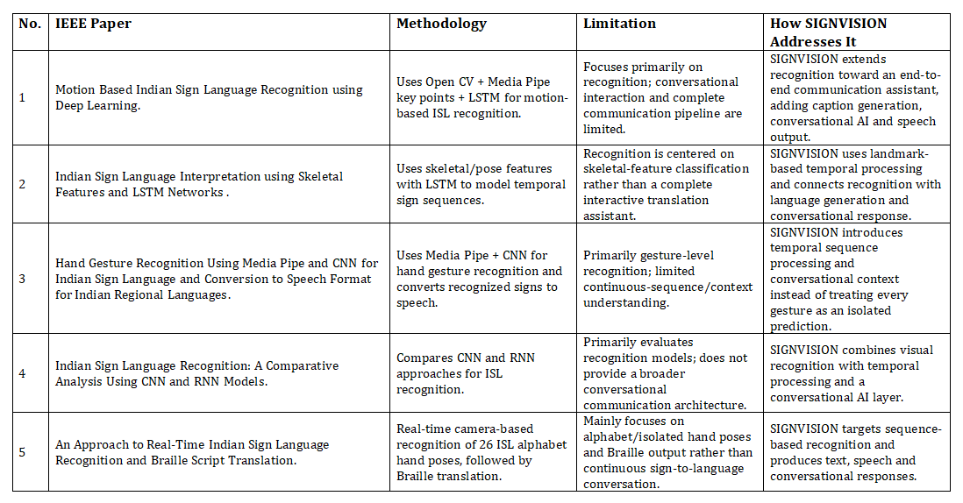
Literature Survey (1 of 2)
Author & Year | Title | Methodology | Limitation / SIGNVISION contrbution
Rawat, Kumar, Tamta, Kumar (2025) | A Comprehensive Approach to ISL Recognition: Leveraging LSTM and MediaPipe Holistic | MediaPipe Holistic landmark extraction + 2-layer LSTM + dense output for ISL gesture classification | [Team to complete]
Khartheesvar, Kumar, Yadav et al. (2024) | Automatic Indian Sign Language Recognition using MediaPipe Holistic and LSTM Network | MediaPipe Holistic feature extraction + LSTM network for isolated-word ISL recognition | [Team to complete]
Anonymous (arXiv, 2024) | Continuous Sign Language Recognition System using Deep Learning with MediaPipe Holistic | MediaPipe Holistic tracking + LSTM for continuous (not isolated) ISL recognition | [Team to complete]
Navendu, Sahula (2024) | Word Level Sign Language Recognition using MediaPipe and LSTM-GRU Network | MediaPipe hand/pose tracking + hybrid LSTM-GRU network, tested on the INCLUDE ISL dataset | [Team to complete]
6

Slide 6
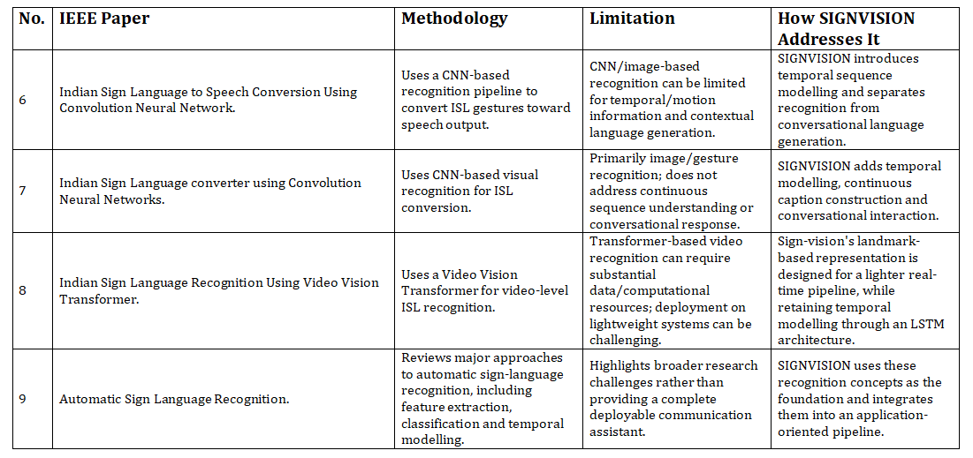
Literature Survey ( 2 of 2)
Author & Year | Title | Methodology | Limitation / SIGNVISION contribution
Rawat, Kumar, Tamta, Kumar (2025) | A Comprehensive Approach to ISL Recognition: Leveraging LSTM and MediaPipe Holistic | MediaPipe Holistic landmark extraction + 2-layer LSTM + dense output for ISL gesture classification | [Team to complete]
Khartheesvar, Kumar, Yadav et al. (2024) | Automatic Indian Sign Language Recognition using MediaPipe Holistic and LSTM Network | MediaPipe Holistic feature extraction + LSTM network for isolated-word ISL recognition | [Team to complete]
Anonymous (arXiv, 2024) | Continuous Sign Language Recognition System using Deep Learning with MediaPipe Holistic | MediaPipe Holistic tracking + LSTM for continuous (not isolated) ISL recognition | [Team to complete]
Navendu, Sahula (2024) | Word Level Sign Language Recognition using MediaPipe and LSTM-GRU Network | MediaPipe hand/pose tracking + hybrid LSTM-GRU network, tested on the INCLUDE ISL dataset | [Team to complete]
6

Slide 7
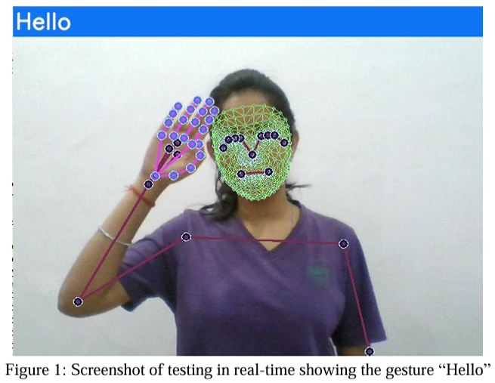
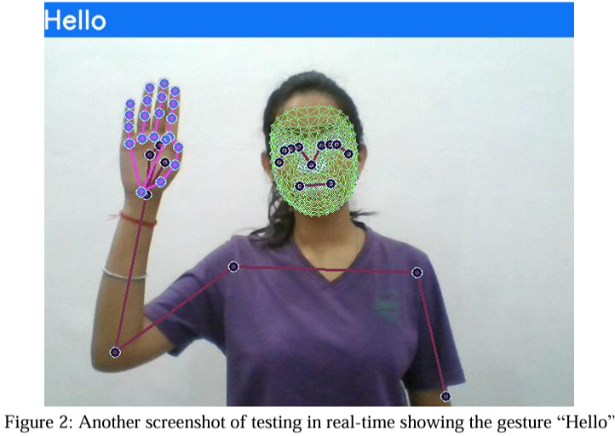
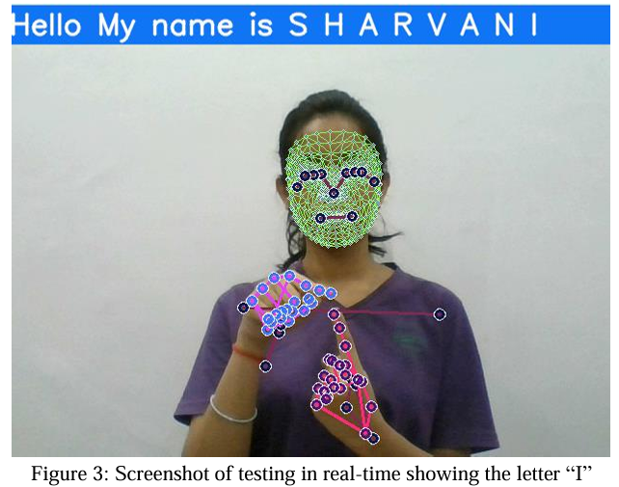
Base Paper
Title | Continuous Sign Language Recognition System using Deep Learning with MediaPipe Holistic.
Authors / Year | Sharvani Srivastava, Sudhakar Singh, Pooja, Shiv Prakash — 2024.
Research Problem | Difficulty in continuous ISL recognition due to complex backgrounds, signer variations, hand–face overlap, and gesture diversity.
Methodology | MediaPipe Holistic landmark extraction + 3-layer LSTM + 3 Dense layers for real-time continuous sign recognition.
Dataset | Self-created ISL dataset containing 45 gestures (26 alphabets + 19 words/phrases), with 1,350 videos, split 95:5 for training/testing.
Result | Achieved 88.23% testing accuracy with approximately 0.5 million model parameters and real-time recognition capability.
Domain overlap with SIGNVISION | computer-vision-based sign language recognition using MediaPipe and deep learning for real-time communication.
SIGNVISION — Review 1
4

Slide 8
SIGNVISION — ISL RECOGNITION & CONVERSATIONAL RESPONSE SYSTEM
USERS & INPUT
APPLICATION / BACKEND (SIGNVISION PIPELINE)
SIGN RECOGNITION MODULE
TEXT & LANGUAGE MODULE
OUTPUT MODULE
ISL Signer
(Sender)
User
Caption Generator
(Signs → Text)
Hand Detection
(MediaPipe)
Text Display
(Web UI)
Web Camera
(Input)
Sentence Assembly
(Continuous Text)
Landmark Extraction
& Preprocessing
•••
Speech Output
Web Interface
AI
Chatbot Engine
(Ollama LLM)
AI
Sign Classification
(LSTM / Deep Learning)
Request Routing
Response Generation
(Context-Aware Reply)
read / write
DATA STORAGE (LOCAL)
Collected Features
(CSV Files)
Dataset Metadata
(JSON Files)
Model Files
(LSTM / Model Weights)
Chat History
(JSON Files)
CSV
JSON
JSON

Slide 9
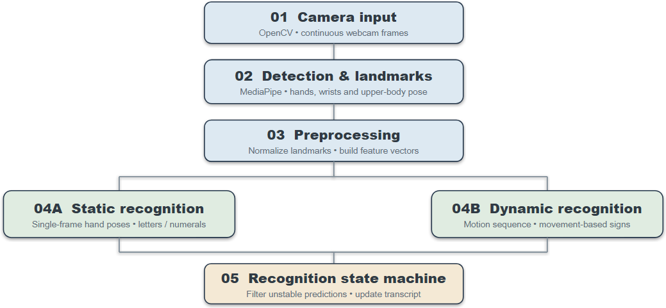
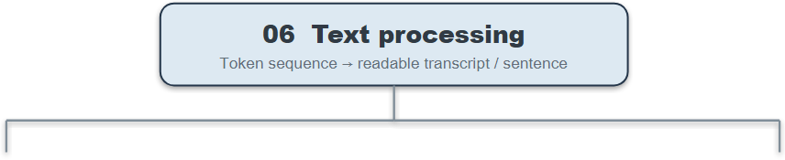
Modules
|

Slide 10
Modules
1. Camera Input
  Captures real-time video using OpenCV.
  Streams webcam frames to the detection pipeline.
2. Detection & Landmarks
  Uses MediaPipe to detect hands and body pose.
  Extracts hand landmarks and wrist coordinates for tracking.
3. Preprocessing
  Normalizes landmark coordinates to reduce positional variation.
  Converts landmarks into feature vectors for model input.
4A. Static Recognition
  Classifies stationary hand gestures using a trained Machine Learning classifier.
  Recognizes hand shapes representing letters and numbers.

Slide 11
Modules
4B. Dynamic Recognition
  Analyzes landmark sequences across multiple frames.
  Uses temporal features and wrist velocity to recognize movement-based signs.
5. Recognition State Machine
  Manages recognition states and filters unstable predictions.
  Controls word confirmation and transcript updates.
6. Text Processing
  Combines recognized tokens into a continuous text sequence.
  Formats predictions into readable captions and sentences.
7A. Speech Output
  Converts recognized text into spoken audio using Text-to-Speech (TTS).
  Provides voice output for communication with hearing users.
7B. Ollama Chatbot
  Uses a locally hosted Large Language Model (LLM) to generate conversational replies.
  Processes recognized text through the Ollama API for privacy-conscious, local inference.

Slide 12
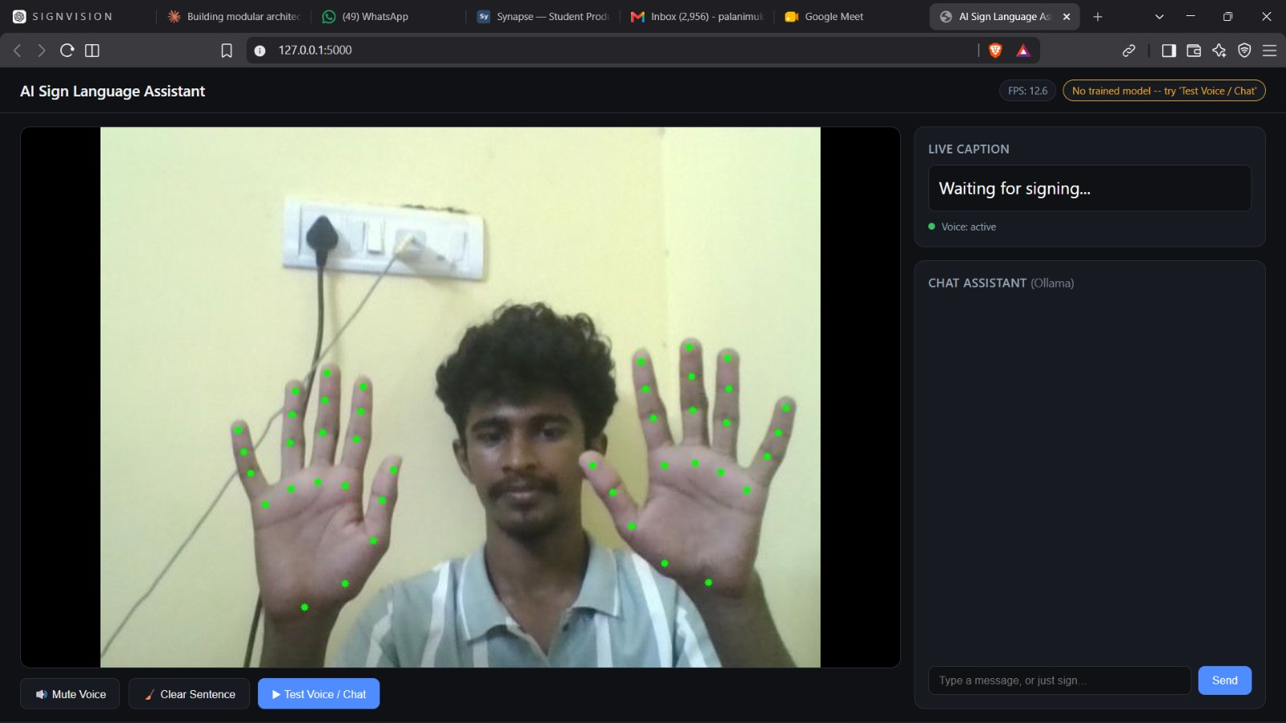
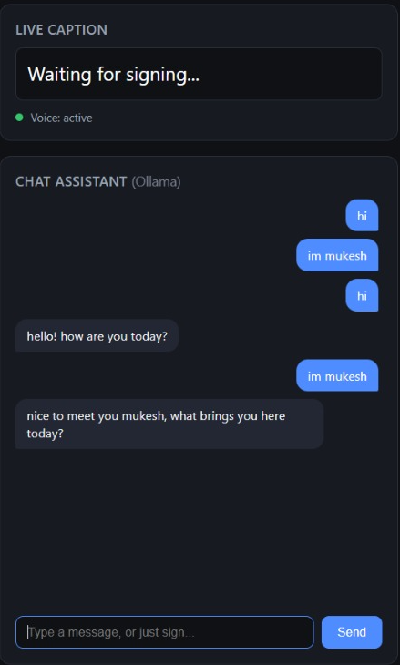
Project Implementation / Prototype
13

Slide 13
Reference
[1] S. Srivastava, S. Singh, Pooja, and S. Prakash, “Continuous sign language recognition system using deep learning with MediaPipe Holistic,” Wireless Personal Communications, 2024.
[2] P. Rawat, P. Kumar, V. K. Tamta, and A. Kumar, “A comprehensive approach to Indian sign language recognition: leveraging LSTM and Media Pipe Holistic for dynamic and static hand gesture recognition, “EAI Endorsed Transactions on AI and Robotics, vol. 4, no. 1, 2025.
[3] G. Khartheesvar M. Kumar, A. K. Yadav, and D. Yadav, “Automatic Indian sign language recognition using MediaPipe Holistic and LSTM network, “Multimedia Tools and Applications, vol. 83, no. 20, pp.58329-58348, 2024.
[4] K. Navendu and V. Sahula, “Word level sign language recognition using MediaPipe and LSTM-GRU network,” in Proc. iSES 2024, pp.13-18.
[5] Google, “Media Pipe Hand Landmarker,” MediaPipe Solutions documentation, Google AI Edge. [Online]. Available: https://ai.google.dev/edge/mediapipe.

Slide 14
Reference
[6] Ollama, “Ollama REST API documentation.” [Online]. Available: https://ollama.com
[7] B.Subramanian, B.olimov S. M. Naik, S. Kim, K-H. Park and J. Kim, “An Integrated Mediapipe -optimized GRU Model for Indian Sign Language Recognition,” Scientific Reports, vol.12, Art. No. 11964,2022.
[8] Velmathi G and kaushal Goyal, “Indian Sign Language Recognition Using Mediapipe Holistic,” arXiv preprint arXiv:2304.10256, 2023.
[9] A. Wadhawan and P. Kumar, “Deep Learning-Based Sign Language Recognition System for Static Signs,” Neural Computing and Applications, vol. 32, pp. 7957-7968,2020.
[10] “A MediaPipe-Powerd Model for Static Indian Sign Language Recognition,” Procedia Computer Science, vol.283, pp. 2220-2229, 2026

Slide 15
Planned Project Timeline (July – October)
PROJECT ACTIVITIES
JULY 2026
AUGUST 2026
SEPTEMBER 2026
OCTOBER 2026
W1
W2
W3
W4
W5
W6
W7
W8
W9
W10
W11
W12
W13
W14
W15
W16
1–7 Jul
8–14 Jul
15–21 Jul
22–31 Jul
1–7 Aug
8–14 Aug
15–21 Aug
22–31 Aug
1–7 Sep
8–14 Sep
15–21 Sep
22–30 Sep
1–7 Oct
8–14 Oct
15–21 Oct
22–31 Oct
1. Problem Identification & Initial Research
2. Literature Survey
3. Abstract & Requirement Analysis
4. System Architecture & Design
5. Dataset Collection & Preparation
6. Camera Input & Hand Detection
7. MediaPipe Landmark Extraction
8. Feature Extraction & Pre-processing
9. LSTM Model (Temporal Recognition)
10. Sign Classification (ISL Recognition)
11. Caption / Text Generation
12. Conversational AI (Ollama Integration)
13. Speech Output (TTS)
14. Frontend / Web Interface Development
15. System Integration
16. Testing & Evaluation
17. Final Demo & Documentation
LEGEND:
GREEN = Completed
BLUE = Planned
PURPLE = In Progress
ORANGE = Review / Finalization

