Slide 1

College PC Monitoring
& Management System
VELS UNIVERSITY · MINI PROJECT · 2026
Keeping an eye on lab computers from one place
Jeevanandham PS · Noorul Aatif Rahman M · Hariharan P
Guide: Mrs. Divya Bairavi S, M.E. (PhD), Assistant Professor, Vels University

Slide 2
Introduction
Why we need one view of every lab PC
The challenge
The need
The approach
Checking PCs by hand is slow.
Admins want to know how each PC is doing.
An admin app and a small agent share data through the cloud.
See which PCs are online and how busy they are.
Review activity, sessions and apps used.
Lock or restart a PC from your desk.
College PC Monitoring & Management System · Vels University · Mini Project
02

Slide 3
Abstract
Project overview
Managing many lab computers is hard. This system lets admins watch every PC from one dashboard. A small agent on each PC sends health and activity data securely. Admins see live status and running apps, and can lock or restart a PC remotely, with every action recorded. Tests and design analysis show it is scalable and practical for college labs.
Monitoring
CPU, memory, heartbeat
Management
Register PCs, send commands
Security
Login, access rules, audit logs
Keywords: Real-Time Monitoring · Proactive Alerting · Remote Management · Academic Labs
College PC Monitoring & Management System · Vels University · Mini Project
03

Slide 4
Literature Review
Similar systems and where our project fits
System | What it does | What it lacks
Ganglia | Cluster metrics on the web | Session tracking, remote control
Supermon | Very fast metric collection | User access control
Nagios | Host checks and alerts | Easy setup, user activity
HiFi | Layered event filtering | Simplicity for one lab
Our idea: a light agent, role-based access, activity history and admin actions in one tool.
College PC Monitoring & Management System · Vels University · Mini Project
04

Slide 5
Base Paper
Distributed Workstation Monitoring and Management System for Academic Laboratories
Core idea
Method
One central view of PC health, apps and sessions.
Agents collect data; a service stores it for the dashboard.
Data used
Limits
CPU, memory, online status, apps, sessions, audit events.
Needs installed agents and a network. Not tested at large scale.
We adapt these ideas into a desktop admin app and PC agent on Supabase.
College PC Monitoring & Management System · Vels University · Mini Project
05

Slide 6
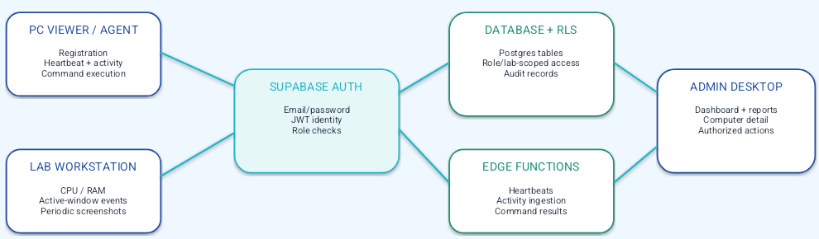
System Architecture
How the parts connect
Good to know: no separate Express or NestJS server. Everything runs on Supabase.
College PC Monitoring & Management System · Vels University · Mini Project
06

Slide 7
System Modules
Six parts, one job each
1. Endpoint Agent
2. Monitoring
3. Activity
Collects data, runs commands
Shows each PC’s status
Records apps and sessions
4. Remote Commands
5. Admin Console
6. Security & Data
Lock, logout, restart, shutdown
Labs, users, reports, alerts
Login, access rules, audit trail
College PC Monitoring & Management System · Vels University · Mini Project
07

Slide 8
Module 1 — Endpoint Agent
The program on each lab computer
Registers with a one-time code from an admin.
Reports in about every 15 seconds.
Tracks CPU, RAM and the active app.
Takes a private screenshot every 60 seconds.
Keeps its token safe and reconnects if the network drops.
Note: screenshots are periodic, not live video.
College PC Monitoring & Management System · Vels University · Mini Project
08

Slide 9
Modules 2 & 3 — Monitoring and Activity
From PC health to a history of what happened
Monitoring
Activity
Gets heartbeat and usage data
Shows online or offline
Updates live
Flags PCs needing attention
Records app open, switch, close
Keeps session history
Feeds reports
Supports investigation
Why it helps: faster checks and a clear record of events.
College PC Monitoring & Management System · Vels University · Mini Project
09

Slide 10
Modules 4 & 5 — Commands and Admin Console
Approved control and everyday administration
Remote commands
Admin console
LOCK, LOGOUT, RESTART, SHUTDOWN
Sent through the cloud
Agent reports the result
Saved in the audit trail
Dashboard and alerts
Computers and labs
Users and roles
Sessions, reports, audit logs
Please note: only authorized staff should use remote actions.
College PC Monitoring & Management System · Vels University · Mini Project
10

Slide 11
Module 6 — Security and Database
How data and actions are protected
Authentication
Authorization
Private records
Email and password login with signed tokens.
Database rules limit access by role and lab.
Audit logs, credentials and screenshots are admin-only.
Edge Functions handle privileged tasks.
Agent credentials are encrypted by the OS.
Every action and result can be audited.
College PC Monitoring & Management System · Vels University · Mini Project
11

Slide 12
End-to-End Process Flow
One monitoring and management cycle
1
2
3
4
Admin setup
Register PC
Authenticate
Collect
Roles and lab list
One-time code
Agent stores its credential
Heartbeat and activity
5
6
7
8
Transmit
Store
Review
Act
Send to Supabase
Admin screen updates
Status, reports, logs
Send a command
Monitoring repeats while the agent runs. Commands only run when an admin asks.
College PC Monitoring & Management System · Vels University · Mini Project
12

Slide 13
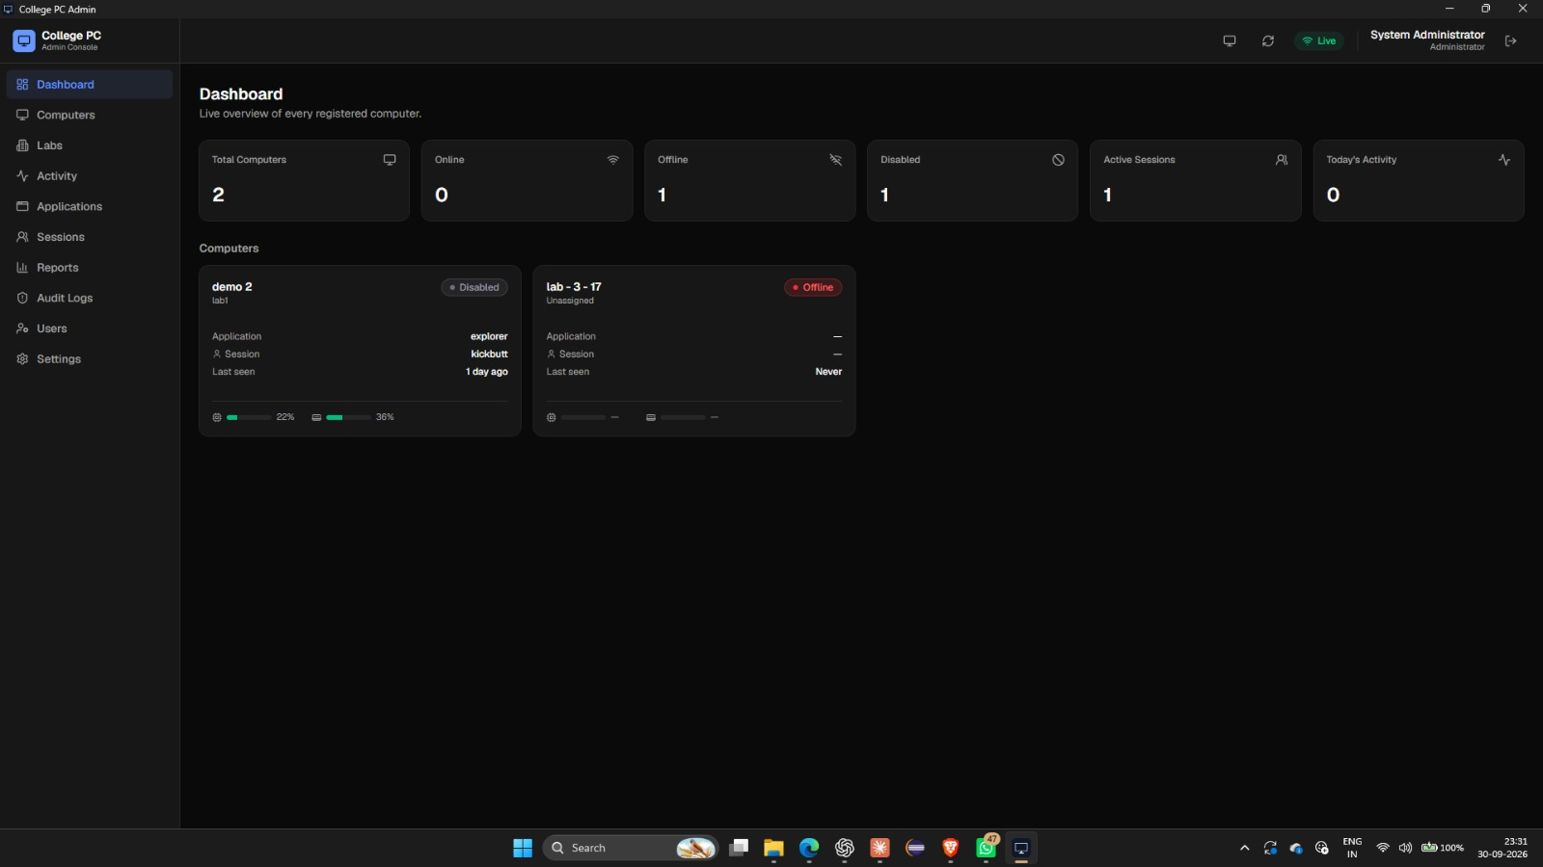
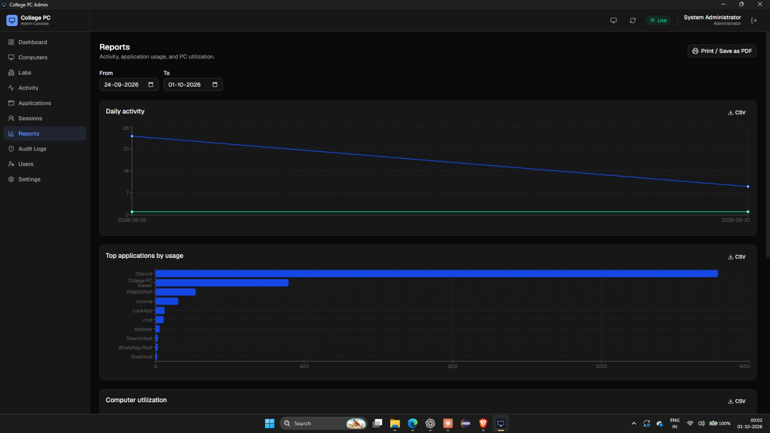
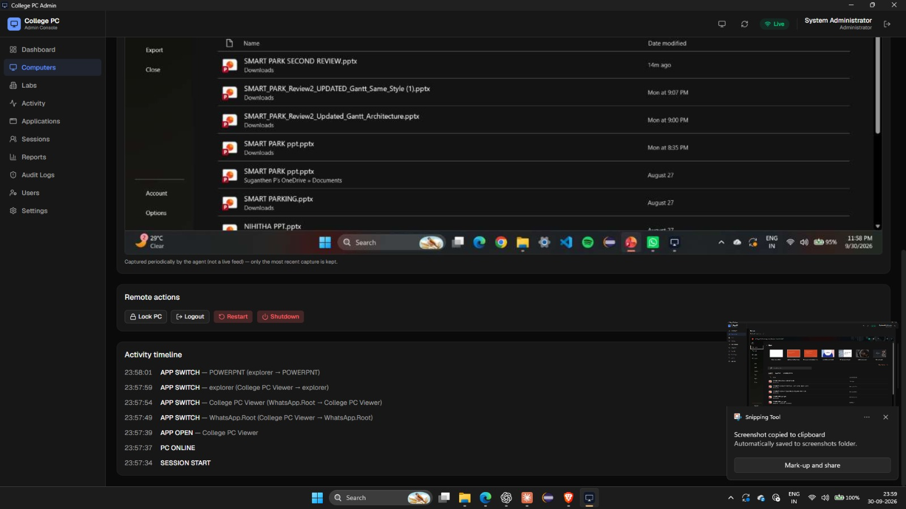
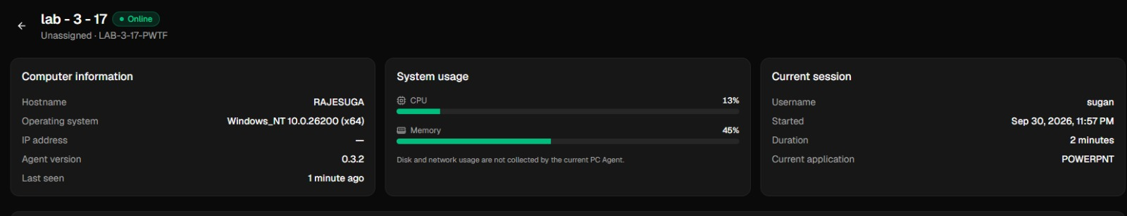
Results and Current Outcomes
The working admin console
Central view of PCs, activity and logs
Remote actions from the admin app
Access control by role and lab
Working prototype with admin and Viewer apps
Next: speed and scale tests in a real lab.
Dashboard
Reports
Computer details
Screen capture and activity timeline
College PC Monitoring & Management System · Vels University · Mini Project
13

Slide 14
Limitations and Future Enhancements
What to keep in mind and what comes next
Limits
Future
Needs agent and network
Sees only what PCs report
Needs lab testing
Test bigger labs
Custom alerts and reports
Stronger security drills
What we will measure
Reliability
Performance
Scale
Security
Heartbeats, reconnects
Delay and response time
Number of PCs
Roles, audit logs
College PC Monitoring & Management System · Vels University · Mini Project
14

Slide 15
References
Sources used for this presentation and the project
[1] M. L. Massie, B. N. Chun, and D. E. Culler, “The Ganglia Distributed Monitoring System: Design, Implementation, and Experience.”
[2] J. Sottile and A. Minnich, “Supermon: A High-Speed Cluster Monitoring System.”
[3] E. Al-Shaer et al., “HiFi: A New Monitoring Architecture for Distributed Systems Management.”
[4] B. Barth, “Nagios: System and Network Monitoring.”
[5] College PC Monitoring & Management System, project repository README and source structure (supplied ZIP archive).
[6] Supabase documentation: Authentication, PostgreSQL Row Level Security, Realtime, Storage and Edge Functions.
Thank you · Questions?
College PC Monitoring & Management System · Vels University · Mini Project
15

