Slide 1

SMART PARK
IOT AND ML BASED REAL – TIME PARKING SLOT AVAILABILITY SYSTEM
Automated parking space detection and allocation system for efficient parking management.
PRESENTED BY
Suganthen P
Sathish kumar K
Chandru K
GUIDED BY – Dr N Meenakshi
SMART PARK— IOT AND ML BASED
1

Slide 2
about the project
OBJECTIVES
Smart Parking System is an IoT-based solution designed to efficiently manage and monitor parking spaces in real-time.
The system detects the availability of parking slots using sensors and provides the information to users through a mobile application or display unit.
Users can get real-time updates on available slots, book a slot in advance, and get navigation assistance.
The system reduces manual effort , prevents unauthorised parking and optimises the use of parking space .
It ensures a seamless , contactless, time – efficient parking experience for both users and administrators .
It utilises IoT sensors microcontrollers and cloud technology to monitor parking occupancy.
.
.
.
SMART PARK — IOT AND ML BASED
2

Slide 3
OVERVIEW
ABSTRACT
Parking in educational institutions causes traffic congestion , time wastage and fuel consumption during peak hours . Manually searching for slots is inefficient.
To solve this, Smart Park - an IoT and Machine Learning based real-time parking and prediction system is proposed. Each parking slot uses an IR proximity sensor to detect vehicle presence.
Data is collected by ESP32 microcontroller and sent to cloud/Firebase via WiFi.
A mobile application displays live status of each block using colour-coded indicators: Green for free, Yellow for less, and Red for full.
For prediction, historical data like Day, Time, Weather, and Occupancy is collected for 2 weeks.
A Random Forest ML model is trained to predict future slot availability.
This helps users plan their arrival time. The system is scalable, and user-friendly.
In future, it can be extended with ANPR and online reservation. Smart Park provides an efficient solution for smart campus parking management.
KEY TERMS : IOT, ESP32, IR Sensor, ML, Prediction, Cloud, Real-time.
03
2
SMART PARK— IoT AND ML BASED
3

Slide 4
Base papers analysis - survey of smart parking systems [ appl. Sci. 2020]
CONTRIBUTIONS:
Classified SPS into 6 types ; PRS, PGIS, CITS , CAPS , AGS, EVPS ; We use PGIS [ Guidance & information system ].
Classified vehicle detection techniques : IRS, ORS [camera / ultrasonic], DFTP, Crowdensing.
Analysed algorithms: dynamic, real – time , AI/ML [ ANN,CNN,RNN,GA].
Identified key researched gaps & challenges.
METHODOLGY [ SLR METHOD]:
Model: kitchenham & charters SLR methodology.
3 Phases : planning [4 RQs] , conducting , reporting .
Databases : scopus , IEEE , ACM, TRID .
Keywords : smart parking , VRP , iot, AI.
Filtering : 1063 papers 274 primary studies selected + 9 via snowballing.
.
DATASET REFERENCED :
No direct dataset [ survey paper]. Referenced datasets from studies .
Santander , spain : 400 city sensors , 1 min interval data [ RNN prediction].
Riyadh : 50 WSN nodes , 98% detection .
Our dataset : HC SR04 + ESP32 , real time data [ slot ID, tine, status ] + PKLot public dataset.
LIMITATIONS & OUR SOLUTION:
Limitation 1 : only 2% real implementation , 50 % stimulation only .
Limitation 2 : No real time re routing if slots gets occupied -> our solution real time firebase update = auto re assign .
Limitation 3 : ignores user preference & prediction using ML [ random forest ].
GAP FILLED : REAL – TIME | IoT + ML | Re scheduling .
.
.
.
.
FBCE — Explainable Loan Prediction
4

Slide 5
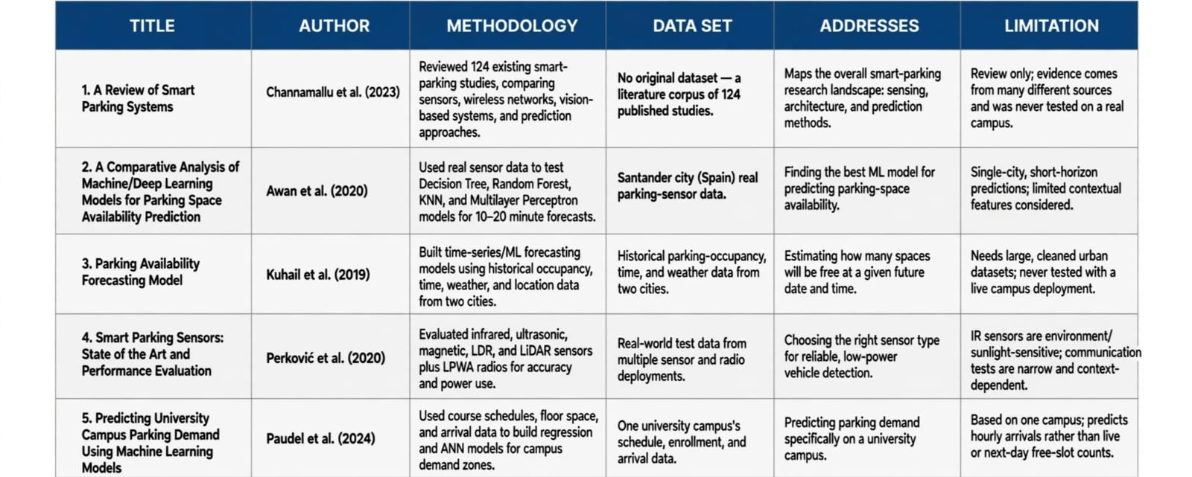
LITERATURE SURVEY

Slide 6
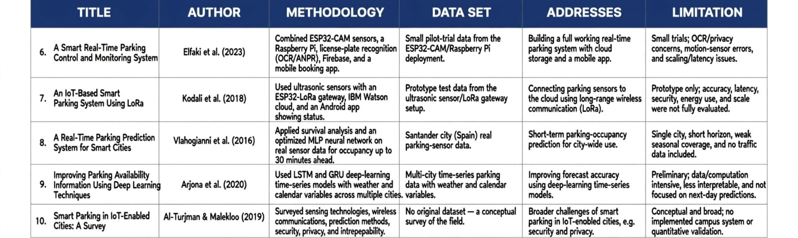
LITERATURE SURVEY

Slide 7
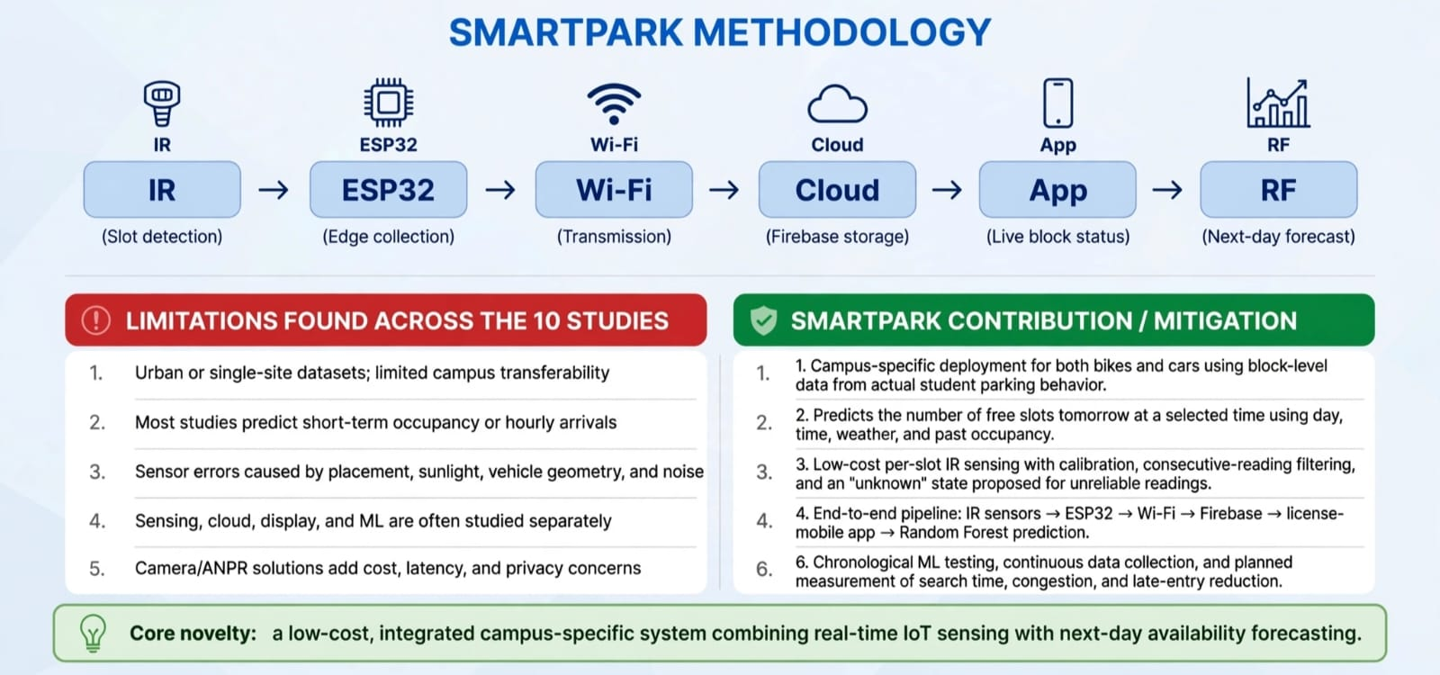
OUR CONTRIBUTION TO OVERCOME LIMITATIONS

Slide 8
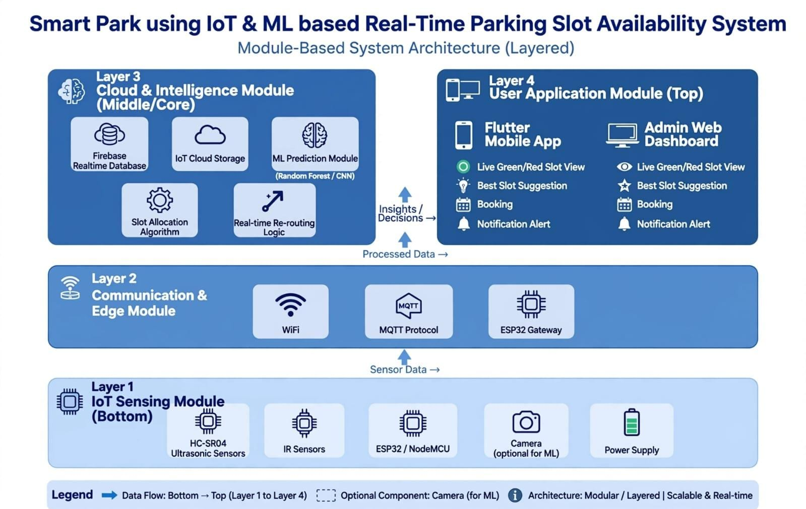
SYSTEM DESIGN

Slide 9
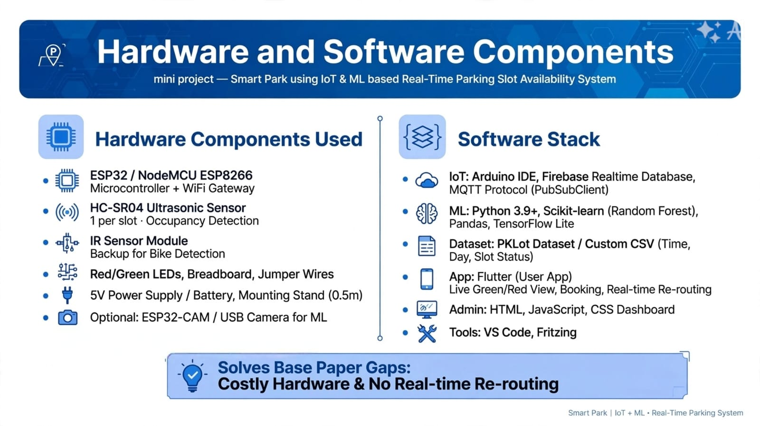
CORE MODULE
HARDWARE AND SOFTWARE COMPONENTS
.
.
SMART PARK – IOT AND ML BASED
6

Slide 10
SMART PARK — DETAILED PROCESS FLOW
IR Sensor
ESP32
Wi-Fi
Firebase
Mobile App
Vehicle detected / absent
Read slot state
Send update
Store + sync
Display live status
TIME-AWARE RESERVATION FLOW
1. Select date
start + end time
2. Fetch live status
+ reservations
3. Remove time
conflicts
4. Show slots
available for period
5. Confirm / pay
6. Create reservation
with time window
ACTUAL PARKING SESSION FLOW
Vehicle enters
Session starts
App shows
Vehicle exits
Session closes
IR becomes OCCUPIED
entry timestamp saved
parked since + expected end
IR becomes FREE
actual exit saved + slot released
ML PREDICTION FLOW
History
Features
Random Forest
Result
2-week parking records
Day • Time • Weather • Occupancy
Train + predict
Expected free slots tomorrow

Slide 11
SMART PARK — MODULES AND CHECKLIST
M1
IoT Slot Detection
IR sensors detect vehicle presence for each slot.
M2
ESP32 Communication
Reads sensors and transmits slot state through Wi-Fi.
M3
Firebase Cloud
Stores live status, users, reservations and parking history.
M4
Mobile App
Shows block/slot availability with clear status indicators.
M5
Parking Session Timing
Stores entry, expected exit and actual exit timestamps.
M6
Time-Based Reservation
User selects date/start/end; conflicts are blocked.
M7
Payment
Reservation payment/confirmation flow, preferably test mode for demo.
M8
ML Prediction
Random Forest predicts future free-slot count from historical features.
M9
Admin & Monitoring
Monitor slots, bookings, overrides and system activity.
M10
Testing & Evaluation
Live sensor test, booking conflict test, prediction and usability metrics.

Slide 12
SMART PARK — EXPECTED OUTCOME
Real-time parking slot monitoring and display
Time-based reservation and conflict checking
Historical data storage
Future availability prediction using ML
User-friendly mobile application
Efficient and smart parking management for educational institutions
Goal: To provide a smart, efficient and user-friendly parking solution using IoT and Machine Learning, reducing traffic, saving time and improving the overall parking experience.

Slide 13
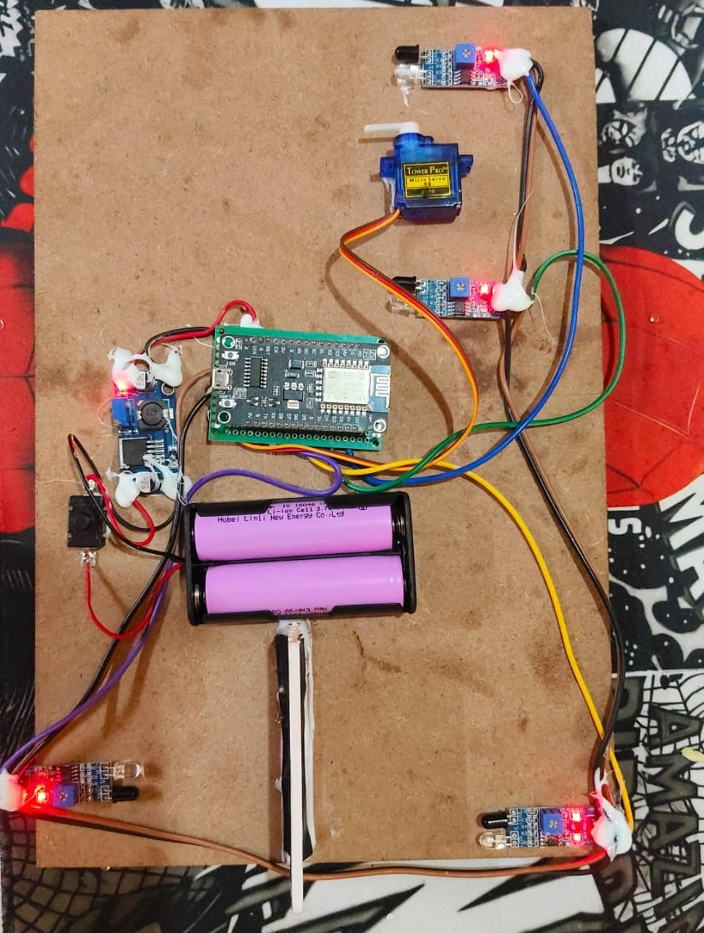
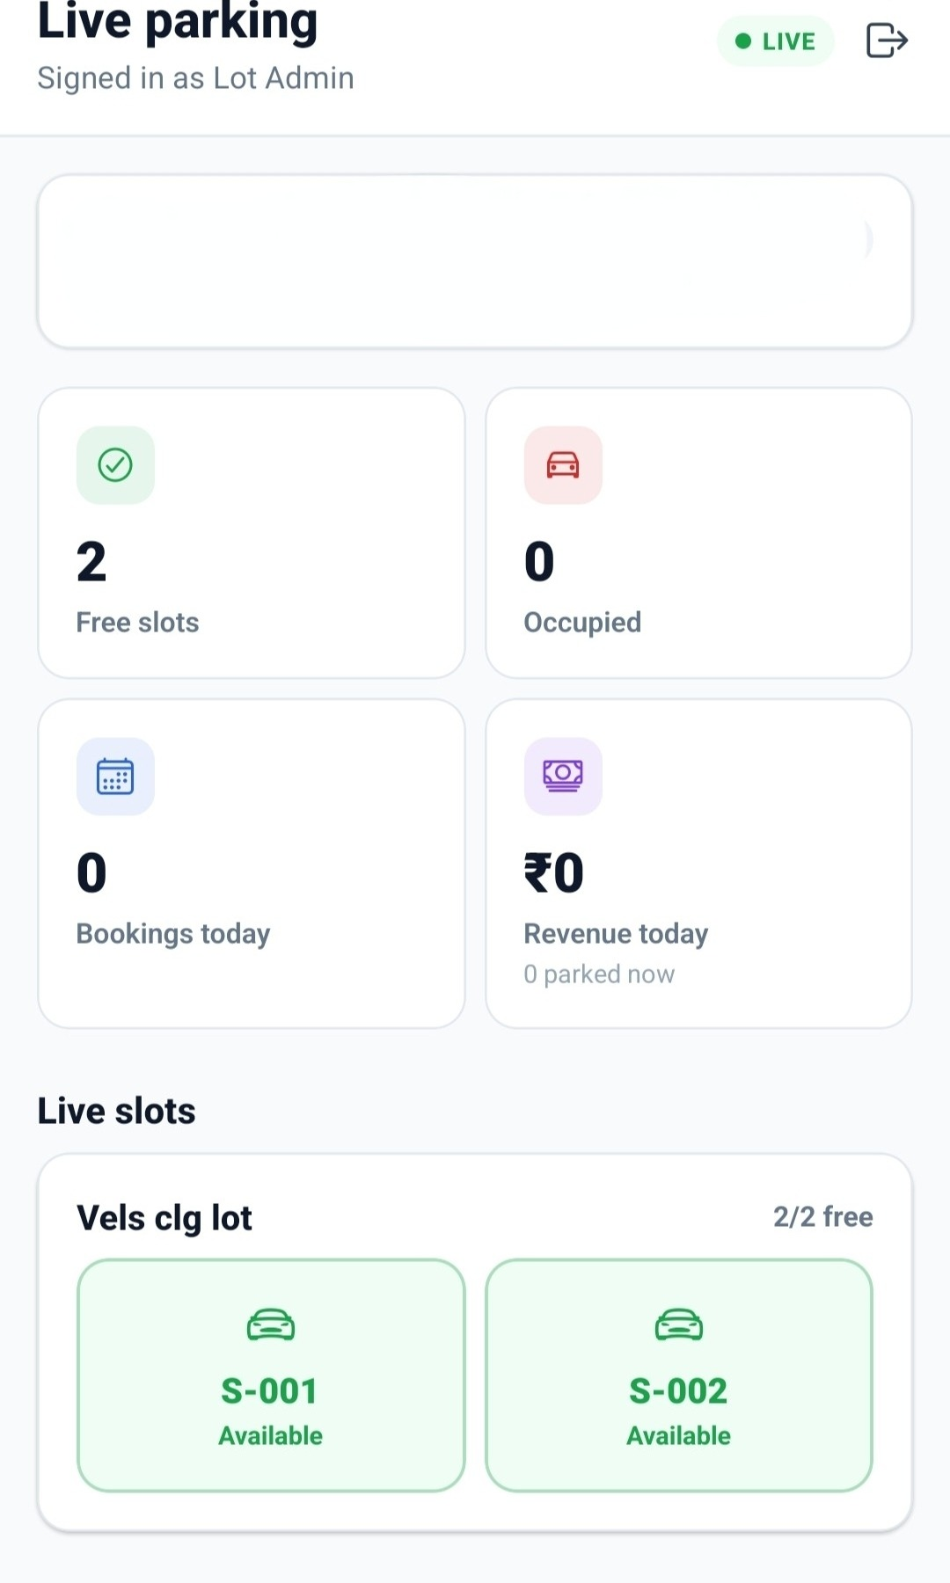
SMART PARK — IMPLEMENTATION & HARDWARE SETUP
Hardware built using ESP32 and IR sensors
Two sensors for two parking slots
Sensor detects vehicle: slot is Occupied
No vehicle: slot is Free
ESP32 sends data to Firebase using WiFi
App shows live status
Fig 1: Hardware Setup
Fig 2: App Home Screen

Slide 14
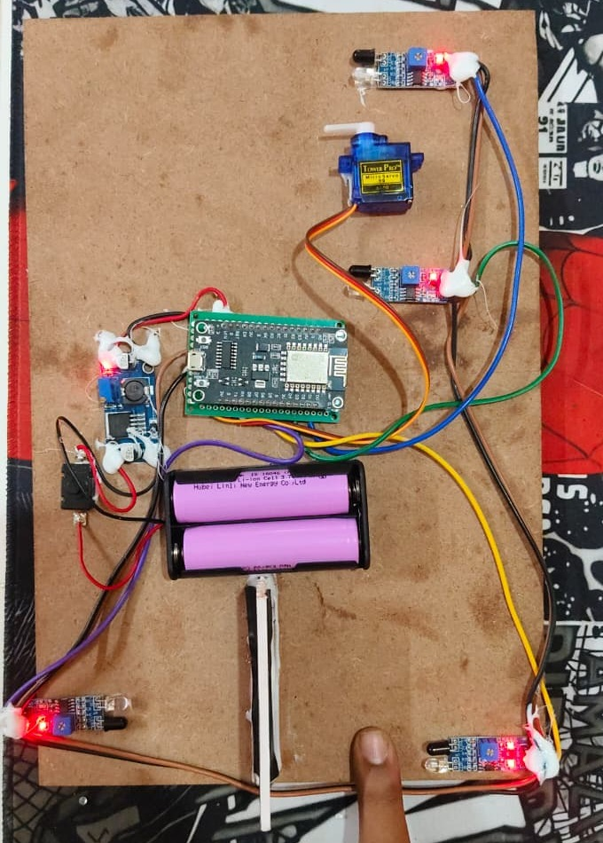
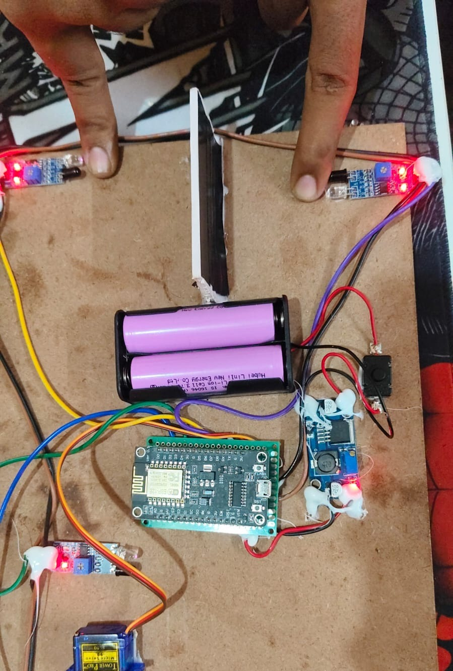
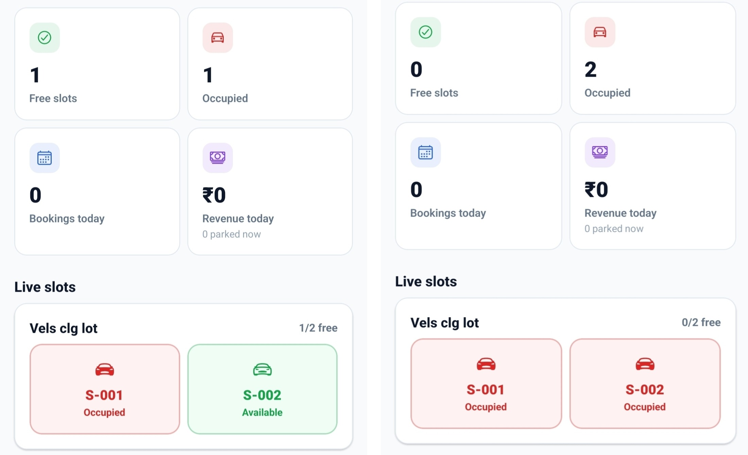
SMART PARK — REAL-TIME RESULTS & SENSOR TESTING
Fig 3: One Slot Occupied
Fig 4: Two Slots Occupied
Fig 5: Live Data in App
Fig 3: One vehicle parked, app shows 1 free, 1 occupied
Fig 4: Two vehicles parked, app shows 0 free, 2 occupied
Fig 5: App updates by itself, no refresh needed
App matched the sensors in every test

Slide 15
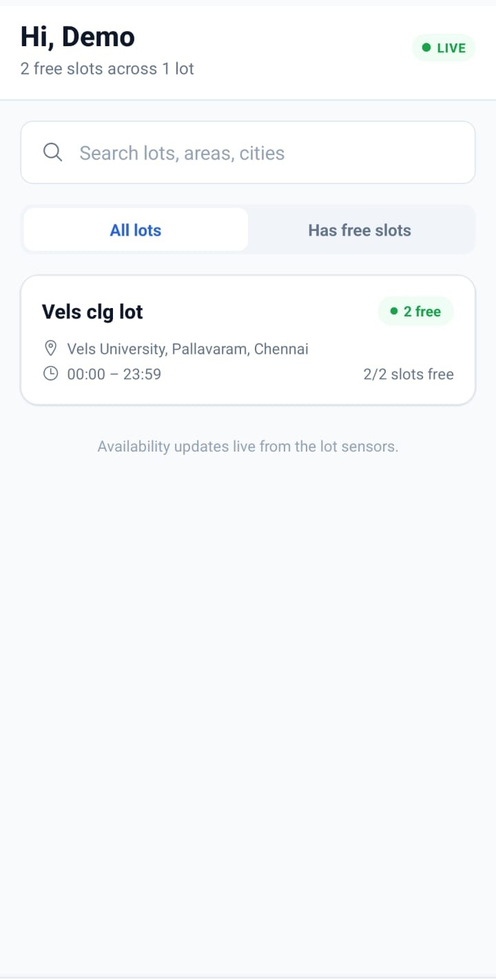
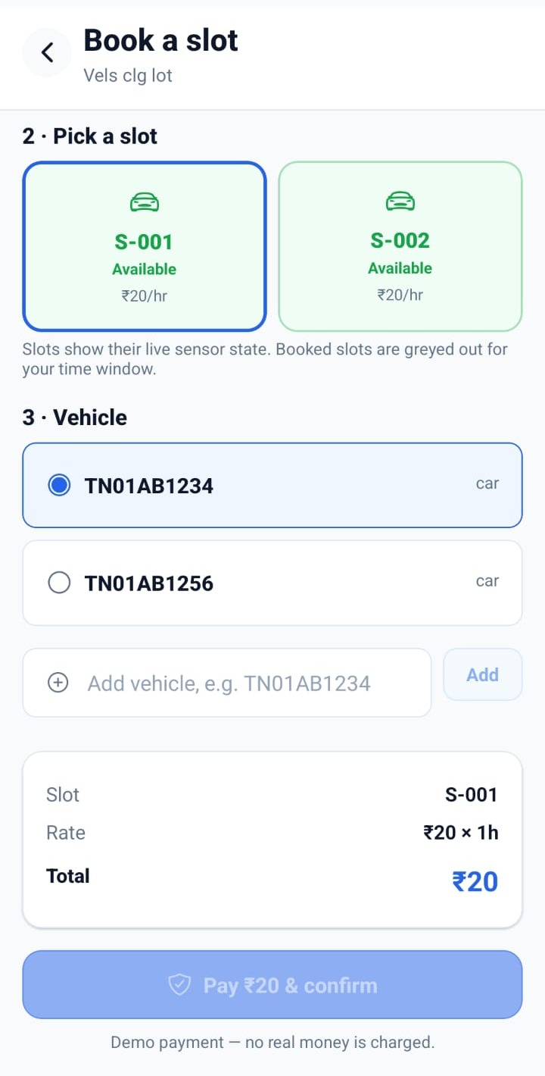
SMART PARK — APP RESULTS: CUSTOMER RESERVATION FLOW
User opens app and sees free slots
User picks a slot, time and vehicle
User taps Book a slot
App shows booking summary and total
User confirms the booking
Firebase marks the slot as reserved
All users see the new status live
Fig 6: Customer Home Screen
Fig 7: Booking Screen

Slide 16


