Slide 1

SMART EXPENSE TRACKER AND GOAL BASED SAVING ANALYZER
BATCH NO:20
TEAM MEMBERS:
P.VENKATA ANIL-24619222
S.R.VIGNESH-24619259
T.SASANK-24619233
GUIDE: MS. P.SHANTHI
DEPARTMENT OF CSE(AIML)
VISTAS

Slide 2
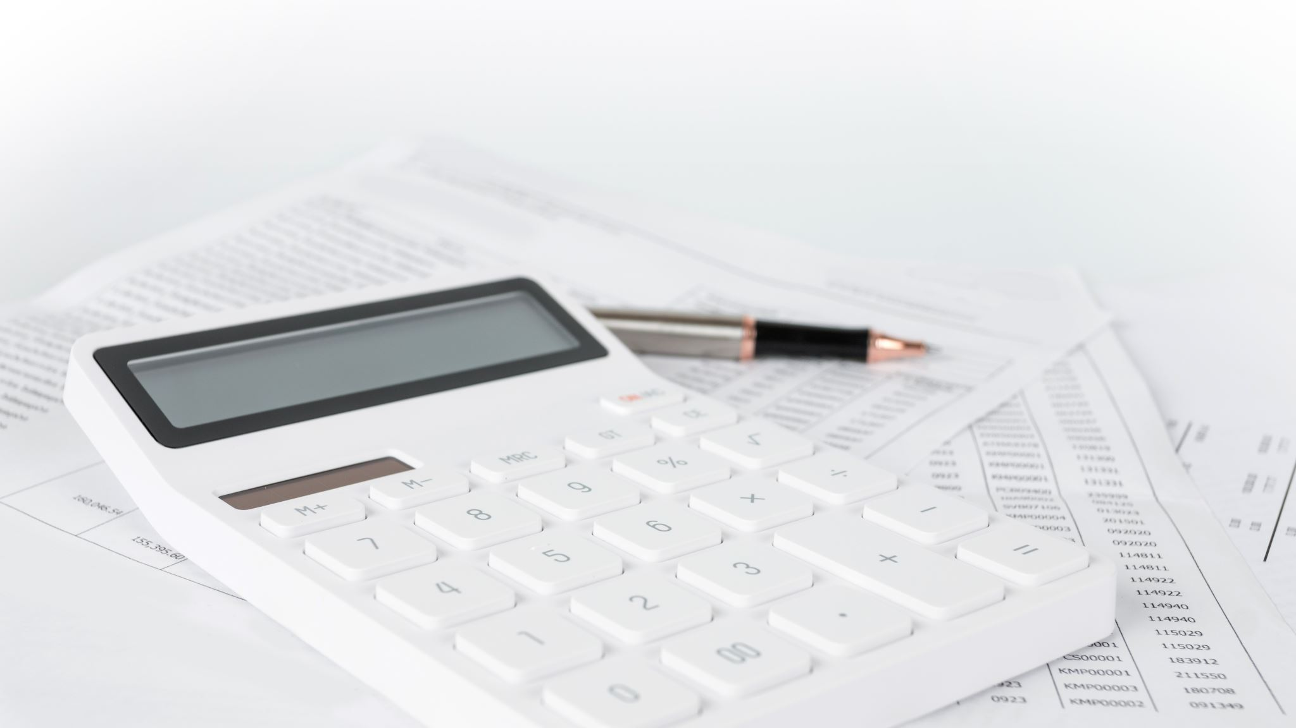
SMART EXPENSE TRACKER AND GOAL BASED SAVING ANALYZER

Slide 3
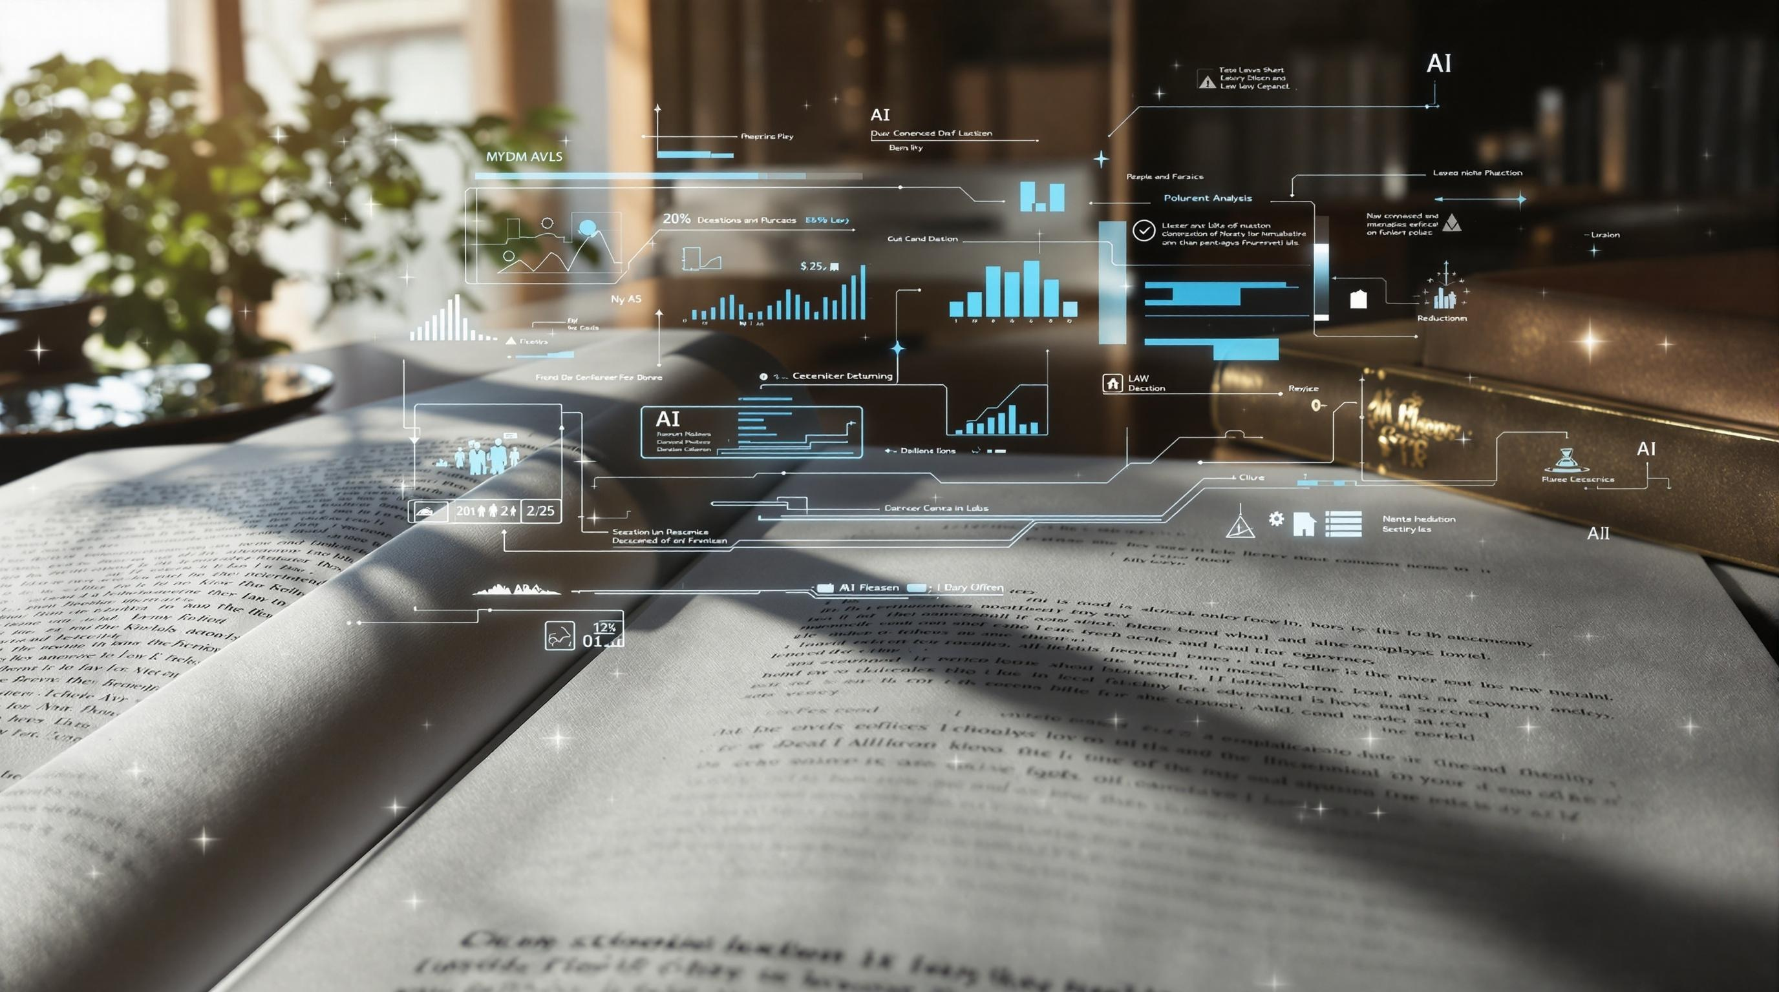
Introduction
Managing personal finances effectively is becoming increasingly important as people deal with regular expenses, changing income, and different financial goals. Many individuals find it difficult to keep track of their daily spending and understand where their money is being used. The smart expense tracker and goal-based saving analyzer is designed to provide a simple and intelligent solution for managing personal finances.. Users can set specific savings goals, and the system estimates the time required to achieve each goal based on their income, expenses, and saving behavior. It also provides personalized saving suggestions and sends goal-based alerts and notifications to help users stay on track. By combining expense tracking, spending pattern analysis, future expense prediction, savings goal management, and graphical visualization, the proposed system helps users make better financial decisions and improve their overall saving habits.

Slide 4
ABSTRACT :
The Smart Expense Tracker and Goal-Based Saving Analyzer is an AI-powered personal finance management application designed to help users manage their income, expenses, and savings efficiently. The system enables users to record financial transactions, categorize expenses, and analyse their spending patterns. It provides a clear overview of income, expenses, and savings through interactive charts, graphs, and a user-friendly dashboard.
The system uses intelligent analysis to identify unnecessary spending, predict future expenses based on historical transaction data, and provide personalized recommendations for better financial management. Users can set specific savings goals and track their progress using percentage-based indicators. If users fail to meet their planned savings targets, the system can recalculate the required savings for the remaining period. By combining expense tracking, predictive analysis, and goal-based planning, the application encourages responsible spending habits and helps users achieve their financial goals effectively.

Slide 5
LITERATURE REVIEW
Study / Year | Main Contribution | Limitation / Gap | Relevance to Our Project
WONGA (2023) | Supports expense categorization and spending analysis; can inform savings planning. | Goal-based savings progress, alerts, and automatic recalculation are not the main focus. | Our system sets savings goals, monitors progress, sends alerts, and recalculates required savings.
Smart Pocket (2025) | Tracks spending patterns and predicts expenses that can help users adjust savings plans. | A complete savings-goal workflow with notifications and recalculation could be added. | Our system links predicted spending with savings targets and alerts users when action is needed.
AI-Powered Expense Tracking (2026) | Uses AI-based analysis to identify spending patterns and provide useful financial insights. | Personalized goal tracking, missed-target alerts, and revised savings plans could be integrated. | Our system uses spending analysis to support personalized notifications and savings recommendations.

Slide 6
RESEARCH GAP & PROPOSED SYSTEM
RESEARCH GAP
• Many systems focus mainly on recording and categorizing transactions.
• Savings goals are not always connected to expense predictions and spending patterns.
• Users need timely alerts when savings targets are missed or progress falls behind.
• Users may need recalculation of the amount to save over the remaining period.
OUR PROPOSED SYSTEM
• Records income and expenses and groups transactions by category.
• Lets users set a savings goal and target date.
• Tracks savings progress using percentages, charts, and dashboard indicators.
• Sends notifications and alerts for upcoming targets or when progress falls behind.
• Recalculates the required savings amount for the remaining period.
• Uses spending analysis and expense predictions to support better decisions.

Slide 7
USER INTERFACE
(Mobile / Web App Dashboard & Quick Action UI)
MODULE ENGINE
1. AUTHENTICATION 2. EXPENSE TRACKING 3. SMART BUDGETING 4. GOAL ANALYZER
MODULE MODULE MODULE MODULE
• User Signup/Login • Manual Input Form • Category Threshold • Savings Target Core
• Profile Config • OCR Receipt Scan • Predictive Alerts • Timeline Calculator
• Session Security • Smart Categorizer • Budget vs Actual • Milestone Tracker
5. ANALYTICS & INSIGHTS ENGINE
(Pattern Recognition, Forecasting, Reporting)
DATABASE LAYER
(User Profiles, Transactions, Goals, Budgets)DATABASE
ARCHITECTURE DIAGRAM

Slide 8
PROJECT MODULES & SYSTEM WORKFLOW
A smarter way to manage money
Track spending, plan savings, and adjust goals with timely insights.
01
TRACK
02
ANALYZE
Income & expenses
Spending patterns
03
SAVE
04
ADJUST
Goals & deadlines
Alerts & recalculation

Slide 9
CORE APPLICATION MODULES
01
User Authentication
02
Income & Expense Management
• User registration and login
• Access to a personal financial dashboard
• Records income and expense transactions
• Categorizes food, travel, shopping, bills, and more
03
Smart Expense Analysis
04
Goal-Based Savings
• Analyzes transaction history and spending patterns
• Highlights high or unnecessary spending
• Sets a savings target and deadline
• Shows progress through amounts, percentages, and charts

Slide 10
INTELLIGENT SAVINGS MODULES
05
AI-Based Expense Prediction
06
Notifications & Alerts
• Estimates future expenses from available transaction history
• Supports budgeting and savings decisions
• Reminds users about savings targets and deadlines
• Alerts users when progress falls behind the plan
07
Automatic Savings Recalculation
08
Dashboard & Visualization
• Calculates the remaining amount needed to reach the goal
• Recalculates the required savings across the remaining period
• Summarizes income, expenses, savings, and goal status
• Uses charts and progress indicators to show trends

Slide 11
SYSTEM WORKFLOW
1. User logs in and records transactions
2. System categorizes and analyzes spending
3. User sets a savings goal and deadline
4. Dashboard monitors savings progress
ON TRACK
Continue monitoring
BEHIND TARGET
Send alert / notification
Update plan and display progress
Recalculate required savings

Slide 12
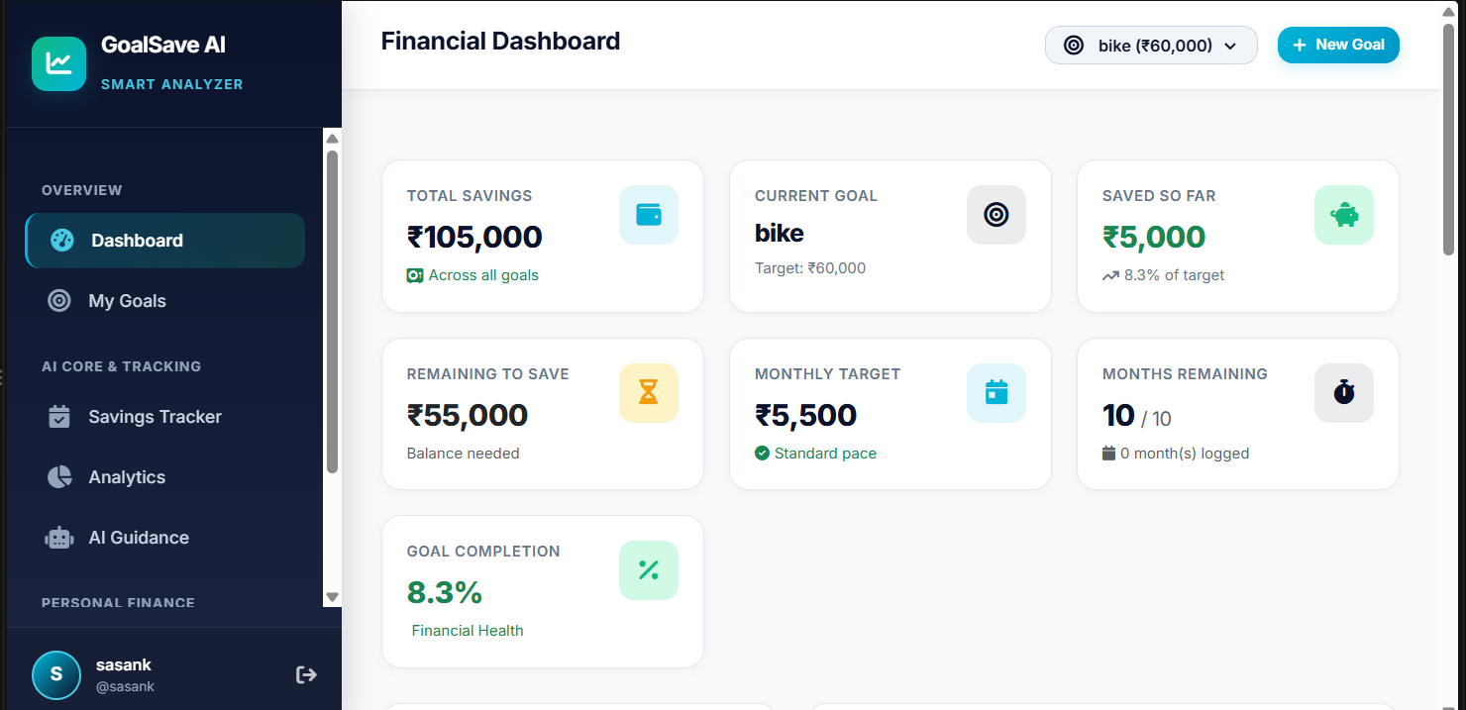
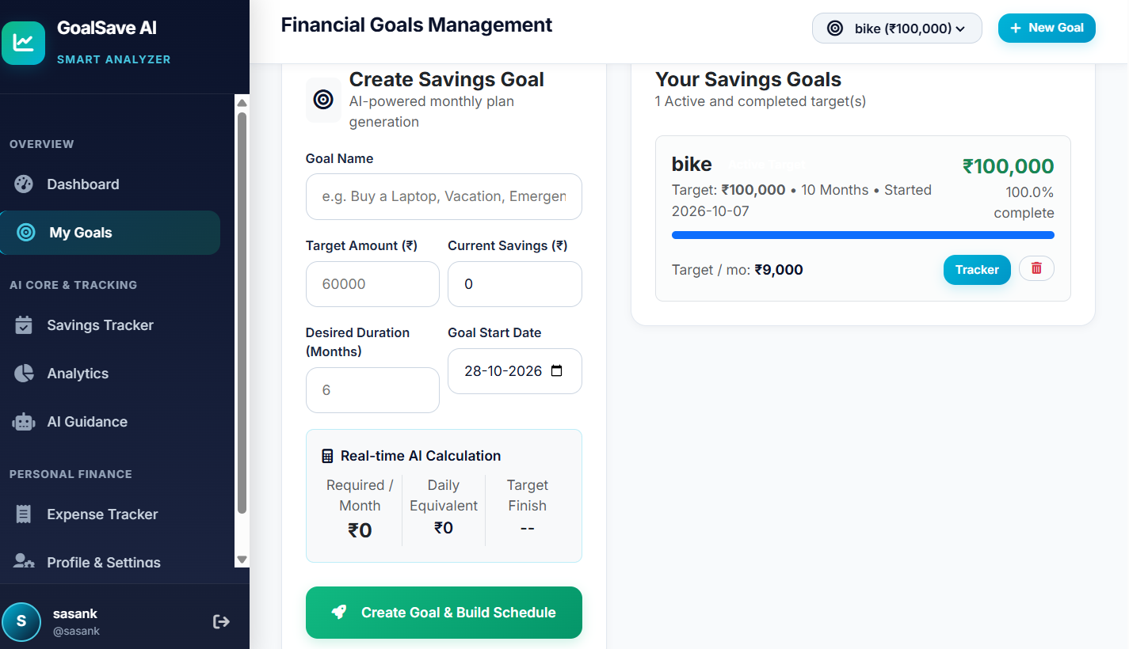
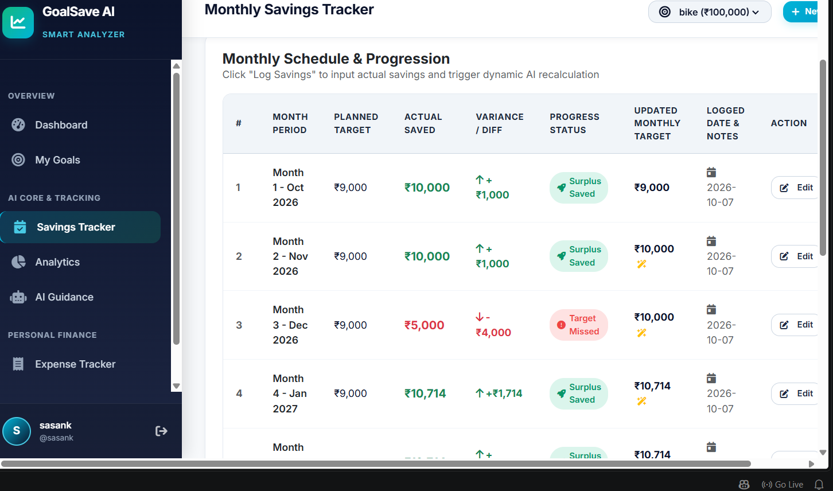
IMPLEMENTATION SCREENSHOTS

Slide 14
REFERENCES:
Uyanahewa, M. I. R., Jayawardana, G. V. H. D., Bandara, M. B. D. N., Hapugala, H. A. V. V., Attanayaka, B., and Nawinna, D. (2023). “WONGA: The Future of Personal Finance Management – A Machine Learning-Driven Approach for Predictive Analysis and Efficient Expense Tracking.” 2023 4th International Conference for Emerging Technology (INCET). DOI: 10.1109/INCET57972.2023.10170209.
Lingayat, L., Yadav, N., Rathod, P., Durutkar, P., and Ghode, S. (2024). “Design and Implement of Real Time Expense Tracker Using ML.” Proceedings of the International Conference on Innovative Computing & Communication (ICICC 2024).
Mahto, B., Varma, A. K., Kumari, S., Parveen, R., Firdous, C., Sharma, A., and Amrendra, K. (2025). “Smart Pocket: A Machine Learning-Based Expense Tracker and Spending Predictor.” International Journal of Research and Innovation in Applied Science, 10(11), 352–362. DOI: 10.51584/IJRIAS.2025.101100032.
Tai, L. W., Poh, L. Z., and Hossen, M. I. (2026). “Designing a Predictive Expense Tracking Mobile Application: A Comparison of Random Forest, Linear Regression, and Prophet-Based Models.” Journal of Informatics and Web Engineering, 5(3), 252–265. DOI: 10.33093/jiwe.2026.5.3.16.
“Expense Radar: An AI-Driven Budget Management System.” (2025). 2025 International Conference on Computer and Applications (ICCA). IEEE. DOI: 10.1109/ICCA66035.2025.11430733.
“An Intelligent Personal Finance Management System With Automated Financial Data Processing and Machine Learning-Based Budget Forecasting.” (2026). International Journal of Latest Research in Publication and Research (IJLRP).
“Finance Tracker: A Personal Expense Management.” (2026). Innovation and Integrative Research Center Journal, 4(5), 501–511.
“Finalyze: An AI Powered Expense Tracker for Smart Financial Management.” (2026). International Journal of Creative Research Thoughts (IJCRT), 14(3), i988–i996.

Slide 15


