Slide 1

IoT-Based Interactive Braille Learning Console
FIRST REVIEW PRESENTATION
B.Tech – Computer Science and Engineering (Artificial Intelligence)
Guide: Dr. A. Manikandan
Hari Shankar M • Prem Kumar H • Dharmendran V
1

Slide 2
1. Introduction
Problem
Proposed Idea
Planned Extension
Braille is an important literacy medium for people who are blind or visually impaired, but learning resources and accessible practice tools are not always affordable or easy to use.
A compact learning console built around an ESP32 and
six tactile input buttons representing the six Braille dots.
The device turns Braille practice into an interactive,
game-like activity.
Bluetooth Low Energy (BLE) can connect the console to a smartphone. A future app can provide spoken instructions, feedback, lessons and progress tracking.
2

Slide 3
2. Abstract
Project Abstract
The proposed project is an IoT-based interactive Braille learning console intended to support beginners in learning Braille
characters through repeated, accessible practice. The prototype uses an ESP32 microcontroller and six push buttons arranged according to the standard six-dot Braille cell, with an additional confirm control.
The ESP32 detects the selected dot pattern and can provide local feedback while also supporting Bluetooth Low Energy communication with a smartphone.
The planned smartphone application can provide audio instructions and feedback, reducing dependence on a visual screen. The project focuses first on a low-cost hardware proof of concept, followed by software, testing and accessibility improvements.
Key focus: low cost • tactile input • audio-assisted learning • IoT connectivity
3

Slide 4
3. Base Paper
An IoT Braille Display towards Assisting Visually Impaired Students in Mexico (2022)
Contributions
Methodology
Dataset / Testing
Limitations
• Affordable single-character refreshable
Braille display
• ESP32 +
electromagnetic
solenoids
• IoT communication
and tactile output
• SCRUM / iterative hardware-
software development
• Edge-oriented
architecture
• MQTT
communication
• Character-by-
character tactile output
• Solenoid heat and
power issues
• Prototype size
required reduction
• User usability/
effectiveness testing
identified as future work
No conventional ML
dataset.
Evaluation focused on
sequential/random
character output, pin correctness
and prototype operation.
4

Slide 5
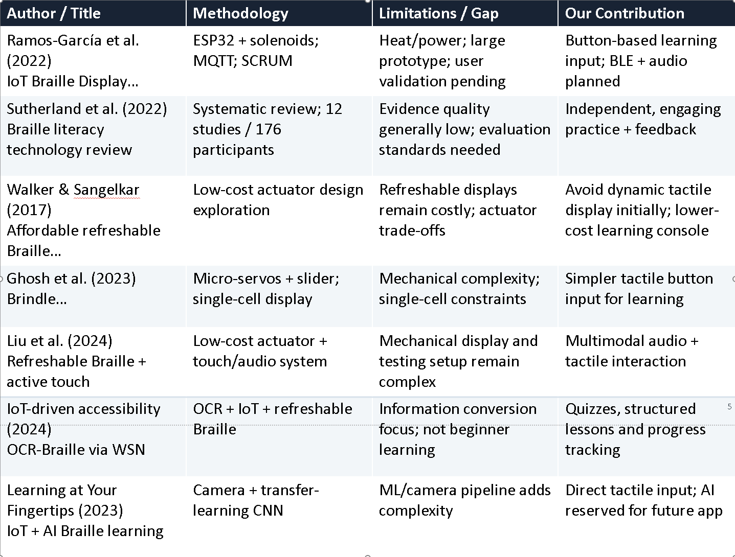
4. Literature Survey
5

Slide 6
5. System Architecture
Braille Input Module
ESP32 Processing Module
Smartphone / App Module
6 tactile push buttons
Dot positions 1–6
+ Confirm button
GPIO input reading
Braille pattern encoding
Local feedback control
BLE communication
Future scope
Audio instructions
Quiz / lessons
Score & progress
Feedback Module
Power Module
Buzzer / LEDs
Optional vibration motor
USB during prototype
Rechargeable battery later
Current scope: ESP32 + Braille buttons + BLE proof of concept. Smartphone app and portable power are planned extensions.
Modular diagram (not workflow)
6

Slide 7
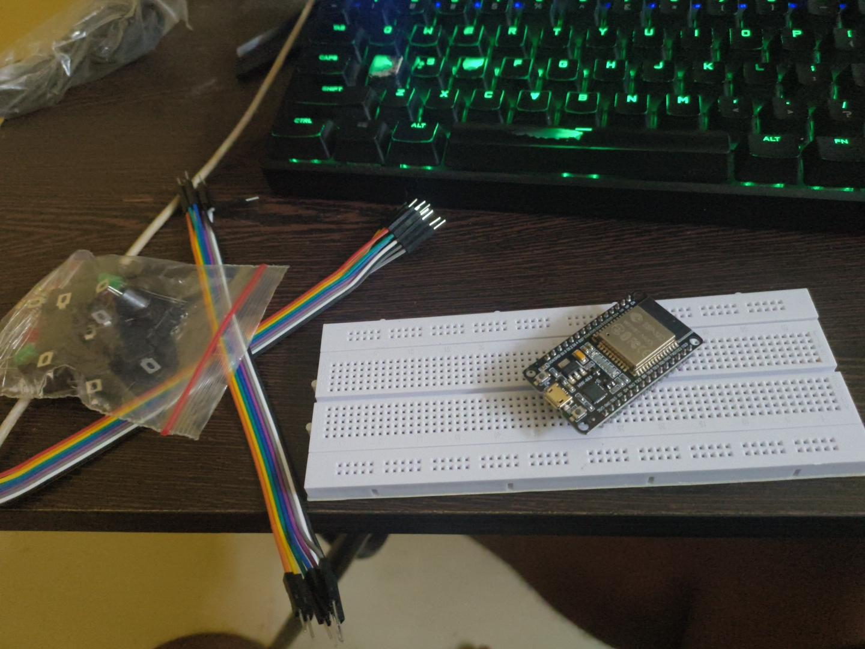
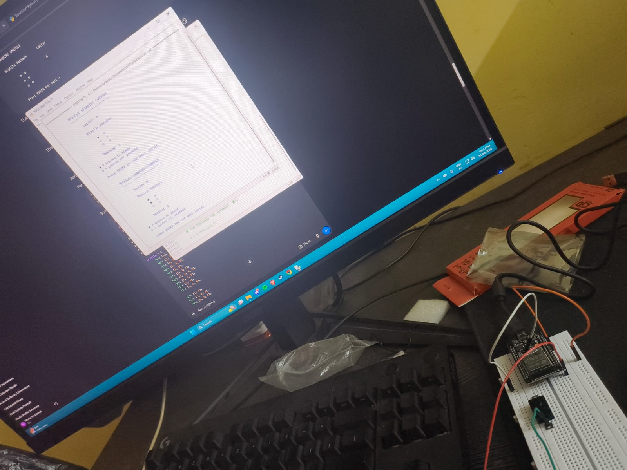
6. Project Implementation Status
Prototype / component photographs — INSERT HERE
Circuit / wiring photographs — INSERT HERE
CURRENT STATUS: PLANNING & THEORY / COMPONENT SELECTION — PHYSICAL PROTOTYPE YET TO BEGIN
7

Slide 8
8. CODE WALKTHROUGH & MOCK IMPLEMENTATION
BrailleLearn.ino • ESP32 firmware logic • visual mock-ups only (hardware testing has not started)
HOW THE CODE WORKS
MOCK SCREENSHOT 1 — SERIAL MONITOR
1
SETUP
Arduino IDE • Serial Monitor • 115200 baud
Starts Serial Monitor at 115200 baud; converts A–Z dot patterns into bit masks; configures 6 dot buttons, Confirm, LEDs and buzzer.
BrailleLearn - letters A-Z
Commands: r random | t targeted | f free | s report | n next
Mode: random
2
READ INPUT
Target letter: B (dots 1,2)
scanButtons() polls 7 inputs. INPUT_PULLUP means a pressed button reads LOW; a 25 ms debounce filters contact bounce.
Response: 1,2 -> CORRECT
Target letter: M (dots 1,3,4)
3
BUILD PATTERN
Each dot press is latched into a 6-bit value, so the learner can press dots one at a time. Tap Confirm to submit; hold ~1 s to clear.
MOCK SCREENSHOT 2 — CONSOLE CONCEPT
CORE CHECK
4
CHECK ANSWER
BRAILLE LEARN • ESP32
missed = target & ~response
evaluate() compares the entered mask with the target. It identifies missed dots and extra dots, then updates attempts and per-dot error scores.
CONFIRM
extra = response & ~target
1
4
5
GIVE FEEDBACK
2
5
If both are zero, the pattern is correct. Otherwise, the learner gets feedback and retries. Targeted mode uses accumulated dot-error scores to choose practice letters.
Correct: green LED + higher-pitched beeps + next letter. Incorrect: red LED + lower beep; the same letter can be retried.
OK
ERR
3
6
Serial commands: r random • t targeted • f free • s report • n next
Illustration of planned wiring/layout — not a real prototype photo
Important: these are illustrative UI/device mock-ups based on the submitted source code; firmware is marked not yet tested on hardware.

Slide 9
7. Gantt Chart — July to October 2026
JUL 2026
AUG 2026
SEP 2026
OCT 2026
Initial project discussion
Theory / problem study
Initial literature survey
Abstract preparation
Literature survey refinement
Component selection & procurement
Hardware prototype
ESP32 + button testing
BLE communication proof of concept
Learning logic / quiz prototype
Initial testing & refinement
Documentation / review preparation
Completed
In progress
Planned
8

Slide 10
References
• 1. Ramos-García, O. I. et al. (2022). An IoT Braille Display towards Assisting Visually Impaired Students in Mexico. Engineering Proceedings, 27(1), 11.
• 2. Sutherland, A. et al. (2022). Effectiveness of technology for braille literacy education for children: a systematic review. Disability and Rehabilitation: Assistive Technology.
• 3. Walker, A. S., & Sangelkar, S. (2017). Design exploration of affordable refreshable Braille display technology for low-income visually impaired users. ASME IDETC/CIE 2017.
• 4. Ghosh, A. et al. (2023). Brindle: A Low-Cost Refreshable Braille Display with Slider Mechanism. IEEE WIECON-ECE 2023.
• 5. Development and Evaluation of Refreshable Braille Display and Active Touch-Reading System for Digital Reading of the Visually Impaired (2024).
• 6. IoT-driven accessibility: A refreshable OCR-Braille solution for visually impaired and deaf-blind users through WSN (2024). Journal of Economy and Technology, 2, 128–137.
• 7. Learning at Your Fingertips: An Innovative IoT-Based AI-Powered Braille Learning System (2023). AI, 6(5), 91.
9

