Slide 1

NEXAM
An Intelligent Examination Management, Assessment and Proctoring Platform
FINAL REPORT
TEAM MEMBERS
SONIYA
POOJITHA
SHARMILA
PROJECT GUIDE
MS. MOHANA PRIYA

Slide 2
INTRODUTION
Proctored Online Examination Platform
Online exams today capture answers — but not honesty. NEXAM AI fixes that.
🎯 Verification of Students
Face-registered identity check before every exam
👁 Monitors the Entire Session
Real-time tracking of face, tabs, and fullscreen activity
⚡ Auto-Flags Dishonest Behavior
Instant violation detection and auto-submission
👩‍🏫 Faculty Toolkit
Create, assign, and auto-grade exams with ease
📊 Manages the Full Exam Lifecycle
From question delivery to result verification
Tech Stack: React (TypeScript) · Node.js/Express · SQLite · face-api.js

Slide 3


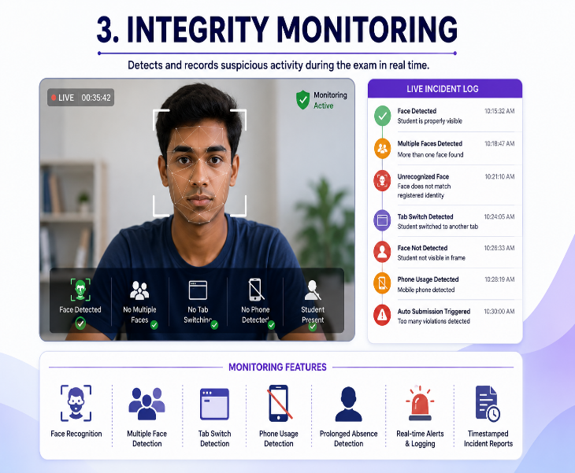
Examination management to enable faculty to conduct examination easily online
What is NEXAM
NEXAM is an examinee management system having three basic pillars:
Exam Management
Identify Verification
Integrity Monitoring
Identity authentication to ensure that the person appearing for the exam is the same person who appeared for the registration
Integrity monitoring to track any irregular activities during the examination.

Slide 4
REASON FOR NEXAM
1.Academic Integrity by Design
Integrity checks are built into the exam flow itself, not added as an afterthought — reducing dependency on trust alone.
2. Institution-Ready Scalability
Built on a modular college → department → class structure, allowing any institution to onboard without custom rework.
3. Actionable Evidence, Not Just Alerts
Every flagged incident is logged against the submission, giving faculty concrete grounds for review rather than vague suspicion.
4. Low Barrier to Adoption
Runs entirely in the browser with no dedicated invigilation staff, paid proctoring subscriptions, or special hardware required.

Slide 5
ABSTRACT
Nexam is an advanced examination management system that is integrated with online examination and real-time attendance management system to make the online examination process foolproof, organized, and quick. the web-based application automates the examination process which includes online examination management, biometric attendance and identity verification, face recognition, proctoring exam, and evaluation. Faculty members design and configure the examinations and manage the question bank, while students take the examinations on the system, configured on a dashboard. During the registration process, facial descriptors are extracted for biometric checks and verification processes. The face of the student is compared to the captured image via the webcam during the examination before and after the examination. the proctoring system tracks and raises an alarm for anomalies such as a missing face, multiple faces, and unrecognized faces and stores this as a timestamp violation for the examinee with a detailed report for the faculty. Objective-type examinations are auto-evaluated with results in the form of percentages to enhance efficiency and examination integrity.

Slide 6
Base Paper
BASED ON : IEEE TRANSACTIONS ON COMPUTATIONAL SOCIAL SYSTEMS, VOL. 11, NO. 1, FEBRUARY 2024
Detecting Fraudulent Student Communication in a Multiple Choice Online Test Environment
Mariana Carrasco, António Rito Silva , and Rui Henriques
2. METHODOLOGY
uses matched answers and timestamps to identify possible communication direction between students and detect repeated suspicious interactions
Student
Response Data
Answer Concordance Analysis
Response Time Analysis
Communication Weight Calculation
Network Generation
Clustering
Statistical Testing
Suspicious Student/Group Detection
1.RESEARCH METHODOLOY
Proposes a statistical method to detect potential collusion and fraudulent communication in online Multiple-Choice Question (MCQ) examinations. Analyzes answer similarity, response timing, choice probability, and recurring suspicious behavior. Distinguishes communication roles between students, including content production (sharing) and content consumption (receiving). Uses a communication network and clustering approach to identify possible groups involved in collusion. Applies null models and statistical testing to differentiate suspicious behavior from normal answer similarity.
3. DATASET / CASE STUDY
Real online quiz data collected from the Quizzes Tutor platform at Técnico Lisboa. Dataset includes quizzes from Software Architecture (SA) and Software Engineering (SE) courses. Students received questions in different randomized orders with shuffled answer options. Students could not return and edit previous answers. SA quizzes had 5 MCQs with 4 options and a 6-minute duration. SE quizzes had a 5-minute duration.
4. LIMITATIONS
The research is primarily focused on online multiple-choice examinations. Detection is mainly based on answer patterns and timestamps, rather than direct observation of student activity. The paper notes that additional approaches such as continuous authentication, online proctoring, browser tab monitoring, and other cheat-resistant mechanisms are complementary strategies.

Slide 7
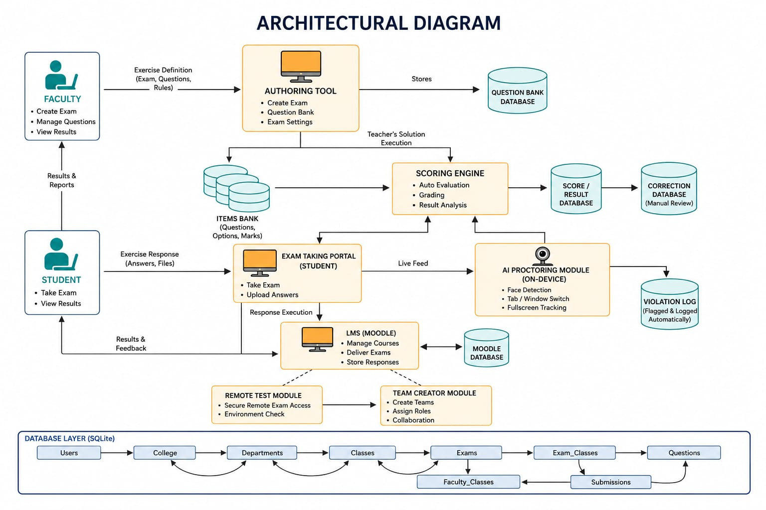
ARCHITECTURE DIAGRAM

Slide 8
Literature Survey
S.no | Author-Title | Methodology | Limitations | Our Contribution
1 | Prathish et al. – "Automated Video Proctoring Using ML" (2016) | Motion and audio-based anomaly detection during recorded exam sessions | High false-positive rate in noisy environments; no identity check | NEXAM AI pairs face-verified identity with motion/tab tracking, reducing false flags tied to environment noise
2 | Atoum et al. – "Multimedia Analytics for Online Exam Proctoring" (2017) | Multi-modal analysis: gaze tracking, audio, phone detection | Heavy server-side processing; not feasible in real-time on low-end devices | Runs entirely client-side via face-api.js (TensorFlow.js), needing no server-side ML infrastructure
3 | Hu et al. – "Facial Recognition-Based E-Exam Authentication" (2018) | CNN-based one-time face verification at login | Accuracy drops under poor lighting; verification only at entry, not continuous | Adds continuous re-verification during the exam, not just a single check-in
4 | Bawarith et al. – "E-Exam Cheating Detection System" (2017) | Rule-based behavior tracking (tab switch, timing anomalies) | No identity verification component at all | Combines behavior tracking with face-based I Identity checks for a complete integrity layer
5 | Kaur & Bathla – "Survey on Online Proctoring Techniques" (2020) | Comparative review of commercial proctoring tools | Most tools are paid, closed-source, and require third-party APIs | Fully open, in-browser AI proctoring with zero paid API dependency
6 | Fenu et al. – "Continuous Biometric Verification in E-Learning" (2018) | Periodic biometric re-authentication during online sessions | High computational cost of continuous checks; not tested at scale | Optimized lightweight face descriptor comparison (128-d vector), tuned for browser performance
7 | Asha & Sadasivam – "Cheating Detection in Online Exams Using Image Processing" (2017) | Frame-by-frame image analysis for suspicious activity | No incident logging; alerts not tied to specific submissions | Every violation is logged against the exact student submission for faculty review
8 | Chuang et al. – "Webcam-Based Gaze Tracking for Remote Proctoring" (2019) | Head-pose/gaze estimation to detect looking away | Requires specialized calibration; error-prone across devices | Identified as a planned future upgrade (head-pose detection) built on the existing face landmark pipeline
9 | Opgen-Rhein et al. – "Trust Models for Remote Assessment" (2019) | Framework-level study on trust and academic integrity in e-assessment | Theoretical; no working implementation | Translates the trust framework into a working system with real-time technical enforcement
10 | Singh & Sharma – "Low-Cost AI Solutions for Educational Institutions" (2021) | Review of affordable AI tools for resource-constrained institutions | Found most solutions incomplete or fragmented across separate tools | NEXAM AI unifies identity, proctoring, exam creation, and grading in a single low-cost platform

Slide 9
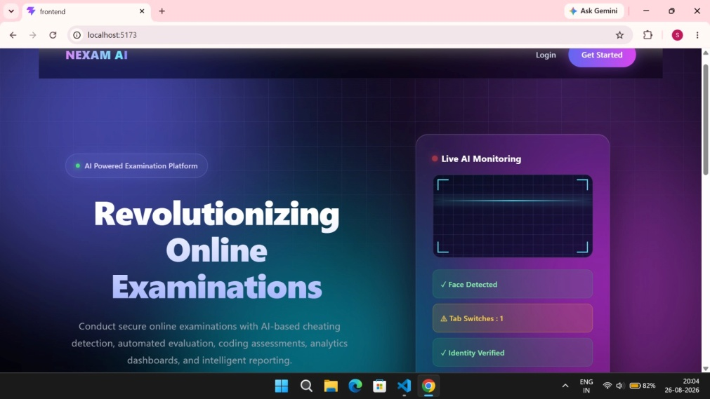
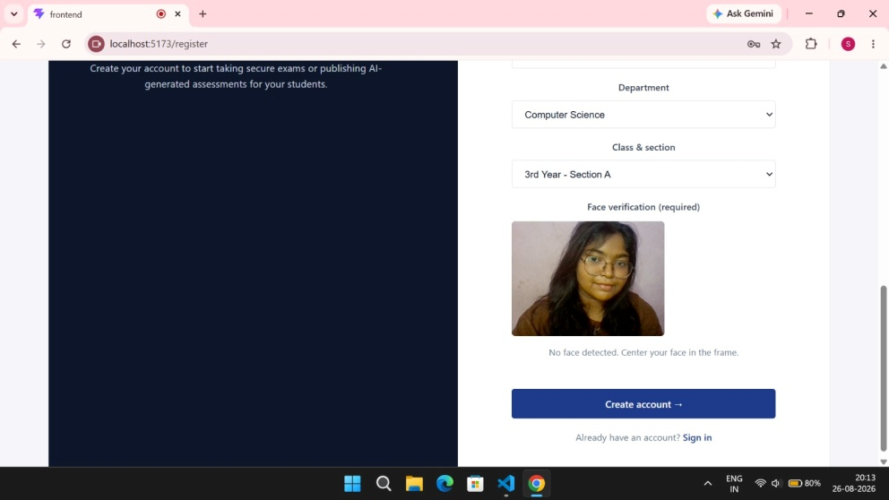
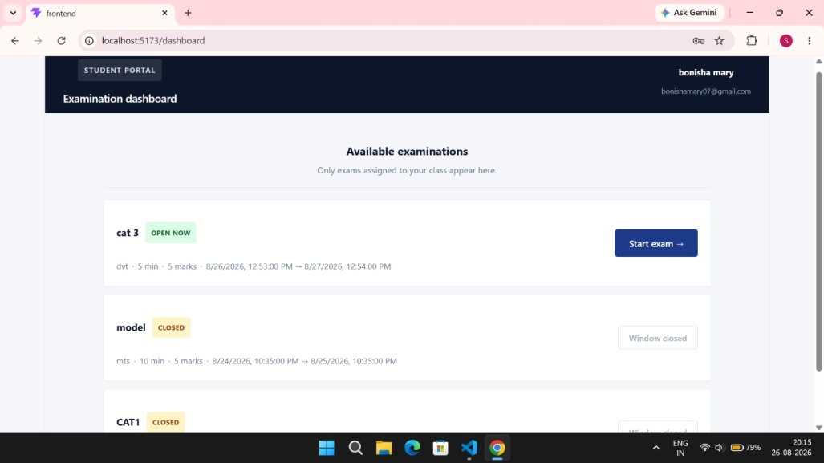
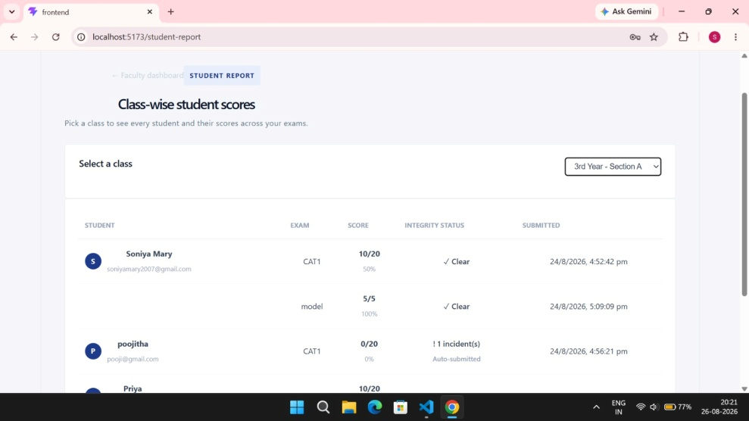
SYSTEM IMPLEMENTATION
Landing Page
FACE VERIFICATION
Student Examination Dashboard
CLASS WISE REPORT

Slide 10
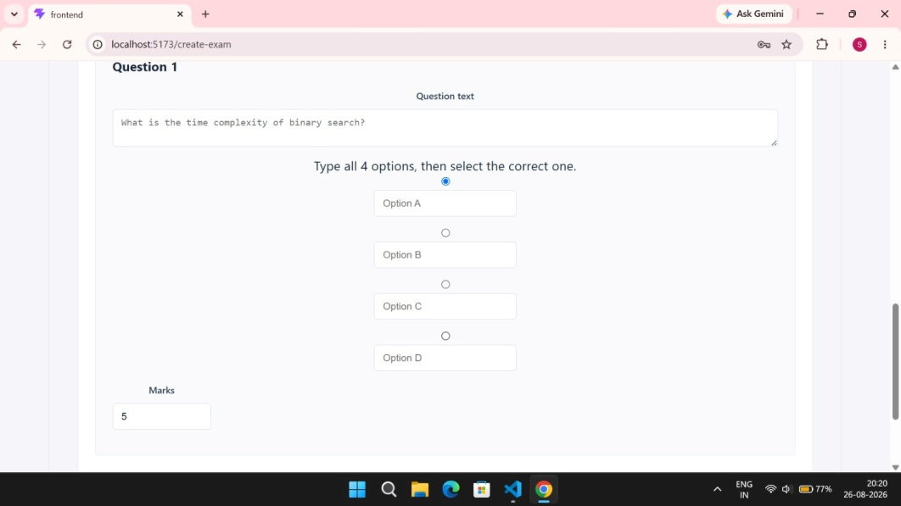
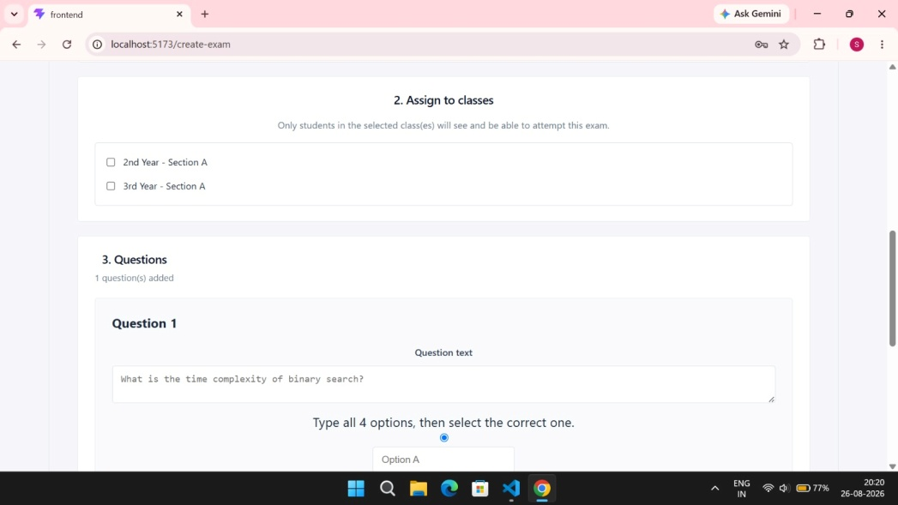
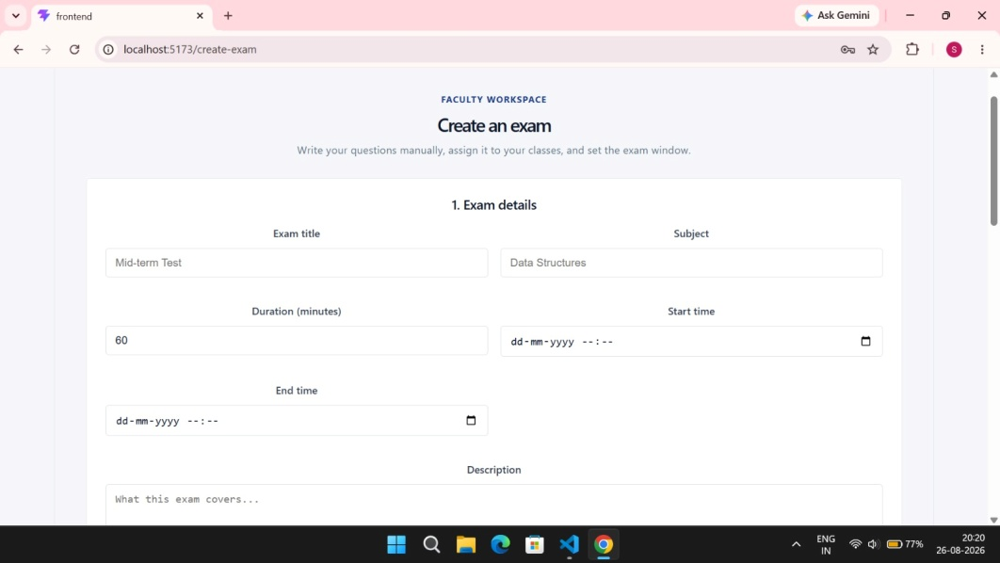
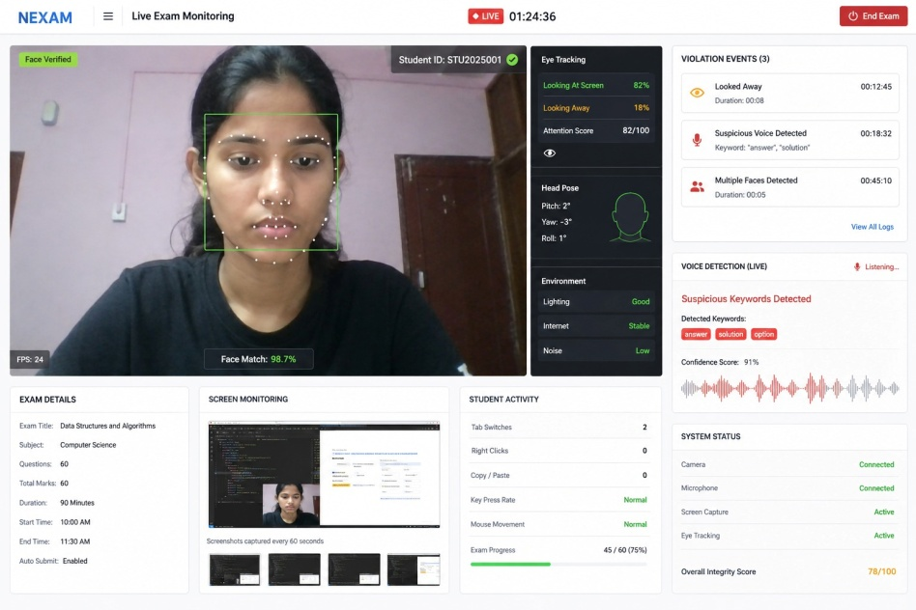
Exam Question Management
Assign Classes
Faculty Exam Management
Live AI Proctored Examination

Slide 11
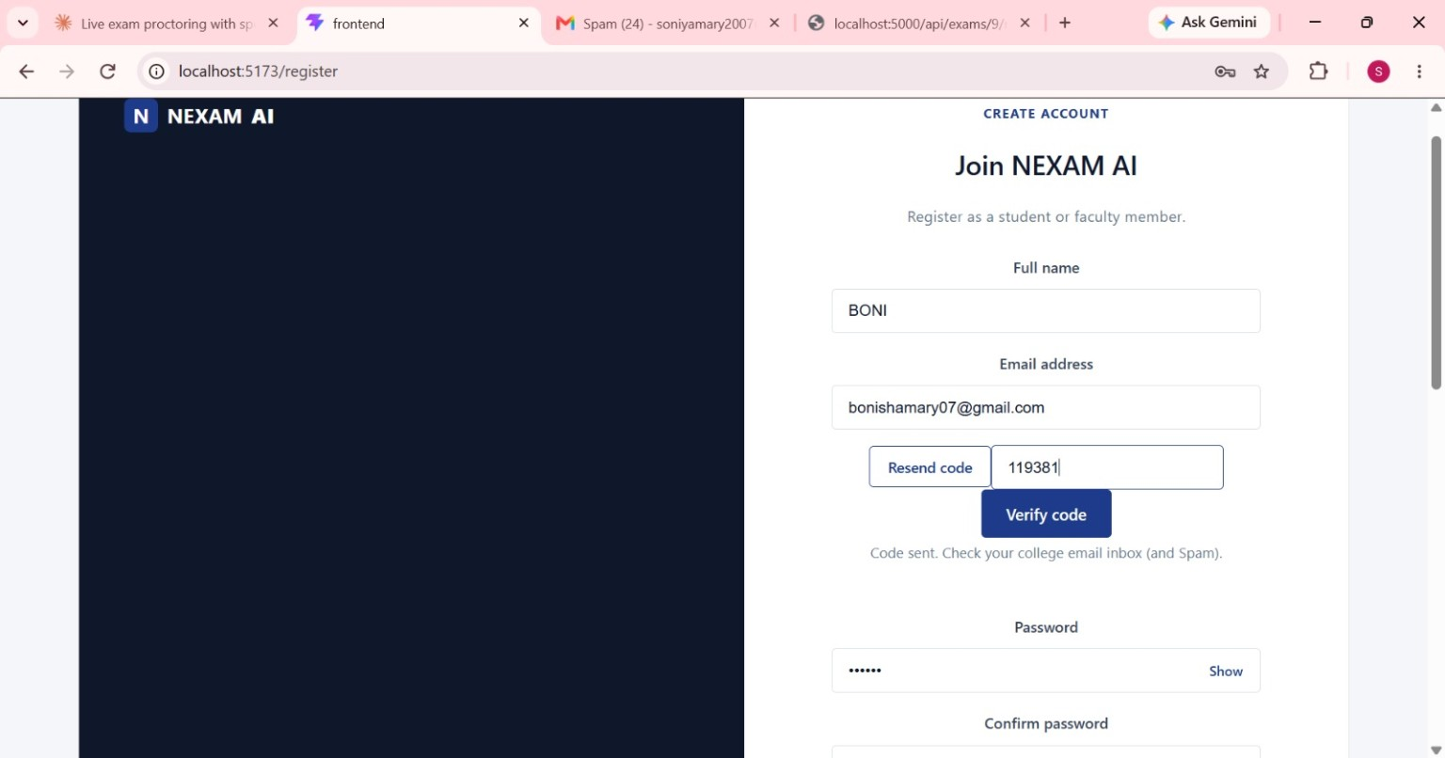
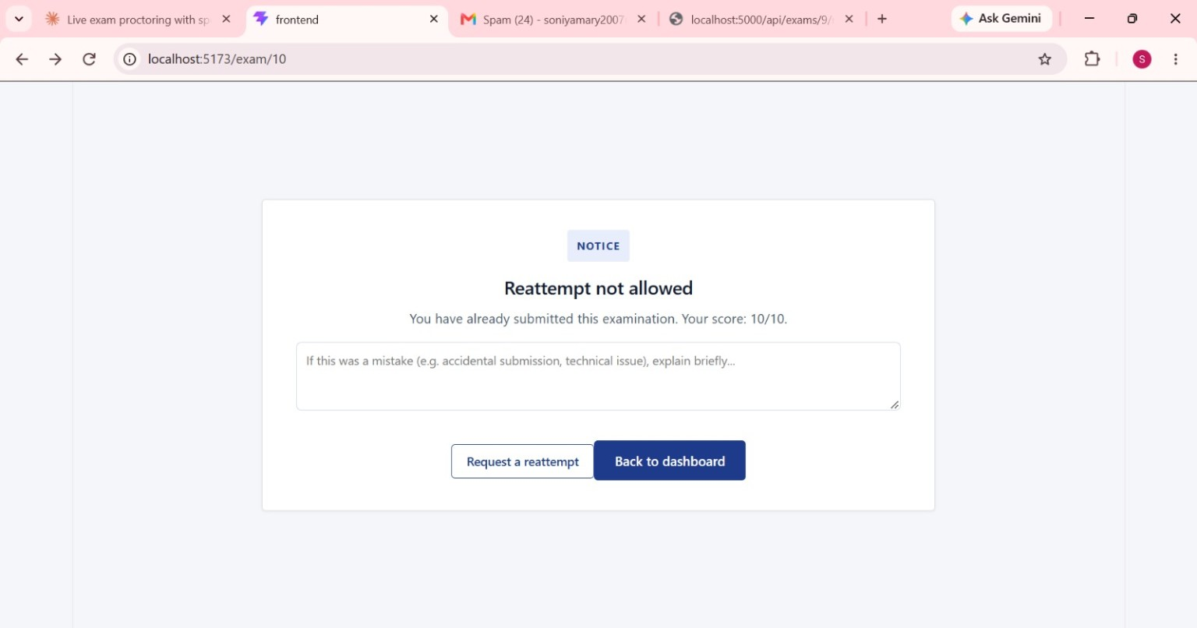
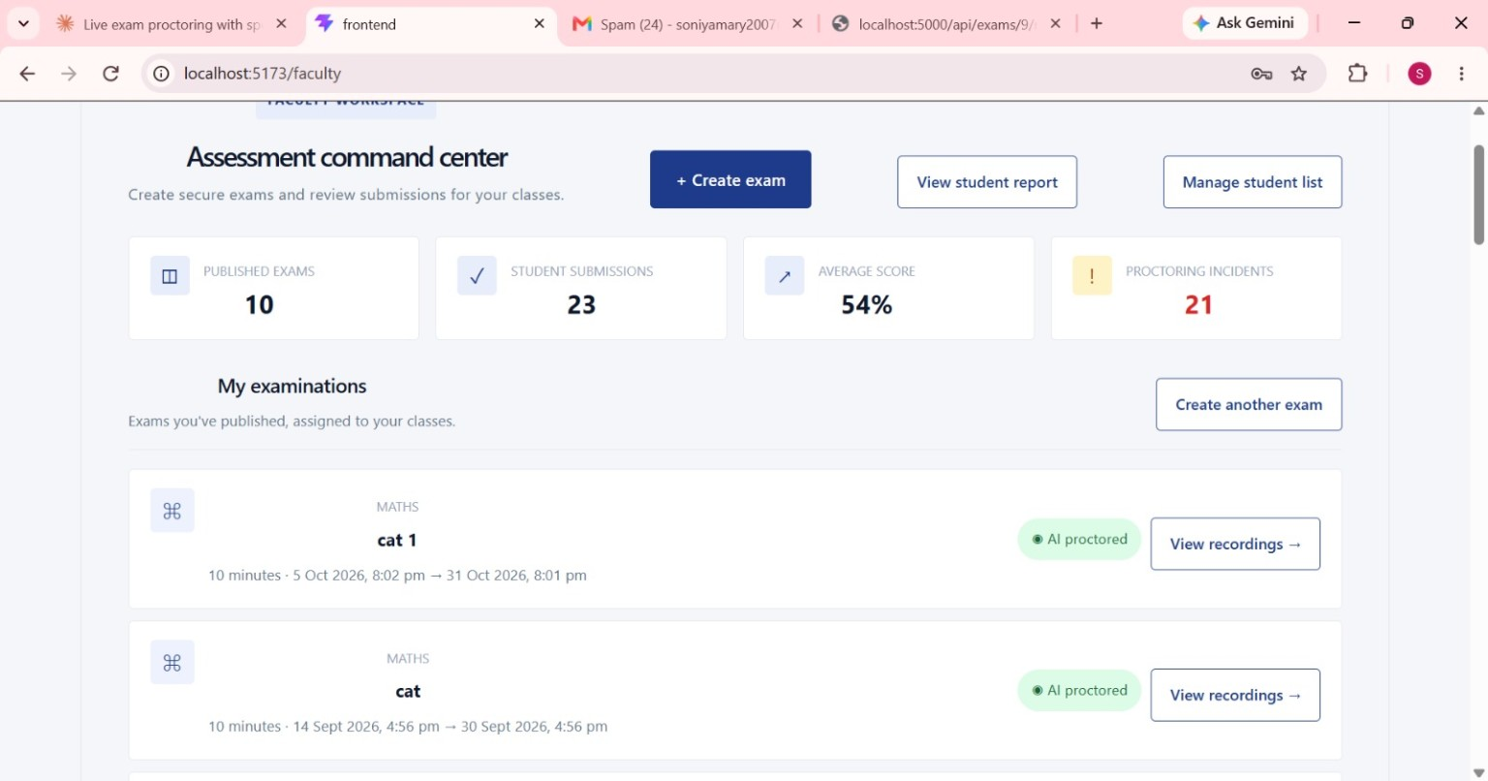
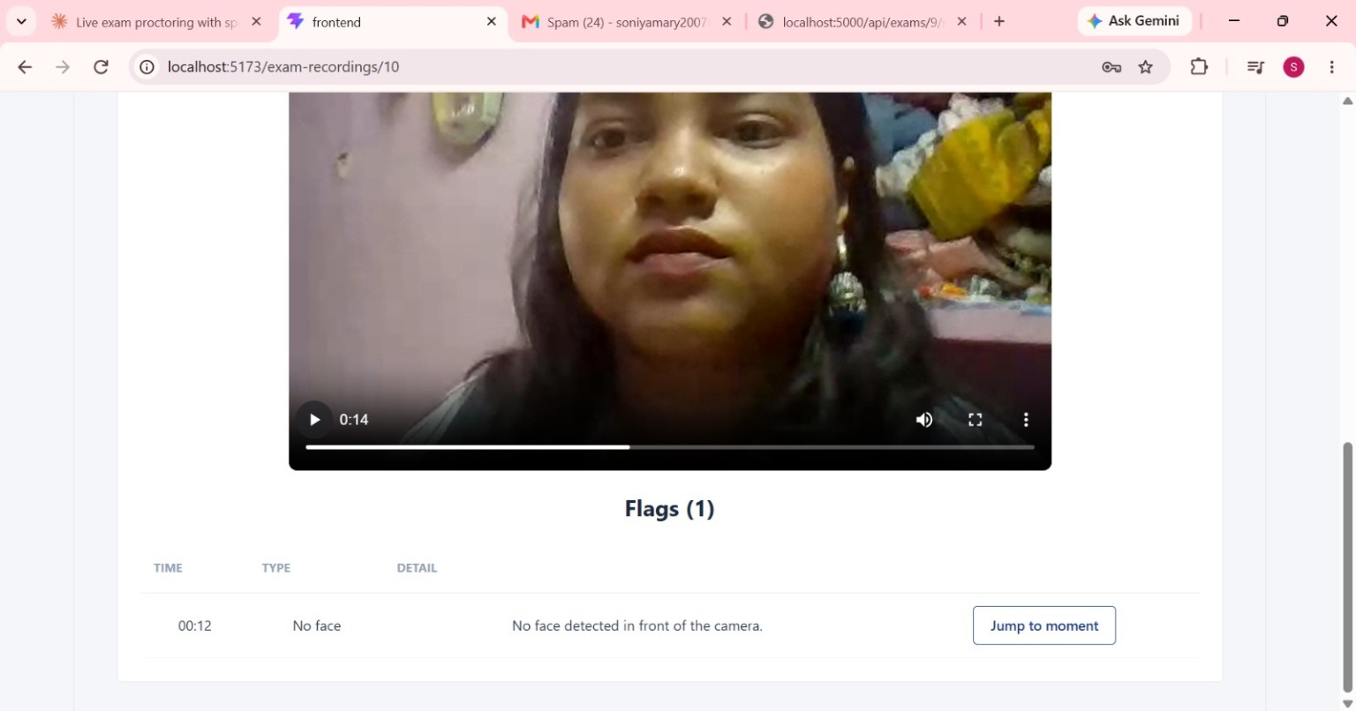
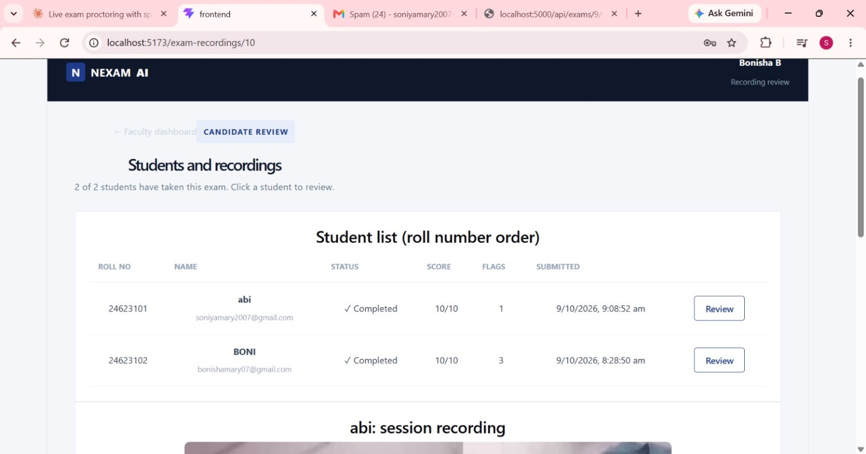
Student Registration & Email Verification
Reattempt Request
Faculty Dashboard
Recording & Violation Flags
Student Recording Review

Slide 12
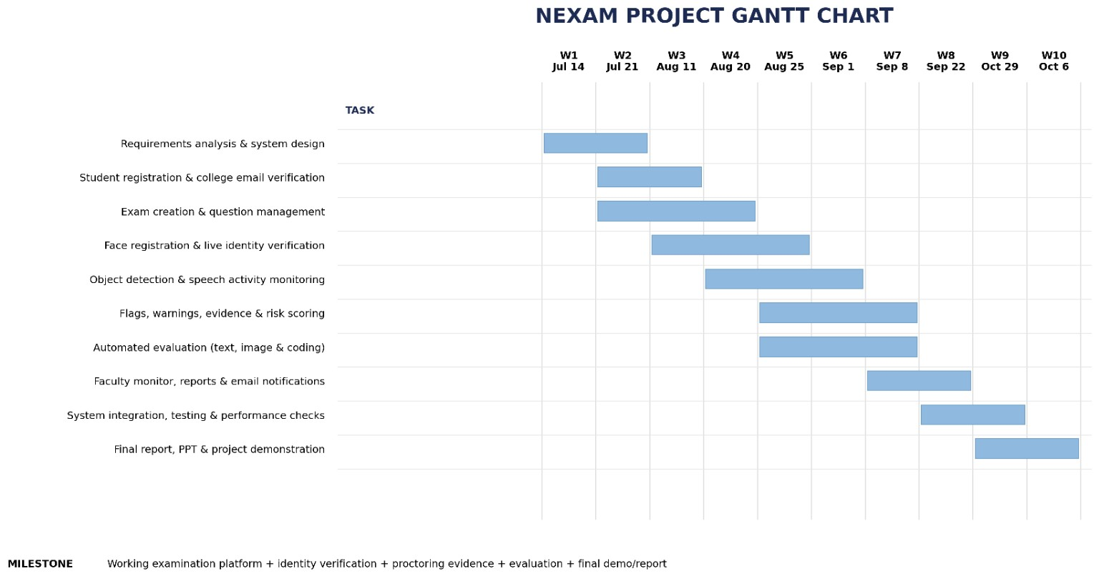

Slide 13
THANK YOU

