Slide 1

Q-TRANSPLANT
ICSIE • INTERNATIONAL CONFERENCE ON SOFTWARE AND INFORMATION ENGINEERING
A Feasible, Reliable & Viable National Organ Transplant Allocation and Intelligence System
AUTHORS
Aravindh A • Jovin Roy S • Priyan E • Ms. Hari Prabha
Department of AIML, Vels Institute of Science, Technology & Advanced Studies (VISTAS), Chennai
REAL-TIME ISCHEMIA DECAY
GIS LOGISTICS
VIRTUAL HLA CROSSMATCH
SHA-256 LEDGER
ESP32 FAILOVER

Slide 2
Abstract
ABSTRACT
Organ transplantation is limited by short preservation windows, manual coordination and opaque allocation. Static registries ignore how quickly an organ decays, how far it must travel and how sensitised the recipient is, so viable organs expire or are matched poorly.
Q-Transplant v4 is a national allocation and intelligence platform built on a deterministic multi-factor matching engine. It combines real-time cold-ischemia tracking, GIS transport decay (Haversine distance with ambulance or air-lift speeds) and virtual six-locus HLA / PRA crossmatching, and ranks donors by a composite of ABO compatibility, HLA match, remaining viability and medical urgency, less a PRA penalty.
Role-based portals onboard accredited hospitals through Aadhaar e-KYC and certificate verification. An ESP32 autonomous failover engine acts when an urgent request is unanswered for 10 minutes, and every allocation is sealed in a SHA-256 hash-chained ledger. The prototype is built with FastAPI, SQLAlchemy, a relational database and a JavaScript web portal, with HL7 FHIR R4 and CSV export.
Keywords: organ allocation · cold ischemia · HLA/PRA crossmatch · GIS logistics · tamper-evident ledger · ESP32 failover · medical informatics

Slide 3
Problem it addresses
01 • INTRODUCTION
1
Fixed Cold-Ischemia Failure
Organs decay rapidly after extraction (a heart expires in 4 hours). Static databases cannot track decay in real time.
2
Geographic Transport Waste
Matches are declared without road or air-lift transit time, so organs expire on the way to the recipient.
3
High PRA% Rejection Risk
Highly sensitised patients with pre-existing antibodies face high rejection rates without virtual crossmatching.
4
Single Point of Failure
Urgent requests wait on manual administrative approval, and viable organs are wasted while they wait.
5
No Transparency or Auditability
Records can be altered and organ priority skipped, with no verifiable trail for regulators.

Slide 4






Key Contributions — Six Core Pillars
02 • KEY CONTRIBUTIONS
Real-Time Viability Engine
GIS Transport Decay
Virtual HLA & PRA Crossmatch
Dynamic organ decay from clinical cold-ischemia limits. Expired organs are excluded automatically.
Haversine distance with ambulance or air-lift speed, deducted from remaining viability.
Six-locus HLA comparison with penalty tiers for sensitised recipients (PRA ≥ 50%).
ESP32 Autonomous Failover
SHA-256 Tamper-Evident Ledger
Database Explorer & Export
A 10-minute watchdog runs the match and emails the requesting surgeon if no one acts.
Hash-chained allocation records make any later alteration immediately detectable.
Live relational inspector, one-click CSV export and HL7 FHIR R4 JSON for EHR interoperability.
Goal: cut donor-to-recipient decision time from hours to seconds, without compromising match precision.

Slide 5
Comparative Literature Review
03 • RELATED WORK
No. | Author – Title (Year) | Methodology | Existing Gap | Q-Transplant v4 Advantage
1 | Medved, Nugues, Nilsson – Simulating Heart Allocation Policies Using Deep Neural Networks, IEEE EMBC 2018 | Deep neural networks simulate outcomes of heart-allocation policies on registry data. | Simulation only; no live hospital system or real-time matching. | Live deterministic matcher with real-time ischemia decay and hospital-facing portals.
2 | Ravindra et al. – Learning Matching Representations for Individualized Organ Allocation, AISTATS 2021 | Representation learning clusters donor features and predicts counterfactual outcomes. | Purely predictive; no HLA-locus scoring, urgency or distance factors, no deployment layer. | Six-locus HLA, urgency, GIS transit and viability combined in one deployable score.
3 | Alqahtani et al. – Transforming Liver Transplant Allocation with AI/ML, Systematic Review, 2025 | PRISMA review of 20 ML/AI studies on urgency, utility and benefit in liver allocation. | Review-level; no working software, audit trail or multi-organ scope. | Running multi-organ platform with a SHA-256 audit ledger and role-based portals.
4 | Kwong et al. – Advancing Kidney Transplantation: ML for Donor–Recipient Matching, Diagnostics 2024 | ML scores donor–recipient compatibility at HLA-A/B/DR to cut manual crossmatch time. | Kidney-specific; no transport logistics or cross-hospital emergency handling. | Adds GIS transport decay and an ESP32 autonomous failover across hospitals.
5 | Norin et al. – ML-Enhanced Immunologic Risk Assessments for Solid Organ Transplantation, Sci. Reports 2025 | ML predicts HLA antibody crossmatch risk (99.3% specificity) to avoid unnecessary physical crossmatches. | Narrow immunologic risk focus; no allocation ranking or coordination. | Folds virtual PRA crossmatch penalties into a full ranking-to-dispatch pipeline.
6 | Deshpande – Smart Match: Revolutionizing Organ Allocation through AI, Frontiers in AI 2024 (base paper) | Narrative review of AI across procurement, matching and post-operative care. | Review only; no deployable system or concrete matching algorithm. | Implements a concrete, benchmarked engine as a working national platform.

Slide 6
System Architecture & Data Flow
04 • SYSTEM ARCHITECTURE
Ischemia Decay Engine
Hospital Dashboard
Real-time viability
Ranked compatible donors
Accredited Hospital Network
FastAPI Backend Engine
GIS Logistics Engine
Multi-Factor Clinical Matcher
SHA-256 Ledger
Donor & recipient profiles
Central API & auth layer
Haversine transit decay
Composite score
Allocation event chain
HLA & PRA Crossmatch
Root Portal & DB Explorer
6-locus + sensitisation
CSV export · FHIR R4
Every service connects through the central FastAPI layer; each allocation event is sealed in the ledger before the Root Organizer can inspect it.

Slide 7
How the Platform Works End to End
05 • PLATFORM WORKFLOW & ROLES
1
Hospital registration
2
Root verification
3
Data ingestion
A hospital submits its government registration code, authorised doctor details and Aadhaar number, and uploads the Aadhaar and accreditation documents.
The Root Organizer reviews each certificate and approves or rejects the application before the hospital can sign in.
Donor datasets are uploaded as CSV by the Root Organizer, and hospitals work from the unified central database.
4
Multi-factor match
5
Privacy-preserving result
6
Audit and failover
The engine drops expired or transit-unviable organs, applies the HLA/PRA crossmatch and ranks donors by composite score.
Rankings disclose the holding hospital's contact details while donor identities stay protected.
Each allocation is appended to the SHA-256 ledger. An urgent request left unanswered triggers the ESP32 failover after 10 minutes.
Two roles: Root Organizer (national oversight) and Accredited Hospital (donor, recipient and request workflows).

Slide 8
Real-Time Ischemia Decay & GIS Transport
06 • METHODOLOGY: VIABILITY & LOGISTICS
Geodesic distance (Haversine)
d = 2R · arcsin √( sin²(Δφ/2) + cos φ₁ · cos φ₂ · sin²(Δλ/2) )
Distance decides the transit mode below.
Ground Ambulance
Air-Lift Transport
< 150 km
> 150 km
60 km/h average urban and highway speed
250 km/h flight + 1 hour airport handling margin
Viability after transport
Remaining = Current viability − Transit hours
Viability = max(0, window − elapsed hours)
Expired organs show EXPIRED (0.0 hrs) and are excluded from every match run.
If remaining ≤ 0, the match is rejected as unviable for transport, so organs never expire in transit.

Slide 9
Virtual HLA Crossmatch & Multi-Factor Scoring
07 • METHODOLOGY: MATCHING
HLA loci compared, donor vs recipient
HLA-A · HLA-B · HLA-C · HLA-DR · HLA-DQ
Low risk
Full match-score eligibility.
PRA < 50%
High risk
10% score penalty for antibody crossmatch risk.
50% ≤ PRA < 80%
Score = 0.25·ABO + 0.40·HLA + 0.20·Viability + 0.15·Urgency − PRA penalty
ABO: O donor is universal, AB recipient is universal.
Critical sensitisation
25% penalty plus a mandatory physical DSA crossmatch before surgery.
PRA ≥ 80%

Slide 10
ESP32 Autonomous Failover & SHA-256 Ledger
08 • METHODOLOGY: RELIABILITY & TRUST
ESP32 Autonomous Failover
Tamper-Evident Hash Chain
1
Urgent request filed
Block n−1
Block n
Block n+1
A 10-minute automated timer starts.
Index
prev_hash
Timestamp
Payload
block_hash
Index
prev_hash
Timestamp
Payload
block_hash
Index
prev_hash
Timestamp
Payload
block_hash
2
No action in 10 minutes
The ESP32 autonomous engine triggers on its own.
3
Match engine runs
Hash n = SHA256( Index n ‖ Hash n−1 ‖ Timestamp n ‖ Payload n )
Best viable donor is selected and an incident log entry is created.
4
Surgeon notified
Altering any past allocation breaks the chain (chain_valid = False), giving regulators and auditors a verifiable history.
Holding-hospital contact details are emailed to the requesting surgeon.

Slide 11
Implementation Stack & Relational Data Model
09 • TECHNOLOGY STACK & DATA MODEL
Backend
FastAPI (Python) REST API with the matching, GIS and ledger services
Relational tables in the current prototype
Table | Rows | Holds
donors | 30 | Donor organ datasets (20 viable, 10 expired)
hospitals | 11 | Accredited hospitals and contacts
recipients | 1 | Waiting recipients
users | 13 | Role-based accounts
audit_ledger | 2 | Hash-chained allocation blocks
Data layer
SQLAlchemy ORM over a relational database
Frontend
Single-page web portal in JavaScript, HTML and CSS
IoT failover
ESP32 autonomous engine with a 10-minute watchdog
Interoperability
HL7 FHIR R4 JSON objects and one-click CSV export
Security
Role-based access, Aadhaar e-KYC, SHA-256 hash chain

Slide 12
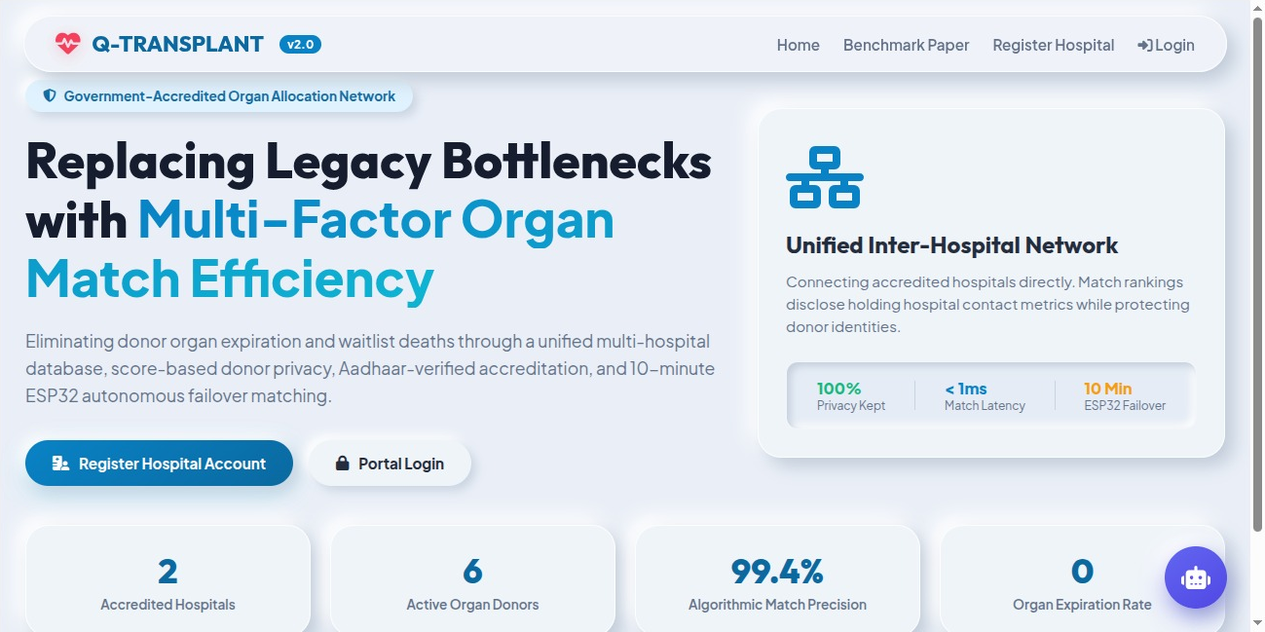
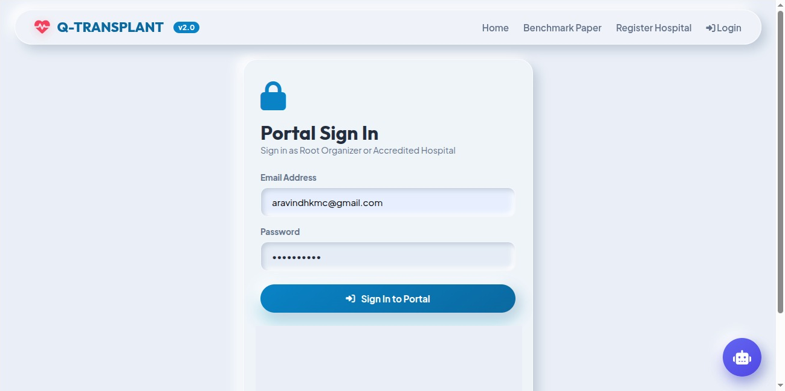
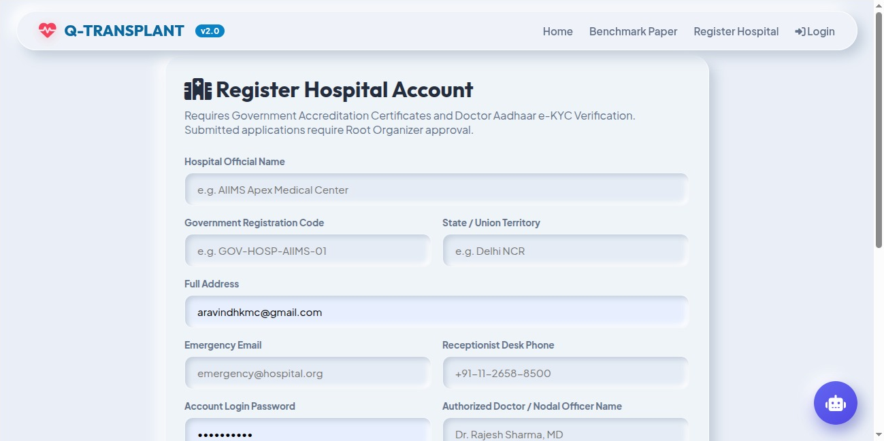
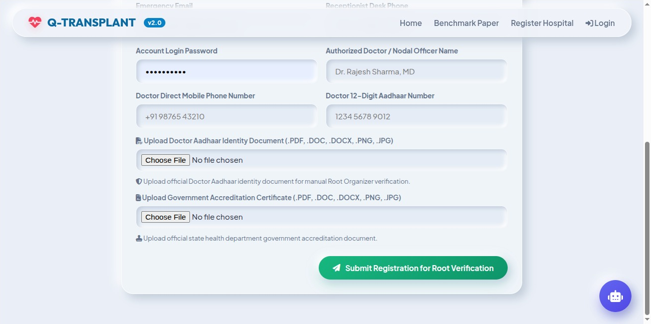
Project Implemented — Public & Hospital Portals
10 • IMPLEMENTATION
Highlights
Government-accredited network landing page with live KPIs
Role-based sign-in for Root Organizer and hospitals
Registration needs Aadhaar e-KYC and an accreditation certificate
Root approval required before a hospital goes live
Landing Page
Portal Sign-In (role-based)
Hospital Registration — Details
Hospital Registration — KYC & Certificates

Slide 13
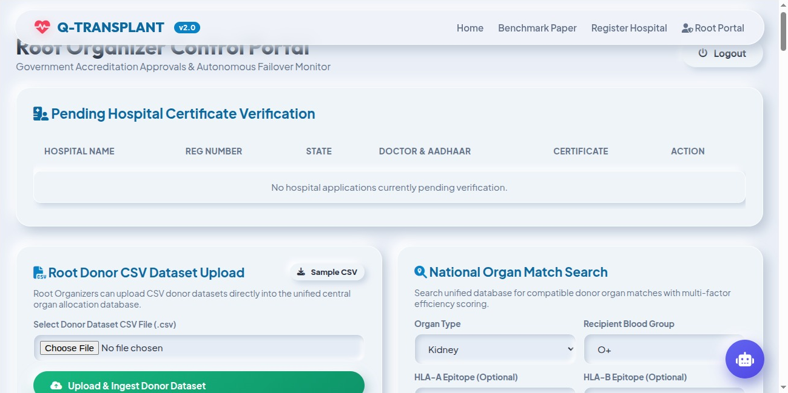
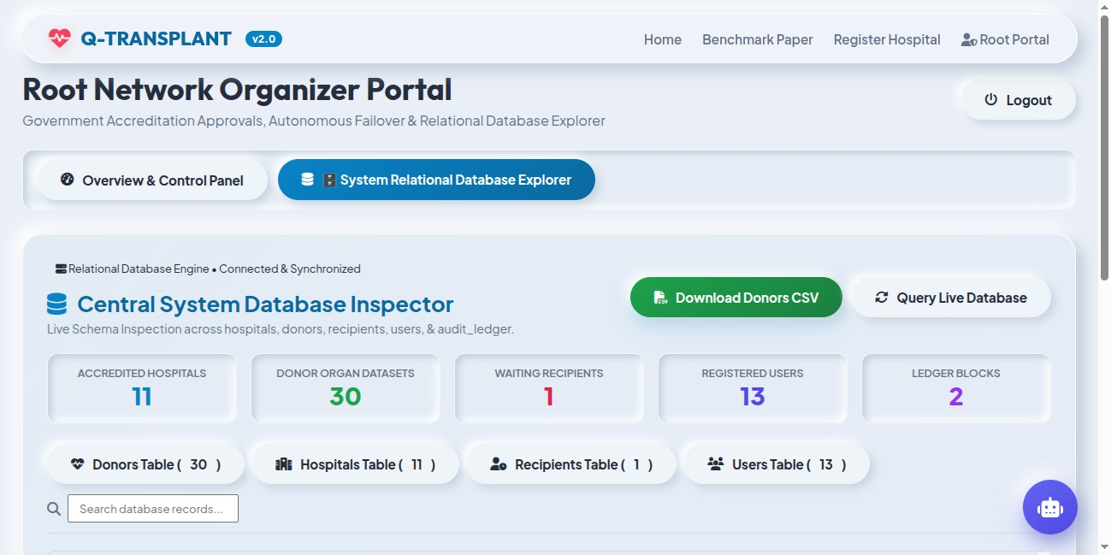
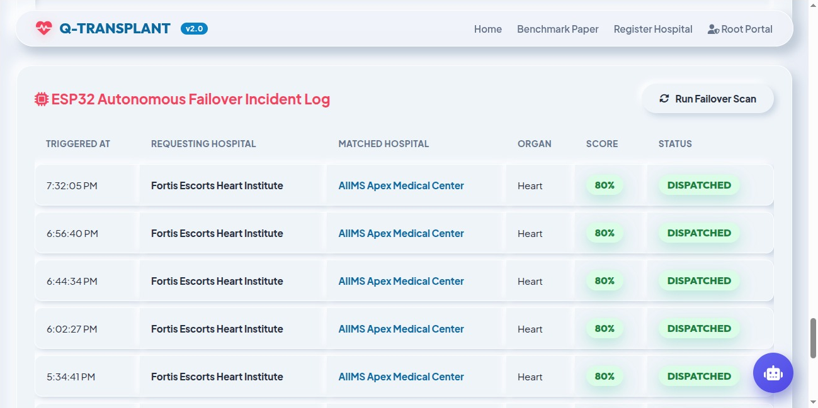
Project Implemented — Root Organizer Portal
10 • IMPLEMENTATION
Highlights
Certificate verification, donor CSV ingest and national match search
Inspector over 11 hospitals, 30 donors, 13 users and the ledger, with one-click Donors CSV
Failover log shows dispatched matches with scores
Root Control Portal
Relational Database Explorer
ESP32 Failover Incident Log

Slide 14
Results & System Validation
11 • RESULTS & SYSTEM VALIDATION
< 15 ms
11
30
80%
Deterministic match execution
Accredited hospitals onboarded
Donor datasets ingested
Score on auto-dispatched failover matches
Observations from the running prototype
Expired organs (10 of 30 donor datasets) are excluded from every match run automatically.
Repeated urgent heart requests from Fortis Escorts Heart Institute were auto-dispatched by the ESP32 failover to AIIMS Apex Medical Center with an 80% match score.
Each allocation is appended to the SHA-256 ledger, and altering any past block breaks the chain (chain_valid = False).
The Database Explorer reports live counts across all tables and streams the full donor dataset as CSV in one click.

Slide 15



Conclusion & Future Work
12 • CONCLUSION & FUTURE WORK
No Allocation Delays
No Organ Waste
Safer Matches
Full Transparency
Autonomous failover acts within 10 minutes.
Ischemia and GIS decay stop organs expiring in transit.
Virtual HLA and PRA crossmatch reduces rejection risk.
SHA-256 ledger gives an auditable allocation history.
Q-Transplant v4 delivers a feasible, reliable and viable national organ allocation platform that reduces allocation delays, prevents organ waste and provides transparent, tamper-evident auditability.
Future work
Pilot deployment with accredited transplant centres · validation against historical allocation data · production-grade ESP32 hardware

Slide 16
References
REFERENCES
[1] Medved, Nugues and Nilsson, “Simulating Heart Allocation Policies Using Deep Neural Networks,” IEEE EMBC, 2018.
[2] Ravindra et al., “Learning Matching Representations for Individualized Organ Allocation,” AISTATS, 2021.
[3] Alqahtani et al., “Transforming Liver Transplant Allocation with AI/ML: A Systematic Review,” 2025.
[4] Kwong et al., “Advancing Kidney Transplantation: Machine Learning for Donor–Recipient Matching,” Diagnostics, 2024.
[5] Norin et al., “Machine Learning-Enhanced Immunologic Risk Assessments for Solid Organ Transplantation,” Scientific Reports, 2025.
[6] R. Deshpande, “Smart Match: Revolutionizing Organ Allocation through Artificial Intelligence,” Frontiers in Artificial Intelligence, 2024.
[7] HL7 International, “FHIR Release 4 (R4) Specification.”
[8] NIST, “Secure Hash Standard (SHS),” FIPS PUB 180-4 (SHA-256).

Slide 17
Thank You
Questions & Discussion
Aravindh A • Jovin Roy S • Priyan E • Ms. Hari Prabha
Department of AIML, Vels Institute of Science, Technology & Advanced Studies (VISTAS), Chennai

