Slide 1

AI Based Crowd Monitoring and Real-Time Evacuation Assistance System
FINAL REVIEW
Project Guide:
Ms. B. RekhaDevi
Batch no:14
Team Members:
S.Krish Priyan
S.Sanjay
R.Immanuel

Slide 2
AGENDA
01
INTRODUCTION
04
ARCHITECTURE DIAGRAM
About the Team
Market Trends
Competitive Landscape
SWOT Analysis
KPIs/Objectives
Action Plan
Timeline
Revenue
02
ABSTRACT
05
PROJECT IMPLEMENTATION
Market Size
Differentiators
Questions
Thank You
03
LITERATURE SURVEY
06
GANTT CHART PROGRESS
Vision
Strategy Canvas
Goals

Slide 3
INTRODUCTION
Predicting and managing crowd dynamics using deep learning.
Application in smart cities and public events.
Predicting and managing crowd dynamics.
Improving safety,efficiency,and user experience.
Detect and warn against mass crowd stampedes or dangerous overcrowding.
Identify unusual or abnormal behavior in crowds (e.g., panics, sudden scattering).
Count crowds in public places of high and low densities to monitor social distancing.

Slide 4
ABSTRACT:
Large public gatherings such as festivals, concerts, railway stations, shopping malls, and college events can experience overcrowding, panic, and uncontrolled crowd movement. Traditional surveillance systems mainly depend on humans continuously observing CCTV footage, which can make it difficult to analyse large crowds and identify rapidly changing situations in real time.
The proposed system uses Artificial Intelligence (AI) and Computer Vision to automatically monitor people, analyse crowd density, identify potentially critical zones, and provide real-time alerts. The system further uses real-time crowd mapping and path-planning algorithms to recommend evacuation routes based on the current crowd conditions. This provides an intelligent decision-support system that can assist authorities in managing crowds and responding more efficiently during emergency situations.

Slide 5
Technical Problem Statement:
Traditional CCTV setup provides raw video feeds but lacks automated continuous analysis for:
Live spatial crowd counting and density estimation.
Identification of high-density risk zones.
Real-time tracking of changing crowd evacuation conditions.
To replace manual video inspection with an automated AI system capable of real-time crowd-density estimation, risk detection, visual zone mapping, dynamic alerts, and congestion-aware evacuation route recommendations.
Core Objective:
Problem Statement :
During rapidly developing emergencies, manually identifying congested bottlenecks and determining safe exit routes is difficult and slow.

Slide 6
Proposed Idea & System Core (Objective):
OUR SOLUTION :
An end-to-end AI-based decision-support prototype that converts live surveillance feeds into actionable crowd intelligence and evacuation guidance
Key Pipeline Stages:
AI Surveillance Layer: YOLO-based person detection and real-time tracking from video feeds.
Spatial Analysis Layer: Environment segmentation into dynamic zones with automated density calculation.
Risk & Alert Layer: Automated risk classification (Safe / Moderate / Critical) triggering immediate notifications.
Live Mapping & Evacuation Layer: Real-time spatial visual map and congestion-aware pathfinding (e.g., A*/Dijkstra) to recommend optimal evacuation routes.

Slide 7
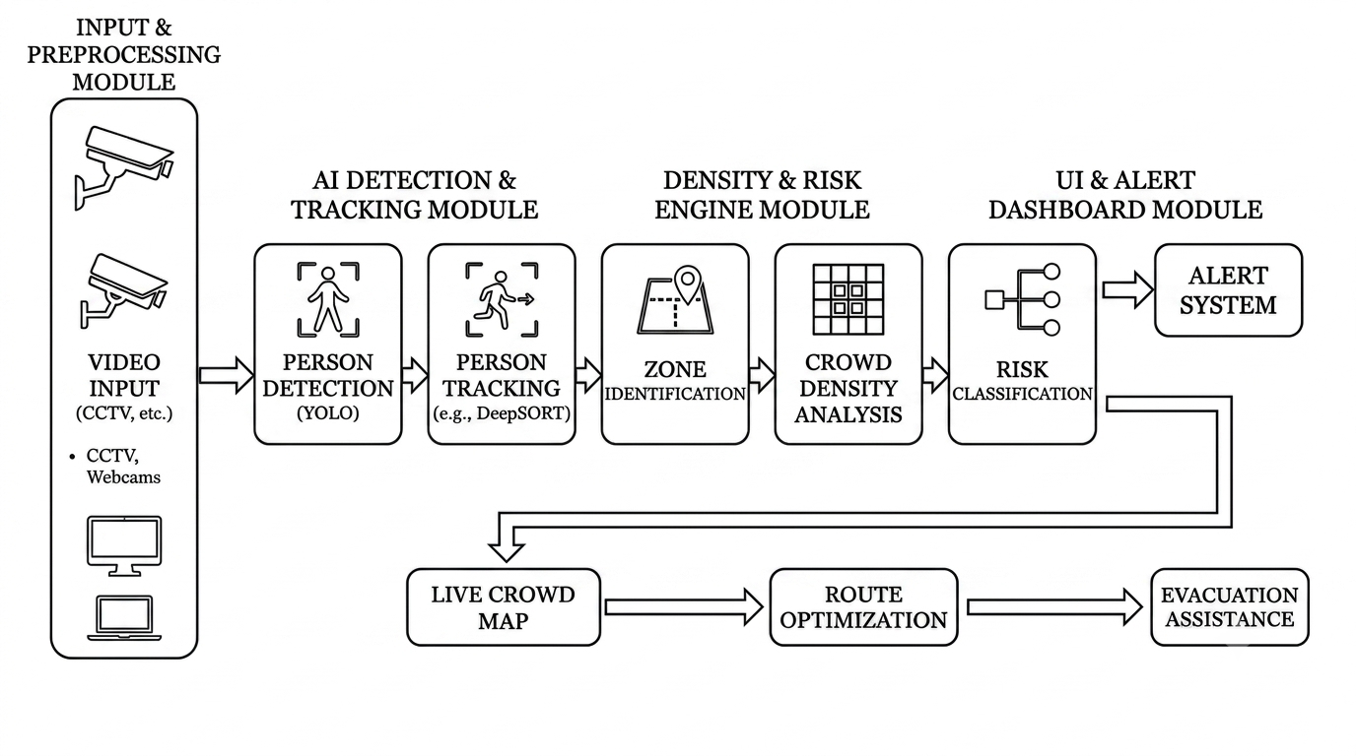
System Architecture:
Structured matching the CareFlow architecture layer breakdown

Slide 8
LITERATURE SURVEY:
No. | Author & Paper | Methodology | Limitations | Our Extension / Contribution
1 | Zhang et al., 2016 (CVPR) | Multi-column CNN for crowd counting. | Focuses solely on density counting; no evacuation routing. | Feeds crowd counts into zone risk levels and exit planning.
2 | Huang et al., 2023 (Safety Science) | YOLOv3 + pedestrian positioning + simulation. | High reliance on complex simulation setups. | Lightweight real-time web dashboard for direct operator use.
3 | Alasmari et al., 2024 | Systematic review of deep learning in crowd management. | Identifies real-world deployment and generalisation gaps. | End-to-end functional prototype with UI alerts.
4 | Zhang et al., 2020 (ICRA) | Density map + congestion-aware A* for indoor evacuation using AR devices. | Needs evacuees' AR devices; evaluated mainly in simulation. | Density comes from CCTV video; no user devices needed.
5 | Choudhury et al., 2026 (Drishti, arXiv preprint) | YOLOv8, multi-camera fusion, congestion forecasting, guard reallocation. | Cloud/UAV-heavy; no route guidance for the crowd. | Low-cost local system with congestion-aware evacuation routes.
6 | GPEvac, 2026 (arXiv preprint) | GNN + PPO adaptive evacuation routing. | RL training complexity; shooting-event scenario. | Simple graph search on live density; easy to explain and deploy.

Slide 9
Base Paper:
Mini-Project: AI-based Crowd Management System
S.no | Paper | Goal | Method | Dataset | Result | Limitation
1 | CSRNet for Crowd Counting (Li et al., CVPR 2018) | Estimate a crowd density map and count from one image | VGG-16 backbone with dilated convolutions | ShanghaiTech Part A & B | MAE 68.2 on Part A, a strong baseline | Needs well-annotated data; affected by lighting changes
2 | Social-LSTM (Alahi et al., CVPR 2016) | Predict future paths of pedestrians in crowds | LSTM with a social pooling layer | ETH & UCY | More accurate path prediction than earlier methods | Heavy for real-time dense crowds; short look-ahead
3 | Abnormal Crowd Behavior Detection (Direkoglu, IEEE Access 2020) | Detect panic and escape events in surveillance video | Optical-flow motion images fed to a CNN | UMN & PETS2009 | Detects panic and escape behaviour on standard datasets | Detects events only; gives no exit guidance
4 | Realtime Crowd Monitoring (Khel et al., IEEE Access 2023) | Count people and estimate their speed and direction in real time | Hybrid, lighter YOLOv4 | JHU dataset | Lower memory use; close to real-time needs | Monitoring only; no risk zones or evacuation routes
5 | DeepSOCIAL (Rezaei & Azarmi, 2020) | Monitor social distancing and infection risk using CCTV | YOLOv4 + SORT tracking + inverse perspective mapping | Oxford Town Centre | 99.8% mAP at 24.1 fps | Built for distancing risk, not evacuation

Slide 10
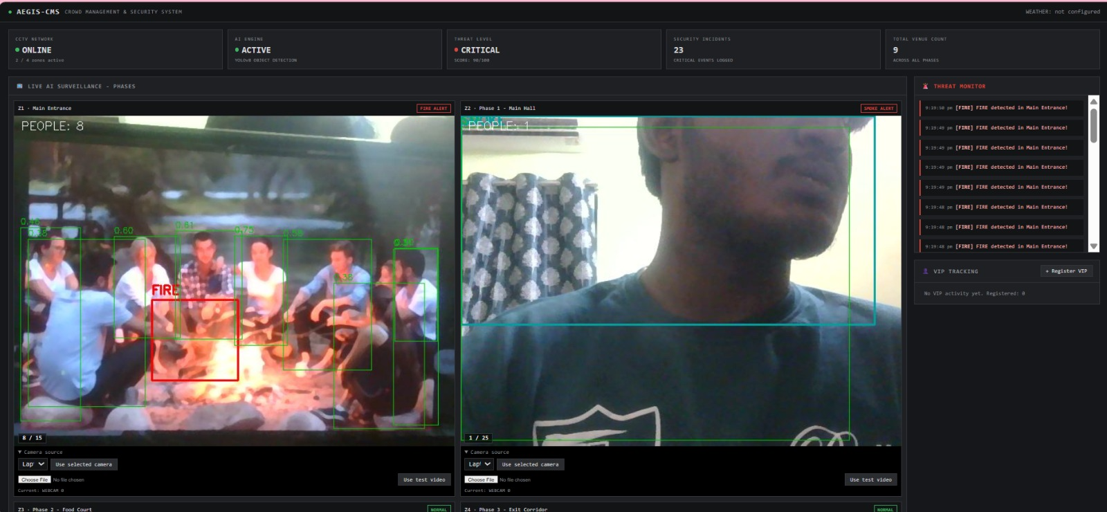
Project Interface-

Slide 11
Research Gap & Project Positioning
Recent YOLO systems only count, measure density or alert; they don't guide evacuation.
Evacuation routing mostly uses simulations, RL or sensors/AR devices, not ordinary CCTV.
Congestion-aware routing exists but is rarely combined with live detection and a dashboard.
Large platforms (e.g., Drishti, 2026) need cloud, drones and many cameras.
What Prior Work Often Assumes:
Our Positioning:
A lightweight CCTV-only system: detect people, measure zone density, classify risk (Safe / Moderate / Critical), route around congestion with A*/Dijkstra, and show it all on a live dashboard.

Slide 12
Software Requirements
PROGRAMMING LANGUAGES
Back-End Framework:
Python: Main programming language used for computer vision processing, AI model inference.
JavaScript (ES6+): Frontend dashboard interactivity and dynamic map rendering.
HTML5 & CSS3: UI layout, styling, and dashboard structure.
Flask (Python web server for streaming video and rendering API data).
Computer Vision & AI Libraries:
Database:
OpenCV, PyTorch, Ultralytics (YOLOv8/YOLOv5), NumPy.
SQLite / PostgreSQL (for logging crowd events and risk alerts).

Slide 13
Hardware
Requirements
Processor:
GPU:
Intel Core i5 / AMD Ryzen 5 or higher.
NVIDIA Dedicated GPU (CUDA-enabled recommended for real-time video FPS).
RAM:
Storage :
8 GB minimum; 16 GB recommended for AI inference .
20 GB+ free SSD space .

Slide 14
Conclusion:
Automated Decision Support: Successfully transitions crowd management from passive manual CCTV monitoring to a proactive, automated AI decision-support system.
Real-Time Risk Prevention: Combines YOLO-based detection with dynamic zone density analysis to detect severe congestion and predict potential stampede risks early.
Dynamic Evacuation Routing: Leverages congestion-aware pathfinding algorithms (A*/Dijkstra) to dynamically route crowds away from high-density bottlenecks.
Unified Monitoring Platform: Delivers a real-time web dashboard that provides emergency authorities with immediate visual maps, live metrics, and instant alerts for accelerated response times.

Slide 15
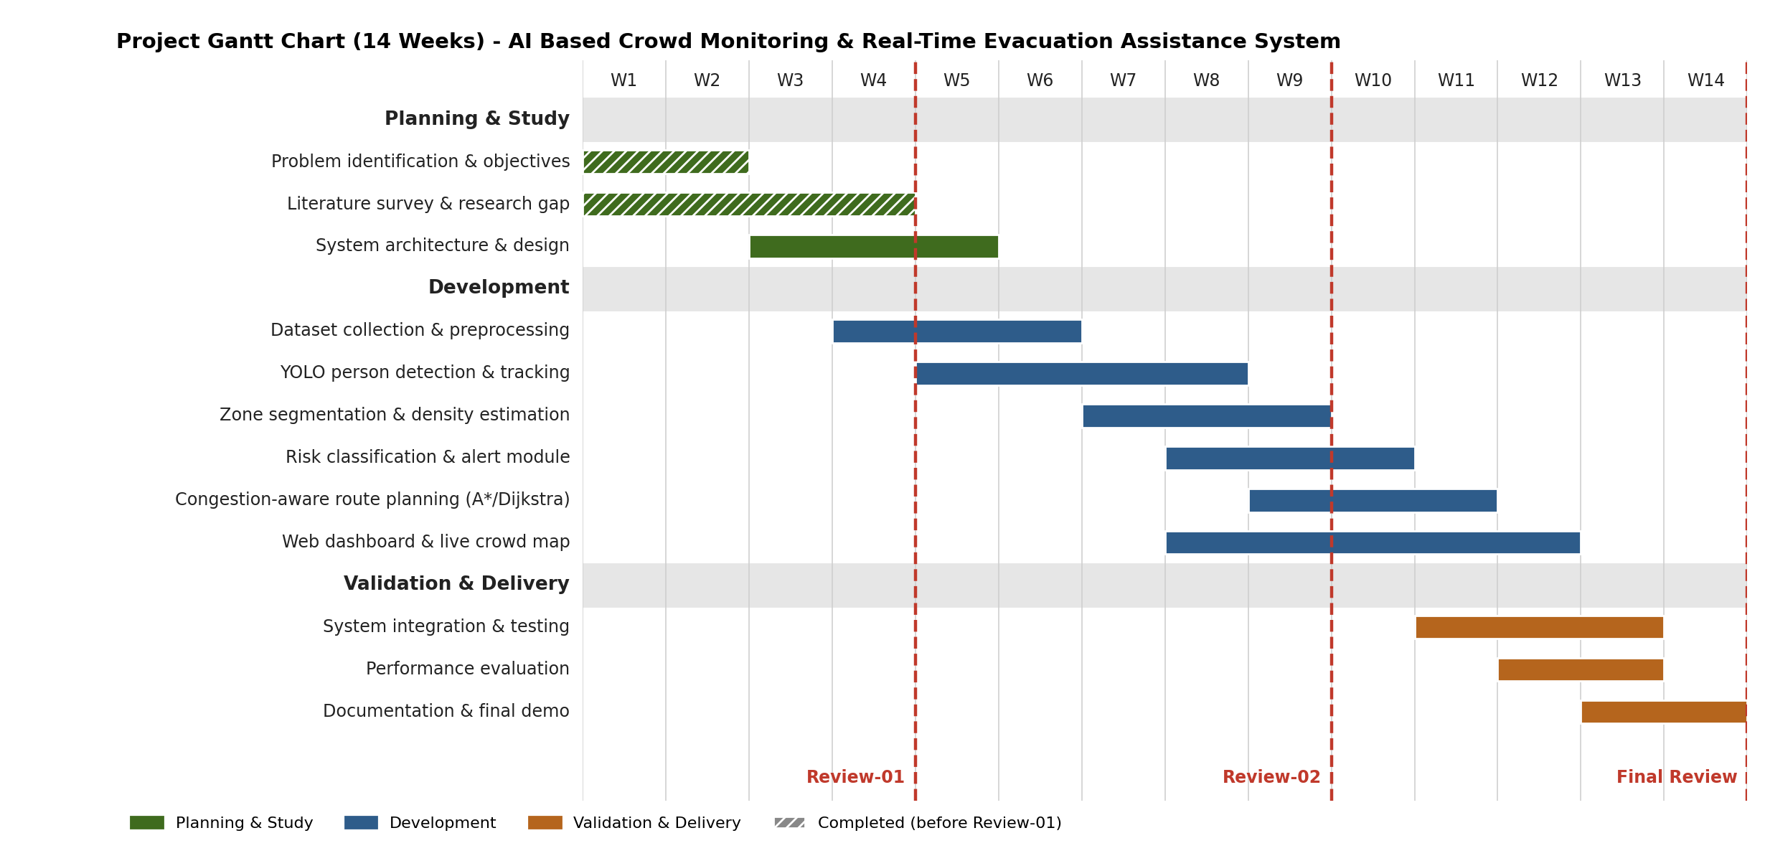
Gantt Chart

Slide 16
THANK YOU

