Slide 1

FINAL-YEAR PROJECT REVIEW
EarlySign: Early Autism Risk Screening using Behavioural and Biological Biomarkers
Submitted by
HARNESH.G (24623502)
KISHORE.R (24623140)
DHARUN KUMAR.R (2462501)
Under the guidance of
MS.P.JANANI
Batch No: 2
Department of B.Tech CSE (AI) · VISTAS · 2024–2028
Notes:
Good morning everyone. Our project is called EarlySign. The idea is simple: can we look at a few early signs in a toddler, things like how they respond to their name, where they look, or how they babble, and help a doctor decide whether that child should be seen by a specialist sooner? We built a working tool for this, and today we'll walk you through why we built it, how it works, and what we found. One thing up front: this is a screening aid, not something that diagnoses autism.

Slide 2
Introduction
Autism spectrum disorder (ASD) is a lifelong developmental condition that affects how a child communicates, plays and connects with people
Signs can show up as early as 12–24 months, but many children are diagnosed only at 3 or 4 years
Around 1 in 100 children worldwide have autism (WHO)
Most screening depends on what parents report and what a doctor sees in a short visit
Biomarkers are things we can measure, such as:
  where a child looks (eye tracking), brain activity (EEG), speech and movement
  blood markers and known gene variants
Spotting differences early means families can start therapy sooner, while the brain is developing fastest
Notes:
Let's start with autism itself. It's a lifelong developmental condition, and it mainly affects how a child communicates and connects with people. What surprised us during our reading is the gap: signs can show up between 12 and 24 months, but a lot of children aren't diagnosed until they're three or four. Part of the reason is that screening mostly depends on what parents tell the doctor and what the doctor notices in a short visit. Biomarkers are measurable signals, like where a child looks or how their brain activity looks, and they might help pick up differences earlier. And early matters, because that's when therapy helps the most.

Slide 3
Problem Statement
Late diagnosis: many children miss the best years for early support
Subjective screening: questionnaires depend on who fills them in
Weak single markers: no single test is accurate enough to screen every child
Scattered data: clinics rarely have every test, and results sit in different places
Our question: Can we combine several early signs in one place, explain the result clearly, and help doctors decide which toddlers to refer for a full assessment sooner?
Notes:
So here's the problem as we see it. Diagnosis often comes late. Screening is subjective, because it depends on who's filling in the form. No single test is strong enough on its own. And in real clinics, you rarely have every test, and the results are scattered. That led to our question: can we put several early signs together in one place, explain the result clearly, and help doctors decide who to refer first?

Slide 4
Existing System
Method | Advantages | Limitations
Screening questionnaires (e.g. M-CHAT-R/F) | Quick, low cost, widely used in primary care | Depend on parent recall; fixed cut-offs miss some children
Eye-tracking and EEG research | Objective signals; can show differences in infancy | Needs special equipment and trained staff; mostly in labs
MRI, blood and genetic tests | Measurable biological evidence | Costly, not routine for toddlers; each looked at on its own
Each method looks at only one kind of signal
There is no single screen that brings the results together and works with whatever tests a clinic has
Notes:
Before building anything, we looked at what already exists. Questionnaires like M-CHAT are cheap and widely used, but they rely on what parents remember. Eye tracking and EEG give more objective signals, but you need special equipment, so they mostly stay in research labs. MRI, blood and genetic tests give biological evidence, but they're expensive and usually looked at one by one. Each approach has its place. Our idea was to bring them together.

Slide 5
Objectives
To combine up to eight early-sign modules into one ASD risk level (Low, Medium or High) for children aged 12–36 months
To give a score even when some tests are missing, and show how much data it is based on
To compare a simple weighted score with two machine learning models: logistic regression and a decision tree
To explain every result, module by module, in plain language
To track the same child over repeat visits and alert when risk rises sharply
Notes:
Our objectives were simple. First, combine up to eight kinds of early signs into one risk level. Second, make it work even when some tests are missing, and be honest about how much data the score is based on. Third, compare a simple weighted score with two machine learning models. Fourth, explain every result in plain language. And fifth, track the same child over time and raise an alert when the risk jumps.

Slide 6
Proposed System
Child profile
Scoring engine
Rule-based score
Logistic regression
Decision tree
Screening report
ASD risk: Low / Medium / High
What drove the score
Next steps
8 biomarker modules
Parent questionnaire
Every module is optional; the report says how much data the score is based on
All three models are shown side by side, so disagreements are easy to see
The output is a risk level to help clinicians, not a diagnosis
Notes:
This is our proposed system at a high level. On the left are the inputs: the child's basic profile, up to eight biomarker modules, and a questionnaire the parent can fill in. In the middle is the scoring engine, where we run three different models and show them next to each other. On the right is the report: the risk level, what pushed the score up, and what to do next. The key things are that it works even with missing tests, it compares models, and it always explains itself.

Slide 7
Biomarker Modules
No. | Module | What we measure | Weight
1 | Behaviour | 20-question parent questionnaire (M-CHAT style) | 25%
2 | Eye tracking | Time on faces, social vs. geometric scenes, gaze-following speed | 18%
3 | EEG | Alpha and gamma power, theta/alpha ratio, long-range coherence | 12%
4 | MRI | Extra-axial fluid, brain volume growth, surface-area growth | 10%
5 | Blood | Oxidative stress, serotonin, lactate/pyruvate, IL-6, TNF-alpha | 7%
6 | Genetic | Fragile X, CHD8, SHANK3, 16p11.2, PTEN, SCN2A; polygenic score | 10%
7 | Speech | Babbling, pitch variability, response to name | 10%
8 | Motor | Head lag, postural control, movement variability | 8%
Weight = default weight in the rule-based score (can be changed in Settings). Reference ranges are placeholders.
Notes:
These are the eight modules we support. Behaviour is a 20-question parent questionnaire. Eye tracking looks at how much a child looks at faces. EEG and MRI cover brain activity and brain growth. Blood and genetic tests cover biological markers and known gene variants. Speech looks at babbling and response to name, and motor looks at things like head control and posture. The percentages are the weights we gave each module in the rule-based score. Behaviour gets the most, because questionnaires are the best-tested early screen we have.

Slide 8
System Flow
1. Child profile
ID, age, sex, family history
2. Biomarker input
Any of the 8 modules
3. Normalisation
Compare with reference ranges
4. Module scores
Each module 0–100%
8. Report
Next steps, compare, trend alerts
7. Explanation
What drove the score
6. ASD risk level
Low < 35%, Medium, High ≥ 60%
5. Risk scoring
Rule-based / LR / tree
Everything runs inside the browser. Data is saved only on the device and is never sent to a server.
Notes:
Here's the full flow of the system, step by step. First, the clinician creates a profile for the child with an ID instead of a name. Then they enter whichever modules they have. Each raw value is compared to a reference range, and each module turns into a score between 0 and 100 percent. Next, one of our three models combines those into an overall risk, which becomes Low below 35, Medium from 35 to 60, or High above 60. Finally, the app explains what drove the score and produces a report, and for repeat visits it can compare children and raise trend alerts. All of this happens inside the browser, so no data goes anywhere.

Slide 9
Scoring Models
Model | How it works | How it explains the result
Rule-based weighted score | Weighted average of the modules that were filled in. Sibling with autism +5%, family history +3%. A known high-risk gene variant lifts the genetic score to at least 85%. | Every part of the score can be read straight from the weights
Logistic regression | Coded in JavaScript and trained in the browser on 210 simulated children. A missing module counts as a neutral 50%. | Shapley values show how much each module pushed the score up or down
Decision tree (depth 3) | Asks at most three yes/no questions about the module scores. Trained on the same 210 children. | Shows the path the child took through the tree
Every report shows all three models together and warns when they don't agree.
Notes:
We use three ways to score a child. The first is a simple weighted average, which is easy to explain because you can see exactly where every point comes from. The second is logistic regression, which learns its own weights from data. We coded it ourselves and it trains right in the browser. The third is a small decision tree that asks at most three yes-or-no questions. For each one we show an explanation, and the report always shows all three together, so if they disagree, the doctor can see that straight away.

Slide 10
Model Training and Testing
Simulated data
300 children, ~30% ASD
Prepare features
8 module scores each
Split 70 / 30
210 train, 90 test
Train
LR and decision tree
Evaluate
AUC, sensitivity, specificity
Rules learned by the decision tree
Condition | ASD share | Risk | Children
Behaviour ≤ 39%, Speech ≤ 60% | 4% | Low | 126
Behaviour ≤ 39%, Speech > 60% | 33% | Low | 10
39% < Behaviour ≤ 61% | 40% | Medium | 18
Behaviour > 61%, EEG ≤ 31% | 42% | Medium | 10
Behaviour > 61%, EEG > 31%, Blood ≤ 24% | 75% | High | 10
Behaviour > 61%, EEG > 31%, Blood > 24% | 95% | High | 36
Notes:
This slide shows how we trained and tested the models. Since we don't have real patient data, we generated 300 simulated children, about 30 percent with an ASD label, and we deliberately left some tests missing to make it realistic. We trained on 210 children and kept 90 aside for testing. The table shows the rules the tree learned. It looks at behaviour first, then speech, EEG and blood. The chart shows what logistic regression learned, where behaviour matters most. These patterns come from how we generated the data, so they're not claims about real biology.

Slide 11
Implementation
EarlySign is one HTML file that opens in any modern browser, with nothing to install and no server.
Dashboard with search and risk filter
Step-by-step assessment form (any step can be skipped)
Simple questionnaire for parents
Screening report (print or save as PDF)
Compare two children side by side
Trend alert when the score rises 15+ points
Settings for weights, thresholds and ranges
19-step live demo with voice-over
Tools used: HTML, CSS, JavaScript, SVG charts, browser localStorage, Web Speech API
Notes:
This is what we actually built. The whole app is one HTML file that runs in any browser. It has a dashboard, a step-by-step assessment form where any step can be skipped, a simple form for parents, the screening report, a compare view, trend alerts for follow-up visits, a settings page, and a guided live demo with voice-over. We used plain HTML, CSS and JavaScript, drew the charts ourselves, and used the browser's built-in speech for the voice-over.

Slide 12
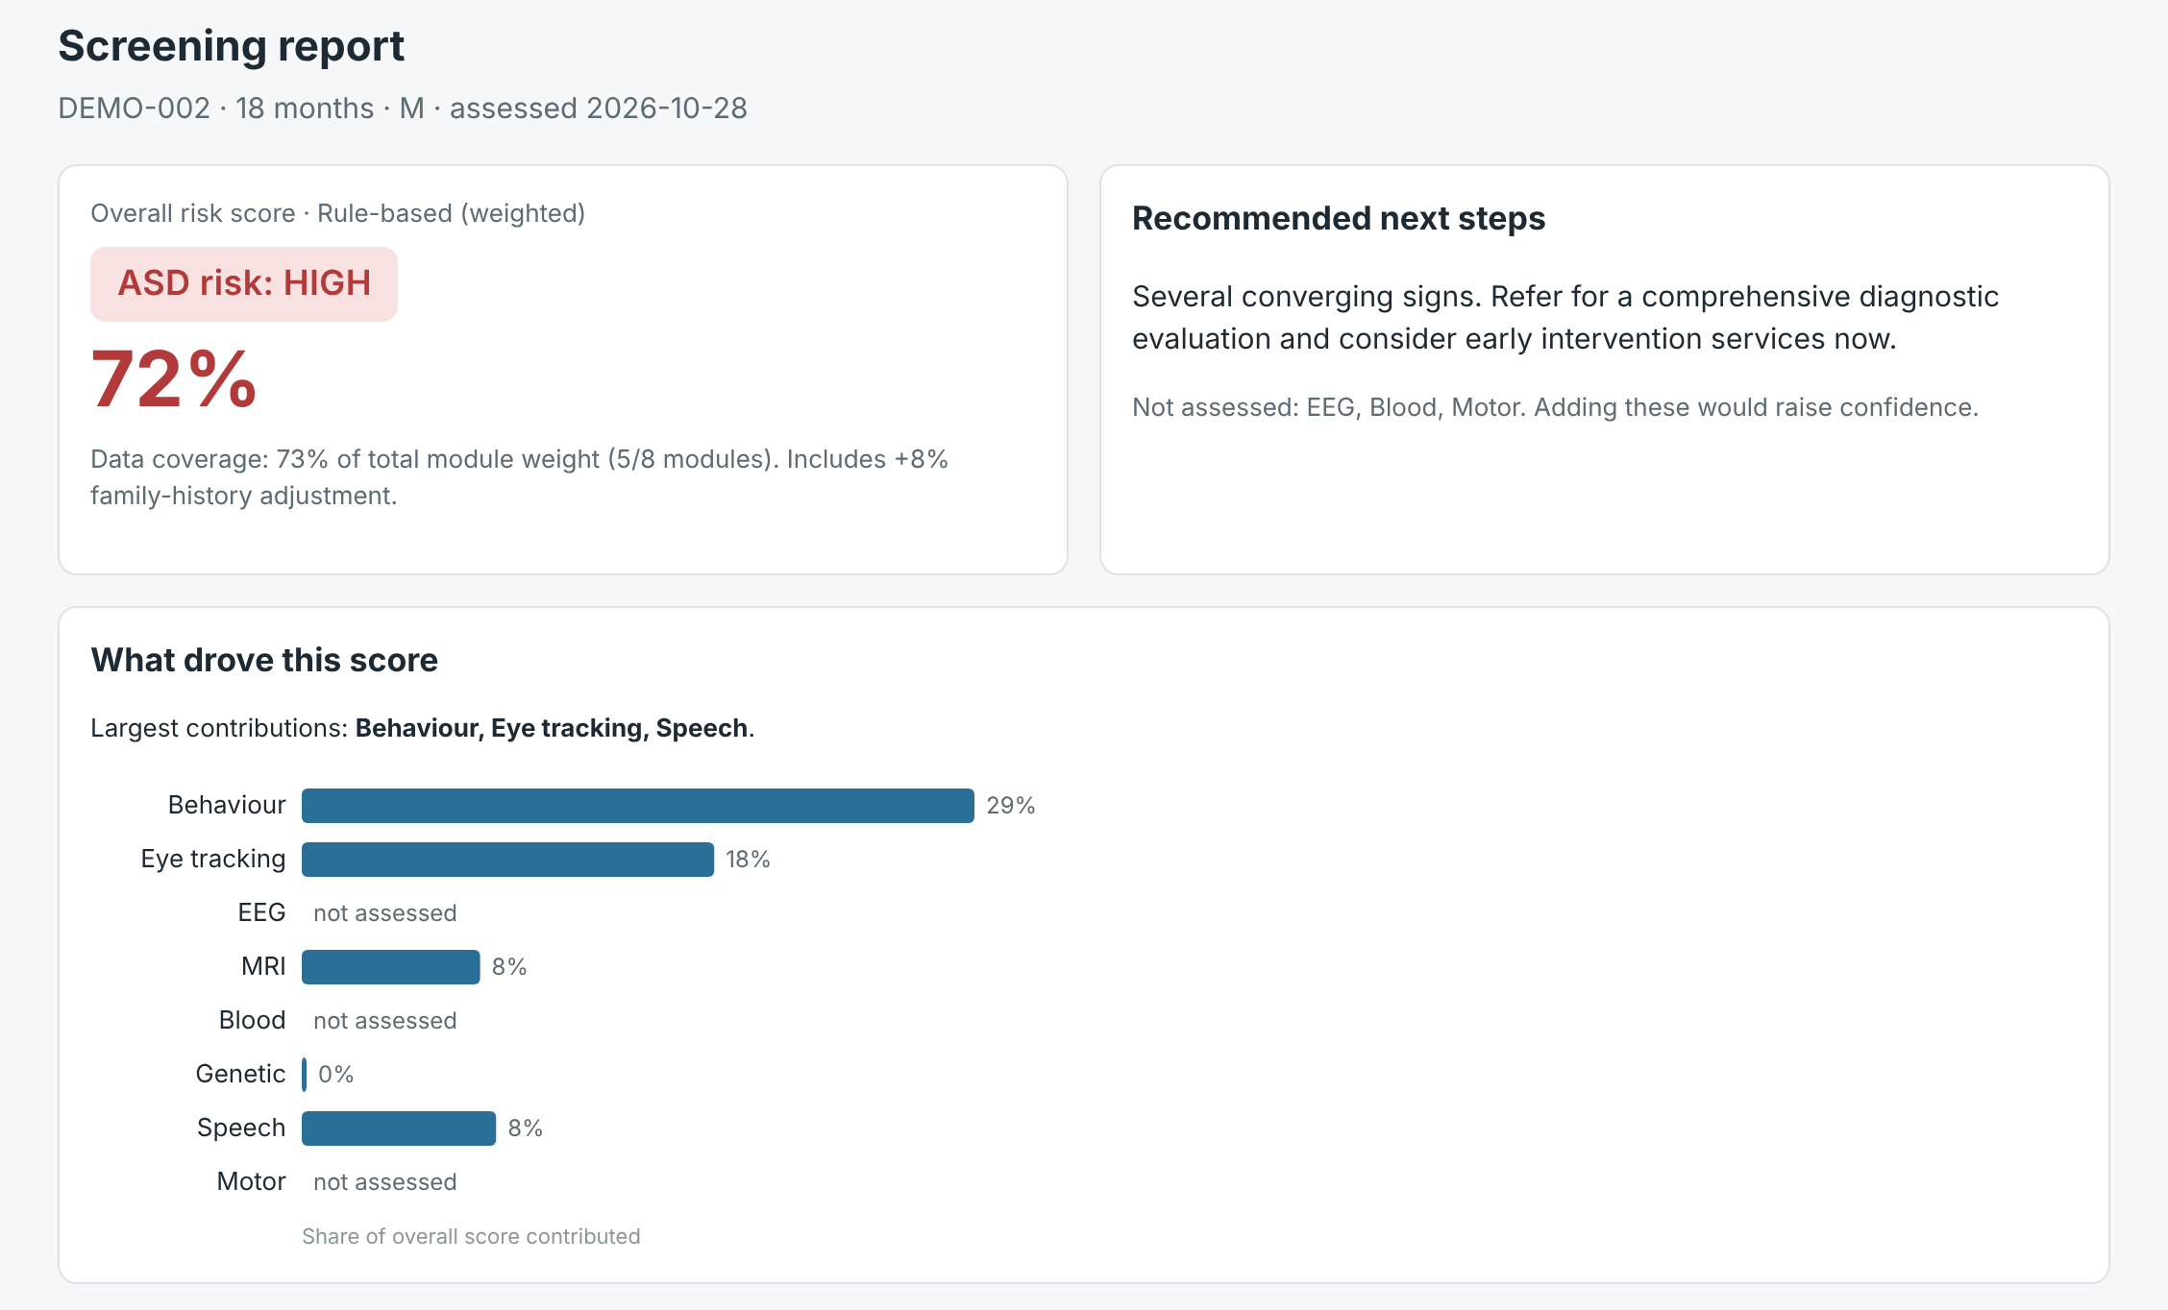
Output Screen: Screening Report
Risk level and score at the top: this demo child is High (72%)
Bars show what drove the score; here behaviour and eye tracking matter most
Next steps in plain words, plus tests not done yet
Data coverage: 5 of 8 modules (73% of the weight)
Notes:
Here's a real screen from our app, for one of our demo children. At the top you can see the risk level, High, with a score of 72 percent. Below that, the bars show what drove the score. For this child it's mainly behaviour and eye tracking. On the right are the next steps in plain words, and it also tells you which tests haven't been done yet. This child only had five of eight modules, so the report says the data covers 73 percent of the total weight.

Slide 13
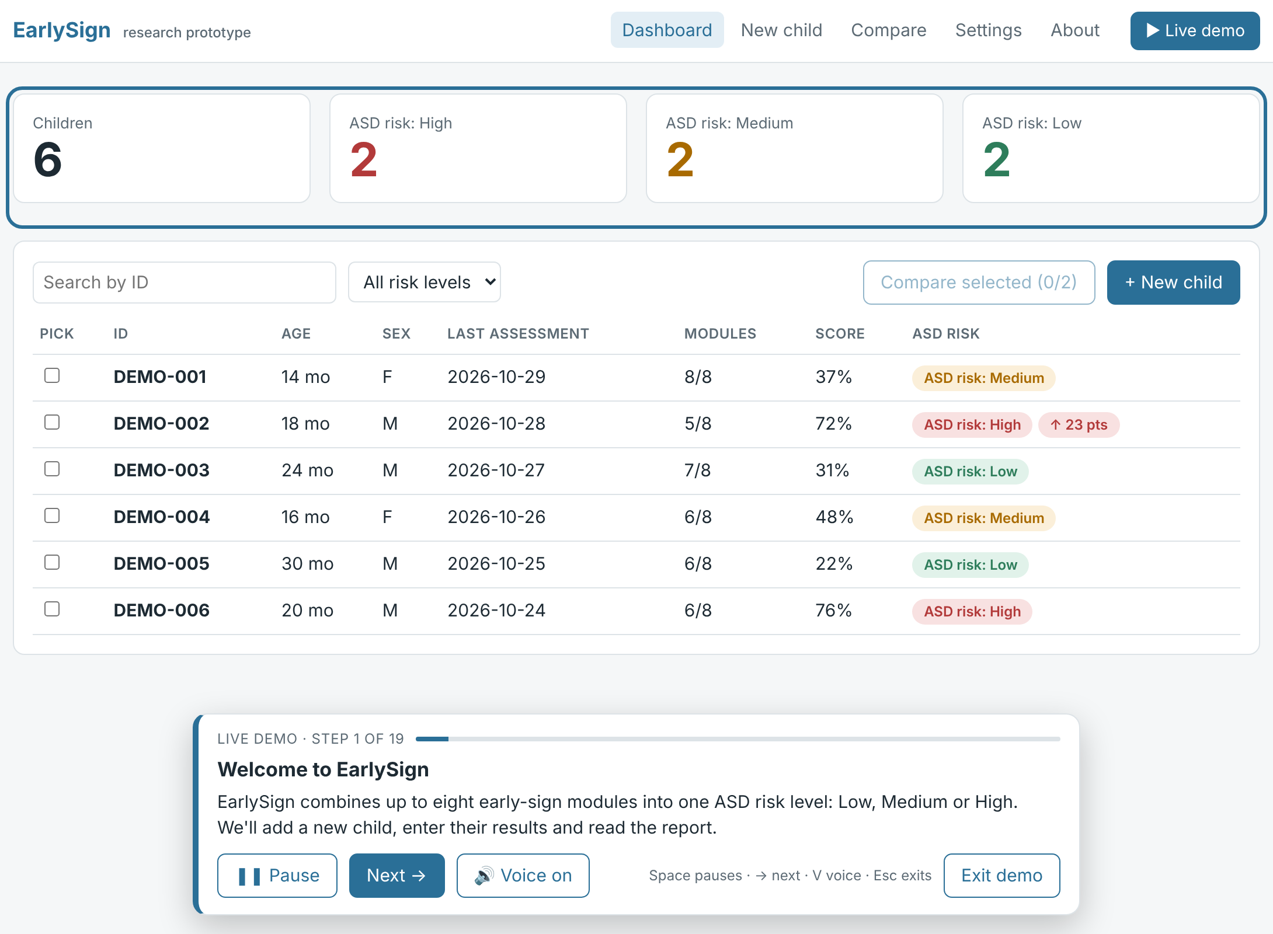
Output Screen: Dashboard and Live Demo
Count of children at Low, Medium and High risk
Red arrow: DEMO-002's score rose 23 points since the last visit
Live demo walks through adding a child and reading the report
Optional voice-over; Space pauses, → skips
Notes:
This is the dashboard, with the live demo running. At the top you get a quick count of how many children are at each risk level. Notice the red arrow next to DEMO-002. That means the score jumped 23 points since the last visit. The live demo is something we added for presentations like this one. It walks through adding a child and reading the report, step by step, and it can narrate itself.

Slide 14
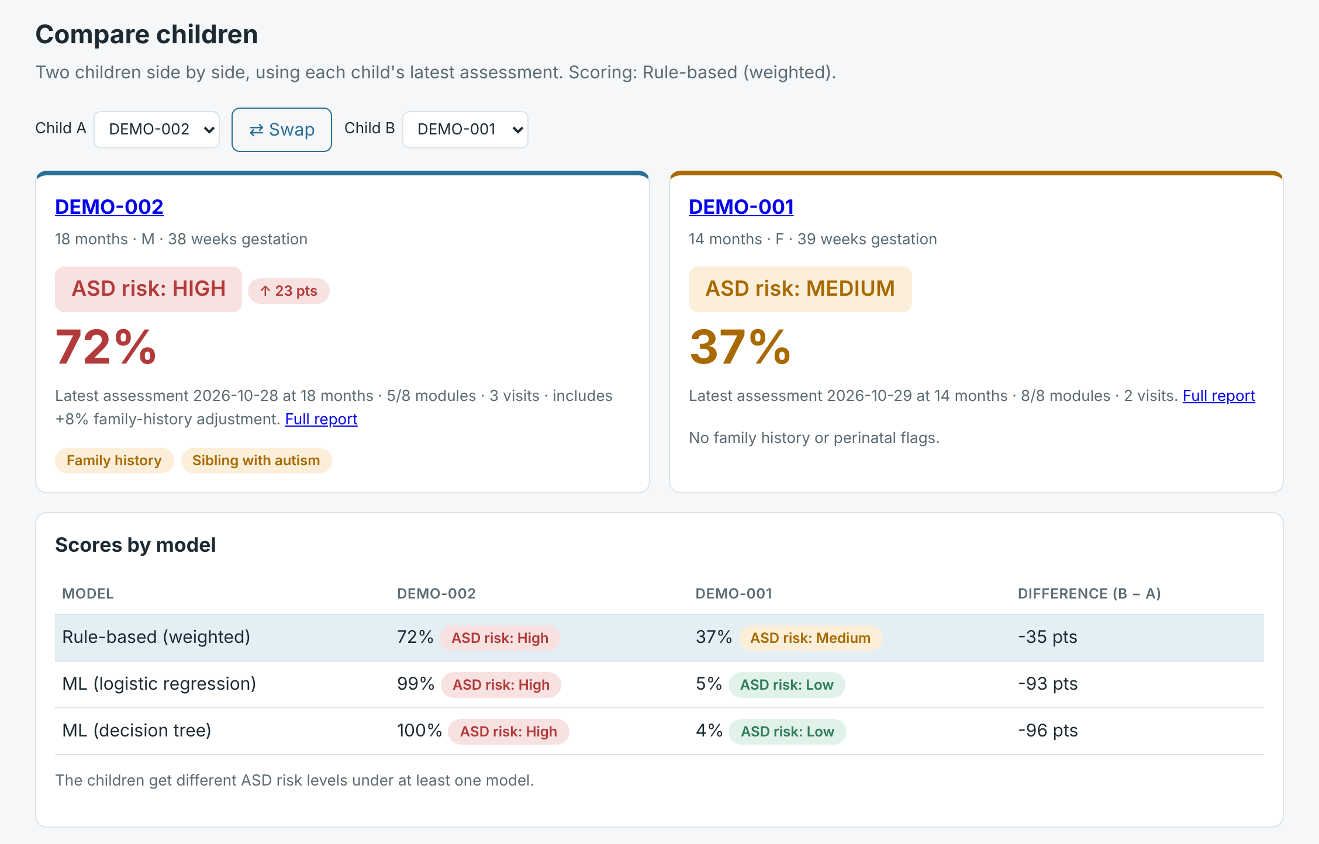
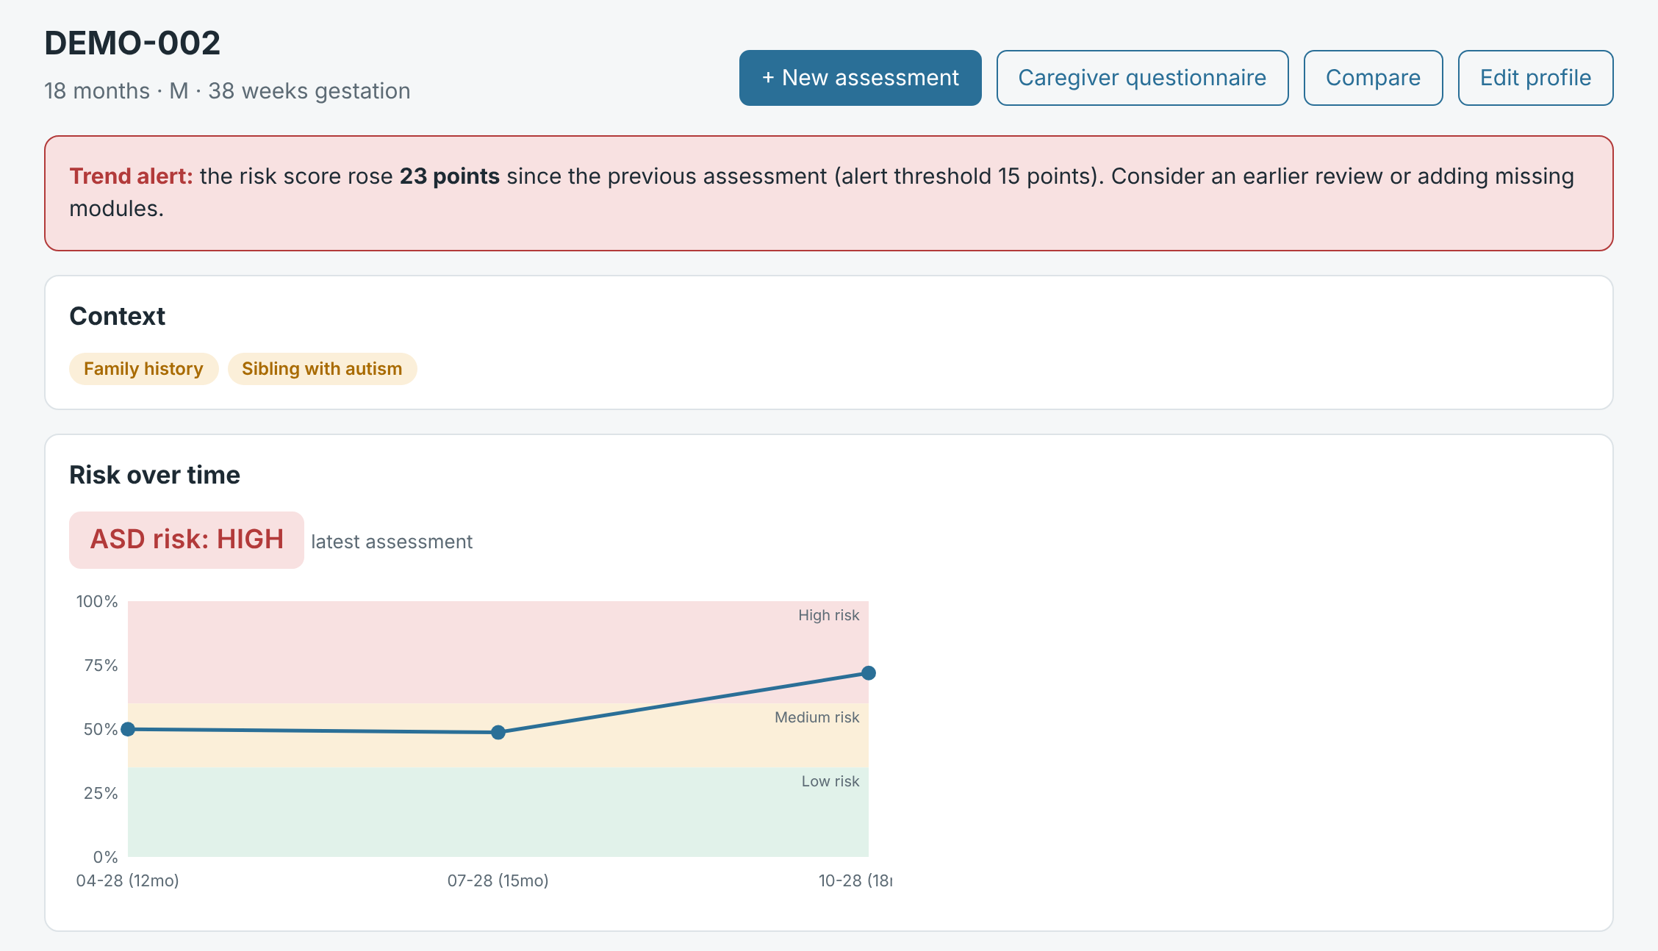
Output Screen: Compare and Trend Alert
Fig. 2: Risk over three visits, with a trend alert
Fig. 1: Two children compared under all three models
The models can disagree: DEMO-001 is Medium on the rule-based score but Low on both ML models
A jump of 15 points or more between visits raises an alert
Notes:
On the left is the compare view. DEMO-002 is High under all three models. But DEMO-001 is Medium on the rule-based score and Low on both ML models. That kind of disagreement is exactly what we want the doctor to notice. On the right is one child's history across three visits. The line climbs into the High band, and the red banner is the trend alert, because the score jumped 23 points.

Slide 15
Results and Discussion
Test set: 90 held-out simulated children (24 with an ASD label). Cut-off: High risk, score ≥ 60%.
Model | AUC | Accuracy (%) | Precision (%) | Sensitivity (%) | Specificity (%) | F1-score (%)
Rule-based (weighted) | 0.892 | 84.4 | 100.0 | 41.7 | 100.0 | 58.8
Logistic regression | 0.851 | 90.0 | 100.0 | 62.5 | 100.0 | 76.9
Decision tree | 0.852 | 85.6 | 82.4 | 58.3 | 95.5 | 68.3
Rule-based score had the best AUC (0.892); both ML models scored about 0.85
At High, logistic regression caught 15 of 24 with zero false alarms
Rule-based is cautious at High (10 of 24) but catches 21 of 24 at Medium
Only 90 test children, so small differences don't mean much
Notes:
Now our results. Please keep in mind these are from simulated children, so they show that the system works end to end, not how it would do on real patients. The rule-based score was best at separating the two groups, with an AUC of 0.89. The two ML models were close behind at about 0.85. At the High cut-off, logistic regression did best: it caught 15 out of 24 children with the label and gave zero false alarms. The rule-based score is more cautious at High, but at Medium it catches 21 out of 24. And with only 90 test children, a single child changes the numbers by about four points, so we don't read too much into small gaps.

Slide 16
Confusion Matrices
At the High-risk cut-off (score ≥ 60%), 90 test children
Rule-based (weighted)
Logistic regression
Decision tree
 | Flagged | Not flagged
ASD label | 10 | 14
No ASD label | 0 | 66
 | Flagged | Not flagged
ASD label | 15 | 9
No ASD label | 0 | 66
 | Flagged | Not flagged
ASD label | 14 | 10
No ASD label | 3 | 63
If we lower the cut-off to Medium (score ≥ 35%)
Medium catches more children but gives more false alarms (17 for the rule-based score)
Missing a child is worse than an extra referral, so Medium means "review" and High means "refer"
Model | Sensitivity (%) | Specificity (%) | Precision (%) | Accuracy (%)
Rule-based (weighted) | 87.5 | 74.2 | 55.3 | 77.8
Logistic regression | 66.7 | 97.0 | 88.9 | 88.9
Decision tree | 70.8 | 92.4 | 77.3 | 86.7
Notes:
These are the confusion matrices at the High cut-off. Logistic regression caught 15 and missed 9, with no false alarms. The tree caught 14 and had 3 false alarms. The rule-based score caught 10 and missed 14. The table below shows what happens when we lower the cut-off to Medium. The rule-based score now catches almost 88 percent, but it also flags 17 children who don't have the label. In screening, missing a child is the worse mistake, so we see Medium as a sign to take a closer look, and High as a sign to refer.

Slide 17
Advantages, Limitations and Future Scope
Advantages
Limitations
Future Scope
All eight kinds of signs in one screen
Works even when some tests are missing
Every score comes with an explanation
Three models side by side
Data stays on the device
Tested only on simulated data
Reference ranges and weights are placeholders
90 test children is a small sample
Not yet checked with real patients
Some modules need costly lab tests
Test with real, consented clinical data
Proper age- and sex-specific norms
Features from raw eye-tracking, EEG and audio
Stronger models such as gradient boosting
Pilot with a paediatric clinic
Notes:
To be honest about where we stand: the good parts are that it brings everything into one screen, works with missing tests, explains itself, and keeps data on the device. The main limitation is that we've only tested it on simulated data, and our reference ranges and weights are placeholders. Ninety test children is also a small sample. Next, we'd like to test it on real, consented clinical data, use proper norms for age and sex, try stronger models, and ideally run a small pilot with a clinic.

Slide 18
Conclusion
We built a working tool that combines eight early signs of autism into one risk level: Low, Medium or High
A simple weighted score and two ML models are shown side by side, each with an explanation
On 90 simulated test children, the models reached an AUC of 0.85 to 0.89
Our goal is to help doctors decide which toddlers to refer for a full assessment sooner
Note: EarlySign is a research prototype. It cannot diagnose autism or replace a clinical assessment, and our results so far use simulated data.
Notes:
To wrap up: we built a tool that combines eight kinds of early signs into one simple risk level, shows three models side by side, and explains every result. On our simulated test set the models reached an AUC between 0.85 and 0.89. What we really hope is that something like this could help doctors decide which toddlers to see first. But it's a research prototype, and it can't diagnose autism.

Slide 19
References
[1] A. Puri, "Early detection of autism with the help of biomarkers: A narrative review," NeuroMarkers, 2025. doi:10.1016/j.neumar.2025.100109
[2] D. L. Robins et al., "Validation of the Modified Checklist for Autism in Toddlers, Revised with Follow-up (M-CHAT-R/F)," Pediatrics, 2014.
[3] W. Jones and A. Klin, "Attention to eyes is present but in decline in 2–6-month-old infants later diagnosed with autism," Nature, 2013.
[4] M. D. Shen et al., "Early brain enlargement and elevated extra-axial fluid in infants who develop autism spectrum disorder," Brain, 2013.
[5] H. C. Hazlett et al., "Early brain development in infants at high risk for autism spectrum disorder," Nature, 2017.
[6] W. J. Bosl, H. Tager-Flusberg and C. A. Nelson, "EEG analytics for early detection of autism spectrum disorder: a data-driven approach," Scientific Reports, 2018.
Notes:
These are the main papers we relied on. The first is the review that our biomarker modules are based on, and the others are the studies behind the questionnaire, eye tracking, MRI and EEG modules.

Slide 20
Thank You
Questions?
Notes:
Thank you for listening. We're happy to take your questions.

