Slide 1

BharatVoice AI: A Multilingual Voice Assistant for Grounded, Everyday Citizen Services in Five Indian Languages
FINAL REVIEW PRESENTATION
REVIEW-03
TEAM MEMBERS
Sri Ram Rajendrakumar R (24623156)
Jonathan David D (24623150)
Joe Anto Prakash J (24623149)
PROJECT GUIDE:
Ms. VP. Anitha
Assistant Professor, Dept. of AI & ML
BATCH NO: 19
Department of Artificial Intelligence and Machine Learning · School of Engineering · VISTAS, Chennai
Notes:
Good morning. We are presenting BharatVoice AI, a voice-first assistant that answers everyday citizen questions in Tamil, Hindi, Telugu, Kannada and English. This is our final review, under the guidance of Ms. VP. Anitha.

Slide 2
INTRODUCTION
More public services in India are moving online, but most portals expect the visitor to read English or Hindi, move through menus and type a search.
Many citizens would rather ask out loud in their own language, and when they type, they often write in Roman letters mixed with English, as in "PAN card kaise banaye".
A confident wrong answer about a document, scheme or helpline can cost a wasted trip or a fee that was not owed.
BharatVoice AI is a voice-first web assistant for Tamil, Hindi, Telugu, Kannada and English that identifies the language and intent and answers only from curated content or named live sources.
It uses no large language model, runs on an ordinary laptop without a GPU, and says "I don't know" instead of guessing.
How people actually ask
ஆதார் அட்டை என்றால் என்ன?
Tamil script
PAN card kaise banaye?
Hindi in Roman letters + English
Chennai la weather epdi irukku?
Tamil + English mixed
Notes:
Two problems kept coming back: how people actually type, which is often romanized and code-mixed, and whether they can trust the answer. The examples on the right are the kind of input our system has to handle.

Slide 3
ABSTRACT
BharatVoice AI is a voice-first web assistant for everyday citizen needs in Tamil, Hindi, Telugu, Kannada and English, including romanized and code-mixed input. It covers identity documents, emergency helplines, weather, mandi prices, reminders, arithmetic and unit conversion, and a question bank with cited answers. No large language model is used. Speech is captured in the browser through the Web Speech API, and a FastAPI backend processes each request rules-first: a four-stage cascade (Unicode script share, romanized cue words, a fine-tuned MuRIL classifier and a statistical fallback) identifies the language, emergency requests are matched before any classifier, and every factual reply either names its source or states that the assistant does not know. Two fine-tuned MuRIL classifiers extend the rules only above a confidence floor, and every heavy component has a light substitute, so the system runs on a laptop without a GPU. On a held-out development test set, intent accuracy rose from 67% to 89% and language-identification accuracy from 60% to 95%.
5
languages
89%
intent accuracy
95%
language ID accuracy
0
GPUs needed
Notes:
The key points: five languages including mixed typing, no large language model, every answer has a source or an honest refusal, and it runs on a normal laptop. The accuracy figures come from a test set we wrote ourselves, so they are indicative.

Slide 4
PROBLEM STATEMENT
1
Language barrier
Most portals are in English or Hindi and assume the visitor can read them and navigate menus.
2
Mixed typing
"PAN card kaise banaye" is detected as English by common language identifiers, so the reply comes back in the wrong language.
3
Wrong answers hurt
Text generators can state things no source supports; a wrong answer about a document or helpline costs time and money.
4
Heavy models
Large speech and language models usually need a GPU and gigabytes of downloads, which small teams and offices lack.
Need: a voice assistant that understands Indian languages, including romanized and code-mixed typing, gives only answers it can back with a source, refuses when it cannot, and still runs on ordinary hardware.
Notes:
Four practical difficulties: language, mixed typing, trust and hardware. Our project addresses all four together.

Slide 5
LITERATURE REVIEW
# | Author(s) | Year | Title | Methodology | Contribution | Limitation
1 | T. Javed, J. A. Nawale, E. I. George et al. | 2024 | IndicVoices: Towards building an inclusive multilingual speech dataset for Indian languages | Collected natural speech from a large, diverse pool of speakers across Indian languages. | 7,348 hours of natural speech from 16,237 speakers. | A dataset, not an assistant; models trained on it are GPU-heavy.
2 | A. Radford, J. W. Kim, T. Xu et al. | 2023 | Robust speech recognition via large-scale weak supervision (Whisper) | One model trained on a very large amount of loosely labelled audio. | Transcribes many languages without per-language tuning. | Larger models need a GPU to run at conversational speed.
3 | K. S. Bhogale, S. Sundaresan, A. Raman et al. | 2023 | Vistaar: Diverse benchmarks and training sets for Indian language ASR | Shared benchmark with fine-tuned recognisers for Indian languages. | Common evaluation across twelve Indian languages. | Recognition only; no understanding or answer layer.
4 | Y. Madhani, M. M. Khapra, A. Kunchukuttan | 2023 | Bhasha-Abhijnaanam: Native-script and romanized LID for 22 Indic languages | IndicLID classifiers for native-script and romanized text. | Language identification across 22 Indic languages. | Romanized input remains hard; scarce labels, neighbouring languages confused.
5 | J. Gala, P. A. Chitale, R. AK et al. | 2023 | IndicTrans2: High-quality machine translation for all 22 scheduled Indian languages | Large multilingual translation models. | Translation for all 22 scheduled languages. | Large model for a small, low-resource deployment.
Notes:
Recent work on speech recognition, language identification and translation for Indian languages. The common limitation is heavy compute or that each work is a component, not a full assistant.

Slide 6
LITERATURE REVIEW (CONTD.)
# | Author(s) | Year | Title | Methodology | Contribution | Limitation
6 | Z. Ji, N. Lee, R. Frieske et al. | 2023 | Survey of hallucination in natural language generation | Survey of generated text against its source. | Separates content that contradicts its source from content the source never had. | Generators can still state facts no source supports.
7 | T. Javed, S. Doddapaneni, A. Raman et al. | 2022 | Towards building ASR systems for the next billion users | Self-supervised pretraining on about 17,000 h of audio in 40 languages. | Strong ASR for low-resource Indian languages. | Heavy compute and model size; not a complete assistant.
8 | S. Khanuja, D. Bansal, S. Mehtani et al. | 2021 | MuRIL: Multilingual representations for Indian languages | BERT encoder pretrained on native-script and transliterated text pairs. | Often recommended for romanized Indian-language input. | Encoder only; needs labelled data and fine-tuning per task.
9 | S. Khanuja, S. Dandapat, A. Srinivasan et al. | 2020 | GLUECoS: An evaluation benchmark for code-switched NLP | Benchmark of NLP tasks on code-switched data. | Measures the accuracy standard models lose on code-mixed text. | Benchmark only, not a running assistant.
10 | P. Lewis, E. Perez, A. Piktus et al. | 2020 | Retrieval-augmented generation for knowledge-intensive NLP tasks | Generator conditioned on retrieved passages. | Gives generated answers passages to work from. | Can still state unsupported facts; mostly English encyclopaedic questions.
Notes:
Encoders, code-mixed benchmarks and grounded generation. The gap: a citizen-facing system that copes with romanized input, refuses without a source, and runs on modest hardware.

Slide 7
BHARATVOICE AI SYSTEM ARCHIETECURE
Module-level workflow: one request, from utterance to stored reply
1. User Input
Tap the orb and speak, or type (up to 2,000 characters).
2. Owner Identification
Signed-in token, guest ID or none; scopes history and reminders.
3. Speech to Text
Browser Web Speech API in the language chosen in the header.
4. Language Identification
Script share, cue words, MuRIL, then langdetect.
8. Source-aware Policy
Curated answer, live value with source, or a refusal.
7. Handler Routing
Local skills, curated Q&A, live data or the reminder store.
6. Entity Extraction
Places, dates, times and numbers; reminders saved in UTC.
5. Intent Arbitration
Emergency patterns first, then rules, then MuRIL above a floor.
9. Reply & Speech
Shown and spoken in the detected language; tap-to-call helplines.
10. Storage
Saved with language, intent, entities and sources in SQLite.
11. Reminder Delivery
In-page alert or Web Push after the tab closes, sent once.
Notes:
Eleven modules from the user's question to the stored reply. Emergency requests are matched before any classifier, so getting a helpline never depends on a model; and if there is no source, the reply becomes a refusal with the official website.

Slide 8
ARCHITECTURE DIAGRAM
Browser Client
React 18 + Vite
Voice-first interface
Orb, language toggle, history, reminders
Web Speech API
Speech in and out, in the user's language
Service worker
Receives Web Push reminders
1
FastAPI Backend
Request handling + NLU
Request handling
Auth, guest ID, ownership
NLU pipeline
Language ID → intent → entities
Source-aware policy
Answer + source, live value + time, or refusal
2
Answer Sources
Handlers
Local skills
Time, calculator, units, helplines, ID documents
Curated content
18 topics × 5 languages, with sources
Live adapters + reminders
Open-Meteo, IMD, AGMARKNET; reminder store
3
Persistence
SQLite + SQLAlchemy + Alembic
Users & sessions
scrypt hashes, hashed tokens
Conversations & messages
Language, intent, entities, sources
Reminders & push
UTC due times, subscriptions
4
Notes:
Four layers. The browser handles speech and push. FastAPI establishes who is calling, runs the NLU pipeline and routes to a handler. Every handler's output passes through the same source-aware policy. Underneath is SQLite, versioned with Alembic. Every heavy model has a light substitute, so the system runs without a GPU.

Slide 9
TECH STACK
Frontend
React 18, Vite 5, axios, framer-motion, HTML, CSS
Backend
Python 3.12, FastAPI, Pydantic 2, Uvicorn
AI / NLU
Fine-tuned MuRIL (intent + language), PyTorch, Hugging Face Transformers (CPU), langdetect
Speech
Browser Web Speech API and speechSynthesis; Whisper, Bhashini, Coqui XTTS optional
Database
SQLite, SQLAlchemy 2, Alembic migrations
Live data
Open-Meteo, IMD warnings, AGMARKNET (data.gov.in), National Hospital Directory
Security & delivery
scrypt password hashes, hashed session tokens, Web Push with VAPID
Tools
VS Code, Git, GitHub, Node.js, npm, pytest, Vitest, ESLint, Docker (optional)
Notes:
No large model, so modest hardware is enough. Speech recognition runs in the browser, which is why Chrome or Edge is needed for voice. The two MuRIL models run on the CPU.

Slide 10
METHODOLOGY
1
Owner Identification: Signed-in token, guest ID or none; history and reminders are filtered by owner.
2
Speech Capture: Browser Web Speech API in the chosen language, or typed text up to 2,000 characters.
3
Language Identification: Unicode script share, romanized cue words, fine-tuned MuRIL, then langdetect; default English.
4
Intent Arbitration: Emergency patterns first, then ordered rules; MuRIL only if rules find nothing, above a calibrated floor.
5
Entity Extraction: Places, dates, times and numbers; reminder times are saved as one moment in UTC.
6
Source-aware Response: Curated answer + source, live value + source + time, or refusal + official portal.
7
Reply and Storage: Text and speech; only server-marked helplines become tap-to-call; saved with language, intent and sources.
Rules run first because they need no GPU, every decision can be inspected afterwards, and a rule can say "not sure" instead of guessing.
Notes:
Seven steps from the question to the stored reply. The rules-first choice is deliberate: it runs on ordinary hardware and keeps every decision explainable.

Slide 11
LIMITATIONS
Accuracy: MuRIL figures come from a development test set we wrote; speech recognition is not yet measured.
Romanized emergencies: Phrases like "mujhe bachao, aag lagi hai" were missed by the rule-based stages.
Time words: Morning times in Tamil or Hindi words (kaalai, subah) were scheduled for the evening.
Language review: About 190 Hindi, Telugu and Kannada strings still need native-speaker review.
Live data: Mandi, IMD and hospital adapters are not yet confirmed against live responses.
Security: No password reset or sign-in rate limit, so it is not ready for the public internet.
Users: Not yet tested with real users, a range of devices or screen readers.
Notes:
We are upfront about the limits. The most serious one is the missed romanized call for help, which is first on our future-work list.

Slide 12
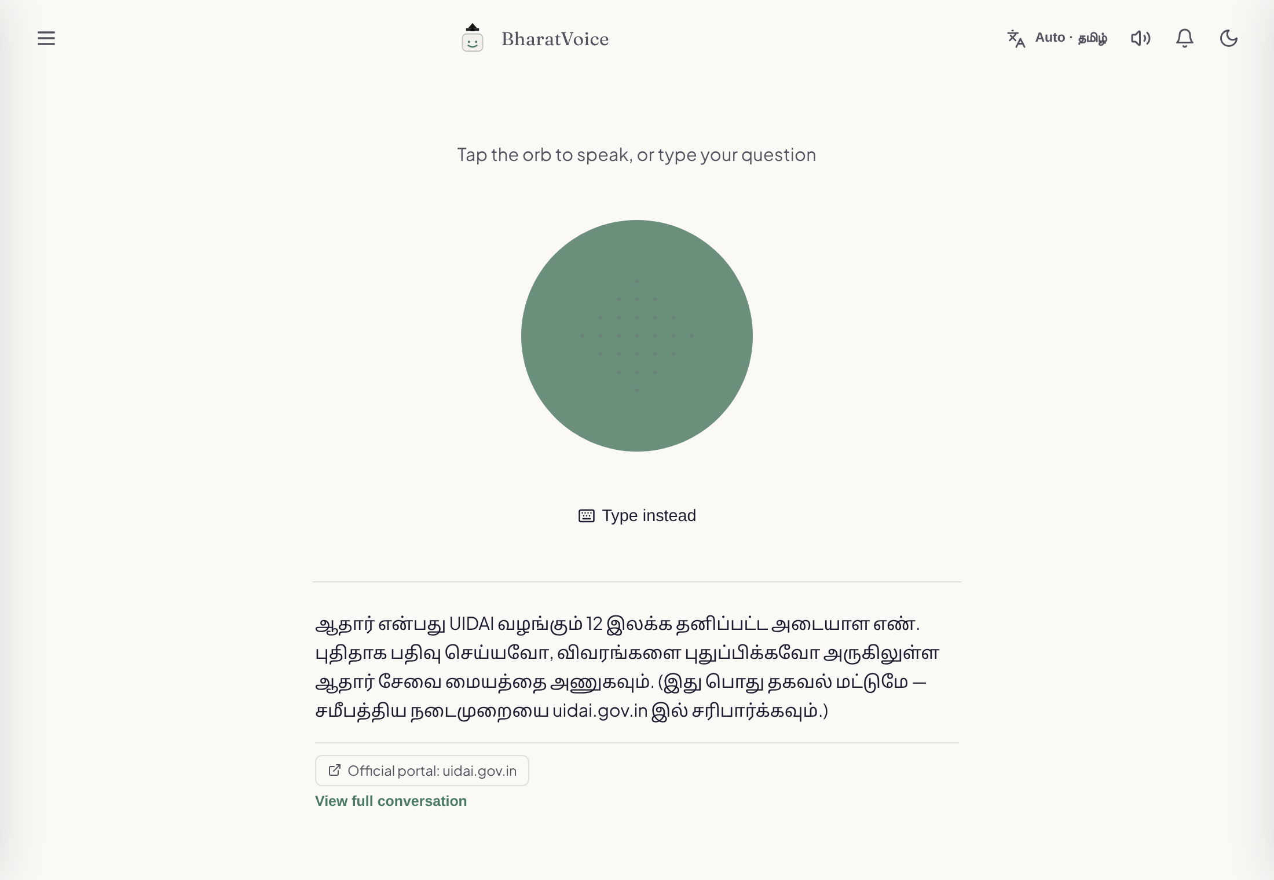
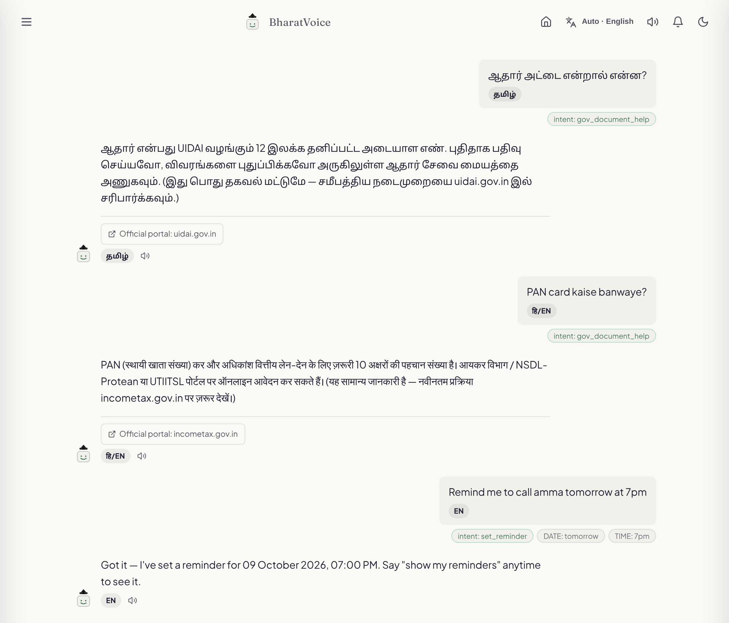
PROJECT IMPLEMENTATION
Home screen
Tap the orb to speak. A Tamil question gets a Tamil reply with the official portal link.
Conversation view
Tamil, romanized Hindi and English, with detected language, intent and time.
Notes:
Home screen on the left: we asked what an Aadhaar card is in Tamil and got a Tamil reply with uidai.gov.in. On the right: the same Tamil question, "PAN card kaise banwaye" answered in Hindi with incometax.gov.in, and an English reminder with the date and time it picked out.

Slide 13
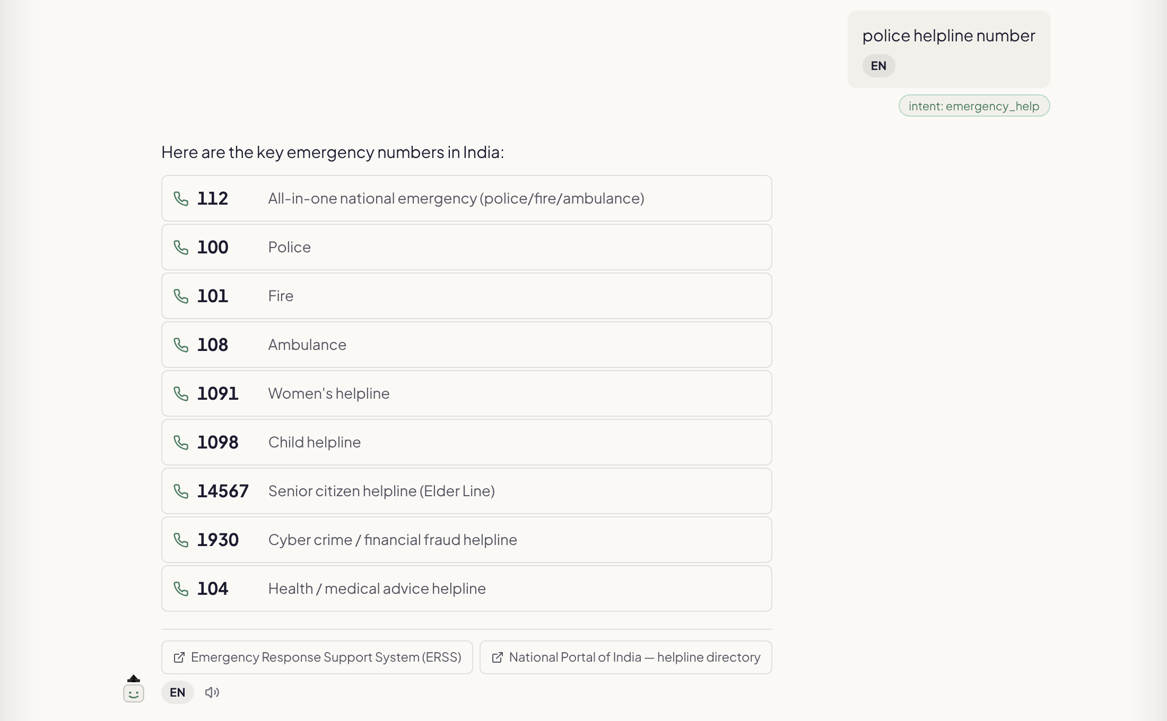
PROJECT IMPLEMENTATION
Emergency intent is matched before any classifier.
Nine national numbers, each a row you can tap to call.
Sources shown: ERSS and the National Portal of India.
Only numbers the server marks become links, so a price or a sum like 100 never dials the police.
Emergency helpline reply
Notes:
The helpline reply for "police helpline number". In an early build any short number became a link; now the server sends the exact set of numbers it put in the reply, and only those become links.

Slide 14
RESULTS
752
backend tests passing
45
frontend tests passing
87 / 90
out-of-scope questions left alone
The test set and training data share an author, so real-world accuracy is probably lower.
Notes:
Fine-tuning MuRIL behind the rules raised intent accuracy from 67 to 89 percent and language ID from 60 to 95 percent on sentences it never saw in training. We wrote both the training and test data, so an independent native-speaker test is our next step.

Slide 15
PROJECT GANTT CHART
Project review schedule, July to October 2026
Task | W1 27 Jul | W2 3 Aug | W3 10 Aug | W4 17 Aug | W5 24 Aug | W6 31 Aug | W7 7 Sep | W8 14 Sep | W9 21 Sep | W10 28 Sep
1. Review 0: abstract + base paper submission
2. Review 1: problem, objectives, literature, methodology
3. Review 2: design, implementation, prototype, testing
4. Review 3: final results, GitHub
5. Draft report and journal paper
6. Final submission: report + paper
Milestones: conference paper for ICAI-CEME 2026 (21-22 Oct 2026); final review and viva-voce on 30 Oct 2026.
Notes:
Our schedule, from the abstract in late July through design, implementation and testing to the report and paper. Check the week dates against the department schedule before presenting.

Slide 16
THANK YOU
BharatVoice AI: A Multilingual Voice Assistant for Grounded, Everyday Citizen Services in Five Indian Languages
FINAL REVIEW PRESENTATION
Notes:
Thank you. We are happy to take questions or show a live demo.

