Slide 1

Prediction of Genetic Disorders Using Chromosome Images with Deep Learning and Convolutional Neural Network (CNN)
FINAL REVIEW
TEAM MEMBERS
ELAMATHI C - 24623109
JOSLYN J R - 24623115
JASMINE EPSIBA A - 24623103
PROJECT GUIDE
Ms BENASIR BEGAM, F. M.E. (PhD)
BATCH N0:02

Slide 2
INTRODUCTION
Genetic disorders can occur due to chromosomal abnormalities.
Early detection helps in accurate diagnosis and treatment planning.
Traditional chromosome analysis involves manual examination of karyotype images.
Manual analysis is time-consuming and may be prone to human error.
This project uses Artificial Intelligence and CNN to analyse chromosome images.
The system helps to identify abnormal chromosomes and predict genetic disorders

Slide 3
ABSTRACT
Chromosomal abnormalities are a major cause of genetic disorders and require accurate diagnosis. Traditional karyotype analysis is time-consuming and depends heavily on manual examination. Our proposed AI-based system uses image processing and CNN to automatically analyse chromosome images, identify abnormalities, and assist in predicting genetic disorders. The system aims to reduce manual effort, improve accuracy, speed up diagnosis, and support healthcare professionals in making reliable clinical decisions.

Slide 4
LITERATURE SURVEY
No. | Author(s) & Year | Title | Methodology | Limitation | Your Contribution
1 | Chih-En Kuo et al., 2024 (IEEE ÈEMBS) | ChromosomeNet: Deep Learning-Based Automated Chromosome Detection in Metaphase Cell Images | Hybrid CNN detection (Res2Net + BiFPN + IoU strategy) | Complex hybrid model; limited cross-hospital validation | Develop pure CNN-based detection with adaptive IoU for robustness
2 | Chuan Yang et al., 2023 (Elsevier, Medical Engineering & Physics) | Chromosome classification via deep learning and its application to patients with structural abnormalities | Single-stage CNN for normal/abnormal chromosomes | Small dataset; limited abnormal types | Expand dataset and improve CNN depth for better generalization
3 | Chengyu Wang et al., 2020 (IEEE Access) | Extended ResNet and Label Feature Vector Based Chromosome Classification | CNN + Hausdorff distance + Label Redistribution | Accuracy 94.72%; struggles with overlaps | Replace ResNet with pure CNN and enhance overlap handling
4 | Shinya Matsumoto et al., 2025 (IEICE Transactions) | Automatic Classification of Human Chromosome Shapes using CNN Models | CNN ensemble for chromosome shape classification | Accuracy 93.33%; limited to shape-based features | Integrate CNN with intensity and texture features for better accuracy
5 | Qin et al., 2018 (IEEE Conference on Biomedical Imaging) | VarifocalNet for Chromosome Classification | CNN-based fused feature extraction | Focused on simple karyotypes | Train CNN on complex metaphase images with overlaps

Slide 5
6 | Sharma et al., 2019 (IEEE ICIP) | Res-CRANN: CNN + Attention for Chromosome Classification | CNN + attention mechanism | Computationally heavy | Optimize lightweight CNN-attention for clinical speed
7 | Qin et al., 2018 (IEEE ISBI) | VarifocalNet for Chromosome Classification | CNN fused feature extraction | Focused on simple karyotypes | Train CNN on complex metaphase images
8 | Matsumoto et al., 2025 (IEICE Transactions) | Automatic Classification of Human Chromosome Shapes using CNN Models | CNN ensemble for chromosome shape classification | Accuracy ~93%; limited to shape features | Integrate CNN with banding/intensity features
9 | Remeseiro et al., 2025 (Neurocomputing) | Deep Learning-Based Chromosome Segmentation and Extraction: A Comprehensive Review | Survey of CNN segmentation methods | Lacks unified evaluation metrics | Propose standardized CNN evaluation pipeline
10 | Swati et al., 2020 (Springer BMC Bioinformatics) | Siamese CNN for Chromosome Pair Classification | CNN-based similarity metric | Requires paired inputs; training overhead | Simplify with single-input CNN classifier

Slide 6
Research Gap & Project Positioning
What Prior Work Often Assumes:
_____________________________
Focuses mainly on segmentation of chromosomes, not full classification.
Uses small datasets or simulated images, limiting generalization.
Relies on complex enterprise systems that are costly and not patient‑friendly.
Provides limited real‑time prediction capability for genetic disorders.
What This Project Addresses:
________________________
Builds a CNN‑based pipeline for direct chromosome classification and genetic disorder prediction.
Uses data augmentation to overcome limited dataset size.
Provides a light-weight CNN pipeline with simple Flask for affordable and patient‑friendly chromosome analysis.
Focuses on clinical usability with clear outputs (chromosome class + disorder likelihood).

Slide 7
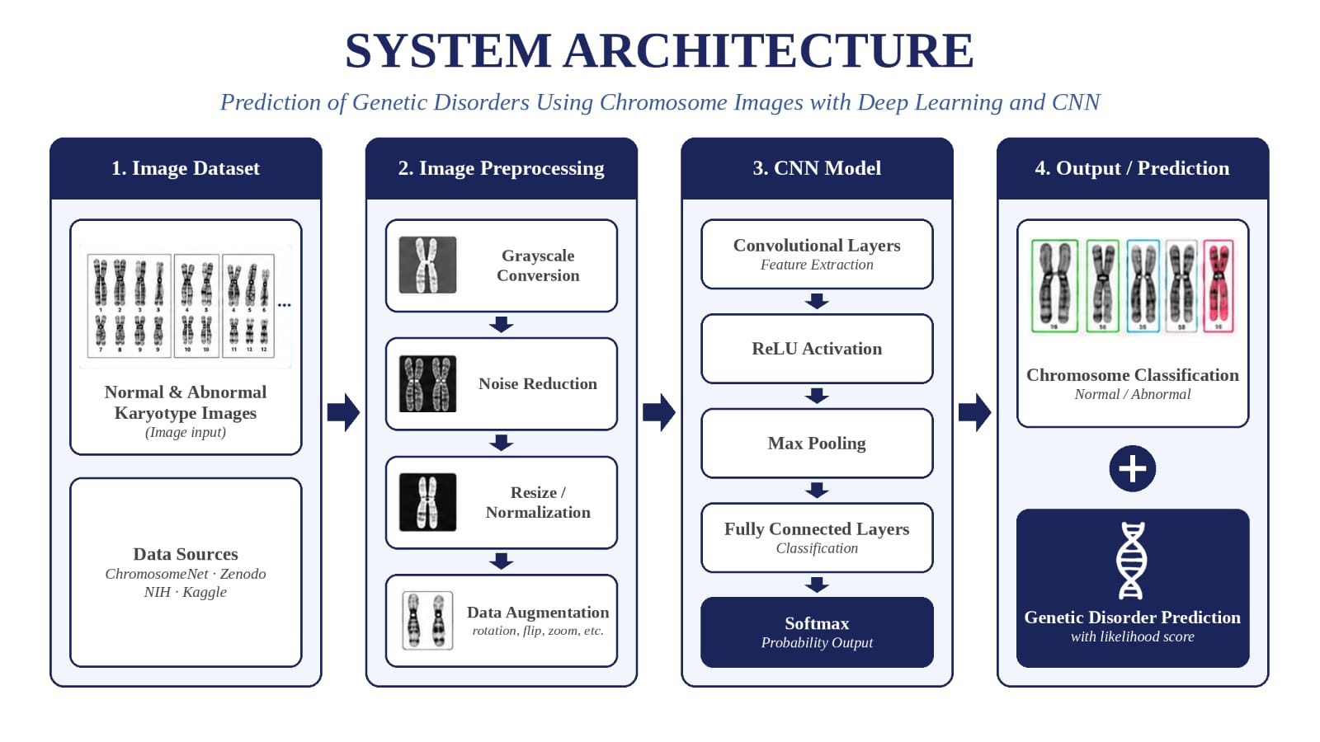

Slide 8
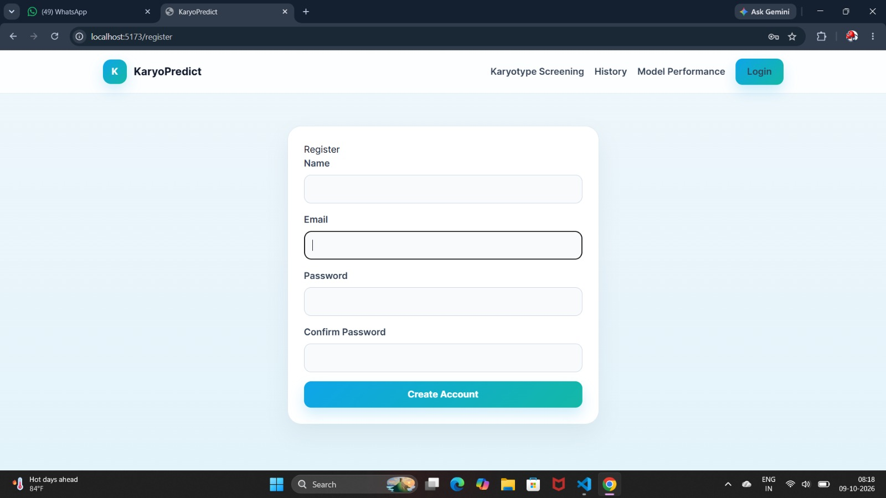
IMPLEMENTATION SCREENSHOT

Slide 9
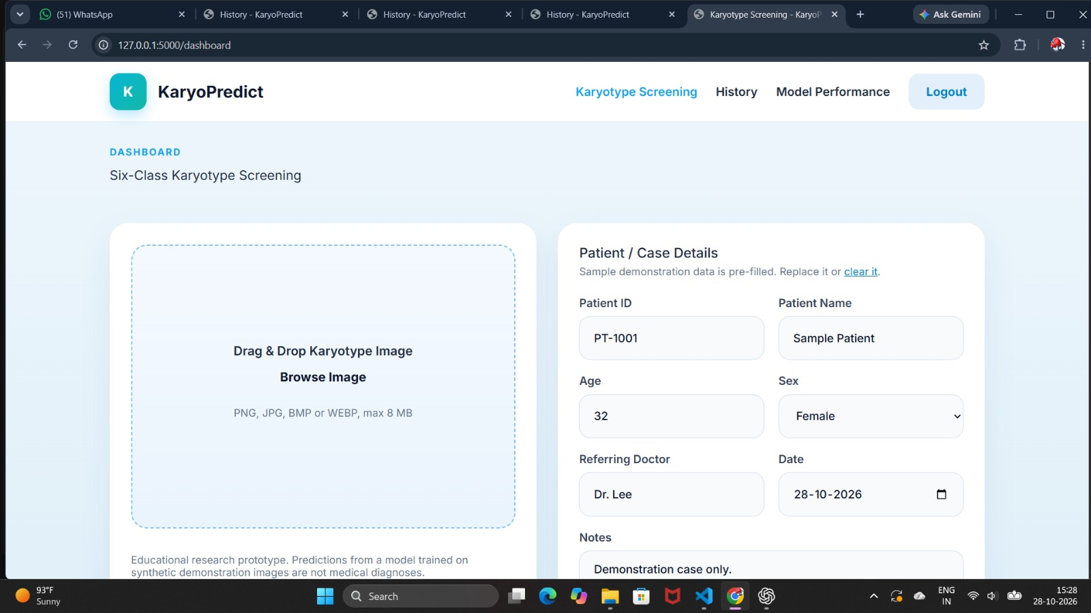

Slide 10
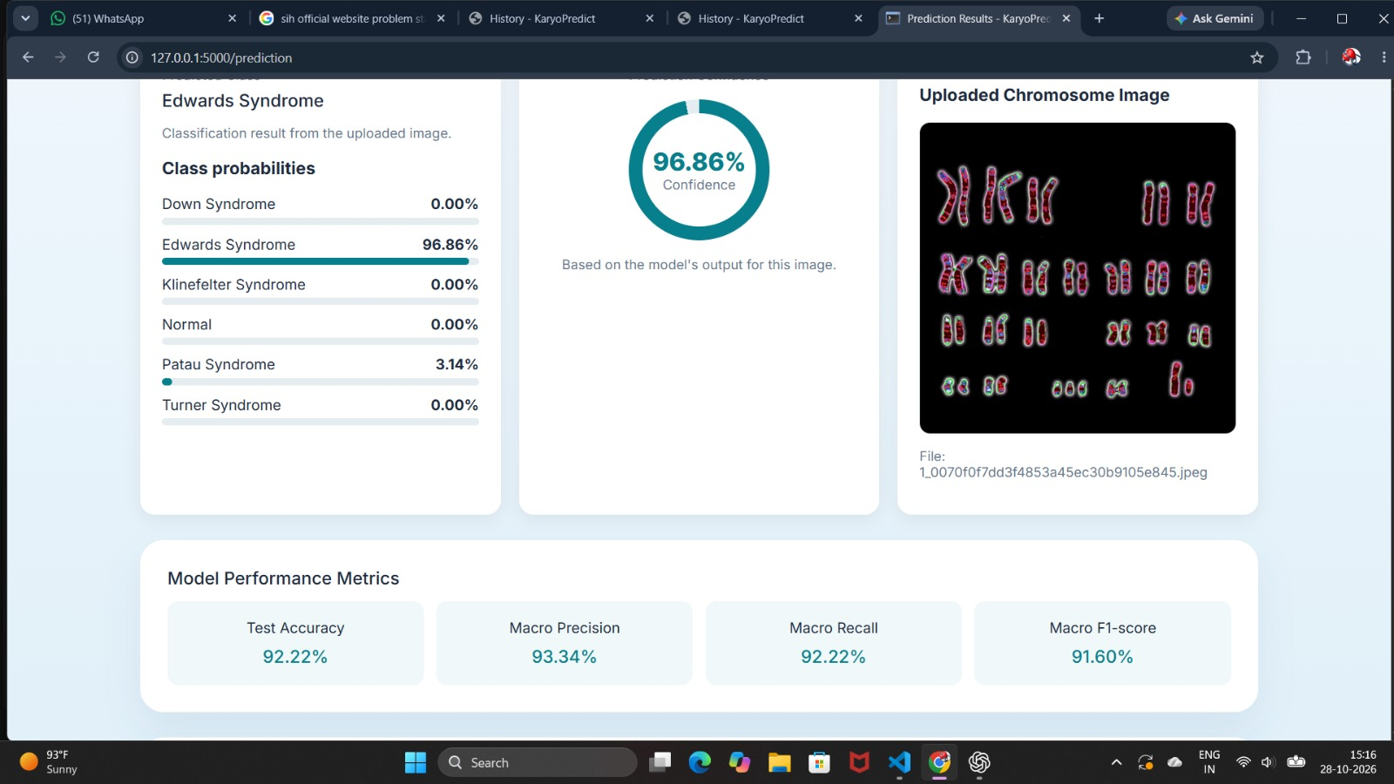

Slide 11
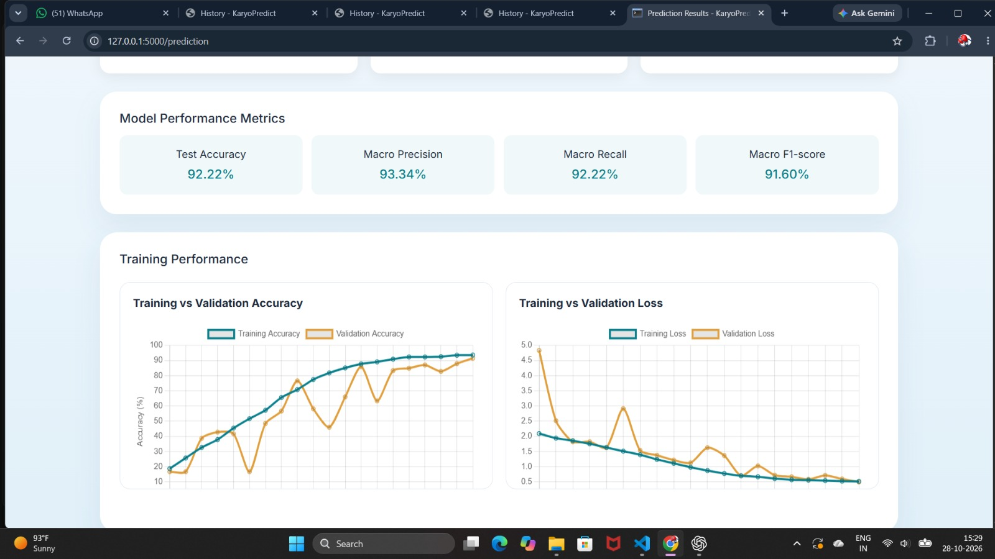

Slide 12
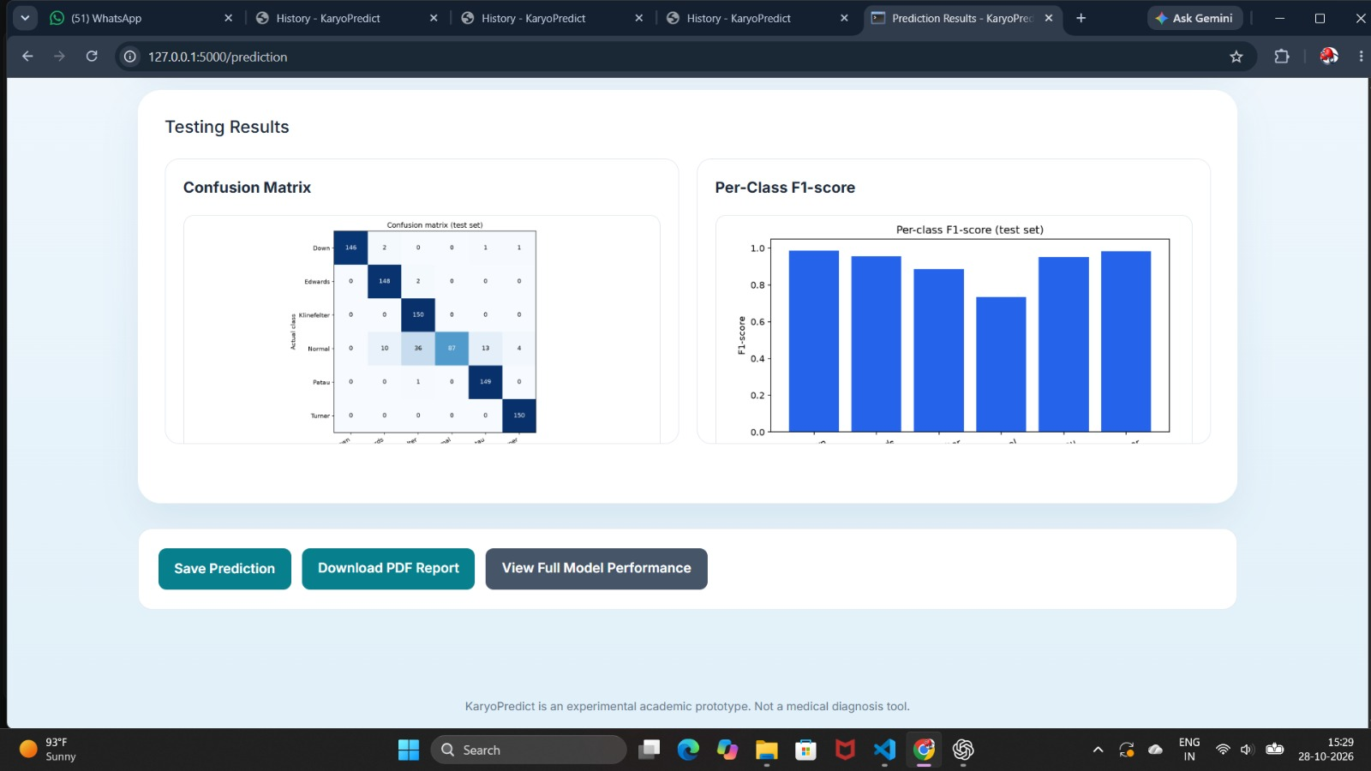

Slide 13
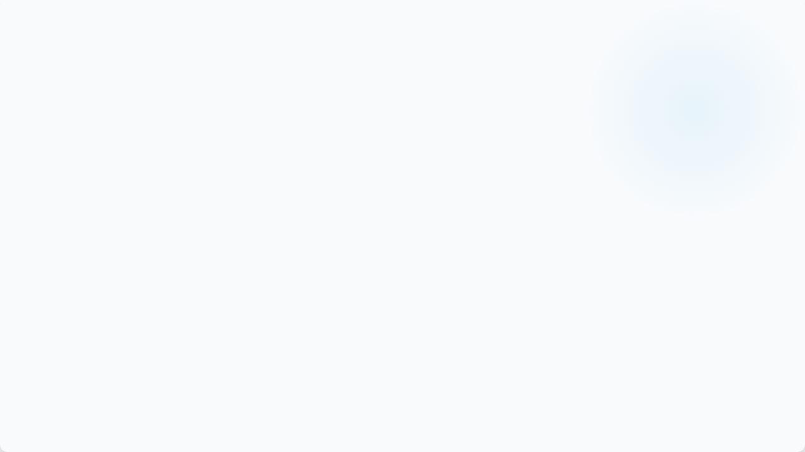
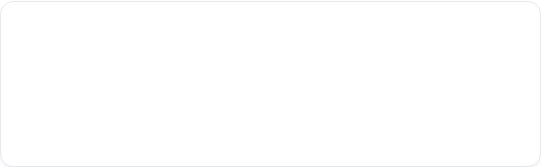



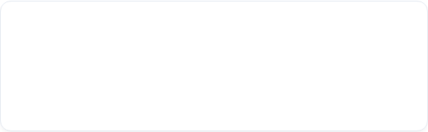
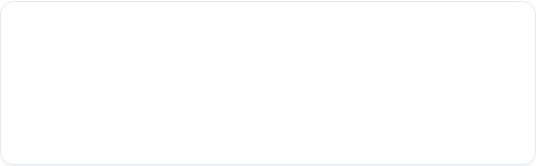


Hardware Specifications
Processor (CPU)
GPU Acceleration
Intel Core i7 / AMD Ryzen 7 (10th Gen+)
NVIDIA RTX 3060 / Tesla T4 (6GB+ VRAM)
Handles dataset batch reading, Pascal VOC XML annotation parsing, dynamic image augmentation, and system pipeline orchestration efficiently.
Accelerates Convolutional Neural Network (CNN) training, matrix operations, bounding box coordinate regression, and CUDA parallel computing.
System Memory (RAM)
Storage
16 GB DDR4 / DDR5 (32 GB Recommended)
512 GB NVMe M.2 Solid State Drive
Prevents memory overflow when staging 5,000+ high-resolution metaphase cell images and storing feature vectors during training epochs.
Provides fast input/output (I/O) throughput speeds for loading image datasets, saving model weights, checkpoints, and evaluation artifacts.

Slide 14



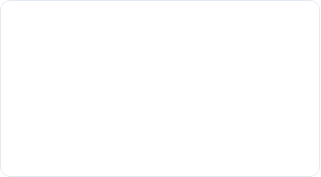


Software Specifications
Environment & OS
Deep Learning
Computer Vision
•
OS: Windows 11 / Ubuntu 22.04 LTS
•
Framework: TensorFlow 2.x / Keras
•
OpenCV: Image loading, cropping & scaling
•
IDE: JupyterLab / VS Code
•
GPU Drivers: NVIDIA CUDA 11.8 & cuDNN
•
Pillow (PIL): Metaphase image rendering
•
Runtime: Python 3.10+ (64-bit)
•
Model Task: CNN Feature Extraction & Categorization
•
Augmentation: Rotation, zoom, flip ops
Data & Parsing
Visualization
Evaluation Metrics
•
ElementTree: XML annotation parser
•
Matplotlib: Bounding box overlay & plots
•
Scikit-Learn: Accuracy, Precision, Recall
•
NumPy: Multi-dimensional array processing
•
Patches: Bounding box rectangle rendering
•
Classification Report: F1-Score & Loss
•
Pandas: Metadata & evaluation structuring
•
Seaborn: Confusion matrix heatmap visualizer
•
Metrics: Per-class confusion matrix

Slide 15
PERFORMANCE METRICS AND FORMULAS
Computed from the actual test-set predictions and ground-truth labels — no manually typed values
Accuracy
Precision
Accuracy = (TP + TN) / (TP + TN + FP + FN)
Multi-class: Accuracy = Correct Predictions / Total Predictions
Precision = TP / (TP + FP)
Of the samples predicted as a given syndrome, how many truly were that syndrome.
Recall / Sensitivity
F1-Score
Recall = TP / (TP + FN)
Of the actual samples of a syndrome, how many were correctly detected.
F1 = 2 × (Precision × Recall) / (Precision + Recall)
Harmonic mean of precision and recall; balances false positives and false negatives.

Slide 16
PROJECT GANTT CHART
W1
July14
W2
July 21
W3
Aug 11
W4
Aug 20
W5
Aug 25
W6
Sept 1
W7
Sept 8
W8
Sept 22
W9
Oct 29
W10
Oct 6
Task
Dataset collection & labeling
Preprocessing & augmentation
CNN model development
Training & tuning
Evaluation & confusion matrix
Prediction interface / demo
Report & PPT preparation
Milestone
Final trained model + evaluation results + working demonstration + report

Slide 17
CONCLUSION
“Our model bridges genetics and AI — turning chromosome images into actionable insights for early disorder prediction.”
________________________________________________________________________________________________________________
KaryoPredict demonstrates the potential of Convolutional Neural Networks (CNNs) to classify chromosome images into
six categories: Normal, Down syndrome, Edwards syndrome, Patau syndrome, Turner syndrome, and Klinefelter syndrome.
The system integrates image preprocessing, automated classification, and performance evaluation through accuracy,
precision, recall, F1-score, and a confusion matrix.
The model achieved 96.83% test accuracy on the current test dataset. With further validation using diverse, clinically verified
chromosome images, KaryoPredict could support research and assist in preliminary chromosome-image analysis.

Slide 18
THANK YOU
KaryoPredict
Questions & Discussion

