Slide 1

AI-Based Expense Tracker with Analytics and Investment Recommendations
FINAL REVIEW PRESENTATION
REVIEW-03
TEAM MEMBERS
PROJECT GUIDE
M. Prem Kumar
A. Subash
K. Dhanush Raj
Dr. Meenakshi.N
BATCH NO: 11

Slide 2
INTRODUCTION:
AI Expense Tracker is an intelligent personal finance management system designed to help users record, monitor, and analyze their income and expenses efficiently. The system uses data analytics and AI-based techniques to identify spending patterns, predict future expenses, recommend suitable budgets and savings strategies, track financial goals, and provide insights into the user's overall financial health. By providing these features through a single platform, the proposed system helps users make informed financial decisions and develop better money management habits.

Slide 3
ABSTRACT
The AI Expense Tracker is a personal financial management system developed to help users efficiently manage and understand their financial activities. The system allows users to record income and expenses, verify transactions, analyze spending patterns, predict future expenses, and receive personalized budget and saving recommendations. It also provides financial goal planning, investment guidance, bill reminders, financial health assessment, balance analysis, and monthly financial reports. By integrating these features into a single platform, the system provides users with meaningful financial insights and supports better decision-making and responsible money management.

Slide 4
PROBLEM STATEMENT:
Traditional expense tracking methods often require users to manually monitor and analyze their financial activities, making it difficult to understand overall spending patterns.
Users may not have a clear view of their income, expenses, savings, and financial balance in one place.
Existing basic expense trackers generally provide record-keeping but offer limited prediction, budgeting, goal planning, and personalized financial insights.
Therefore, there is a need for an integrated and intelligent financial management system that can track transactions, analyze spending behavior, predict expenses, provide recommendations, monitor goals and bills, and assess overall financial health.

Slide 5
OBJECTIVE:
To develop a centralized personal financial management system for recording and monitoring income and expenses.
To analyze users' spending patterns and financial behavior using transaction data.
To provide expense prediction and budget recommendations for better financial planning.
To help users set and monitor financial goals with personalized goal analysis.
To provide saving suggestions, investment guidance, and bill reminders based on the user's financial information.
To evaluate the user's overall financial condition through a Financial Health Score and balance analysis.

Slide 6
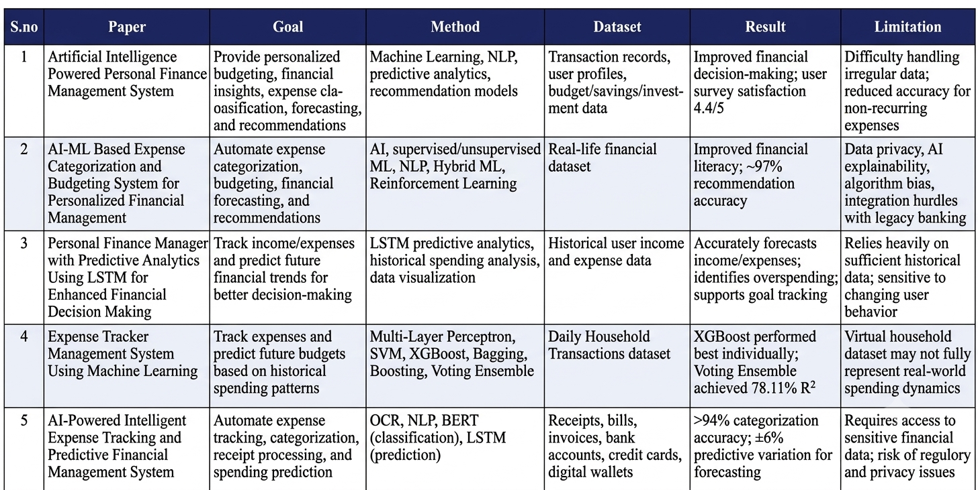
BASE PAPER:

Slide 7
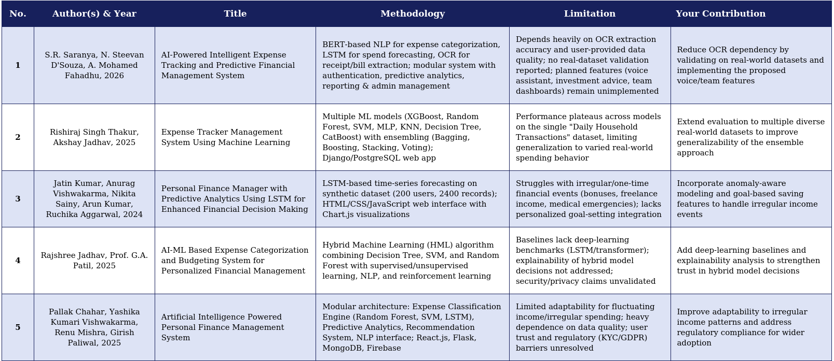
LITERATURE REVIEW

Slide 8
RESEARCH GAP:
Limited Integration: Existing personal finance systems often focus mainly on recording and tracking transactions, with limited integration of analysis, prediction, budgeting, goal planning, and financial guidance.
Limited Personalized Insights: Many existing systems provide basic summaries of income and expenses but do not provide sufficient personalized insights based on individual spending behavior.
Lack of Predictive Support: Traditional expense tracking approaches mainly analyze past transactions and provide limited support for predicting future expenses and planning upcoming financial needs.
Limited Goal and Saving Assistance: Existing solutions may not effectively connect users' spending patterns with financial goals, saving suggestions, investment guidance, and financial health assessment.
Need for an Integrated Solution: There is a need for a unified system that combines transaction management, spending analysis, expense prediction, budget recommendation, financial goal planning, saving guidance, bill management, and financial health assessment to support informed financial decision-making.

Slide 9
HARDWARE & SOFTWARE USED
HARDWARE:
Processor: Intel Core i3 or above
RAM: Minimum 4 GB (8 GB recommended)
Storage: Minimum 10 GB free space
System: Laptop/Desktop Computer
Internet Connection: Required for development and updates
SOFTWARE:
Operating System: Windows 10/11
Frontend: React.js, HTML, CSS, JavaScript
Backend: Python, Flask
Database: SQLite
IDE/Editor: Visual Studio Code
Tools: Node.js, npm

Slide 10
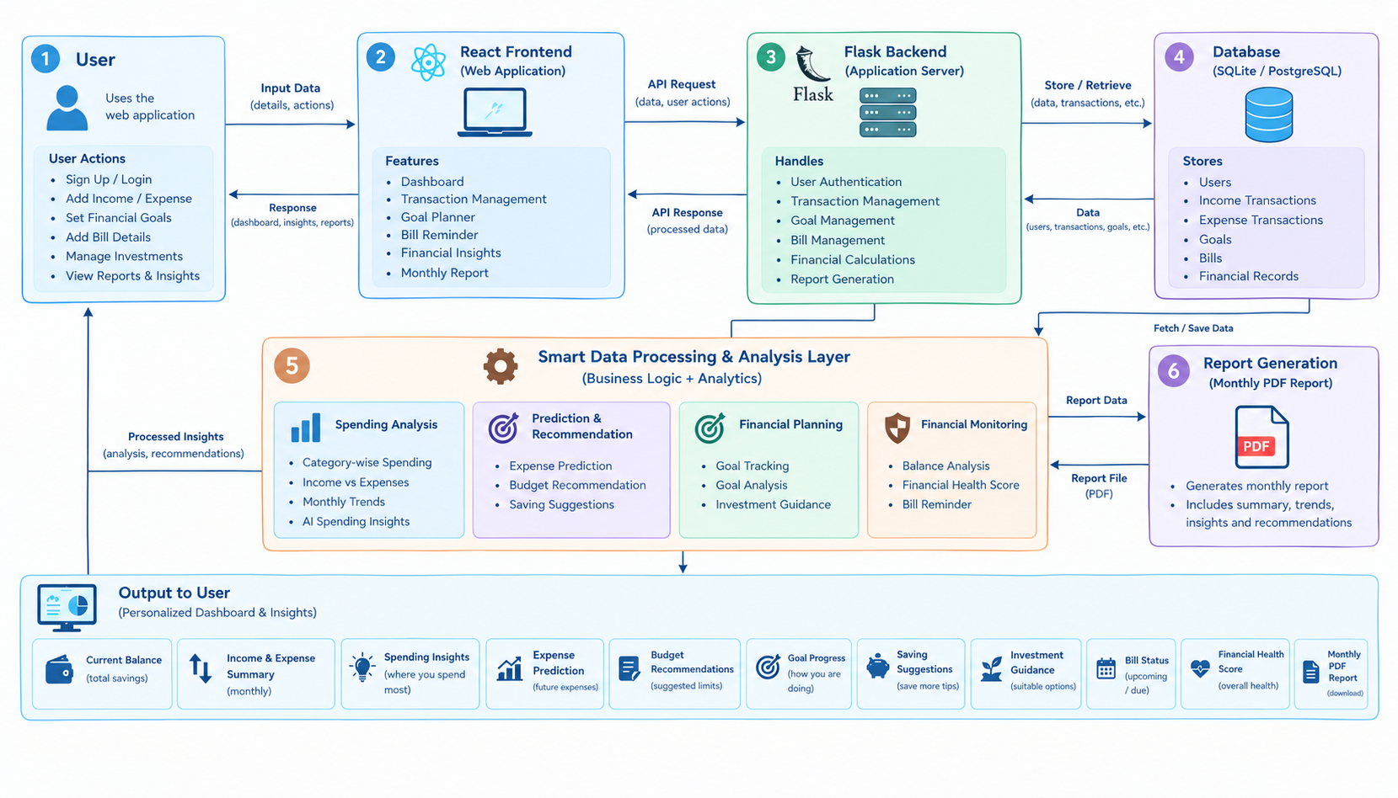
SYSTEM ARCHITECTURE:

Slide 11
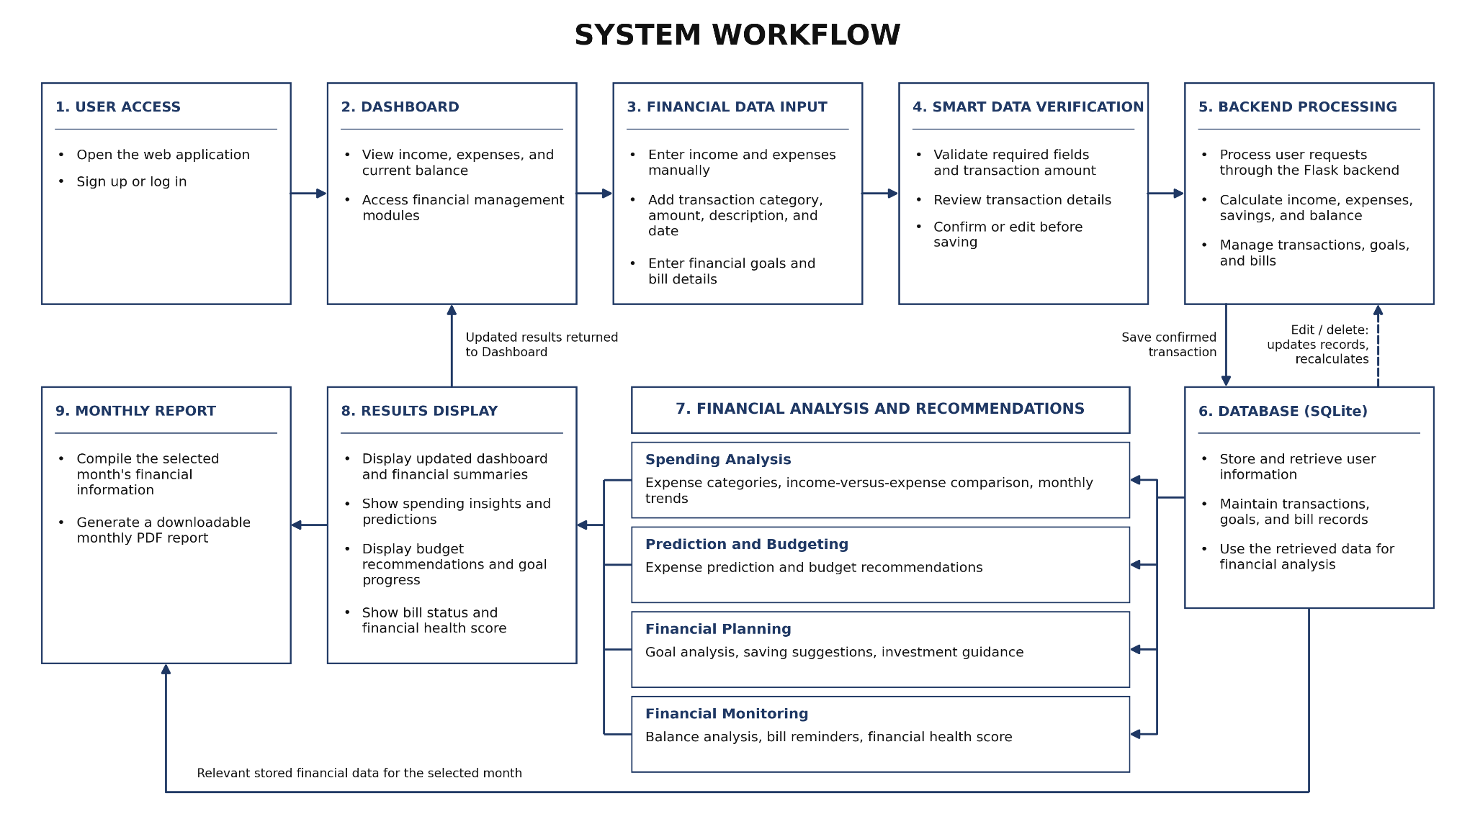

Slide 12
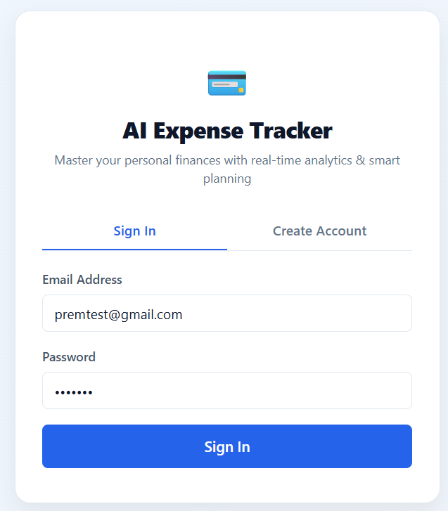
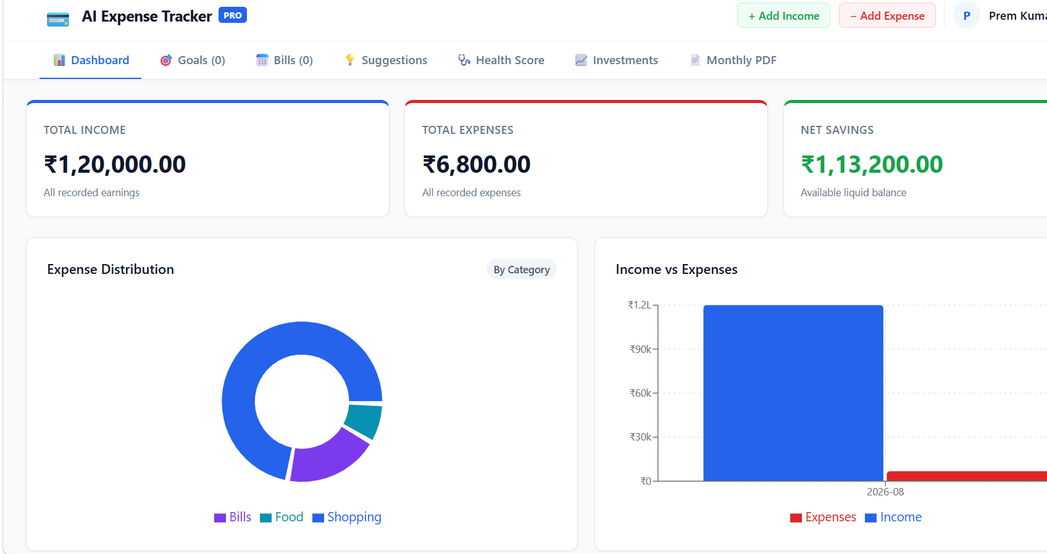
PROJECT IMPLEMENTATION:
LOGIN PAGE
DASHBOARD & VISUALIZATION

Slide 13
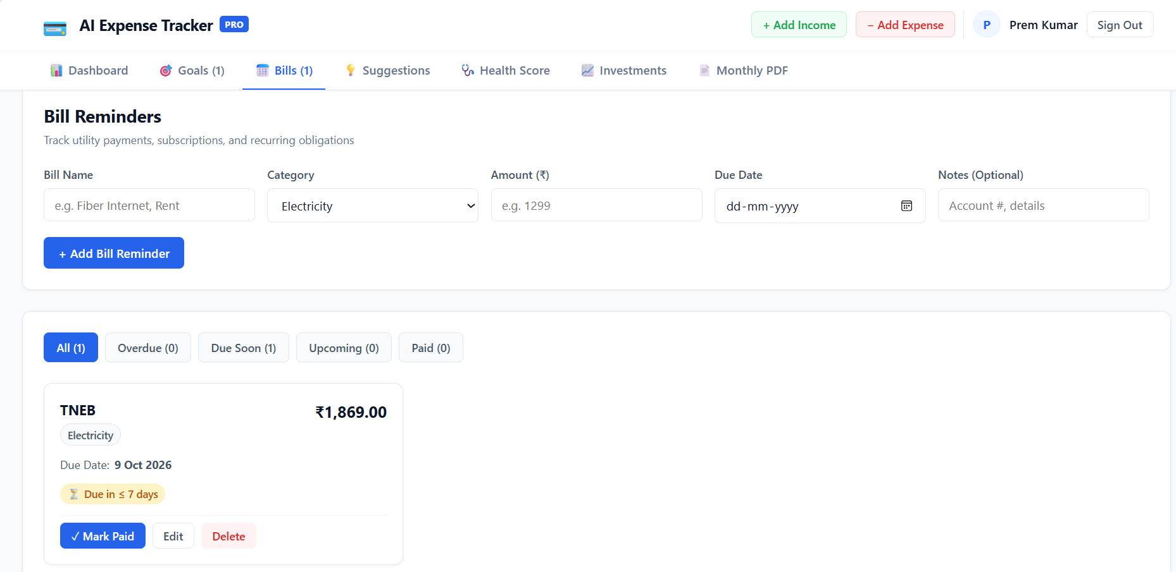
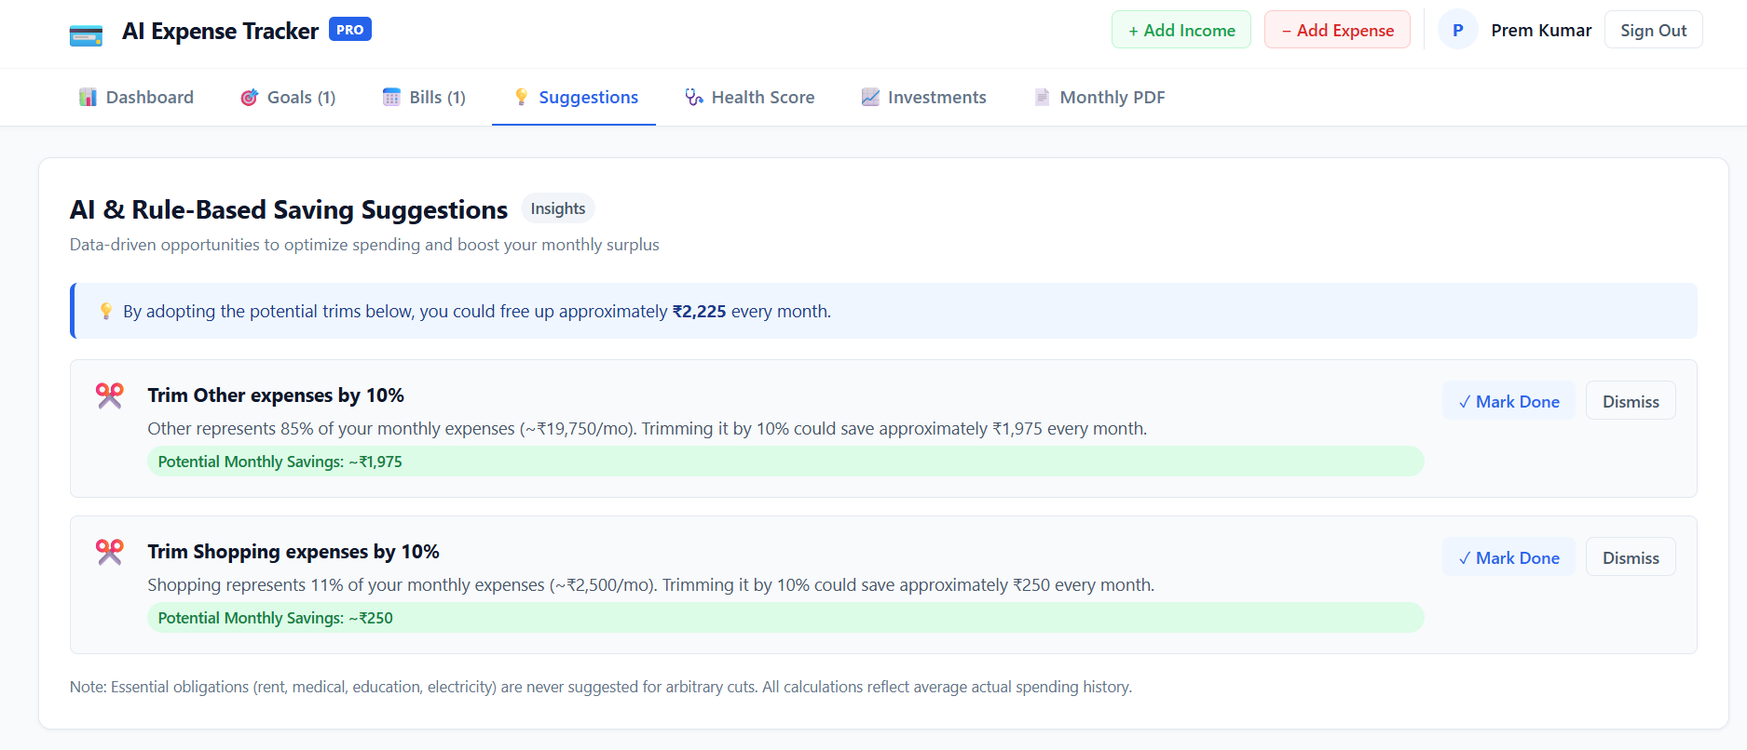
BILL REMIANDER
AI SUGGESTION

Slide 14
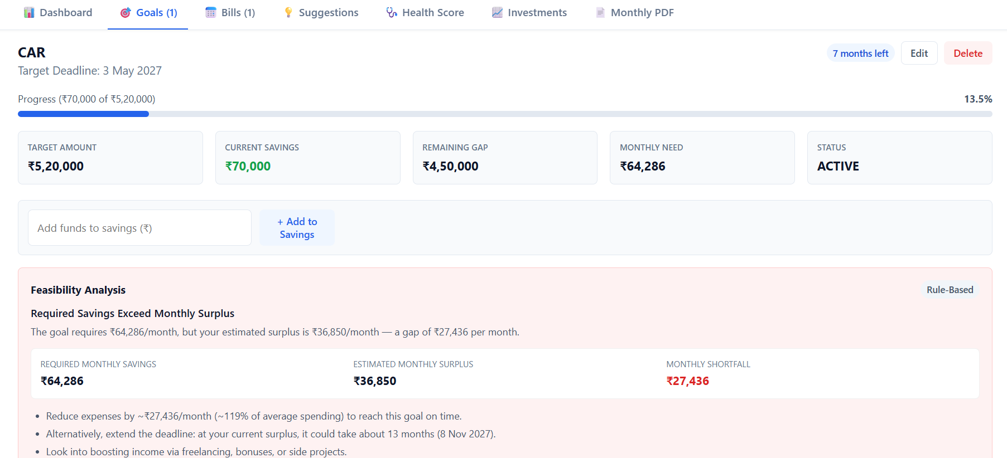
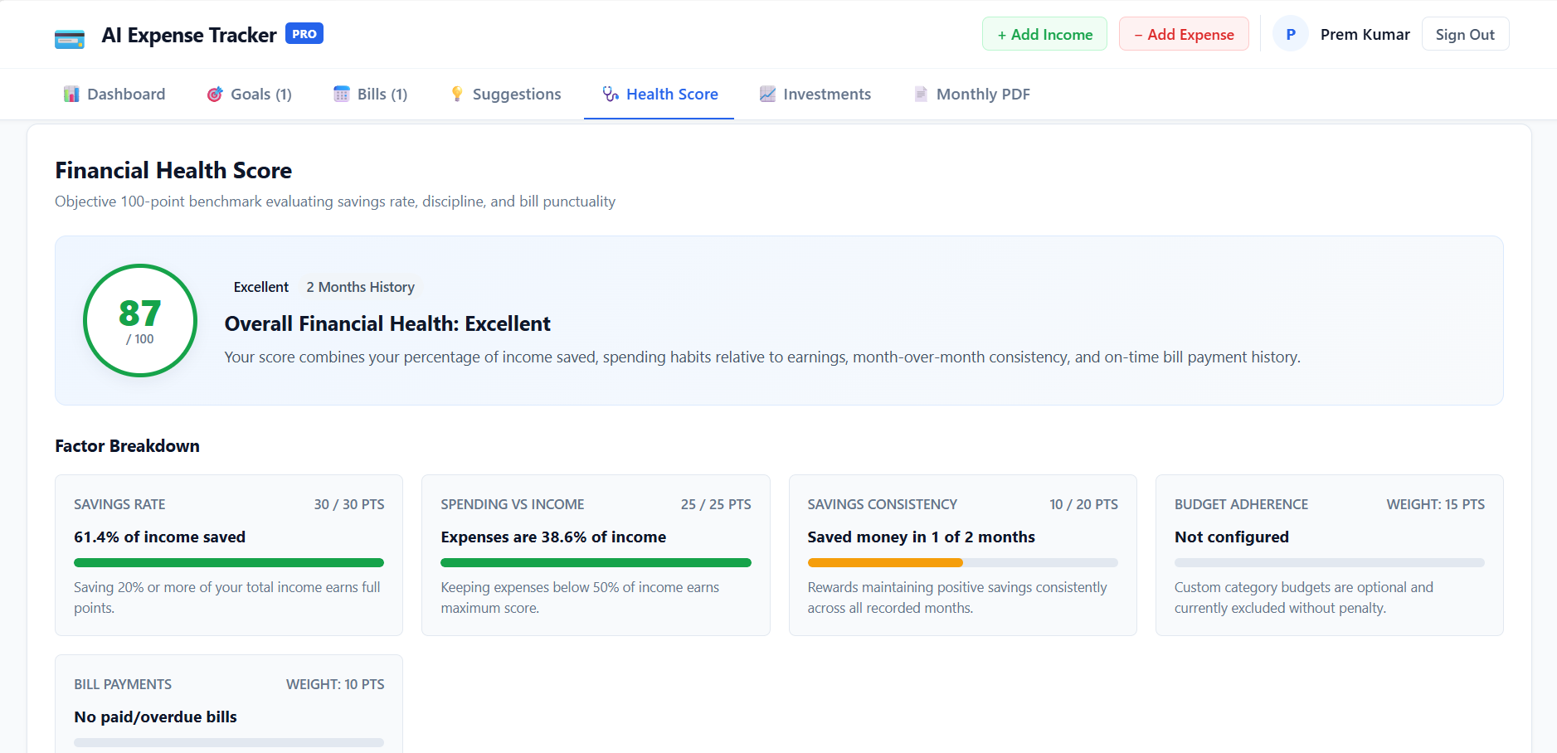
HEALTH SCORE
GOAL PLANNER

Slide 15
LIMITATIONS:
Manual Data Entry: The system currently depends mainly on users manually entering income, expenses, goals, and bill details.
Limited Historical Data: Prediction and financial insights become more accurate when sufficient transaction history is available.
Rule-Based Intelligence: Some recommendations and analysis are based on predefined rules and calculations rather than a fully trained AI model.
Basic Investment Guidance: Investment suggestions are provided for general educational guidance and do not replace professional financial advice.
Local/Controlled Deployment: The current system is primarily designed as a college-project web application rather than a large-scale production financial platform.

Slide 16
FUTURE WORK:
Automated Data Import: Integrate secure bank/financial data sources with appropriate privacy and security mechanisms.
Advanced Machine Learning: Use larger datasets and trained ML models to improve expense prediction and personalized recommendations.
Personalized AI Financial Assistant: Add a conversational assistant that can answer questions about the user's financial data.
Real-Time Notifications: Provide email/mobile notifications for upcoming bills, unusual spending, and financial goals.
Advanced Investment Analysis: Provide more detailed and up-to-date investment information based on user preferences and market data.
Cloud Deployment: Deploy the system with scalable cloud infrastructure and a production-grade database..

Slide 17
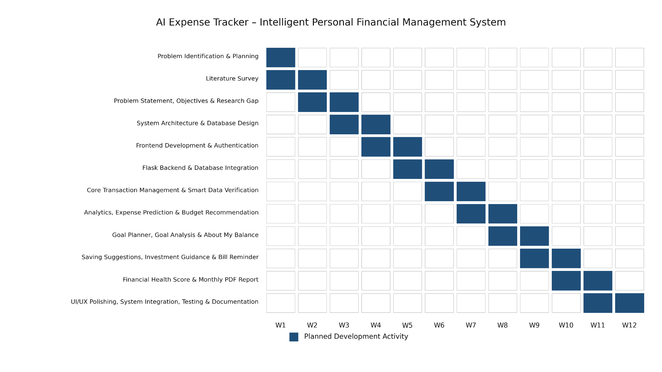
GANTT CHART:

Slide 18
THANK YOU

