Slide 1
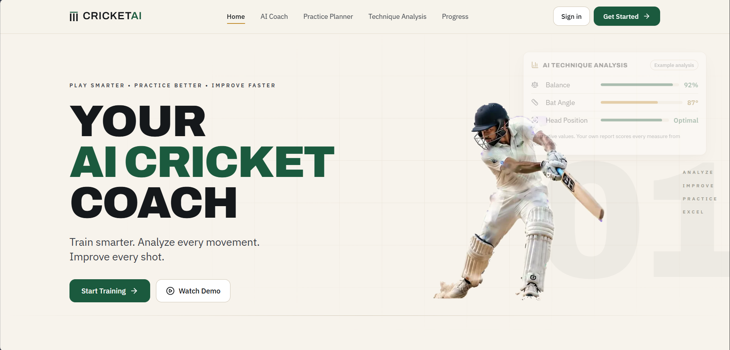
Your AI Cricket Coach
CRICKETAI
Pose-based technique analysis, a report-aware AI coach and personalised practice — in one web app
Abdul Wahid H · Sarveshwaran K · Vignesh P
Guide: Dr. N. Meenakshi
Dept. of CSE, VISTAS, Chennai
Notes:
Introduce the team and the project. CricketAI is a web-based virtual cricket coach combining computer vision, a retrieval-augmented AI coach and structured practice.

Slide 2



Most players train without expert feedback
Technique improves through observation and correction — and that is exactly what amateurs lack
Scarce coaching
Video without insight
Generic AI answers
One coach for many players; academies are costly or far away, so personal attention is rare.
Phones record practice easily, but interpreting body position needs an expert eye.
General chatbots are not grounded in coaching manuals and can give confident but wrong advice.
Notes:
Three gaps motivate the project: access to coaching, interpretation of video, and trustworthy domain-specific guidance.

Slide 3





One app, five connected features
Every feature feeds from the same analysed session, so advice is always about your own technique
Technique Analysis
AI Coach
Practice Planner
Skills Library
Progress
Upload a batting stroke or bowling delivery; joint-by-joint score and full report.
Chat that has read your report and answers from cricket coaching manuals.
Lowest-scoring areas and the corrective drills prescribed for them.
36 skills — batting, bowling, fielding — with lessons, drills and levels.
Dashboard and weekly progress across all analysed sessions.
Notes:
Walk through the five features. The key design point: the AI Coach and Practice Planner both use the selected analysis report.

Slide 4
Current system architecture
CLIENT
React + TypeScript SPA (Vite, Tailwind) · Landing · Dashboard · Analysis · AI Coach · Practice · Skills · Progress · Profile
API
FastAPI on Uvicorn · JWT auth · Pydantic schemas · sessions · analyses · coach · skills · progress routes
ENGINES
Technique-analysis engine
OpenCV decode → MediaPipe Pose (33 pts)
Batting | Bowling (pace / spin, L / R arm)
Joint scores · confidence · observations · drills
Report-aware RAG coach
Report context + question
BGE embed → ChromaDB → BGE rerank
Qwen3:4B via Ollama (local)
Practice &
skills logic
weak areas →
drills, lessons
DATA
MongoDB (Beanie)
users · analyses
Video storage
MP4 / MOV ≤ 200 MB
ChromaDB
coaching manuals
Skills & drills
catalogue (36)
Notes:
Four layers. The analysis engine writes a report to MongoDB; the coach reads that report as context alongside retrieved manual passages, so answers are about the user's own session. All model inference is local.

Slide 5




End-to-end workflow
From one uploaded clip to a report, a coaching conversation and a practice plan
01
02
03
04
05
06
Upload
Track pose
Score joints
Report
AI coach
Practice
Discipline, arm, style + one clip
33 landmarks frame by frame
0–100 per measure, grouped by segment
Score, confidence, strengths, areas
Questions answered from report + manuals
Drills for lowest-scoring areas
Progress loop Every report is stored per user, so the dashboard tracks weekly progress and the next analysis shows what improved.
Notes:
Six steps. Steps 1-4 run on the server in one analysis request; steps 5-6 reuse the stored report.

Slide 6
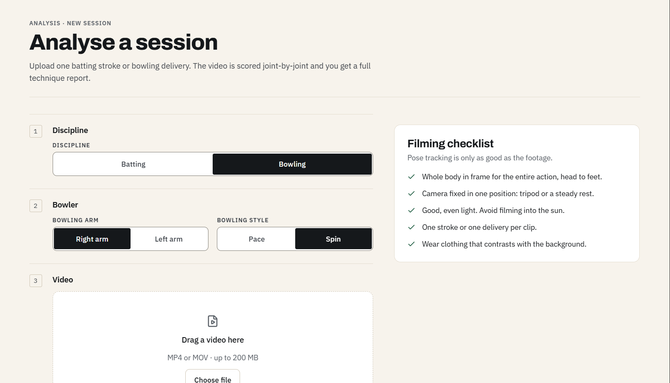
Analyse a session
Guided upload
Batting or bowling; bowling arm and pace / spin
MP4 or MOV up to 200 MB, one stroke or delivery
Filming checklist: full body, fixed camera, even light, contrasting clothing
Server tracks pose frame by frame and scores each joint while the page shows progress
Notes:
The filming checklist exists because pose tracking is only as good as the footage.

Slide 7
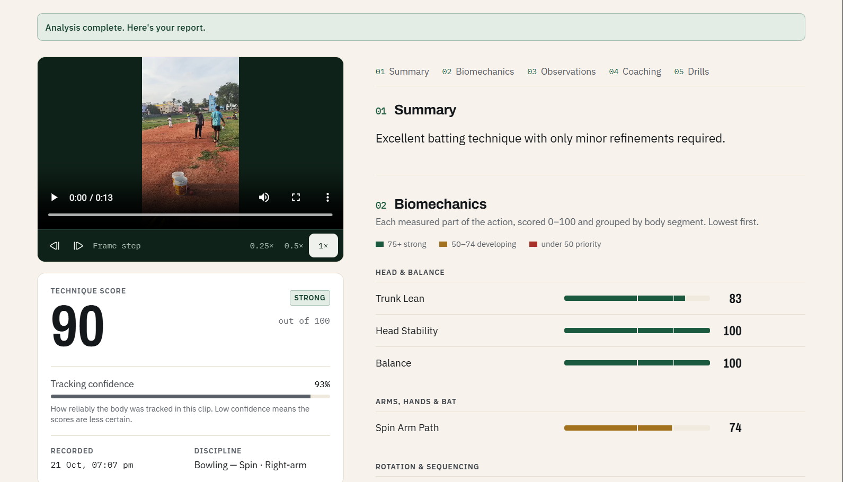
Technique report
90/100
Technique score on the sample spin delivery (rated Strong)
93%
Tracking confidence — how reliably the body was followed
Measures scored 0–100 and grouped by body segment: 75+ strong, 50–74 developing, under 50 priority. Slow-motion and frame-step playback sit beside the report.
Notes:
Example values from one 13-second spin-bowling clip. Head stability and balance 100, trunk lean 83, spin arm path 74. These scores are rule-based and not yet validated against coaches.

Slide 8
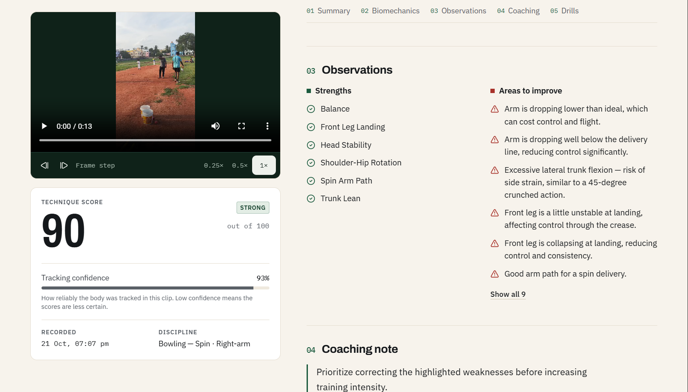
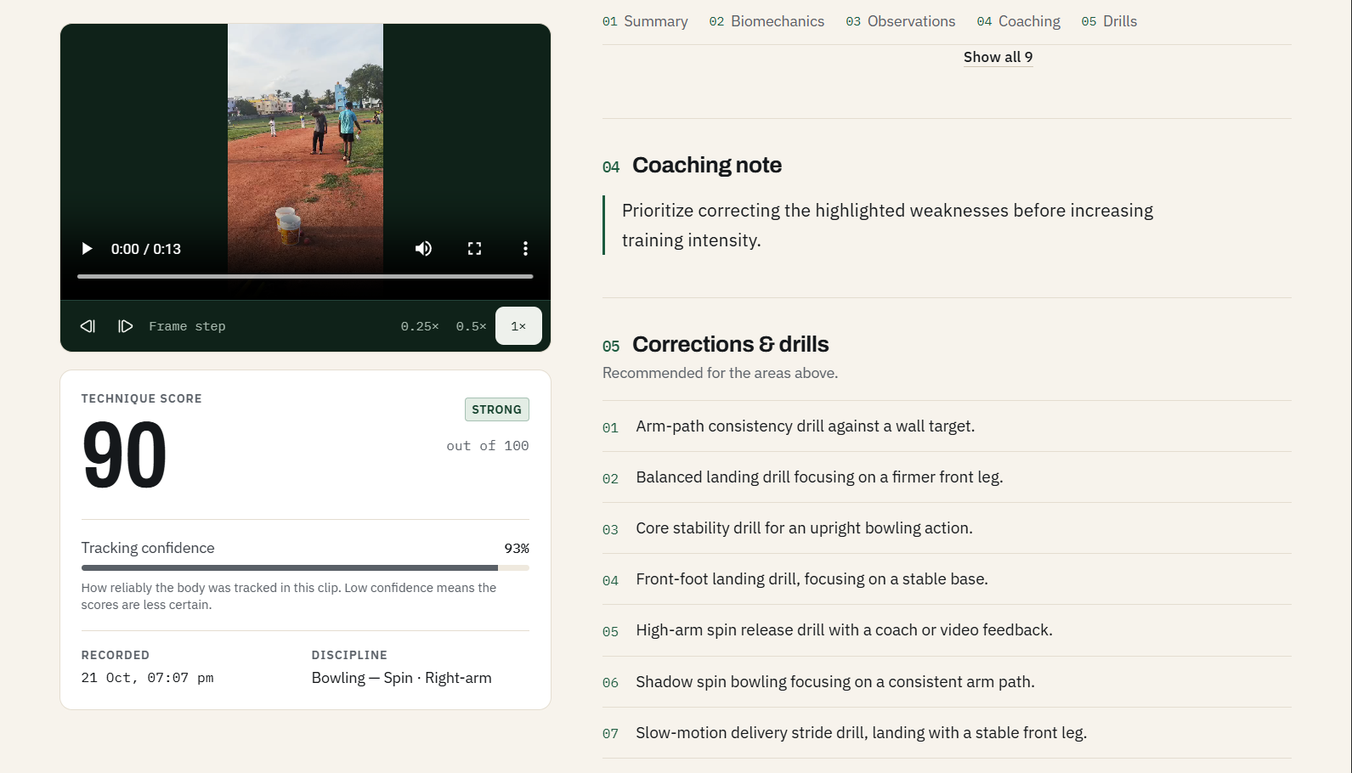
Observations, coaching note and drills
Strengths and areas to improve turn straight into corrective drills
Strengths vs. areas to improve
Coaching note + prescribed drills
Notes:
Each area to improve maps to one or more drills from the catalogue.

Slide 9
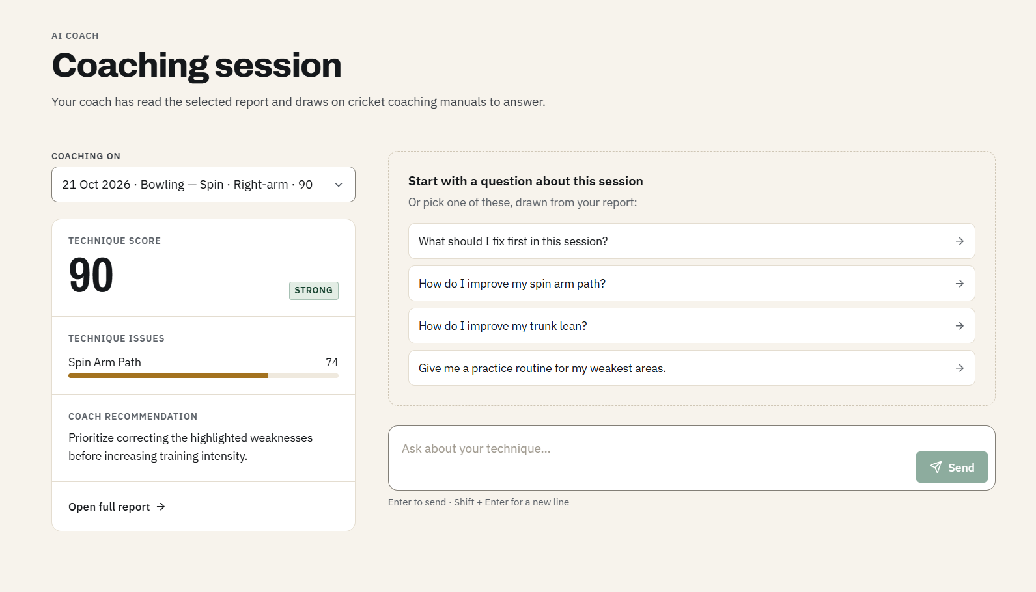
Report-aware AI coach
How an answer is built
1
Selected report + question
2
BGE embedding
3
ChromaDB top-k (coaching manuals)
4
BGE cross-encoder rerank
5
Qwen3:4B answer (local, Ollama)
Suggested questions are drawn from the report, e.g. “How do I improve my spin arm path?”
Notes:
The coach reads the selected report and retrieves passages from coaching manuals. Running Qwen3:4B locally keeps data private; answers can take a minute or two on a laptop.

Slide 10
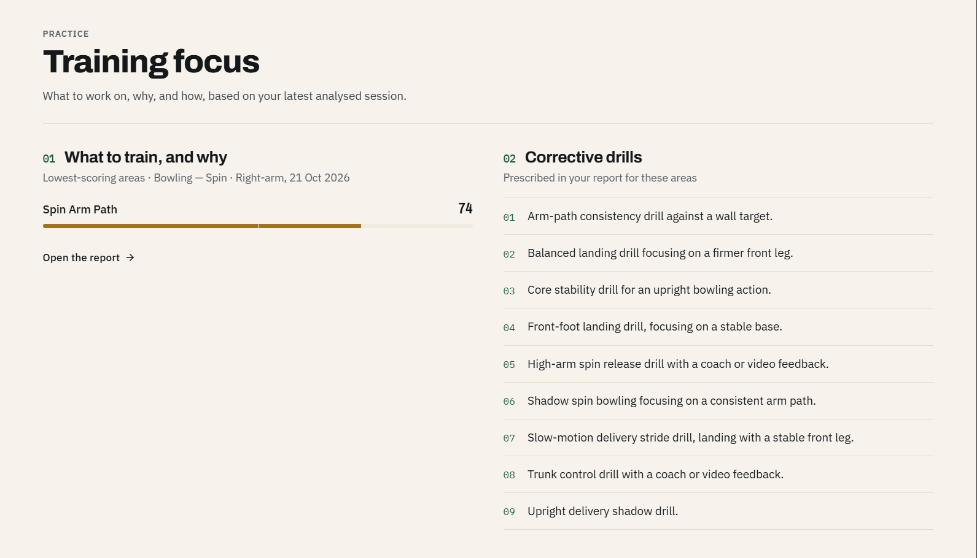
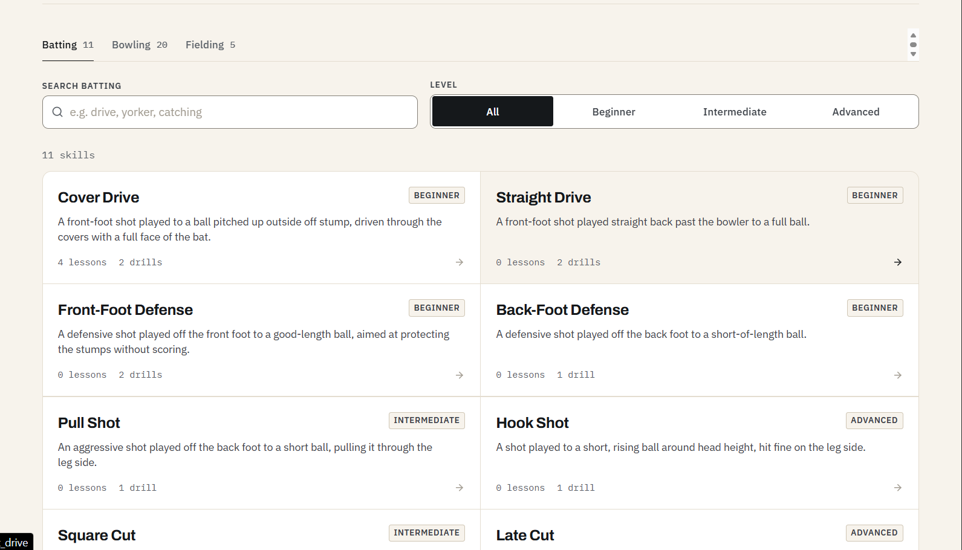
Practice planner and skills library
From “what went wrong” to “what to do next”
Training focus from the latest session
11 batting · 20 bowling · 5 fielding skills
Lowest-scoring areas with the drills prescribed in the report
Searchable, filtered by Beginner / Intermediate / Advanced
Notes:
Skills carry lessons and drills; several skills still have zero lessons and only drills — lesson content is being filled in.

Slide 11






Technology stack
Frontend
Backend
React · TypeScript · Vite · Tailwind CSS
Python · FastAPI · Uvicorn · Pydantic
Auth & data
Computer vision
JWT · MongoDB · Beanie ODM
OpenCV · MediaPipe Pose (33 landmarks)
Retrieval
Language model
BGE-base-en-v1.5 · ChromaDB · BGE reranker
Qwen3:4B served locally with Ollama
Notes:
Fully open-source stack; no paid AI APIs.

Slide 12
Where we stand
Working today
Honest limitations
Batting and bowling (pace / spin, left / right arm) analysis end to end
Report with score, confidence, segment scores, observations and drills
AI coach grounded in the selected report and coaching manuals
Practice planner, 36-skill library, dashboard and progress
Local inference — no user video or question leaves the server
Single camera = 2D angles; viewpoint, occlusion and light affect them
Scores are rule-based, not yet validated against qualified coaches
Local 4B model: answers can take a minute or two
Accuracy, retrieval quality and usability not yet measured
Several skills have drills but no lessons yet
Notes:
Be upfront: the system works end to end, but its scores need validation before anyone relies on them.

Slide 13
Our vision: theory + practical AI coach
Books teach how a shot should be played. Experienced players show how it is really played.
TODAY
NEXT
Theory knowledge
Practical knowledge
+
Coaching manuals and books in the knowledge base
Explains how a cover drive should be played
RAG: BGE + ChromaDB + reranker + Qwen3:4B
State-level players with 10+ years of experience
200–400 videos for every shot and delivery
Clips labelled by qualified coaches
Models learn the expert movement range
= An AI coach that guides like a real coach. “At impact your front elbow is lower than in most expert cover drives — keep it high and lead with the shoulder.”
Notes:
Today the coach learns only from books and manuals - theory. Next we record state-level players with about 10 years of experience, 200 to 400 clips for every shot and delivery, labelled by coaches. Models trained on these clips learn how experts actually move, so the coach can combine theory and practice like a real coach. Every recorded player gives written consent.

Slide 14
Futuristic goals
Three steps from a theory-based coach to a theory + practical coach
STEP 1
STEP 2
STEP 3
Expert video dataset
Train practical models
A real-coach-like AI
Record state-level players (10+ years)
200–400 clips per shot and delivery
Coaches label shot, phase and quality
Written consent from every player
Recognise the shot or delivery type
Detect phases: backlift to follow-through
Expert movement range for each joint
Score against experts, checked by coaches
Answers from theory + practice together
Mobile live feedback and expert “ghost” view
Voice coach in Tamil, Hindi and English
Adaptive plans and an academy portal
Notes:
Step 1 is data: expert clips with coach labels. Step 2 trains models that learn expert movement and replace fixed rules with expert-based scoring, validated by coaches. Step 3 combines theory and practice in one coach, delivered on mobile with voice in local languages.

Slide 15

Thank you
Train smarter. Analyse every movement. Improve every shot.
Questions & live demo
Abdul Wahid H · Sarveshwaran K · Vignesh P | Guide: Dr. N. Meenakshi | Dept. of CSE, VISTAS
Notes:
Offer a live demo: upload a clip, open the report, ask the coach a question, open the practice page.

