Slide 1

SCHOOL OF ENGINEERING
Department of Artificial Intelligence and Machine Learning
Academic Year: 2026-2027
B.TECH - CSE AI– Third Year
MINI PROJECT
Final Review Presentation

Slide 2
A RECIPROCAL SKILL-EXCHANGE PLATFORM
PRESENTED BY : Guide Name:Dr.G.Revathy
Veerajebika.R(24623132)
Pooja.S(24623144)
GracyRose.A(24623110)

Slide 3
CONTENTS:
Abstract
Problem statement
Objective
Introduction
Literature Survey
Project gap
Existing System with Limitations
Proposed System with Advantages
System Architecture
System Requirements
Results and Discussion
Final Output Screenshots
Sample Coding
Conclusion and Future work
References

Slide 4
Problem Statement:
Traditional learning platforms mainly focus on one-way learning, where users learn skills from instructors or online courses. However, many users already possess valuable skills but lack a suitable platform to exchange their knowledge with others. Finding the right learning partner who can teach the required skills and learn the skills offered in return is also challenging. Existing platforms may not effectively support reciprocal skill matching among multiple users.Therefore, SkillLoop aims to develop a web-based skill exchange platform that connects users based on their skills and learning needs. The system supports reciprocal skill matching, match-score generation, exchange requests, and collaborative learning through communication features. This helps users share knowledge, learn new skills, and improve their abilities through mutual learning.

Slide 5
Abstract:
Technical skills are often learned outside the classroom, where many learners lack access to an instructor or a paid mentor. Peer learning offers an alternative, but existing platforms rarely model the two-sided condition that keeps an exchange sustainable, namely that each participant can teach what the other wishes to learn. This paper presents SkillLoop, a web-based platform for reciprocal peer-to-peer skill exchange. Users declare the skills they can teach and the skills they want to learn, and the system pairs them with members whose profiles complement their own. Matching compares skill sets in both directions and assigns an interpretable rule-based score from 1 to 100, constructed so that every reciprocal pair ranks above every one-way pair. A recommendation layer adds an activity term and generates a textual reason for each suggestion. Matched users collaborate through exchange requests, live rooms with text chat and browser-based video calls (WebRTC), and mentor bookings. A token wallet with an append-only ledger rewards confirmed teaching within anti-abuse limits

Slide 6
The platform is implemented in Python with Django and SQLite, and it includes a self-hosted captcha, a honeypot field, and login throttling. The evidence reported consists of worked scoring examples, a verified module inventory, and an automated test suite covering security and room workflows. Skills are currently matched as exact strings, the score constants are uncalibrated, and no user study has yet been conducted. Planned work includes semantic skill matching, project recommendation, and a formal evaluation with real users.

Slide 7
Objective
To develop a web-based platform for students to exchange their skills with other students.
To help users find people who can teach the skills they want to learn.
To identify suitable skill-exchange partners by comparing the skills users can teach and want to learn.
To provide match scores and simple reasons for the recommendations.
To support learning through exchange requests, live rooms, mentor bookings and a token system.

Slide 8
Introduction
Skill exchange is a useful way for students to learn new skills and share their knowledge with others. Every student may have different skills and learning interests. Some students can teach a skill but may want to learn another skill from someone else. Finding a suitable person for exchanging skills can be difficult. SkillLoop is a web-based platform that connects users based on the skills they can teach and the skills they want to learn. It uses reciprocal matching to suggest suitable partners and supports learning through exchange requests and collaboration features.

Slide 9
Literature survey
Author Name | Title | Journal | Methodology | Limitation
Ayush Yadav et al(2026) | Skill Swap: A Peer-to-Peer Skill Exchange Platform | Skill profiles, matching, and real-time communication | International Journal of Emerging Technologies and Innovative Research (JETIR) | International Journal of Emerging Technologies and Innovative Research (JETIR)
Swetha Kanuka (2026) | A Peer-to-Peer Skill Sharing Platform with a Time-Based Rewards | international Journal of Sciences and Innovation Engineering (IJSCI), July 2026 | Skill sharing with time-based learning credits | AI-based recommendations are suggested for future work

Slide 10
Literature survey
Author Name | Title | Journal | Methodology | Limitation
Rohit Kumar Kushwaha et al. (2026) | SkillSwap: A Peer-to-Peer Skill Exchange Platform for Community-Driven Learning | International Journal of Creative and Open Research in Engineering | Complementary skill matching and skill-swap requests | Further validation across larger user groups is needed
Aliya Tabusum et al. (2026) | Knowle: A Peer-to-Peer Knowledge Exchange Platform | SSRN research paper; a journal publication was not confirmed | Microservices architecture and real-time communication | Real-world performance needs further evaluation

Slide 11
Literature survey
Author Name | Title | Journal | Methodology | Limitation
Linfang Xu et al. (2026) | The Effects of Reciprocal Peer Practice with Digital Platform on Undergraduate Nursing Students’ Operational Skills, Critical Thinking, and Self-Efficacy | BMC Medical Education | Quasi-experimental study of digital peer learning | Quasi-experimental study of digital peer learning
Priyanka Mahale et al. (2026) | A Semantic Embedding Approach for Peer-to-Peer Skill Exchange Networks | International Journal on Advanced Electrical and Computer Engineering (IJAECE) | Semantic embeddings for skill exchange matching | Further testing in real-world settings may be needed

Slide 12
Project Gap:
Existing learning platforms provide courses, learning materials and communication facilities.
Finding a suitable skill-exchange partner can still be difficult.
Matching should consider the requirements of both users.
A clear scoring method can help users understand why a partner is suggested.
SkillLoop combines reciprocal skill matching with exchange requests and collaboration features.

Slide 13
Existing System
In the existing system, students usually learn new skills through online courses, tutorials, and individual learning platforms.
Students may use separate platforms to learn skills, find mentors, and communicate with other learners.
Finding a suitable person who can teach the required skill and is also interested in learning another skill can be difficult.
Traditional learning platforms mainly focus on providing courses or connecting learners with instructors.
They may not provide a dedicated mechanism for arranging reciprocal skill exchanges between multiple users.
Manual searching for suitable learning partners can take more time and effort.
Therefore, there is a need for a platform that connects users based on the skills they can teach and the skills they want to learn.

Slide 14
Limitations
Students may find it difficult to identify suitable skill exchange partners.
Most learning platforms focus on online courses rather than reciprocal skill exchange.
Finding a person who can teach the required skill and learn another skill in return may be challenging.
Manual searching for learning partners requires more time and effort.
Some platforms provide limited opportunities for direct interaction between learners.
Learning resources, mentor booking, and communication may be available on separate platforms.
Traditional systems may not prioritize matching users based on mutually beneficial skill exchange.

Slide 15
Proposed System
Skill Loop is a web-based platform designed to help students exchange skills and learn from one another.
Users can register, log in, create profiles, and add the skills they can teach and the skills they want to learn.
The system uses a rule-based reciprocal matching mechanism to identify suitable skill exchange partners based on users’ skill details.
Matching scores are calculated to rank potential partners, with reciprocal matches given higher priority than one-way matches.
The platform provides matching recommendations with simple explanations to help users understand why a partner is suggested.
Users can send exchange requests and collaborate through available communication features, including chat and browser-based video calls.
Additional features include mentor booking, a token wallet, and security mechanisms to support a more organized learning experience.
SkillLoop aims to make peer-to-peer learning easier by connecting students who can teach and learn different skills from one another.

Slide 16
Advantages
SkillLoop helps students learn new skills by exchanging knowledge with other learners.
It connects users based on the skills they can teach and the skills they want to learn.
The reciprocal matching mechanism helps identify mutually suitable learning partners.
Matching scores help users compare potential skill exchange partners.
The platform provides recommendations with simple explanations for suggested matches.
Users can send skill exchange requests and communicate through chat and browser-based video calls.
Mentor booking and token wallet features support organized learning activities.
Security features help protect the platform against common unwanted login and form submissions.
SkillLoop encourages collaborative learning, knowledge sharing, and skill development among students.

Slide 17
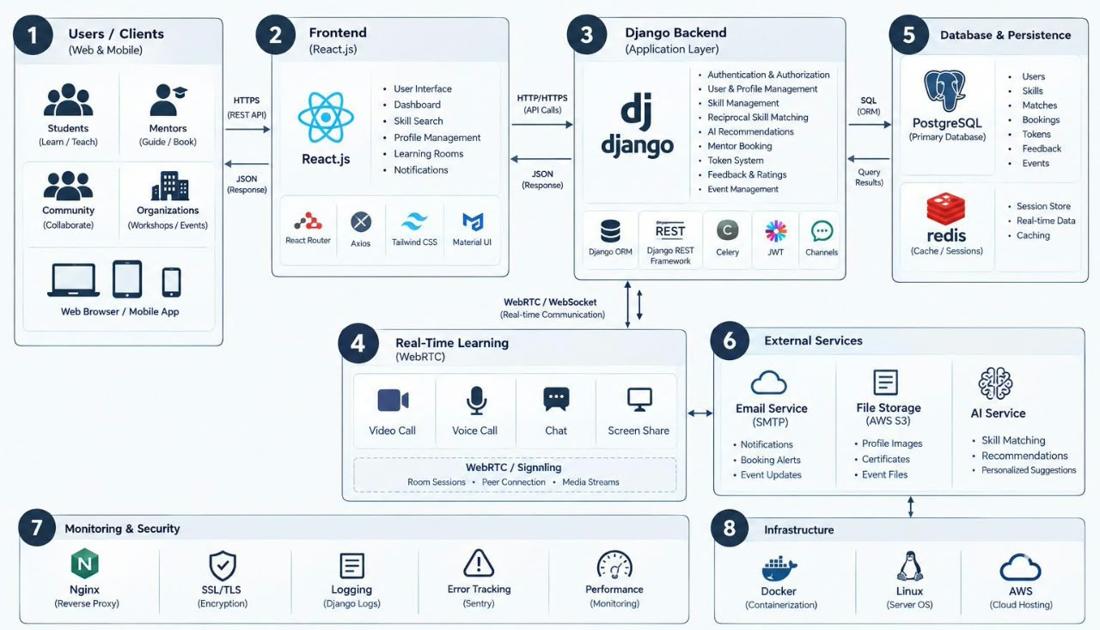
System
Architecture:

Slide 18
System Requirements
Software Requirements:
Software Requirements
Operating System: Windows
Programming Language: Python
Web Framework: Django
Database: SQLite
Frontend: HTML, CSS and JavaScript
Browser: Google Chrome or another modern web browser
Additional technology: Browser-based video communication
Hardware Requirements:
Laptop or desktop computer
Minimum 4 GB RAM recommended
Sufficient storage for the project and database
Internet or network access as required for collaboration features

Slide 19
Reciprocal Skill Matching
The system collects the skills that each user can teach and wants to learn.
It compares both users' skill lists.
It checks whether the first user can teach something the second user wants to learn.
It also checks the reverse direction.
A reciprocal match is given a higher base score than a one-way match.
The system adds suitable bonuses and limits the final score to the range of 1–100.
The recommendation page displays the score and a reason for the suggested match.
Example:
User A can teach Python and wants to learn Artificial Intelligence.
User B can teach Artificial Intelligence and wants to learn Python.
Both users can benefit from the exchange, so the system identifies a reciprocal match.

Slide 20
Implementation
1.SkillLoop is developed as a web-based skill exchange platform using Python and the Django framework.
2.HTML and CSS are used to create the user interface.
SQLite is used to store user profiles, skill details, and exchange-related information.
3.The user authentication module supports registration and login.
4.The skill management module allows users to add teaching and learning skills.
5.A rule-based reciprocal matching algorithm compares user skills and calculates match scores.
6.The recommendation module displays suitable partners along with reasons for the suggested matches.
7.Additional features include exchange requests, chat, browser-based video calls, mentor booking, and a token wallet.

Slide 21
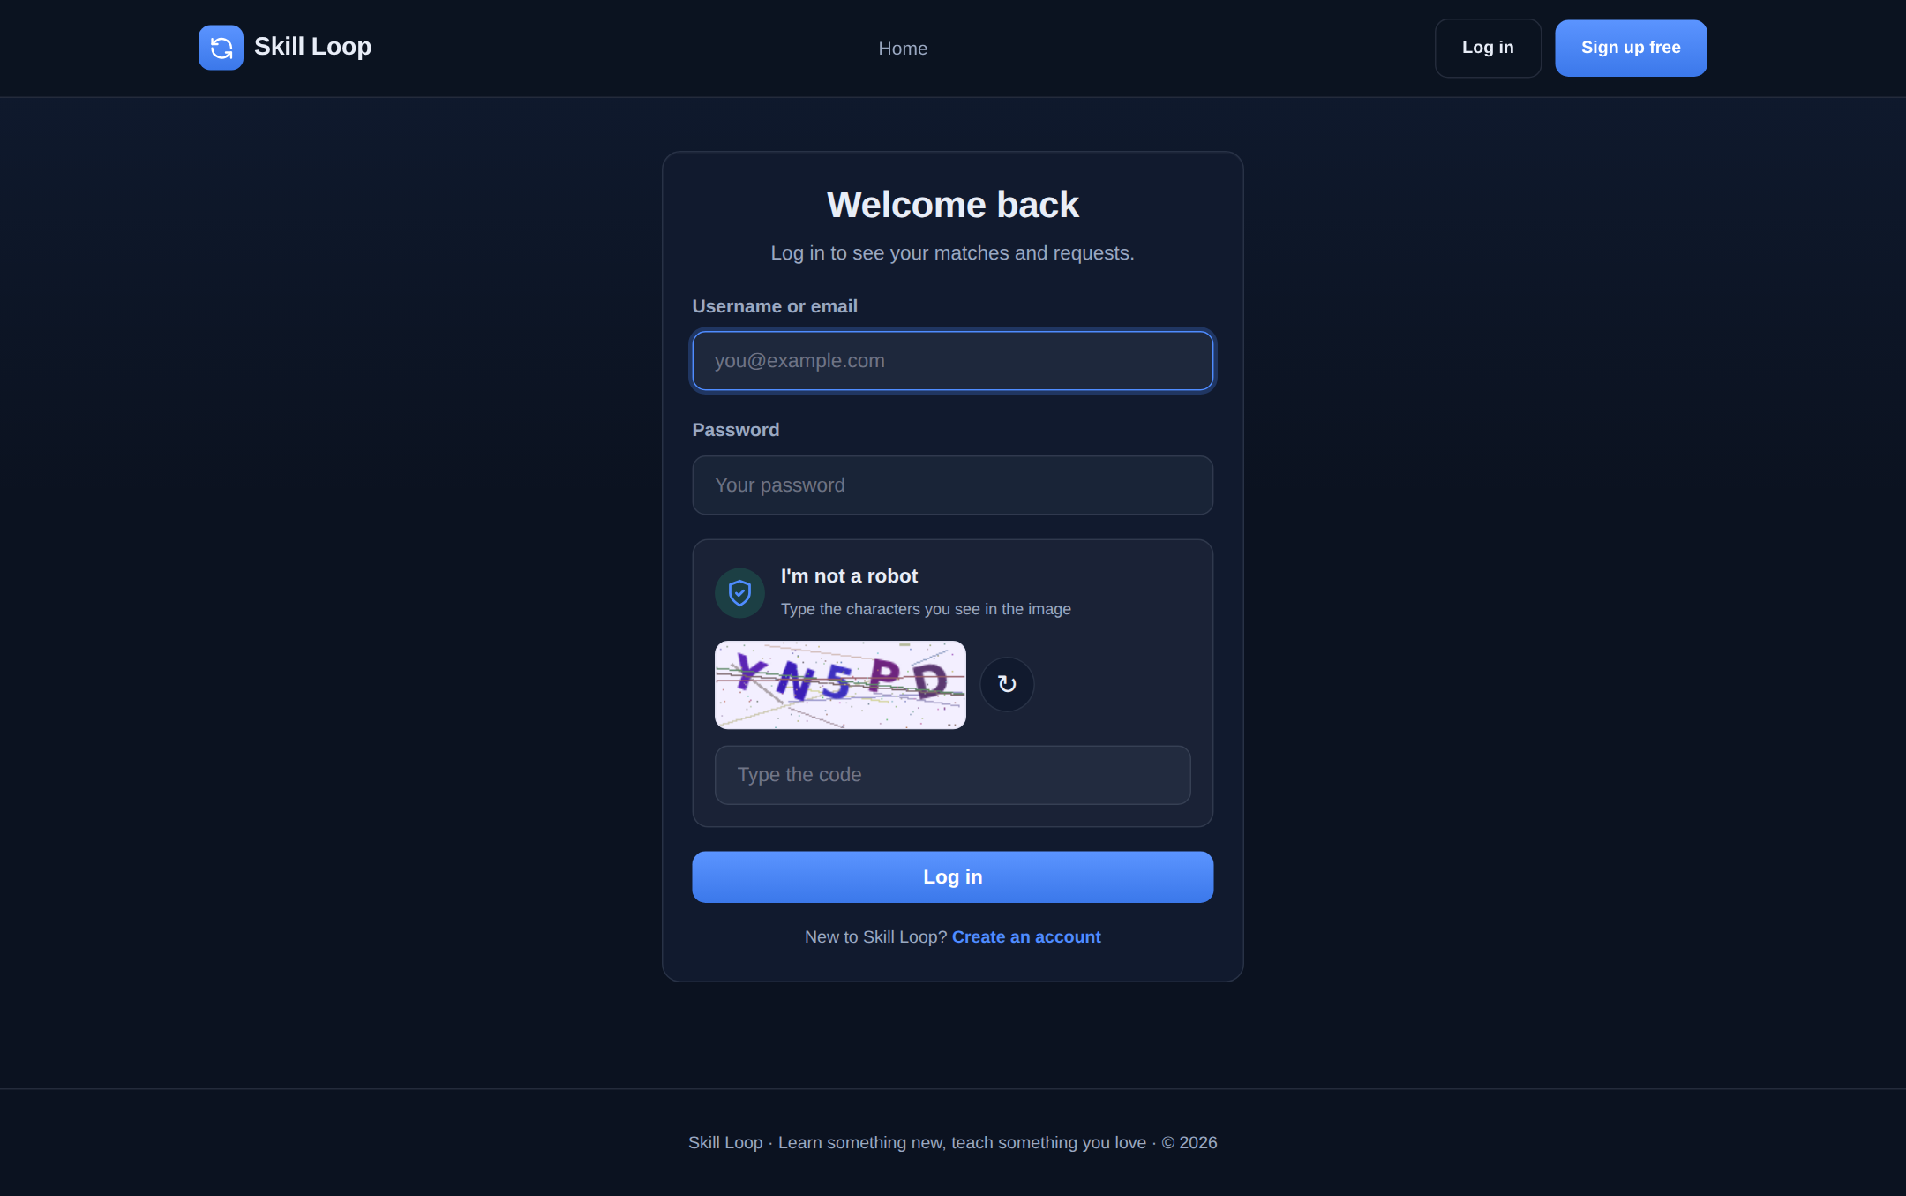
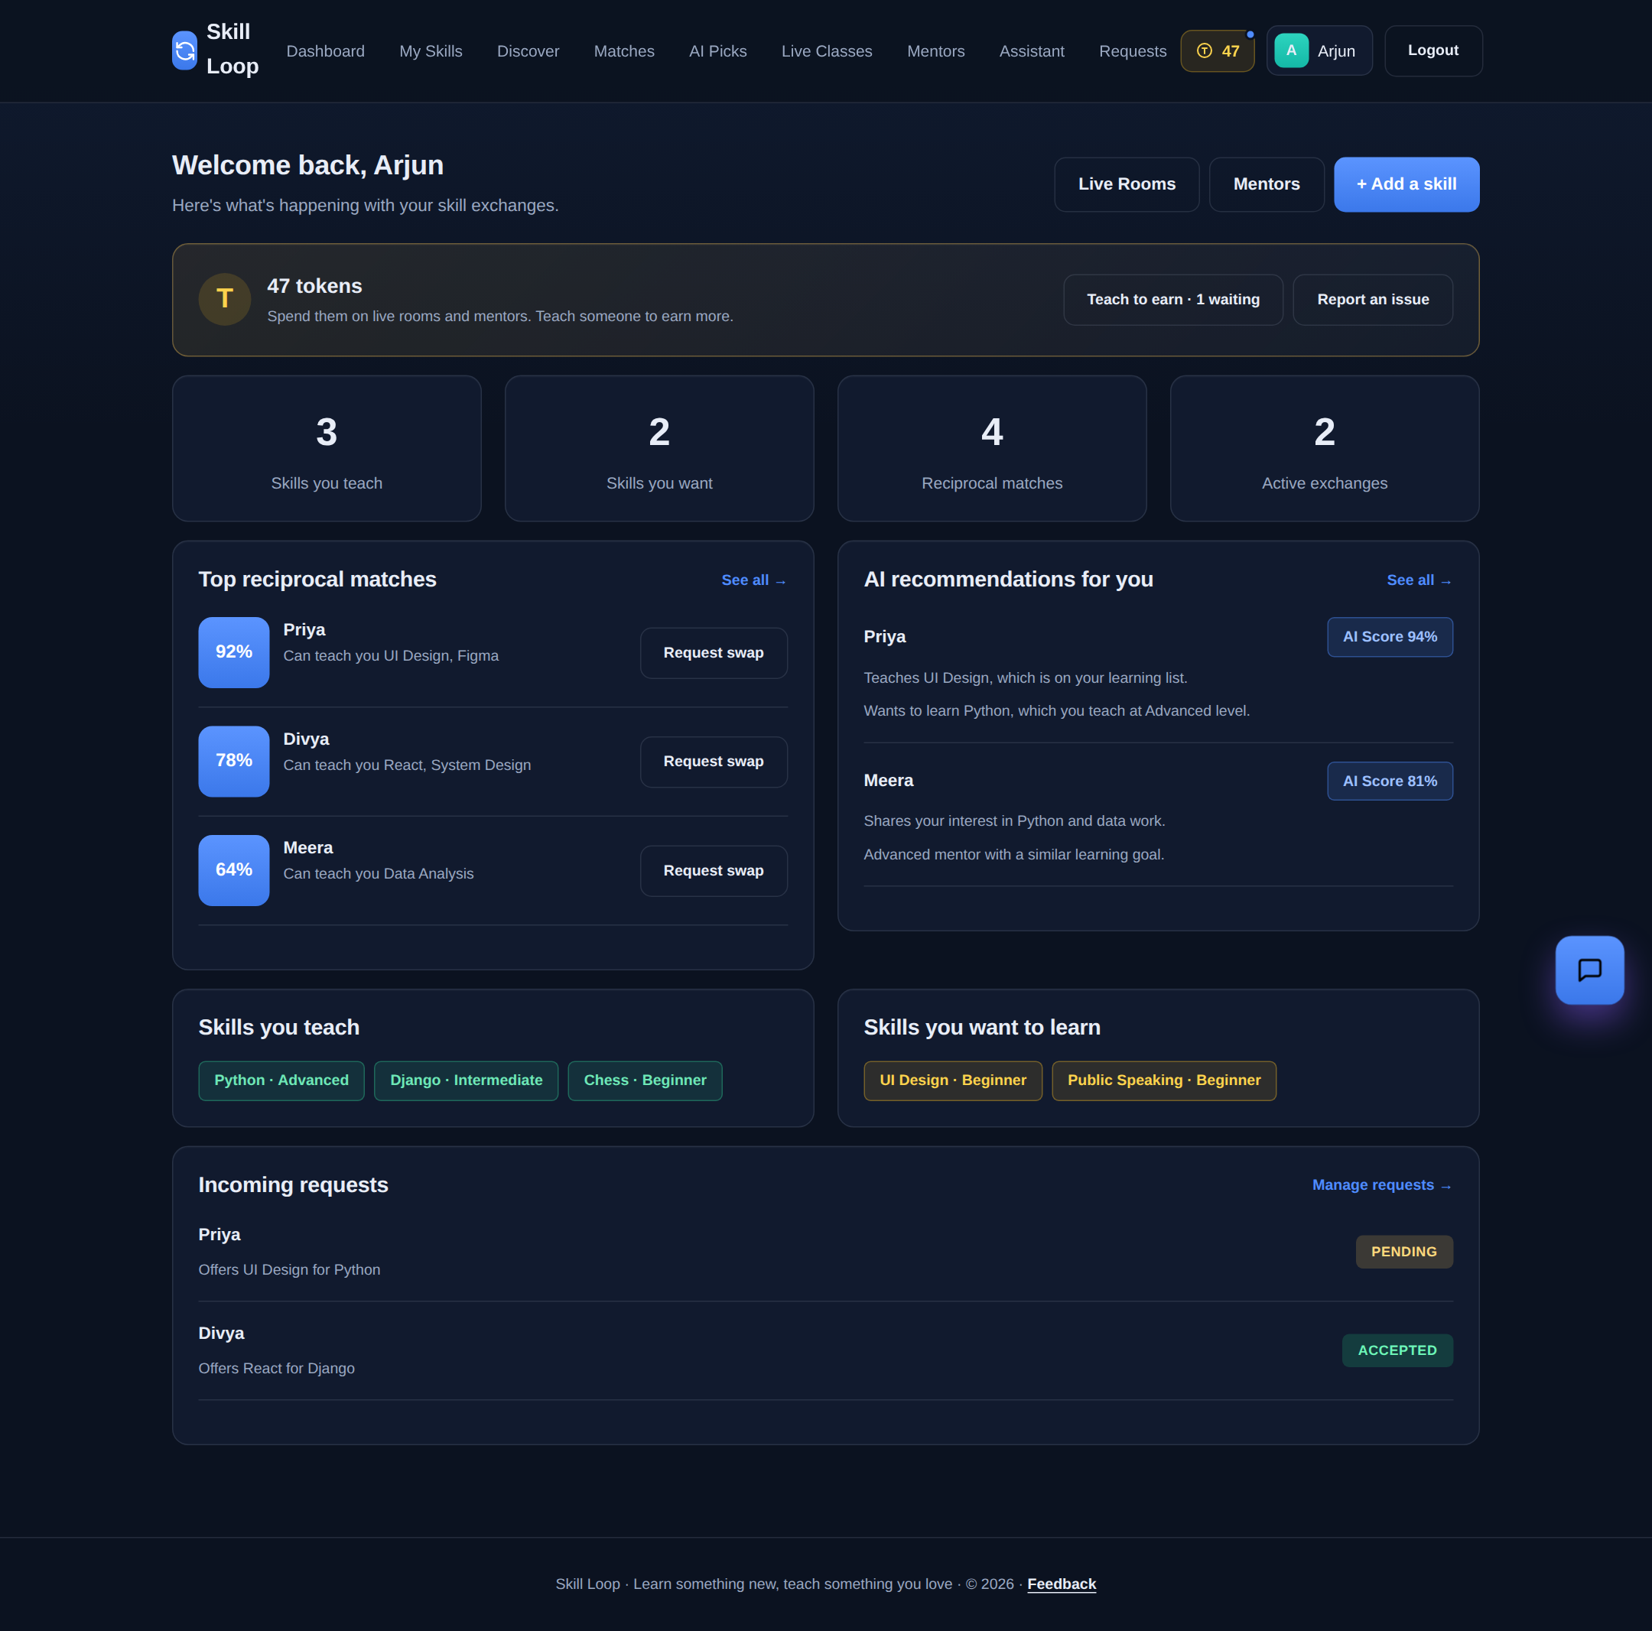
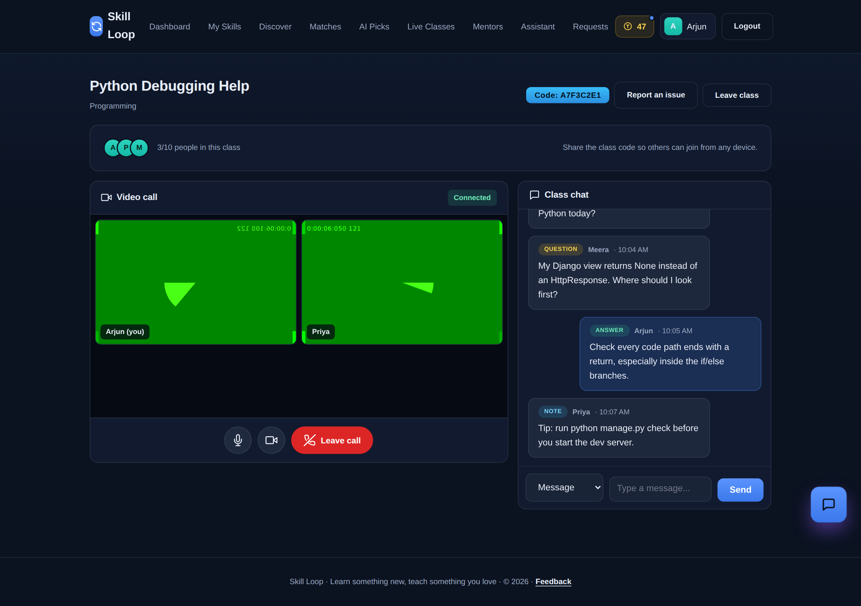
Project screenshots/output:

Slide 22
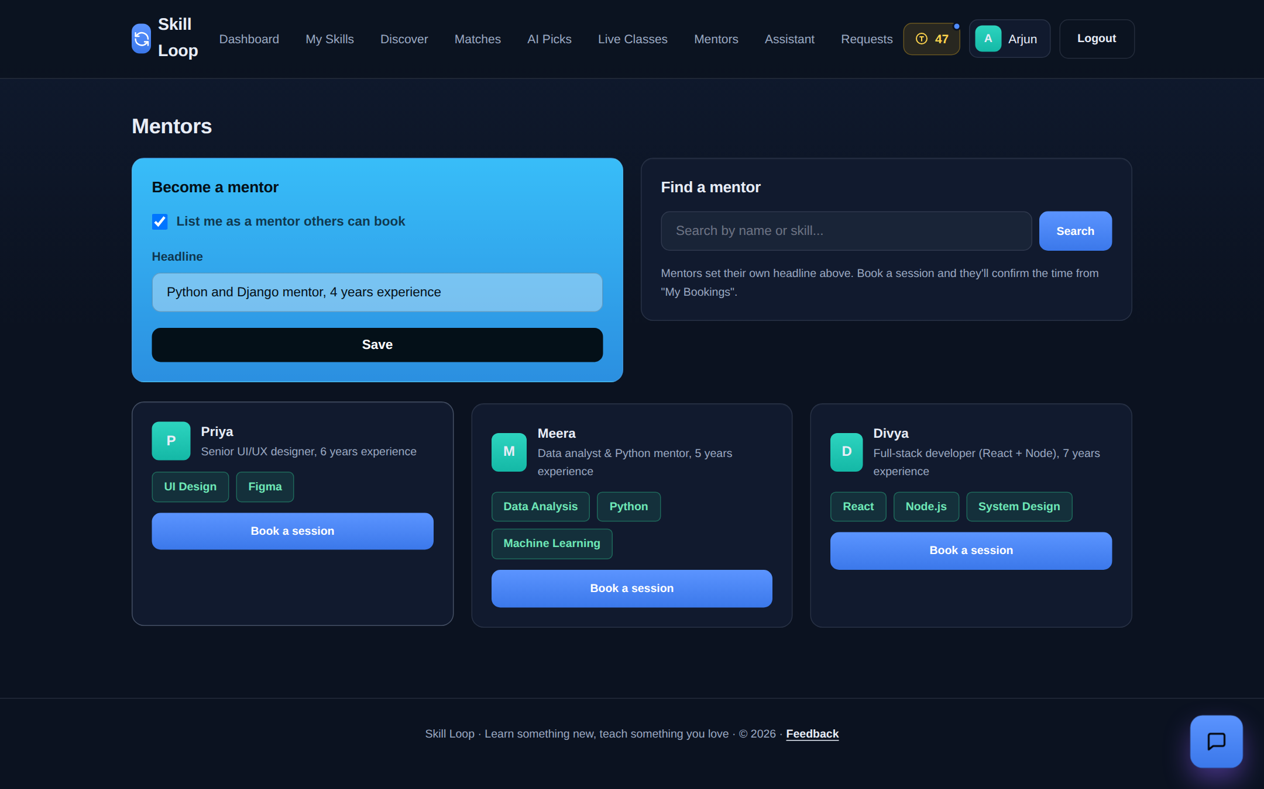
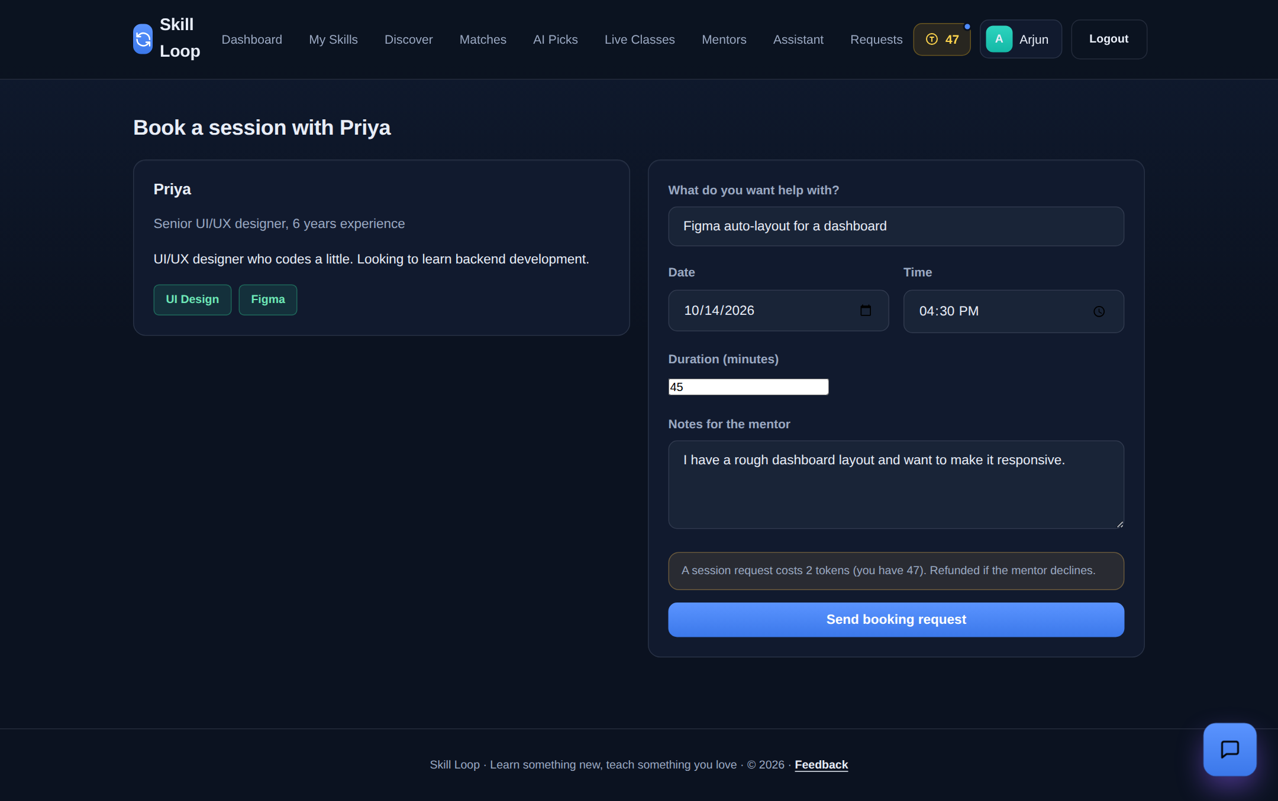
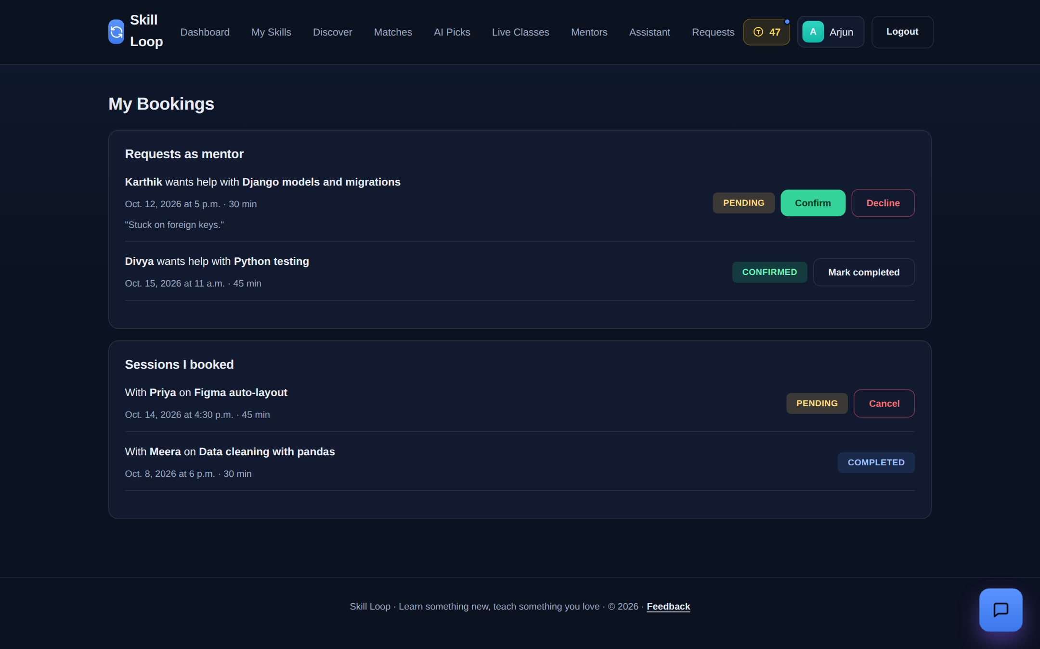
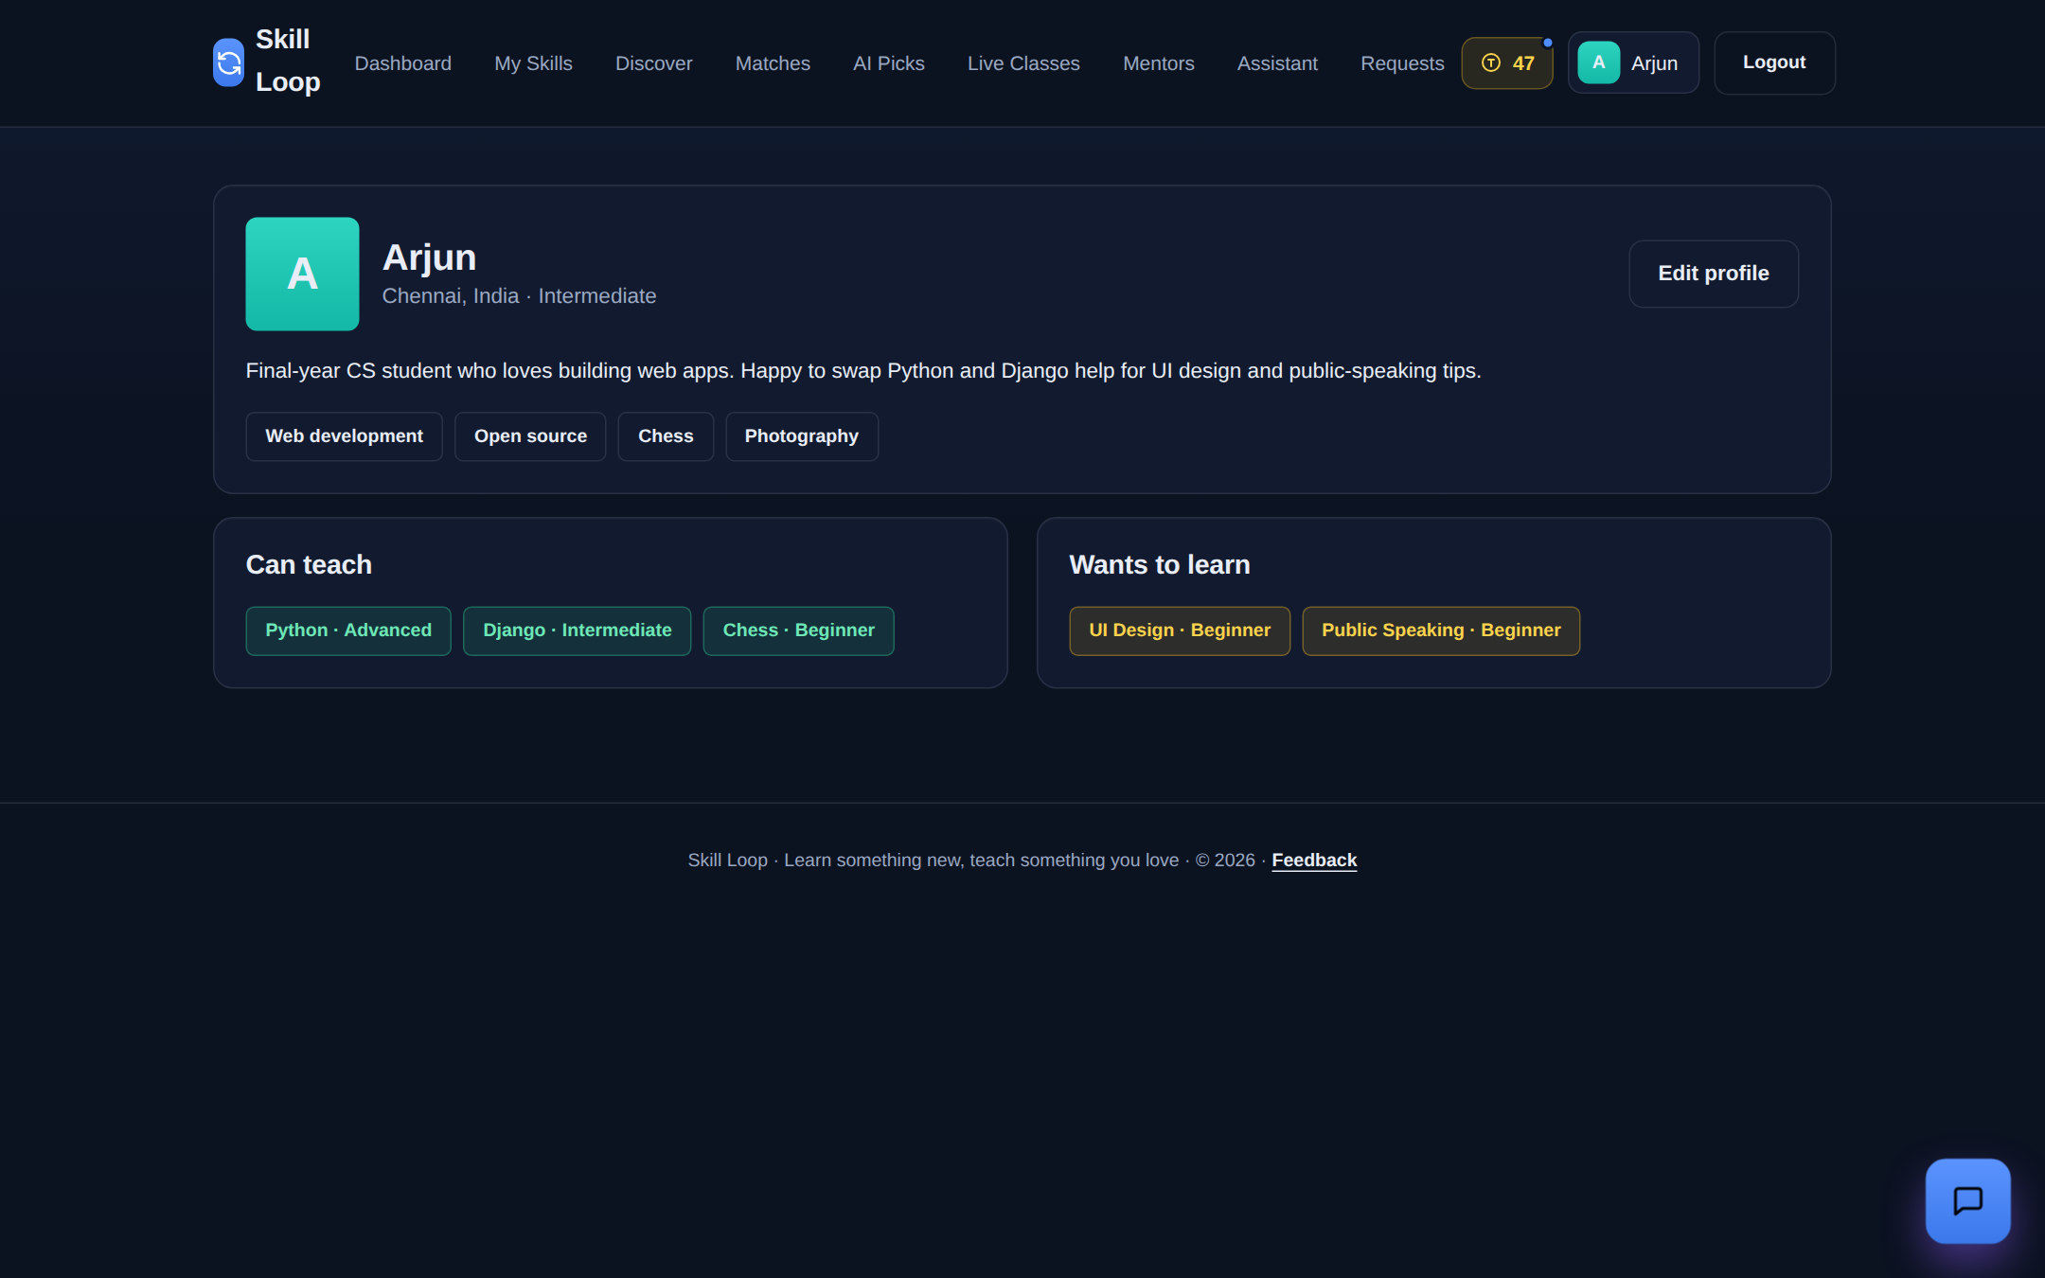

Slide 23
RESULT AND DISCUSSION
The SkillLoop platform provides a web-based solution for reciprocal skill exchange among users. The system allows users to register, create profiles, add their skills, and find suitable learning partners based on their skills and learning requirements. The rule-based matching mechanism calculates match scores and provides recommendations to help users identify potential partners. Users can send exchange requests and collaborate through chat, live rooms, video calls, and mentor booking features. The results demonstrate the implementation of the main platform functionalities. However, further user testing is required to evaluate matching effectiveness, usability, and overall performance in real-world situations.

Slide 24
SAMPLE CODINGS
SAMPLE CODING – RECIPROCAL SKILL MATCHING
def find_match(user1, user2):
teach1 = user1["teach"].lower()
learn1 = user1["learn"].lower()
teach2 = user2["teach"].lower()
learn2 = user2["learn"].lower()
if teach1 == learn2 and teach2 == learn1:
return "Reciprocal Match Found"
else:
return "No Reciprocal Match"
user1 = {
"teach": "Python",
"learn": "Web Development"
}
user2 = {
"teach": "Web Development",
"learn": "Python"
}
result = find_match(user1, user2)
print(result)
OUTPUT
Reciprocal Match Found
CODE EXPLANATION
- The "find_match()" function receives two users' skill details.
- The "lower()" function converts skill names to lowercase for comparison.
- The program checks whether each user's teaching skill matches the other user's learning skill.
- If both conditions are satisfied, a reciprocal match is found.
- Otherwise, the program returns “No Reciprocal Match”.
EXAMPLE
User 1 teaches Python and wants to learn Web Development. User 2 teaches Web Development and wants to learn Python. Since both users' skills match reciprocally, the program displays “Reciprocal Match Found”.

Slide 25
CONCLUSION
Skill Loop provides an effective web-based platform for reciprocal skill exchange and collaborative learning. It enables users to register, manage their skills, find suitable learning partners, and exchange knowledge based on their learning needs. The rule-based matching mechanism helps identify compatible users and generate match scores. Features such as exchange requests, chat, live rooms, video calls, and mentor booking support communication and learning between users. In conclusion, SkillLoop encourages knowledge sharing, mutual learning, and skill development. In the future, the platform can be enhanced with AI-based recommendations and evaluated with more users to improve matching effectiveness and overall performance.

Slide 26
References
1. Tonape, Y. L., Johari, C., Pathan, M., Chinchkar, A., & Chavan, K. (2026). Growora: A Peer-to-Peer Learning Platform for Collaborative Skill Development.
2.Yadav, A., Chandra, A., Rathore, P., & Nema, N. K. (2026). Skill Swap: A Peer-to-Peer Skill Exchange Platform.
3. Tabusum, A., Singh, H., Singh, V., Ritesh, & Singh, V. (2026). Knowle: A Peer-to-Peer Knowledge Exchange Platform.
4. Kushwaha, R. K., Sharma, R. R., Dangi, S., et al. (2026). SkillSwap: A Peer-to-Peer Skill Exchange Platform for Community-Driven Learning.
5. Xu, L., Zeng, L., Liu, C., et al. (2026). The Effects of Reciprocal Peer Practice with Digital Platform on Undergraduate Nursing Students’ Operational Skills, Critical Thinking, and Self-Efficacy. BMC Medical Education.

Slide 27
6. You, H., Xu, L., & Wu, D. (2026). MFF-CF: A Multi-Feature Fused Collaborative Filtering Framework for Personalized Learning Resource Recommendation in Smart Education.
7. Liu, B., Sun, X., & Song, J. (2026). A Hybrid Collaborative Filtering and Knowledge Graph-Based Cross-Domain Recommendation Method for Multimodal Teaching Resources.
8. Soler, M., Corcelles-Seuba, M., & Duran, D. (2026). Reciprocal Peer Observation for Enhancing Teachers’ Digital Competence: Insights from Educational Robotics Implementation.
9. Mahankale, D. B., Shaikh, M. R., Chavhan, A. A., et al. (2026). Design and Implementation of SkillSwap: A Web-Based Platform for Free Student Skill Exchange.
10. SkillMitra: A Hybrid AI Framework for Intelligent Skill Swapping Using SBERT Embeddings, Collaborative Filtering, and NLP-Driven Micro-Challenge Generation. (2026). IEEE Conference Publication.

Slide 28
THANK YOU

