Slide 1
MODULE-3
FACULTY OD REQUEST AND APPROVAL MODULE
TEAM MEMBERS
1. Visvesswar A M - 2022103013
2. Shibani Selvakumar - 2023103005
3. Nikhitaa M - 2023103010
4. Sai Nikitha - 2023103006

Slide 2
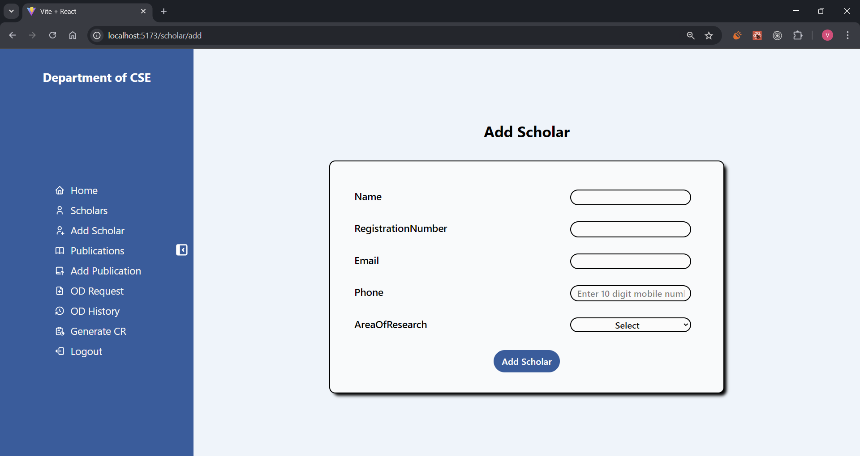
This is the Add scholar page, where faculty/admin can add scholar details

Slide 3

Form details are validated before submission

Slide 4

Submission of form with valid details.

Slide 5

A toast message is received for successful addition of scholar.( or failure of action )

Slide 6
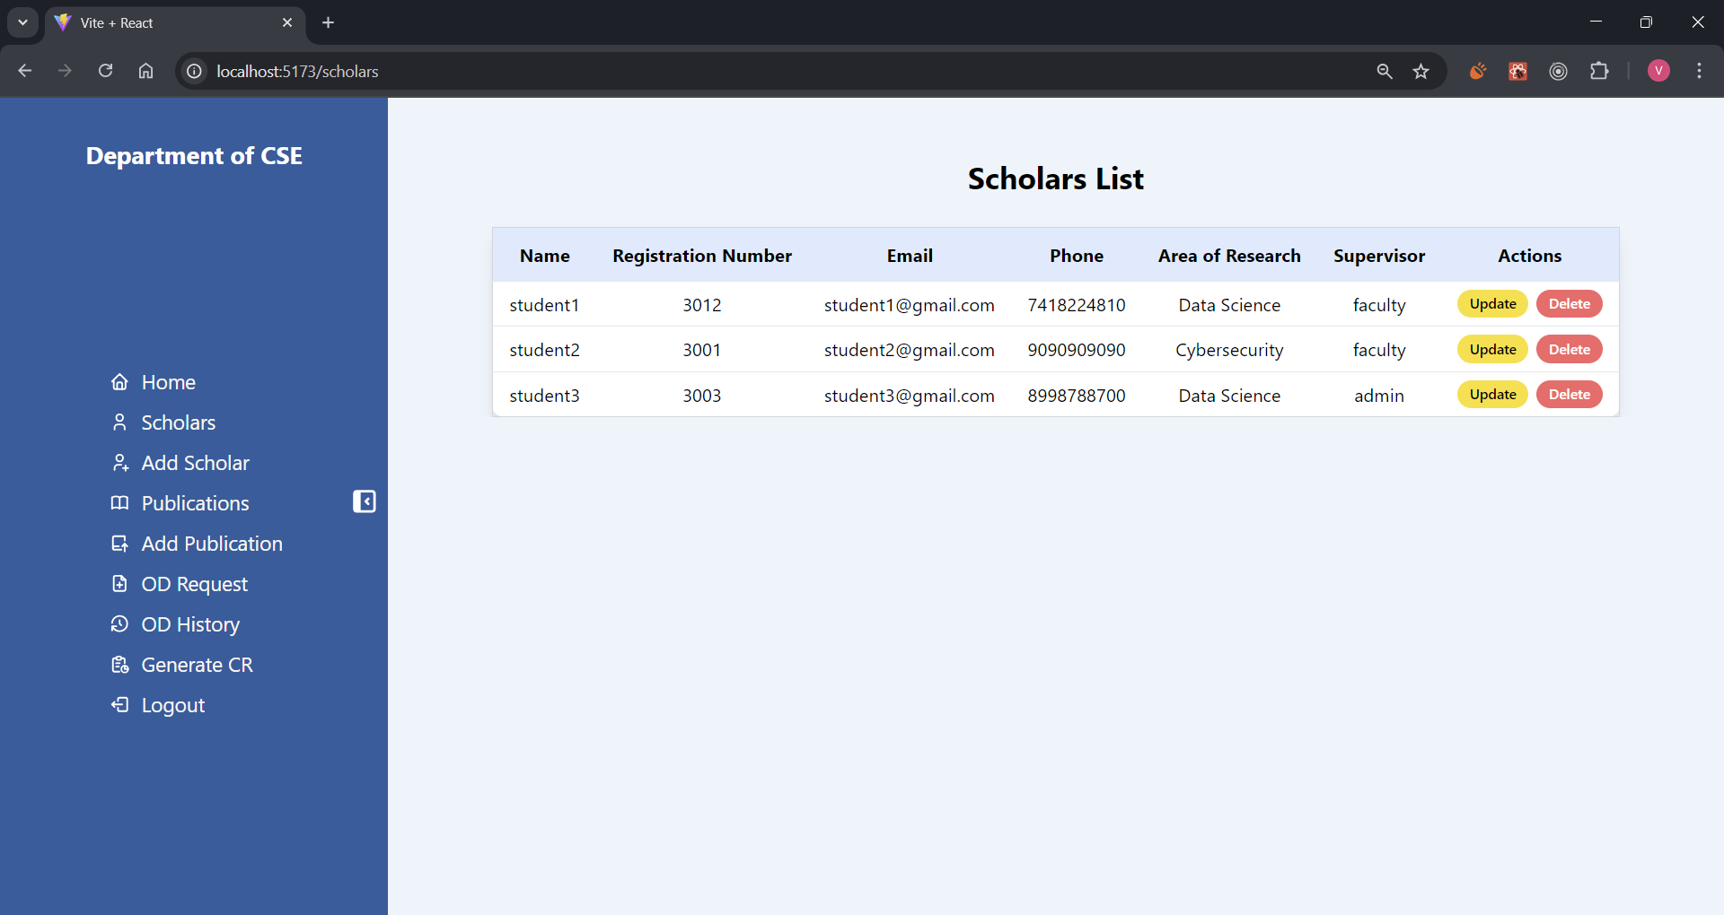
Admin's view of Scholars List

Slide 7
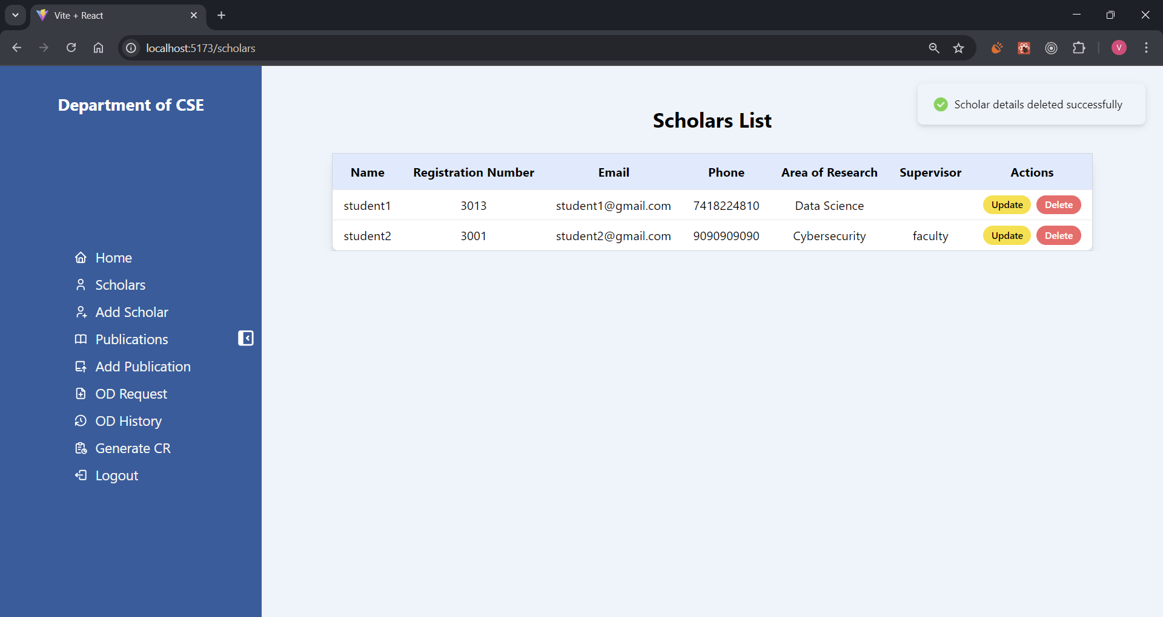
A toast message is received for successful deletion.( or failure of action )

Slide 8

Faculty's view of Scholar List

Slide 9
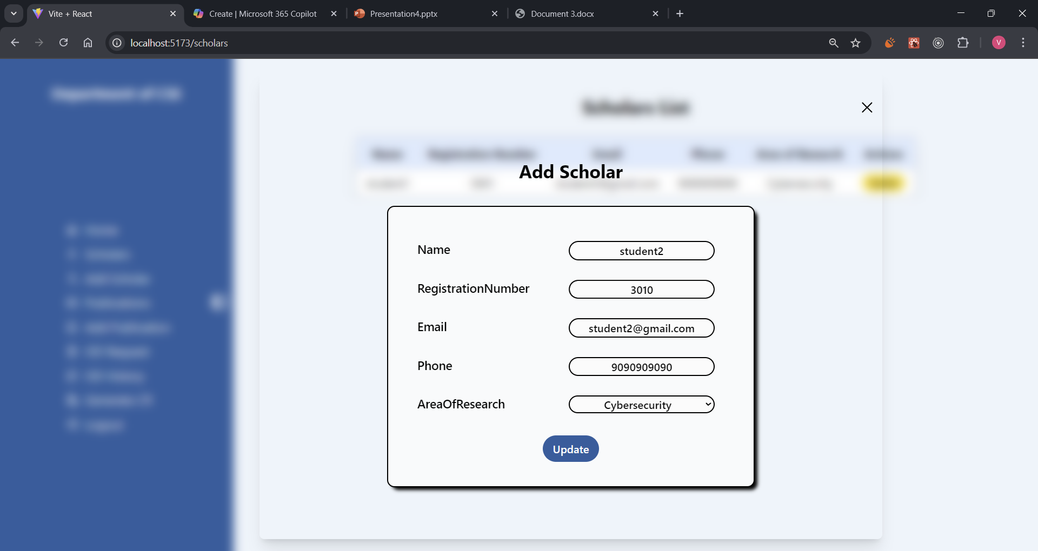
A pop-up modal through which scholar details can be updated

Slide 10

A toast message is received for successful updation of details.( or failure of action )

