Slide 1
MODULE - 3
FACULTY OD REQUEST AND APPROVAL MODULE
TEAM MEMBERS
1. Visvesswar A M - 2022103013
2. Shibani Selvakumar - 2023103005
3. Nikhitaa M - 2023103010
4. Sai Nikitha - 2023103006

Slide 2
Objective
To design and implement a comprehensive module that facilitates :
Submission and Approval of OD request.
Manages PG-Scholar details.
Manages Publication records.
Generates CR ( based on provided format )

Slide 3
Requirements
1. Faculty Portal Requirements
OD Request
Choose whether the faculty conducted or participated in the event.
Enter event details:
Type of event (e.g., course, workshop, seminar), Period/dates of participation or conduction, Name and location of the event, Upload supporting documents, Specify departmental procurements required (if applicable).
Add, update, or delete PG scholar information:
Name, Area of Research, Contact Information, Registration Number
Manage Publications.
Add or update publication details:
Title, Author(s), Date of Publication, Journal or Publisher, DOI
Generate Confidential Reports.
Generate CRs using:
Event participation/conduction history, Publications, Supervised PG scholars.
2. Admin Portal Requirements
OD Request Management
View all OD requests.
Filter requests by status (Pending, Approved, Rejected).
Approve or reject requests.
CR Management
View and download generated Confidential Reports (CRs).

Slide 4
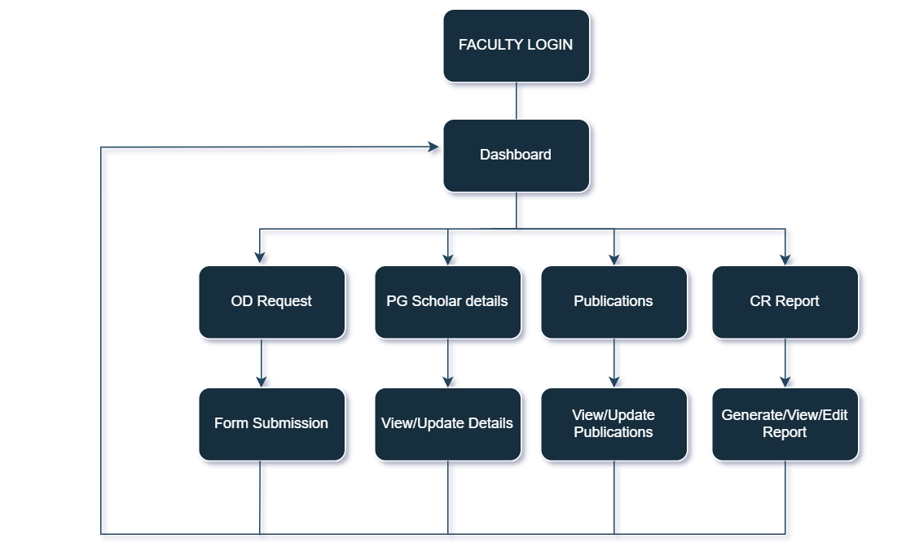
Faculty Login Workflow

Slide 5
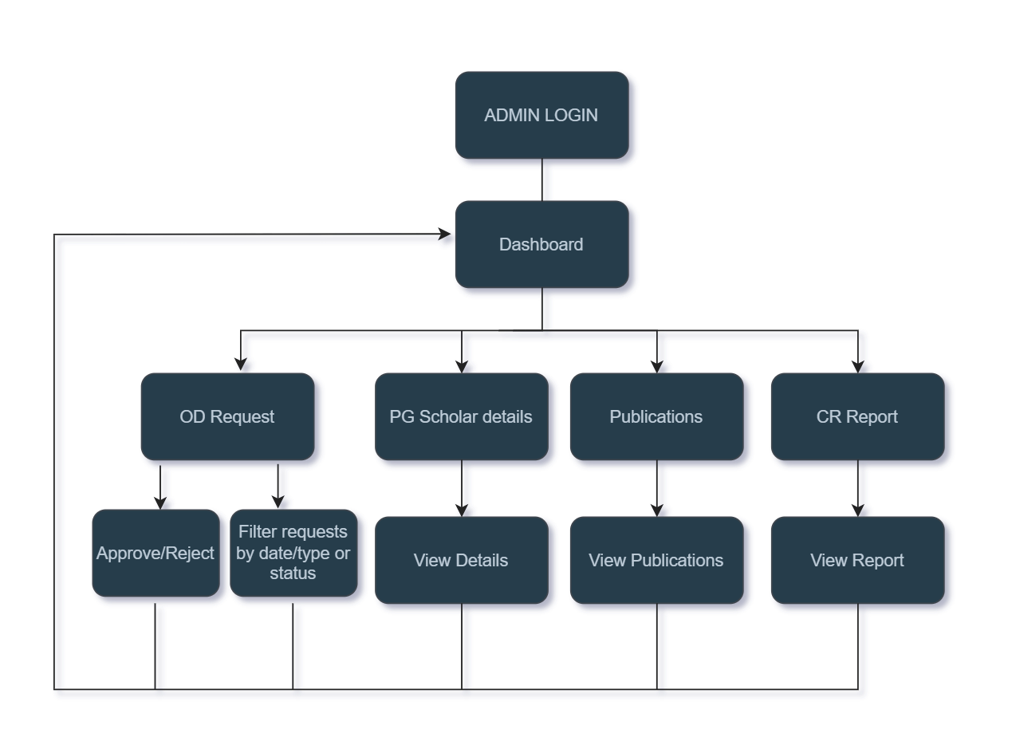
Admin Login Workflow

Slide 6
Deliverables
Web Components
Faculty Module:
OD Request Form
Faculty Dashboard
PG Scholar & Publication Management Pages
CR Generation Page
Admin Module:
OD Request Validation Menu
CR Report Overview Page
Publication and Scholar Overview Pages
Documentation
User Manual (Faculty & Admin)
Technical Documentation (DB schema, flowcharts, API reference)
Reports
CRs generated per faculty based on input data
Deployment
Source Code Repository (GitHub/ZIP)

Slide 7
Features
Faculty Features
Submit OD requests by specifying event type (participation/conduction), dates, location, and documents.
View status of submitted OD requests via the Faculty Dashboard.
Option to download OD letter.
Manage PG scholar details.
Add and update publications.
Generate Confidential Reports (CRs) with data from event participation, publications, and scholar supervision.
Admin Features
View, filter, and manage OD requests based on status (Pending, Approved, Rejected).
Approve or reject faculty OD requests.
View and download generated Confidential Reports.
Access overview pages of all publications and scholar data for verification and administrative records.
Common Features
Secure login and role-based access.
User-friendly UI with structured navigation.
Real-time feedback on actions (e.g., toasts for success/failure messages).
Data validation for forms and uploads.
Responsive Design.
Fast API Responses.

